Slide 1
Storm surge modelling in the North Sea - Baltic sea transition zone: model inter-comparison of static wind simulations
Elin Andrée^{1,3}, Asger Bendix Hansen², Morten Andreas Dahl Larsen³,
Jian Su¹, Kristine Skovgaard Madsen¹, and Martin Drews³,
Danish Meteorological Institute, Denmark
DHI, Denmark
Technical University of Denmark, Denmark

Slide 2
Abstract
Extreme water levels in the micro-tidal transition zone between the North Sea and the semi-enclosed Baltic sea are predominantly determined by wind forcing associated with synoptic-scale weather systems. This connection between the two seas is partly blocked by low-lying islands, and the bathymetry comprises a complex mixture of narrow, deep channels and shallow sills. Coastlines in the Southern Kattegat and the Western Baltic Sea are therefore exposed to wind forcing from a large range of directions, and the extent of water build-up varies strongly between locations.
IThe simulations are conducted with two different regional 3D ocean models to enable model inter-comparison. The DMI-HBM model implements a structured grid with fully dynamic 2-way nesting, while the MIKE 3 FM invokes an unstructured mesh. Both models have grid resolutions of ~0.5–1 km within the Danish Straits and 4–6 km in the offshore Baltic Sea. The models are forced by synthetic wind fields, where both wind speed and wind direction are maintained at fixed levels over the entire model domains. Pairs of model simulations are then obtained by varying the angle from which the wind is blowing.
From the model outputs, we describe the temporal evolution of the water level by the site-specific peak water level, and the time required for the response to reach its peak value. Our results show a steady rise of the water level up until the peak value. The peak water level significantly overshoots the final equilibrium water level, which develops further into the simulations. Our study facilitates a better understanding of the sea level's response to extreme and persistent winds in a region with highly complex geometry.

Slide 3
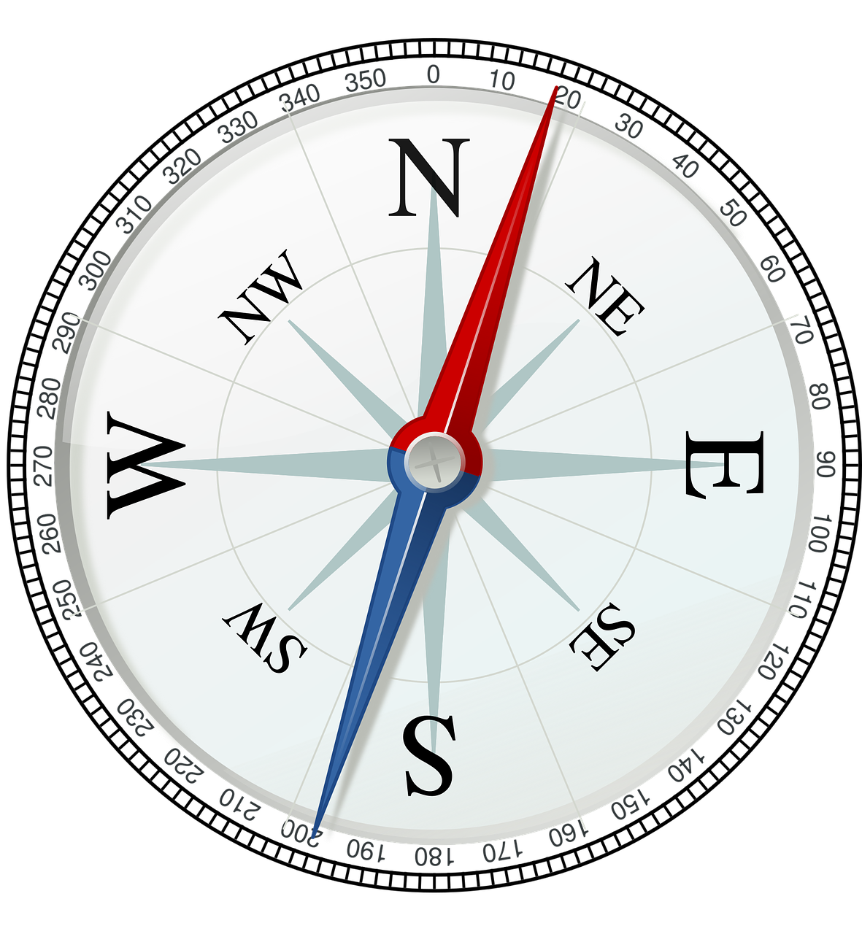
Motivation
Denmark is a low-lying country comprised by a mainland peninsula and over 400 islands.
Denmark is exposed to extreme sea levels (ESL) that can cause coastal flooding.
Since Denmark’s coastlines are facing many different directions and several water bodies, ESLs due to strong or persistent winds can be generated by wind from a large range of directions.
Objective
To assess the simulated maximum water level for Danish coastlines using synthetic wind fields that maintain a fixed wind speed and direction for the entire model domain.

Slide 4
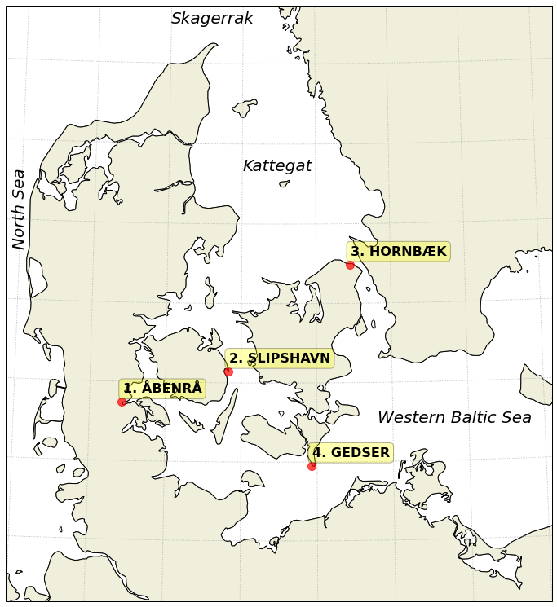
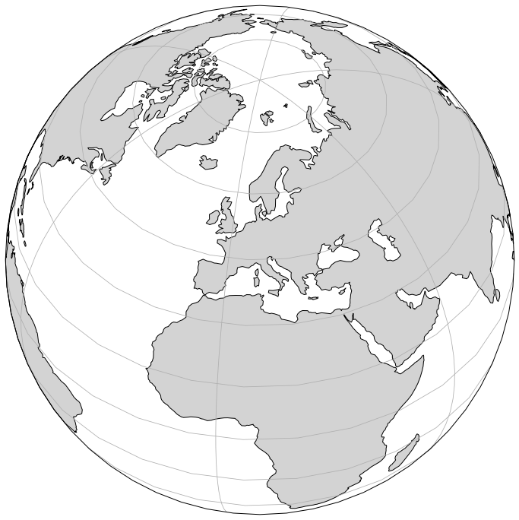
Study area
Figure 1: Denmark is nestled between the North Sea and the Baltic Sea. Red dots show locations highlighted in this presentation.
Transition zone between the North Sea and the semi-enclosed Baltic Sea
Connection is partly blocked in the Danish Straits
Bathymetry is a complex mixture of narrow, deep channels and shallow sills
Coastlines are exposed to extreme sea levels from large range of directions

Slide 5
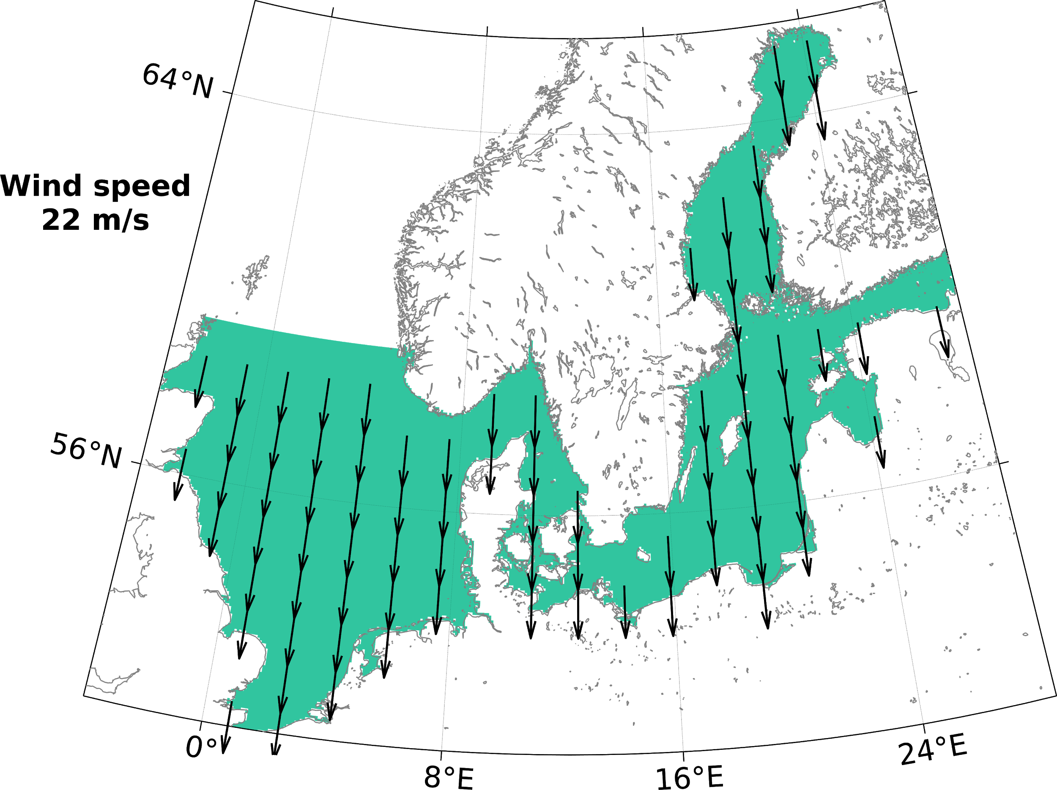
Method
Simulating extreme water levels using the 3-dimensional, numerical ocean models DMI-HBM and MIKE 3 FM.
Models are driven by synthetic wind fields
both wind speed and direction are maintained at a fixed level over entire model domain
Simulations are conducted for one wind speed and one wind direction at a time.
Figure 2: Example of wind field for constant wind from north over the entire DMI-HBM model domain (coloured).

Slide 6
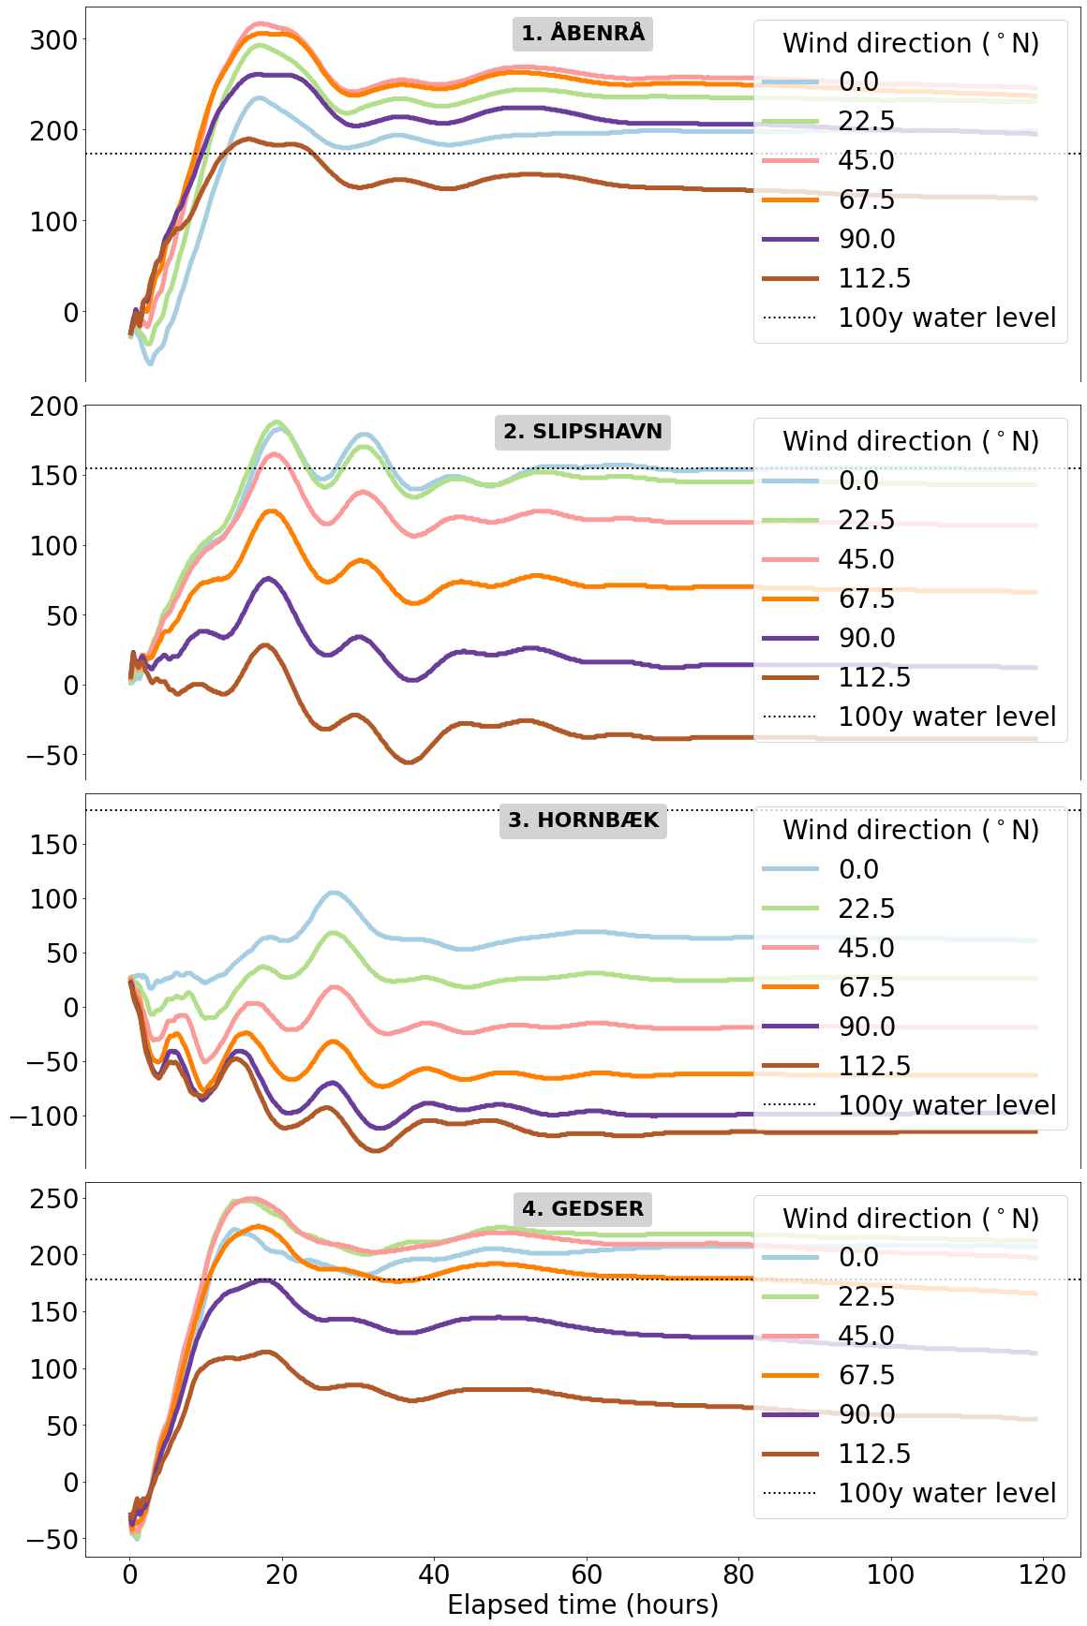
Results
Figure 3:
Water level from DMI-HBM at locations indicated on the map.
Different line color represents different wind directions (see figure legend).
Dashed line indicates 100 year return water level (1% chance of occurring in any given year).¹
Wind speed is 80 km/h (22m/s).
The simulated water levels significantly overshoot the 100 year return water level for all stations except Hornbæk
(1) Kystdirektoratet (KDI) https://kyst.dk/media/80372/hoejvandsstatistikker2017revideret11022019.pdf

Slide 7
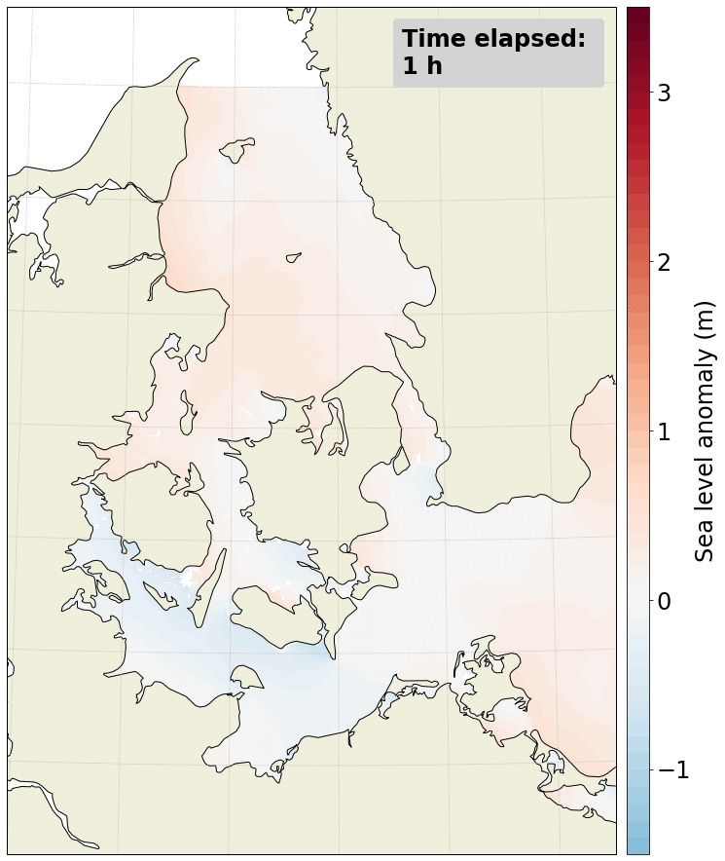
Results
Figure 4:
Hourly snapshots of sea level anomaly from DMI-HBM.
The wind direction is 45 ºN (from northeast)
The wind speed is 80 km/h (22m/s).
+ anomaly (red) propagating into southwestern Baltic from the east, causing water to pile up.
Extreme water levels are reached within the first 15 h after onset of the synthetic wind.
After around 20 h they taper off slightly, but remain on extreme levels.

Slide 8
Next steps
Summary
Expanding ensemble to assess water level response for all coastlines using
more wind directions
higher wind speed
Thanks for reading!
Questions, comments, suggestions? Please reach out to us: elina@dtu.dk
We simulate extreme water levels driven by wind from single directions in the transition zone between the North Sea and the Baltic Sea
We show results for wind speeds of 80 km/h and N to ESE wind directions.
Extreme water levels were reached within the first day after onset of the synthetic wind.
The water level responds very differently north (Hornbæk, needs westerly wind component), middle (Slipshavn) and south (Åbenrå, Gedser) of the straits.

