Slide 1
Test of Dust Emission Over
the Middle East
S. Mostamandi, A. Ukhov, G. Stenchikov, A. Anisimov, I. Shevchenko, Y. AlShehri
EGU
May 2020

Slide 2
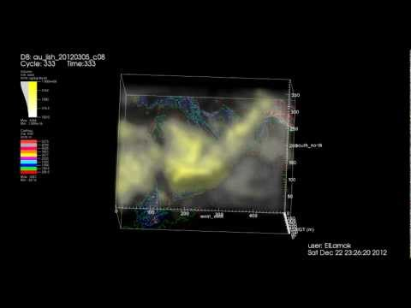
Objectives
Dust is the most abundant aerosol on the earth. Greatly affecting climate, health and transportation.
Dust contributes largely to ambient air pollution, which was recently recognized as a major health risk that reduces life expectancy.
Dust affects air quality. It reduces incoming solar radiation and cools the surface.
Dust is one of important climate driver especially in the ME because it is very abundant in this area. Anauly this region emites 500 to 700 Tg dust to the atmosphere, which is third of the global dust emission.
Notes:
Dust is the most abundant aerosol on the earth. Greatly affecting climate, health and transportation. Dust contributes largely to ambient air pollution, which was recently recognized as a major health risk that reduces life expectancy. Here we try to estimate amount of dust emitted to the atmosphere in ME, Its effect on regional climate. Show how it change the local air circulation by absorbing and reflecting solar and IR radiation. Dust reduces the extreme surface temperature over the land and lowers SST which help to protect marine habitats and coral reefs.
Dust is one of important climate driver especially in the ME because it is very abundant in this area. Anauly this region emites 500 to 700 Tg dust to the atmosphere.
It affects air quality but also reduces incoming solar radiation and cools the surface.

Slide 3
Objectives:
Compare MERRA-2, CAMS and WRF-Chem dust deposition rates with observations?
Evaluate how well the dust mass balance over the Arabian Peninsula is reproduced in WRF-Chem free running model, and in MERRA-2 and MACC reanalyses?
MERRA2 - Modern-Era Retrospective analysis for Research and Applications, Version 2
MACC - Copernicus Monitoring Atmospheric Composition & Climate
Notes:
The Major weakness in the present description of dust emission processes lies in the physical understanding of the released by the impact of salting grains which has implication for the capability of dust emission models to predict the size distribution of emitted dust. Different models predict different dust size distribution as a function of U* and of soil properties.
Available field experimental data of size resolved dust emission fluxes are not sufficient to estimate these dependencies correctly.
To understand better the detailed processes affecting dust life cycle and climatic impact over the Arabian Peninsula, wrf-chem was used to investigate AP dust emission, deposition, transport mechanism, and dust–climate interaction in the last two years (2015-2016)

Slide 4
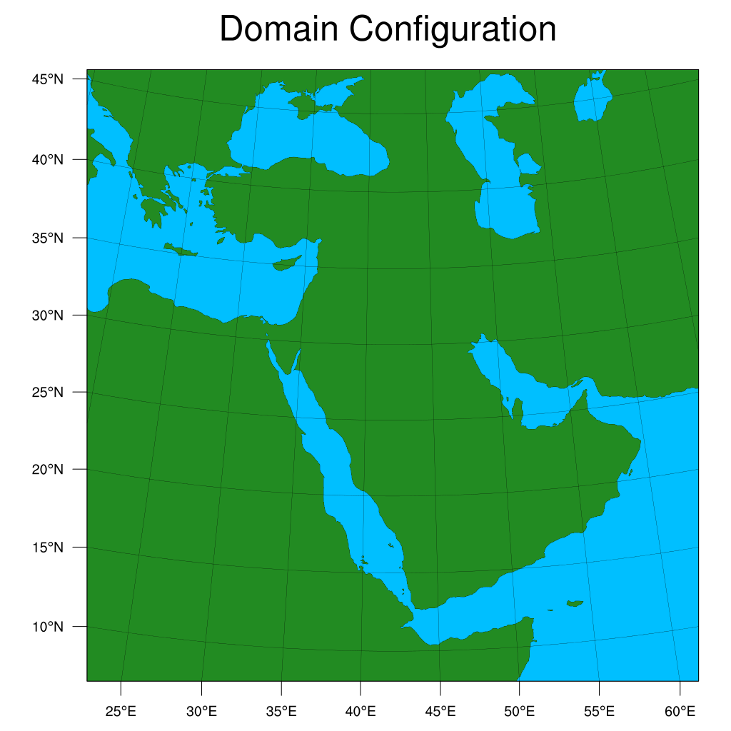
Model setup
Physics options:
Pbl scheme: Yonsei University planetary boundary layer Scheme (YSU) (opt. 1)
Cumulus par. scheme: Grell 3D ensemble scheme (opt. 5)
Microphysics scheme: WRF single moment 5-class scheme (opt. 4)
SW & LW options: RRTMG shortwave & longwave scheme (opt. 4)
Chem options:
GOCART coupled with RACM KPP (opt. 301) Chem_dt: 10 minutes, Fast-j photolysis scheme
Using gas & aer. BC/IC and aerosol radiation feedback: turned on
Simulation period: 01.01.2015 - 31.12.2016
Simulations were reinitialized monthly with one week spin-up
IC/BC: Initial and boundary condition for both meteorology and aerosols are derived from MERRA2 reanalysis.
Domain Configuration:
Nx=Ny=451;
dx=dy=10 km
Nv = 50 sigma levels
dt = 60s
Notes:
We use WRF-Chem to calculate dust emission and dust deposition.
Simulation done for two years.
For first-time we use meteorological and aerosol initial and boundary condition from MERRA2 this allow us first avoid numerical instability between boundary data and model, secondly, it allows us to run the model in the small domain.
RACM KPP Regional Atmospheric Chemistry Mechanism Kinetic PreProcessing

Slide 5
Dust uplifting flux
C_{G} = 0.5
S - Erodibility Source Function = ((Zmax - Zi)/(Zmax - Zmin))⁵ - with added urban mask
U₁₀ - Horizontal wind speed at 10m
U* - Threshold Velocity
S_{p} - fraction of each bin (by default 0.1(Bin1), 0.25(Bin2), 0.25(Bin3), 0.25(Bin4), 0.25(Bin5))
(we use - 0.2, 0.15, 0.15, 0.4, 0.1)
Emission of PM_{2.5} = bin1 + 0.3125*bin2 comprises 25% of total emission dust mass flux
Notes:
Here is show how we can parameterized Dust uplifting flux(Dust Emission).
By modifying Erodibility Source Function (S)
By tuning of Constant
By correction fraction of bins ( it is important
And finally by modifying of threshold velocity

Slide 6
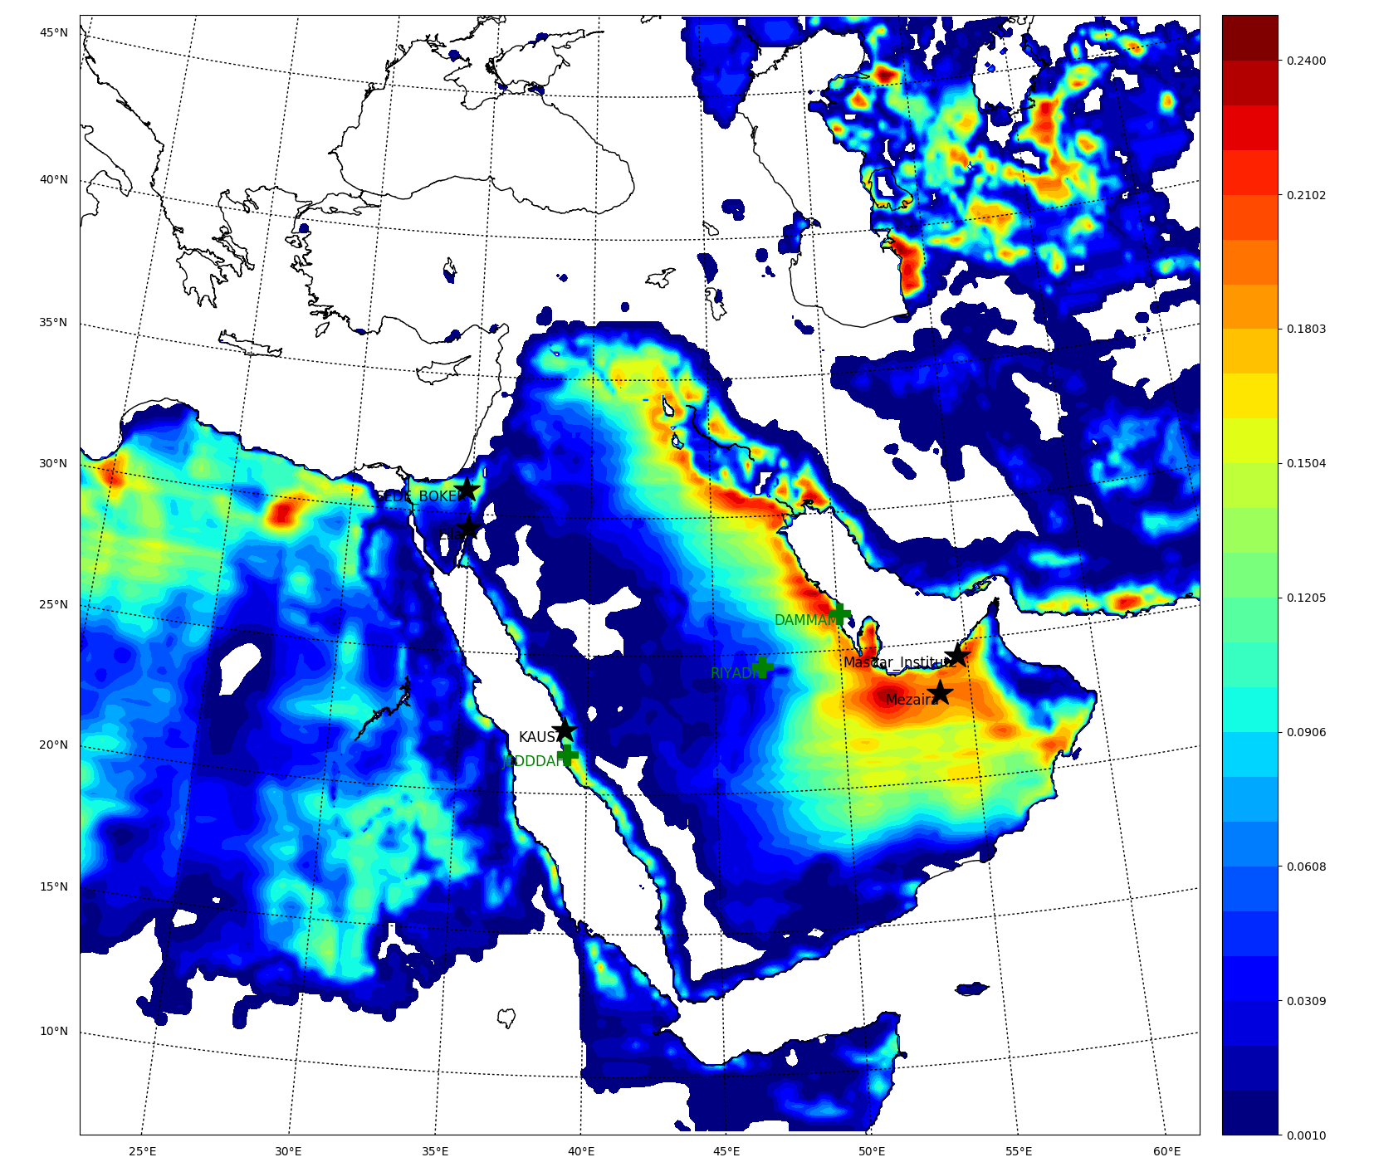
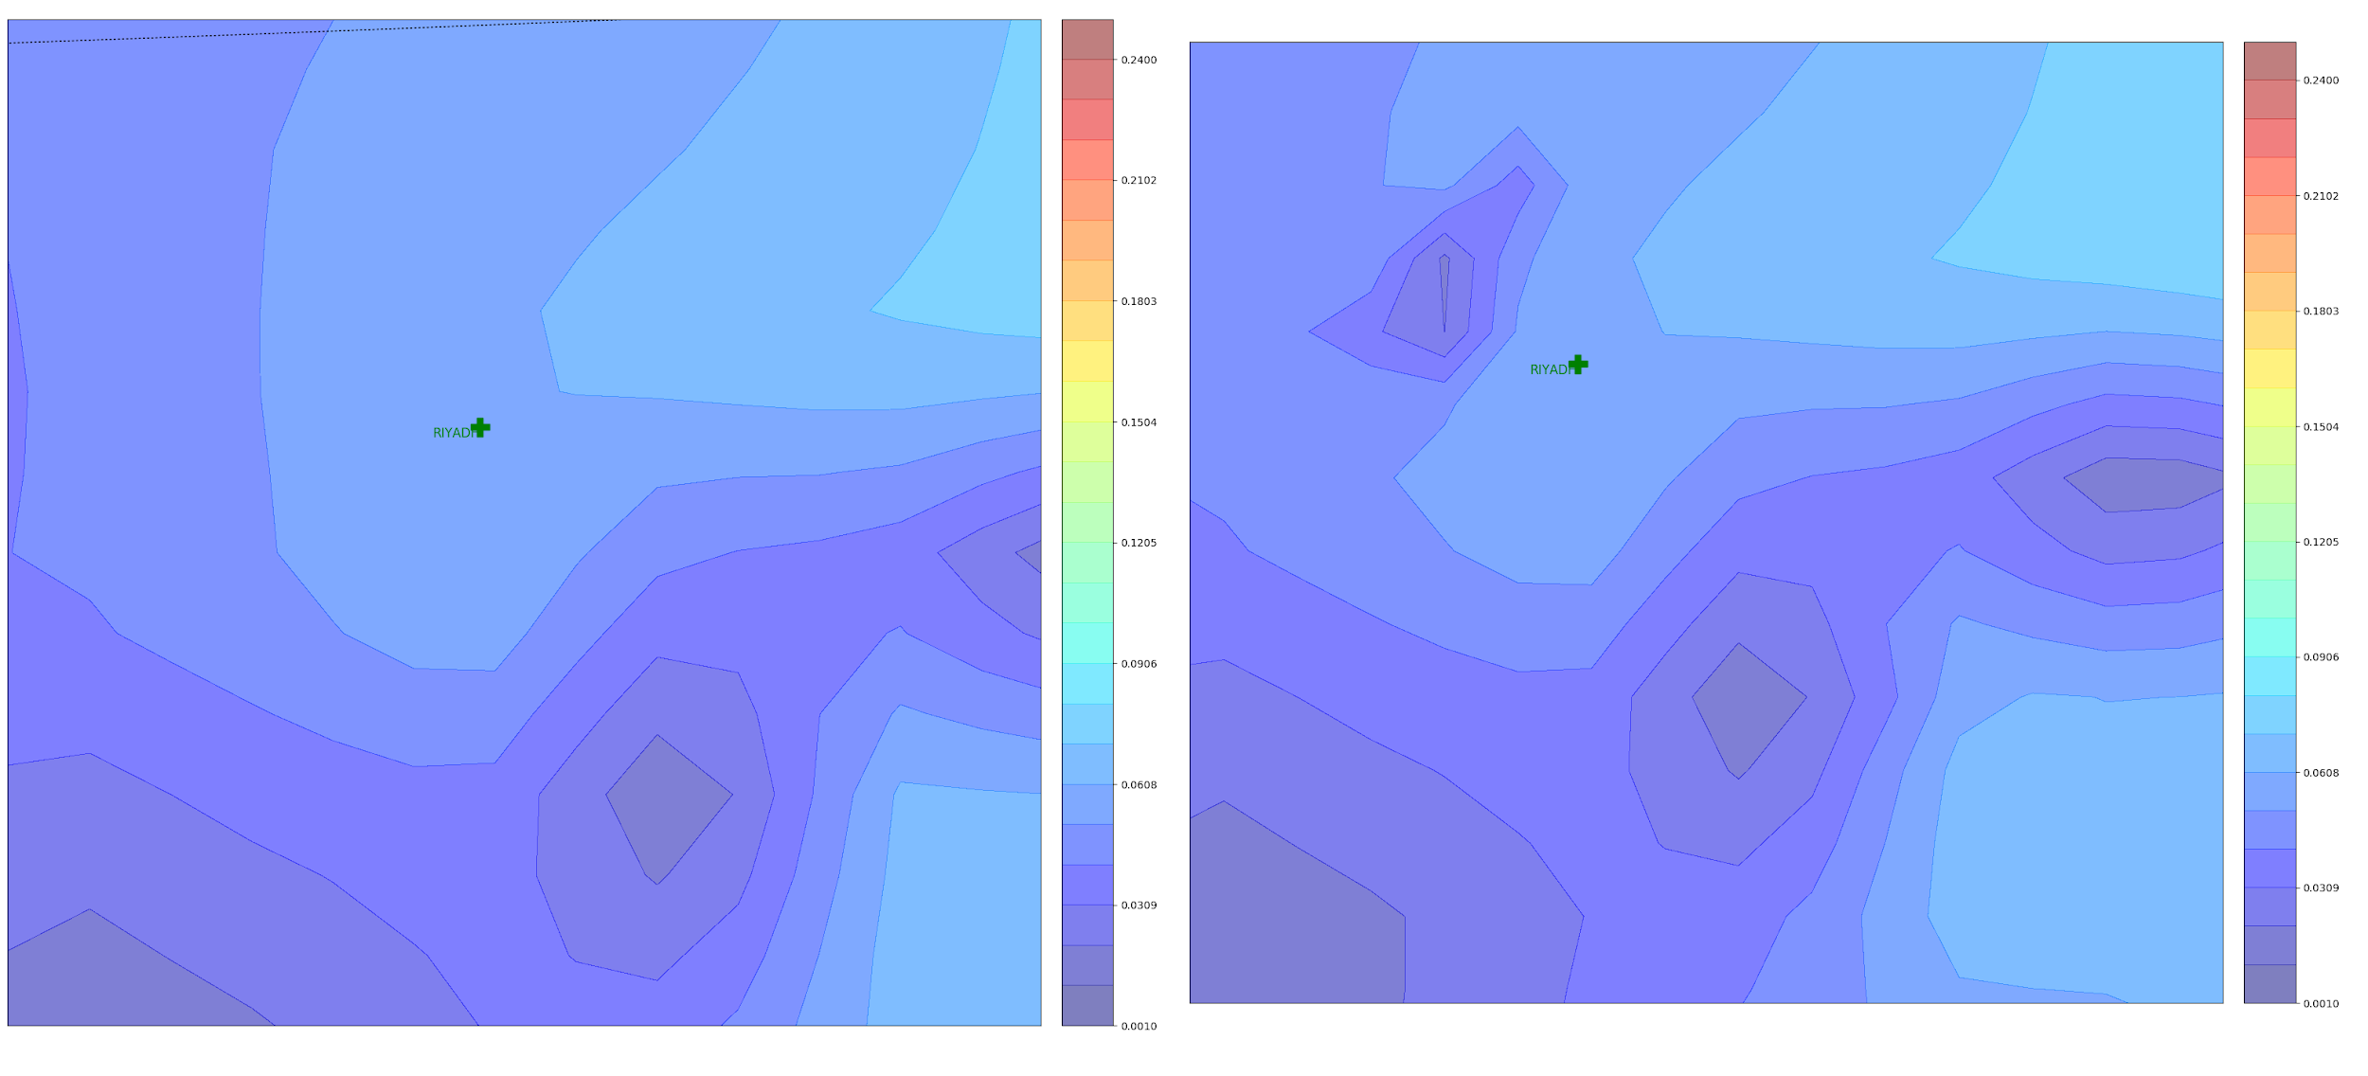
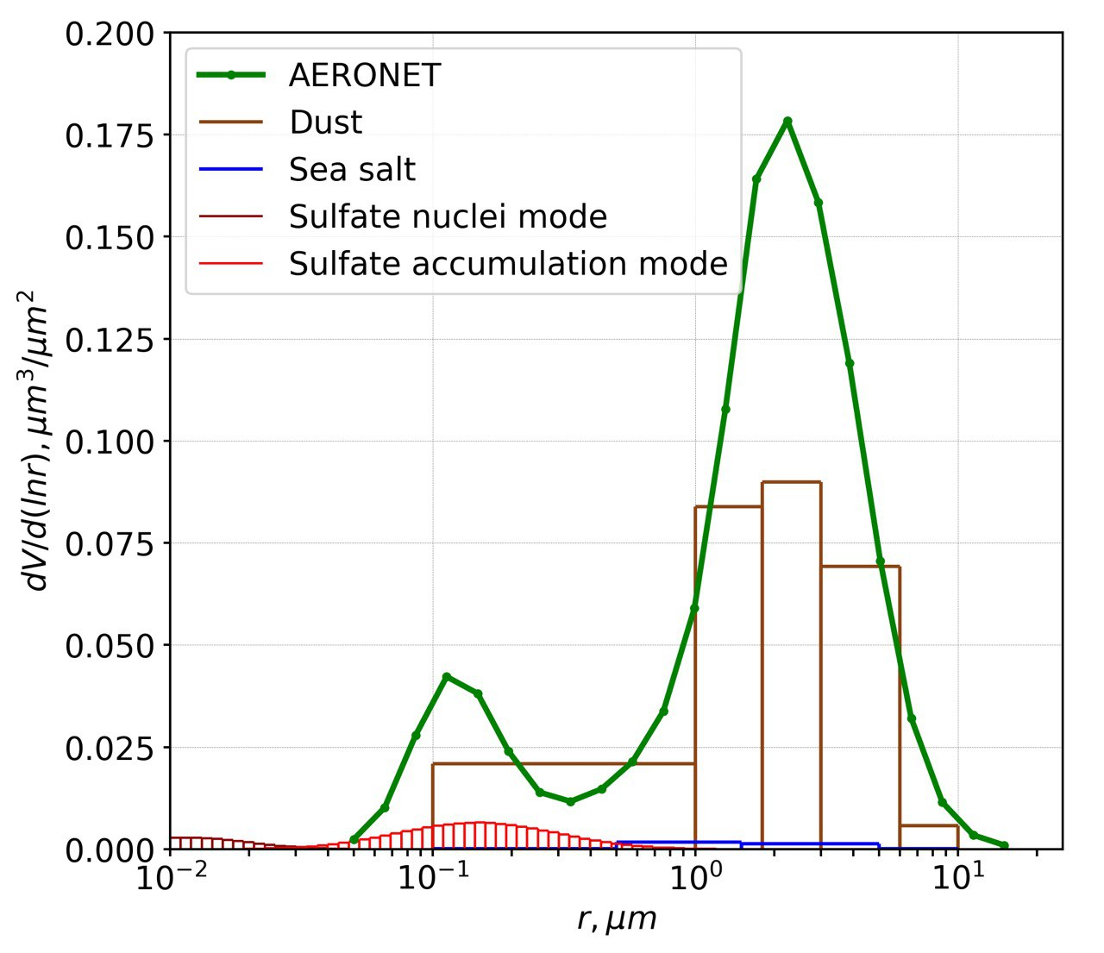
Erodibility without urab-mask
Erodibility with urab-mask
S - modified
Sp correction
Dust source function for GOCART emission scheme updated by urban mask. ✶-location of AERONET station; ＋- MODON air quality stations. (Right) Aeronet fine and coarse mode distributions. According to AERONET observations the GOCART bin distribution of emitted particles was modified to generate 25% of fine mode and by 75% of coarse mode by mass.

Slide 7
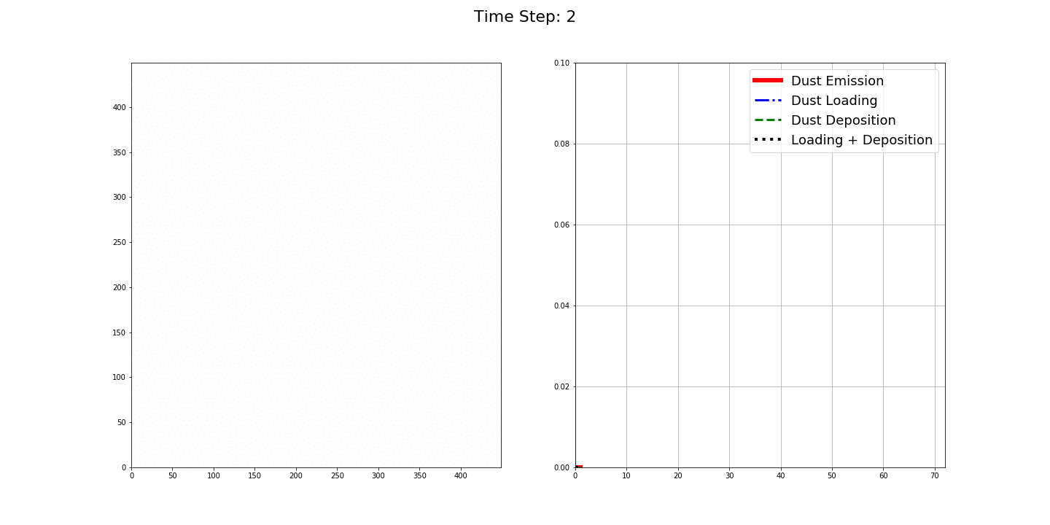
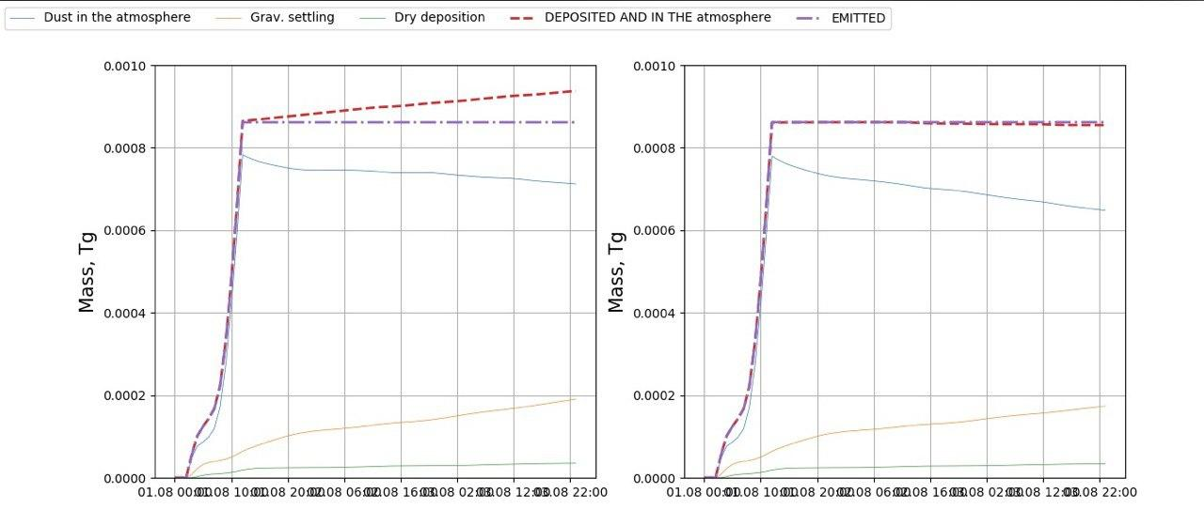
Test Dust Mass Balance
Atmospheric Loading = Emission - Deposition
Our modified dust deposition scheme allows to accurately calculate the dust mass balance within the domain
The original scheme artificially generated dust mass

Slide 8
Observations
Passive dust deposition sampler at KAUST
AERONET AOD (Time series)
MODIS retrieval AOD
MERRA2 reanalysis
CAMS reanalysis
Notes:
Before to demonstrate the result i want to mentioned that for evaluation of model we used MERRA2, MACC reanalysis for spatial comparison as for meteorological fields as for aerosol properties.
Also we analysed at several location AOD with AERONET observation
And finally at AKUST we compared dust deposition
First I will present the evaluation of meteorological fields as it acts as driver for dust emission

Slide 9
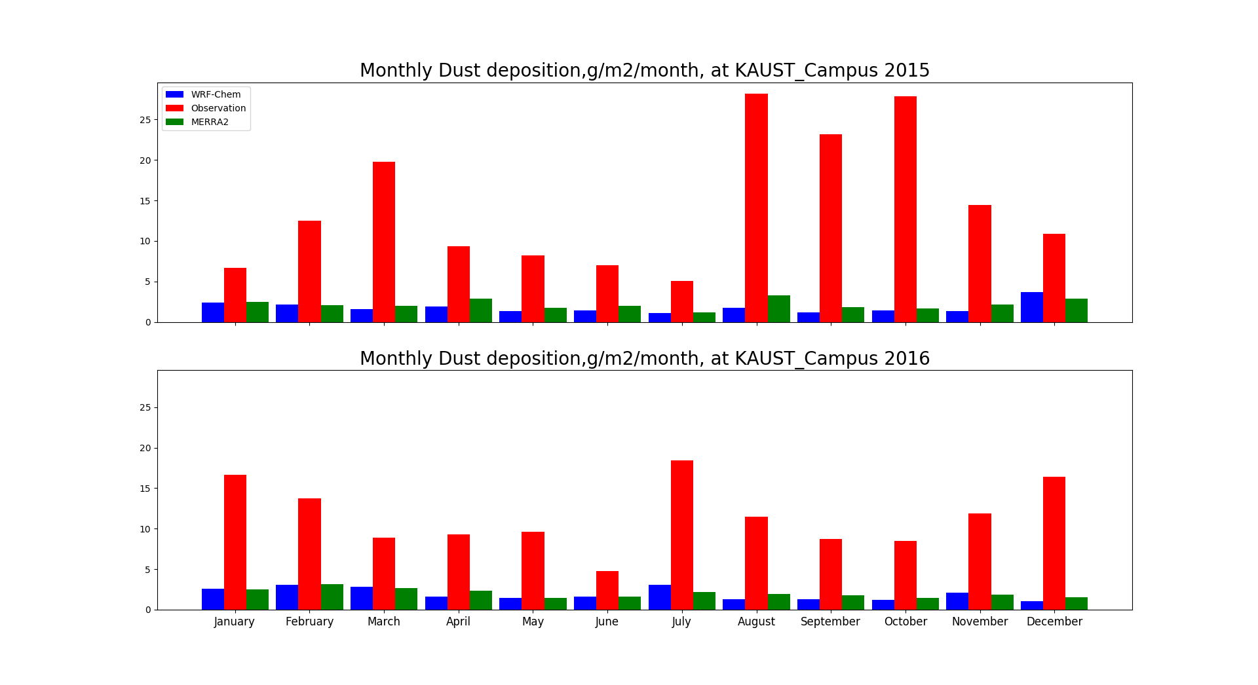
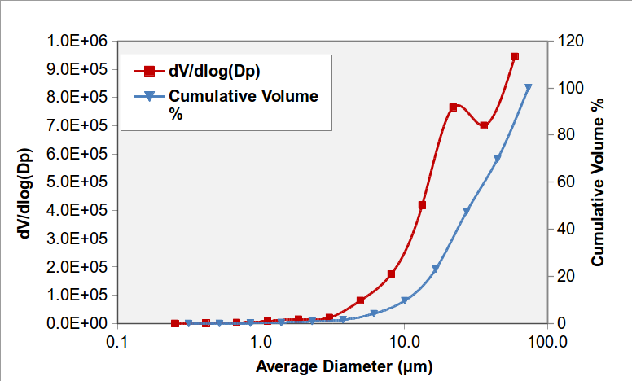
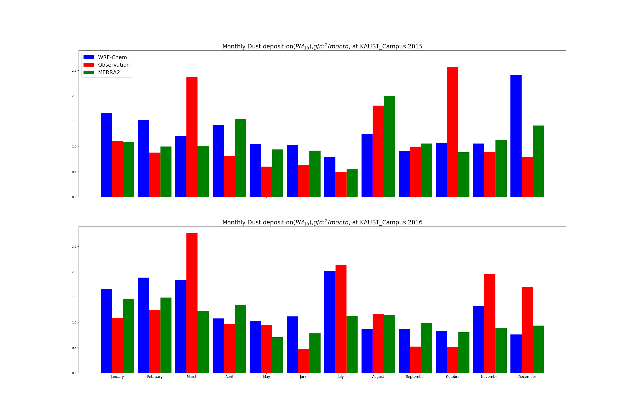
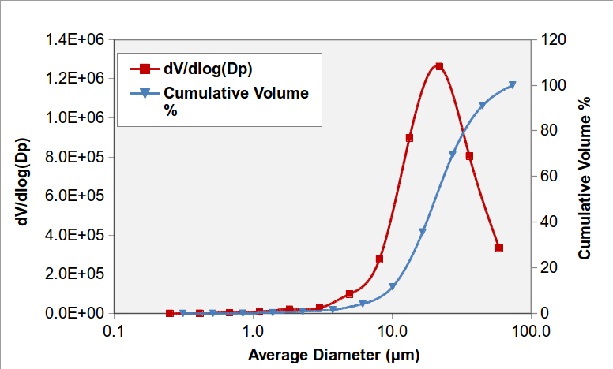
Dust Deposition at KAUST_Campus location
July-2015
July-2016
Observed dust deposition size distribution. Individual particle analysis using scanning electron microscopy (SEM) show that particles less than 10 𝝻m contribute only 10% of the total mass. For example as it shown in above charts for July 2015 the total volume - 6.75x10⁵, Pm10-6.65x10⁴(10%), Pm2.5 - 7.47x10³ (1.1%).
Monthly dust deposition (g/m2/month) at KAUST_Campus(22.30N, 39.10E): Green - MERRA2; Blue – WRF-Chem; Red – Kaust_Campus observations. The Top two charts show comparison with total observed mass deposition, while bottom charts - only with PM10.
Notes:
WRF-chem shows good agreement with point observation of dust deposition despite the fact that we used 10x10 km horizontal resolution.
It should be noted that ground observation of dust deposition contains a different particle size of dust (up to 100 μm), whereas in the model we take into account only up to 10 μm

Slide 10
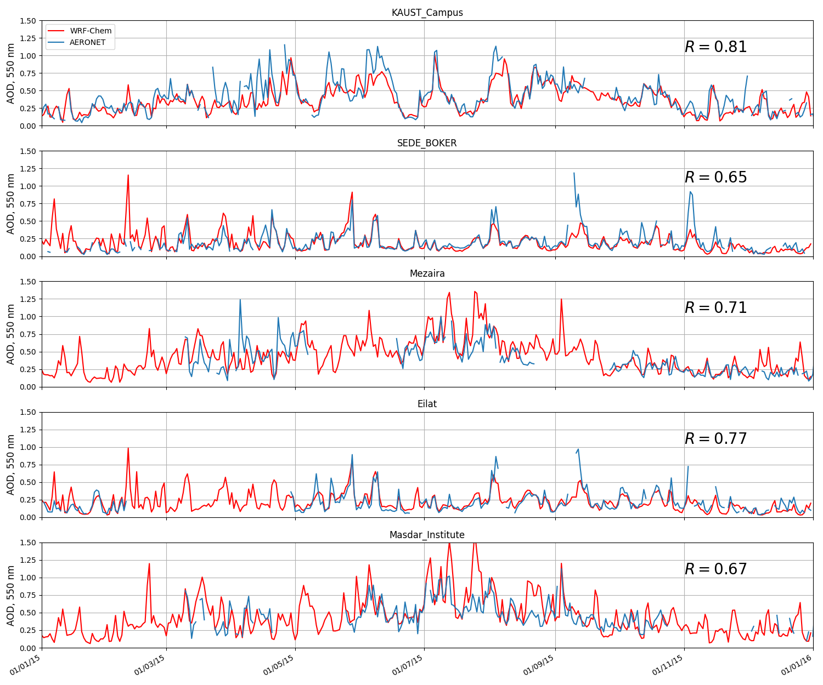
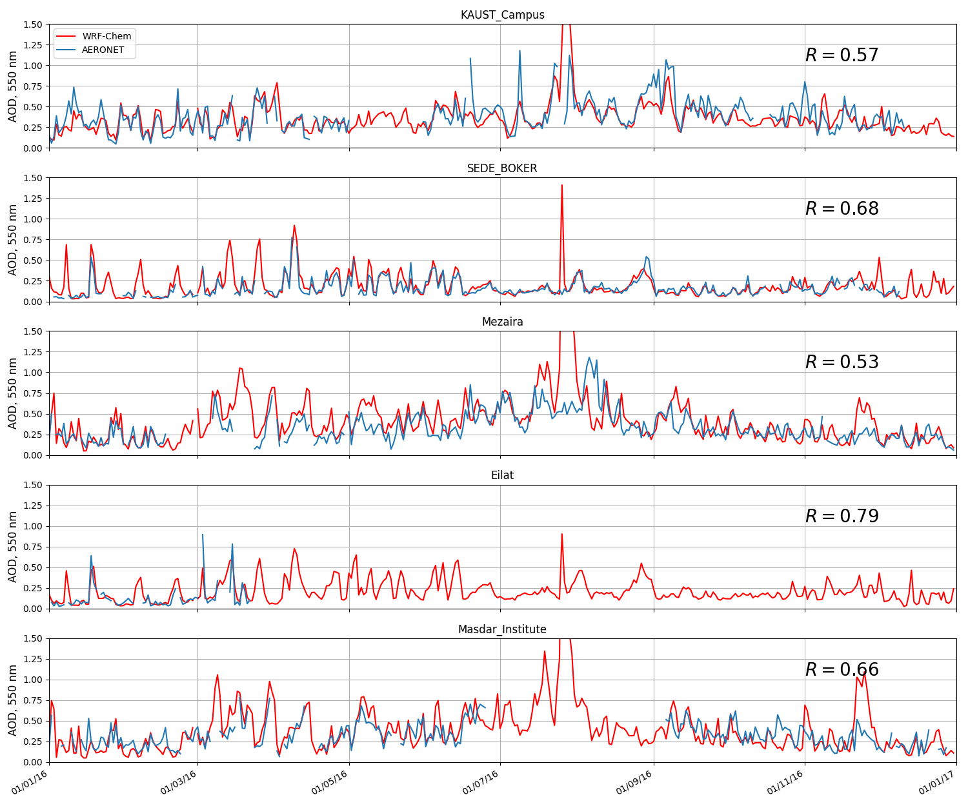
Daily averaged AOD at three AERONET sites (KAUST Campus, Mezaira, Sede Boker, Elat, Masdar Institute)
2015
2016

Slide 11
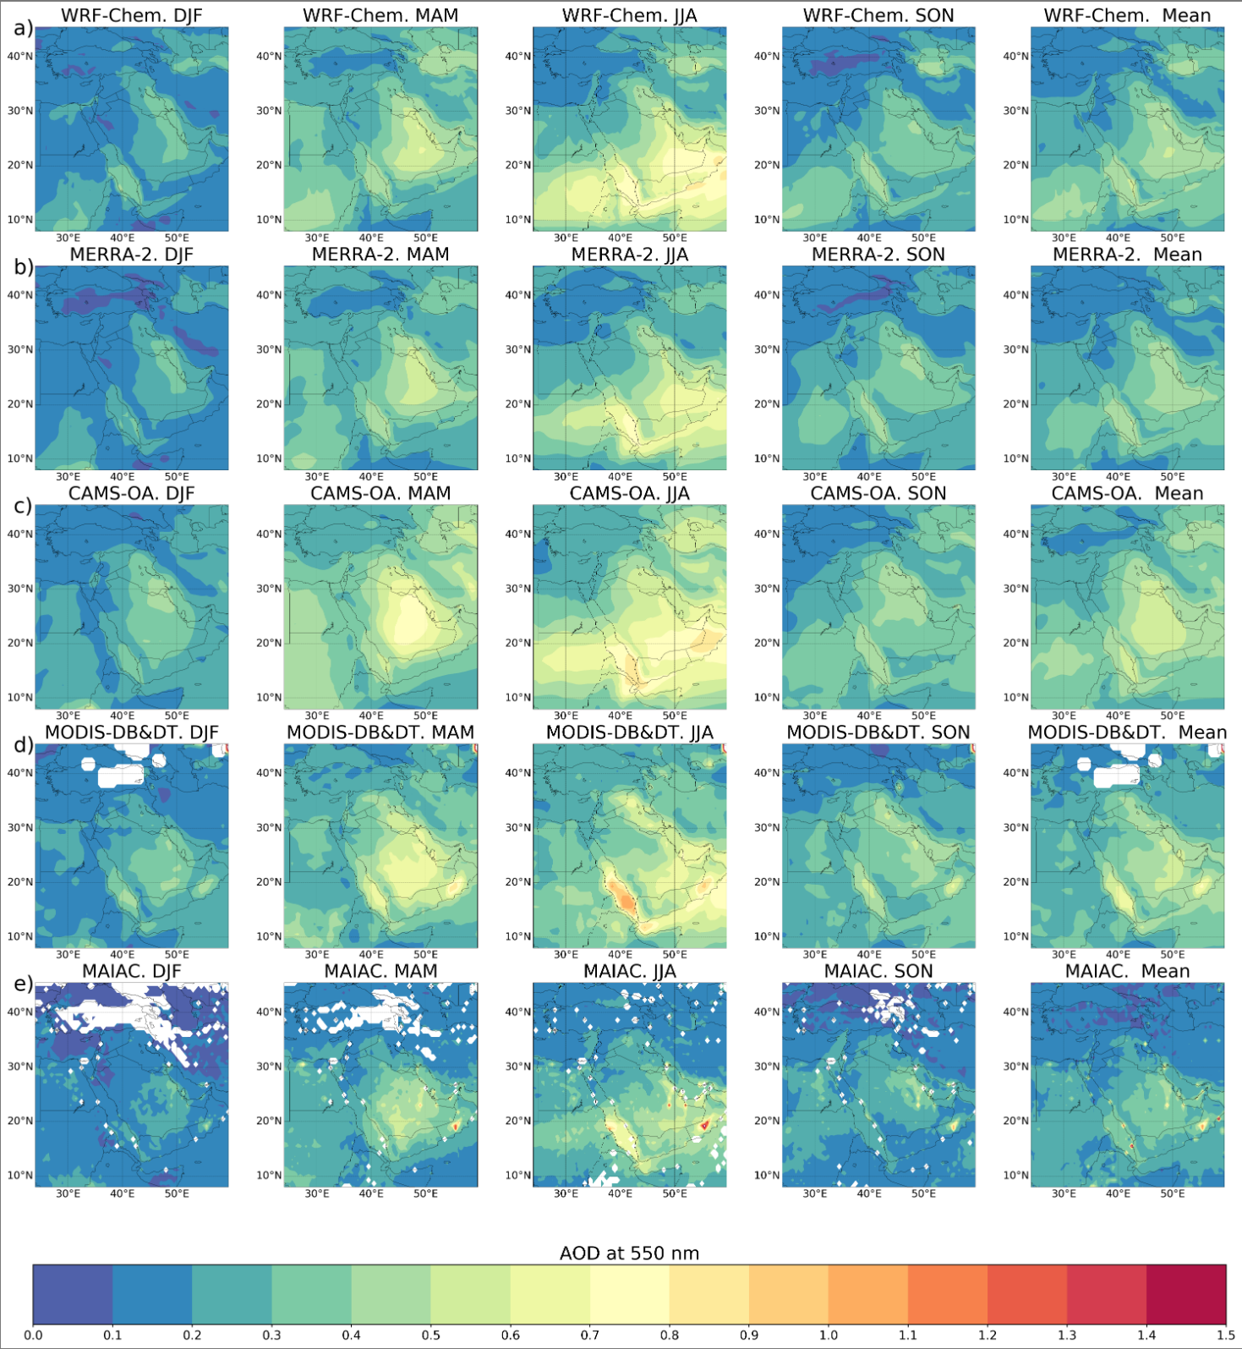
Spatial Comparison of aerosol optical depth(AOD) from
WRF-Chem, MERRA2, CAMS and MODIS
Seasonally averaged 2015-2016 AOD
Correlation Coefficient
Season | WRF- CAMS | WRF- MERRA2 | WRF- MODIS | CAMS- MODIS | MERRA- MODIS | CAMS- MERRA2
DJF | 0.762 | 0.928 | 0.481 | 0.635 | 0.590 | 0.846
MAM | 0.880 | 0.960 | 0.701 | 0.750 | 0.758 | 0.897
JJA | 0.907 | 0.946 | 0.745 | 0.739 | 0.789 | 0.938
SON | 0.836 | 0.895 | 0.537 | 0.644 | 0.647 | 0.903
mean | 0.846 | 0.932 | 0.616 | 0.692 | 0.696 | 0.896
RMSE
Season | WRF- CAMS | WRF- MERRA2 | WRF- MODIS | CAMS- MODIS | MERRA- MODIS | CAMS- MERRA2
DJF | 0.064 | 0.025 | 0.083 | 0.075 | 0.077 | 0.065
MAM | 0.106 | 0.033 | 0.100 | 0.113 | 0.096 | 0.116
JJA | 0.120 | 0.074 | 0.129 | 0.147 | 0.107 | 0.133
SON | 0.087 | 0.042 | 0.097 | 0.089 | 0.081 | 0.064
mean | 0.094 | 0.043 | 0.102 | 0.106 | 0.090 | 0.094
WRF-Chem AOD demonstrates a good spatial and temporal agreement with AOD from reanalysis, Modis AOD and MAIAC AOD. Columns from left to right: DJF, MAM, JJA, SON, MEAN

Slide 12
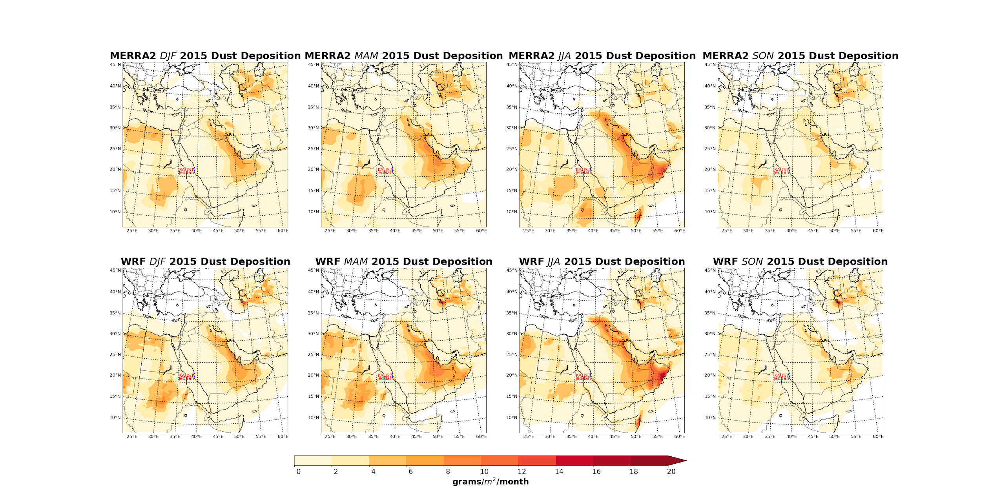
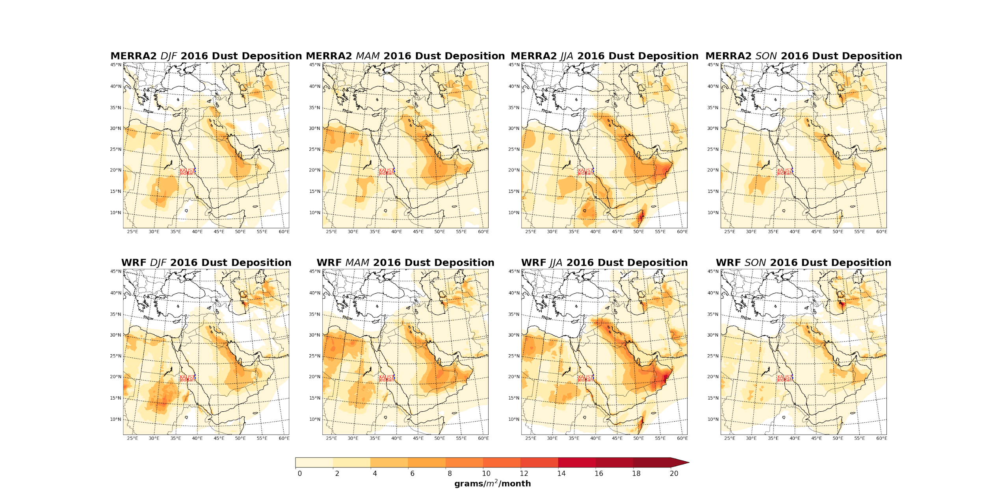
Comparison of DUST deposition of
CAMS, MERRA2 and WRF-CHEM 2015-2016
WRF-Chem Dust Deposition demonstrates a good spatial and temporal agreement with Dust deposition from MERRA2 reanalysis. Columns from left to right: DJF, MAM, JJA, SON. Top row - CAMS, middle row is MERRA2 and bottom row is WRF-Chem dust deposition.

Slide 13
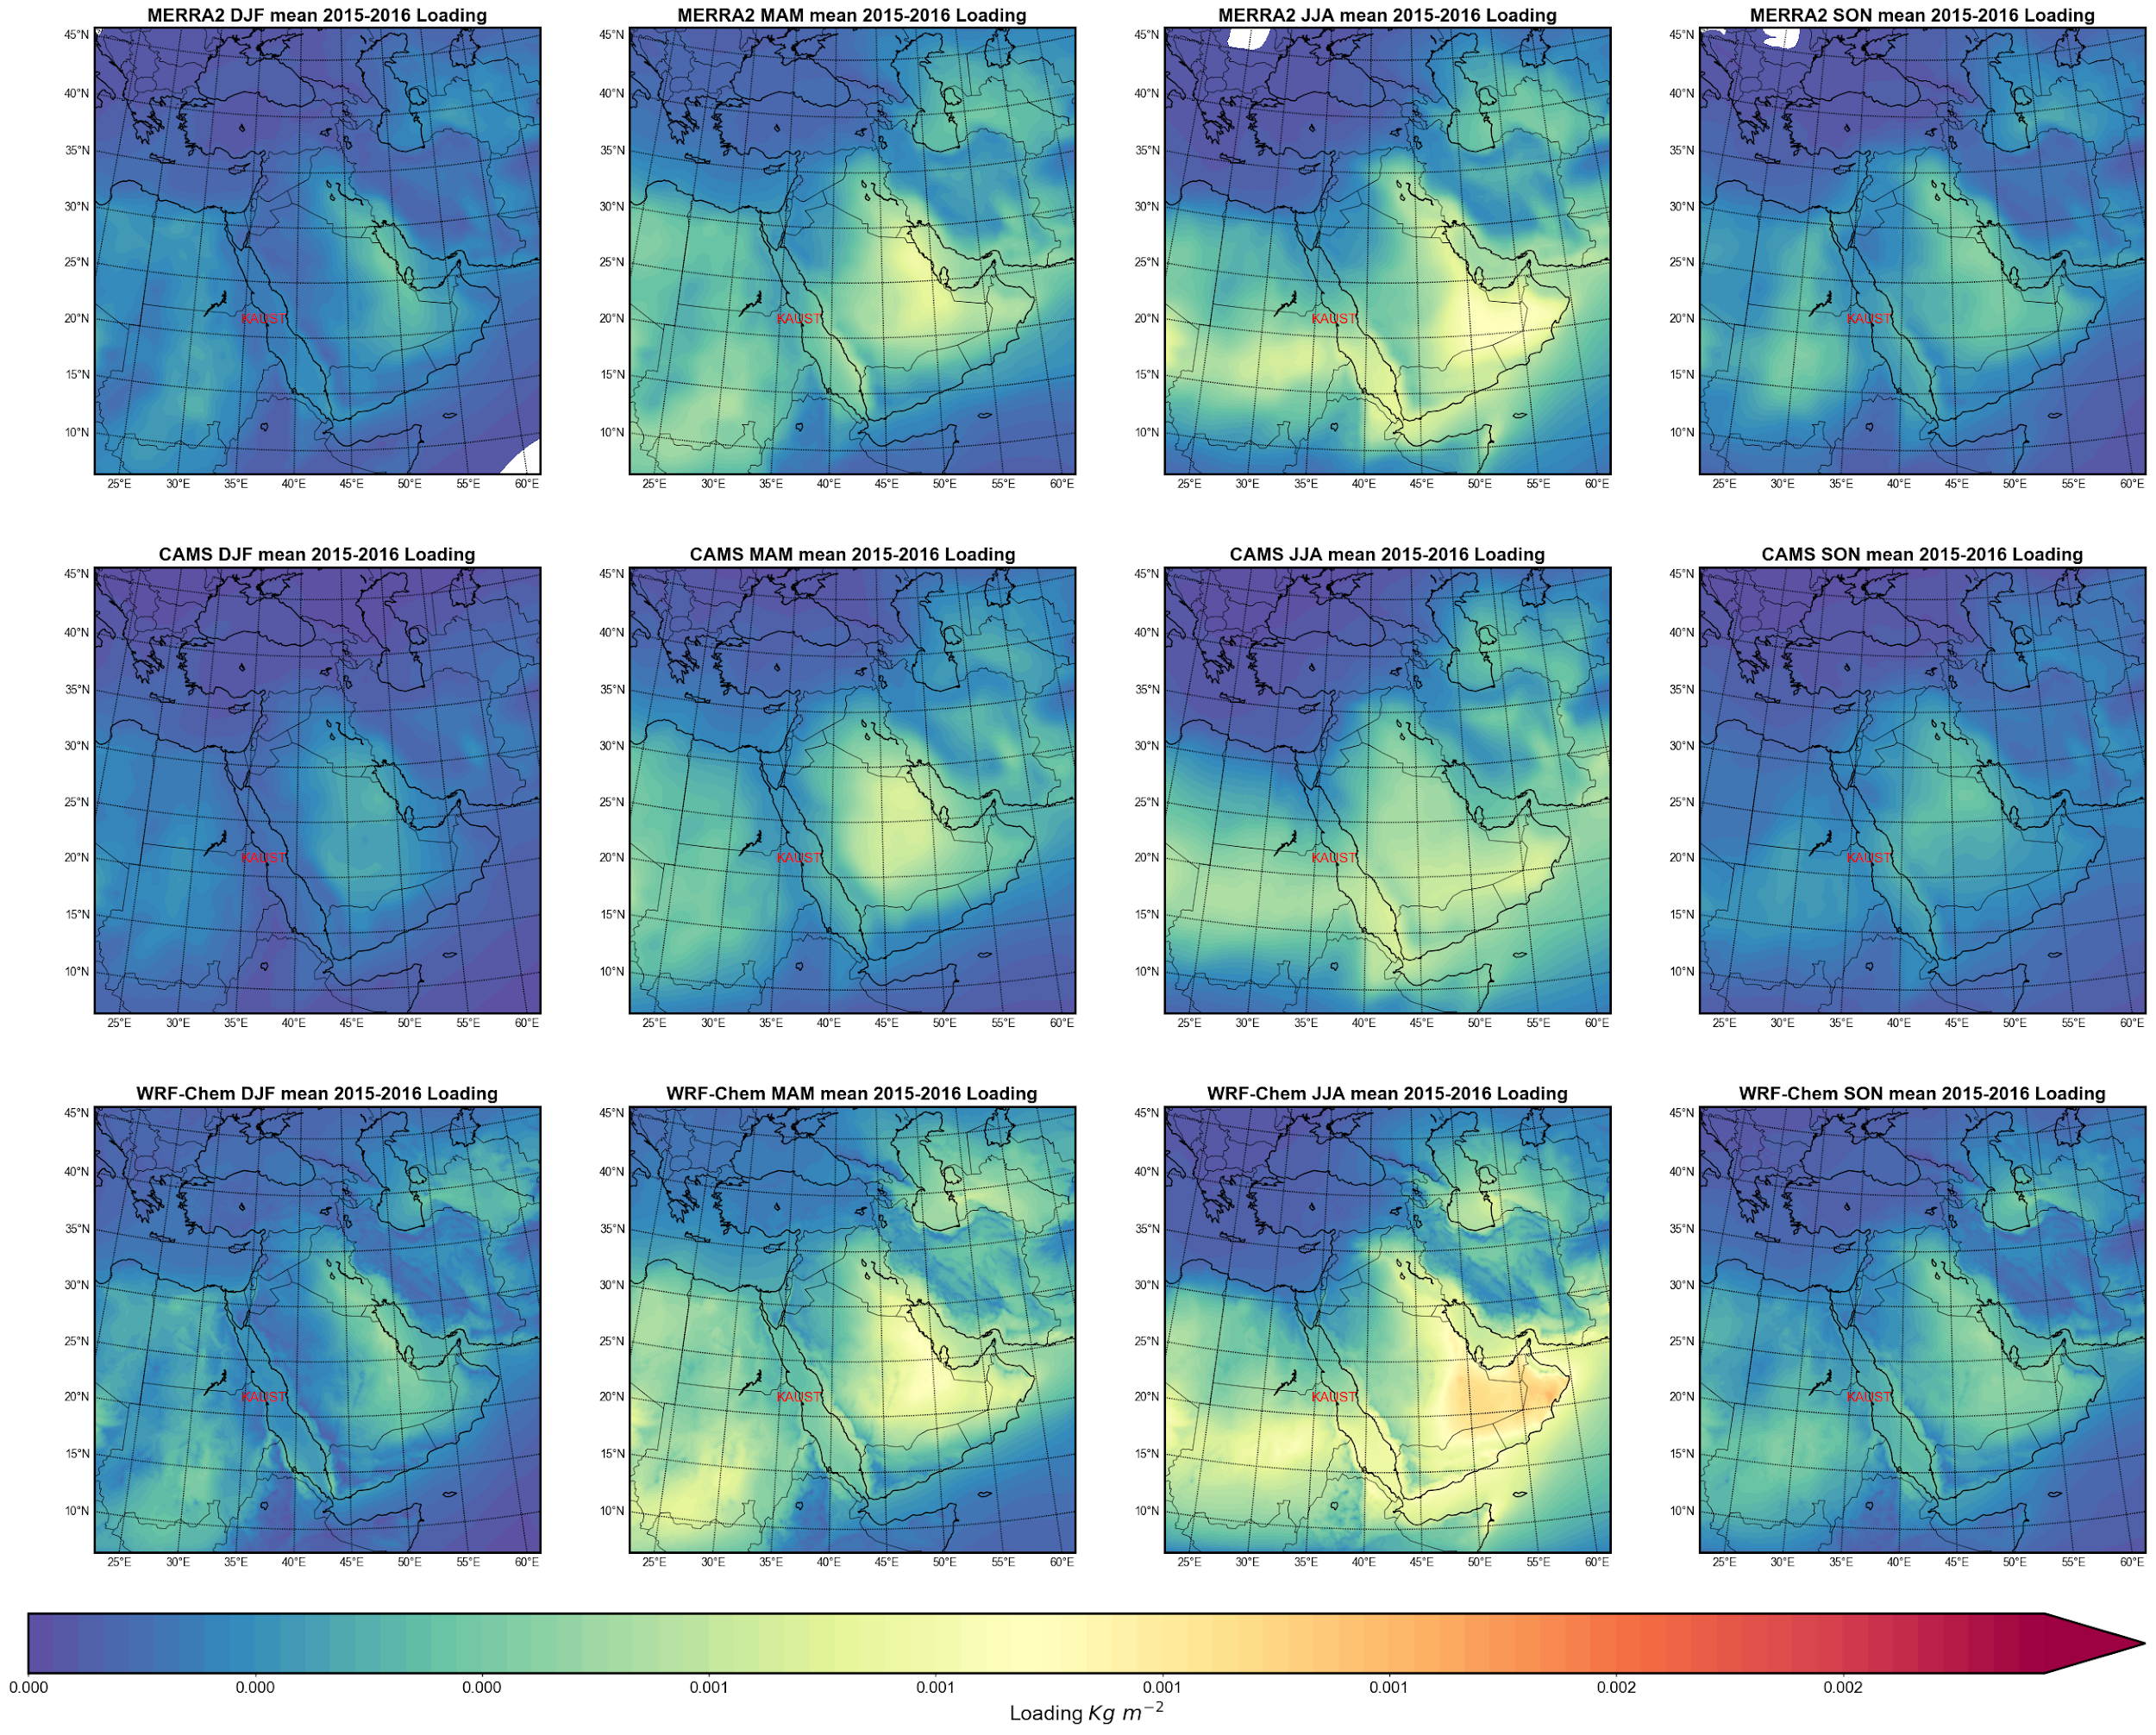
Comparison of DUST Loading between
WRF-Chem & MERRA2 2015-2016
WRF-Chem Dust loading shows a good agreement with MERRA-2 reanalysis. Columns from left to right: DJF, MAM, JJA, SON. Top row - MERRA-2, middle row - CAMS and bottom row - WRF-Chem dust loading.

Slide 14
Conclusion
The dust deposition and emission for years 2015-2016 have been simulated using WRF-Chem and compared with the ground-based observations and gridded MERRA2 reanalysis. Using initial and lateral boundary condition of aerosols and meteorological data from MERRA2 allow us to conduct a more accurate prediction of dust transport and deposition.
The results show a high spatial correlation in dust emission, deposition, loading and aerosol optical depth (AOD), but WRF-Chem slightly overestimates AOD and emissions, especially in the summer period. Both WRF-Chem and MERRA2 underestimate observed dust deposition.
The analysis of dust size distributions in the observations, reveals that most of the deposited mass is contributed by particles larger than 10 microns. These sizes are not represented in the model dust scheme. However, the calculated amount of deposited PM10 in samples compares well with the model predictions.

