Slide 1





Simplified model for axial dipole moment of the geomagnetic field from Brownian fluctuations
Alberto Molina Cardín^{1,2}, Luis Dinis Vizcaíno³, and María Luisa Osete López^{1,2}
¹Department of Physics of the Earth and Astrophysics, Complutense University of Madrid, Madrid, Spain.
²Geosciences Institute IGEO (CSIC-UCM), Madrid, Spain.
³Complex Systems Interdisciplinary Group (GISC), Madrid, Spain
mail: amcardin@ucm.es

Slide 2

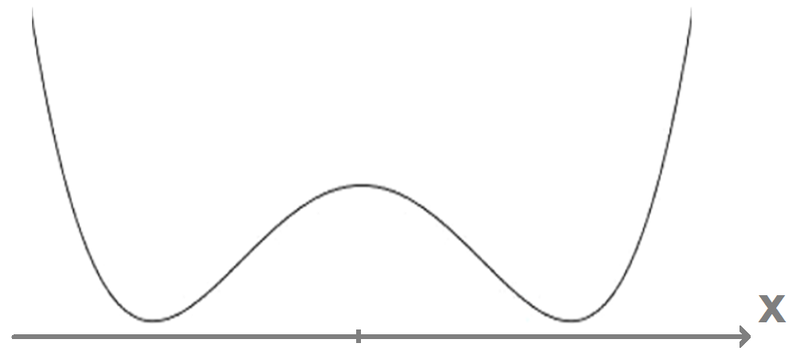

The model
2 Brownian particles in 1D
(affected by random forces).
Within a double-well potential.
Interacting each other
(force proportional to the distance).
ADM (axial dipole moment) provided by the weighted mean of positions.
e.g.: ADM = 0.8·x₁ + 0.2·x₂

Slide 3
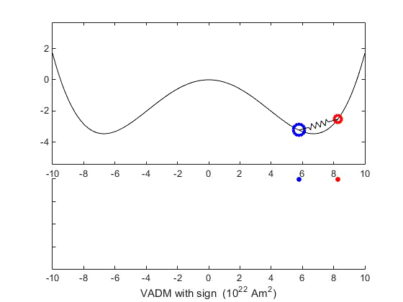
Simulation
Particle 1 (blue)
- More inertia
- Weaker fluctuations
- Represents more % of the ADM
Particle 2 (red)
- Less inertia
- Stronger fluctuations
- Represents less % of the ADM

Slide 4
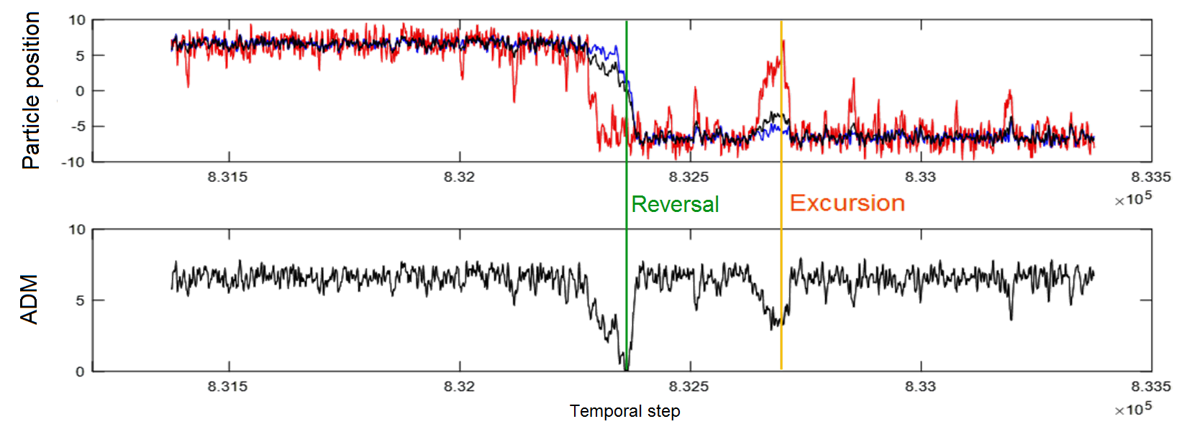
Simulation

Slide 5
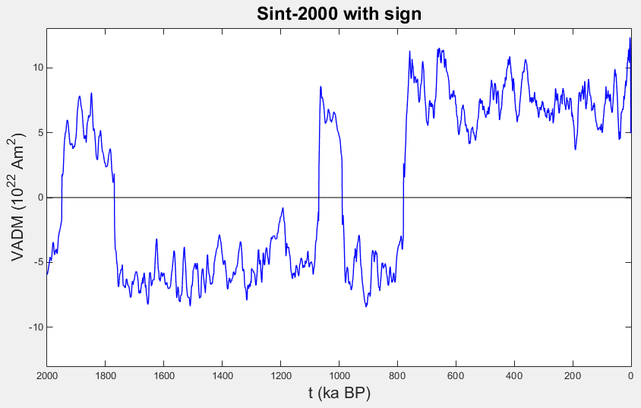
Results
General behavior (non-periodic reversals):
Model Data
(Valet et al., 2005)

Slide 6
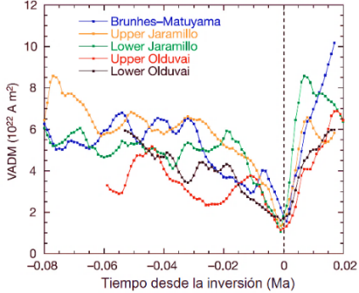
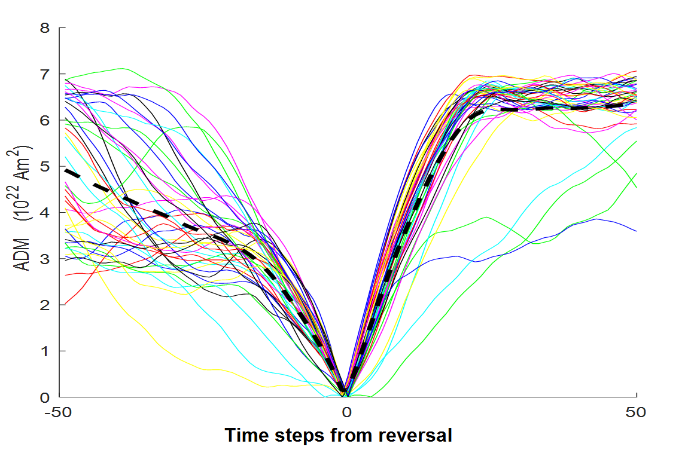
Results
Behavior during a reversal (slow decay and fast recovery):
Model Data
(Valet et al., 2005)

Slide 7
Conclusions
A simple model based on Brownian-type motion is able to reproduce the main features of the ADM variability:
- Non periodical reversals and excursions.
- Asymmetry on temporal evolution during reversals.
Main ingredients of the model that lead to that behavior are:
- Two subsystems interacting.
- Different temperatures (fluctuations).

