Slide 1
Mihir I Desai
IS⨀IS, FIELDS & SWEAP Teams
EGU 2020
Session: ST1.3: Paper No. D2959 | EGU2020-1901
Thursday, May 7, 2020: 14:00 – 15:45
Notes:
introduction

Slide 2
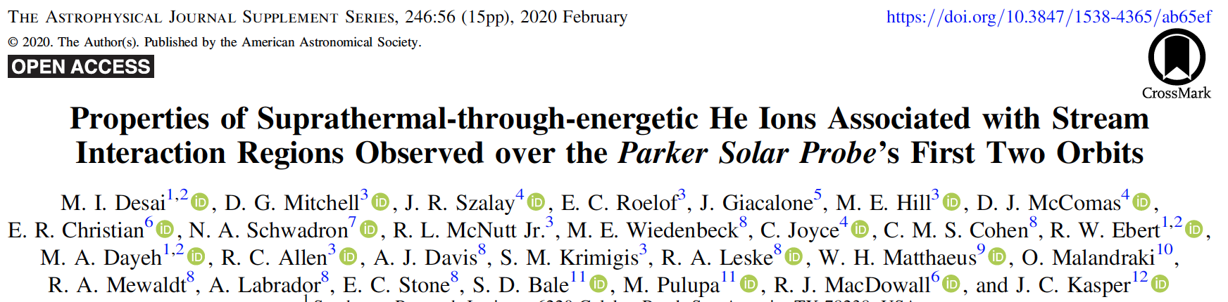
PSP Results in Special Issue of ApJS

Slide 3
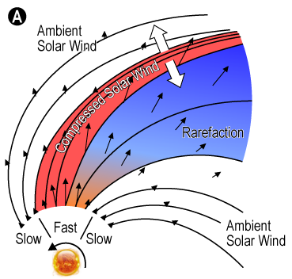
Outline
CIRs and SIRs
PSP Overview
PSP SIR events
  Time histories
  Anisotropies
  Spectral Properties
Summary & Conclusions

Slide 4
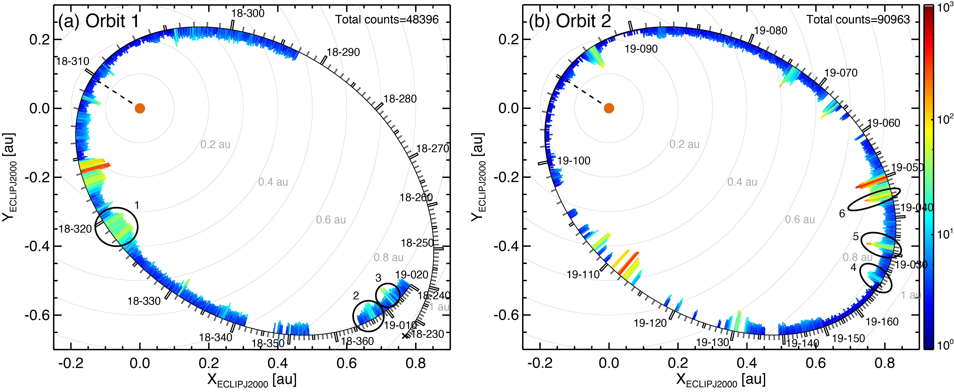
PSP First Two orbits

Slide 5
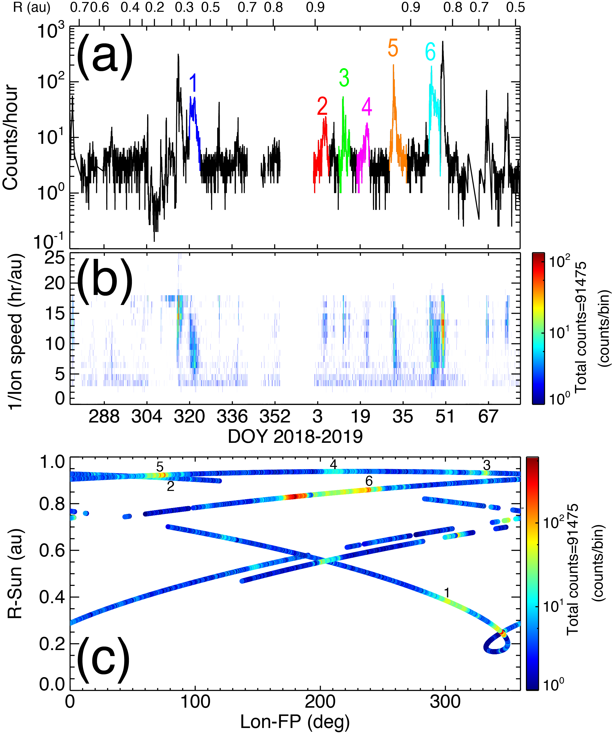
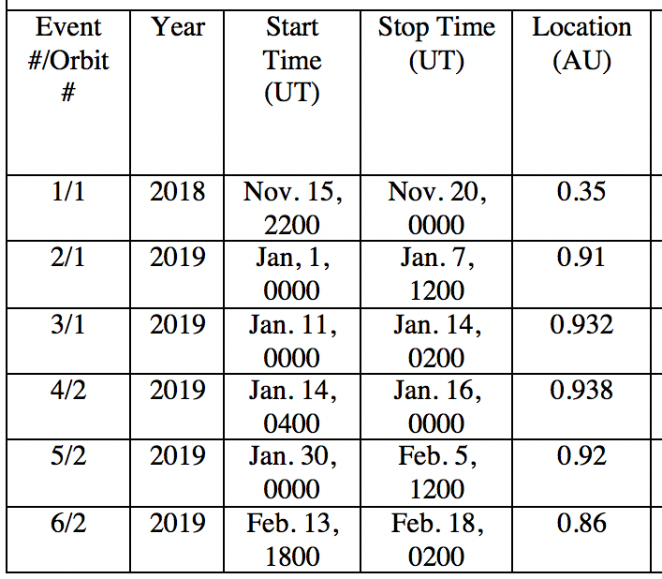
PSP First Two orbits
Events with same footpoint longitude #2 & 5

Slide 6
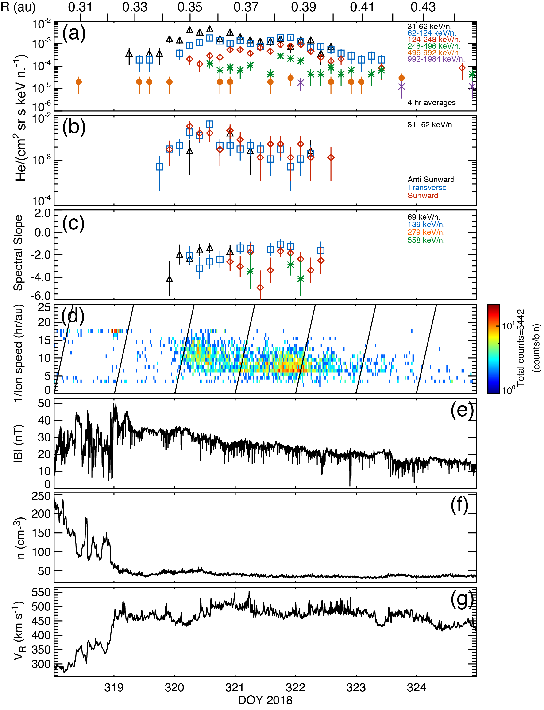
Event #1: PSP at 0.35 au
PSP exits a compression region and enters a rarefaction region
Inverse velocity dispersion ➔Intensity peaks first at lower energies and then at higher energies later in the event
He intensities are either equal to or greater than those seen at lower ==>flat spectrum
Particles flow sunward

Slide 7
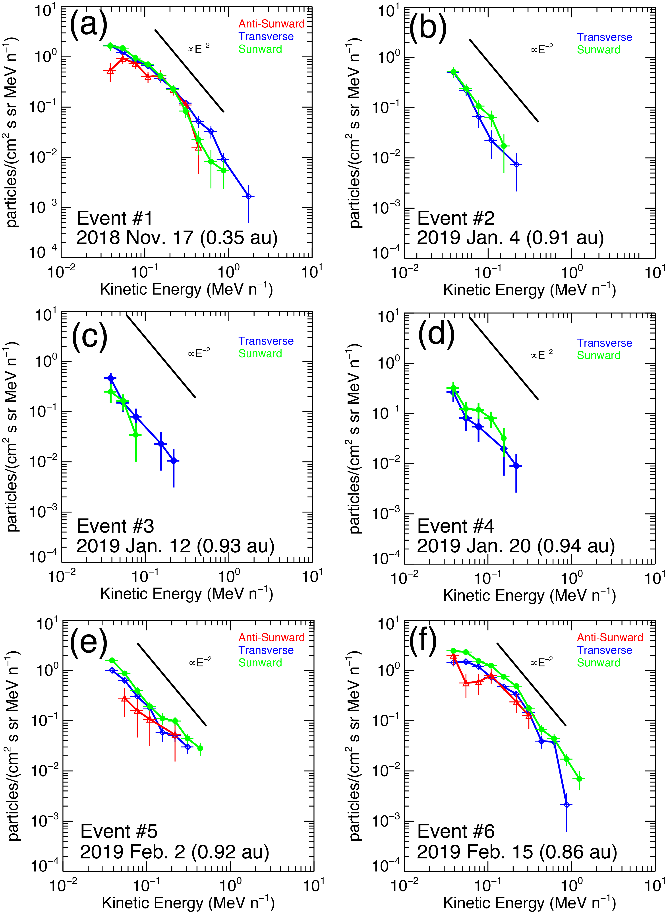
Event #1: PSP at 0.35 au
Spectra flatten at lowest energies, but continue as power-laws in sunward and transverse flow directions
Isotropic distribution above 200 keV/n.

Slide 8
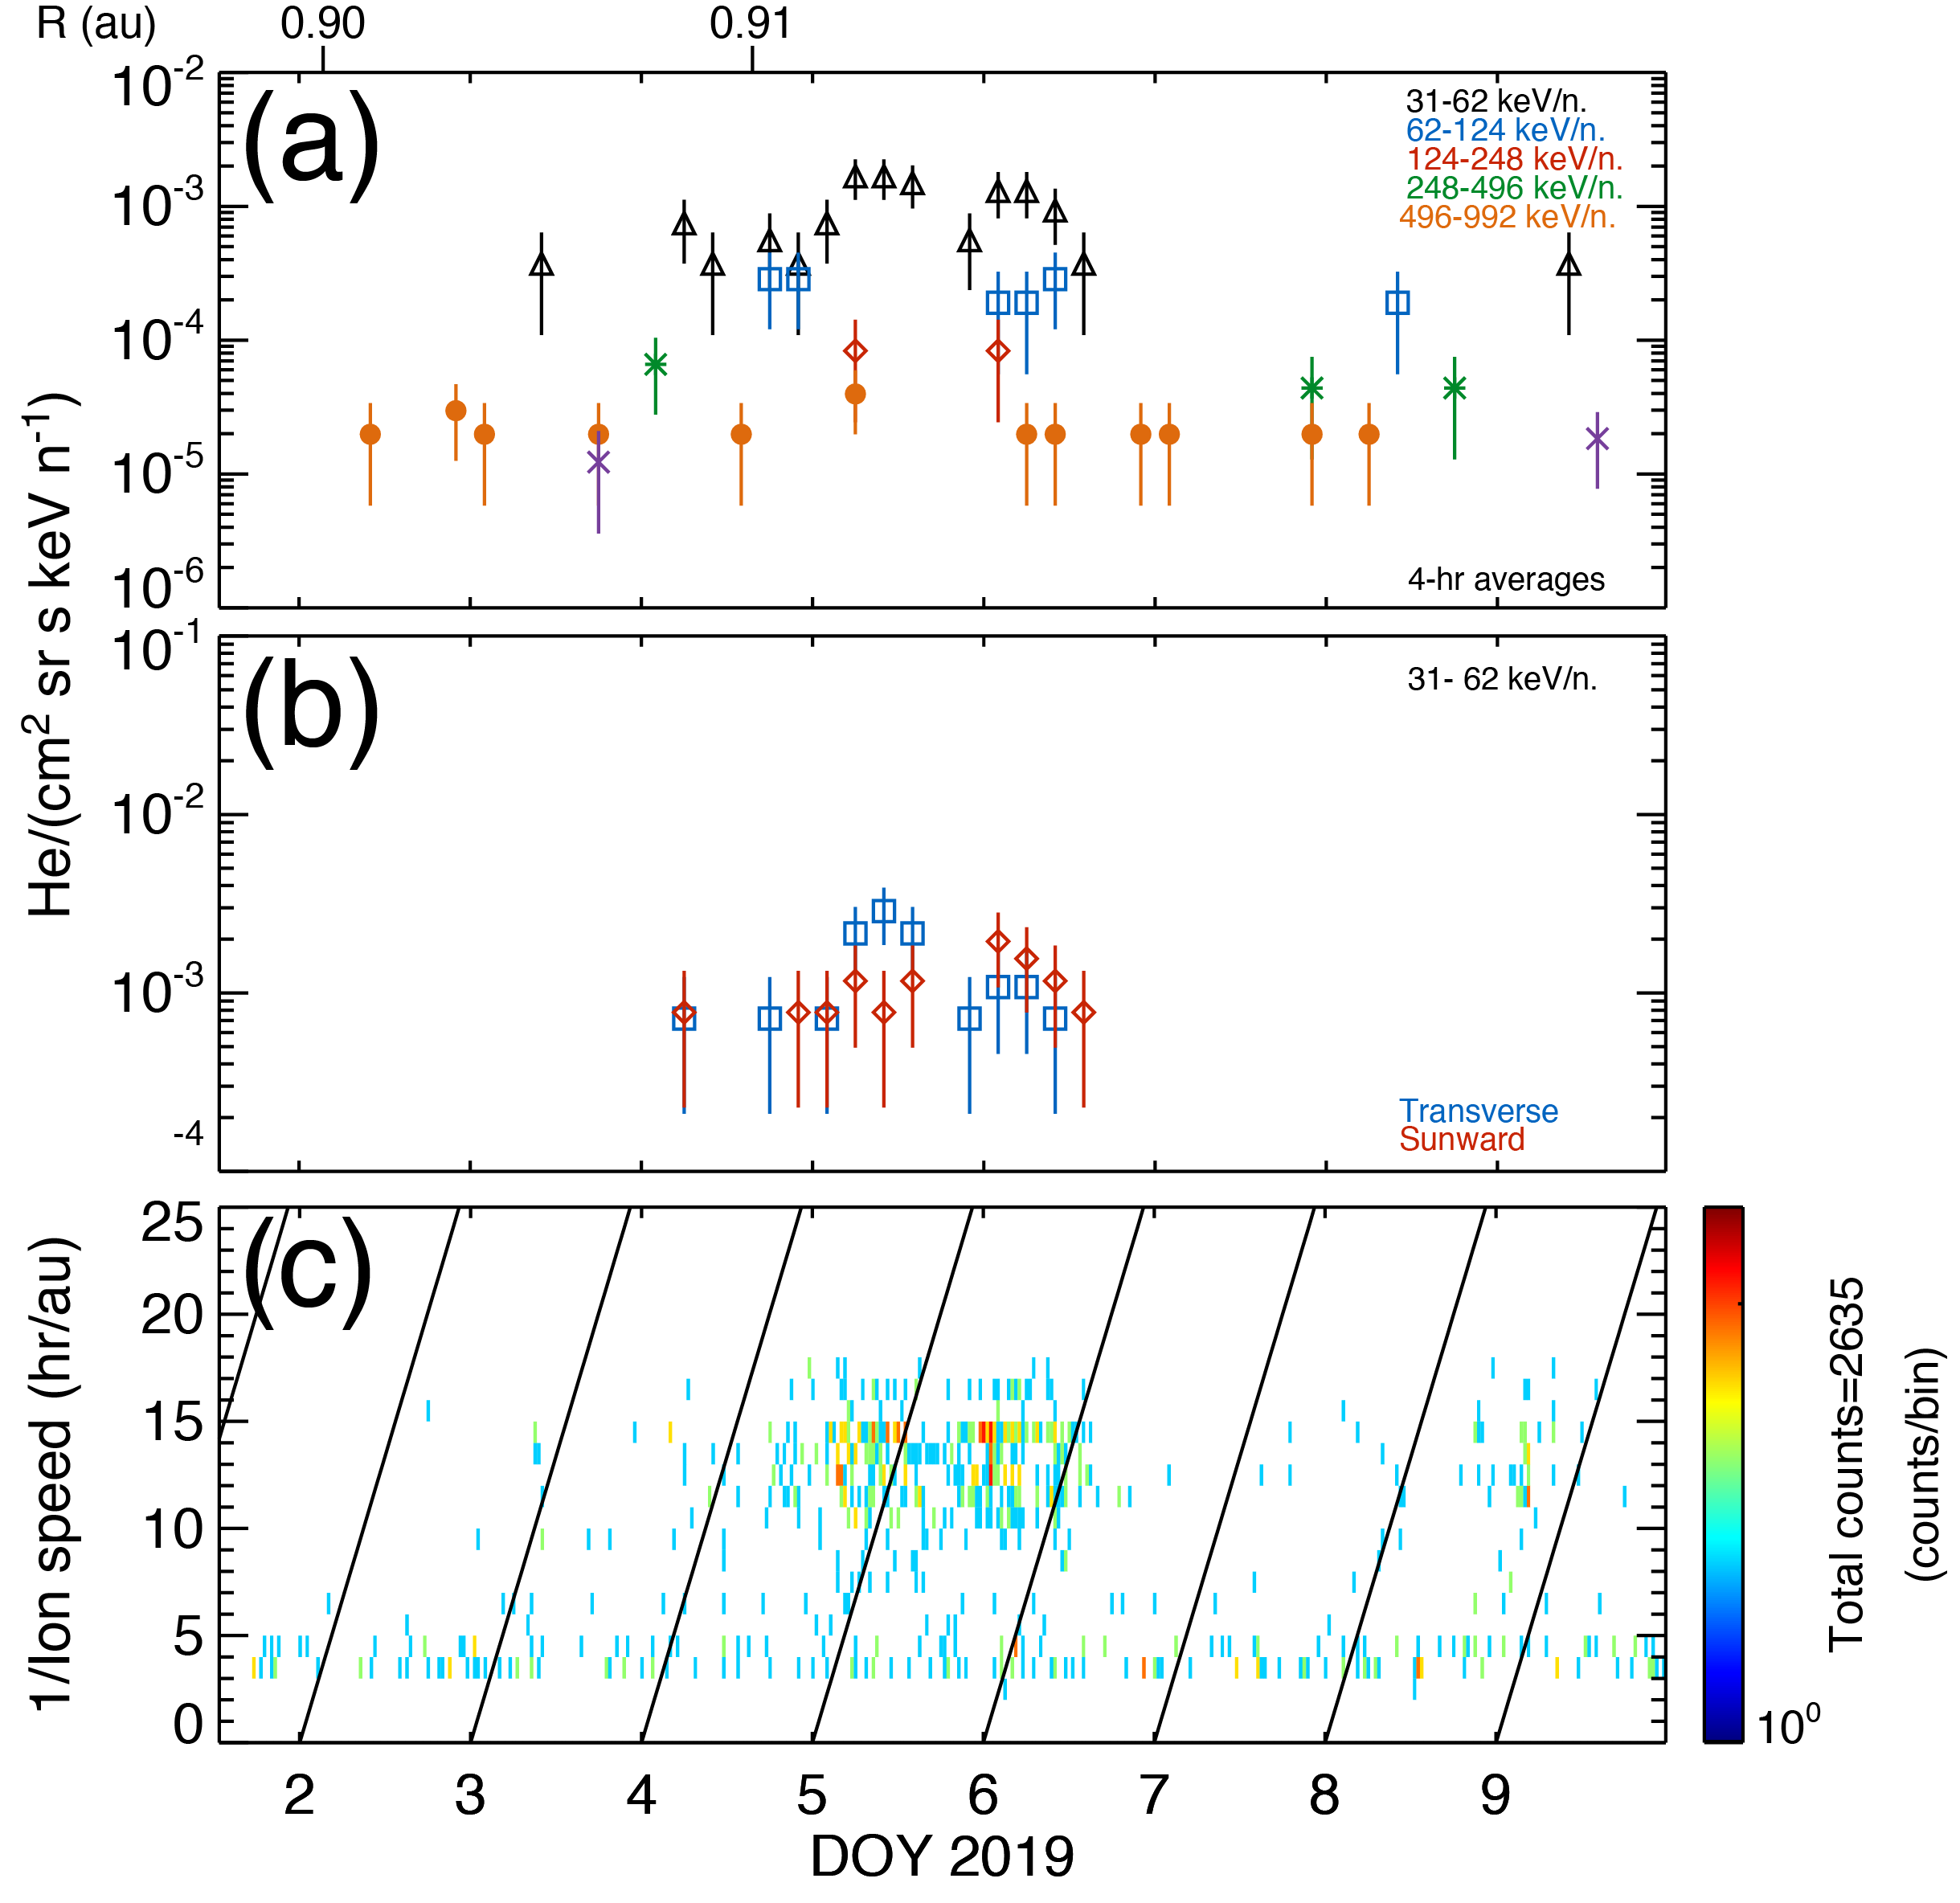
Event #2: PSP at 0.91 au
Continue as power-laws in sunward and transverse flow directions;
No counts in anti-sunward flow direction

Slide 9
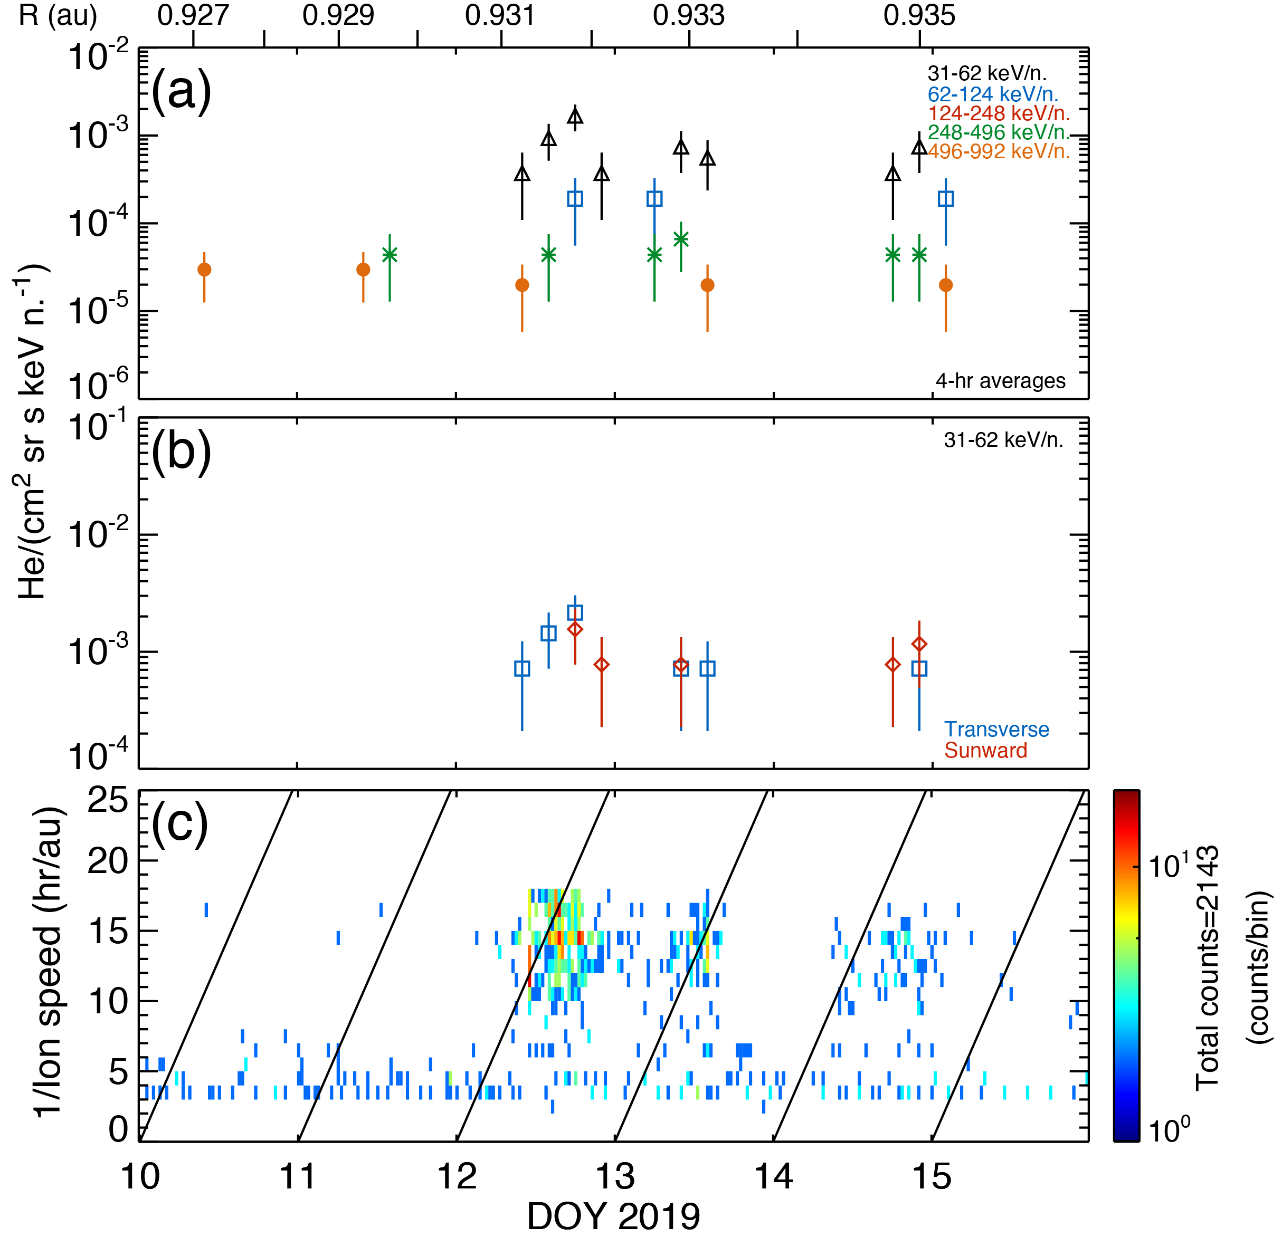
Event #3: PSP at 0.93 au
Continue as power-law in transverse and sunward flow directions;
No counts in anti-sunward flow direction

Slide 10
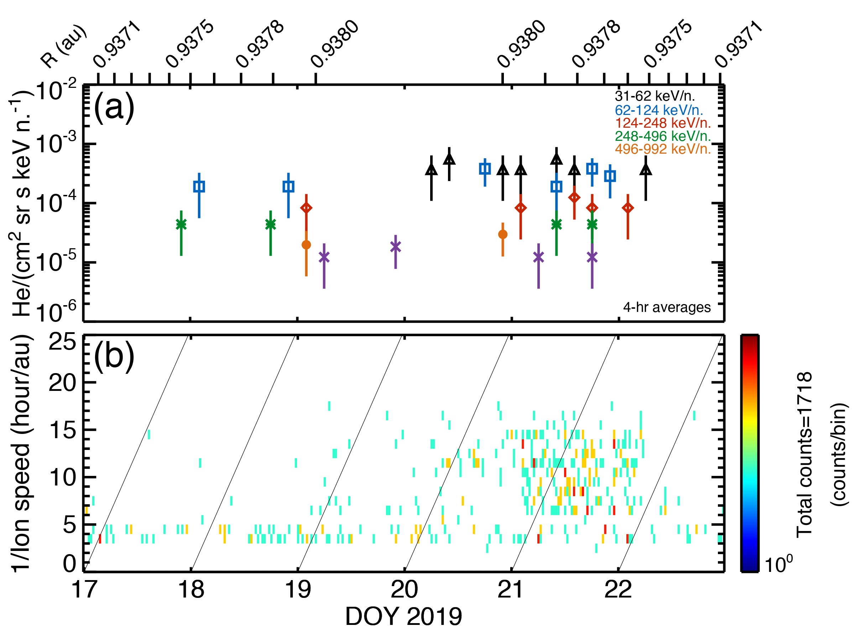
Event #1: PSP at 0.94 au
Continue as power-laws in sunward and transverse flow directions;
No counts in anti-sunward flow direction

Slide 11
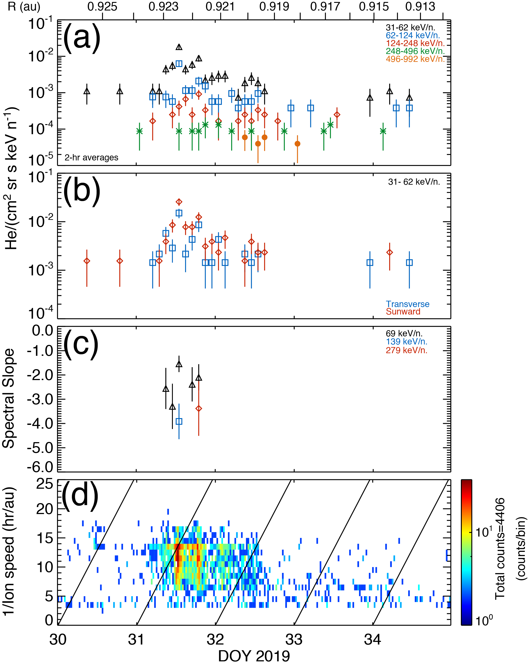
Event #5: PSP at 0.92 au
Continue as power-laws in all look directions;
Net Sunward flow

Slide 12
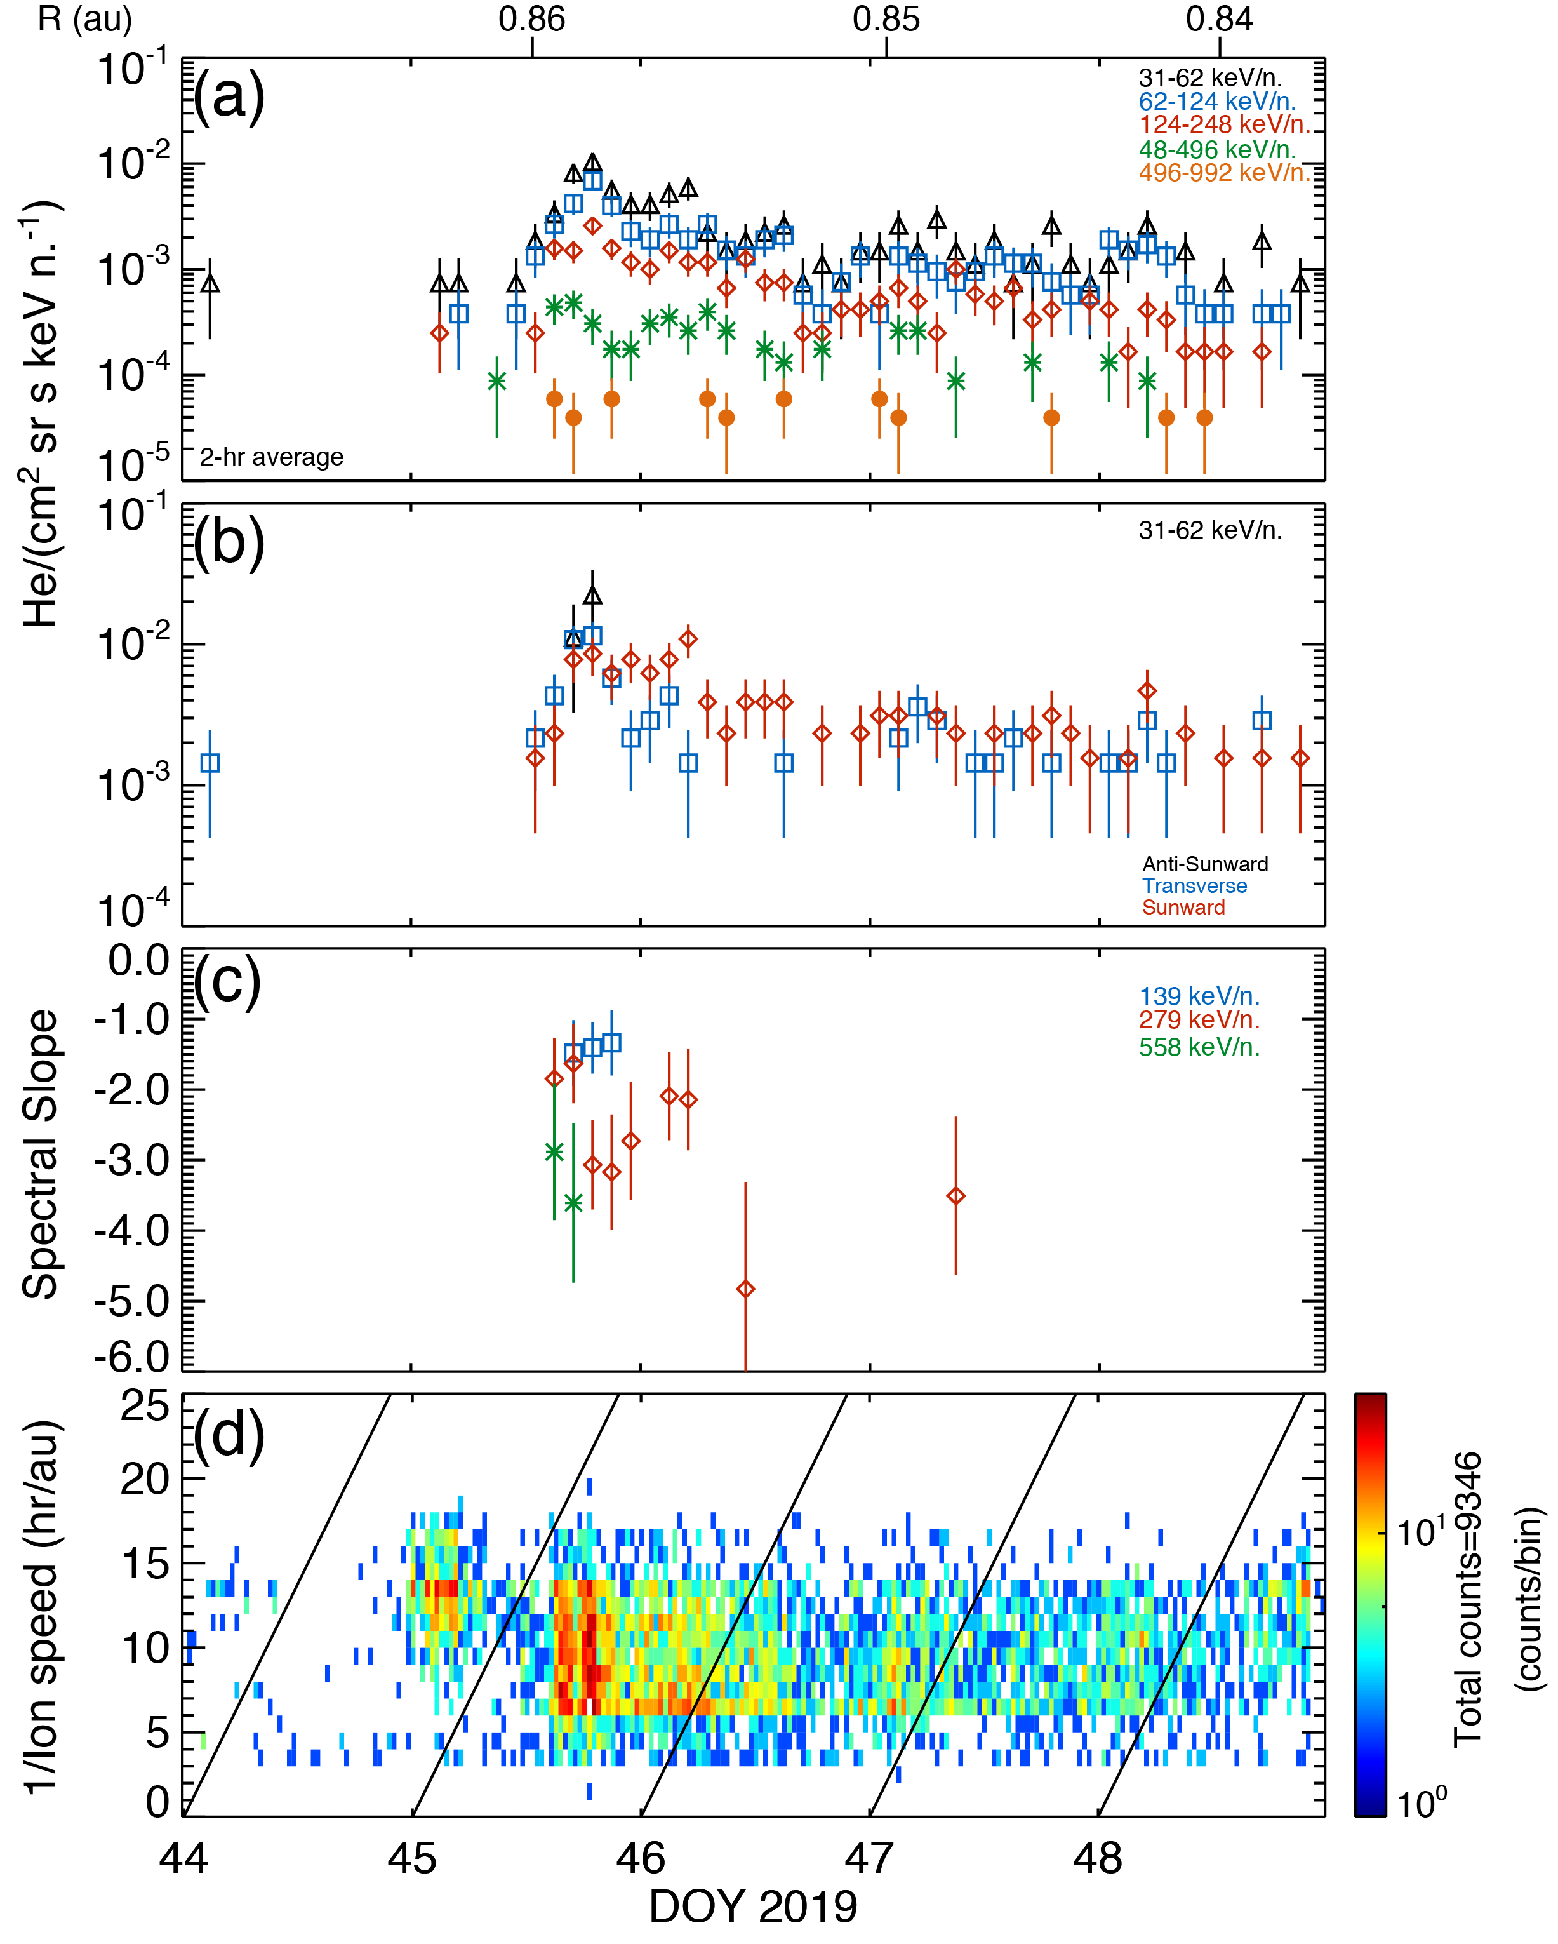
Event #6: PSP at 0.85 au
Spectrum flattens at lowest energies, but still continue as power-laws in sunward and transverse flow directions
Particles show sunward flow

Slide 13
Events #1 & #6: 0.35 au vs 0.85 au

Slide 14
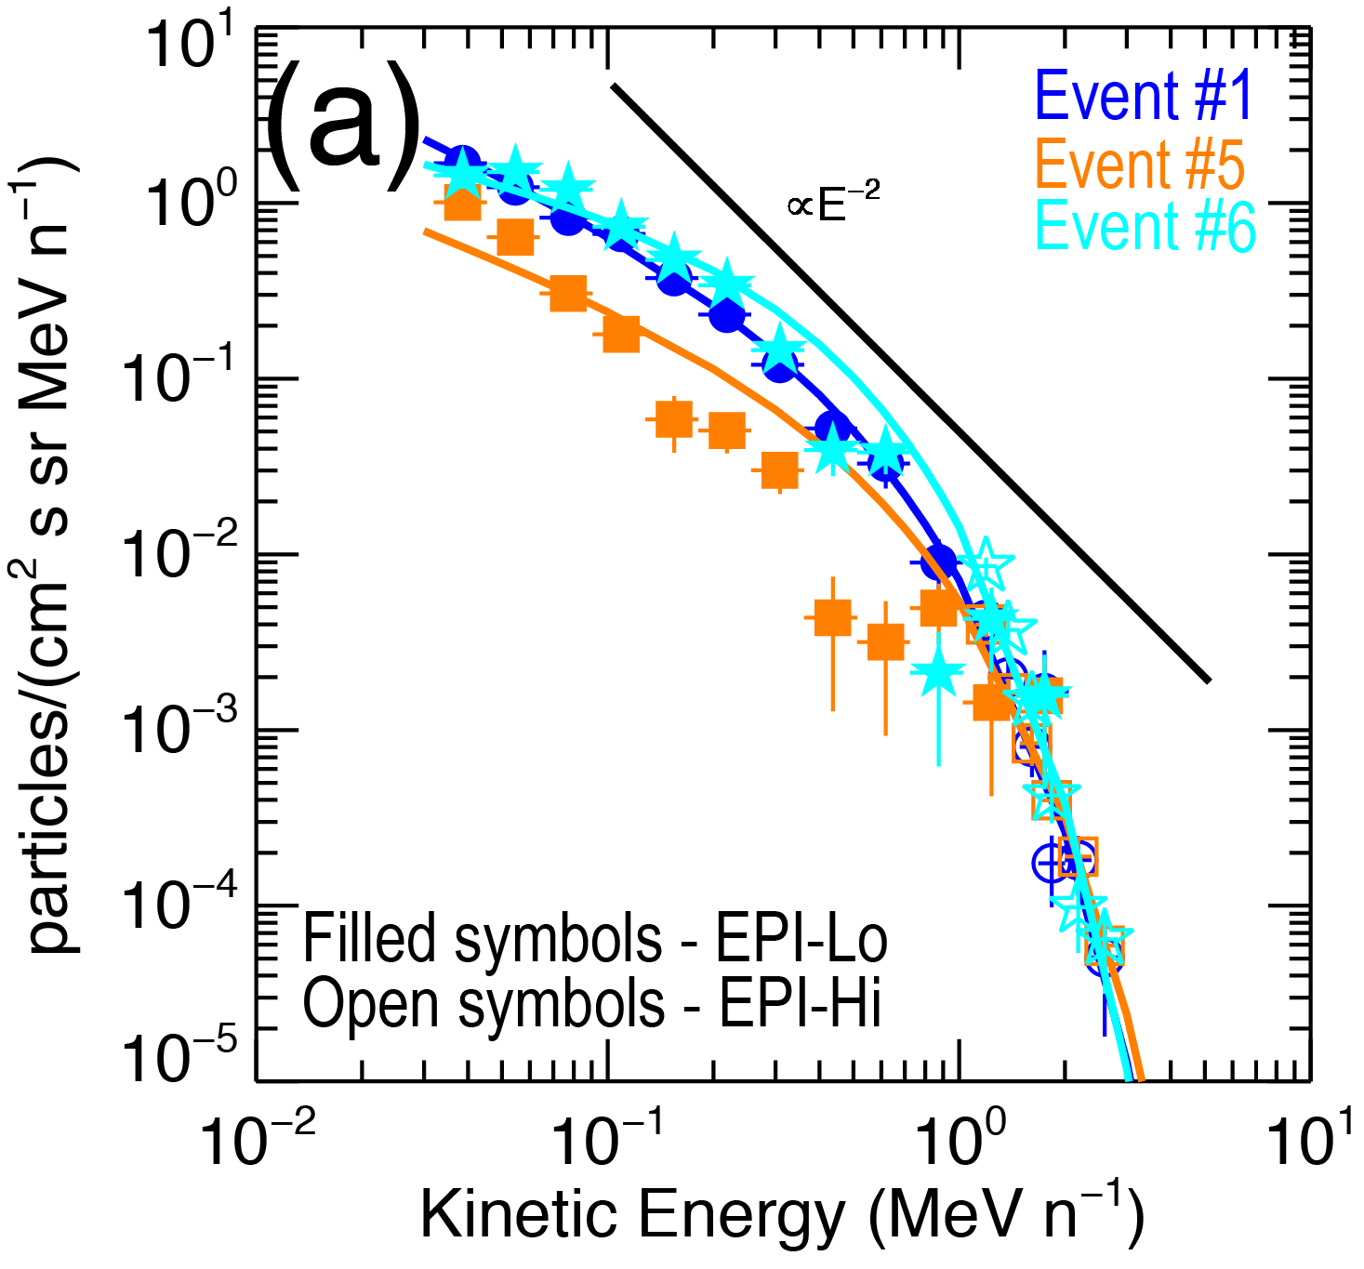
Events #1 #6: 0.35 au vs 0.85 au
Spectra for Events #1 and #6 are identical
Footpoint longitude shows that PSP was not sampling the same CIR
Spectra flatten at lower energy, but still exhibit power-laws
Nearly Isotropic distributions in s/c frame➔sunward flows in plasma frame
Time histories show higher energy ions arrive later in the event
Intensity enhancements occur far away from trailing edge

Slide 15
Summary of Results
PSP/ISOIS/EPI-Lo observed 6 distinct CIR/SIR-associated He intensity enhancements between ~0.03 – 2 MeV nucleon⁻¹
He ions are generally flowing inward toward the sun
In the two strongest events, at 0.35 au and 0.85 au, the higher energy ions arrive later than the lower energy ions
The energy spectra flatten at the lowest energies but still continue as power-laws down to ~0.03 MeV/n
Above ~0.2 MeV/n, the spectra behave as power-laws of the form ∝E⁻²

Slide 16
Discussion & Conclusions
Three possible sources of suprathermal He in SIR/CIR events at PSP
  Local acceleration
    Unlikely because of net sunward anisotropies and no flow reversals
  PSP enters quasi-stationary rarefaction regions/flux tubes filled with CIR shock accelerated particles
    Unlikely because the time histories of He intensities and spectral slopes show that higher energy (speed) ions arrive later in the event –
  Connection to distant CIR shock
    Particles are most likely accelerated at distant CIR shocks, PSP connects to more efficient portions of the shock later in the event
  ➔Identical spectral forms without turn-overs at 0.85 and 0.35 au pose serious challenges for traditional transport models that estimate energy losses due to adiabatic deceleration (Fisk & Lee 1980; Zhao et al., 2016). Note that Roelof (2015) proposed an alternative model for energy losses.

Slide 17
THANK YOU

Slide 18
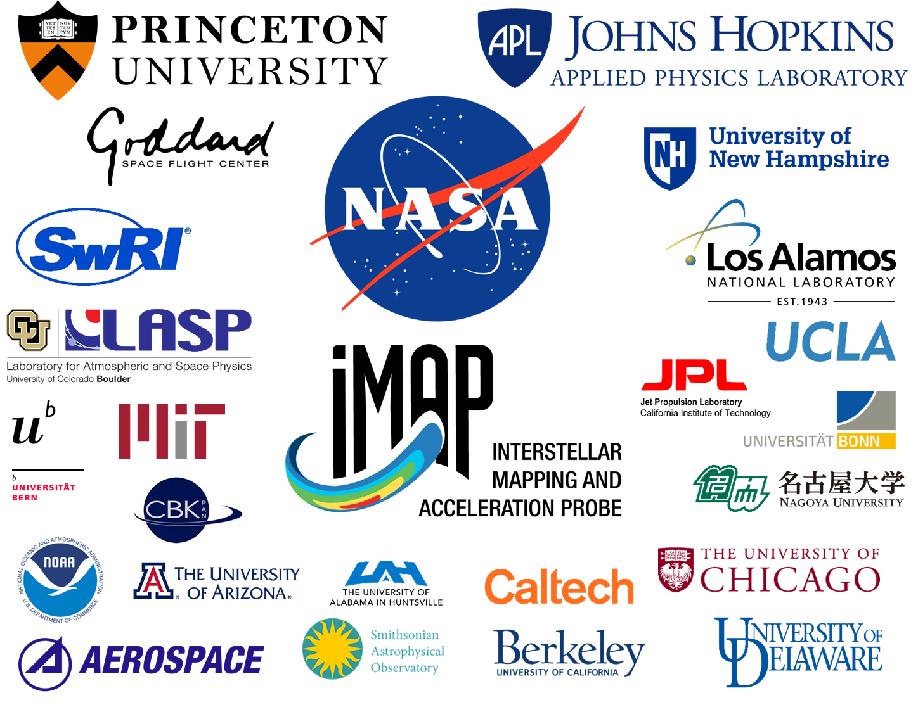
Work in Progress
4 of the 6 events were also observed at STEREO-A
Multi-spacecraft study is in progress
PSP will observe many CIRs and associated energetic particles
Coordinate with
  Solar Orbiter, 2020
  PUNCH, 2022
  IMAP, 2024

Slide 19
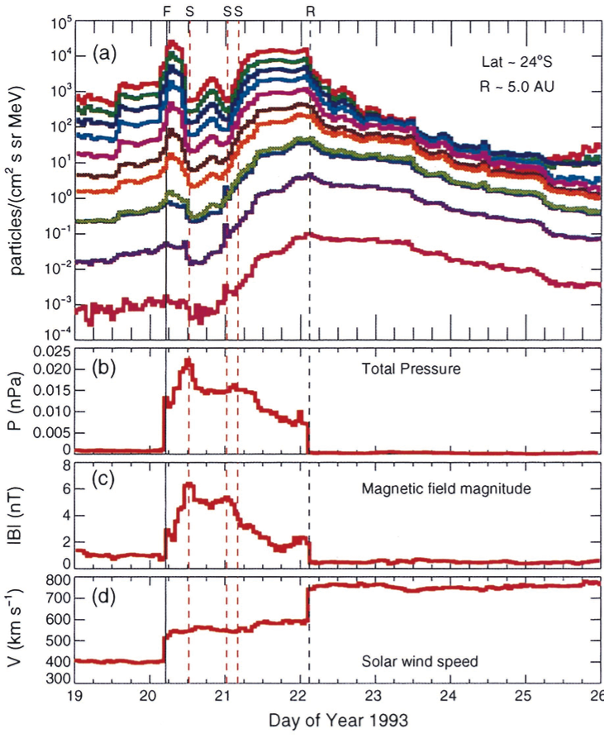
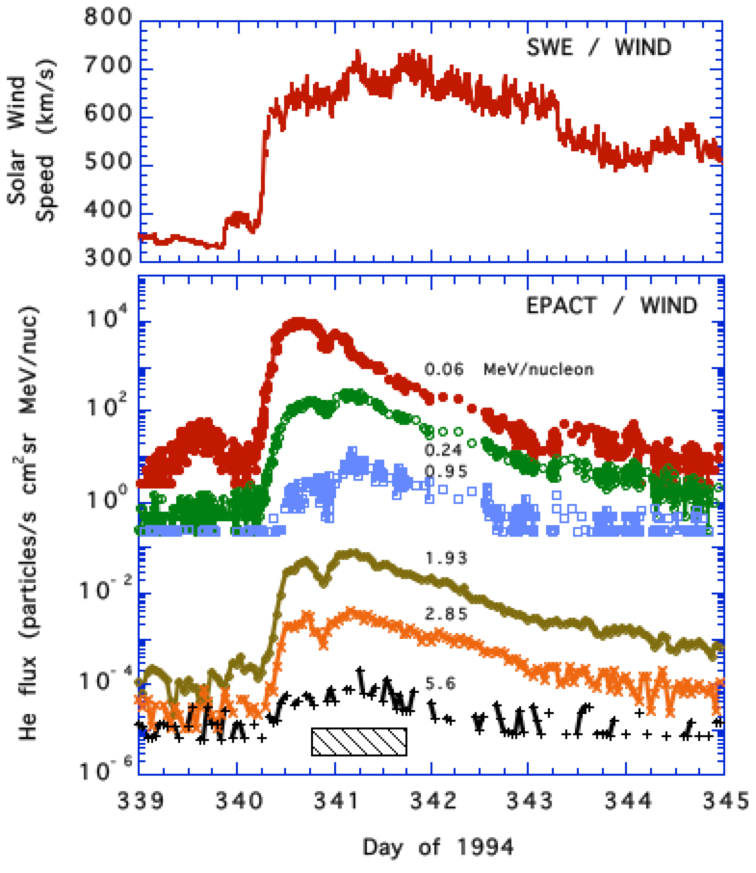
CIRs and Particles: 5 AU and 1AU
Ulysses – well-defined forward/reverse shock pairs
EPs peak at F/R shocks
Wind – shocks not formed
EP peak in high-speed stream
Desai et al. 1999
Mason et al. 1997

Slide 20
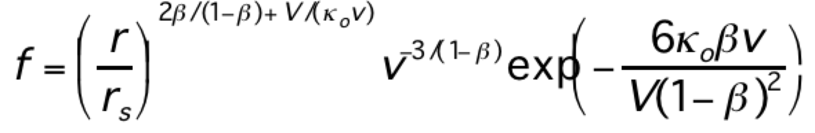
Fisk & Lee CIR spectral form--
CIR spectral form:
where: v = particle speed;
r = radius of observer;
rs = shock radius;
β = shock strength;
κ =diffusion coefficient;
V = solar wind speed
Particles in CIRs accelerated at forward and reverse shocks at several AU
Propagate in to 1 AU while undergoing adiabatic deceleration in solar wind
Yields distribution function, energy spectra and gradients similar to observations above ~500 keV/n
L. A. Fisk and M. A. Lee, Astrophys. J., 237, 620, 1980

Slide 21
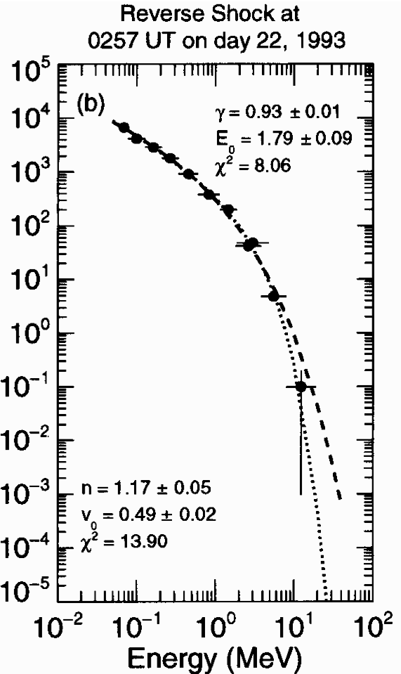
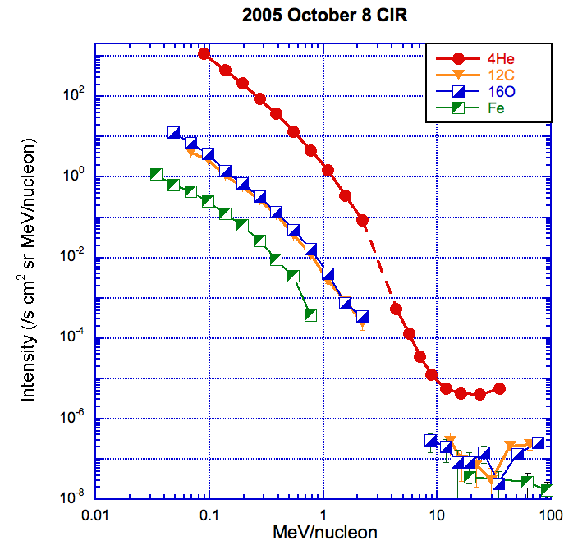
Comparison with Fisk & Lee spectral form
Spectral Forms at 5 AU and 1 AU
Power-law below ~1 MeV; exponential roll-over above ~1 MeV/n.
Desai et al. 1999
Mason et al. 2008

Slide 22
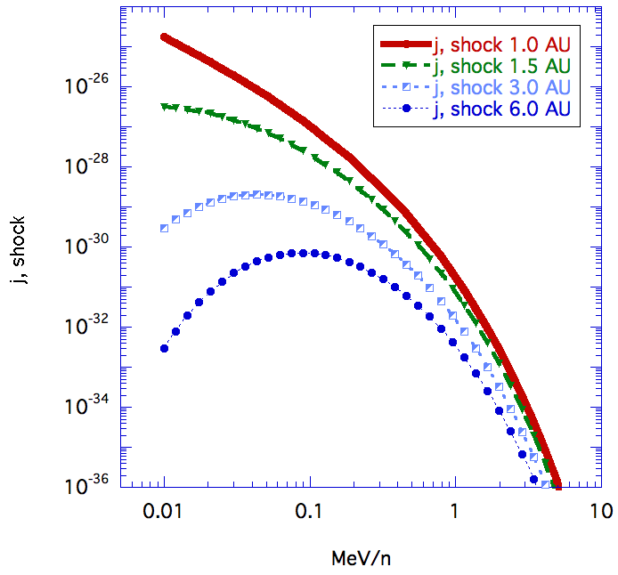
Comparison with Fisk & Lee spectral form
1 AU: No signs of turn-over
Power-laws at <100 keV
Source unlikely from >2 AU
Mason et al. 1997; 2008
Chotoo et al. 2000. JGR, vol. 105; 23107
Desai et al. 1999

Slide 23
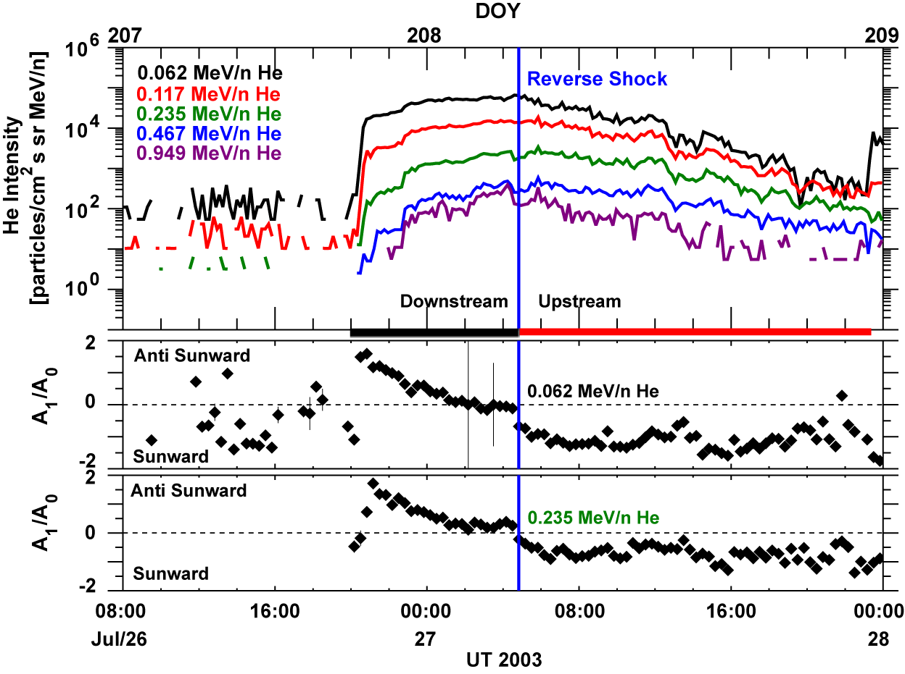
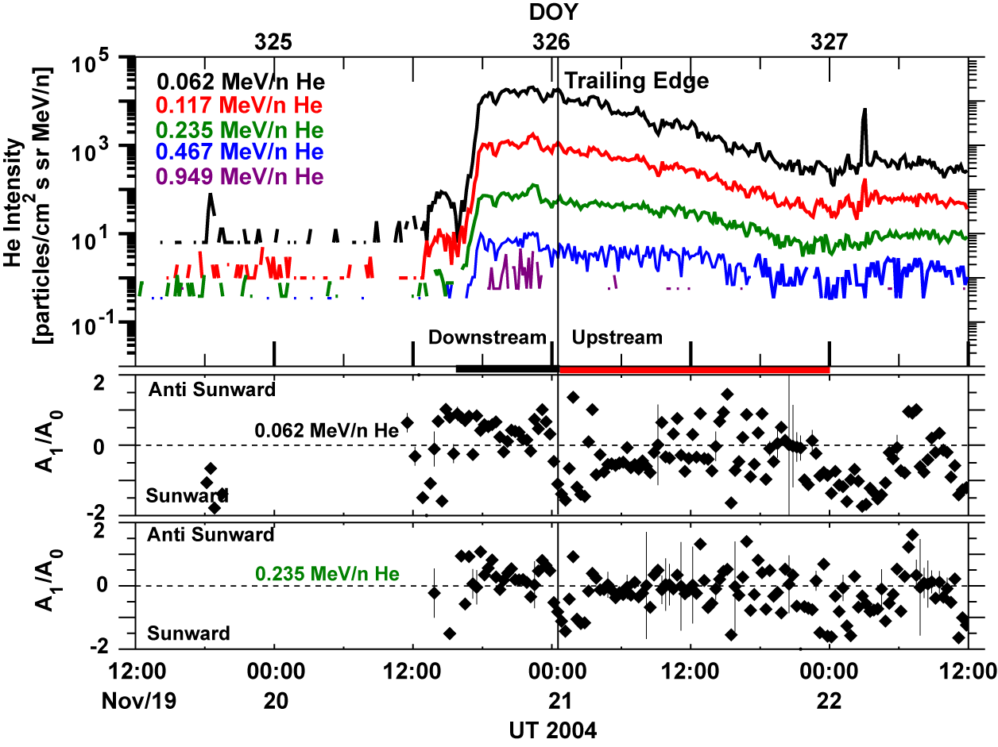
Particle Flow directions at 1 AU
Ebert et al. 2012
Flow directions transition from anti-sunward to sunward across the reverse shock or trailing edge
➔Clear signature of local acceleration
CIR with a Reverse Shock
CIR with Strong Compression

Slide 24
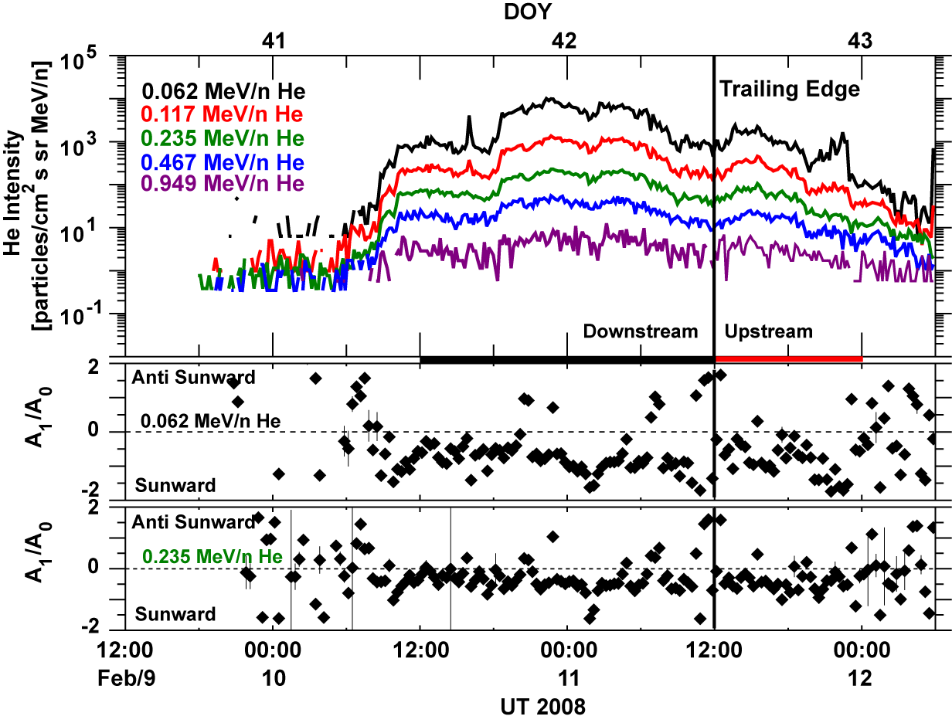
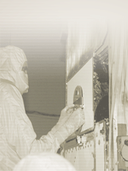
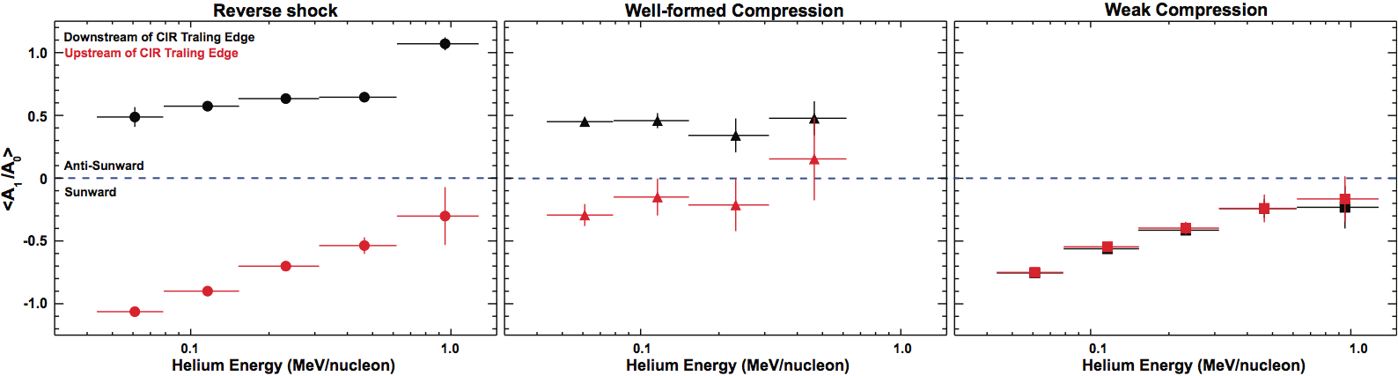
CIR with Weak Compression
Flow reversals in strong compression regions; Sunward flows in weaker compresission regions
Ebert et al. 2012

Slide 25
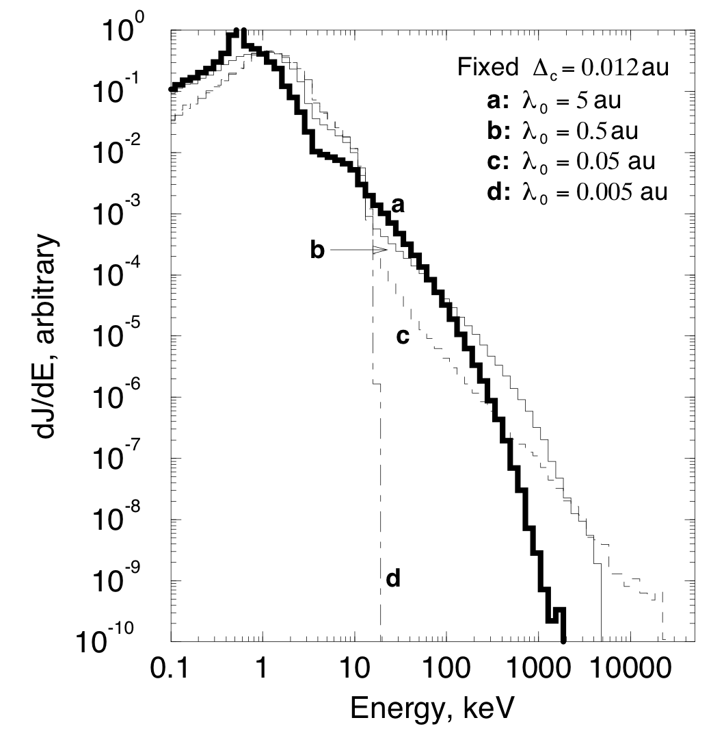
Recent models – local acceleration
Giacalone et al. (2002): Ions can be accelerated in the compression regions, even without shocks.
Li et al., (2014), Zhao et al., 2016:
Model includes particle acceleration and transport,
Ions undergo adiabatic deceleration

Slide 26
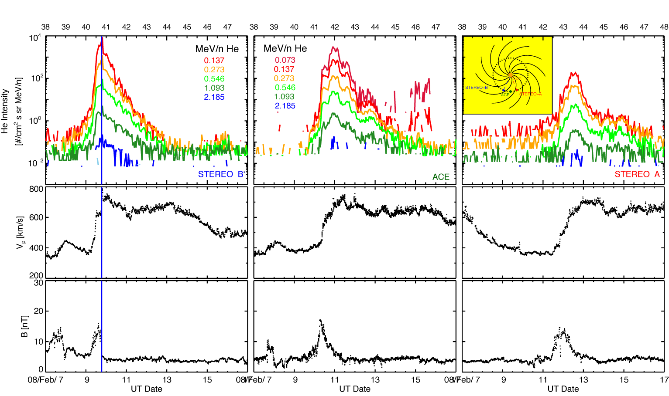
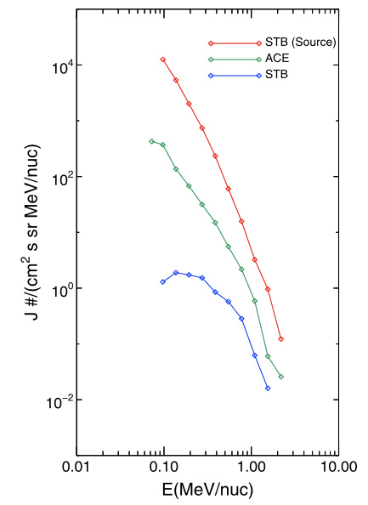
Multi-Point observations

Slide 27
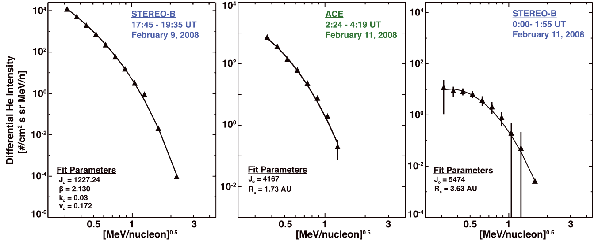
More recent models

