Slide 1
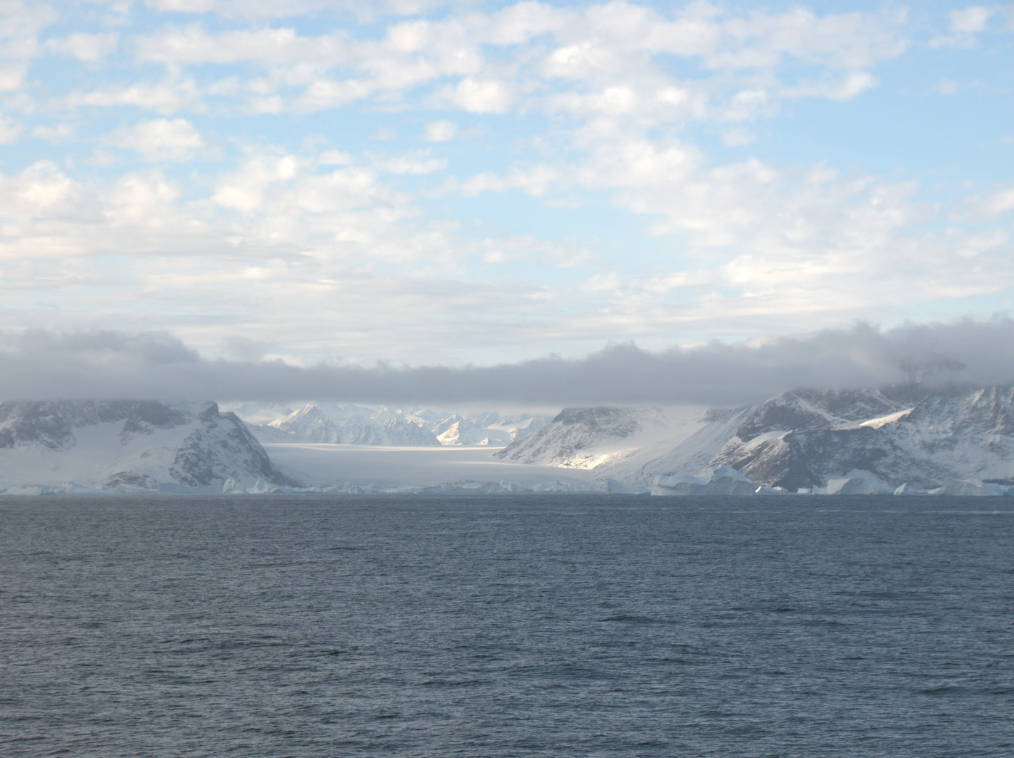

Impact of the North Atlantic Warming Hole on Sensible Weather
Melissa Gervais, Penn State
Jeffrey Shaman, Columbia University
Yochanan Kushnir, Lamont-Doherty Earth Observatory
European Geophysical Union 2020
Photo: Melissa Gervais

Slide 2
Summary
Self-organizing maps are used to Identify North Atlantic jet regimes and associated sensible weather in a series of atmosphere-ocean modelling studies
3 Key Take-Home Points:
The transient eddy-mean forced response jet impacts occurs at different latitudes, strengths, and orientations depending on the jet regime
Dominant impact of the North Atlantic Warming Hole (NAWH) on precipitation is through a suppression over the NAWH and enhancement downstream. This has different local impacts on European precipitation depending on NAWH strength
Large negative surface temperature differences over the NAWH lead to lower surface temperature over Eurasia in regimes where air is advected from the subpolar gyre over Europe
Gervais et al. 2020

Slide 3
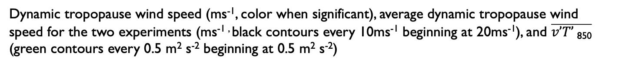
Impact of twice deepened warming hole in jet regimes identified by the SOM analysis
Black contours show average dynamic tropopause wind speeds for these two experiments. SOM classifies into 12 regimes with different jet locations and strengths
DJF SOM Composite Differences CNTRL90-2KFill90
Dynamic tropopause wind speed (ms⁻¹, color when significant), average dynamic tropopause wind speed for the two experiments (ms^{-1 ,} black contours every 10ms⁻¹ beginning at 20ms⁻¹), and $\overline{v’T’ \text{850}}$ (green contours every 0.5 m² s⁻² beginning at 0.5 m² s⁻²)
Green contours show differences in transient eddy activity responsible for feeding the jet enhancements
Colors show differences in wind speed on the dynamic tropopause. Jet is enhanced / elongated in different locations depending on jet regime
Gervais et al. 2020

Slide 4
Mean Impact on Sensible Weather
Colder surface temperatures over NAWH, advected over Europe. Changes in SLP also impact local temperature advection.
Suppressed precipitation over NAWH, enhanced downstream
Impact of NAWH in 2050
Impact of deepened NAWH in 2050
Impact of NAWH in 2090
Impact of deepened NAWH in 2090
Surface
Temperature
Precipitation
Top: Surface temperature (C) and SLP (black contours every 0.2hPa, negative dashed).
Bottom: Precipitation (mm/day, color) with DT wind (black contours every 0.25m/s, negative dashed).
These responses are dependent on SOM node which can lead to greater impacts on the NAWH for different regimes. See Gervais et al. 2020 for details

Slide 5
Want to know more?
To Learn More about:
  How to use self-organizing maps to represent variability in a large ensemble and assess differences in this variability between experiments
  How the development of the North Atlantic Warming Hole may impact daily sensible weather over Europe
Check out our Journal of Climate Paper: https://journals.ametsoc.org/doi/pdf/10.1175/JCLI-D-19-0636.1

