Slide 1



Study of Seismo-Electromagnetic signals in an area characterized by an intense hydrothermal activity: a case study from the Solfatara area (Campi Flegrei, Italy)
Agata Siniscalchi^{1,2}, Marianna Balasco¹,
Gerardo Romano^{1,2}, Simona Tripaldi²
¹Institute of Methodologies for Environmental Analysis, National Research Council of Italy, Tito Scalo - PZ, Italy
²University of Bari, Department of Earth and Geo-Environmental Science, Bari, Italy

Slide 2
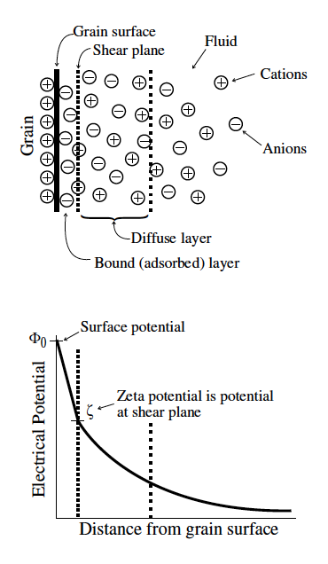

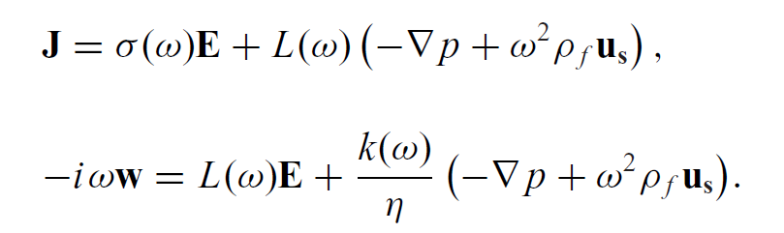

Seismo-Electromagnetic Signals (SES)
pore scale: electric double-layer model
Porous medium fluid-saturated (or partially saturated)
Coupled seismic and electromagnetic equations (Pride, 1994)
Comsol, Typical example of simulated fluid flow through porous media; Image by: E. Holzbecher, S. Oehlmann,Georg-August University Göttingen.
(Shaw, 1992)

Slide 3
Aims of this presentation
SeismoElectromagnetic Signal (SES) detectability during active seismic experiment (RICEN)
using standard magnetotelluric equipment
Object:
Morlet Wavelet analysis
Detection of Frequency range of active SES
Detection of background natural magnetotelluric field
Signal to Noise appraisal in the SES frequency range
Deconvolution of SES signal with seismic source
Amplitude estimation of SES
Methods:
SES - Hy (WE component) in the Solfatara, Campi Flegrei, Italy – maps versus frequency –
Comparison with velocity and resistivity maps in the same area
Results:

Slide 4
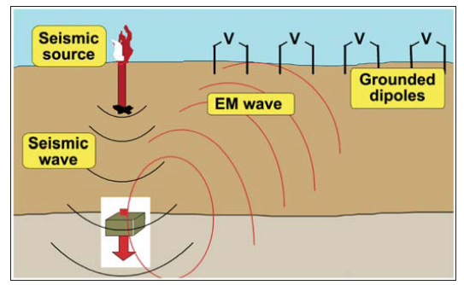
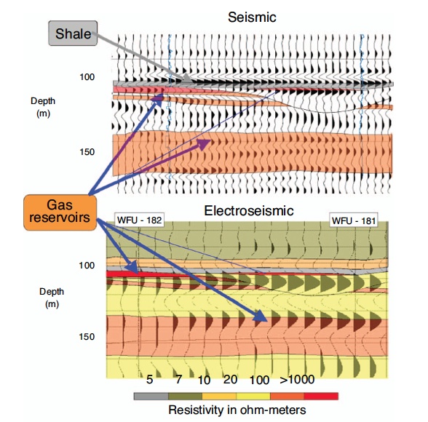
LITERATURE on Active SES
Few experimental examples
Several synthetic studies
(Haarsten & Pride, 1997)
(Garambois & Dietrich, 2001)
(Warden et al., 2012)
(Thompson et al., 2007, ExxonMobil)

Slide 5

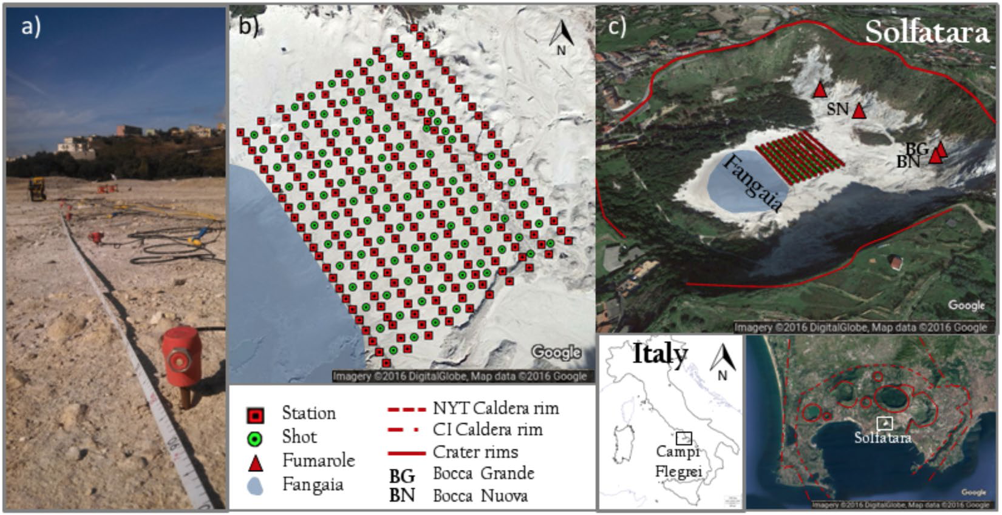
RICEN experiment
(Repeated Induced Earthquake and Noise)
(De Landro et al., 2017)

Slide 6
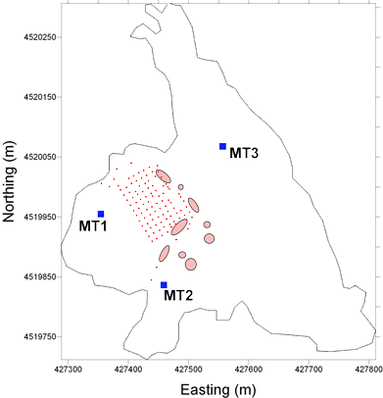
Setup of the RICEN-SES experiment
May, 20, 2014
Seismic Dataset:
108 shots in 108 sites (each one repeated two or three times, red squares in figure)
Seismic Source
      Vibroseis
EM dataset
Continuously recorded EM time series covering the whole last of the seismic experiment
    Recording instruments
    32bit A/D MT instruments
Fangaia
Herein mainly MT3 data and Hy (WE) component will be considered

Slide 7


Low-frequency approximate transfer functions
seismo-electric transfer function:
seismo-magnetic transfer function
(Garambois and Dietrich, 2001)
The amplitude of SES are directly related to velocity of seismic waves

Slide 8
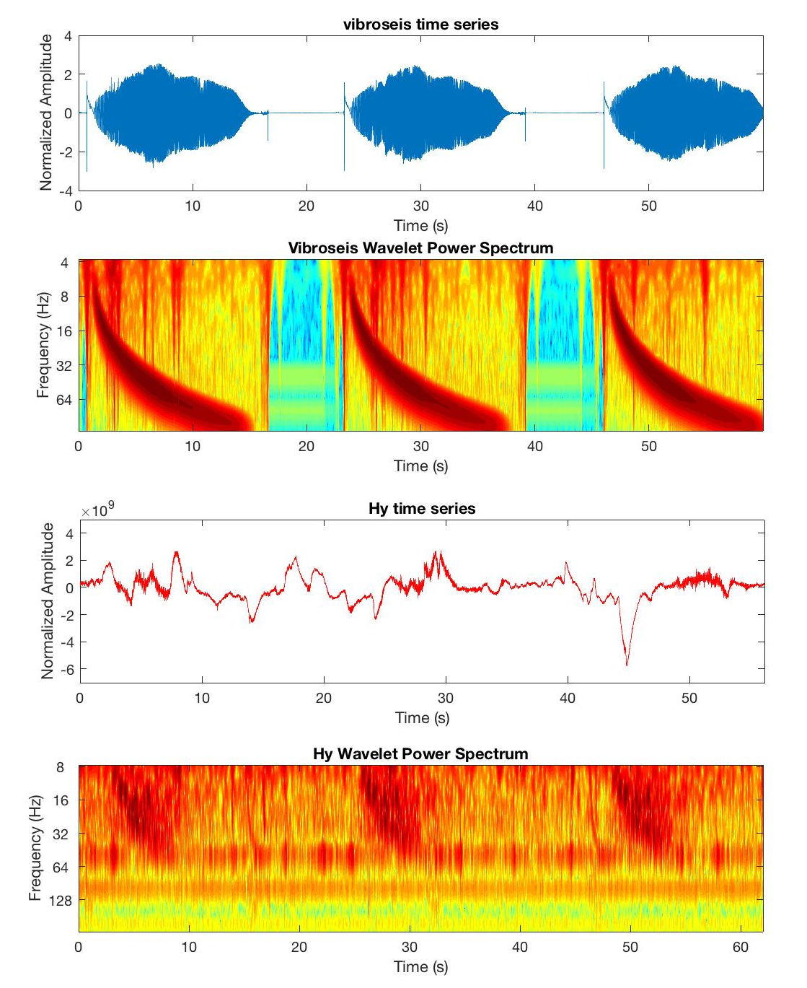
Morlet Wavelet analysis
An example: Shot 199 (3 repetions)
Source signal (vibroseis)
Vibroseis Morlet wavelet
Measured Hy component
Hy Morlet wavelet

Slide 9
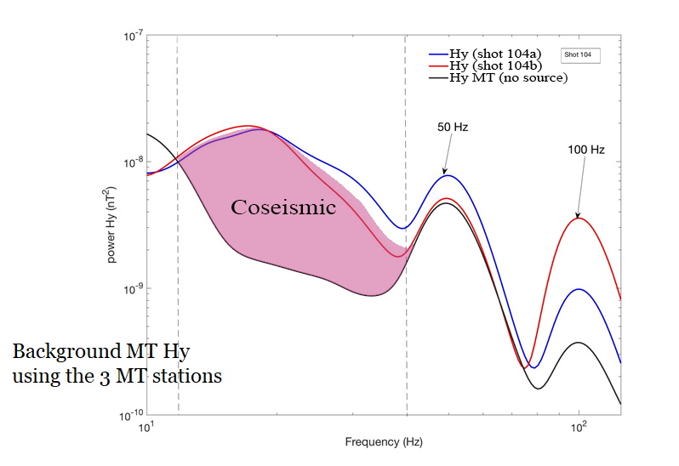
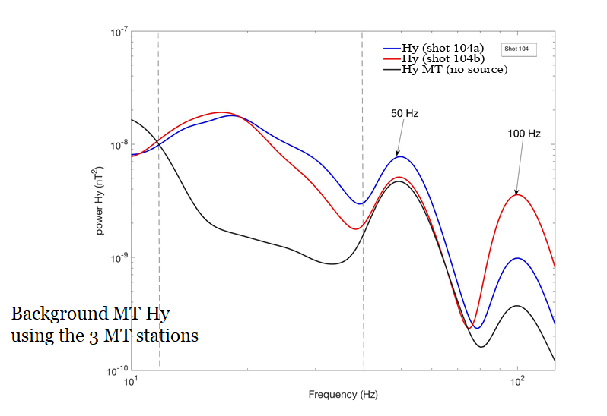
Power spectral density:
What does it change when the seismic source is active?
Travel time of analyzed EM signals compatible with Rayeigh Wave

Slide 10
Background removal
Background natural em field must be removed to estimate SES
It can be estimated using the other two MT sites

Slide 11
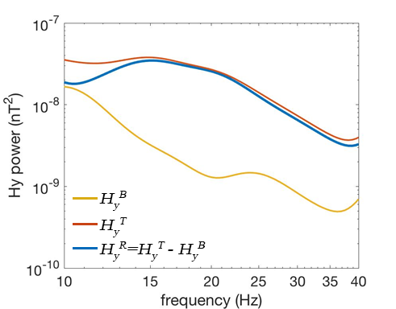
Background removal
Background natural em field must be removed to estimate SES

Slide 12
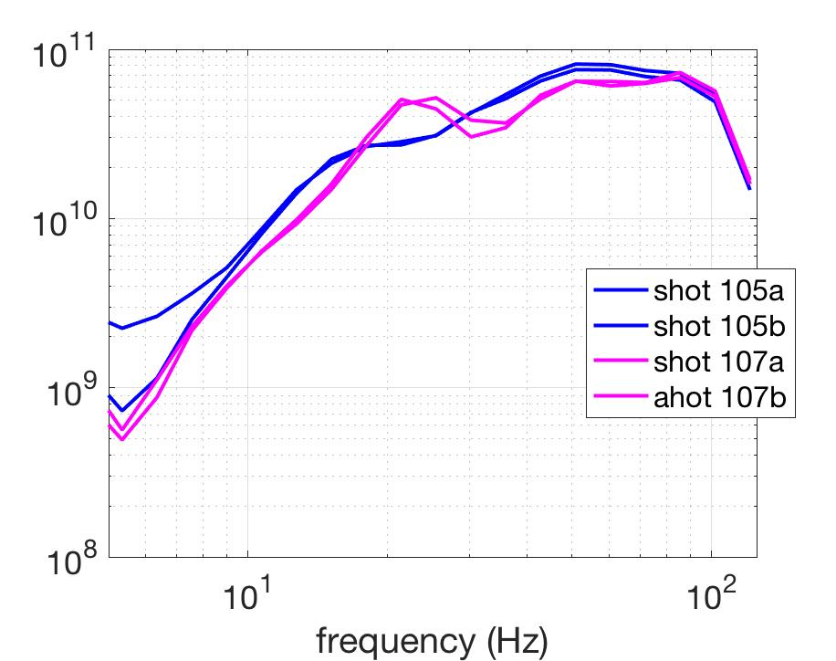
Deconvolution
Vibroseis spectra are site-dependent
Geometric spreading correction
It is possible to create maps of R(ω)
We call them in the following RSEM (Response Seismo-Electro-Magnetic) maps

Slide 13
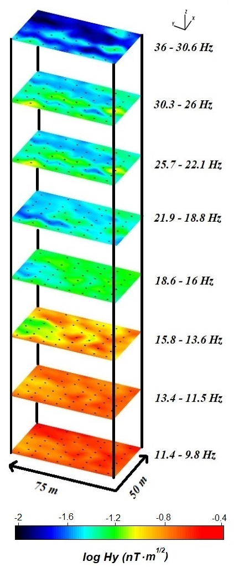
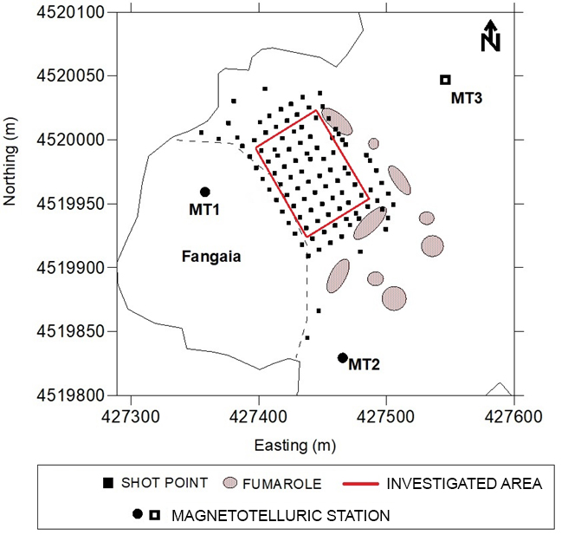
RESULTS
RSEM maps versus frequency

Slide 14
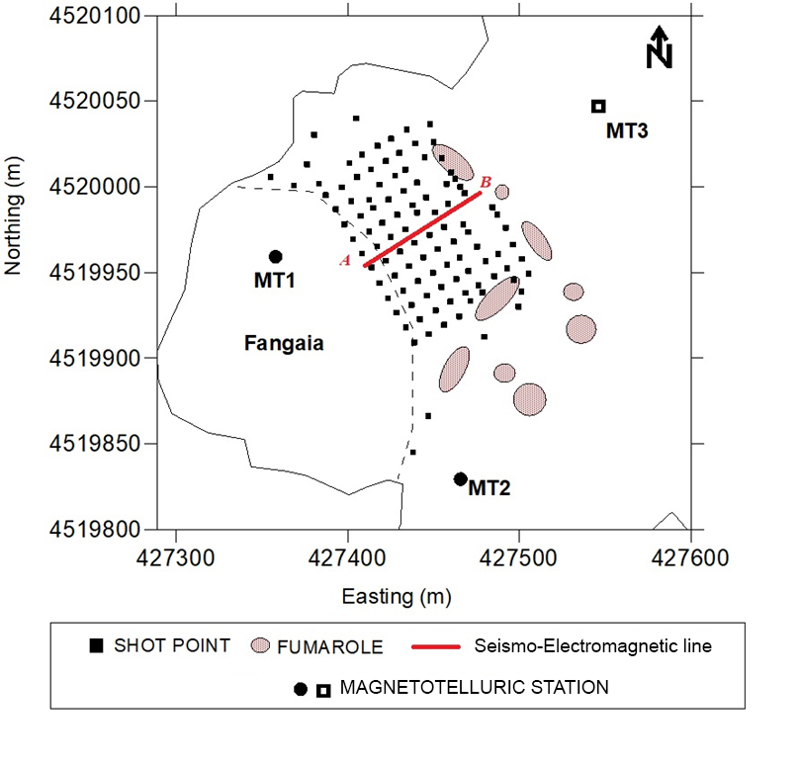
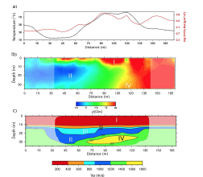
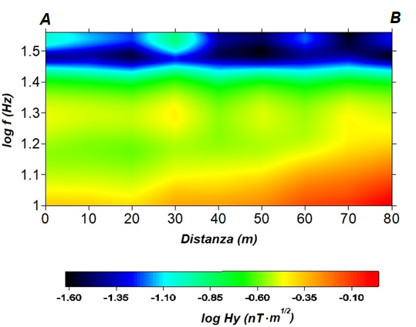
RESULTS
COMPARING RSEM IMAGE WITH GEOCHEMICAL DATA AND OTHER GEOPHYSICAL MODELS ALONG THE SAME PROFILE (De Landro et al., 2017)
RSEM

Slide 15
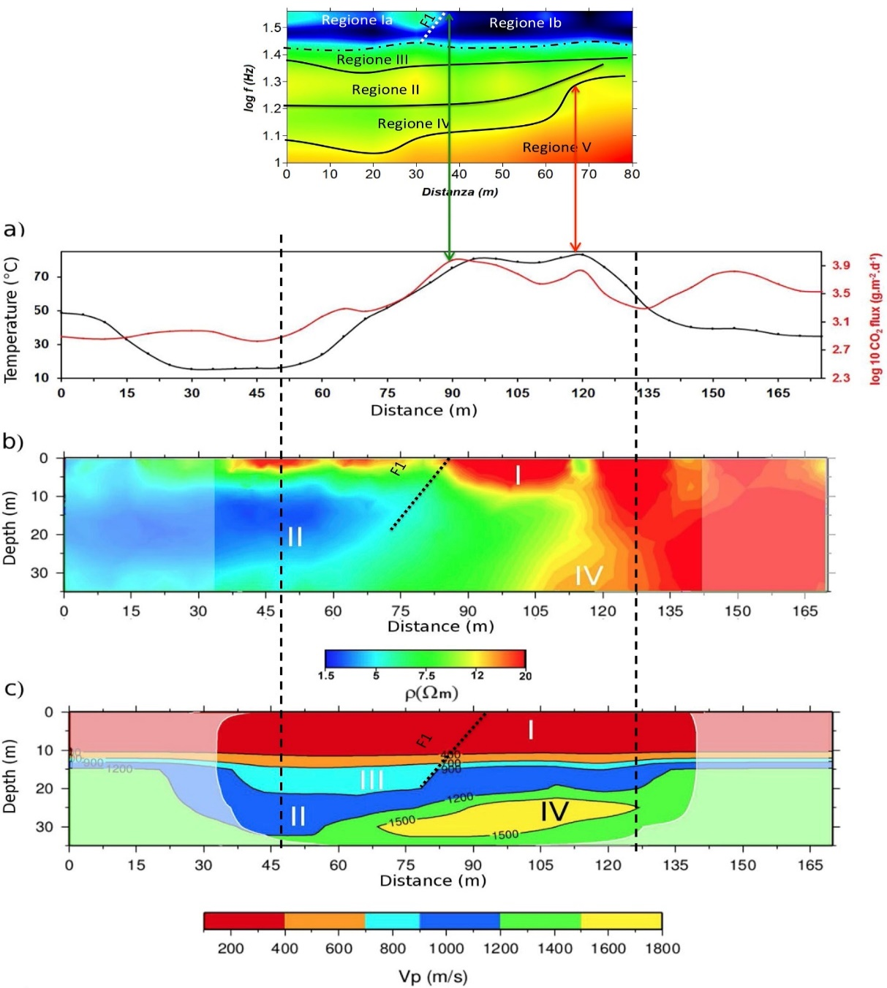
Log (RSEM)
I_{a}
I_{a}
I_{b}
III
IV
II
V

Slide 16
Discussion
RICEN-SES has shown:
Detectability of seismo-magnetic transfer function
Reproducibility of seismo-magnetic transfer function
RSEM versus frequency compared with independent data and models along the same profile shows significant correspondences.
… work in progress

Slide 17
Thank you

