Slide 1
Predictor Dataset Selection Method for Construction of a Flood Detection Model Using Information Theoretic Tools
Mohammad Mehdi Bateni, Mario Martina and Luigi Cesarini
University School for Advanced Studies (IUSS), Pavia, Italy mehdi.bateni@iusspavia.it

Slide 2
Introduction
Input Variable Selection (IVS): Selecting the inputs that are the most useful or the most relevant to be applied into a data-driven model, is a tough job that may require deep knowledge of the problem domain
IVS reduces the complexity of the model, a simpler model is simpler to understand and explain
IVS could provide a better understanding of the underlying process that has generated the data
May not be possible in data scarce regions

Slide 3
Introduction
input usefulness is being a combination of maximizing similarity to the output while minimizing redundancy with the other inputs (May et al. 2011, Abrahart et al. 2012).
Information Theory could be employed to determine similarity & redundancy among random variables.

Slide 4
Literature Review
The theory and the mathematical applications are now mature for physical and dynamical applications in earth sciences (e.g., reviews by DelSole (2004) and Kleeman (2011)).
Information theory in input selection to earth science models:
Sharma and Mehrotra (2014) and Thiesen et al. (2019)
While the former has used an information-theoretic approach to formulate prediction models for cases with weakly known physical relationships yet abundant observational records; the latter emulates expert-based identification of rainfall–runoff events in hydrological time series by adopting few different combinations of input variables.

Slide 5
Information Theory: Key Concepts
Information/Uncertainty/Entropy closely interconnected concepts
The uncertainty is related to lack of information about which possibility is the truth
Entropy is a measure of the variation of uncertainty involved in a variable.
Simply, entropy is the expected number of yes-no questions needed to be asked to find the value of a variable

Slide 6
Mutual Information: Measure of Dependency
a measure of mutual dependence between two variables, an efficient tool to investigate linear or non-linear interactions of variables
$$I\left(X;Y\right)=\sum_{x}{\sum_{y}{\left.p(x,y\right)}}.\log_{2}{\frac{\left.p(x,y\right)}{\left.p\left(x\right).p(y\right)}}$$
Mutual Information between variables X & Y
p represents the probability of occurrence
X could be predictor and Y could be response variables

Slide 7
Maximum Relevance, Minimum Redundancy
Relevance (D)
$D\left(S_{m},Y\right)=\frac{1}{m}\sum_{X_{i}∈S_{m}}{I(X_{i};Y)}$
Where S_{m} s is a set of input variables {X_{i} $∈$ S_{m},i = 1,...,m} and Y is the response variable.
Redundancy (R)
$R={ \frac{1}{m^{2}}\sum_{X_{i},X_{j}∈S_{m}}{I(X_{i};X_{j})}}$
Information Score ($φ$)
$φ\left(D;R\right)=D−R$
variables with $φ>0$ selected as inputs

Slide 8
The Dominican Republic Context
a Data Scarce Country
The Dominican Republic is located on the eastern part of the island of Hispaniola, one of the Greater Antilles, in the Caribbean region. Its area is approximately 48,671 km².
No long record history of congested rain gauges, No flood vulnerability map, No local systematic reports on floods, …

Slide 9
Historical Event Catalogue
The historical event catalogue used for model construction needs to contain data on past flood events that caused significant losses.
A set of international disaster databases have been taken into account:
EM-DAT (Centre for Research on the Epidemiology of Disasters - CRED, 1988)
DesInventar (United Nations Office for Disaster Risk Reduction, 1994)
Global Disaster Identifier (GLIDE) (Asian Disaster Reduction Center, 2006)
Dartmouth Flood Observatory (DFO) (University of Colorado, 1993)
FloodList (Davies et al., 2008)
The utilized databases are all open-access.
The retrieved data is verified by local sources and expert knowledge.

Slide 10
Experimental Design (1)
Daily CMORPH precipitation data (Joyce et al., 2004) employed.
To classify each day (t) as flood/no flood day, the precipitation values at the concurrent and two precedent days are included as input variables (t, t-1, t-2).
It includes 907 pixel values for each day all over the Dominican Republic.
All in all, there are 2721 candidate input variables for each flood/ no-flood day.

Slide 11
Experimental Design (2)
Support Vector Machine (SVM) adopts the selected inputs to classify flood/no flood events for each day (i.e. binary classification).
Benchmark: average values of daily precipitation for the current and two precedent days over the whole country have been used as the input to SVM.
There is a huge class imbalance in our problem. weight balancing technique has been employed to balance the data. The weights have been chosen inversely proportional to the class distribution.
Using all gridded data over the country as the inputs makes the problem intractable.
we used e1071 package in R software environment to classify by the SVM.

Slide 12
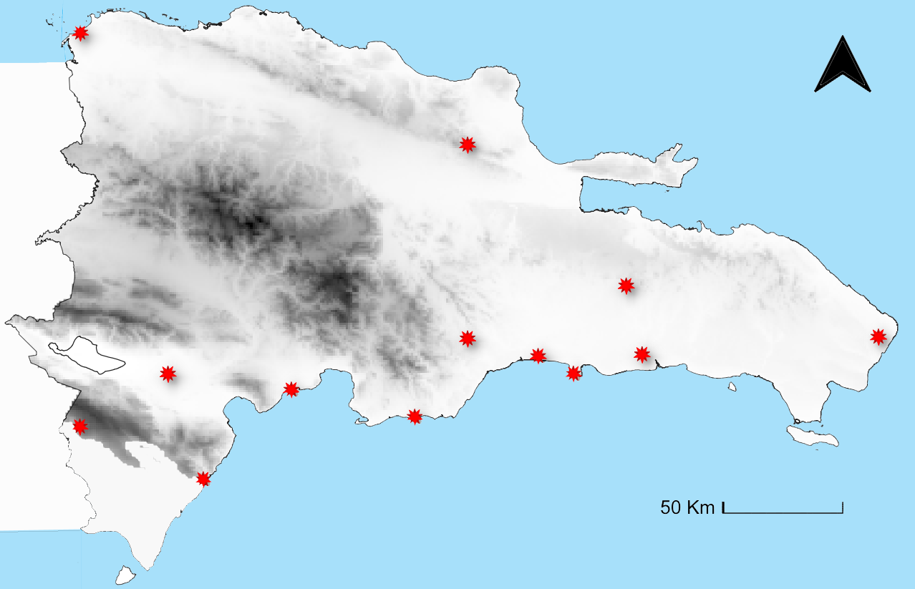
Results (1)
in accordance with the fact:
Most of the hurricanes and tropical storms pathway is from east/southeast to west/northwest of Dominican Republic (Horst, 1992).
Selected most informative data points over Dominican Republic shown by red suns.
Darker depicts higher altitudes.

Slide 13
Results (2)
Selected most informative input variables all belong to the concurrent day (t) of flood/no flood event
in accordance with the fact:
Most of the hurricanes and tropical storms move such fast so that they are effective over Dominican Republic for less than a day (Horst, 1992)

Slide 14
Results (3)
Among SVMs with three different kernels, namely linear, polynomial and radial, the one with the best performance results has been reported for both cases.
Data set | F1-Score
Average/Linear Kernel | 0.37
Selected/Polynomial Kernel | 0.44
F1-Score performance metric for SVM with the selected most informative inputs and averages as inputs
Notes:
As we are dealing with imbalanced classes and both specificity and sensitivity are important, F1-Score metric is chosen to be reported

Slide 15
Discussion
Using Input Variable Selection (IVS) techniques could significantly decrease computational cost of the Machine Learning problem.
Information theoretic measures, which are able to quantify linear/non-linear dependences, could be adopted in IVS.
Results of the Information-based IVS were in accordance with physical properties of the case study.
There is a desirable improvement in performance of SVM due to consideration of the most informative data points instead of the average value throughout the country.

Slide 16
References
Abrahart, R. J., Anctil, F., Coulibaly, P., Dawson, C. W., Mount, N. J., See, L. M., . . . Wilby, R. L. (2012). Two decades of anarchy? Emerging themes and outstanding challenges for neural network river forecasting. Progress in Physical Geography: Earth and Environment, 36(4), 480-513. doi:10.1177/0309133312444943
Asian Disaster Reduction Center. (2006). GLobal unique disaster IDEntifier number - GLIDE. Retrieved from http://www.glidenumber.net/
Centre for Research on the Epidemiology of Disasters - CRED. (1988). EM-DAT The International Disasters Database. Retrieved from https://www.emdat.be/
Davies, R., Behrend, J., and Hill, E. (2008). FloodList. Retrieved from http://floodlist.com/
DelSole, T. (2004). Predictability and information theory. Part I: Measures of predictability. Journal of the atmospheric sciences, 61(20), 2425-2440.
Joyce, R. J., Janowiak, J. E., Arkin, P. A., & Xie, P. (2004). CMORPH: A Method that Produces Global Precipitation Estimates from Passive Microwave and Infrared Data at High Spatial and Temporal Resolution. Journal of Hydrometeorology, 5(3), 487-503. doi:10.1175/1525-7541(2004)005<0487:CAMTPG>2.0.CO;2

Slide 17
References
Kleeman, R. (2011). Information theory and dynamical system predictability. Entropy, 13(3), 612-649.
May, R., Dandy, G., & Maier, H. (2011). Review of input variable selection methods for artificial neural networks. Artificial neural networks-methodological advances and biomedical applications, 10, 16004.
Oscar H. Horst (1992) Climate and the “Encounter” in the Dominican Republic, Journal of Geography, 91:5, 205-210, DOI: 10.1080/00221349208979844
R Core Team (2020). R: A language and environment for statistical computing. R Foundation for Statistical Computing, Vienna, Austria. URL http://www.R-project.org/.
Sharma, A., & Mehrotra, R. (2014). An information theoretic alternative to model a natural system using observational information alone. Water Resources Research, 50(1), 650-660.
Thiesen, S., Darscheid, P., & Ehret, U. (2019). Identifying rainfall-runoff events in discharge time series: a data-driven method based on information theory. Hydrology and earth system sciences, 23(2), 1015-1034. doi:10.5194/hess-23-1015-2019
United Nations Office for Disaster Risk Reduction. (1994). DesInventar. Retrieved from https://www.desinventar.net
University of Colorado. (1993). Dartmouth Flood Observatory. Retrieved from https://floodobservatory.colorado.edu/

Slide 18
END

