Slide 1
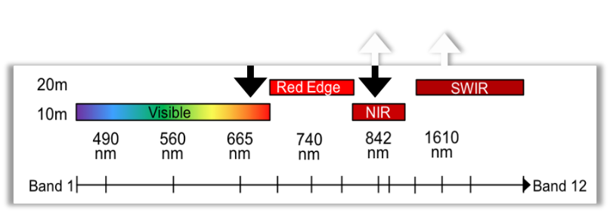
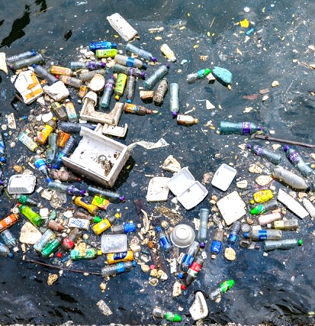
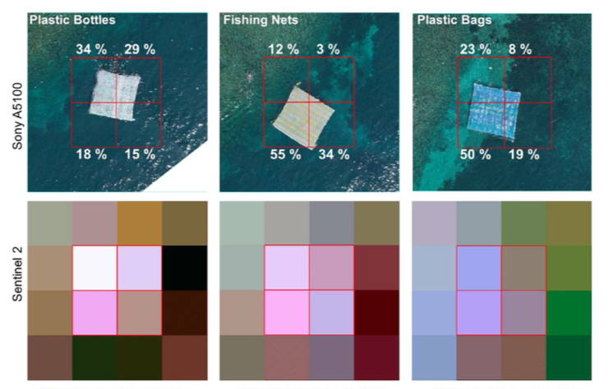
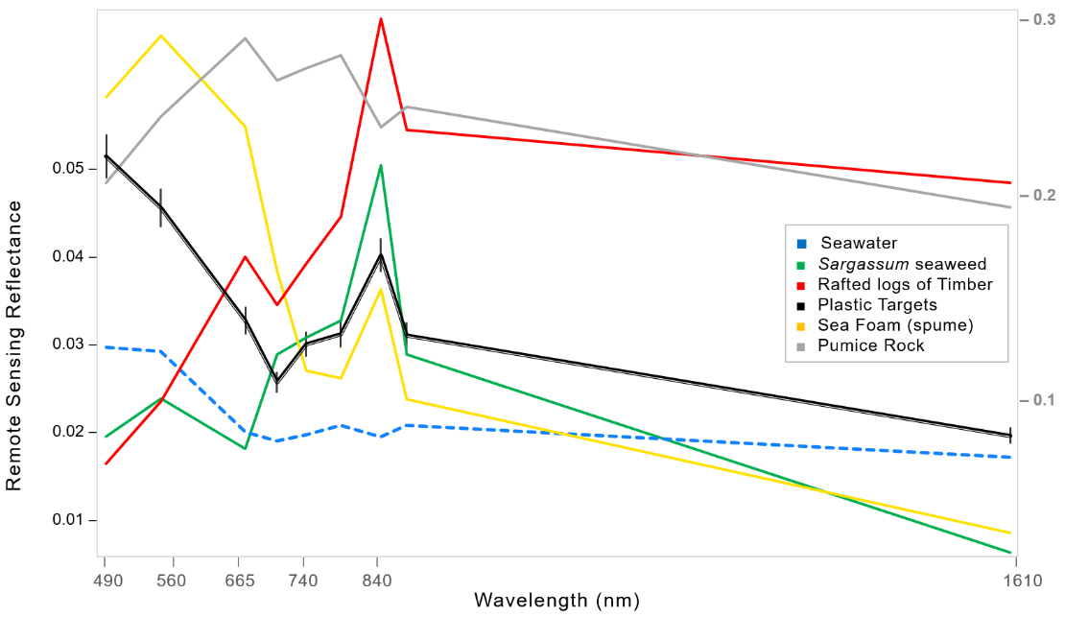
Finding Plastic Patches in Coastal Waters using the Sentinel-2 Satellites
Lauren Biermann, Dan Clewley, Victor Martinez-Vicente, Konstantinos Topouzelis
Sentinel-2A & B launched in 2015 & 2017.
Coverage includes coastal waters every 2 to 5 days at 10 m spatial resolution.
Limitations for detecting plastic includes cloudiness and bright wave caps.
Reliant on submesoscale features like fronts to aggregate floating debris→
Floating Debris
Index (FDI)
Macroplastics : plastics or plastic fragments >5mm.
Coastal waters: plastic pollution mostly from land.
If not recirculated onto beaches / sunk / removed through clean-up operations, these plastics will enter open ocean…
Vegetation Index
(NDVI)
Microplastics
Video from
@HFiskJohnson
Entangled
Ingested
FDI Subpixel Detection on 10 m Plastic Targets:
Spectral Signatures of Marine Debris:
(Figure adapted from Topouzelis et al., 2019).
X-axis shows Sentinel-2 MSI bands from visible (490 nm) to the short-wave infrared at 1610 nm

Slide 2
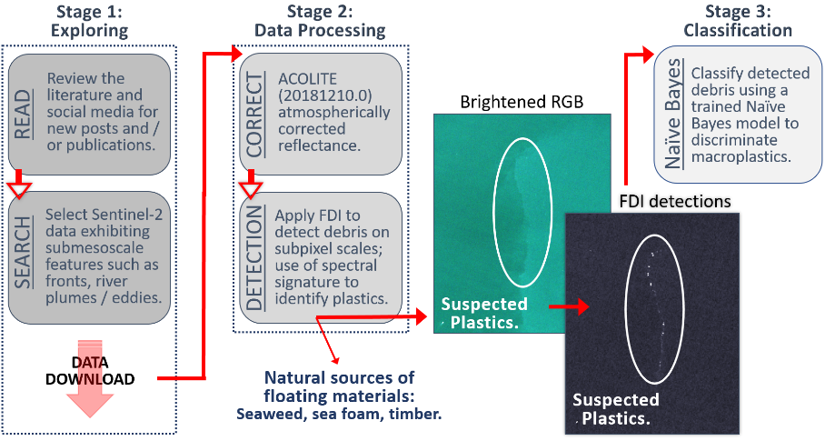
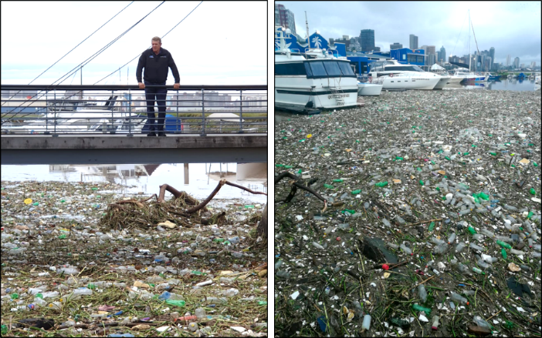
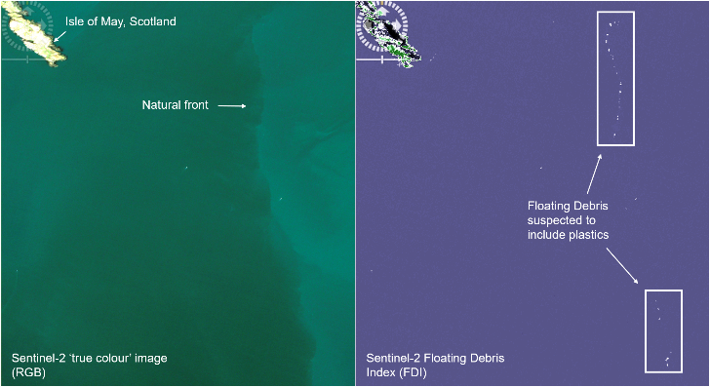
Finding Plastic Patches in Coastal Waters using the Sentinel-2 Satellites
Lauren Biermann, Dan Clewley, Victor Martinez-Vicente, Konstantinos Topouzelis
Building a spectral library of floating marine materials:
Searching for patches of floating plastics ‘in the wild’:
Classification Results:
Across all sites, suspected plastics were classified as plastics by the Naïve Bayes model 86% of the time
Detections off Ghana and Canada had highest agreement between suspected plastics and the model at 87% and 100%, respectively.
Detections off Vietnam and Scotland showed agreements of 77% and 83%, respectively.
Suspected plastics not classified as plastics were instead identified as seawater, suggesting that an insufficient amount of pixel was filled with floating debris, or spume.
To discriminate plastic we used a Naïve Bayes (Bayesian) ML classification approach.
Requires small number of samples to train. However, we only had 9 pixels from plastic targets; added validated plastic detections from Durban:
Based on reports of marine plastic pollution in the literature, popular press and social media, we detected aggregations of debris in the coastal waters off Ghana, Canada, Vietnam, and Scotland. Aggregating features such as plumes, fronts and/or eddies were visible in the RGB imagery, but the FDI was essential for highlighting debris. Example from Scotland below:
Shown in two-variable feature space of NDVI and FDI, clustering of validated plastics from Durban, seaweed from Barbados, timber from Canada, sea foam from the UK, Pumice off Toga and seawater from all sites is evident:
Sentinel-2 MSI satellite imagery generated using the ESA open-source Sentinel Applications Platform (SNAP) software.

