Slide 1

– towards a long term global snow climate data record from satellite data
Gabriele Schwaizer, Lars Keuris, Thomas Nagler,
Chris Derksen, Kari Luojus, Carlo Marin, Sari Metsämäki, Lawrence Mudryk, Kathrin Naegeli, Claudia Notarnicola, Arnt-Borre Salberg, Rune Solberg, Andreas Wiesmann, Stefan Wunderle, Richard Essery, David Gustafsson, Gerhard Krinner, and Anna-Maria Trofaier

Slide 2


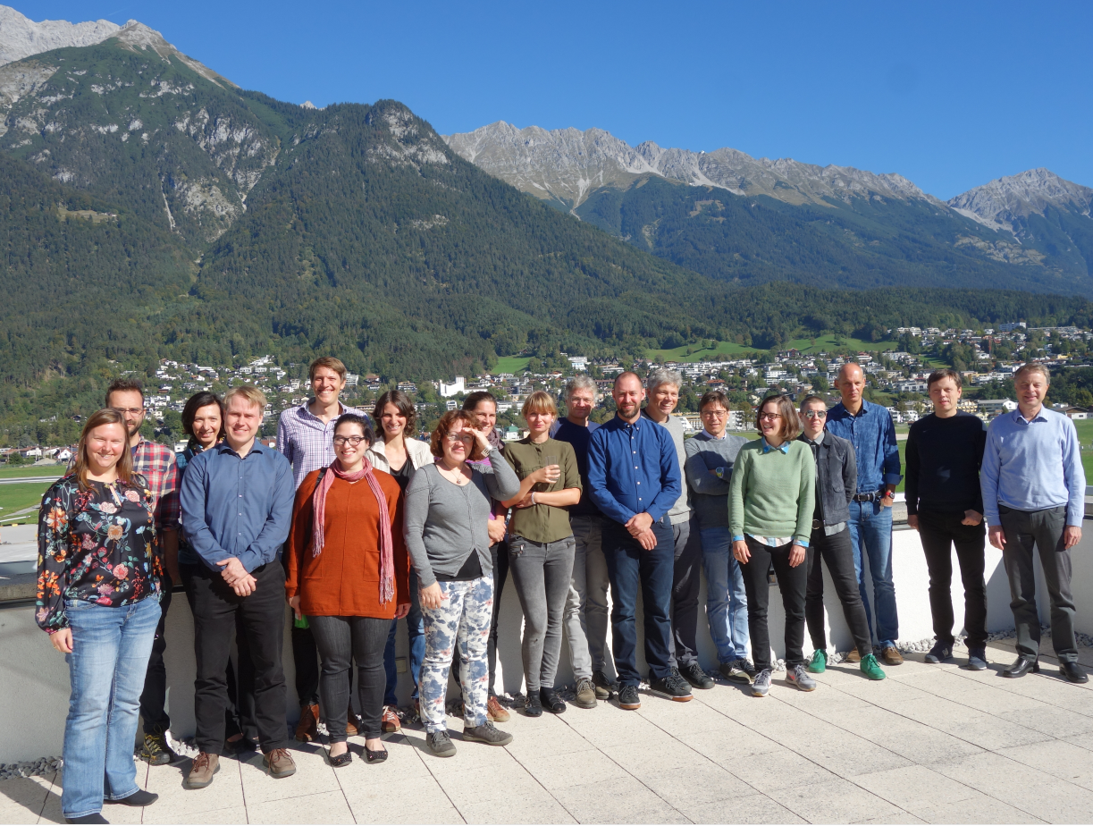











Snow CCI Team
ENVEO Environmental Earth Observation IT, Innsbruck, Austria (Science Lead + Project Management)
Environmental and Climate Change Canada, Toronto, Canada
EURAC Earth Observation, Bolzano, Italy
Finnish Meteorological Institute, Helsinki, Finland
Finnish Environment Institute, Helsinki, Finland
GAMMA Remote Sensing, Gümligen, Switzerland
Norwegian Computing Centre, Oslo, Norway
University of Berne, Berne, Switzerland
Centre National de la Recherche Scientifique, IGE, Grenoble, France
Swedish Meteorological and Hydrological Institute, Norrköping, Sweden
University of Edinburgh, Edinburgh , United Kingdom
ECMWF, United Kingdom

Slide 3
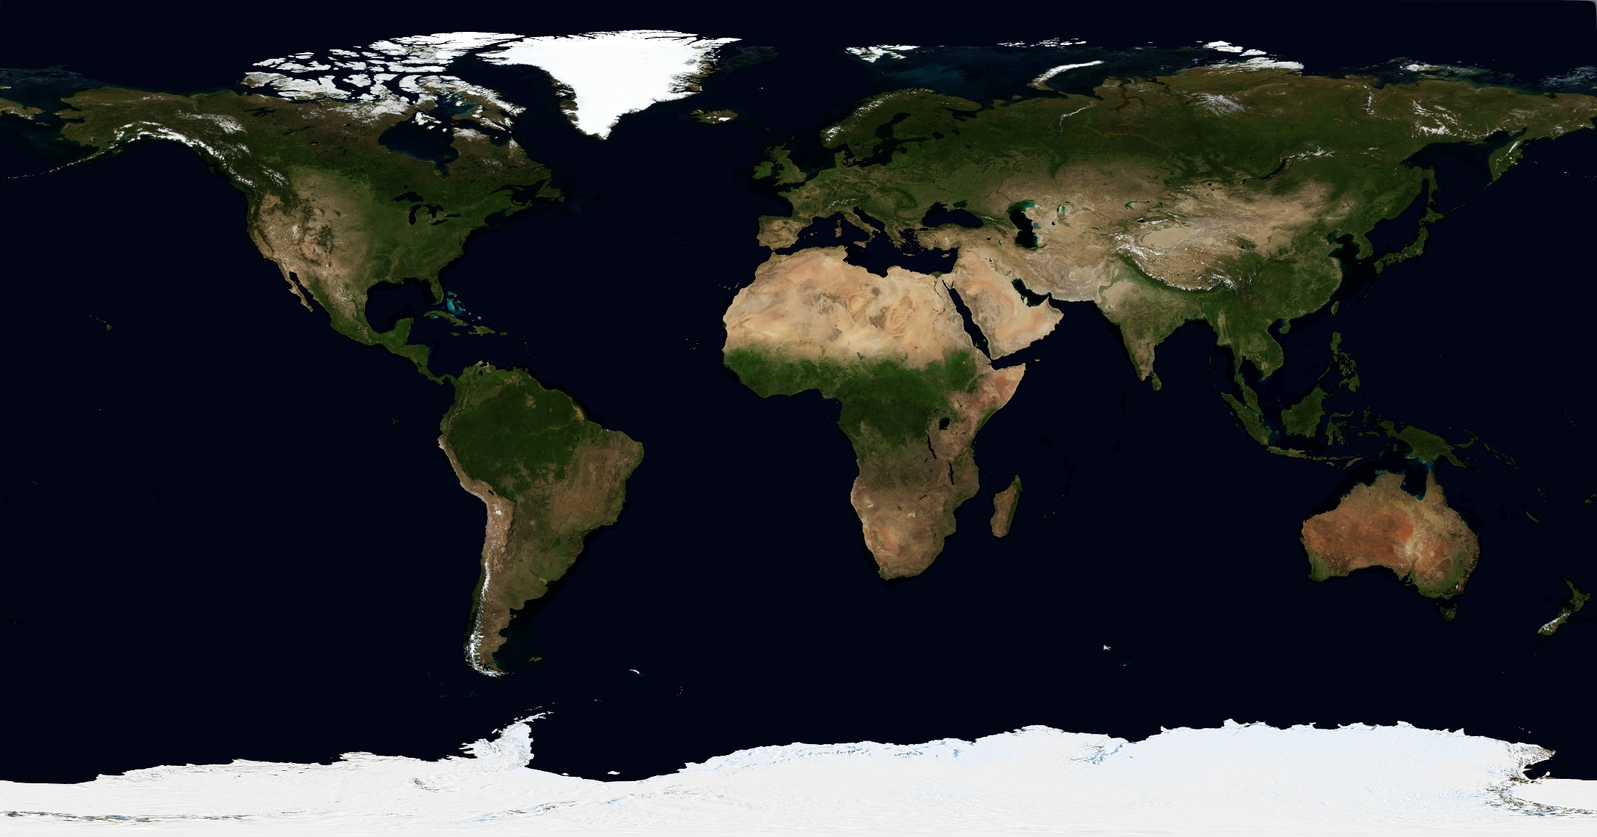
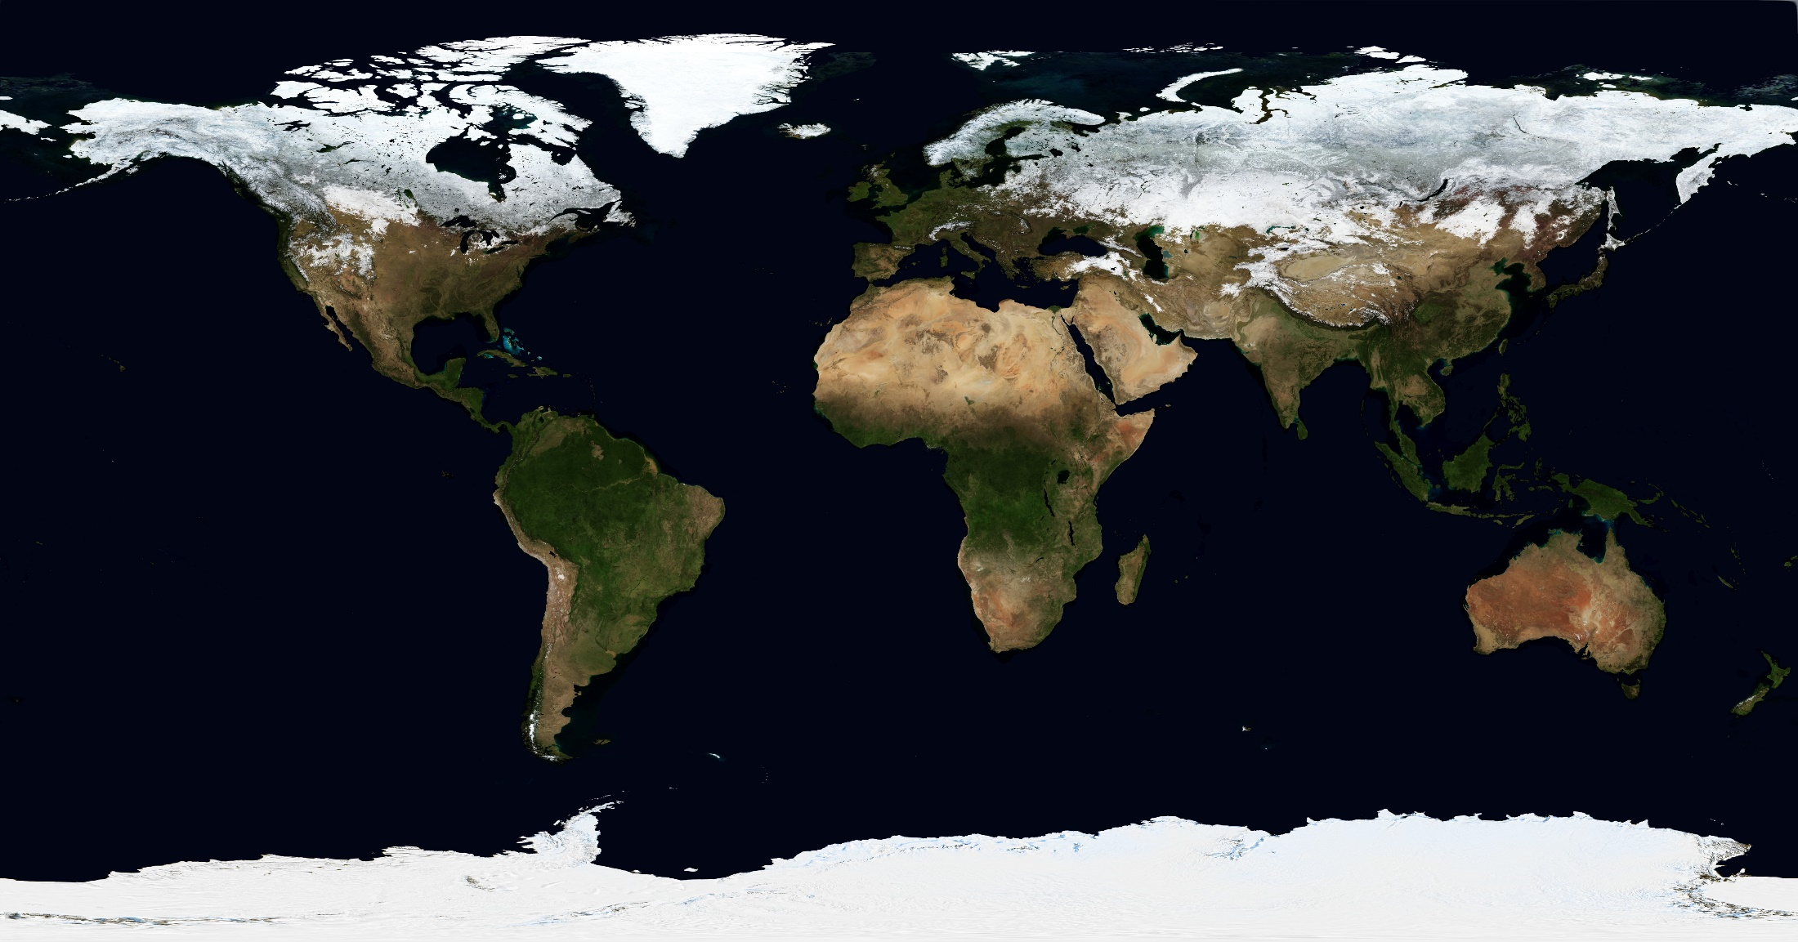
Seasonal Snow
covers up to ~47 Mio km² in extent and has a mass of ~3000 Gt
~98% of seasonal snow cover occurs in the Northern Hemisphere
highly variable in space and time
very sensitive to weather on short term and to climate change on long term

Slide 4

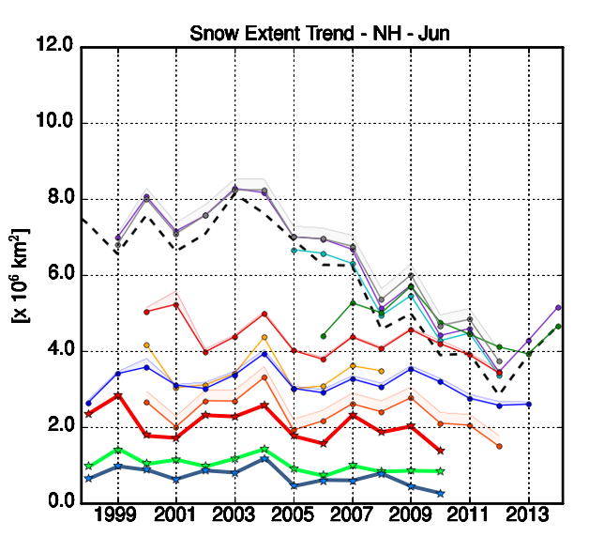
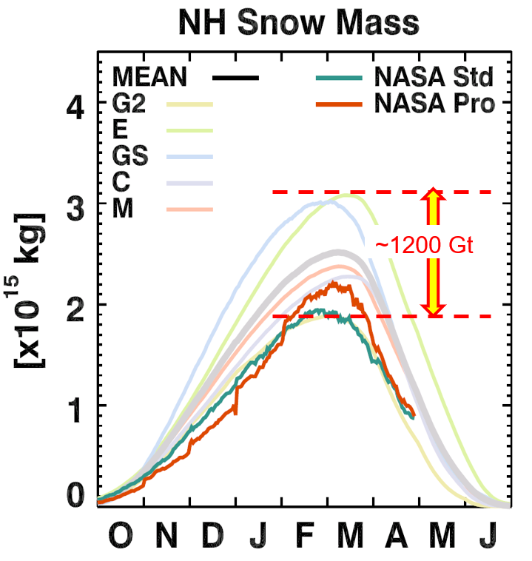
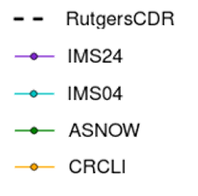
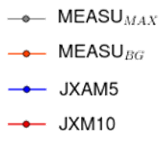
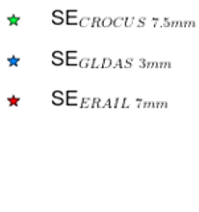
Trends of Current Snow Products
©
There is considerable inter-dataset spread and differences in the
NH Snow Extent and Snow Mass derived from satellite data and modelled products

Slide 5
Snow CCI Primary Objectives
The overarching goal of Snow CCI is the generation of homogeneous, well calibrated, long-term time series of key snow cover parameters (snow area extent and snow mass) from multi-sensor satellite data for climate applications.
A main motivation for this initiative are significant discrepancies in the climatologies, anomalies, and trends in global snow cover time series from different products, detected in the ESA Snow Product Intercomparison project (SnowPEx).
In order to ensure the suitability of the snow products, representatives of the climate research community are directly involved in Snow CCI, advising on product requirements, contributing to product evaluation, and utilizing the data for specific research tasks (5 use cases defined).

Slide 6
Product Specifications
 | Snow Cover | Snow Water Equivalent
Parameter | Fractional snow extent [%] | Snow mass
Description | Viewable Snow (VS) / Snow on Ground (SoG) | Snow water equivalent
Spatial Coverage | Global (without Antarctica, land ice, open water) | Global non-mountain areas (without Antarctica, Greenland, land ice, open water, )
EO Data | Optical imagery | Passive microwave brightness temperatures
Spatial Resolution | Ca. 5 km (0.05 deg) Ca. 1 km (0.01 deg) | Ca. 25 km (0.25 deg)
Period | 1982 – onwards (5 km) 2000 – onwards (1 km) | 1979 - onwards
Frequency | Daily | Daily
Temporal Aggregation | V0+V1: None; V2: TBD | Monthly
Update Frequency | Annual | Annual
Map Projection | Geographic Grid (Lat/Lon) | Geographic Grid (Lat/Lon)
Format | netCDF | netCDF
Accuracy Target | < 20% RMSE | < 30% RMSE
Uncertainty Metric | Unbiased RMSE | Unbiased RMSE

Slide 7
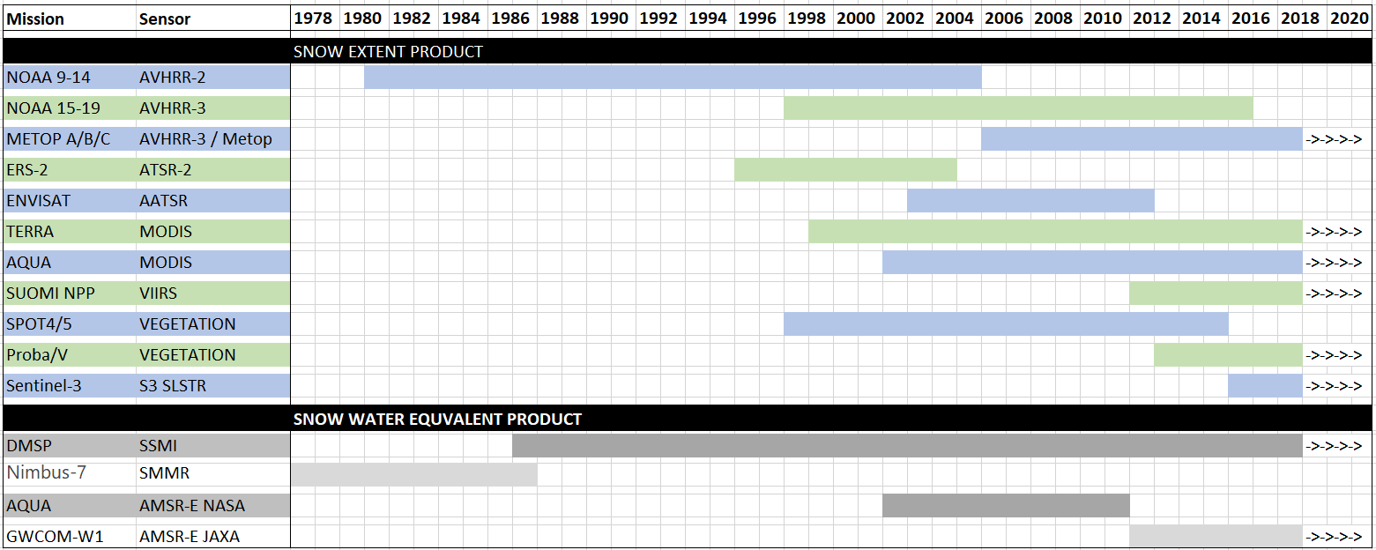
Satellite Data Sets for Snow CCI

Slide 8
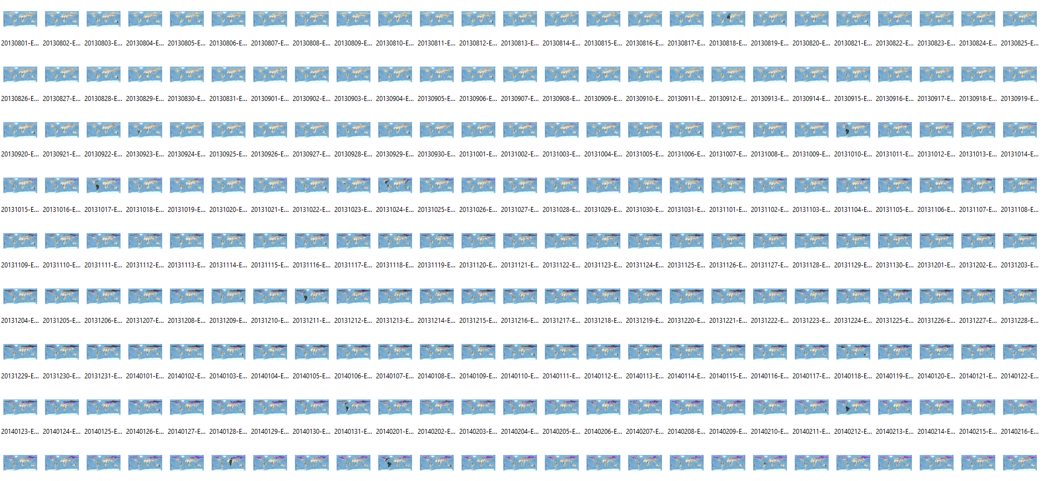
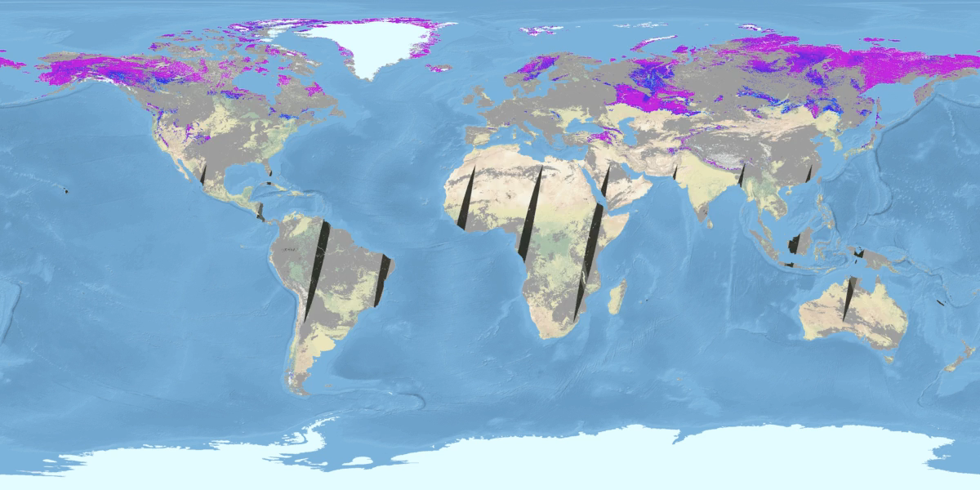

Daily 1 km SCF Products - MODIS 2000-2018
©
1 April - 2000 - 2018

Slide 9
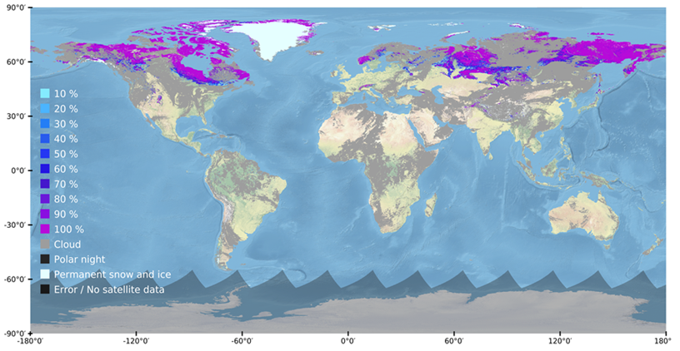
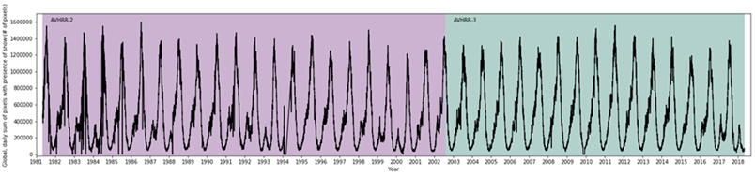
Daily 5 km SCF Product - AVHRR 1981-2018
©
Number of pixels with snow

Slide 10
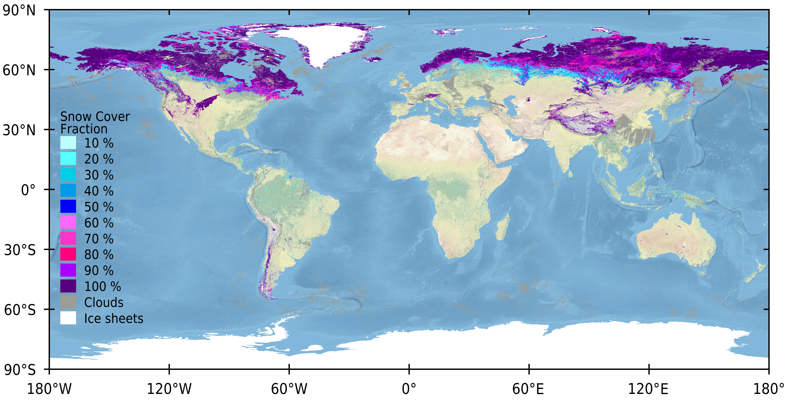
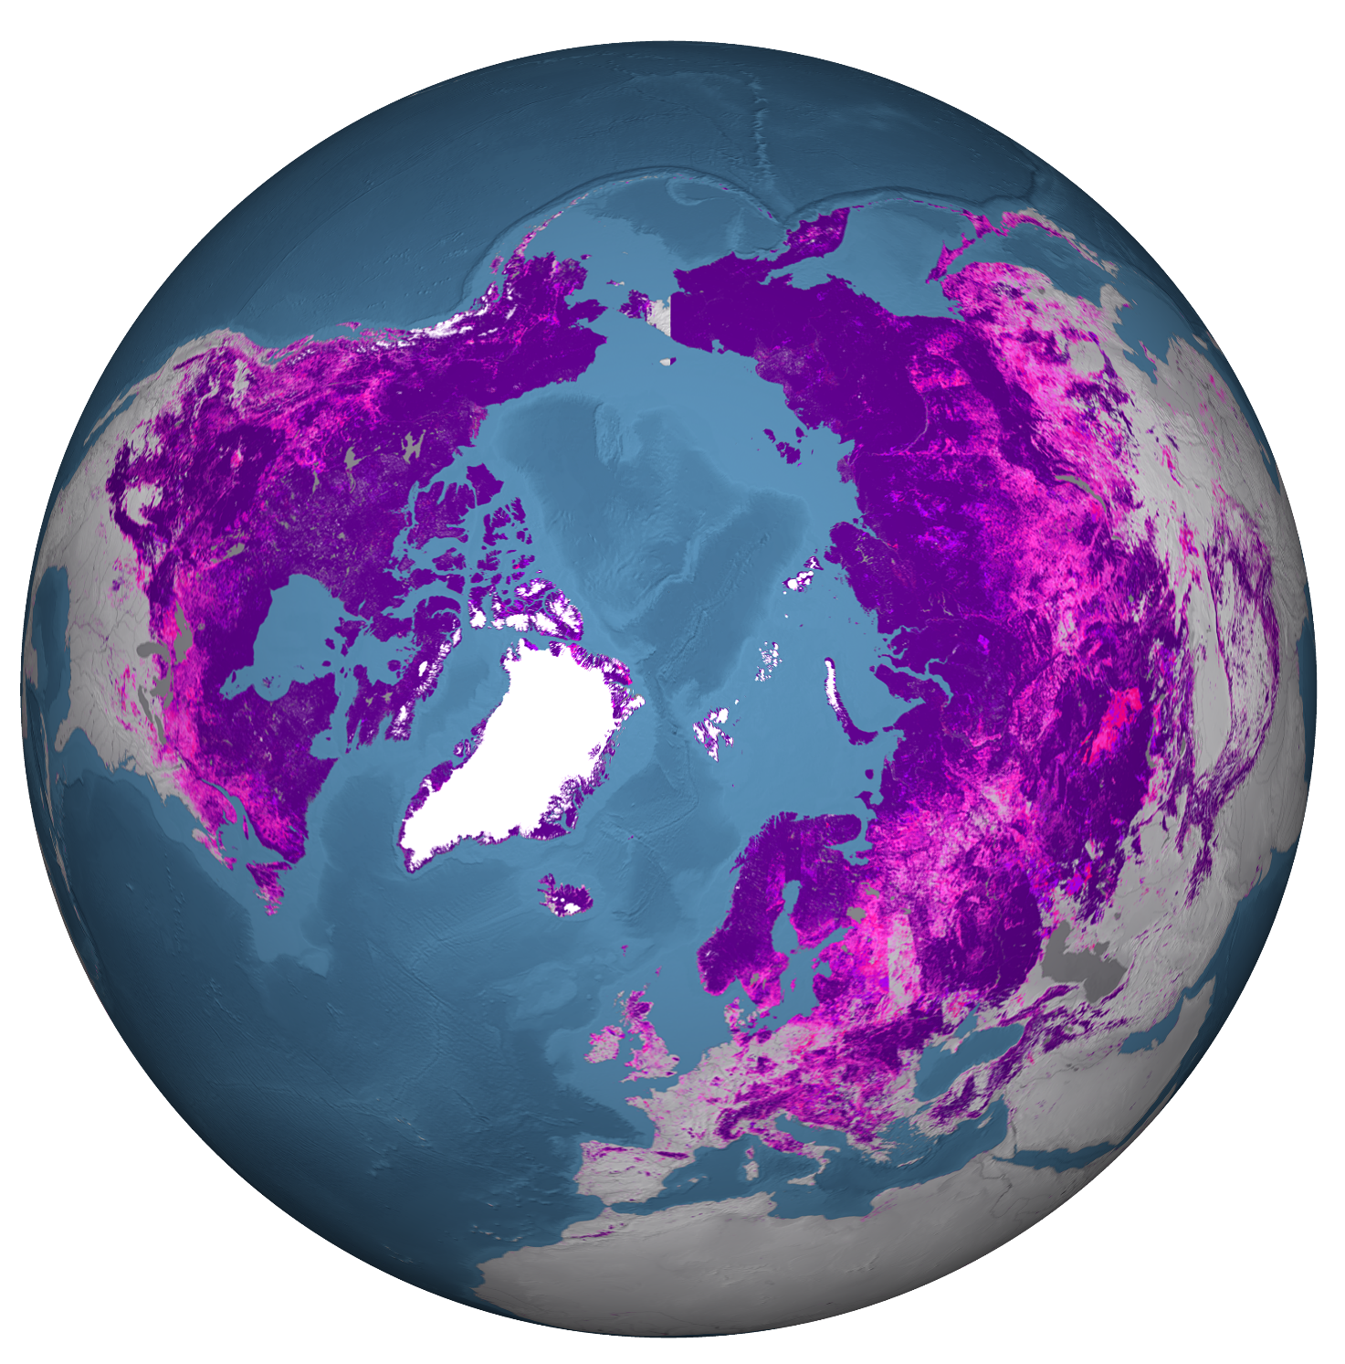
Sentinel-3 SLSTR – multi-day SCE composite
©

Slide 11
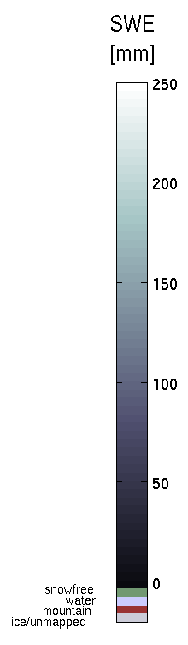
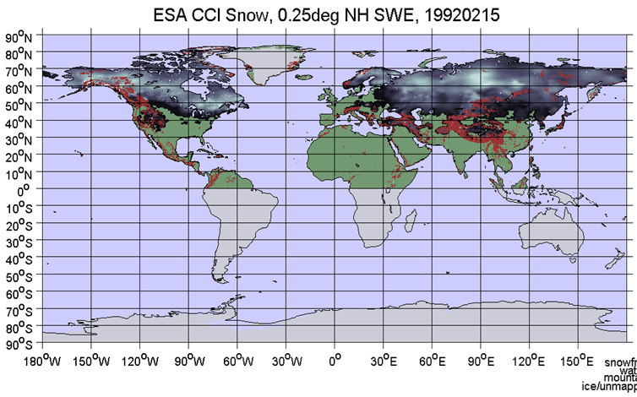
Daily 25 km SWE products 1979-2018
©

Slide 12
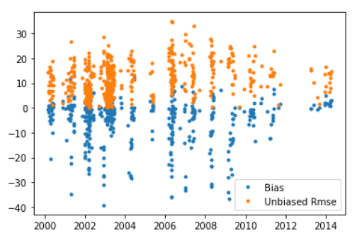
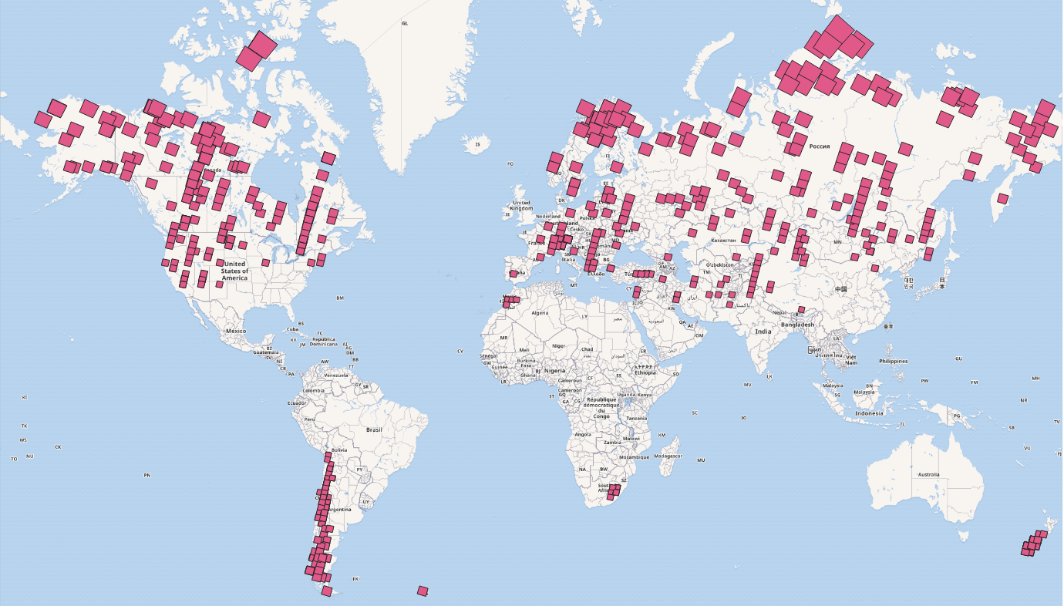
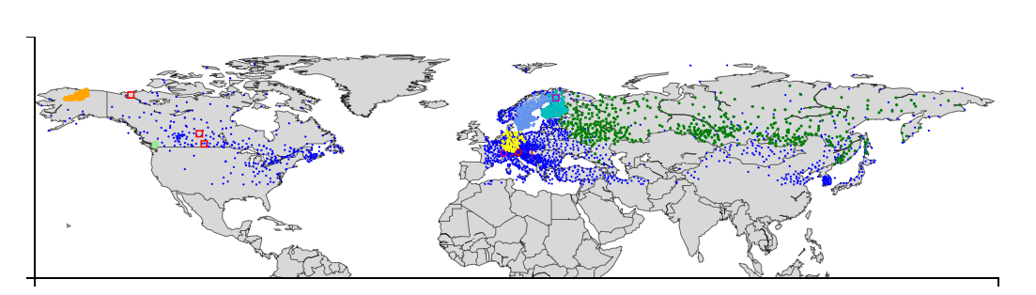
Validation of Snow Products
Validation methods for SCE and SWE follows SnowPEx protocols
Validation data set include: Landsat, Sentinel-2, and in-situ data
©
Landsat FSC versus MODIS, 1 km, NH
High Resolution Snow Reference Data Set – 1985 – 2018
Multi-annual in-situ data sets for snow validation

Slide 13
Release Schedule of Snow CCI Products
Oct 2018
Oct 2019
Oct 2020
Oct 2021
SNOW CCI PHASE 1
PHASE 2
User
Requirements
Prototpye
Product V1
Product V2
SNOW COVER FRACTION
AVHRR (1982-2018)
MODIS (2000-2018)
AVHRR (1982-2019)
MODIS (2000-2019)
SLSTR (2016-2019)
ATSR-2/AATSR (1995-2013)
Homogenized all missions
(1982-2020)
SNOW WATER EQUIVALENT
SMMR (1979-1987)
SSM/I, SSMI/S (1987-2018)
SMMR (1979-1987)
SSM/I, SSMI/S (1987-2019)
Merged all missions (1979-2019)
Homogenized all missions
(1979-2020)
©

Slide 14
Case Studies to be performed by CRG
Case study 1 – Regional and global snow cover trend analysis & AR6 – (C. Derksen / ECCC) Analysis of CCI+ products will be used to estimate global and regional SE and SWE trends
Case study 2 – Evaluation of CMIP6 simulations using snow_cci products (G. Krinner / CNRS) Apply snow_cci products to evaluation of CMIP6 simulations from a large ensemble of models
IPCC 5th Assessment Report
Case study 3 – Evaluation of ESM-SnowMIP simulations using snow_cci products (R. Essery, UED) Apply snow_cci products to extend ESM-SnowMIP model evaluation to broader regions around reference sites
Case study 4 – Use of CCI+ snow products to explain impacts of climate change on the hydrological regime in the pan-arctic drainage basin of the Arctic Ocean (D. Gustafsson, SMHI) Apply snow_cci products to evaluate long term simulations of hydrological runoff into the Arctic Ocean (HYPE model evaluation)
Use Case - Multi-decadal comparison between the ECMWF ERA5 climate reanalysis and the snow_cci snow cover data records (P. de Rosnay, EMCWF) Assess the potential contribution of snow_cci products to ERA5 ECMWF reanalysis

Slide 15
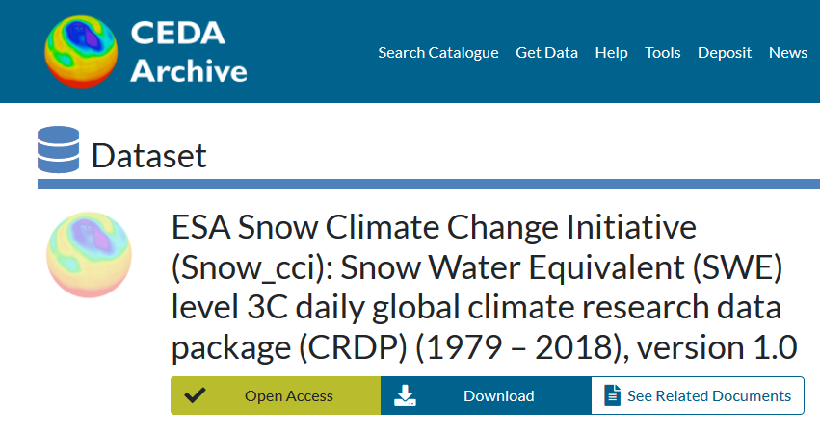
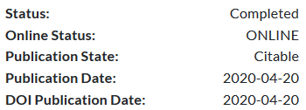
SWE CRDP v1.0 released in April 2020
Search and download data via the CCI Data Portal:
http://cci.esa.int/data
Citable as: Luojus, K.; Moisander, M.; Pulliainen, J.; Takala, M.; Lemmetyinen, J.; Derksen, C.; Mortimer, C.; Schwaizer, G.; Nagler, T. (2020): ESA Snow Climate Change Initiative (Snow_cci): Snow Water Equivalent (SWE) level 3C daily global climate research data package (CRDP) (1979 – 2018), version 1.0. Centre for Environmental Data Analysis, 20 April 2020. http://dx.doi.org/10.5285/fa20aaa2060e40cabf5fedce7a9716d0

Slide 16
http://cci.esa.int
http://snow-cci.enveo.at
©

