Slide 1
Bio-optimisation of a tidal channel
Rory O’Hara Murray, Marine Scotland Science, UK
Matt Lewis, Bangor University, UK
Please run as a slideshow / present mode with your speakers tuned on as there are animations and a voice over…
Some slides have timings recorded, but you’ll have to advance some yourself.
Notes:
Hello everyone, and thanks for taking the time to view/listen to our display. This work was done with Matt Lewis, at Bangor University in the UK. Feel free to simply browse through the slides or listen to the voice over. If you just listen to the voice over then it should take you around 7-8 minutes to view/listen to the whole display. Even if you’re just viewing the slides, then it’s worth using the present mode as there are few animations.

Slide 2
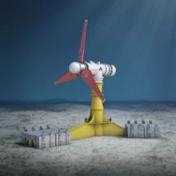
Motivation
Pressing need for decarbonisation
Can macro-algae enhance
the tidal stream resource?
Notes:
The SG recognises there is a pressing need for decarbonisation and has ambitious renewable energy plans. Mainly offshore wind, but tidal stream energy is also part of the energy mix. There are however a limited number of sites with adequate resource.
Typically, today’s tidal stream turbines have a cut in speed of at a least 1 m/s. but really 1.5 – 2 m/s is required as a minimum to make it economically viable.
There has been some research into utilising slower currents, but if we can somehow increase the flow speed we can potentially open up new areas for tidal stream exploitation.
So, this presentation explores whether the presence of macro-algae could enhance the tidal stream resource?

Slide 3
Global tidal stream resource and macro-algae occurrence
Laminaria and Marcocystis
Macro-algae occurrence
dynamic environment
up to 30 m depth
hard rocky substrate
large stands / forests
from seafloor to water surface
Large potential overlap with tidal stream energy
Notes:
This slide simply highlights that there is a large potential overlap between macro algae, such as Kelp, and areas of tidal stream resource around the world. This is because they both require relatively shallow water and reasonably fast flows.
In general macro-algae occurs in large stands and individual strands/plants can extend all the way from the seabed to the sea surface.

Slide 4
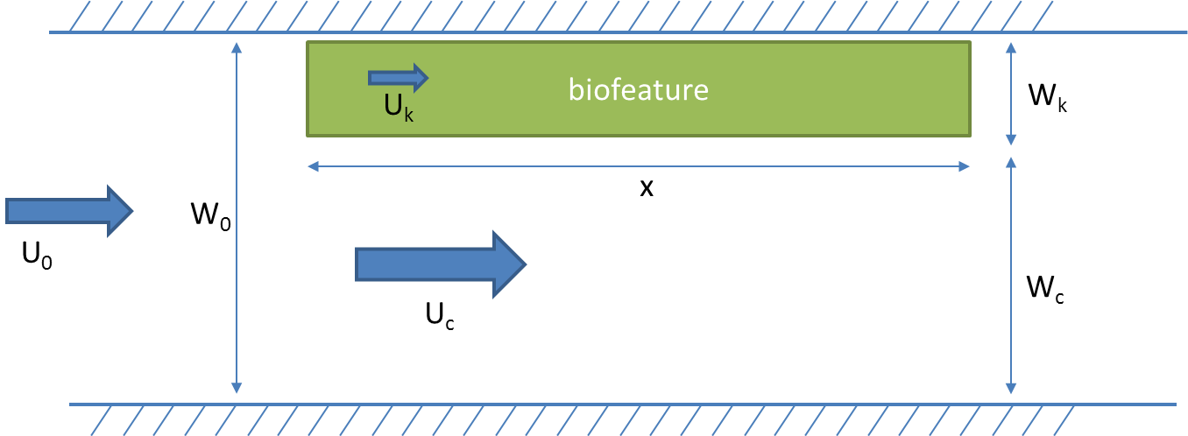
Kelp as drag and mass continuity
“Kelp forests” can reduce current speed by a third in their immediate vicinity (e.g. Dayton 1985)
Studies found an increase in flow around aquaculture of up to 50% (Plew et al. 2011)
Physical and numerical modelling has determined what drag coefficient are appropriate (e.g. Wang et al. 2014)
n = number of plants
CD = drag coefficient
d = diameter of each plant
h = water depth
$$U_{0}h_{0}W_{0}=U_{c}h_{c}W_{c}+U_{k}h_{k}W_{k}$$
Notes:
This slide simply explains how the presence of large stands of macro-algae would change to the flow, both within the stand and nearby.
If a tidal channel with some undisturbed flow speed U0 was to have a large stand of Kelp added (a bio-feature) with some drag coefficient, then locally within the bio-feature the flow will be reduced whilst outside the bio-feature the flow will be increased in order to conserve momentum within the channel.

Slide 5
Hypothesis
Macro-algae could enhance, or “bio-optimise”, tidal currents
Co-locating large forests and tidal turbines could lead to enhanced power output from tidal turbines, or even enable them to be placed in additional ‘marginal’ locations
Notes:
So our hypothesis is that the addition of non naturally occurring macro-algae could enhance tidal currents. And if this was done in a marginal region where the flow rate was just below an economically viable flow, then it could be increased to make it economically viable.

Slide 6
Idealised channel model
Numerical hydrodynamic model
Finite Volume Community Ocean Model (FVCOM)
1 x 10 km channel
50 m node spacing
M₂ tide
Notes:
We started by exploring what would happen in an idealised channel using a numerical model – FVCOM. We forced it with a simple M2 tide with a phase difference at either end of the channel. The animation here shows the rise and fall of the tide along the channel, and the resulting velocities along channel, as well as a cross section through the middle of the channel.

Slide 7
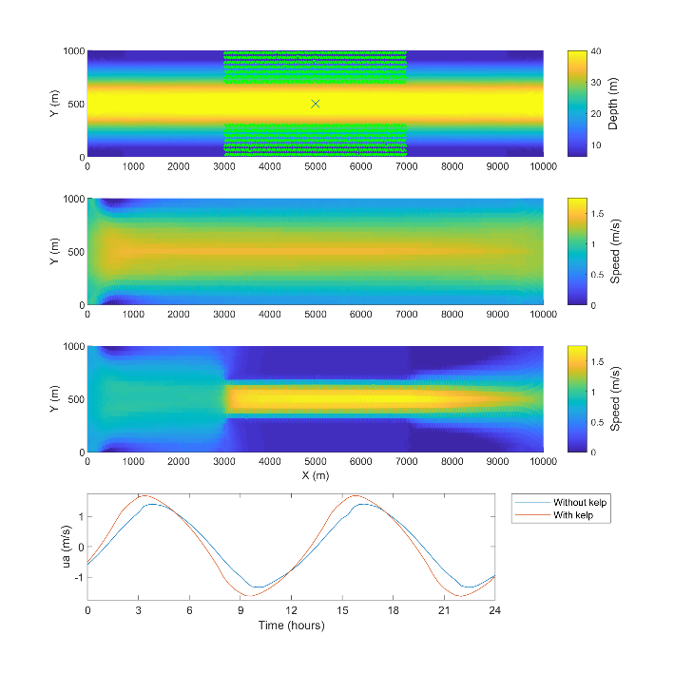
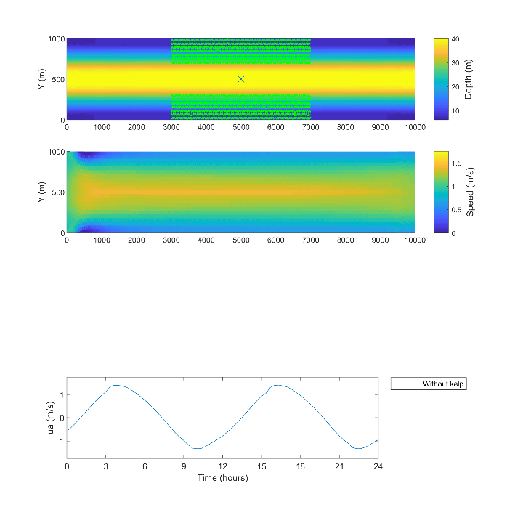
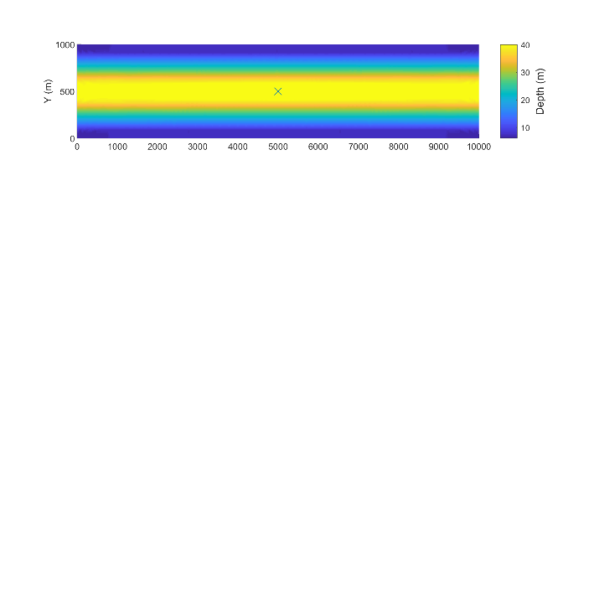
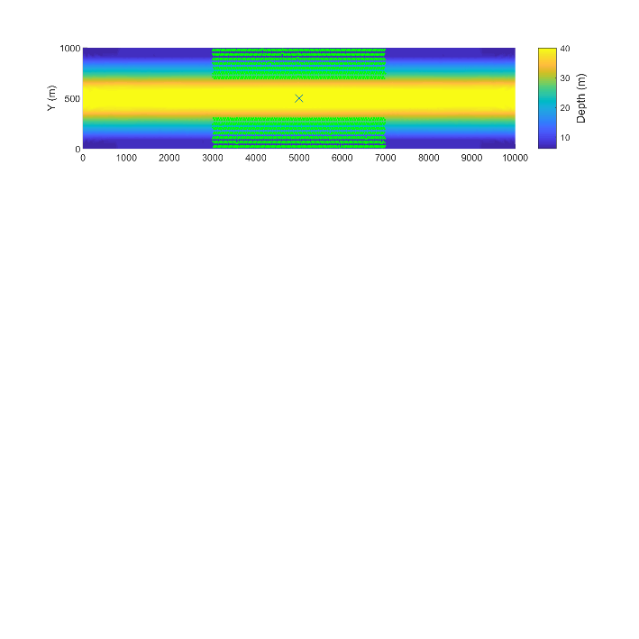
Idealised channel model
Kelp modelled as an addition body force term in the momentum equations
400 m long forests either side of the channel
1 plant per m²
5 cm trunk diameter
full water depth
Notes:
We added macro-algae, Kelp, to the model by representing it as an additional body force term in the momentum equations. We added 400 m long stands, or forests, either side of the channel.
The first figure shows the bathymetry within the channel, and where Kelp were added.
The second figure shows the undisturbed speeds in the channel
The third figure shows the resulting speeds with the addition of the Kelp
The last figure shows a comparison of the along channel velocity, in the centre of the channel, with and without the Kelp. You can see there is a small increase tin the along channel velocity magnitude.

Slide 8
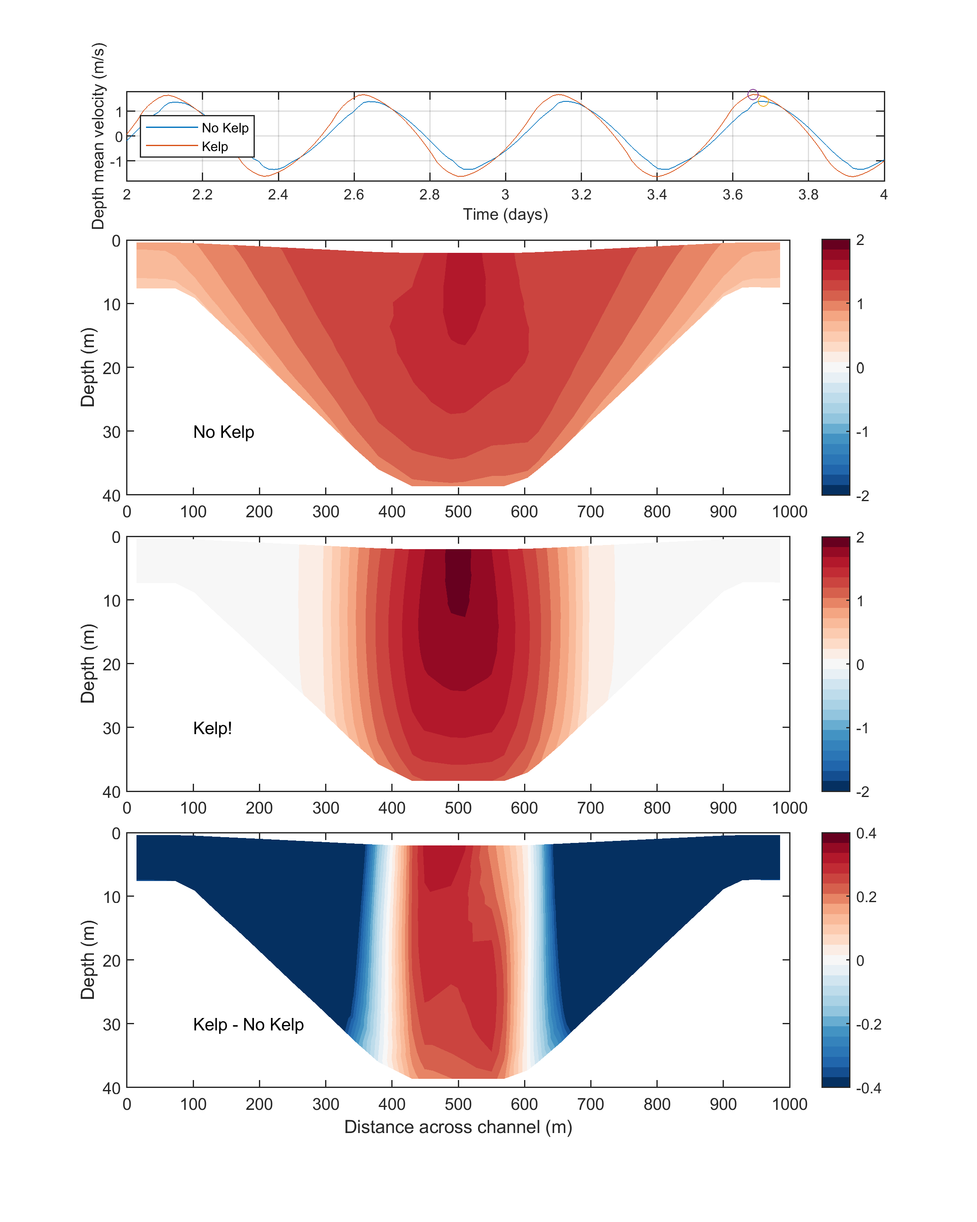
Idealised channel model
Kelp modelled as an addition body force term in the momentum equations
400 m long forests either side of the channel
1 plant per m²
5 cm trunk diameter
full water depth
Notes:
This slide just shows a cross section in the middle of the channel and how the Kelp can change the along channel flow through the cross section. With flow reductions at the edges of the channel, within the kelp forests, and increases in the flow in the centre.

Slide 9
Idealised channel model
Tidal turbine in the middle of the channel
Radius, r = 5 m, A = $π r^{2}$
Thrust coefficient C_{T} = 0.85
$P=\frac{1}{2} C_{T} ρ A u^{3}$
Notes:
These figures compare time series, over 1 day, of the along channel velocity and the power using this power equation. Power is proportional to the velocity cubed. A small increase in speed results in a large increase in power.

Slide 10
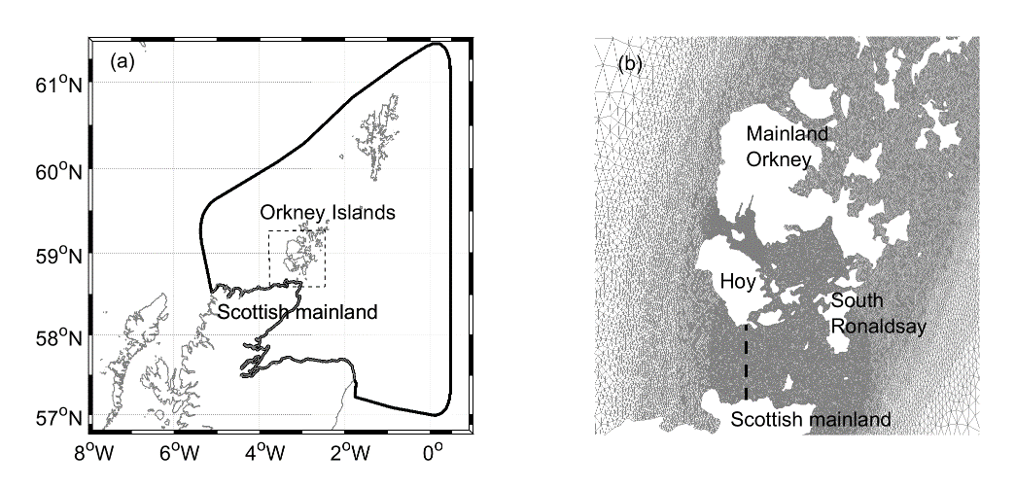
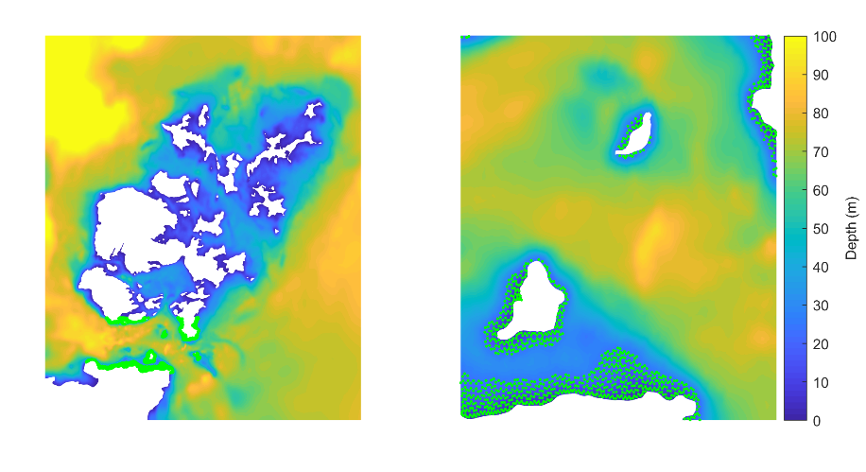
Pentland Firth and Orkney Waters model
FVCOM unstructured grid
~ 100 m node spacing in Pentland Firth
M₂ tide
Kelp added to water depths < 25 m
1 plant per m²
5 cm trunk diameter
full water depth
Notes:
We next decided to add Kelp to an existing hydrodynamic model of the Pentland Firth region in Scotland. This is a region with very fast tidal currents actively being considered for commercial tidal stream energy development. The model is an FVCOM model with a domain shown here, and we added Kelp to the areas shown in these figures.

Slide 11
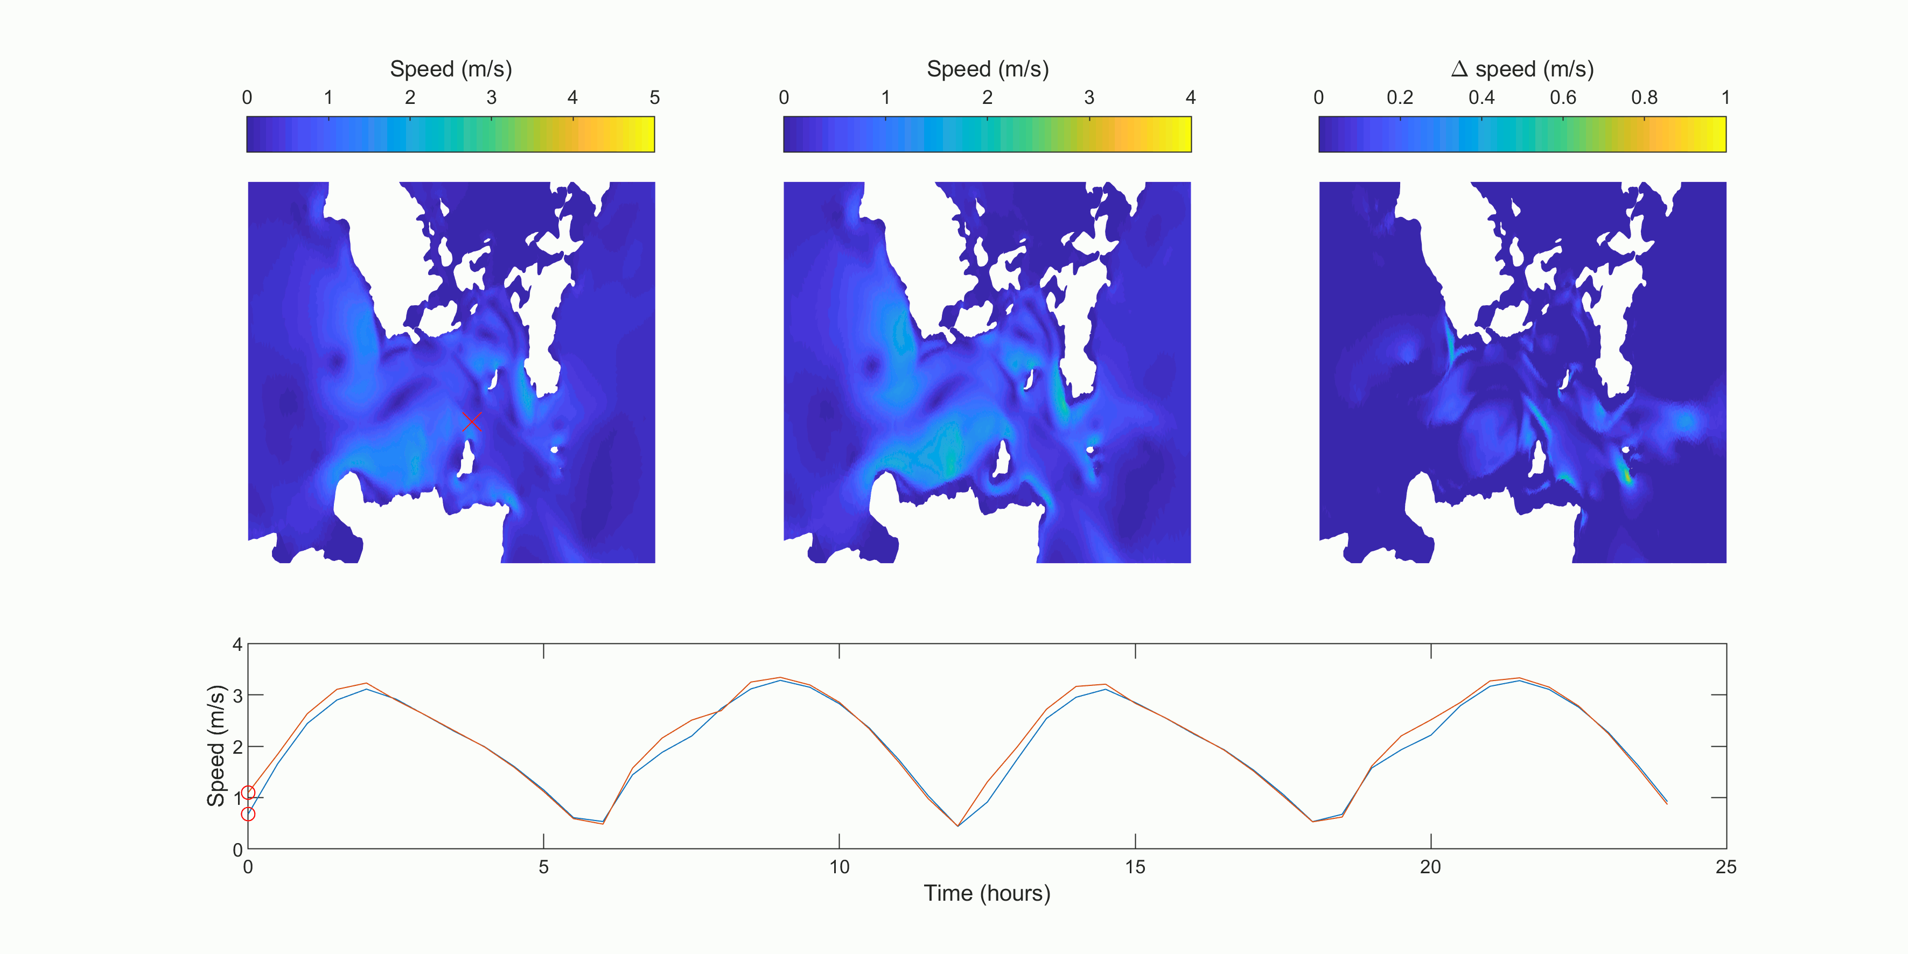
Pentland Firth and Orkney Waters model
Instantaneous speed changes
Without Kelp
With Kelp
Difference
Notes:
This is an animation of the modelled instantaneous currents with and without Kelp, as well as the difference. A time series at the location marked with the red cross is shown. There are potentially large instantaneous differences in speed, but this can be deceptive as the Kelp may just be causing a phase difference without actually changing the peak speeds through a tidal cycle. An alternative way of exploring the changes is to examine time average changes in power.

Slide 12
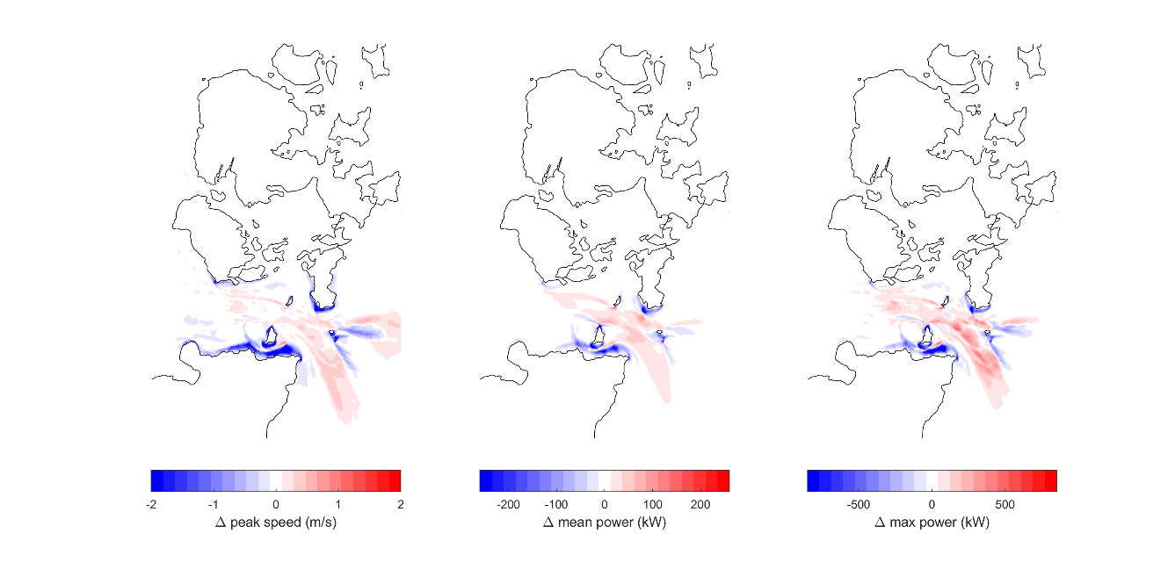
Pentland Firth and Orkney Water model
Changes to tidal stream resource
Notes:
This slide shows three time average statistic of the change in speed and power, change in peak speed, mean power and maximum power through a tidal cycle. You can see that there are both substantial increases and decreases in power. This is to be expected with the flow reducing within the Kelp forests and increasing around them.

Slide 13
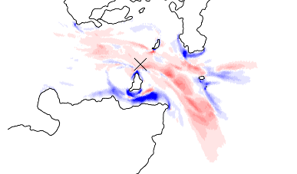
Pentland Firth and Orkney Water model
Changes to tidal stream resource
Total energy over 1 day at this location from one 10 m diameter turbine:
Without Kelp: 39.3 GJ ~11 MWh/day
With Kelp: 43.1 GJ ~12 MWh/day
Almost 4 GJ increase in energy ~ 1 MWh/day
Average UK household uses 10 kWh/day
→ 100 extra homes powered by adding Kelp
Notes:
Here we examine the modelled tidal stream resource at a location within the Pentland Firth, with and without kelp. We considered what power could be produced form a single 10 m diameter turbine.
The difference in energy extracted, with and without the addition of Kelp, is around 1 MWh/day.
On average, a UK home uses around 10 kWh/day
100 homes powered by kelp…

Slide 14
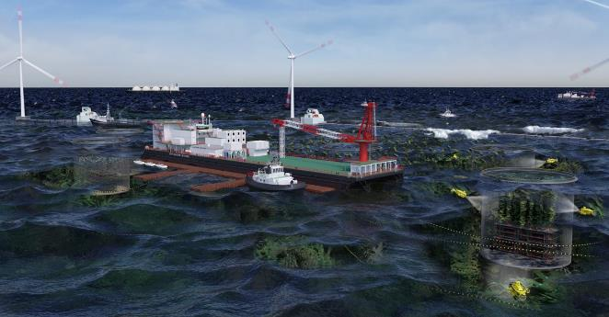
Conclusions and future work
Broad spatial overlap in kelp habitat and tidal stream sites
Potential for Kelp to ‘bio-optimise’ tidal stream resource
This could open up new areas for economic exploitation
Kelp in < 25 m
Turbines in > 25 m
Could other aquaculture developments be used?
How much Kelp are already in these areas and should we be representing them in our models?
Kelp and tidal turbine interactions
[image from Blue Economy CRC centre]
Notes:
Here are our conclusions. I’ll let you read them, but in summary,
The addition of macro-algae has the potential to marginally increase current speeds, potentially opening up new areas of economically viable tidal stream energy production. This would potentially have to be done at a very large scale for the Pentland Firth, but there are most likely other, more marginal sites, within Scotland and around the world where this may be more viable.

