Slide 1




Structural styles of the External Rif and Flysch Domain (Rif belt, northern Morocco) through thermal maturity and structural data
Achraf Atouabat, Andrea Schito, Sveva Corrado, Faouziya Haissen, Geoffroy Mohn and Dominique Frizon de Lamotte
Presenting author: Achraf ATOUABAT
achraf.atouabat@uniroma3.it

Slide 2
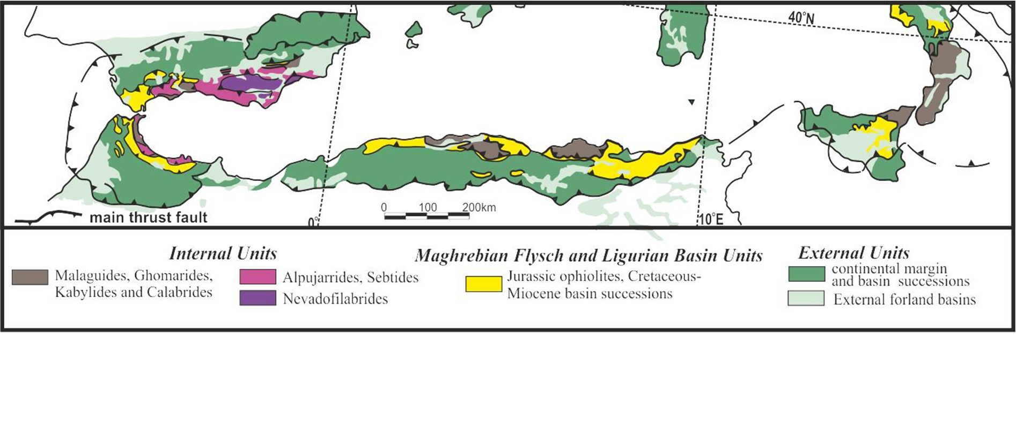
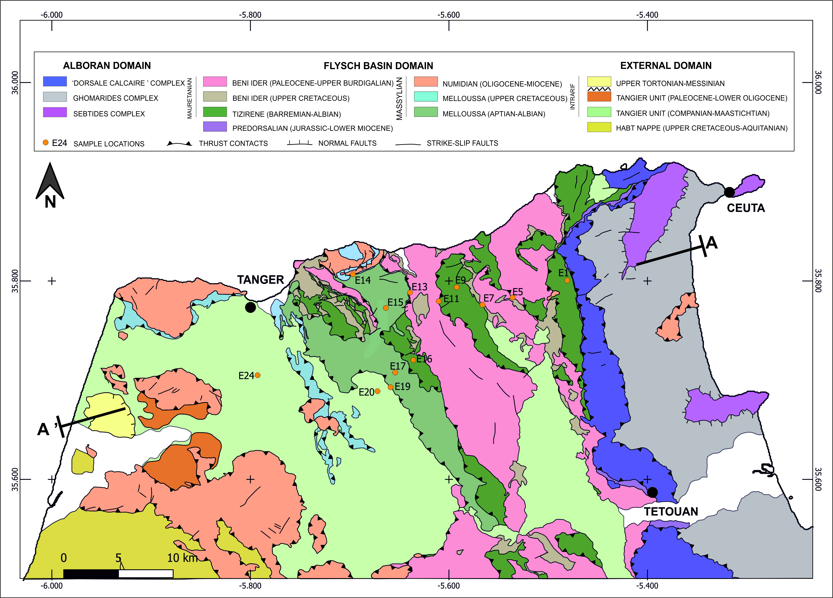
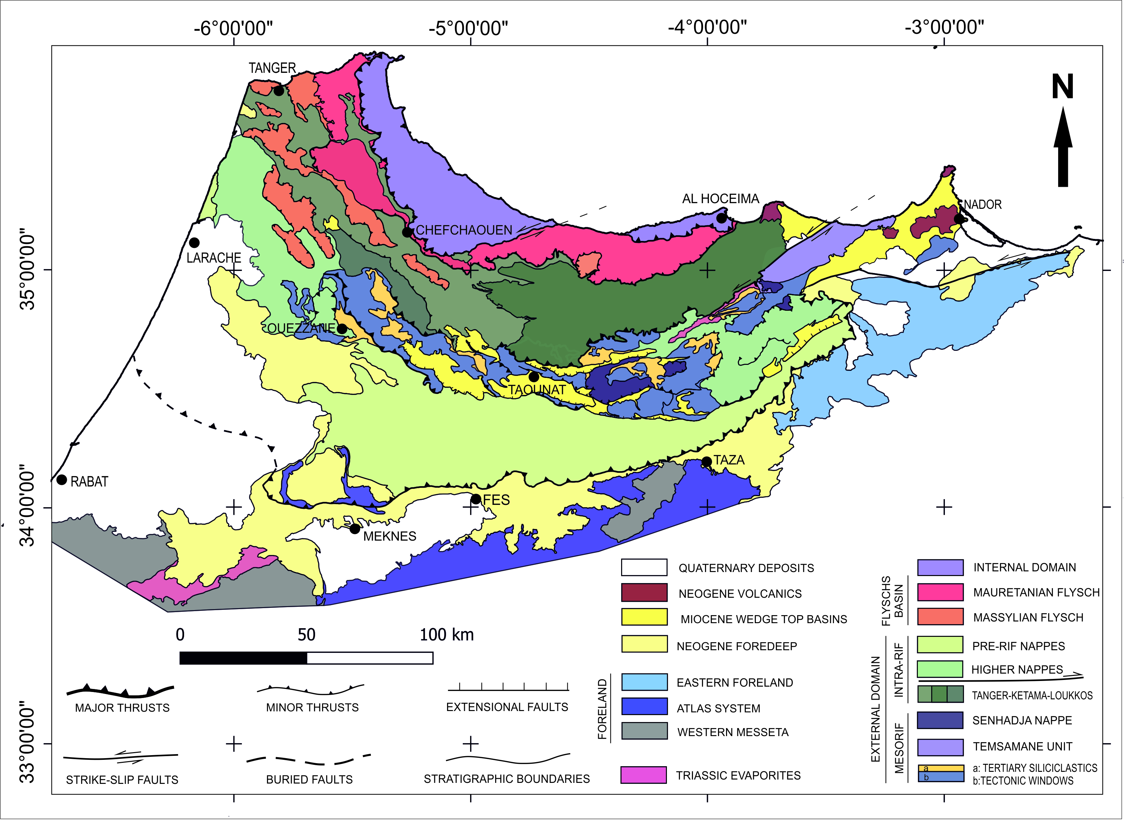
Introduction & aims
Methods
Results & Discussion
Part of an orocline Betic-Rif-Tell (B-R-T)
Western most part of the Mediterranean alpine belts
Betic and Rif forms Gibraltar arc
Unravelling the burial and thermal histories of the Maghrebian Flysch basin calculating the tectonic loads suffered by sedimentary successions during the wedge formation.

Slide 3
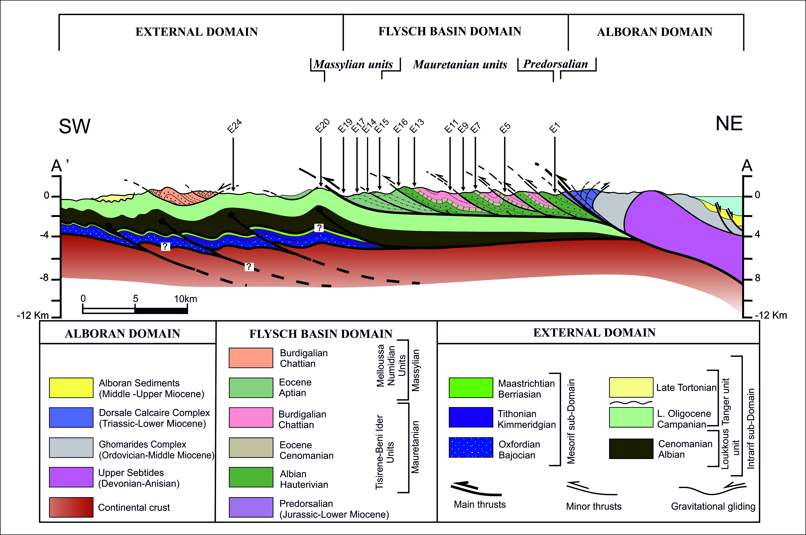
Introduction & aims
Methods
Results & Discussion

Slide 4
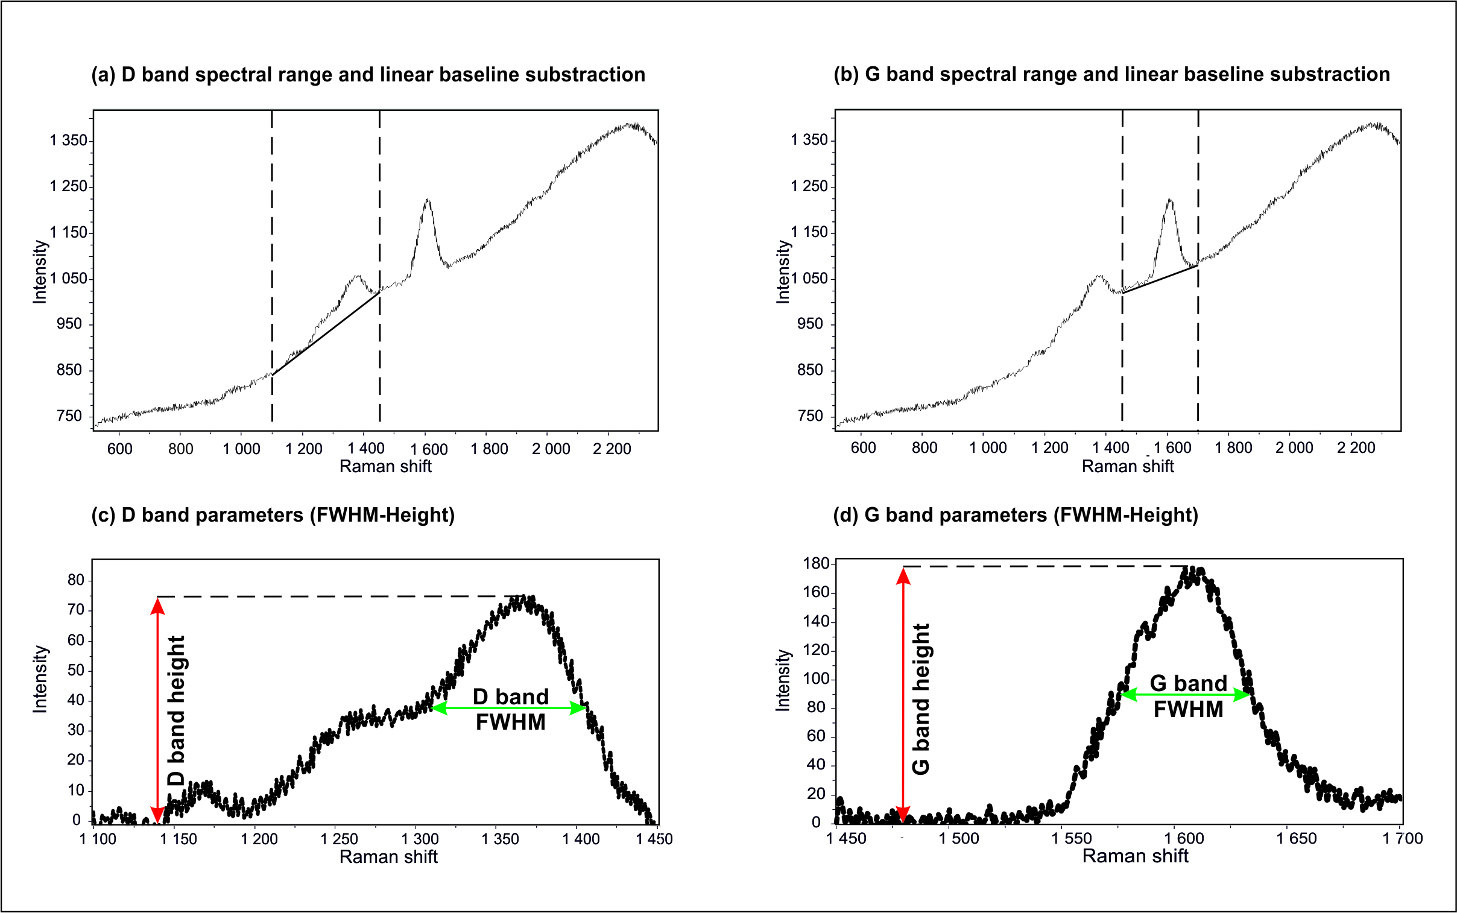
Introduction & aims
Methods
Results & Discussion
Vitrinite Reflectance
Micro-Raman spectroscopy
Ro%= 0.82±0.06
A. Photomicrograph of vitirnite fragment from the Massylian units (sample E19), B. Vitrinite reflectance histogram of the sample E19 showing an uni-modal distribution shape.

Slide 5
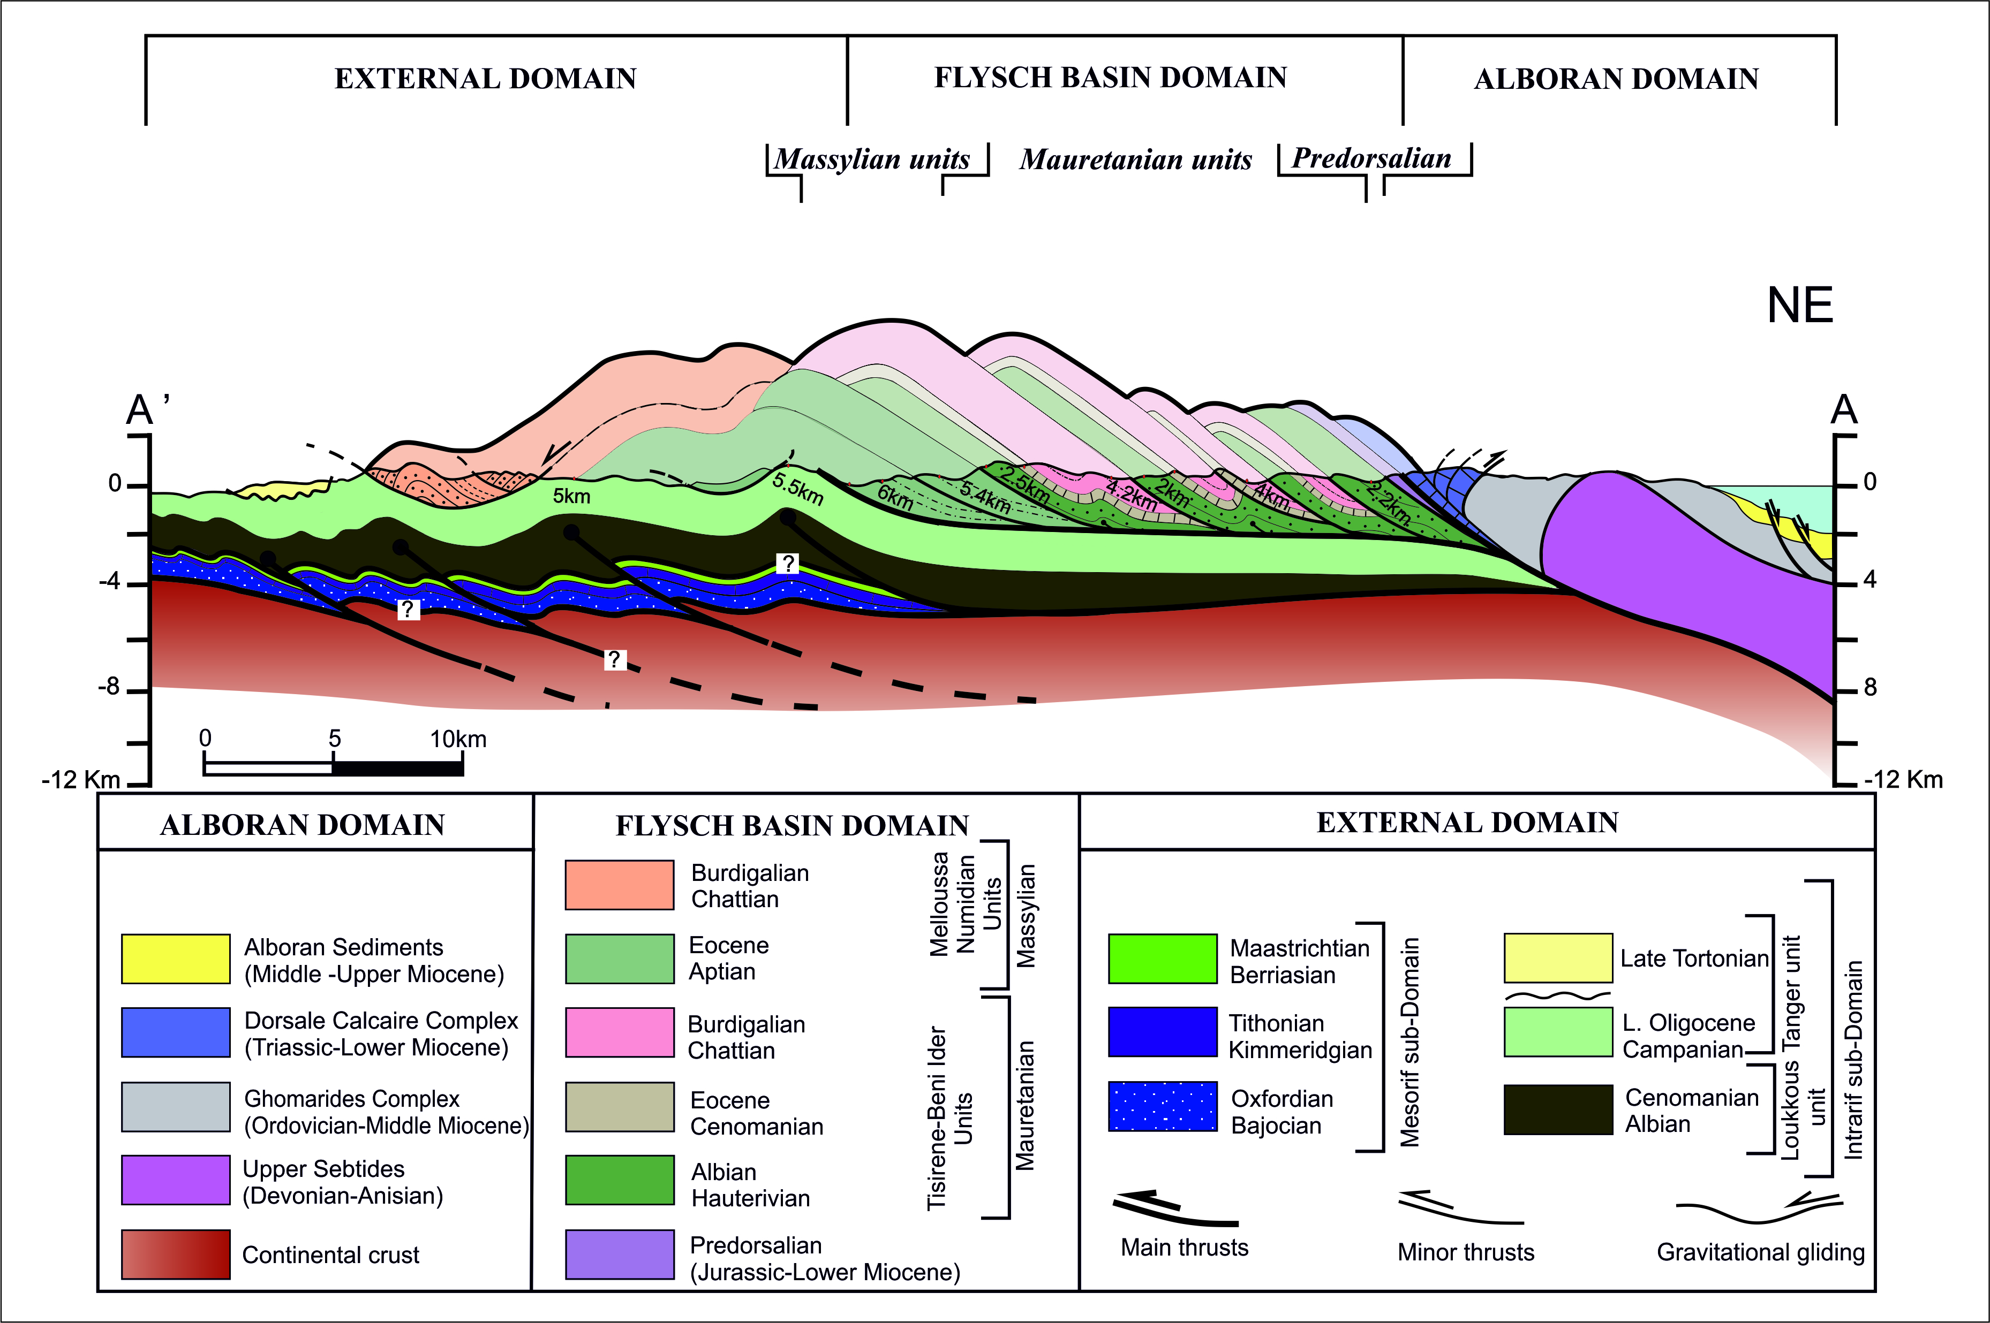
Introduction & aims
Methods
Results & Discussion
5km
5.5km
6km
5.4km
2.5km
4.2km
4km
2.2km

Slide 6
Introduction & aims
Methods
Results & Discussion
1
The Mauretanian flysch thermal trend can be explained by the tectonic loading due its internal stacking.
2
The Massylian sub-basin is more mature than the Mauretanian, due to the regional antiformal stacking of the internal flysch thrust sheets.
3
The maturity of the Tangier Intrarifain unit is mainly due to the overthrusting of the Numidian flysch onto its inner part.

