Slide 1
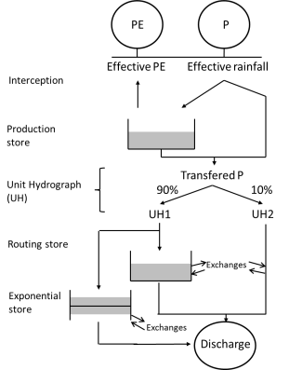
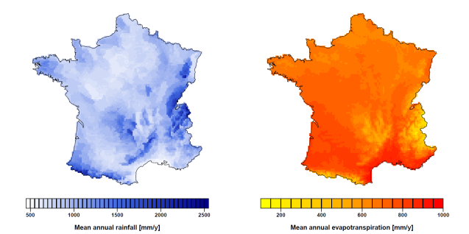
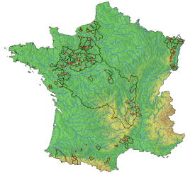
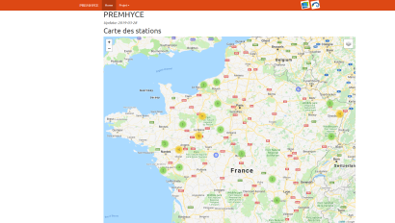
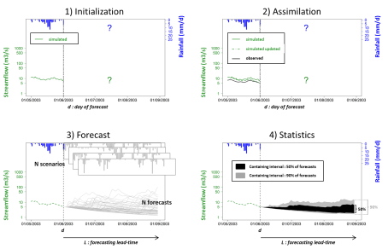

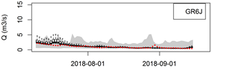
Introduction
Models
Gardenia (BRGM)
GR6J (Inrae)
Mordor (EDF)
PRESAGES (LOTERR)
SIM (Météo-France)
Perspectives
Data
P
Daily Q
Daily P, PE, T
Catchments
Website
PE
Method
Calibration
Real-time forecasting
Scenarios
Results
ESP
ECMWF
P0
Tool outputs
2017-2019 low-flow periods

Slide 2
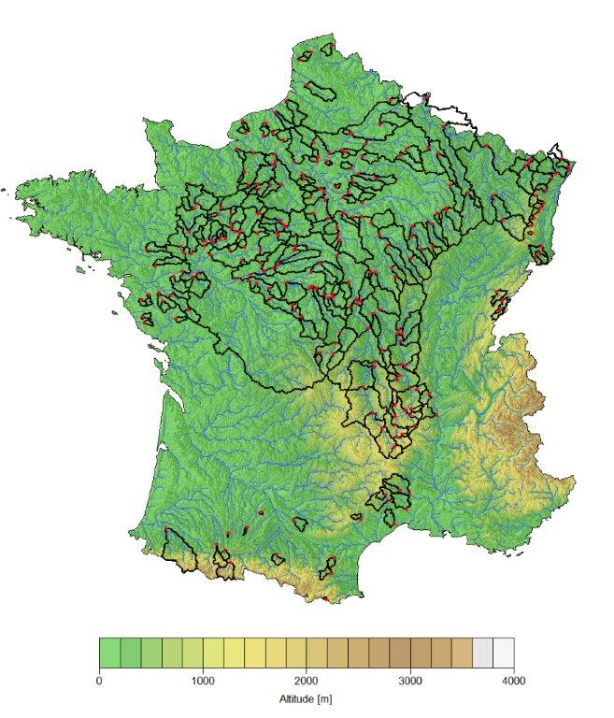











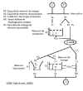
Main characteristics
Developed in R (based on airGR package) and Fortran
Five hydrological models (SIM run independently)
Daily ensemble low-flow forecasting up to 90-day ahead
Operational on 210 French catchments since July 2017
GARDENIA/EROS
SIM
PRESAGES
GR6J
MORDOR
GR6J

Slide 3
Introduction
Models
Gardenia (BRGM)
GR6J (Inrae)
Mordor (EDF)
PRESAGES (LOTERR)
SIM (Météo-France)
Perspectives
Data
P
Daily Q
Daily P, PE, T
Catchments
Website
PE
Method
Calibration
Real-time forecasting
Scenarios
Results
ESP
ECMWF
P0
Tool outputs
2017-2018 low-flow periods

Slide 4
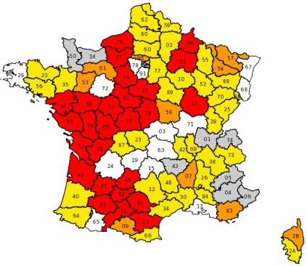
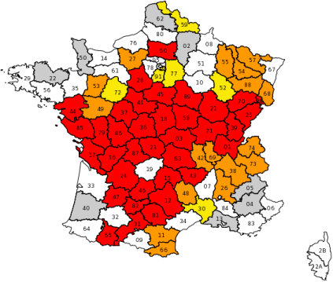
Introduction
In France in 2013: 73% of total withdrawals from rivers
Water uses affected by water shortages in rivers
Climate change: perspectives of more severe summer low flows
Lack of forecasting tool at national scale
Early anticipitation of low-flow periods needed to improve water management
Restrictions in water use due to drought in France
24 July 2017
17 October 2018
Vigilance
Alerte
home
Reinforced alert
Crisis

Slide 5
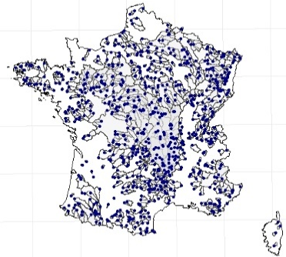
Catchments
Test catchments selected by French operational services (OS) involved in low-flow management
OS provided lists of catchment with limited human influences
210 catchments for real-time operational forecasting:
9 to 110 000 km²
Various hydrological regimes (oceanic, Mediterranean, mountainous)
2020: spatial extension to around 800 catchments over France
 | Min | 25% | Median | 75% | Max
Area (km²) | 9 | 167 | 385 | 1169 | 110188
Median elevation (m) | 29 | 132 | 193 | 423 | 1794
Flow availability (years) | 4 | 25 | 44 | 52 | 61
Rate of missing data (%) | 0 | 1 | 3 | 7 | 69
home

Slide 6
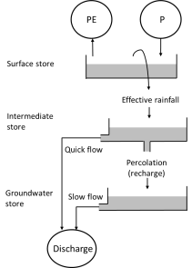
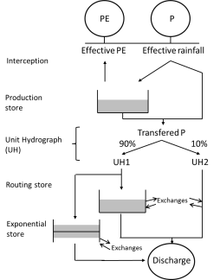
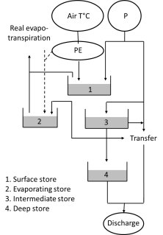
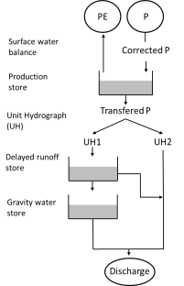
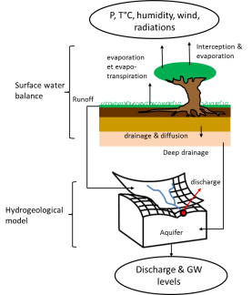
Which hydrological models?
Five hydrological models available in PREMHYCE
Four lumped storage-type models (called here GARD, GR6J, MORD and PRES) and one distributed and more physically oriented model (SIM)
Various formulations of low-flow simulation
Use of assimilation schemes and/or statistical correction procedures in forecasting mode
Different numbers of free parameters (prior expert calibration and/or automatic calibration through the PREMHYCE module)
Multi-model combination to be implemented soon
GARD
GR6J
MORD
PRES
SIM
Multi-model combination
Hydrological model | Short name | Institution | Type | Spatial resolution | Number of free parameter | Assimilation method | Post-treatment method
GARDÉNIA | GARD | BRGM | Conceptual | Lumped | 4 to 13 | X
GR6J | GR6J | Inrae | Conceptual | Lumped | 6 to 8 | X
MORDOR | MORD | EDF-DTG | Conceptual | Lumped or semi-ditributed | 11 to 18 | X
PRESAGES | PRES | Lorraine Univ, | Conceptual | lumped | 7 to 10 | X
SIM | SIM | Météo-France | Physically based | Distributed | No calibration |  | X
home

Slide 7
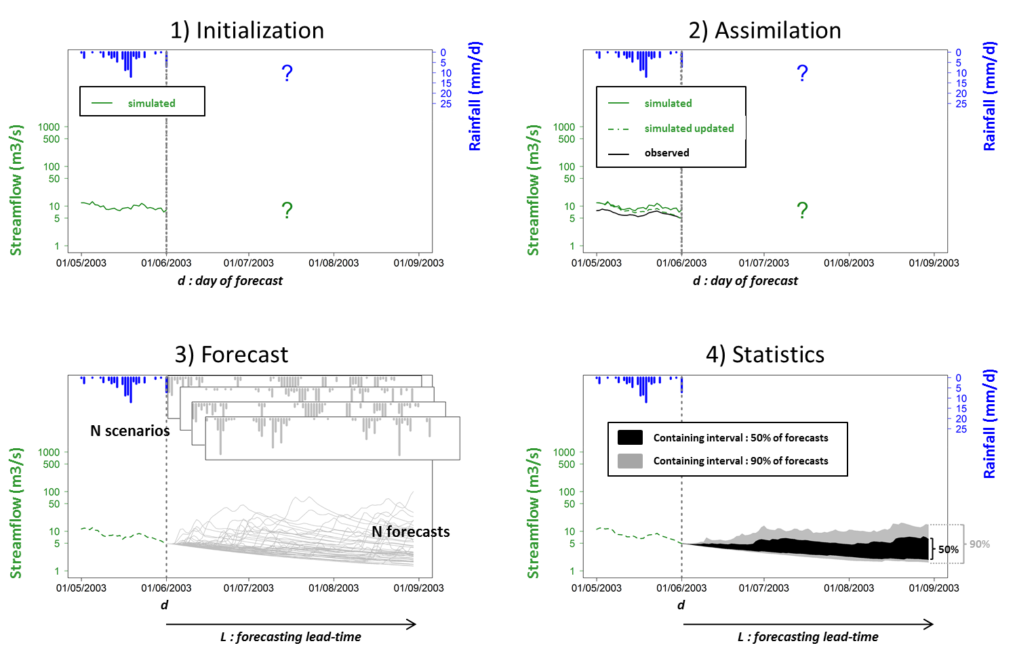
How to forecast low-flow using hydrological models?
1. Initialization
Streamflow simulation by the model over a past period (typically at least one year) prior to the date j, using weather inputs observation over that period.
At time j, available model state variables, resulting from the integration of past conditions and representing the basin's potential to generate runoff
2. Assimilation (also called updating)
Use of the measurements available on the catchment to correct the model errors at time j, typically a difference between the observed and simulated values ​​of flow at this time
Appropriate assimilation approaches to minimize these errors, for example by updating model internal states, thereby generating an updated state vector
This step of assimilation is not systematically implemented in all models
3. Forecast
From the previously determined initial conditions, model simulations of streamflows over the forecast period, using a weather forecast scenario derived or a climate archive
Simulation of future streamflow from j+1 to j+L
Step repeated for each available scenario, starting each time with the same initial conditions at j
An ensemble of streamflow forecasts is generated, each member of this set being relative to a given scenario.
4. Statistical processing
Statistical analysis of the members of the hydrological forecast to determine probabilities of being under low-flow thresholds
Post-processing approaches to correct the observed average model bias over a long time period (e.g. a systematic overestimation of low flows)
home
Which scenarios are used?
2009

Slide 8

Which data are used?
Daily streamflow
  National streamflow archive (HYDRO database)
  4 to 61 years (1959-2019)
Daily climatic variables
  Precip. (P), Potential evapotransp. (PE), Temp. (T)
  SAFRAN climate reanalysis (Météo-France)
  61 years (1959-2019)
  Forecasting scenarios
P
PE
home

Slide 9
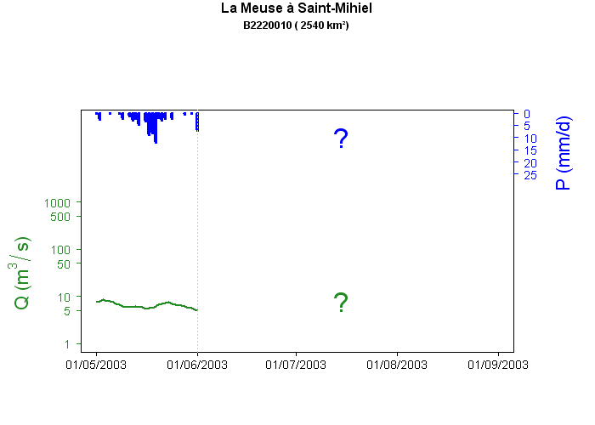
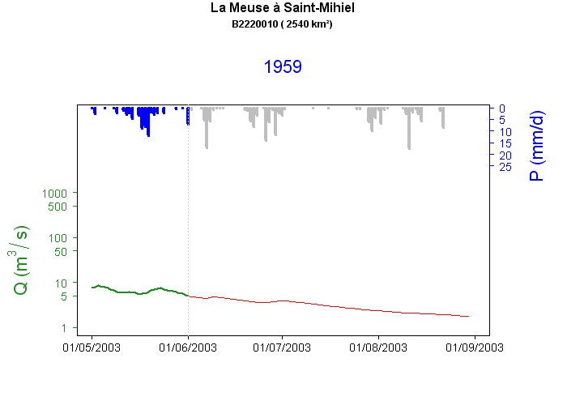
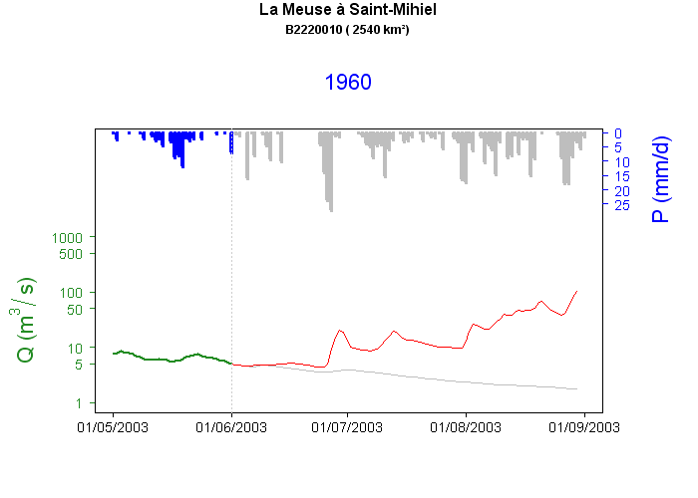
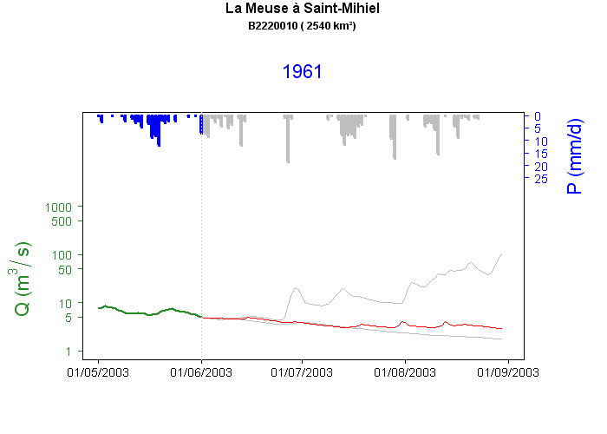
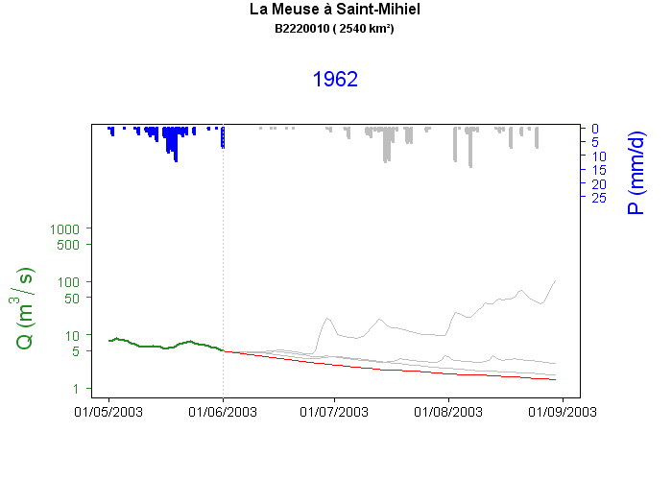
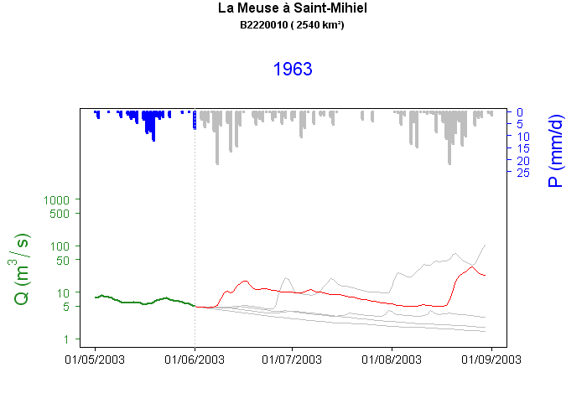

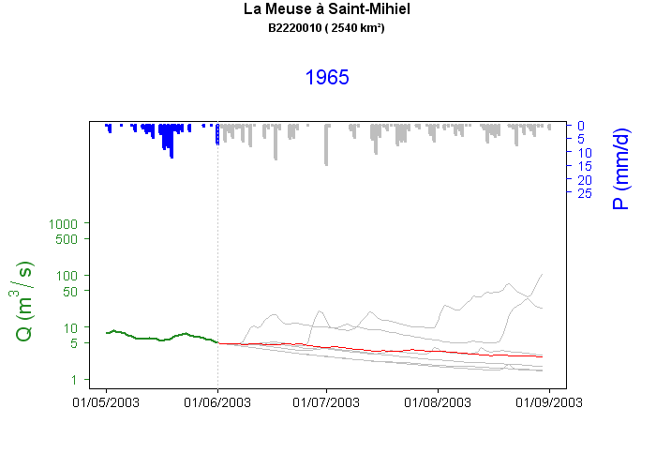
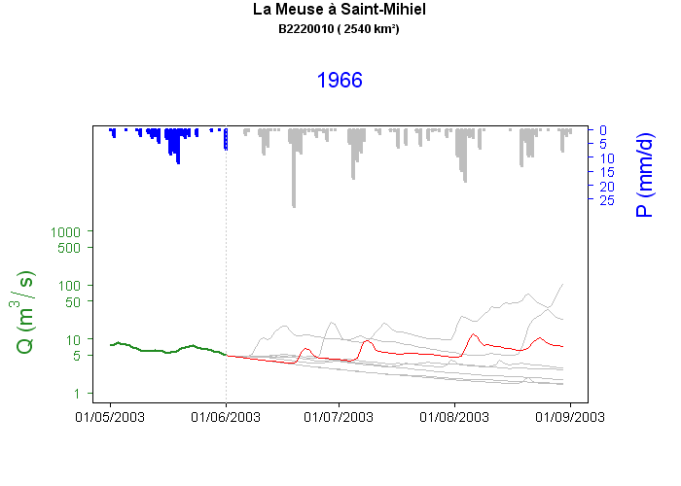
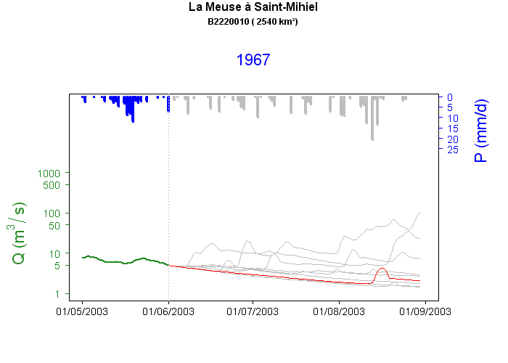
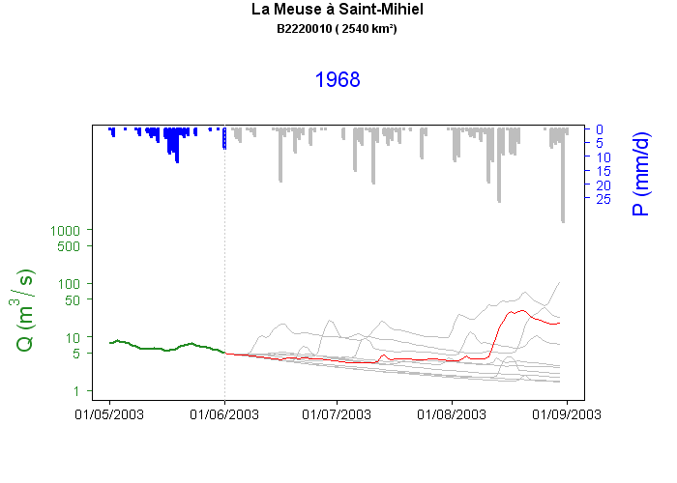

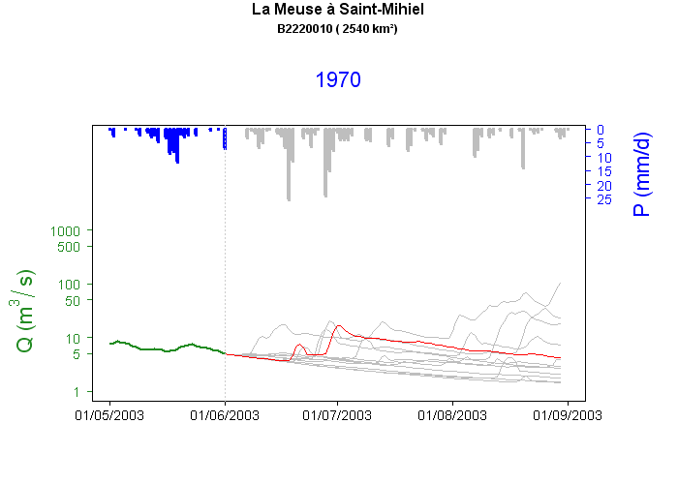

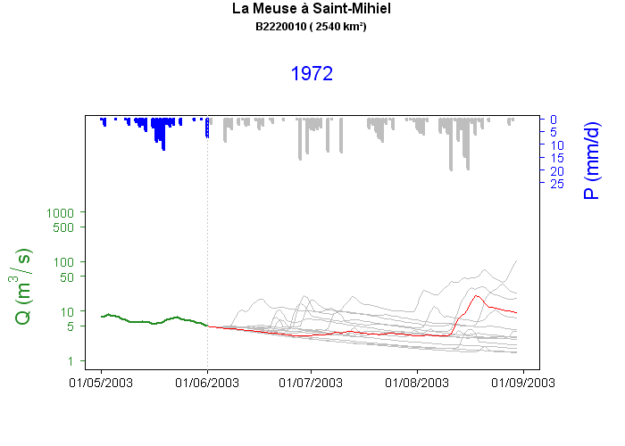
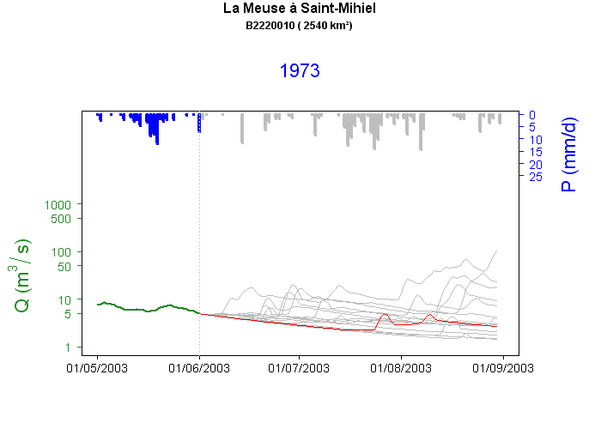
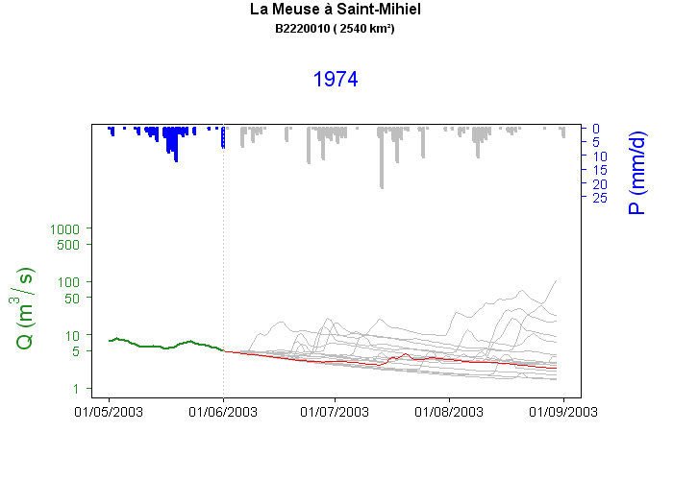
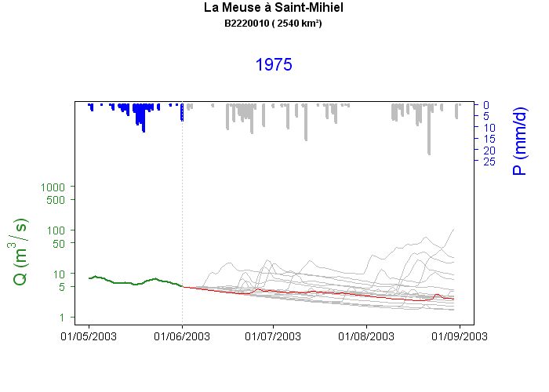
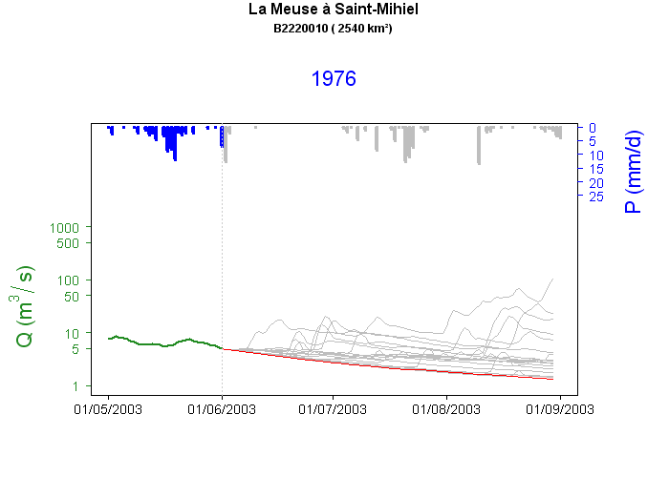
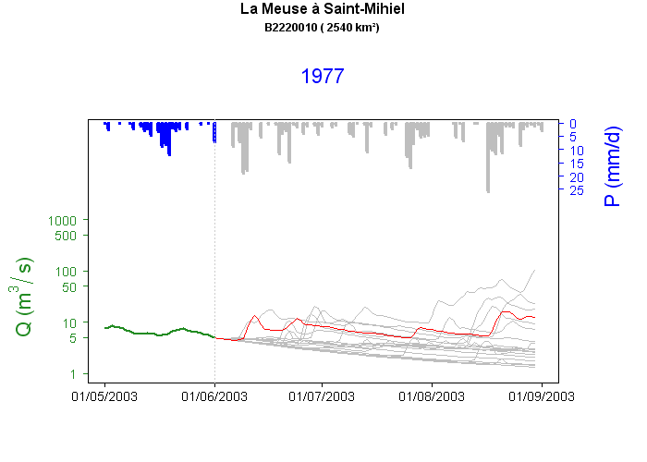

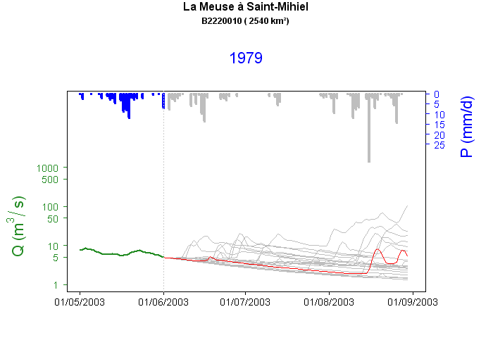

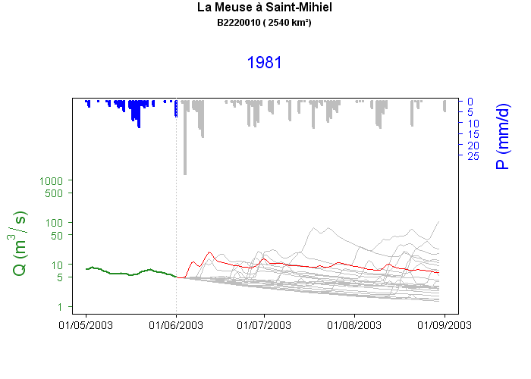



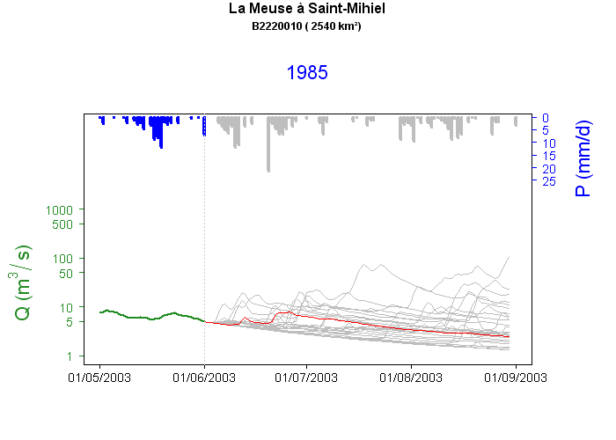
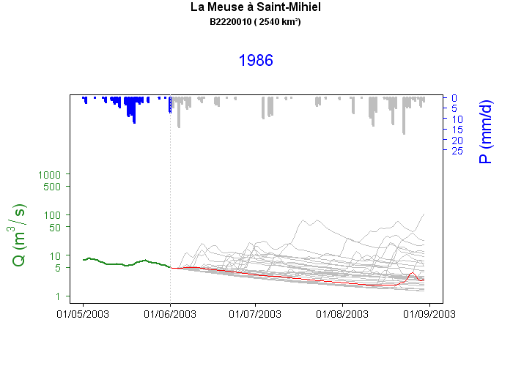
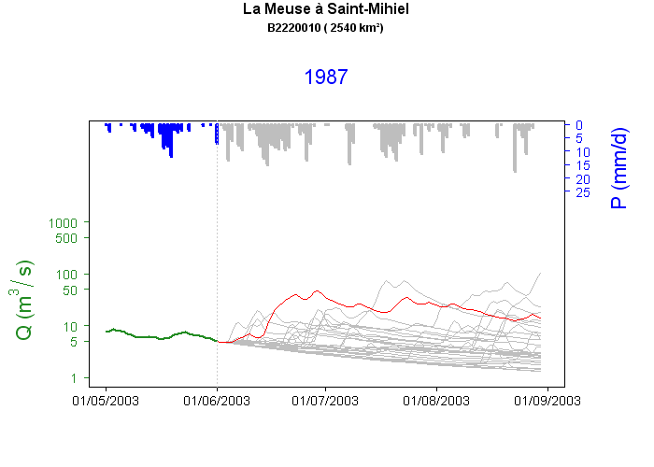
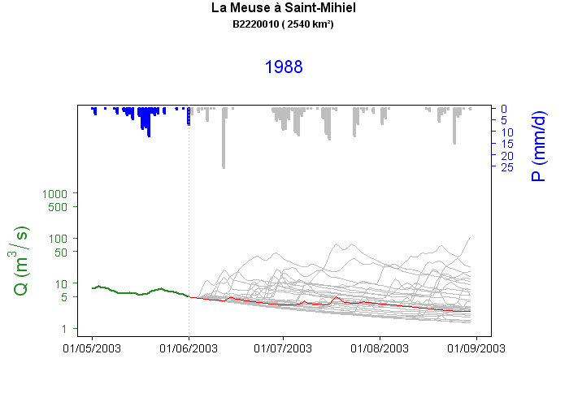
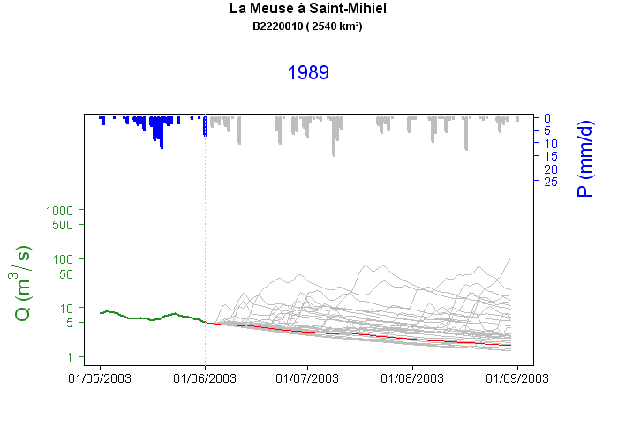
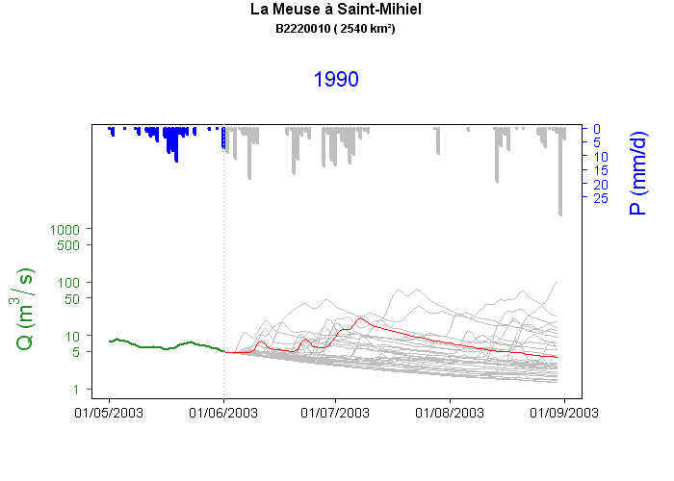

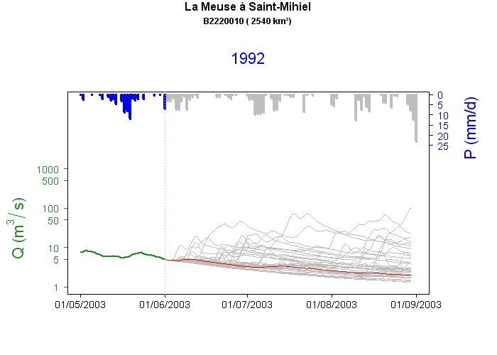

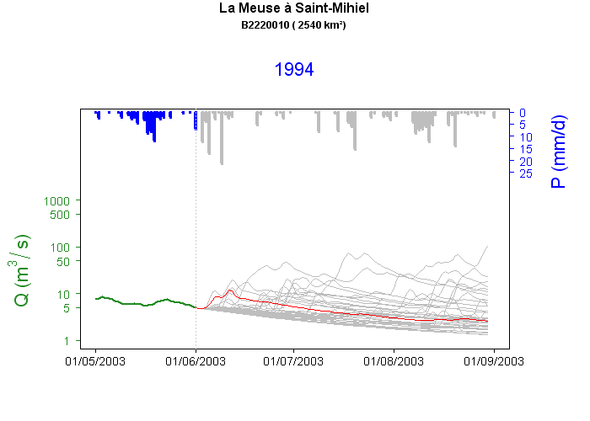

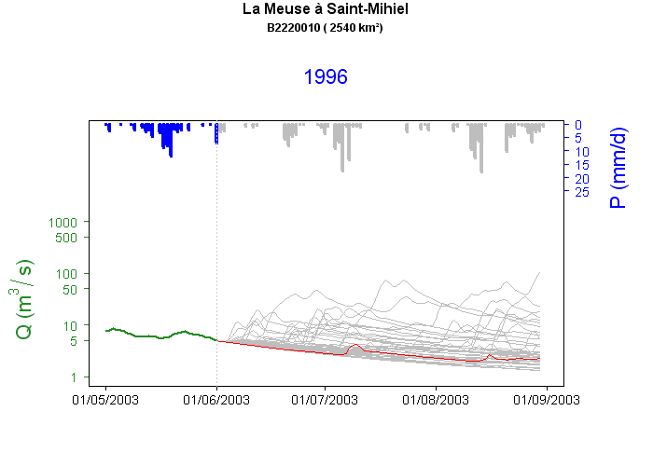
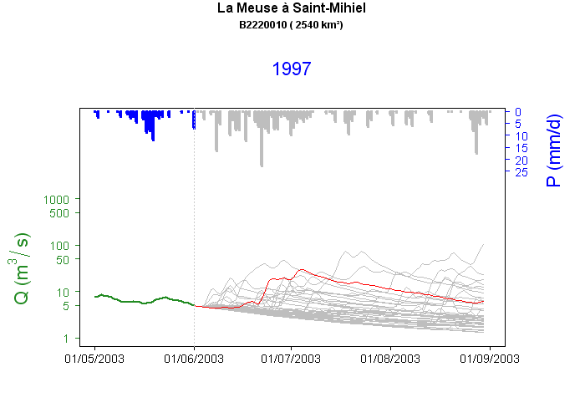
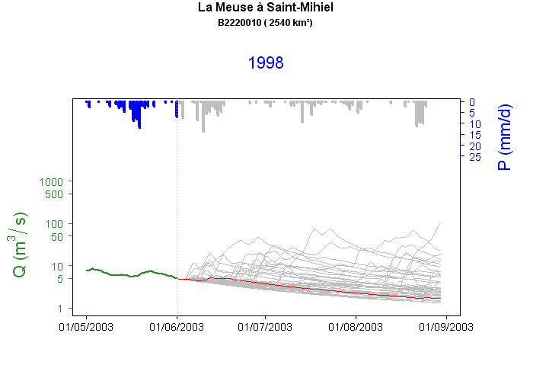
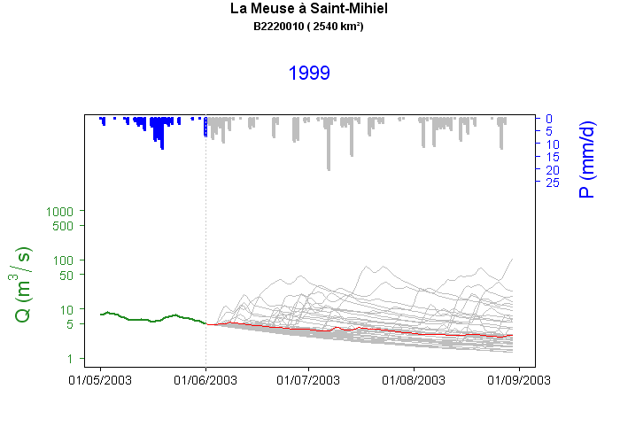
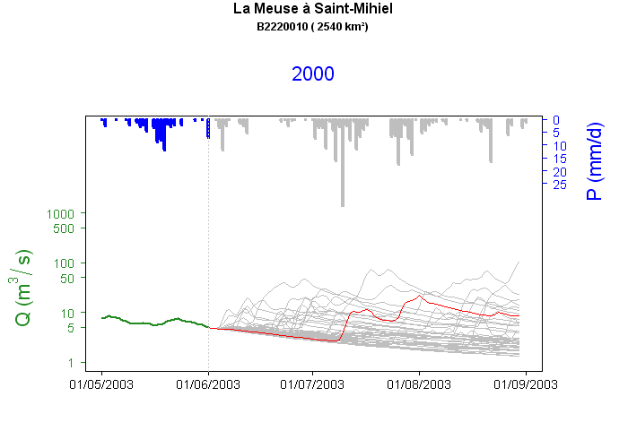

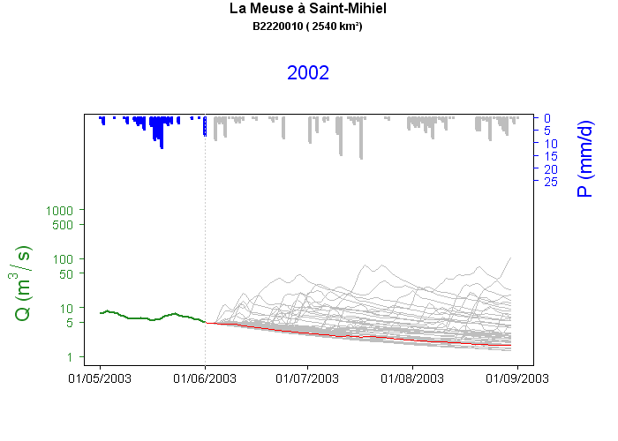






Which forecasting scenarios?
  Several future meteorological inputs sources:
  ESP: Climatic archive (~60 scenarios) → includes severe drought conditions
  Zero-precipitation scenario → worst case streamflow forecast
  ECMWF ensemble meteorological forecasts (up to 10 days)
Model
home
01/05/2010
01/06/2010
01/07/2010
01/08/2010
01/09/2010
2009

Slide 10



Website
(restricted
access)
Click
here
home

Slide 11

Website
(restricted
access)
back
Click on a model

Slide 12


Synthesis plot
Catchment : | Ill at Didenheim | Code HYDRO : | A1080330
Hydrol. Model | Gardenia | Date of forecast : | 11/04/2017 | Lead-time (days) | 90
Thresholds | Vigilance (m3/s) : 1,10 | Alert (m3/s) : 1,10 | Reinforced alert (m3/s) : 1,10 | Crisis (m3/s) : 1,10
Q forecast with P & PE obs
Outputs for the Gardenia model
Natural variability of Q
Q forecast with climatic archive (ESP)
Q obs
Synthesis plot
Text files
Q forecast with P=0
Normal
Vigilance
Alert
Reinforced alert
Cumulative P with climatic archive
back
Quantiles 10-90%
home
Temperature with climatic archive

Slide 13

Synthesis plot
Catchment : | Ill at Didenheim | Code HYDRO : | A1080330
Hydrol. Model | GR6J | Date of forecast : | 11/04/2017 | Lead-time (days) | 90
Thresholds | Vigilance (m3/s) : 1,10 | Alert (m3/s) : 1,10 | Reinforced alert (m3/s) : 1,10 | Crisis (m3/s) : 1,10
Q forecast with P & PE obs
Outputs for the GR6J model
Natural variability of Q
Q forecast with climatic archive (ESP)
Q obs
Synthesis plot
Text files
Q forecast with P=0
Normal
Vigilance
Alert
Reinforced alert
Cumulative P with climatic archive
back
Quantiles 10-90%
home
Temperature with climatic archive

Slide 14

Synthesis plot
Catchment : | Ill at Didenheim | Code HYDRO : | A1080330
Hydrol. Model | Mordor | Date of forecast : | 11/04/2017 | Lead-time (days) | 90
Thresholds | Vigilance (m3/s) : 1,10 | Alert (m3/s) : 1,10 | Reinforced alert (m3/s) : 1,10 | Crisis (m3/s) : 1,10
Q forecast with P & PE obs
Outputs for the Mordor model
Natural variability of Q
Q forecast with climatic archive (ESP)
Q obs
Synthesis plot
Text files
Q forecast with P=0
Normal
Vigilance
Alert
Crisis
Cumulative P with climatic archive
back
Quantiles 10-90%
home
Temperature with climatic archive

Slide 15

Synthesis plot
Catchment : | Ill at Didenheim | Code HYDRO : | A1080330
Hydrol. Model | Presages | Date of forecast : | 11/04/2017 | Lead-time (days) | 90
Thresholds | Vigilance (m3/s) : 1,10 | Alert (m3/s) : 1,10 | Reinforced alert (m3/s) : 1,10 | Crisis (m3/s) : 1,10
Q forecast with P & PE obs
Outputs for the PRESAGES model
Natural variability of Q
Q forecast with climatic archive (ESP)
Q obs
Synthesis plot
Text files
Q forecast with P=0
Normal
Vigilance
Alert
Crisis
Cumulative P with climatic archive
back
Quantiles 10-90%
home
Temperature with climatic archive

Slide 16

2017-2018-2019 drought periods
Observed precipitation
Rainy start of year 2018
Extremely wet
Deficit on spring & summer
Spring-summer 2019: slight but long deficit
Moderately wet
Wet
Neutral
Dry
Moderately dry
Winter 2016/2017: Large rainfall deficit
Summer/Autumn 2018: large deficit
Extremely dry
next
SPI (Standardized Precipitation Index): Comparison between P and historical mean P over a same period of the year

Slide 17

2017-2018-2019 drought periods
Observed Streamflow
+ wet
General streamflow deficit
+ dry
General streamflow deficit
Wet start of year 2018
next

Slide 18

Forecasts with PREMHYCE on the 2017 & 2018 periods
Mayenne river at Ambrières-les-Vallées : d+15
Qobs
Natural variability of Q
Ensemble streamflow forecast (ESP)
Observation in the low part
of ensemble streamflow forecasts
next

Slide 19
Forecasts with PREMHYCE on the 2017 & 2018 periods
Mayenne river at Ambrières-les-Vallées : d+15
Qobs
Natural variability of Q
Ensemble streamflow forecast (ESP)
Late low-flow period well forecasted
Usefulness Q forecasts compared to historical Q
back
home

Slide 20
Perspectives
  Deployment over France
  Module to take into account human influences
  Improvement of assimilation methods
  Implementation of multi-model combination
  Seamless hydrological forecasts

