Slide 1

The Western Tibetan Vortex as an emergent feature of near-surface temperature variation?
—Numerical Simulations and Error Checks
Xiao-Feng Li* and Jingjing Yu
School of Engineering, Newcastle University, UK
The EGU General Assembly 2020 online
Email: Xiaofeng.Li@newcastle.ac.uk

Slide 2
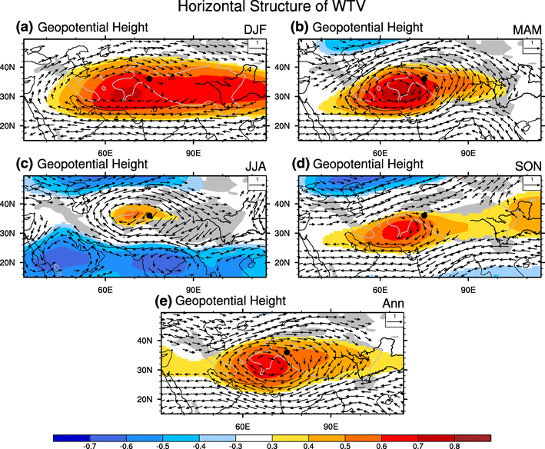
1. Introduction
The “Western Tibetan Vortex” (WTV) or the “Karakoram Vortex” (KV) is a large-scale atmospheric system with a deep or quasi-barotropic structure existing in all four seasons, (recognized by Forsythe et al. 2017; Li et al. 2018; hereafter cited as FL1718) in circulation anomalies over the western Tibetan Plateau (TP, see Fig. 1).
It has interested glaciologists as it significantly impacts (FL1718; Li et al. 2019) the near surface climate over the western TP, providing a possible explanation (Forsythe et al. 2017) for the “Karakoram Anomaly” .
Refs:
Forsythe, N.D., Fowler, H.J., Li, X.-F., Blenkinsop, S., Pritchard, D. 2017: Karakoram temperature and glacial melt driven by regional atmospheric circulation variability. Nature Climate Change, 7, 664–670, doi:10.1038/nclimate3361.
Li, X-F., Fowler, H.J., Forsythe, N.D., Blenkinsop, S., Pritchard, D. 2018: The Karakoram/Western Tibetan Vortex: seasonal and year-to-year variability. Climate Dynamics, 51, 3883–3906, DOI: 10.1007/s00382-018-4118-2.
Li, X-F., Fowler, H.J., Yu, J., Forsythe, N.D., Blenkinsop, S., Pritchard, D. 2019. Thermodynamic controls of the Western Tibetan Vortex on Tibetan air temperature. Climate Dynamics, 53(7–8), 4267–4290, DOI: 10.1007/s00382-019-04785-2.
Fig.1 Vectors and color-shading respectively denote the Pearson correlations between KZI (Karakoram Zonal Index, an intensity index of the WTV) and the horizontal wind vector and geopotential height on 500 hPa (near-surface level of Tibetan Plateau). From Li et al. (2018).

Slide 3
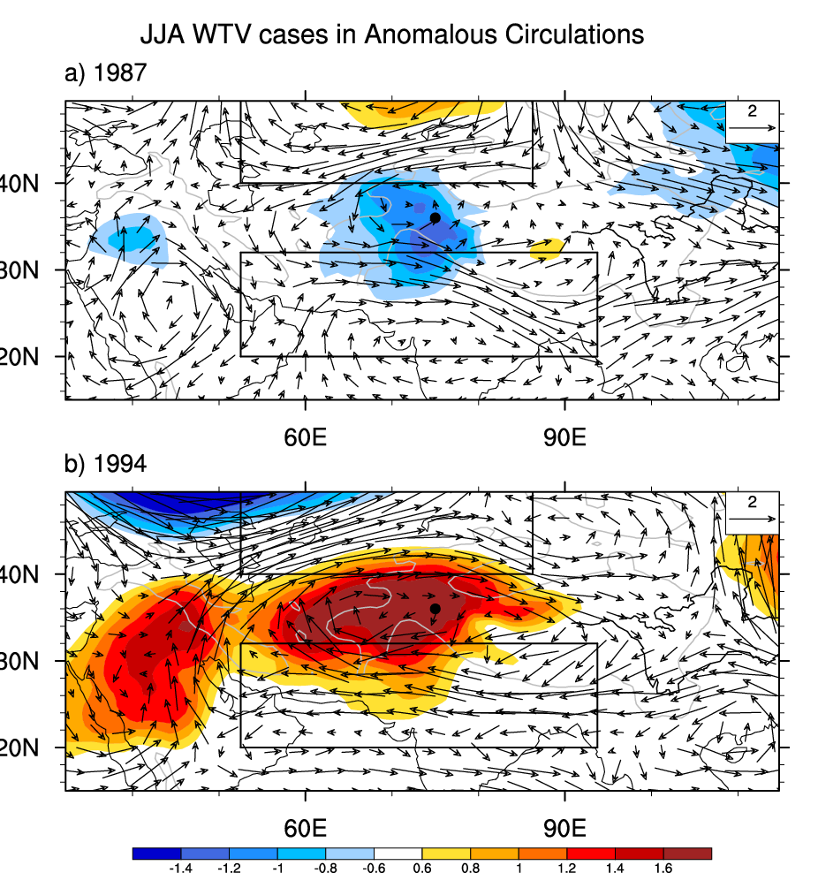
The WTV is not a semi-permanent pressure system such as the Icelandic/Greenland or Aleutian Lows or the Azores/Bermuda or South Atlantic/Saint Helena highs, neither is it (predominantly) an instantaneous synoptic circulation feature such as offshoot of the Arctic Polar vortex penetrating into the mid-latitudes via a jet stream meander.
Notably, the WTV exists in circulation anomalies from the climatological mean (see Fig. 2). Other well-known atmospheric systems, e.g. Northern and Southern Hemispheric Annular modes (Thompson and Wallace 1998;2000), NAO, ENSO and etc. are also defined in monthly and seasonal atmospheric circulation anomalies instead of initial circulations.
Fig. 2 WTV cases in anomalous circulations. Vectors and color-shading respectively denote the horizontal wind (m s⁻¹) and temperature (K) anomalies on 500 hPa (the near-surface level of Tibetan Plateau).

Slide 4
Arguments from de Kok and Immerzeel (2019) - dKI19
Recently, de Kok and Immerzeel (2019, hereafter cited as dKI19) have started a discussion on the WTV by arguing that the WTV is a thermally-driven wind circulation generated from near-surface temperature gradients over the western Tibetan Plateau. In contrast to our work (FL1817; Li et al., 2019), dKI19 propose that surface net radiation “likely” drives near-surface temperature changes that, in turn, generate the WTV.
In short, dKI19 argue that the WTV is a thermally direct circulation.
These arguments can spur constructive discussion for improving our understanding of the WTV.
Net Radiation
Near Surface Air Temperature
WTV/KV
dKI19’s Arguments:
de Kok, R. J., & Immerzeel, W. W. (2019). The Western Tibetan Vortex as an emergent feature of near‐surface temperature variations. Geophysical Research Letters, 46, 14,145–14,152. https://doi.org/10.1029/2019GL085757
FL1718; Li et al, 2019:
WTV/KV
Near Surface Air Temperature
Forsythe, N.D., Fowler, H.J., Li, X.-F., Blenkinsop, S., Pritchard, D. 2017: Karakoram temperature and glacial melt driven by regional atmospheric circulation variability. Nature Climate Change, 7, 664–670, doi:10.1038/nclimate3361.

Slide 5
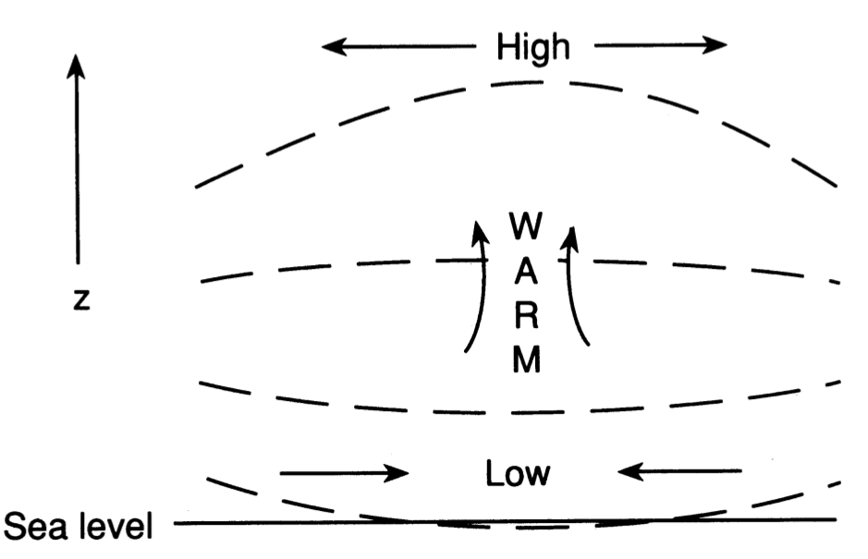
What is a thermally direct circulation?
A thermally direct circulation (e.g. Halley 1687; Holton 2004) is usually induced by a heating source in the lower- or mid-troposphere, which generates a local warm anomaly. The warm air expands, becomes less dense, then rises, resulting in a baroclinic structure featuring lower pressure (and with cyclonic winds if located in the extra-tropics) in the mid-lower troposphere, but higher pressure (and with anticyclonic winds if located in the extra-tropics) in the upper troposphere, e.g. the rising branches of the Hadley circulation (e.g. Hadley 1735) and Walker circulation (e.g. Lau and Yang 2003).
Two basic features (Fig. 3) of a thermally direct circulation are :
Anomalous rising motions;
A baroclinic structure (lower pressure at the ground surface and lower troposphere, but higher pressure at the upper troposphere).
Structure of an Ideal Thermally Direct Circulation
Fig. 3 An idealised thermally direct circulation associated with the adjustment of surface pressure to a mid-tropospheric heat source. Dashed lines indicate isobars. From Page 78 of Holton (2004).

Slide 6
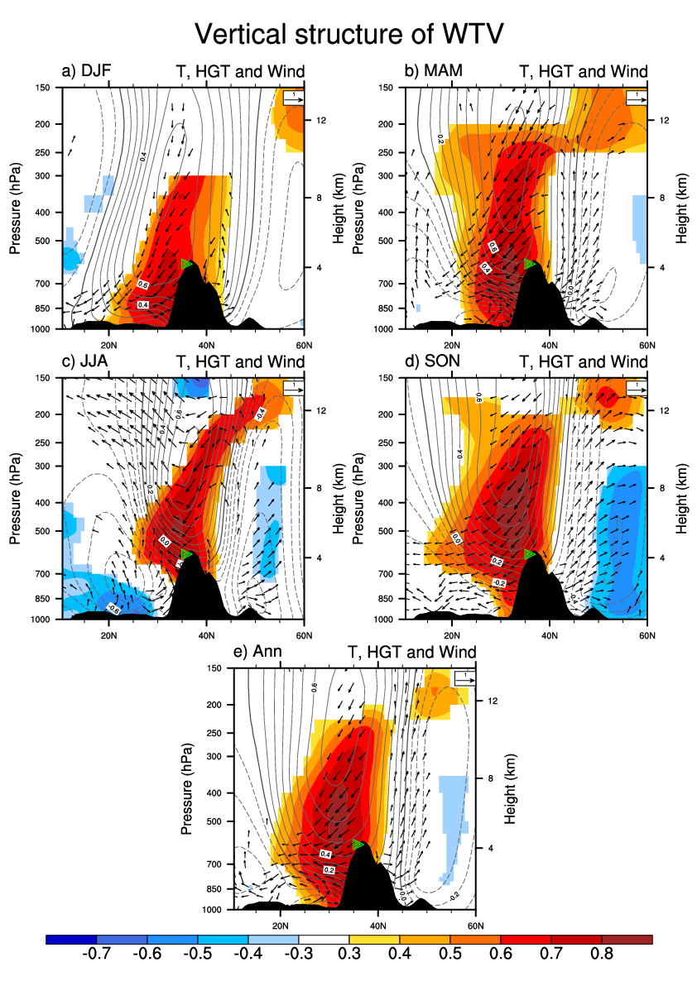
Does the WTV look like a thermally direct circulation?
The WTV has the opposite structure to a thermally direct circulation. The WTV features:
A warm anomaly (warm color-shading in Fig. 4) in the mid-lower troposphere associated with anomalous sinking (“↓” in Fig. 4) rather than rising motions, and;
A barotropic structure featuring higher pressure (solid contours in Fig. 4) associated with an anticyclonic wind (not shown) anomaly under the anti-cyclonic WTV phase (or lower pressure associated with a cyclonic wind anomaly under the cyclonic WTV phase) in both the upper and the mid-lower troposphere above the topography, rather than a baroclinic structure.
So, a ‘thermally direct’ circulation mechanism for the WTV conflicts with well-known basic physics.
Fig. 4 The vertical structure of the WTV at WTV’s anti-cyclonic phase, represented by correlations between KZI and geopotential height (HGT, contour), air temperature (T, colour-shaded), and vertical wind (arrows) vectors (V,W) along a latitudinal profile (across 70°E–80°E) in all seasons and annual mean for 1979–2016. From Li. et al. (2018).
The physical conflicts suggest it is necessary to carefully examine whether a putative thermal-generating mechanism for the WTV is acceptable.

Slide 7
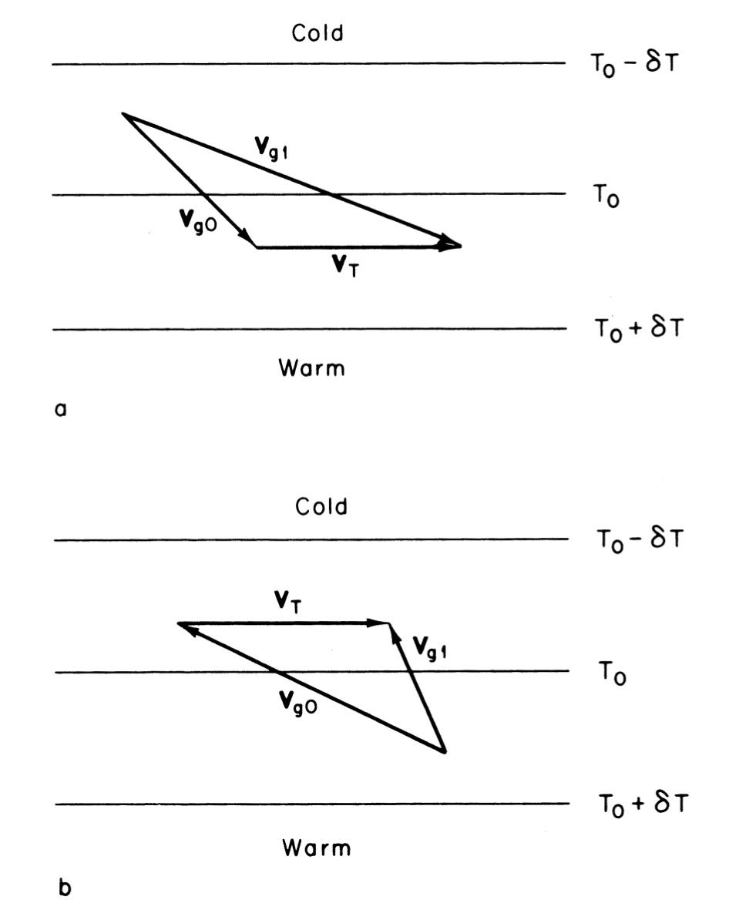
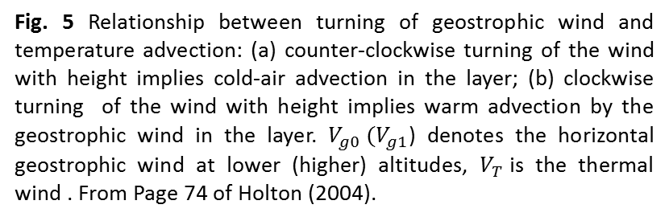

Is the thermal wind equation suitable for attributing the climate drivers?
More importantly, the thermal wind equation cannot provide a definitive attribution of whether wind drives temperature or the reverse, as proposed by dKI19. Because:
The thermal wind equation only reflects an internal balance between the horizontal gradient of temperature and vertical shear of geostrophic wind in geostrophic flows (Fig. 5). It is mainly used (Holton 2004) to check analyses of observed wind and temperature fields for consistency in large-scale extratropical systems. It can also be used to estimate the mean horizontal temperature advection in a layer as shown in Fig. 5.
In the mid-high latitudes, “the large-scale atmospheric motions are fundamentally quasi-geostrophic” (Yeh, 1957), so the large-scale winds and temperature are generally consistent and satisfy the thermal wind equation.
$V_{g0} :$ low altitude geostrophic wind
$V_{g1}:$ high altitude geostrophic wind
$V_{T} :$ thermal wind
Fig. 5 Relationship between turning of geostrophic wind and temperature advection: (a) counter-clockwise turning of the wind with height implies cold-air advection in the layer; (b) clockwise turning of the wind with height implies warm advection by the geostrophic wind in the layer. $V_{g0} (V_{g1}$) denotes the horizontal geostrophic wind at lower (higher) altitudes, $V_{T}$is the thermal wind . From Page 74 of Holton (2004).
To check whether near-surface thermal forcing can drive a WTV-like structure, numerical simulations are needed.

Slide 8
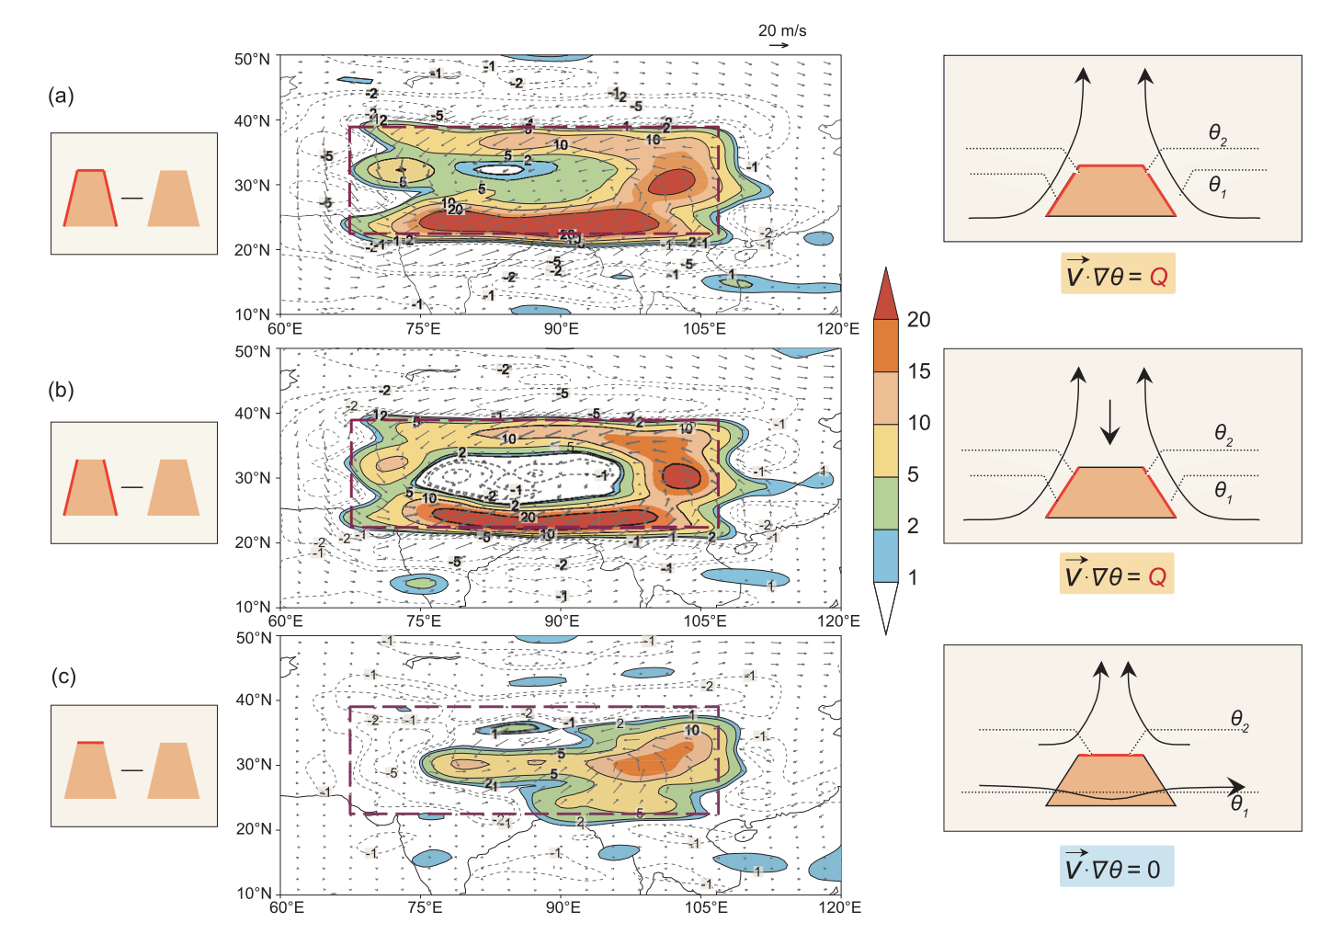
What do the existing simulated thermally direct circulations over the TP look like?
Previously, a few thermal forcing sensitivity simulations have been conducted over the TP to examine the thermal effects in the mid-eastern TP. But, none of the simulations have produced a structure like the WTV.
For example, by adding sensible heating on an ideal topography covering the mid-eastern TP, Wu et al. (2007) demonstrated that anomalous rising motions occur above the heat sources that were placed on either the sloping lateral surfaces or the top surface of the TP (see Fig. 6), using SAMIL (Version R42L9).
Wang et al. (2018) studied the response of Pakistan monsoon rainfall to the south-eastern TP heating by adding latent heating over the near surface of the south-eastern TP centred at 30°N, 90°E in the numerical experiments using the WRF model, which produced a classic thermally direct circulation.
Fig. 6 Distributions of difference in wind (vectors, m s−1) and vertical velocity (–ω, shading, 10⁻² Pa s⁻¹) at the σ = 0.991 surface between the two perpetual July experiments: (a) ALLSH–NOSH, (b) SLPSH–NOSH, and (c) TOPSH–NOSH, with the dashed rectangle indicating the prescribed mountain base. Left panels indicate the experiment designs and right panels are interpretations of the relevant mechanisms, with orange shading representing mountain and heavy red bar denoting the imposed surface sensible heating. From Wu et al. (2007;2015)
It is still worth conducting extra simulations over the western TP to confirm whether there may be an exception for the WTV.

Slide 9
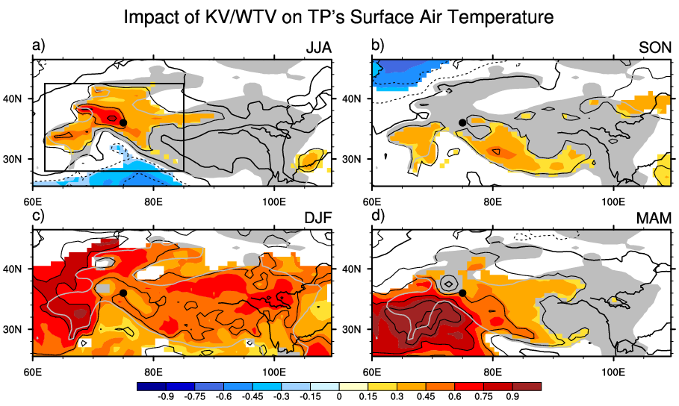
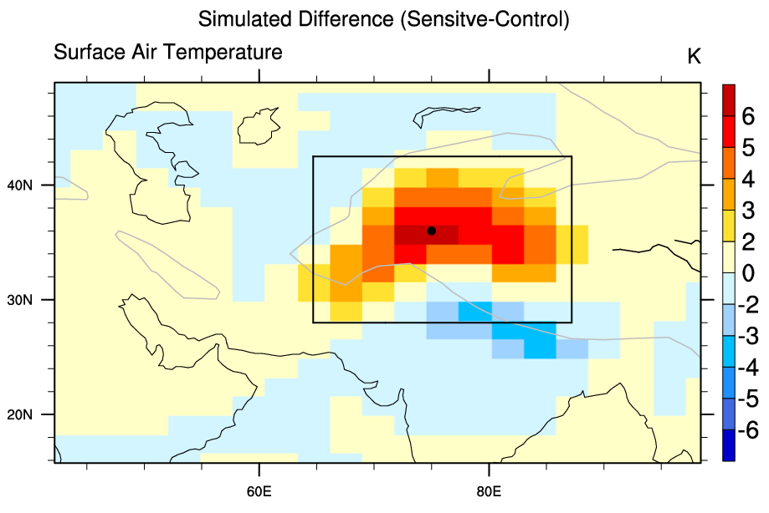
2. Model and Data
Model: We use the SAMIL (version R42L26), a well known (Wu et al. 2003; Wang et al. 2004) Spectral Atmospheric Model developed at the State Key Laboratory of Numerical Modelling for Atmospheric Sciences and Geophysical Fluid Dynamics (LASG), Institute of Atmospheric Physics (IAP), Chinese Academy of Sciences (CAS). It has 26 isobaric levels, 2.5X2.5 degrees in horizontal resolution, global domain. SAMIL has been intensively used in Tibetan Climate simulations.
Settings: Summer is chosen for the simulations, when (1) the WTV’s impacts are focused on the western TP above 1,500 m (Fig. 7), and (2) a thermally direct circulation is likely easier to develop. Both sensitivity and control runs have been executed for 60 years with the solar zenith angle fixed at 15 July; the last 30 years of data were used for the analysis.
Sensitivity Run: A constant sensible heating flux (2 times the climatological mean of July) is added in the rectangular area at the topography surface (with elevation higher than 1,500 m) to produce the warmer near-surface air temperature over the western TP (Fig. 8).
Simulated Circulation Responses to the thermal forcing are checked as the difference between circulations in the sensitivity run and the control run, i.e. sensitivity - control run. See Fig. 8.
Fig. 7 Linear regression of 2m air temperature (K, ERA-Interim) on standardized KZI (intensity index of WTV) in four seasons. Color-Shading denotes significance at the 0.05 level after taking account of the efficient numbers of degrees of freedom. Grey-shading denotes the topography above 1,500 m. Black rectangle is the region where the sensible heating is added on the TP topography surface (above 1,500 m) in sensitivity experiments of SAMIL.
Fig.8 The near-surface air temperature (SAT: color shading) response to near-surface sensible heating forcing in SAMIL, represented by the SAT differences between the thermal forcing sensitivity run and the control run. The sensible heating is added at the topography surface with elevation higher than 1,500 m within the black rectangle area.

Slide 10
2. Model and Data
Reanalysis Data: We mainly use the ERA-Interim data for presenting the observed features of the WTV. We also use ERA5 radiation data for rechecking the results of dKL19. But it is important to note that further evaluations of the skill of the newly released ERA5 dataset in representing the atmospheric conditions accurately over the western TP are still needed.
Composites: We composite the anti-cyclonic phase of the WTV, i.e. the positive KZI events, for a fairer comparison with the numerical simulations.
Circulation Anomalies: The circulation anomaly indicates the circulation deviation from the climatological mean. The climatological mean is calculated separately from January to December using 30 years of data in the period of 1981-2010.

Slide 11
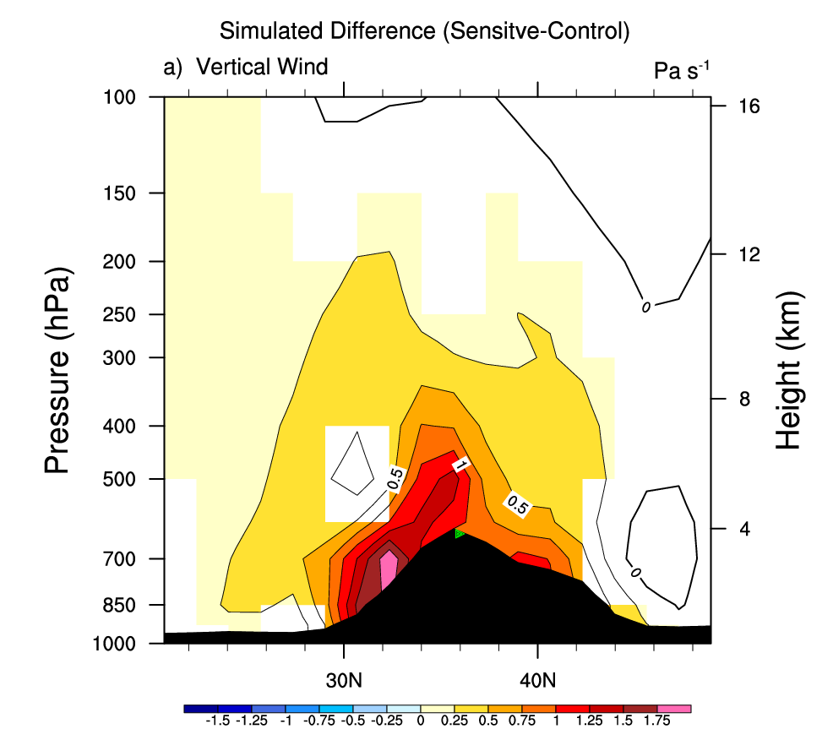
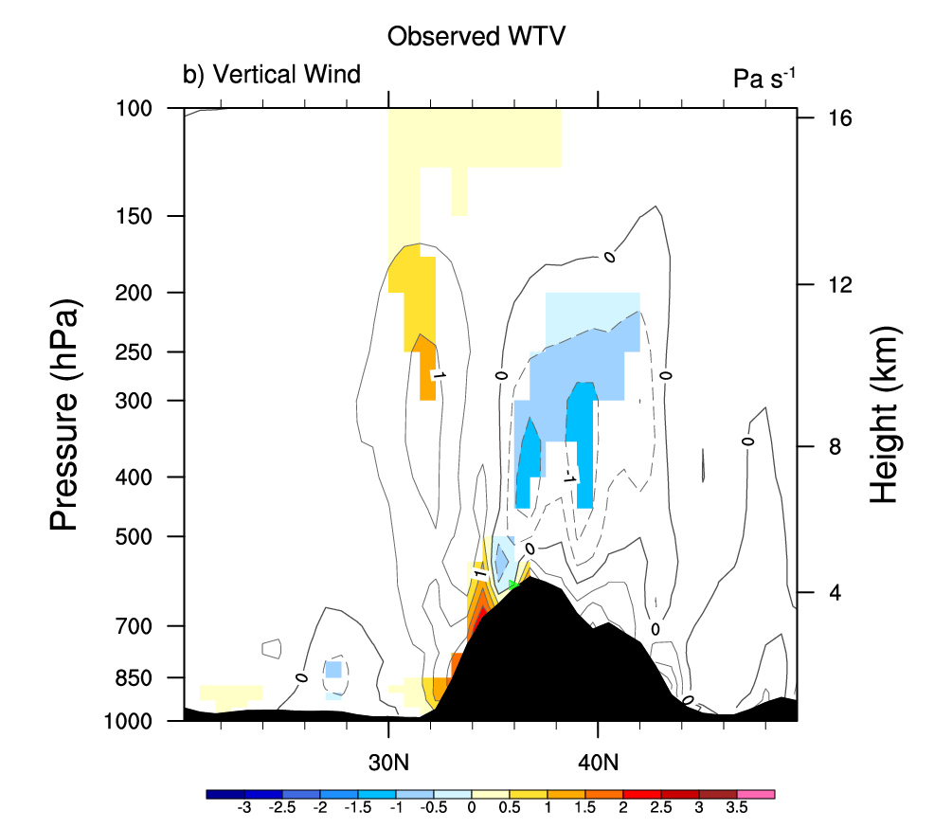
3. Numerical Results (No surprise – classic response)
simulated rising
VS
observed sinking
Fig.9 The meridionally-averaged (70°E~80°E) vertical profile of vertical velocity anomalies (a) responding to near-surface thermal forcing in SAMIL (sensitivity-control), and (b) in the observed WTV’s anti-cyclonic phase (which is associated with warmer near- surface air temperature) in ERA-Interim. Contours are vertical velocity anomalies represented by the reversed omega (but amplified to similar magnitudes for better comparison), positive means rising motions, negative means sinking motions. Colour shading denotes significance at the 0.05 level, after taking into account the efficient degrees of freedom.

Slide 12
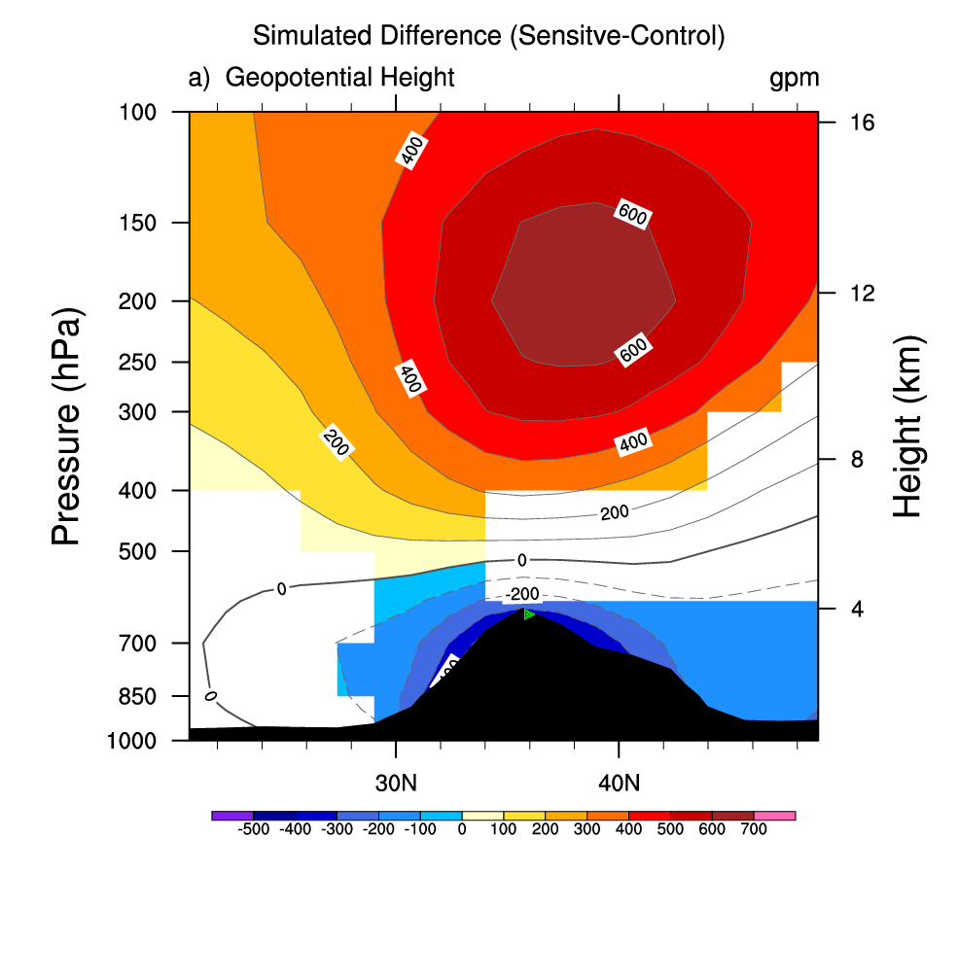
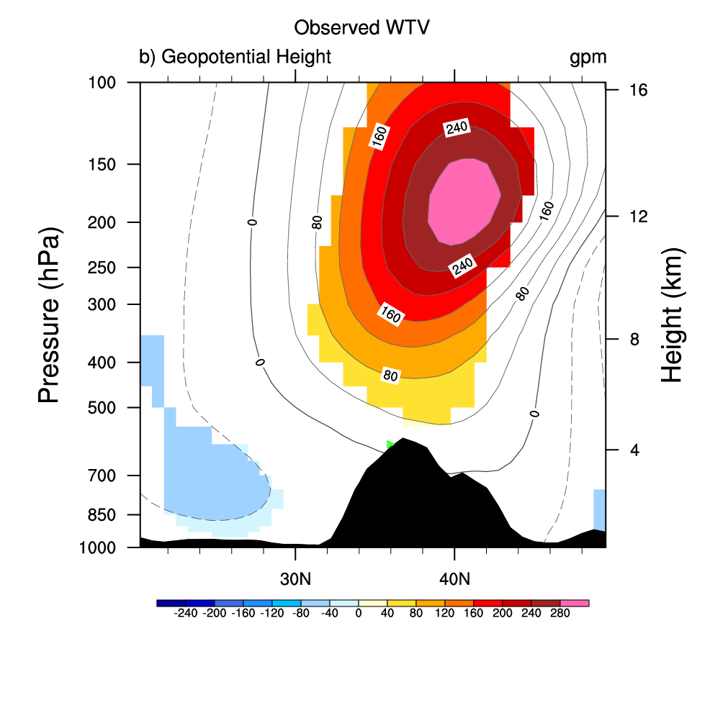
3. Numerical Results (No surprise – classic response)
simulated baroclinic
VS
observed quasi-barotropic
Baroclinic: Higher (lower) pressure at upper (lower) level above the western TP
Quasi-barotropic : Higher pressure at both upper and lower levels above the western TP
Fig.10 Same as Fig. 9, but for the geopotential height, (a) the response to near-surface thermal forcing in SAMIL (sensitivity-control), and (b) in observed WTV’s anti-cyclonic phase. Higher geopotential height represents higher pressure at the layer, and vice versa.

Slide 13
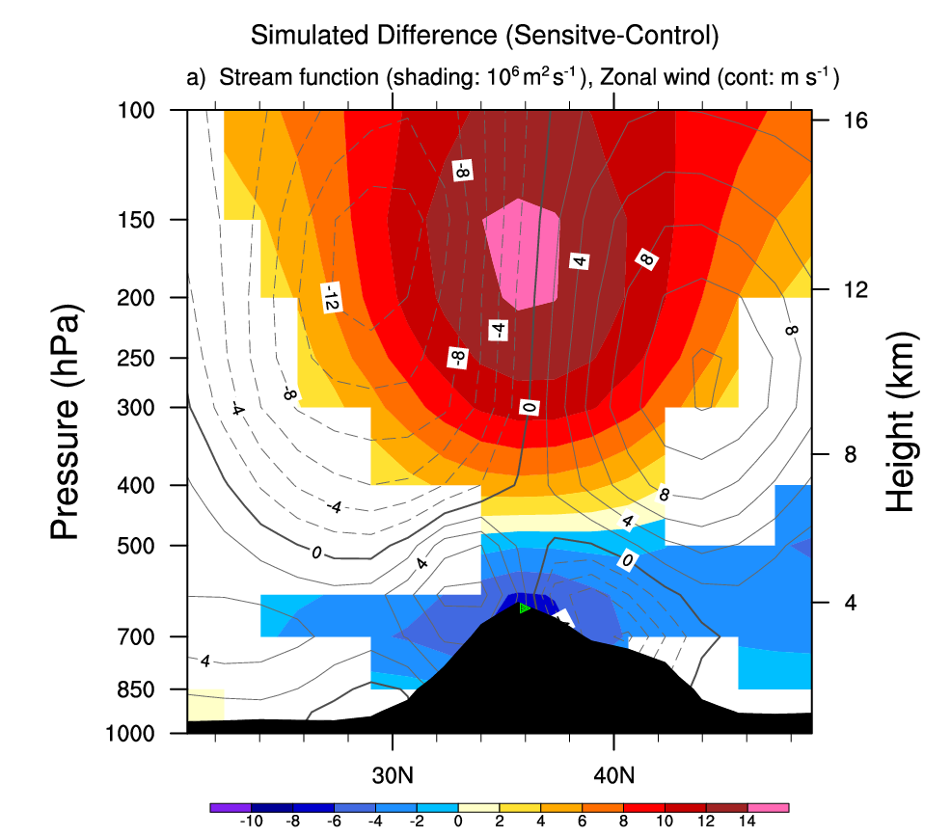
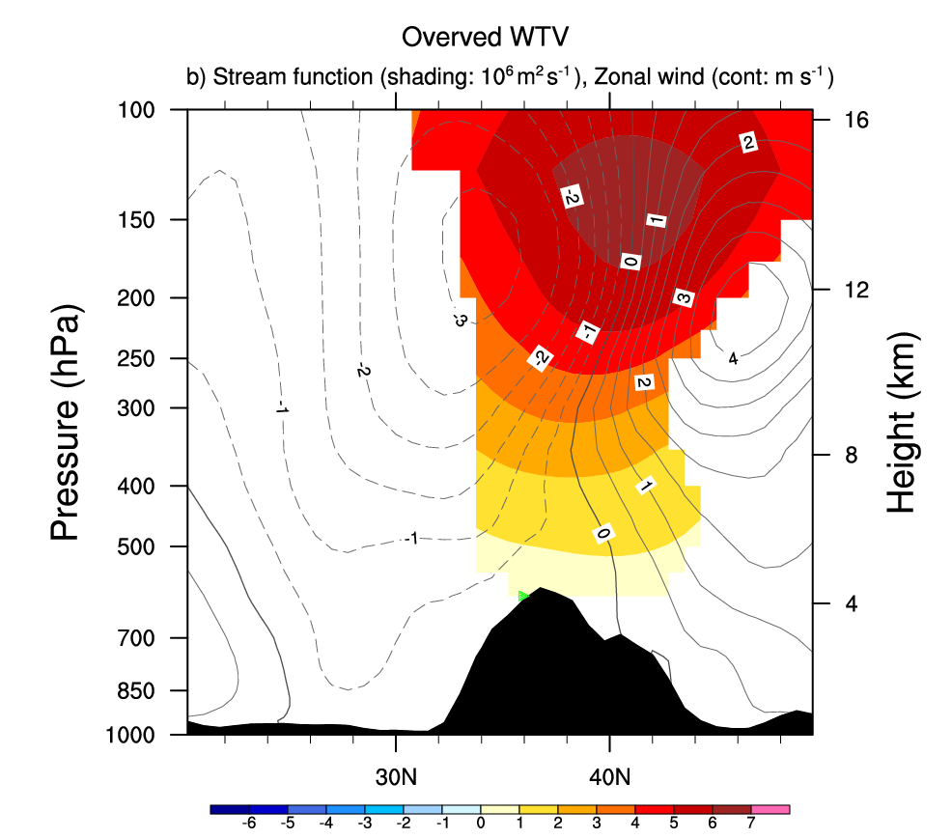
3. Numerical Results (No surprise – classic response)
simulated baroclinic
VS
observed quasi-barotropic
Baroclinic: Anti-cyclonic (cyclonic) wind anomalies at upper (lower) level above the western TP
Quasi-barotropic : Anti-cyclonic wind anomalies at both upper and lower levels above the western TP
Fig.11 Same as Fig. 9, but for the stream function (colour-shading, only showing the value significance at 0.05 level) and zonal wind (contours), (a) is the response to near-surface thermal forcing in SAMIL (sensitivity-control), and (b) in observed WTV’s anti-cyclonic phase. Positive stream function represents anti-cyclonic wind anomalies, and vice versa.

Slide 14
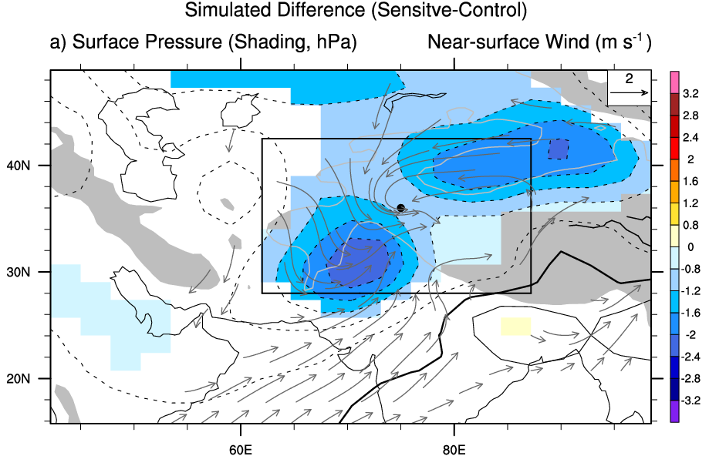
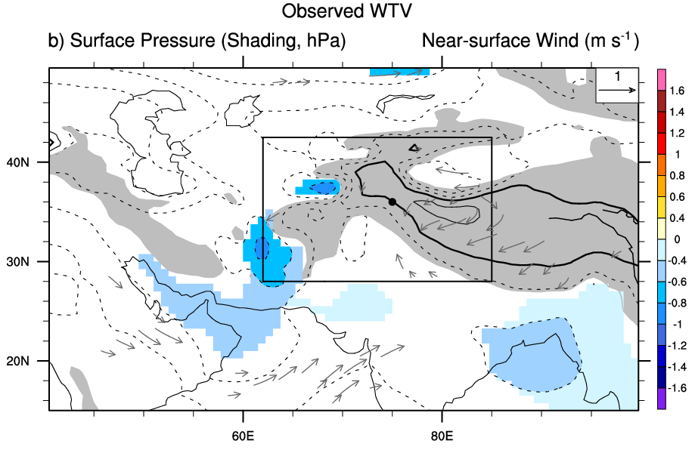
3. Numerical Results (No surprise – classic response)
simulated significant lower surface pressure
VS
observed non-significant change in surface pressure
Fig.12 The anomalous surface pressure (colour shading and contours) and near-surface wind vector (at 0.92 sigma level) (a) in response to near-surface thermal forcing in SAMIL (sensitivity-control), and (b) in observed WTV’s anti-cyclonic phase (which is associated with warmer near-surface air temperature) in ERA-Interim. Colour shading denotes significance at the 0.05 level, after taking into account the efficient degrees of freedom. Only anomalous wind vectors significant at 0.05 level are plotted.

Slide 15
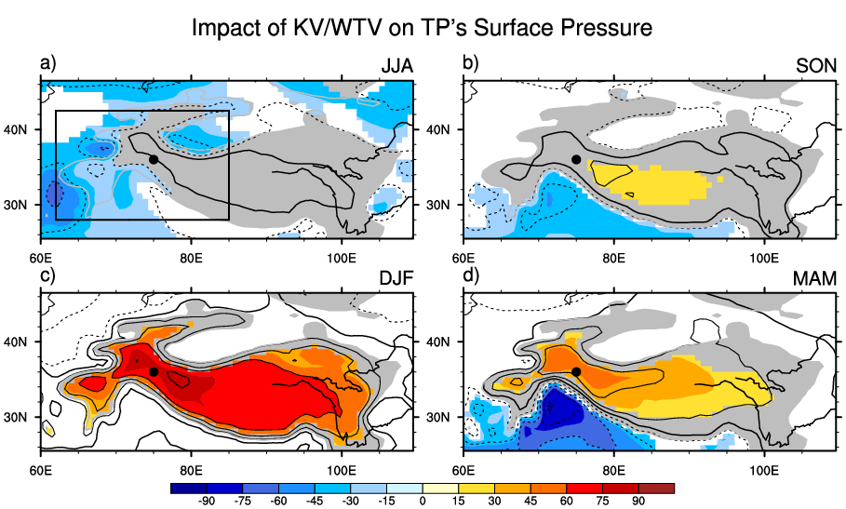
No significant LOWER surface pressure is observed over the western TP in the anti-cyclonic WTV (that is linked to warmer near-surface air temperature):
No significant change in JJA and SON.
Significantly higher pressure in DJF and MAM.
Fig. 13 Linear regression of surface pressure (hPa, ERA-Interim) on standardized KZI (intensity index of WTV) in four seasons. Color-Shading denotes significance at 0.05 level after taking account of the efficient degrees of freedom. Grey-shading denotes the topography above 1,500 m. Black rectangle is the region where the sensible heating is added on the TP topography surface (above 1,500 m) in sensitivity experiments of SAMIL.

Slide 16
Can surface thermal forcing generate a WTV-like structure in numerical simulations?
Simulated Thermal direct circulation
Rising
Baroclinic structure
Observed WTV
Sinking
Quasi-barotropic structure
The thermal forcing experiment produces a classic thermal direct circulation structure, the opposite to the WTV-like structure. It demonstrates that near-surface thermal forcing can NOT generate a WTV-like structure.
But, a near-surface thermal forcing does enhance (weaken) the zonal wind of the pressure anomalies, which are associated with the WTV over the upper (lower) troposphere. It suggests that it may impact (instead of generating) the WTV’s vertical structure. So it deserves further study of the sub-feedbacks of the near-surface thermal forcing, checking on whether it is relevant to why the WTV is a quasi-barotropic structure instead of a barotropic structure.

Slide 17
4. Error Checks
dKI19’s Arguments:
Near Surface Air Temperature generates the WTV
?
Proof 1
The consistency between the vertical shear of horizontal wind and the horizontal temperature gradient represented in the Thermal Wind Equation, cannot make definitive attributions (as clarified in the introduction and shown in experiment).
Proof 2
The diabatic heating (blue line in Fig.5 of dKI19) at the near-surface below 500 hPa is bigger than other terms, which is calculated by using ERA5 hourly data in a reformed Thermal Energy Equation that is introduced in the temporal evolutions of temperature.

Slide 18
4. Error Checks
dKI2019’s Original Version
Corrected Version
Since dKI19 have also published their codes (Python), we’ve checked them and found a few extra errors in the codes, including:
multiple data in the wrong dimensions (Dr. de KoK has conceded this error in email discussions);
the confusion of positive-negative terms in multiple instances in key equations;
plotting the wrong terms. The corrected dKI2019 Fig. 5 does not support the major argument of dKI2019, as the diabatic heating (blue line) at the near-surface below 500 hPa becomes a very small term in the corrected version (Fig.14b vs 14a).
Fig. 14 The corrected Fig.5 of dKI2019. (a) original version in dKI2019, (b) corrected version. Differences in mean temperature between JJA of 1994 and 1987 above 36°N, 75°E (grey, dashed line), separated into contributions from adiabatic heating (red line), diabatic heating (blue line), horizontal temperature advection (green line), and initial temperature difference at 1 June (orange line). Grey and orange lines are multiplied by 100 for visibility. The lowest layer (550 hPa) is close to the surface. The sum of all solid lines equals the dashed line.

Slide 19
4. Error Checks
dKI19’s Arguments:
Near Surface Air Temperature generates the WTV
Proof 1
The consistency between the vertical shear of horizontal wind and the horizontal temperature gradient represented in the Thermal Wind Equation, cannot make definitive attributions (as clarified in the introduction and shown in experiment).
Proof 2
The diabatic heating (blue line in Fig.5 of dKI19) at the near-surface below 500 hPa is bigger than other terms, which is calculated by using ERA5 hourly data in a reformed Thermal Energy Equation that is introduced in the temporal evolutions of temperature.

Slide 20
4. Error Checks
Other issues relevant to the supporting 2 proofs that may deserve further study are :
Why the result of dKI19 Fig. 5 is different from the classic Thermal Energy Equation (TEE)?
dKI19 verified the results of Li et al. (2019) based on the classic TEE calculated from monthly data. However, dKI19 found the results based on the reformed Thermal Energy Equation (Fig.5, dKI19) calculated from hourly data is different.
Is the result of dKI19 Fig. 5 statistically meaningful ?
dKI19 calculated Fig. 5 by using only one grid cell (36°N, 75°E ) in only two years (1987 and 1997) instead of compositing a range of samples.
What is the skill of ERA5 in representing the thermal and circulation variability of the western TP?
ERA5 data is supposed to have a better quality than ERA-Interim.
But, there has been no evaluation study over the western TP yet. Systematic evaluations of ERA5 data over the western TP and other high mountain areas are needed.
dKI19 proposed this is because the hourly scales of variations were neglected by the classic TEE, which deserves further examination (one of our current ongoing works).

Slide 21
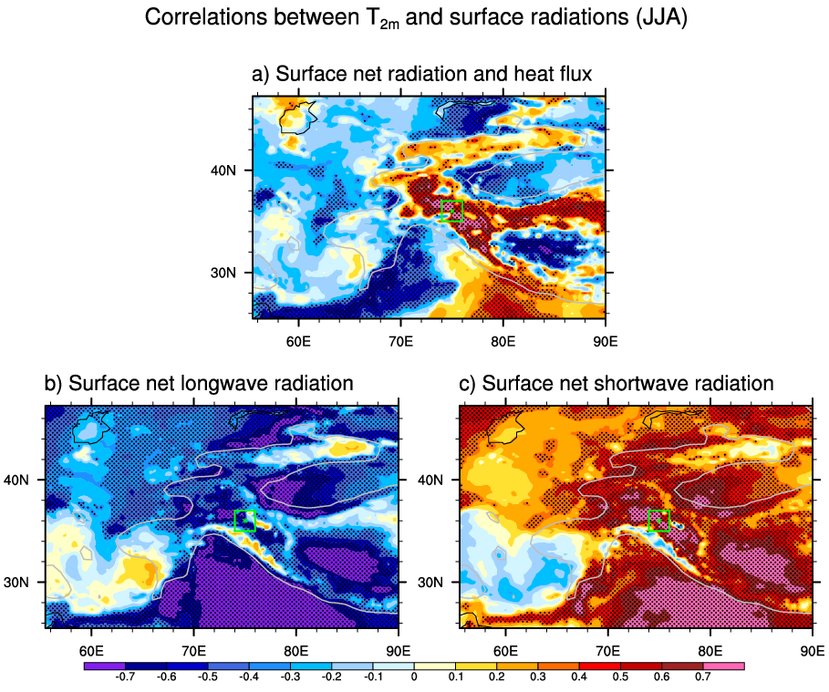
5. Discussion
dKI19’s Argument:
Surface net Radiation
surface air temperature
Proof
Significant correlations between surface net radiation and 2m air temperature (dKI19), which is interesting.
  Figure 15 Pearson correlations between T2m and (a) surface net radiation, (b) surface net longwave radiation, and (c) surface net shortwave radiation during summer (JJA) season in the period of 1979-2018 in ERA5 monthly data. The stippling denotes significance above the 0.10 level, after taking account of the efficient number of degrees of freedom (Zar 1984; Li et al. 2013). The green star denotes the central position (36°N, 75°E) of the Karakoram focus area, the green square denotes area of 35~37°N, 74~76°E. The bold-black-outline denotes topography above 1,500 m.

Slide 22
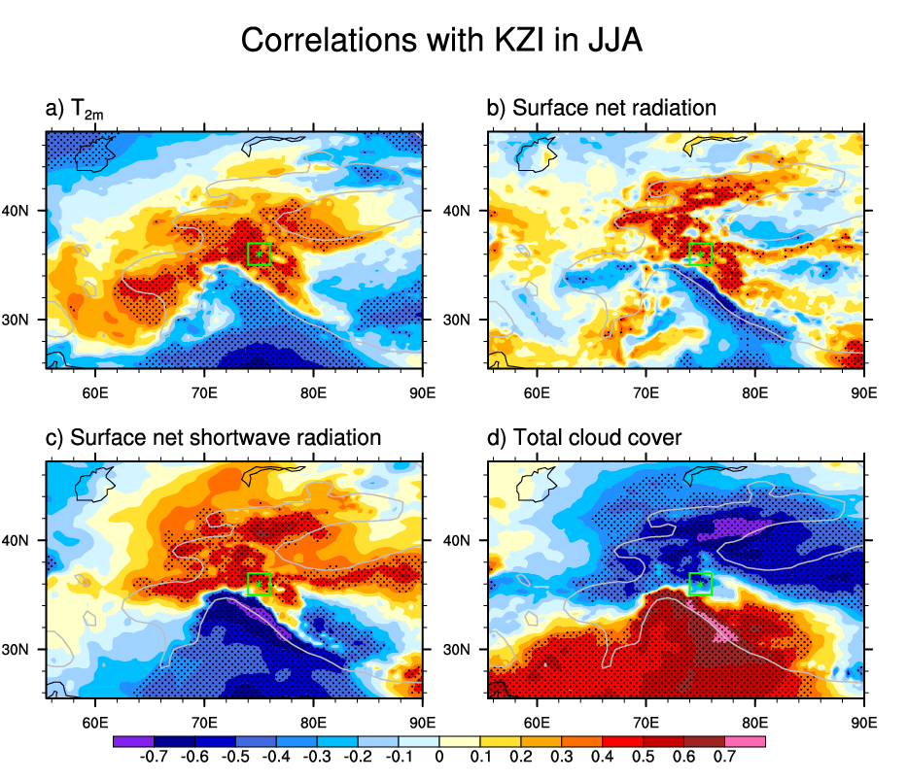
5. Discussion
Another possibility is:
Anti-cyclonic WTV (anomalous sinking)
Atmospheric Circulation
Less cloudiness
Radiation
More input solar radiation
Higher land surface temperature and T_{2m}
  Figure 16 Pearson correlations between KZI and a) T_{2m}, b) surface net radiation, c) surface net shortwave radiation, d) surface net longwave radiation, e) total cloud cover, f) surface sensible heat flux during summer (JJA) season in the period of 1979-2018 in ERA5 monthly data. The stippling denotes significance above the 0.10 level, after taking account of the efficient number of degrees of freedom (Zar 1984; Li et al. 2013). The green star denotes the central position (36°N, 75°E) of the Karakoram focus area, the green square denotes area of 35~37°N, 74~76°E. The bold-black-outline denotes topography above 1,500 m.
T_{2m}

Slide 23

6. Conclusions
The putative thermal-generating mechanism for the WTV proposed by dKI19 is in conflict with the basic physics of thermal direct circulations.
Currently, no reliable proofs support the thermal-generating mechanism for the WTV .
A near-surface thermal forcing experiment over the western TP produces a classic thermal direct circulation structure, opposite to the WTV structure. It demonstrates that near-surface thermal forcing can NOT generate the basic structure of the WTV.
But, we think surface thermal forcing over the western TP may impact (instead of generating) the WTV. It enhances (weakens) the WTV’s circulation anomalies over the upper (lower) troposphere. Further checks are needed on whether it can provide an explanation for why the WTV has a quasi-barotropic rather than barotropic structure.
Is the WTV an emergent feature of near-surface temperature variation?

Slide 24
6. Conclusions
It is possible that the WTV impacts the near surface temperature and net radiations through modulating the cloudiness over the western TP: Under the anti-cyclonic WTV, the anomalous sinking motions cause less cloudiness and more input shortwave (solar) radiations, which warm up the skin and near surface air temperature; under the cyclonic WTV, the anomalous rising motions cause more cloudiness and less input shortwave (solar) radiations, which cool the skin and near surface air temperature. Further numerical simulation are carrying out to verify this hypnosis, which may complement previously published evaluation of the proposed adiabatic heating mechanism through which the WTV impacts the mid-lower tropospheric and near surface air temperature.
Is the WTV an emergent feature of near-surface temperature variation?

Slide 25

Thanks!

