Slide 1
Evidence for Increased LLSVP density from vote-map constrained density inversion
Wolfgang Szwillus¹, Jörg Ebbing¹, Bernhard Steinberger²
1: Institut für Geowissenschaften, Kiel University, Germany
2: Geoforschungszentrum Potsdam, Germany
EGU 2020: Sharing Geoscience Online

Slide 2
Overview
We estimate the density structure in the mantle using satellite gravity data with votemaps as geometry constraints
The inversion results strongly depend on treatement of the lithosphere
We find that LLVPs systematically have increased density
More in-depth information can be found by following links, like this one
Our paper in Solid Earth (under review)

Slide 3
Data and Methods

Slide 4
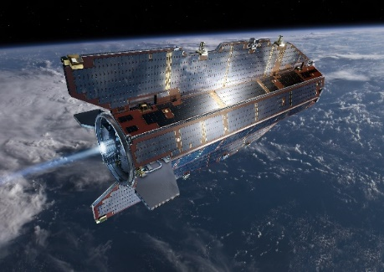
Gravity data sets
GOCE Satellite
Satellite gravity data measured at 225 km height
Two different way of correcting for crust/lithosphere:
Isostatic Residual: Use isostatic Airy Moho and cooling trend in oceans to correct for lithosphere
Crustal Residual: Use interpolated seismic depth determinations from Szwillus et al. (2019) to correct for crust (no isostatic balance).

Slide 5
Isostatic Residual: The amplitude is about 80 mGal. There is no clear correlation with surficial features.
Isostatic Residual: The amplitude is about 250 mGal. The field shows a strong correlation with ocean floor age, because only the crust was corrected.

Slide 6
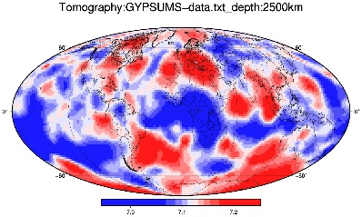
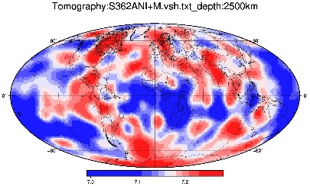
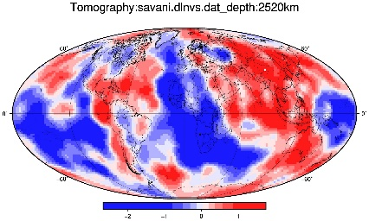
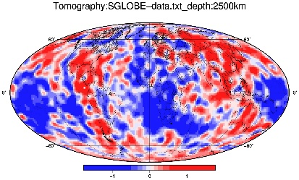
Votemaps
2500 km depth
Take an ensemble of seismic tomographies (17)
At each pixel, count how many tomographies fulfill
$$\left|v_{s}\right|>threshold$$
Here: Threshold = standard deviation
Lekic et al. 2011, Shephard et al. 2017

Slide 7
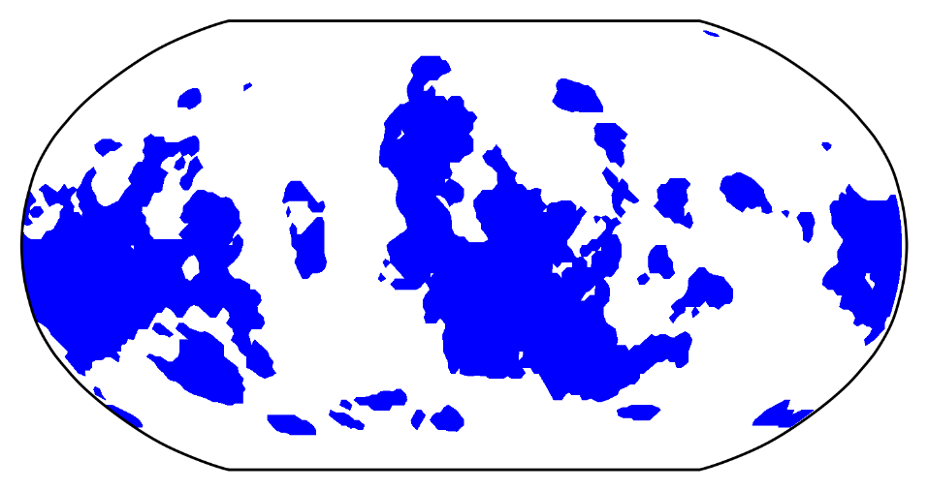
Flood fill (‚blobification‘)
N = 4
Every horizontally connected region of the votemap, with at least N agreeing tomographies is assigned a constant (but unknown) density.
-> Invert the gravity field to find these densities

Slide 8
Inversion approach
Extract positive and negative velocity blobs from votemaps at depths between 0 and 2750 km
N ‚blobs‘
Forward calculate gravity effect of each blob on each satellite station
Collect in Matrix A
To get densities, solve
$$\left(A^{T}A+βI\right)ρ=A^{T}g$$
$$β=\frac{σ_{g}^{2}}{σ_{ρ}^{2}}$$
Ratio of data to model variance
Cross-validation
Small $β$
-> Good data fit
-> High density variance
Large $β$
-> Poor data fit
-> Low density variance

Slide 9
Results – Isostatic Residual

Slide 10
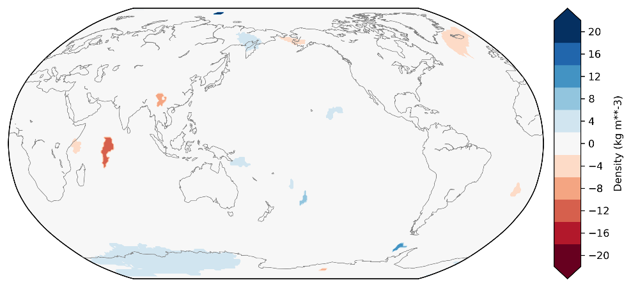
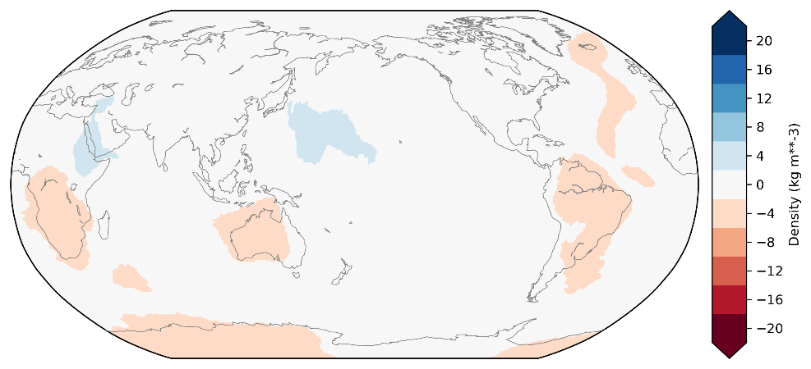
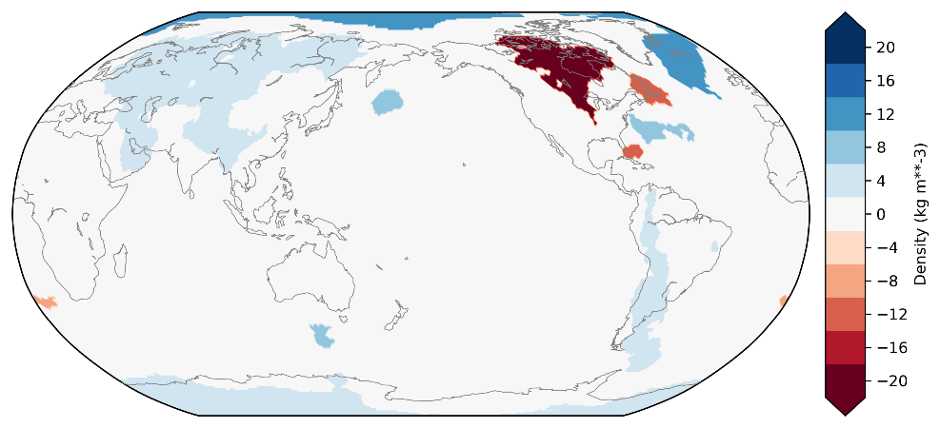
Inversion results
Uppermost (0 km):
Basically nothing
->isostatic residual
But: Outside of tomography depth range (extrapolation)
Lithospheric mantle (250 km)
Negative anomaly associated with some cratons
Mantle below 250 km
Chaotic, but some subduction related signals
0 km
100 km
300 km

Slide 11
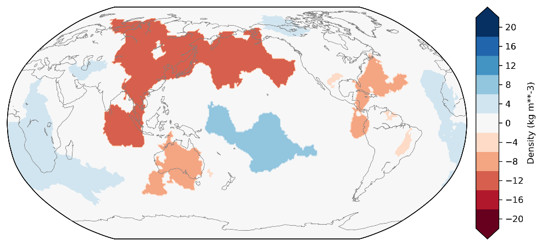
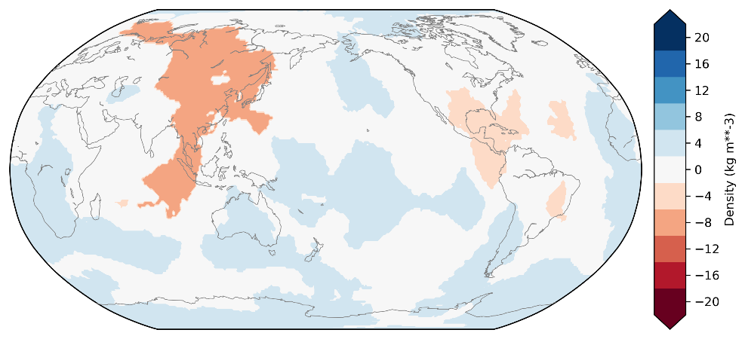
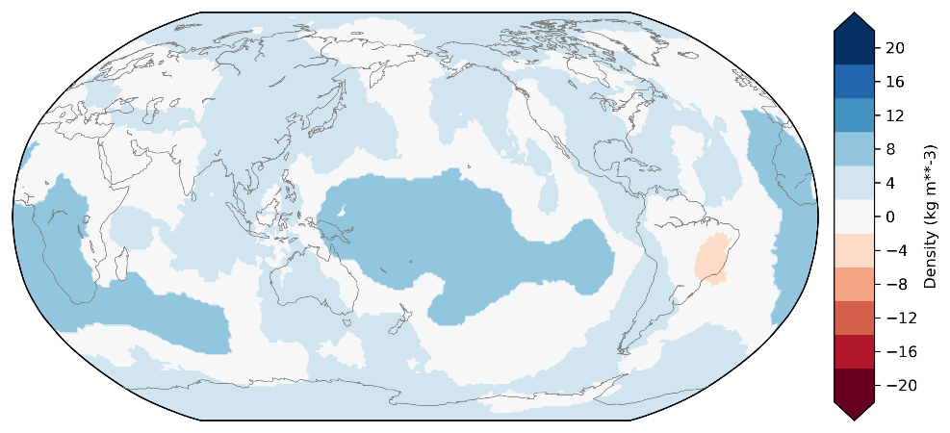
Inversion results
Deep (below 2000 km):
Systematic, positive density anomalies associated with LLSVP (up to +8 $\frac{kg}{m^{3}}$)
Note: Dynamic effects not considered (CMB depression)
Click here for depth slices in 500 km steps
Click here for info on gravity fit
2200 km
2500 km
2750 km

Slide 12
Results – Crustal Residual

Slide 13
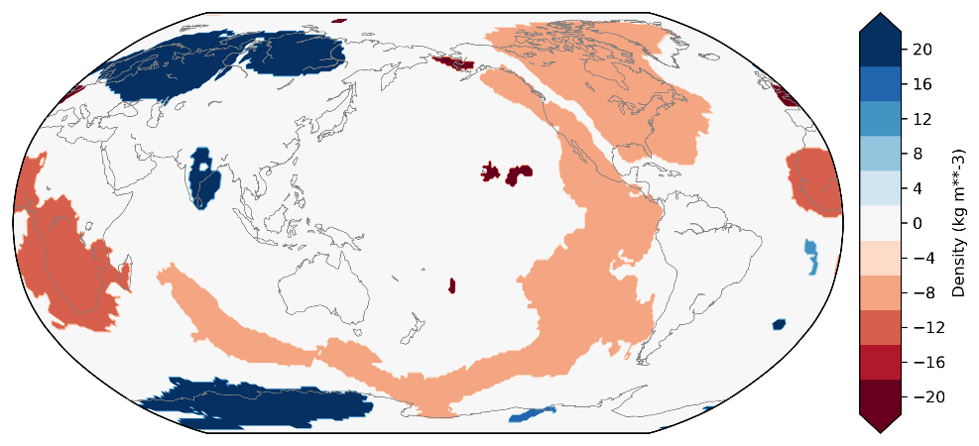
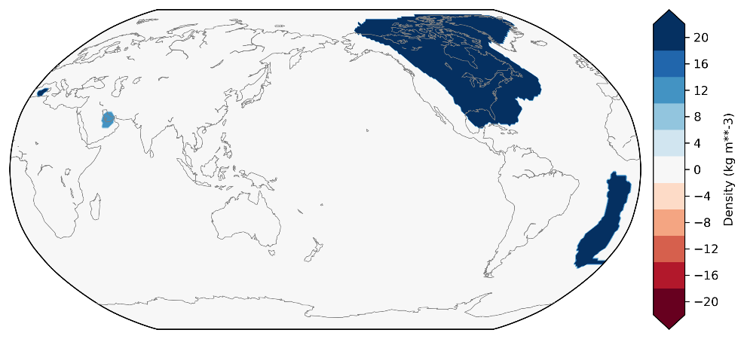
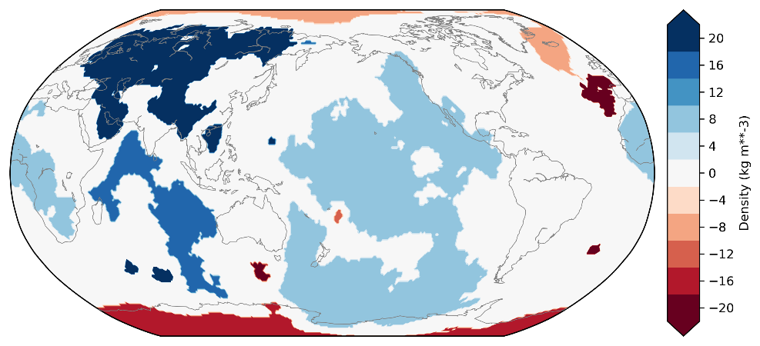
Inversion results (crutsal residual
Uppermost (0 km):
Ocean age trend
But: Outside of tomography depth range (extrapolation)
Lithospheric mantle (250 km)
In sum: positive anomalies from cratons
Not vertically consistent
Mantle below 250 km
Chaotic, but some subduction related signals
0 km
100 km
300 km

Slide 14
Isostatic Residual vs. Crustal Residual
Variation: +/- 10 kg m⁻³
Nearly no density variations in upper 250 km
5 Slabs from Slab1.0 have positive density
LLSVPs have positive density (+0.1 %)
Gravity RMS misfit 25 %
Variation: +/- 30 kg m⁻³
Large density variations in upper 250 km
5 Slabs from Slab1.0 have positive density
LLSVPs have positive density (+0.6 %)
Gravity RMS misfit 40 %

Slide 15
Conclusions

Slide 16
Conclusions
We present a new method to dermine the density structure in the mantle
Vote maps constrain geometry
No assumptions about viscosity structure necessary
Vote maps delineate large scale structures – but resolution is limited
Results strongly depend on treatement of crust and lithosphere
LLSVPs have systematically positive density, which could be explained by compositional variation

Slide 17
Extra slides

Slide 18
Choosing $β$
Don‘t oversample!
Data Correlation length ~ 1000 km
5° Resolution is sufficient
Use distance-based correlation function to calculate data covariance matrix $R_{g}$
New inversion formula
Isostatic residual @ 225 km height
$$\left(A^{T}R_{g}^{−1}A+βI\right)ρ=A^{T}R_{g}^{−1}g$$

Slide 19
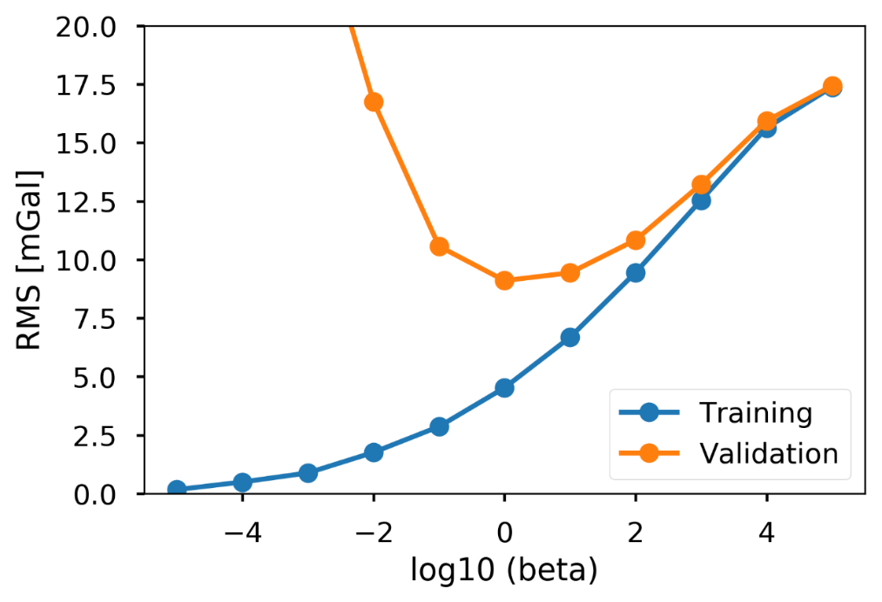
Cross-validation
Split the data into random subsets
Invert one set for density
Validate using the other sets
Repeat for all sets and different values of $β$ and look for minimum validation misfit
Set 1
Set 2
Set 3
Optimal $β= 1$

Slide 20
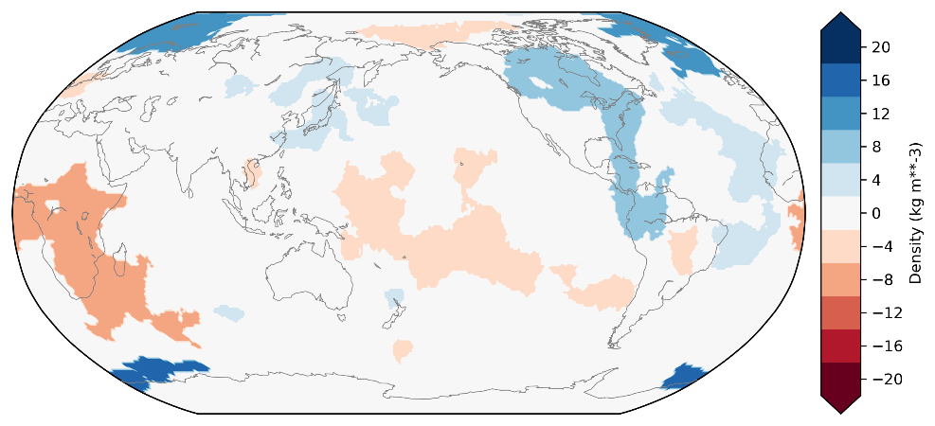
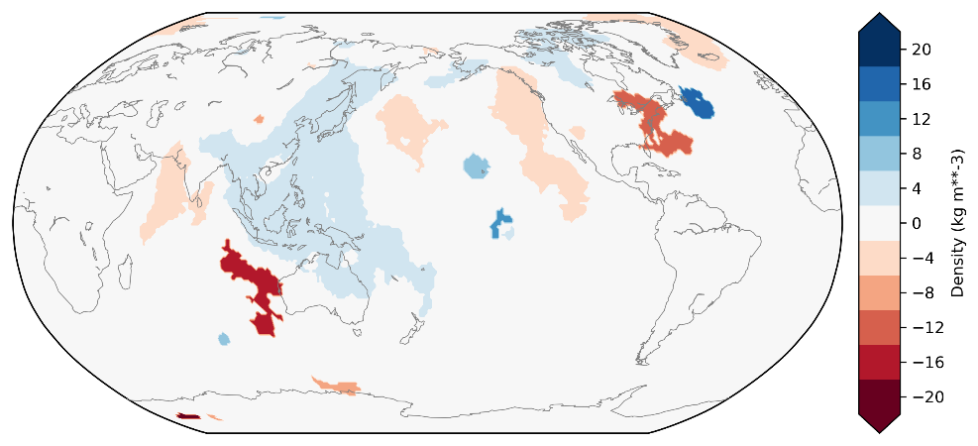
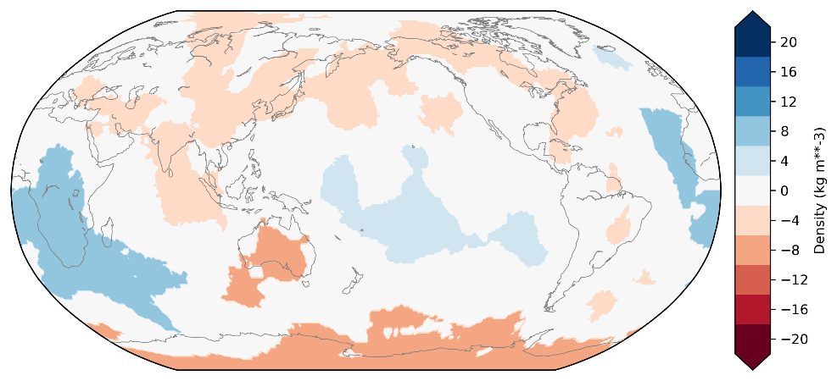
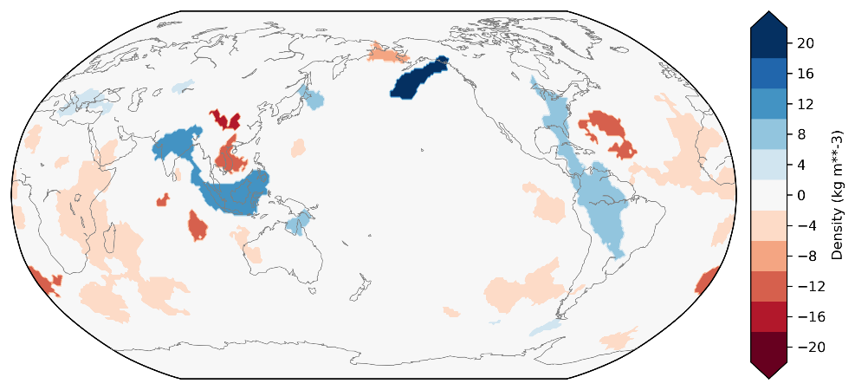
Depth slices for isostatic residual results
0 km
1500 km
500 km
2000 km
1000 km
2500 km

Slide 21
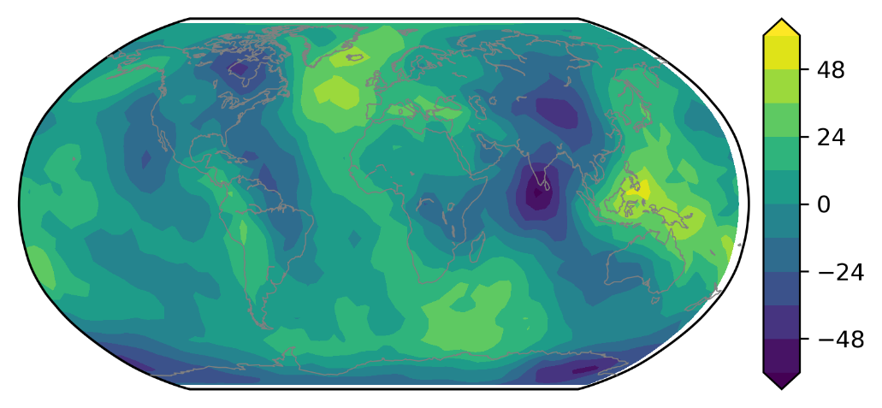
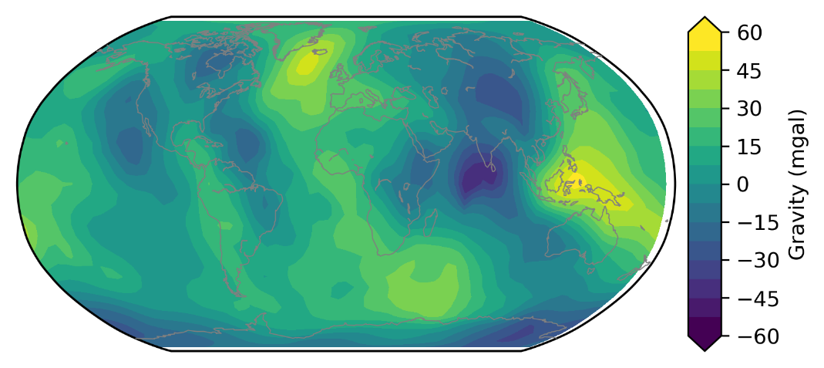
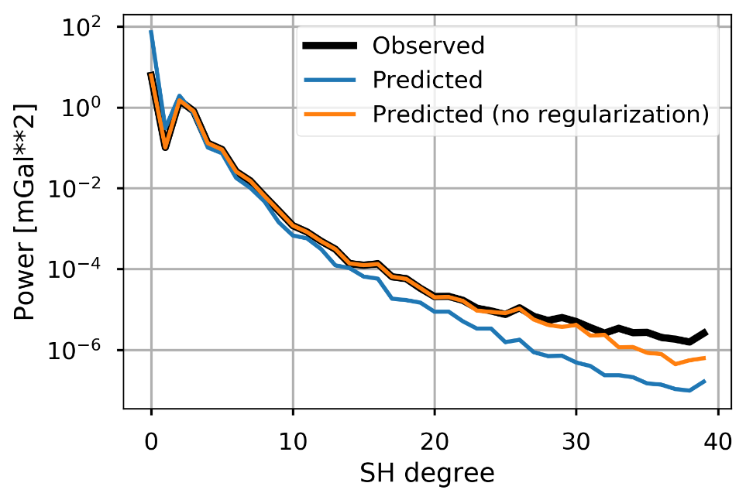
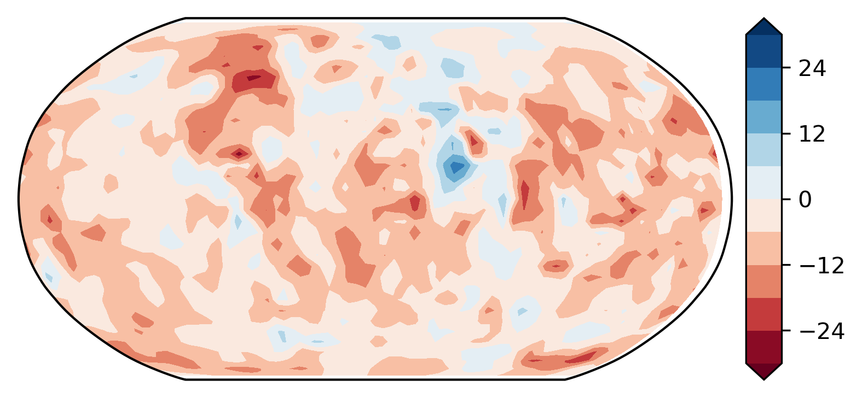
Gravity fit (isostatic)
Misfit (RMS): 4.2 mGal (25 %)
Spectral fit to spherical harmonic degree 10 (4000 km wavelength)
Observed
Modelled
Residual

Slide 22
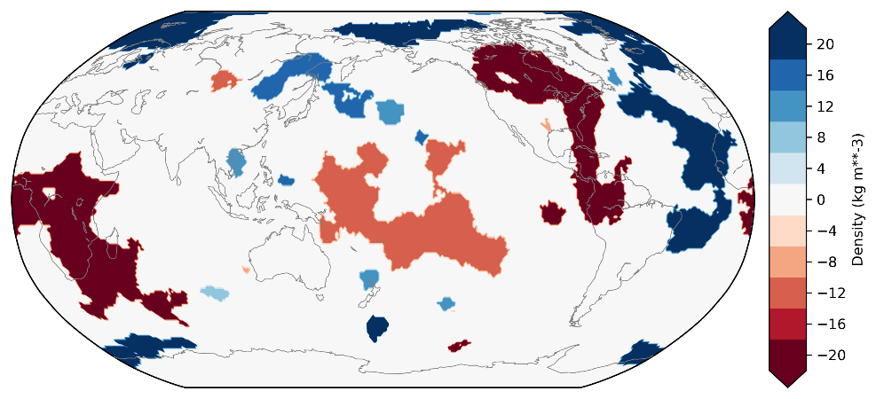
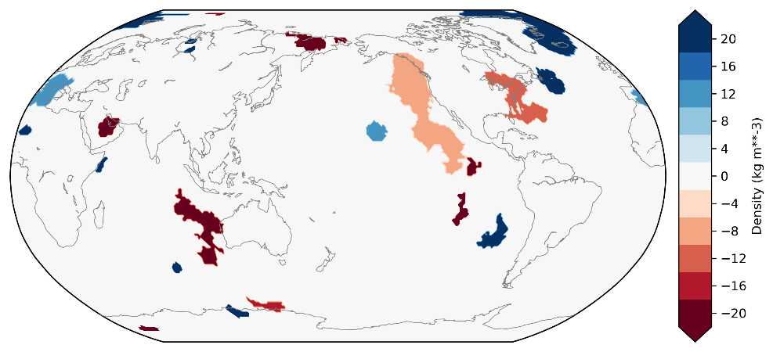
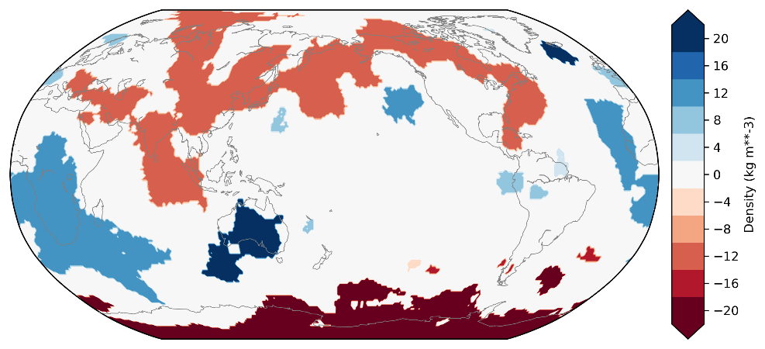
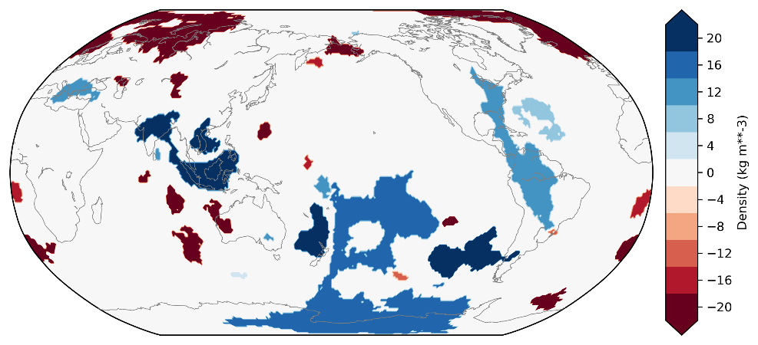
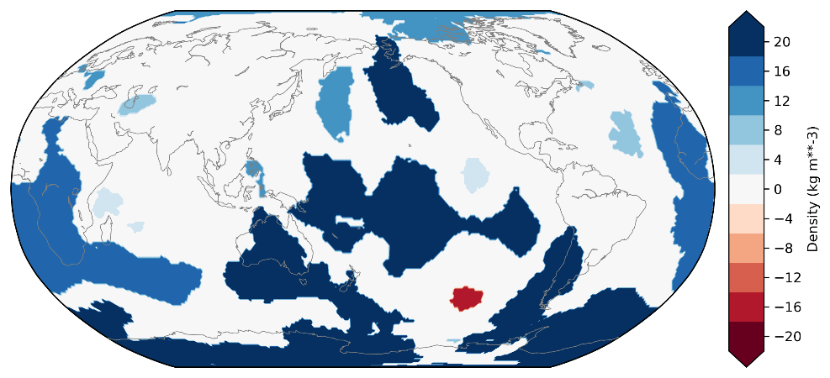
Depth slices for crustal residual results
0 km
1500 km
500 km
2000 km
1000 km
2500 km

Slide 23
Gravity fit (crustal residual)
Observed
Misfit (RMS): 34 mGal (40 %)
Spectral fit to spherical harmonic degree 10 (4000 km wavelength)
Modelled
Residual

Slide 24
Comparison with expected slabs
Vote maps
Slab 1.0:
12 slab-depths
Only 5 are seen in vote maps as positive velocity anomaly
Those slabs that are seen get slightly positive density in inversion
Isostatic residual
Crustal residual

Slide 25
Density interpretation
Goal: Sensitivity of density and vs to temperature and composition
Assumptions:
Mantle has Bulk Silicate Earth composition
Stable mineral assemblage and properties calculated using Perple_X (Stixrude 2011 database)
Mantle is adiabatic and hydrostatic below 80 km depth
1550 K and 2.5 GPa at 80 km depth
Based on fitting fundamental spheroidal normal modes
Phase velocity error relative to PREM as a function of temperature at top of mantle

Slide 26
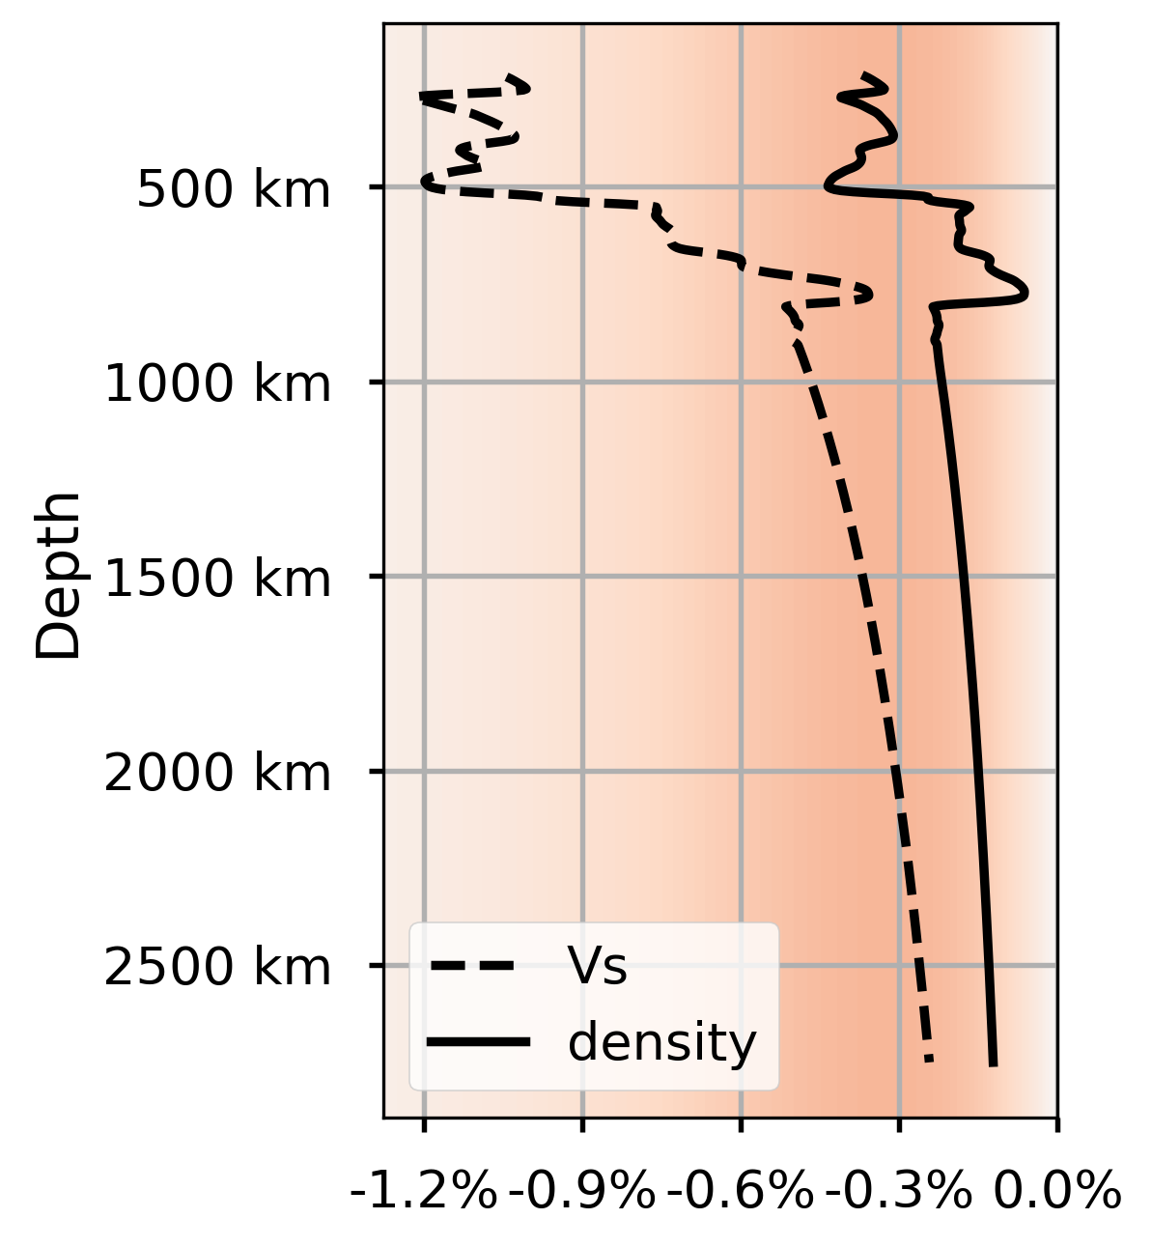
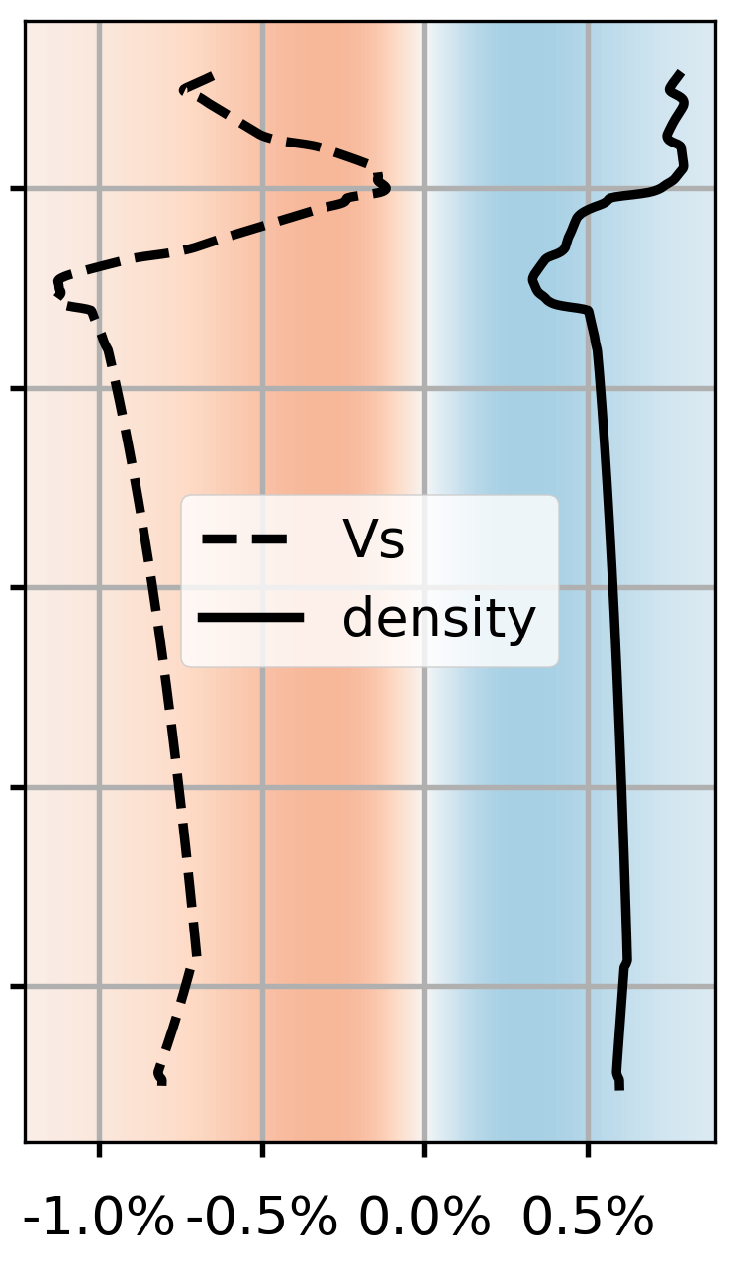
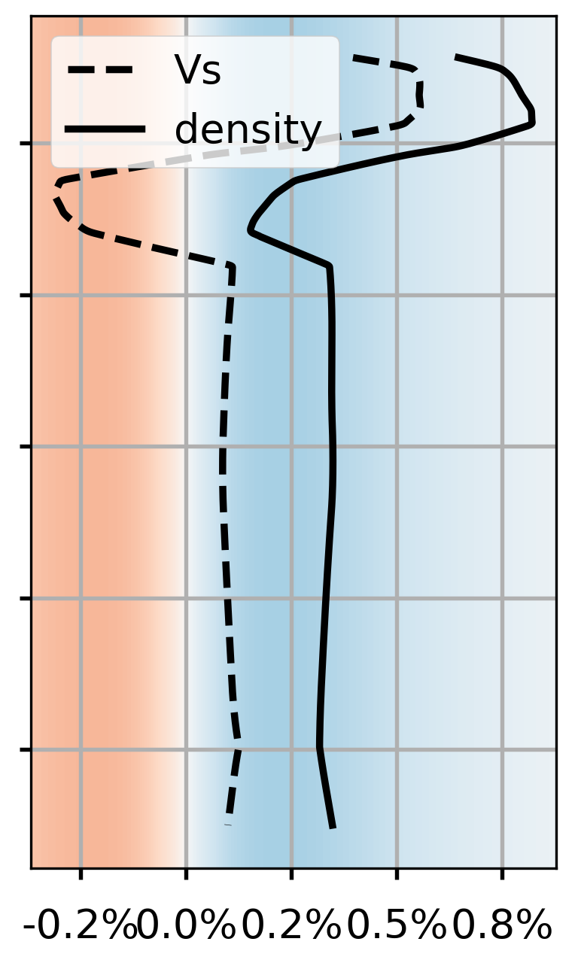
Model pertubation
1% point more FeO
Mix with
10 % MORB
100 K hotter

Slide 27
LLSVP calculation example
For LLSVP @ 2500 km depth:
$δv_{s}≈−1.0 \%$ and $δρ≈+0.1 \%$
Option 1
40 % MORB and 870 K hotter
Option 2
1.1 % more FeO and 380 K hotter

Slide 28
LLSVP calculation example
For LLSVP @ 2500 km depth:
$δv_{s}≈−1.0 \%$ and $δρ≈+0.6 \%$
Option 1
60 % MORB and 960 K hotter
Option 2
1.6 % more FeO and 260 K hotter

Slide 29
Link test
This is just an example
Click on the button below to return to the slide, where you clicked on the link

