Slide 1
EGU2020 Sharing Geoscience Online – Display D884 – Abstract EGU2020-19409
Observations of sediment sorting
over rapidly developed marine bedforms, using multibeam backscatter
Timo C. Gaida¹, Thaiënne A.G.P. Van Dijk^{2,3}, Mirjam Snellen¹ and Dick G. Simons¹
¹Delft University of Technology, Faculty of Aerospace Engineering, Delft, Netherlands
²Deltares, Department of Applied Geology and Geophysics, Utrecht, Netherlands
³University of Illinois at Urbana Champaign, Department of Geology, Urbana, Illinois, USA
© Author(s) 2020. This work is distributed under the Creative Commons Attribution 4.0 License.

Slide 2
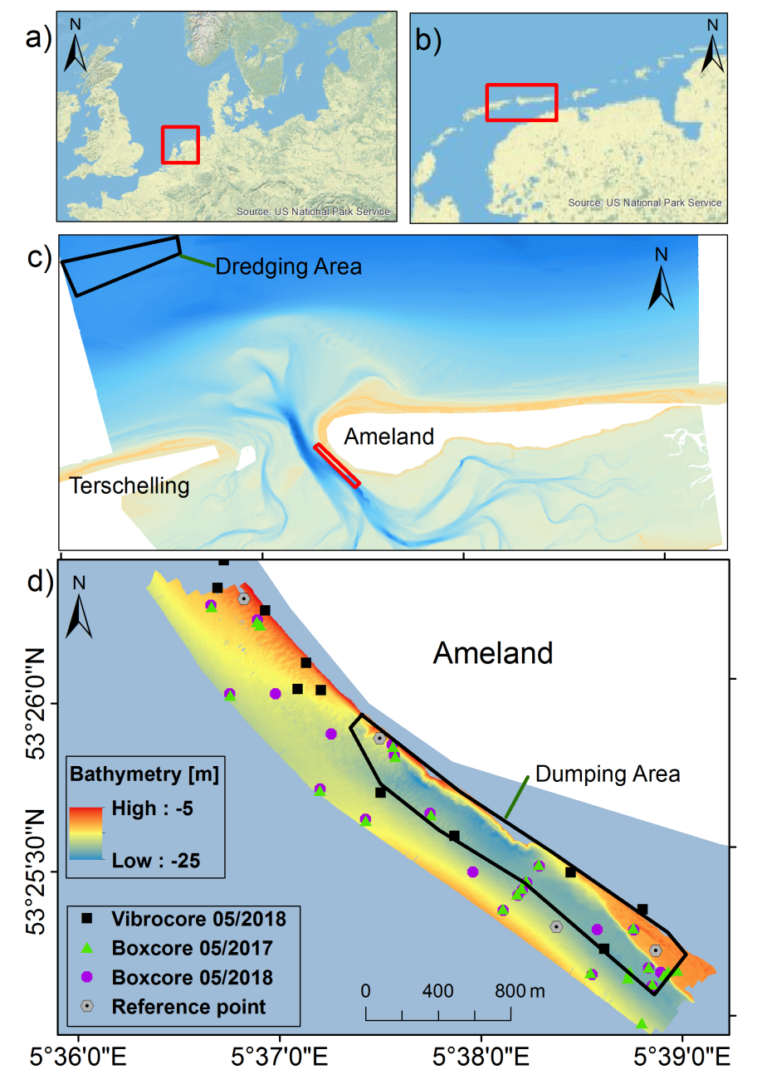
EGU2020-19409 D884: Gaida et al.
Data and nourishment site near Ameland
Multibeam Echo Sounding (MBES) bathymetry and backscatter were used to monitor the morphodynamics and sediment distribution of an underwater nourishment at Ameland,
Wadden Sea, Netherlands
Measurement MBES time series:
7x MBES (April 2017 to May 2019)
2x Box-core sampling (May 2017 and May 2018)
Underwater nourishments
Start: 1 June 2017
End: 22 February 2018
Grain-size spectrum from dredging area

Slide 3
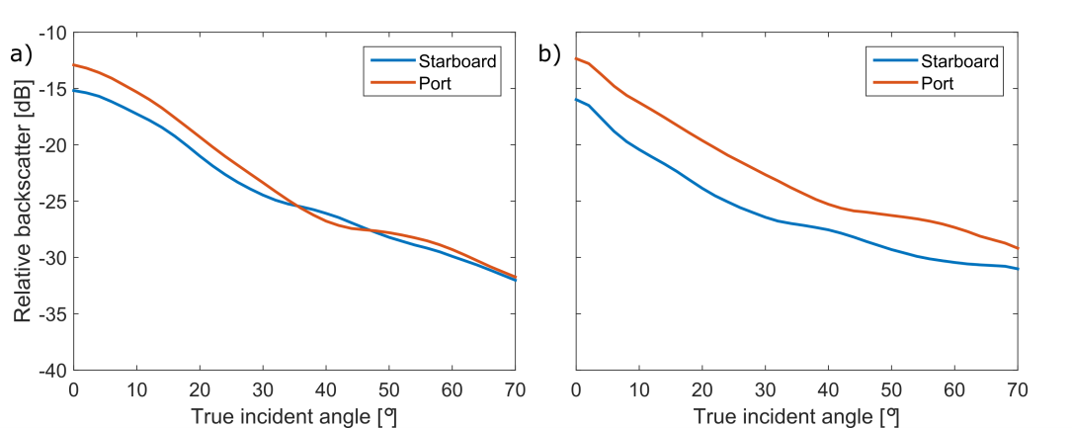
EGU2020-19409 D884: Gaida et al.
Uncertainties in backscatter time series: external factors affecting repeatability of measured backscatter strengths
Related to the multibeam: | Observed in our study | Related to the environment: | Observed in our study
System settings (300kHz, pulse 150) | 1.4 dB (4.1 dB) | survey azimuth (anisotropic bedforms) | 1.1 dB (2.2 dB)
biofouling on sonar heads | not expected | water column properties: salinity, temperature sediment suspension air bubbles | 0.4 dB (0.9 dB) 0.03 dB (0.06 dB) unknown
sensitivity of transducers | between surveys: 0.2 dB (literature) between heads: 0.5-3.5 dB (4.6 dB) | migration, biology | expected to be negligible
May 2018 (Siege)
May 2019 (Amasus)
Required resolution
2 dB between fine, medium and coarse sand
5 dB silt and fine sand
Pre defined uncertainity
1 dB inherent uncertainty of MBES

Slide 4
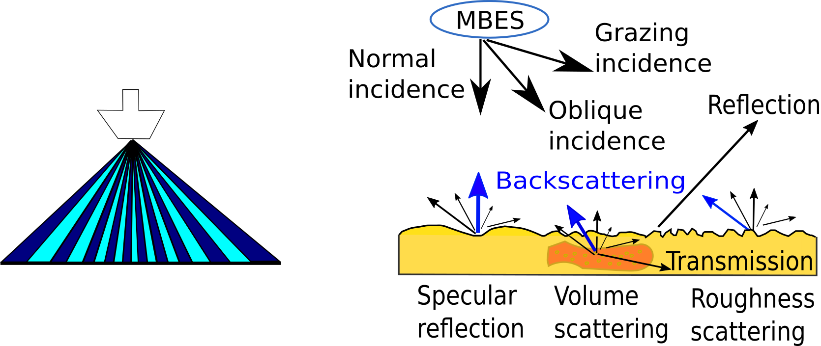
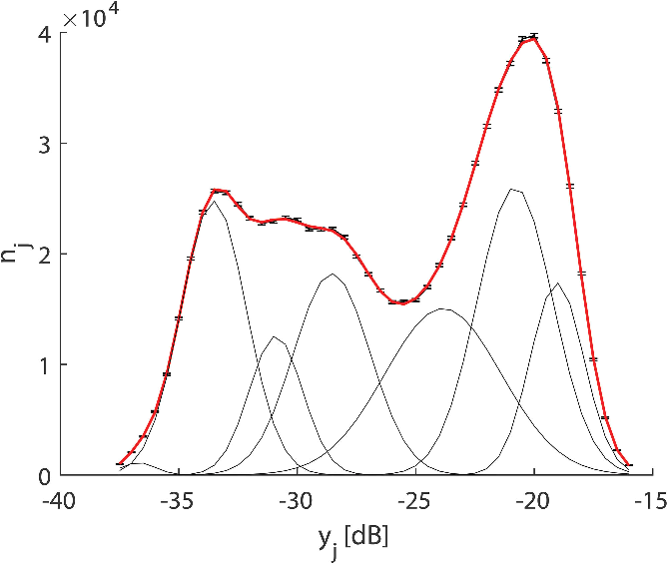
EGU2020-19409 D884: Gaida et al.
Acoustic bed classification
MBES backscatter measurements
BS corrected for acoustics and seabed slope (morphology)
The BS levels then represent sedimentary characteristics of the bed
Acoustic sediment classification:
Bayesian classification method (Snellen et al., 2019)
Gaussian distributions represent sediment types
Acoustic classes are coupled to sediment types by ground truthing
(Snellen et al., 2019)

Slide 5
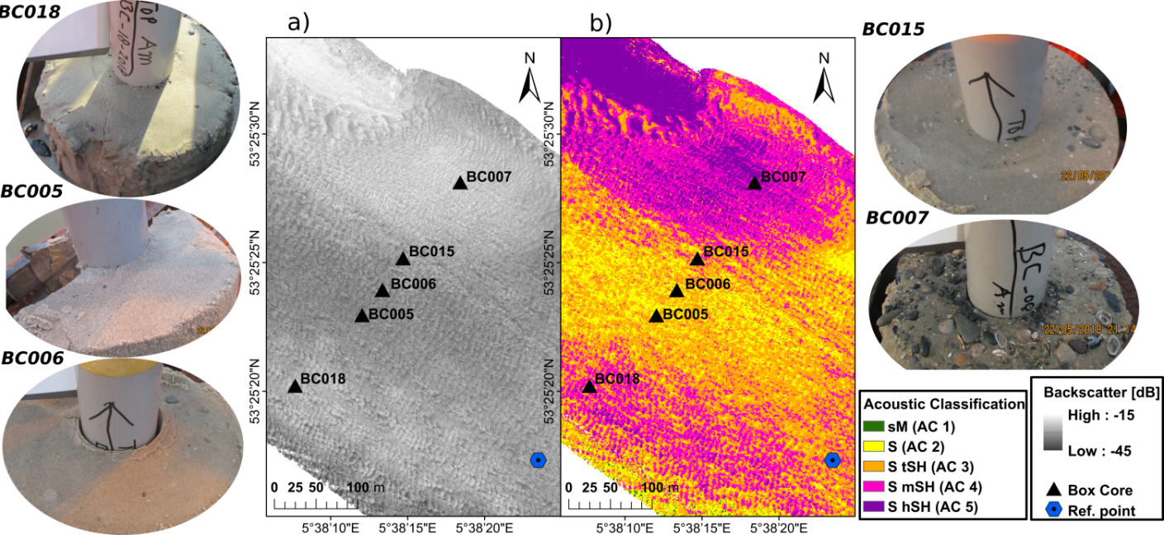
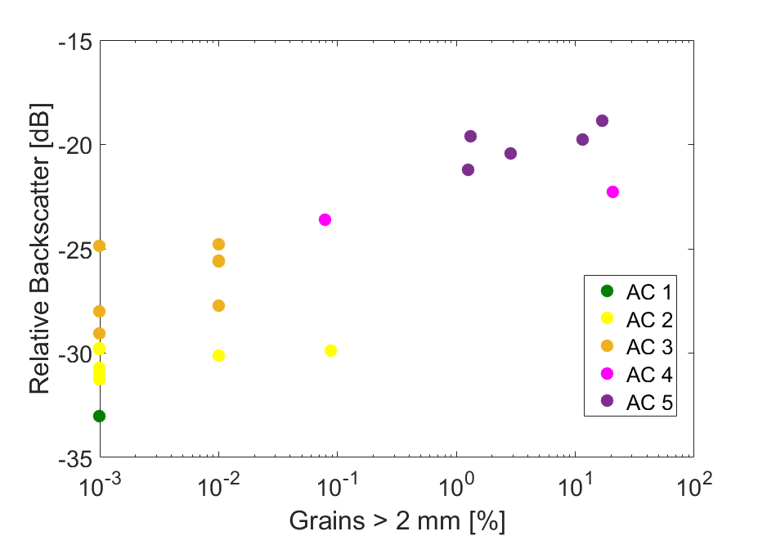
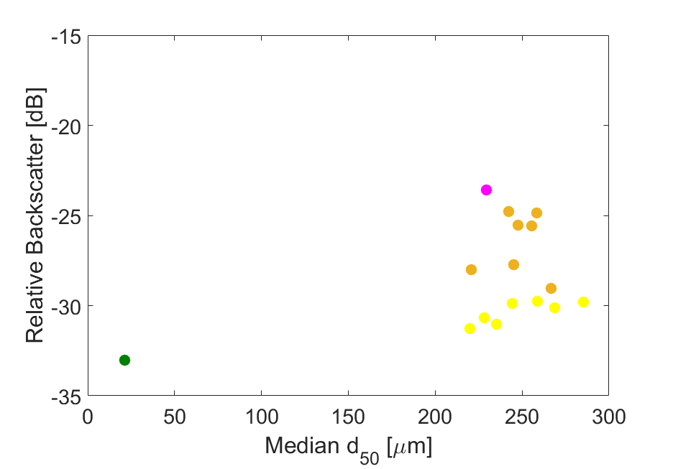
EGU2020-19409 D884: Gaida et al.
Acoustic bed classification and ground truthing
Backscatter
Bed Classification
Box core samples:
Homogeneous sand with a varying amount of shell fragments
Correlation of backscatter with amount of shell fragments
Sand too homogeneous for finer distinction based on backscatter

Slide 6
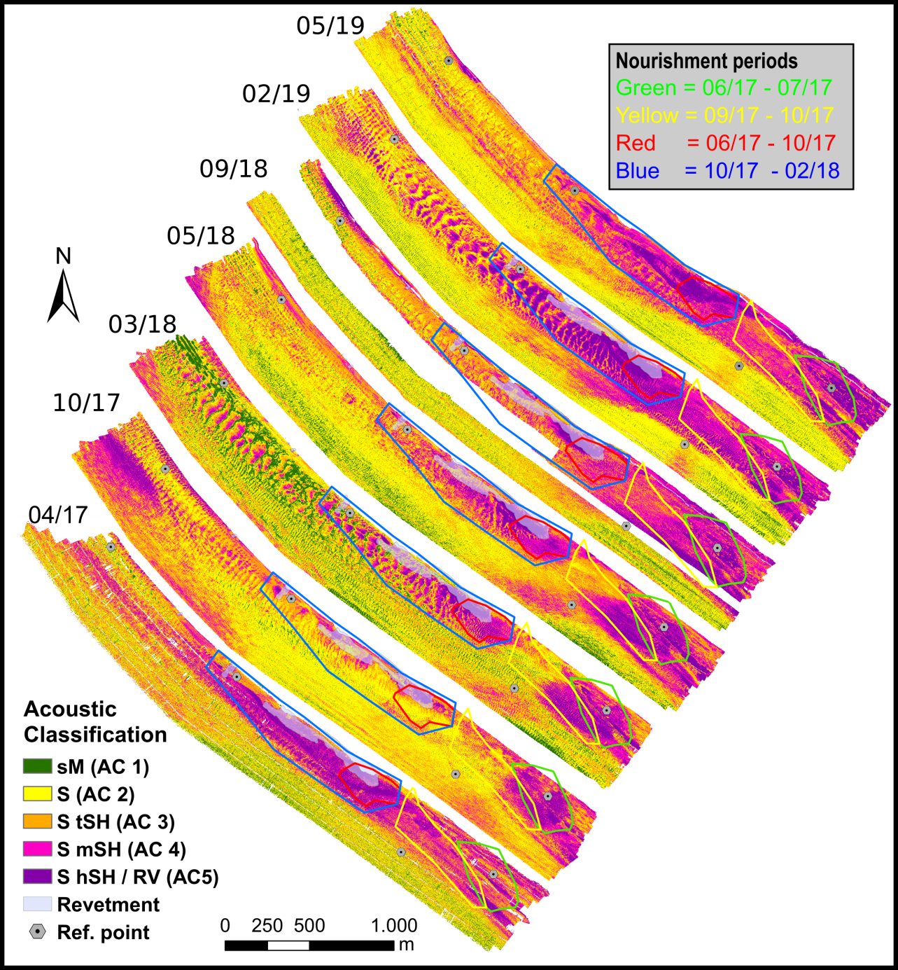
Time series of acoustic sediment classification maps
Location and timing of nourishment indicated
Both bathymetry difference maps and acoustic classification maps show that fine sediments of the (finer-grained) nourished sediments are washed out and deposited to the north west; the pre-nourishment shell content is restored (purple zones)
Bedforms rapidly developed in and around the nourished sediments (e.g. Oct17, Mar18)
Strong sediment sorting over bedforms in and around the nourished area
Results
Valuable information from backscatter in terms of sediment dynamics
Not obtainable from just bathymetry
(Gaida et al., 2020 in press)
EGU2020-19409 D884: Gaida et al.

Slide 7
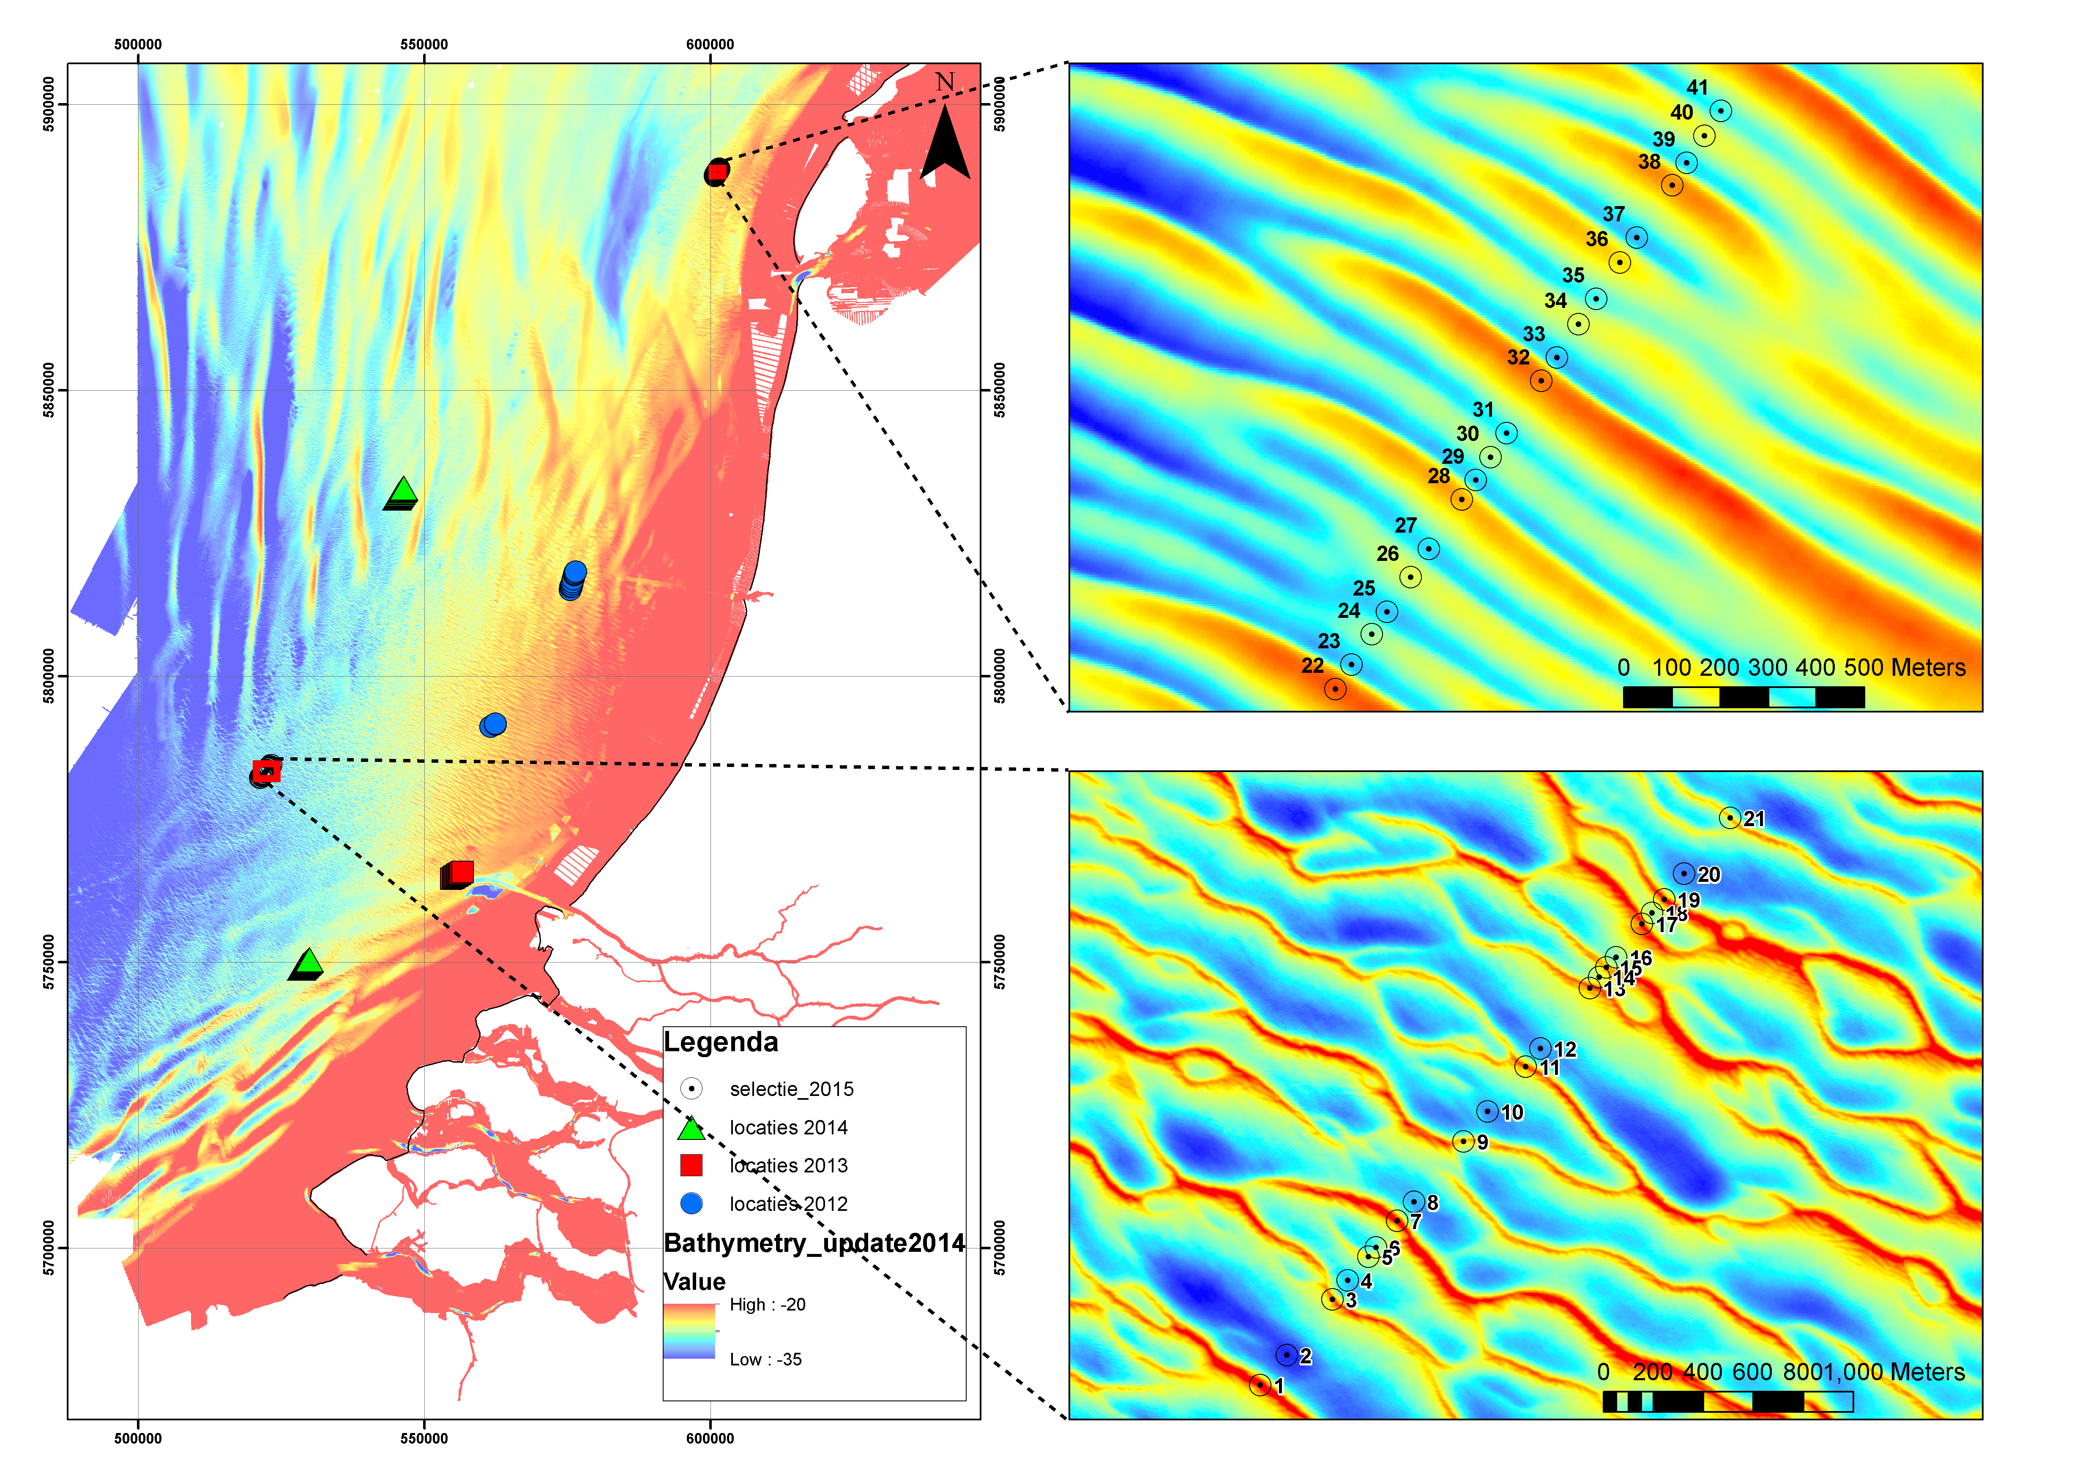
Sediment sorting over offshore bedforms
(Netherlands Continental Shelf)
112 Grab samples (2012 – 2016) at crests and in troughs of individual offshore sand waves reveal a systematic grain-size sorting over fully grown marine bedforms
Average median grain size differences between crests and troughs are up to 85 μm per site
Coarser sand on crests and finer in troughs
However, no backscatter data are available at these sites
Site | 1 | 2 | 3 | 4 | 5 | 6 | 7
Total No. Samples | 11 | 11 | 11 | 17 | 20 | 20 | 22
AV D50 Crests | 316 | 387 | 415 | 297 | 460 | 350 | 410
AV D50 Troughs | 293 | 340 | 330 | 287 | 375 | 313 | 352
Av. D50 CT diff. | 23 | 47 | 84 | 11 | 85 | 37 | 58
EGU2020-19409 D884: Gaida et al.
Average median grain size (D50) in μm per site

Slide 8
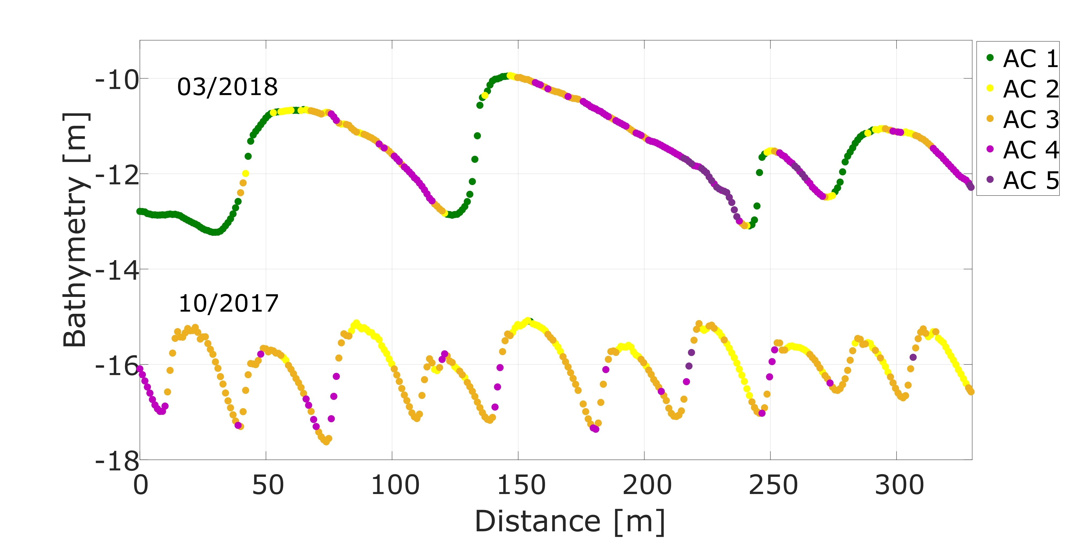
EGU2020-19409 D884: Gaida et al.
Sediment sorting over bedforms using MBES backscatter
In the new nourishments, megaripples rapidly developed and grew into sand waves
Sediment sorting increases over time with evolution of the bedforms
coarse sediment on the stoss sides, medium sediments on the crests and finer sediments on the lee and in the troughs
Pr 1
bathy
Pr 1: ASC plotted on bathy profiles Oct 2017 and March 2018
ASC
(Gaida et al., 2020 in press)

Slide 9
Sediment sorting over bedforms using MBES-BS Conclusions
High-resolution acoustic sediment classification in time series is a powerful tool to map sediment sorting over marine bedforms over time
MBES backscatter resolution is sufficient to resolve sediment sorting patterns for both megaripples and sand waves
Sediment sorting shows increasing contrasts with bedform development, with coarser sediments on stoss slopes, medium sediments on crests and finer sediment on lee slopes and in troughs of bedforms
EGU2020-19409 D884: Gaida et al.

Slide 10
Looking forward to your live questions, feedback and discussion
at EGU2020 Online on Friday 8th of May, 08:30 – 10:15 CET !
EGU2020 Session SSP3.5: Flow and bedform dynamics on Earth and Mars: current understanding of a complex interplay – Display D884
Click here to check out the paper
Gaida, T.C., Van Dijk, T.A.G.P., Snellen, M., Vermaas, T., Mesdag, C. and Simons, D.G. (2020). Monitoring underwater nourishments using multibeam bathymetric and backscatter time series. Coastal Engineering 158, https://doi.org/10.1016/j.coastaleng.2020.103666
EGU2020-19409 D884: Gaida et al.

