Slide 1
Industrial Ecology Programme
Session ERE2.10
EGU2020-19428
Norwegian University of Science and Technology
Helene Muri
helene.muri@ntnu.no
Original content from this work may be used under the terms of the Creative Commons Attribution 3.0 licence. Any further distribution of this work must maintain attribution to the author(s) and the title of the work, journal citation and DOI.

Slide 2
Abstract
Renewable energy will play a key role in transformation of the energy sector to reduce CO₂ emissions. Integrated Assessment Modelling scenarios reaching the temperature targets of the Paris Agreement rely on large scale deployment of Bioenergy with Carbon Capture and Storage (BECCS). BECCS are a key contributor to reducing emissions and achieving net negative emissions in such scenarios.
The potentials of large scale BECCS deployment in reaching the 1.5°C target is evaluated using Earth system model simulations in the work presented here. Fully coupled carbon cycle and interactive biogeochemistry is used to assess different rates of BECCS deployment, alongside assuming strong mitigation. BECCS at large scale influence not only the global carbon cycle, but also the feedbacks between the atmosphere and land surface.
Changing the land cover to biocrops affects the terrestrial store of carbon, and also the physical properties of the land surface, i.e. biogeophysical forcing, which leads to important feedbacks in the climate system.
Renewable energy from BECCS may have implications on several of the SDGs, in particular #13 Climate, #7 Energy, #15 Life on land, as well as #2 Hunger.
It is found that it remains a challenge to achieve the 1.5°C target, relying strongly on bioenergy with CCS, and the mitigation potential depends on geographical location, and availability of suitable land areas.
Notes:
https://meetingorganizer.copernicus.org/EGU2020/EGU2020-19428.html

Slide 3
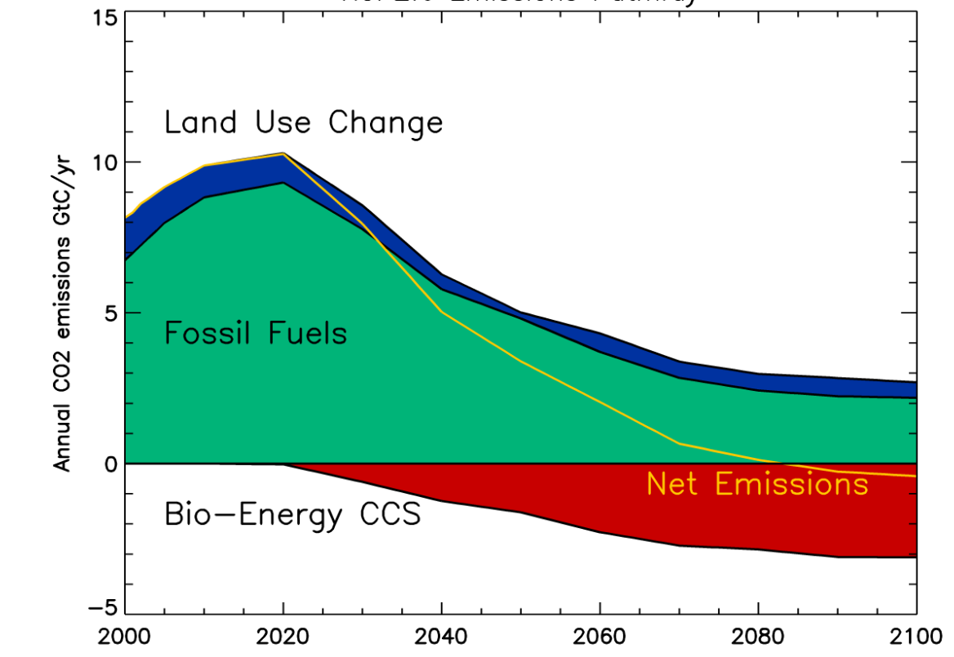
2ºC scenario
- Could it become 1.5ºC by increased deployment of BECCS?
Key characteristics of a 2°C pathway
Early emission peak
Early deployment of BECCS
Net negative by 2070s
Year
(van Vuuren et al. 2011)
Notes:
(RCP2.6) the ~2C scenario. Can it become a 1.5C scenario by increasing the deployment of BECCS?
This scenario is characterised by CCS coupling to the primary energy sources; gas, oil, coal,and bioenergy.
Emissions peak in 2030, and become net negative in the 2070’s.
BECCS is scaled up from 2020.

Slide 4
Increased harvest area for BECCS
Scenario 1: ‘Abandoned land’: re-agriculturing
Scenario 2 ‘Deforestation’: crops and grassland taking over woodlands
Abandoned land
Deforestation
Fractional gridbox cover
Notes:
Baseline case: Emission driven CMIP5 RCP2.6.
Abandoned land: As RCP2.6, but land-use changed to re-cultivate abandoned and marginal land over years 2020–2100, coupled to interactive CCS code.
Deforestation: As RCP2.6, but with land use change deforesting tropics and extra-tropics in favour of biocrops over years 2020–2100, coupled to interactive CCS code.

Slide 5
Fossil fuel emissions per year
Two different large-scale BECCS deployment scenarios:
reduce emissions
achieve negative emissions sooner.
Scenario 1:
‘re-agriculturing’ abandoned land (mid-lats)
Scenario 2:
tropical deforestation in favour of biocrops
2 degree scenario
(Muri, ERL, 2018, doi: 10.1088/1748-9326/aab324)
Notes:
https://iopscience.iop.org/article/10.1088/1748-9326/aab324
- Reductions in fossil fuel carbon emissions from large scale deployment of BECCS in the Norwegian Earth System Model.
- Net negative emissions are reached ~1 decade earlier, ~2065.
~-1Gt C per year, i.e. doubling of the negative emission efforts.

Slide 6
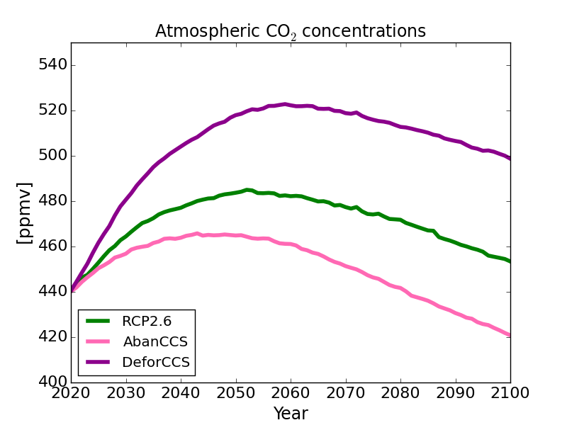
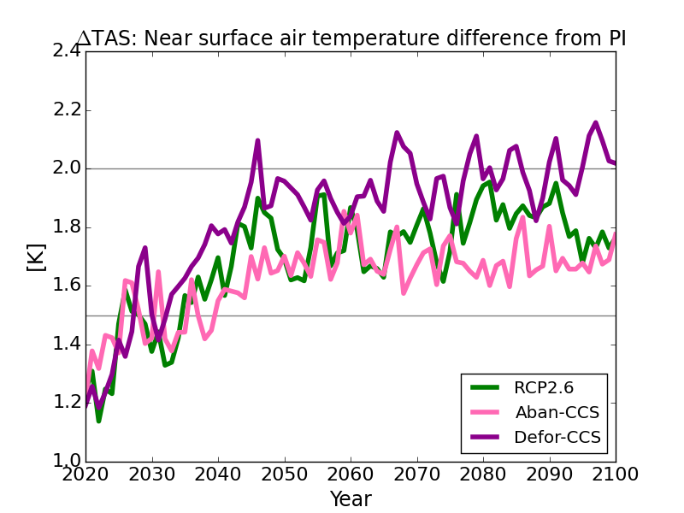
Atmospheric CO₂ concentrations
Atmospheric CO₂ concentrations increase when tropical forests are replaced by biocrops.
-> climate warms.
BECCS in mid-latitudes lowers atmospheric CO₂ concentrations.
-> climate cools.
Global mean temperatures
ºC
Scenario 1:
‘re-agriculturing’ abandoned land (mid-lats)
Scenario 2:
tropical deforestation in favour of biocrops
2 degree scenario
(Muri, ERL, 2018, doi: 10.1088/1748-9326/aab324)
Notes:
Atmospheric CO2 concentrations are increased in the case where tropical forests are replaced by biocrops, resulting in a warming, as this important carbon sink is reduced.
BECCS in mid-latitudes lowers atmospheric CO2 concentrations, and temperatures. But not enough to lower temperatures to 1.5C.

Slide 7
Key messages
Scenarios that achieve 1.5 – 2ºC typically rely on optimistic assumptions about negative emission technologies.
E.g. BECCS.
Not yet proven at the scales required.
Developing deployment strategies requires care, to maximize synergies and minimize trade-offs.
Notes:
- Where you geographically prioritise land for biocrops can have a big impact on net effects.
- Competition for land areas are needed to be considered carefully when planning for large-scale bio-energy croplands.
- Combination of tools such as integrated assessment models and Earth system models useful for assessing achievability and impacts of emission pathways.

Slide 8
For more details, see:
Original content from this work may be used under the terms of the Creative Commons Attribution 3.0 licence. Any further distribution of this work must maintain attribution to the author(s) and the title of the work, journal citation and DOI.
https://iopscience.iop.org/article/10.1088/1748-9326/aab324

