Slide 1

FP_ILM: Extremely fast volcanic SO2 plume height retrieval based on S5P/TROPOMI data using inverse learning machines
Dmitry Efremenko, Pascal Hedelt,
Diego Loyola, and Robert Spurr

Slide 2
SO₂ LH Overview
SO₂ sources: Biogenic emissions, fossil fuel combustion, refineries smelting, volcanoes
Major air pollutant
Volcanic eruption ejects large amounts of ash and trace gases, including SO₂
Ash and SO₂ can be collocated in fresh plumes, SO₂ proxy for ash
Impact on human health, public as well as air traffic safety
Depending on height, lifetime from days to several weeks
  Acid rain, Sulfates
Regular ground-based monitoring only for limited amount of volcanoes
Satellites allow for global daily measurements of SO₂ amount (VCD), plume height (LH) and aerosol load

Slide 3
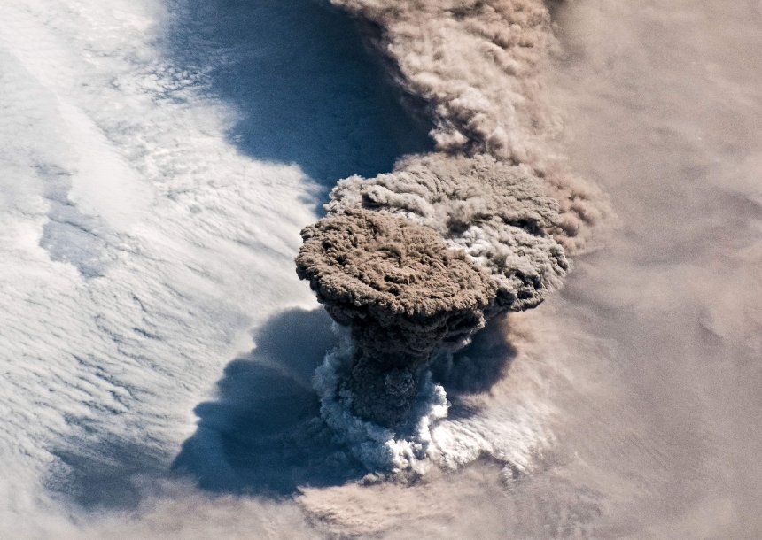
Raikoke eruption June – July 2019

Slide 4
SO₂ LH retrieval
Determination of the vertical distribution is challenging and not easily extracted from UV spectral signatures
  VCD: direct effect on the optical depth
  LH: indirect effect on OD – influence on number of photons passing through the SO₂ layer as well as the layer OD due to the temperature dependency of the SO₂ absorption cross-sections
SO₂ LH retrieval algorithms for UV developed so far rely on direct fitting, which involves time-consuming radiative transfer calculations
  Not applicable in NRT environment
High spatial resolution and data amount of S5P require fast algorithms

Slide 5
SO₂ LH retrieval algorithm
FP-ILM: Full Physics Inverse Learning Machine
Novel method: Full-Physics Inverse Learning Machine (FP_ILM)
for extremely fast and accurate retrieval of the SO₂ plume height
  Combination of smart sampling, dimensionality reduction & machine learning
  Offline training phase (slow)
  Online application of inversion operator (fast)
  Processing speed: 2ms / TROPOMI Pixel
  Accuracy: 2km for SO₂ > 20 DU
    Efremenko et al (2017): Volcanic SO₂ plume height retrieval from UV sensors using inverse learning machines IJRS, Vol 38
    Hedelt et al. (2019): SO₂ Layer Height retrieval from Sentinel-5 Precursor/TROPOMI using FP_ILM, AMT-2019-13, Vol. 12, No. 10
Development in the framework of ESA S5P Innovations: SO2 LH project
https://atmos.eoc.dlr.de/so2-lh/ (Google search: ‘SO2 LH’)

Slide 6
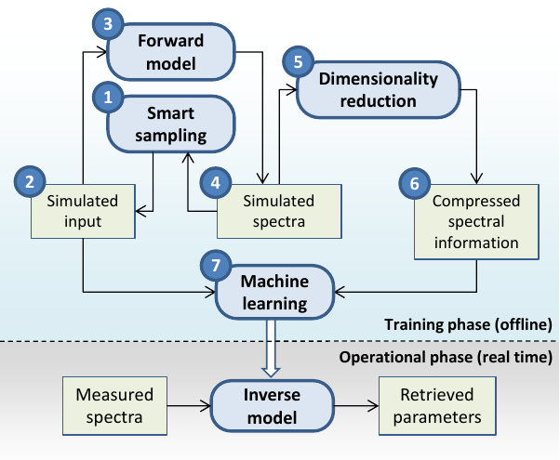
Full Physics Inverse Learning Machine (FP_ILM)
1
Smart parameter grid (8D)
Non-uniform, optimized
(Loyola et al. 2016)
Geometry, surface properties,
O₃ VCD, SO₂ VCD, SO₂ LH
US Standard atmosphere, TOMS O3
Reflectance Spectra (310-335 nm)
LIDORT RRS, (Spurr et al. 2008)
Convolution with ILS, added noise
Principal Component Analysis
Extract main information from spectra, reduce dimensionality
Machine Learning: Neural Network
→Application to measured data
3
5
7

Slide 7
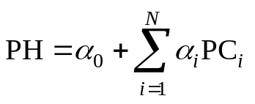
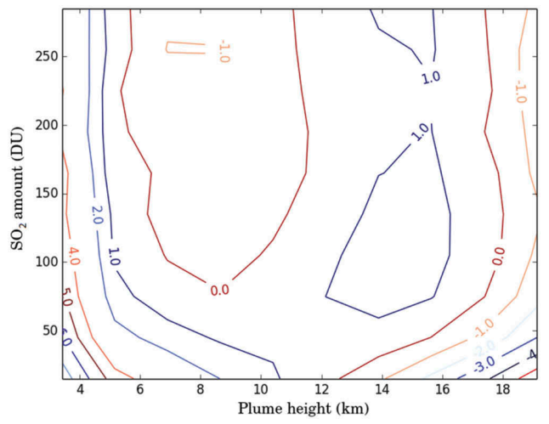
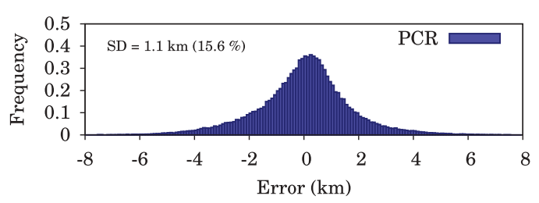
Principal component regression
Plume height (PH) is a weighted sum of principal components (PCs):
Regression coefficients α_{i} and PCs are estimated from synthetic spectra;
Accuracy estimation based on synthetic spectra:

Slide 8
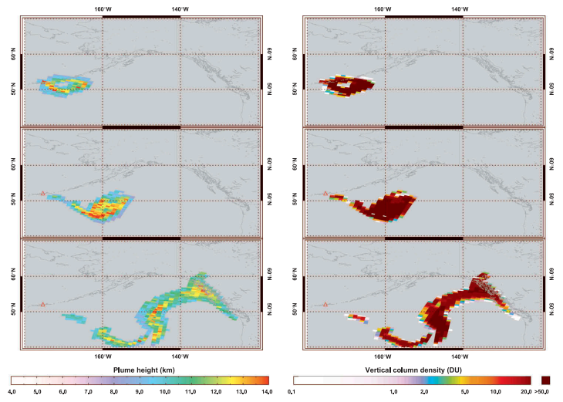
Application to GOME-2 (Kasatochi 2010)

Slide 9
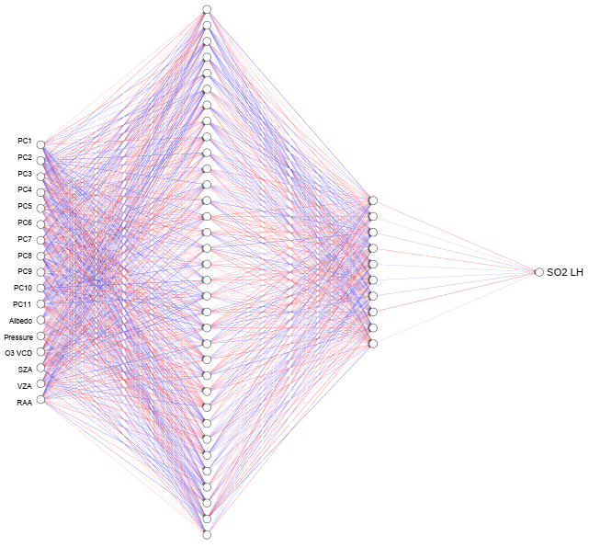
FP-ILM: version with neural network
Training of neural network
Input: Training spectra
  PC scores
  Viewing/surface
  properties
Output:
  SO₂ LH
  Trained NN
Application to real data
1. Application of PC operator
  Dimensionality reduction
  of spectra
  2. Application of NN
    SO₂ LH

Slide 10
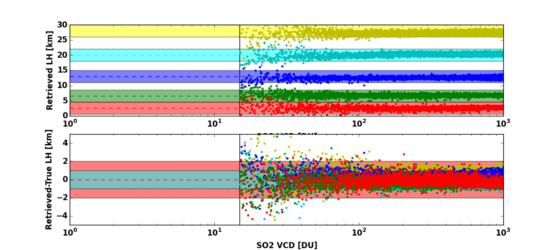
FP-ILM: Application test data
Application to simulated spectra (SNR=1000) test dataset with prescribed
SO₂ LH @ 2.5, 5, 12, 20, and 27km,

Slide 11
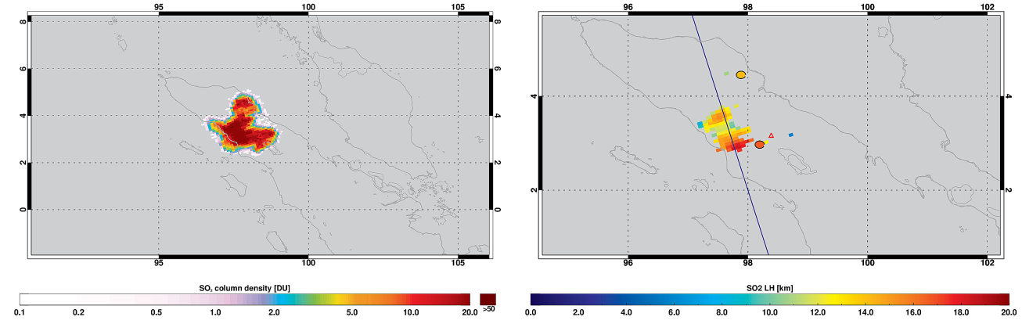
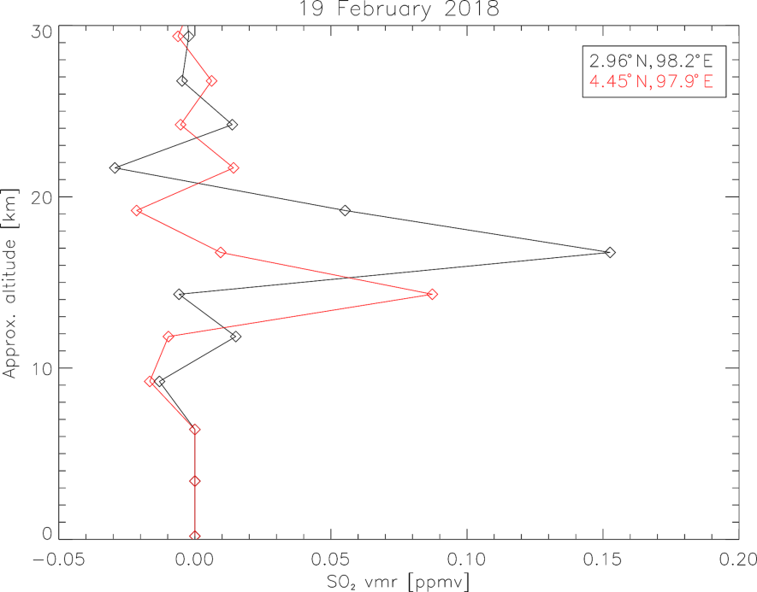
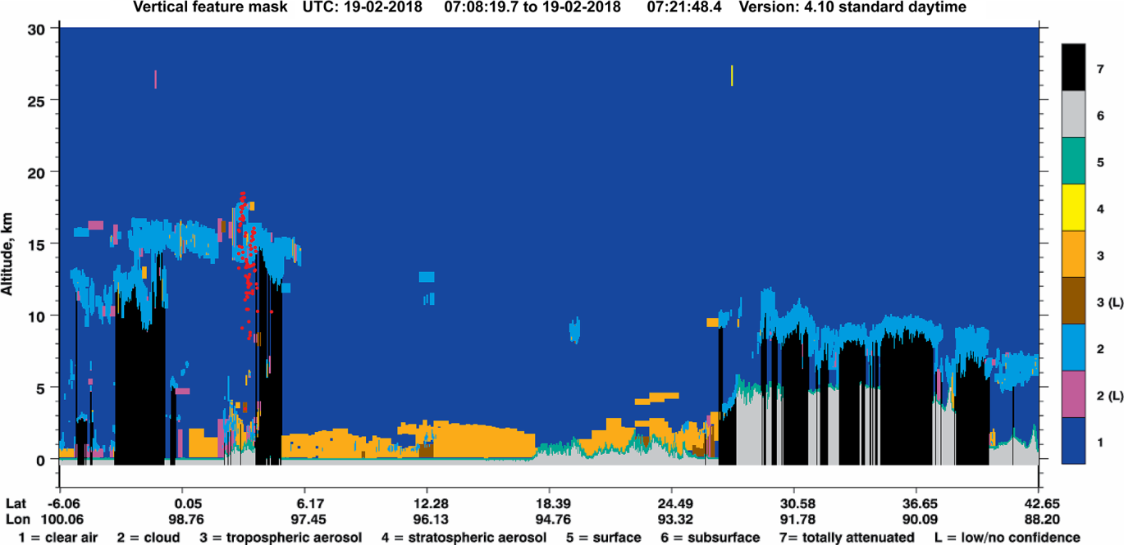
Application to S5p:
Sinabung eruption Feb. 2018 (Hedelt et al. 2019)
VCD
SO₂ LH
CALIPSO
MLS

Slide 12
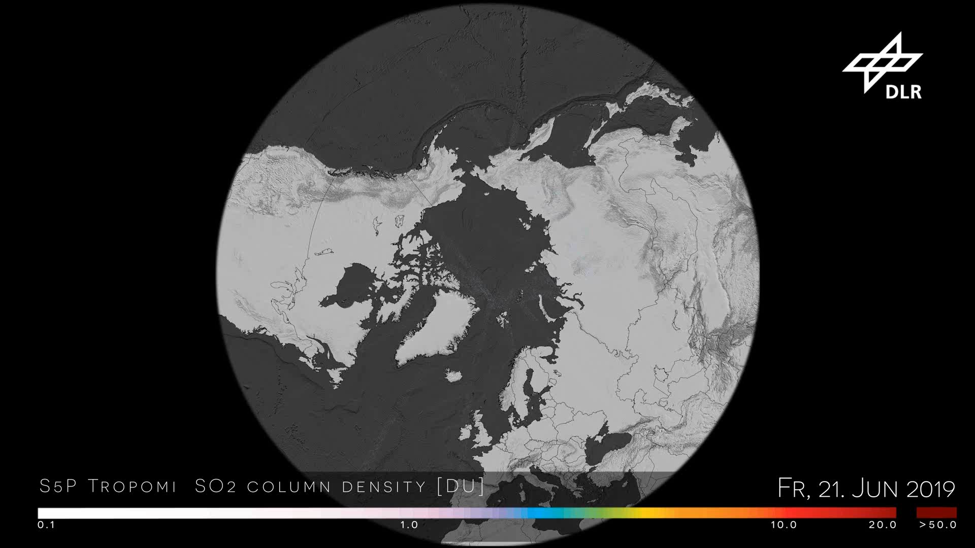
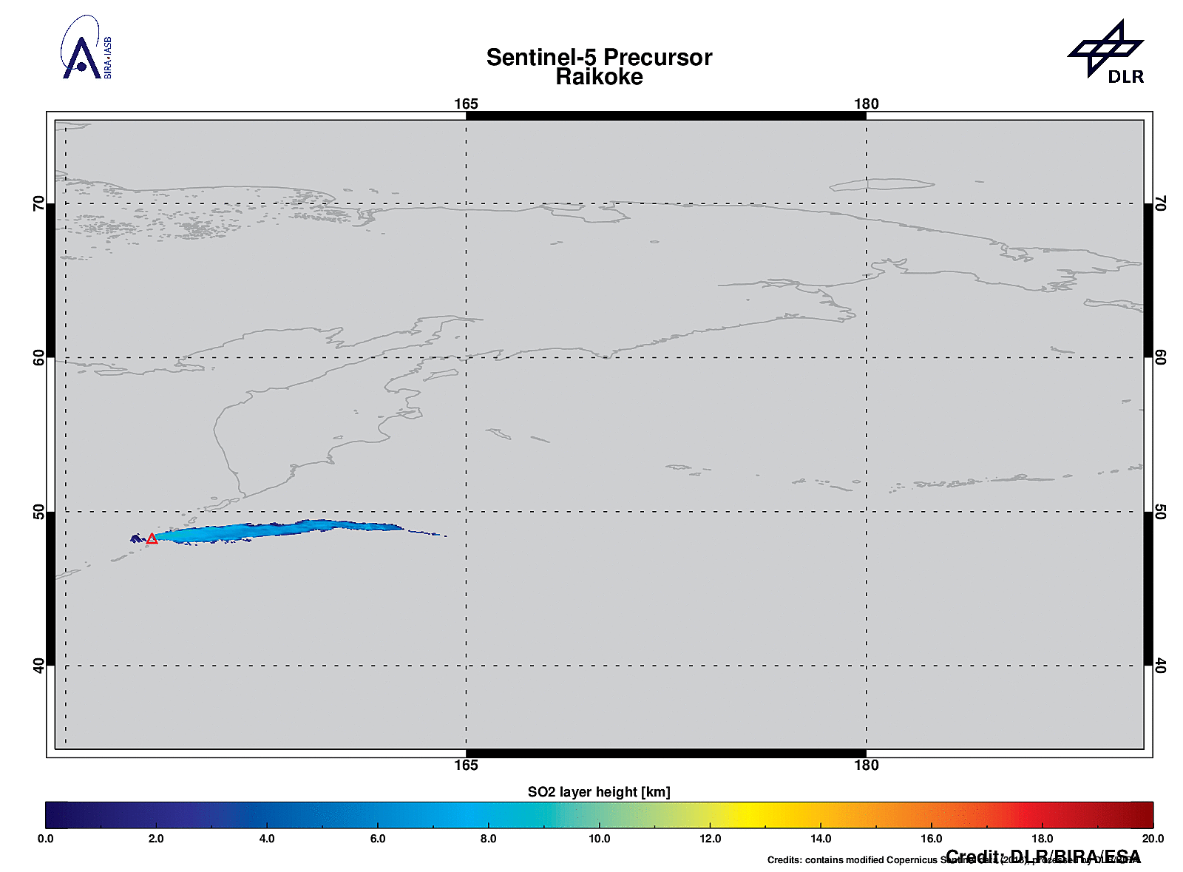
Application to S5p:
Raikoke eruption Jun-Jul 2019 (Hedelt et al. 2019)
~1000DU of SO₂
SO₂ LH: Up to 16km

Slide 13
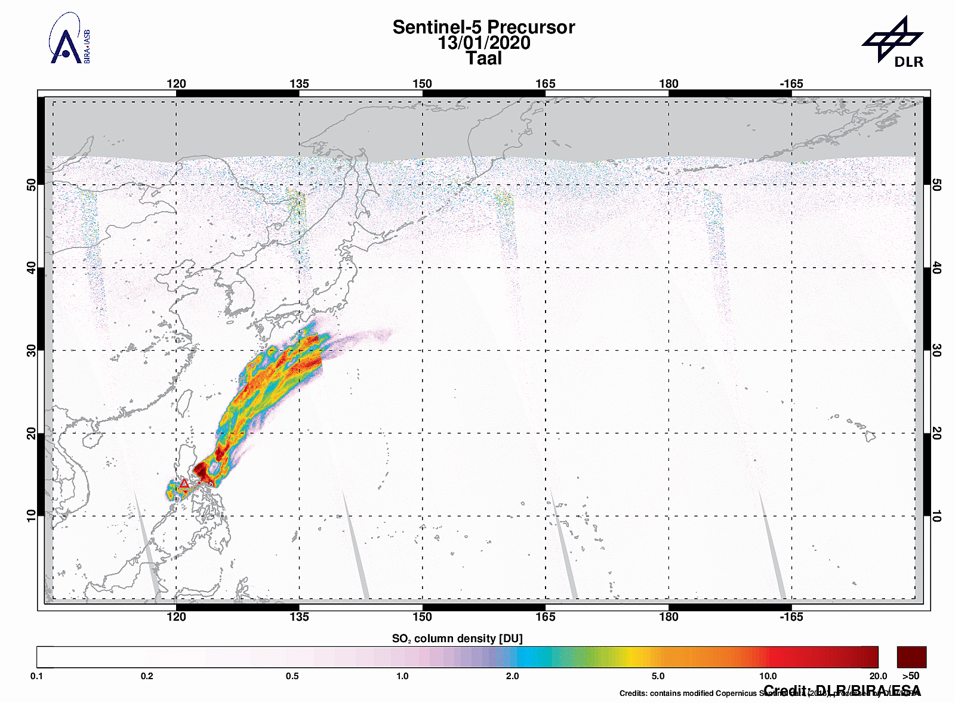
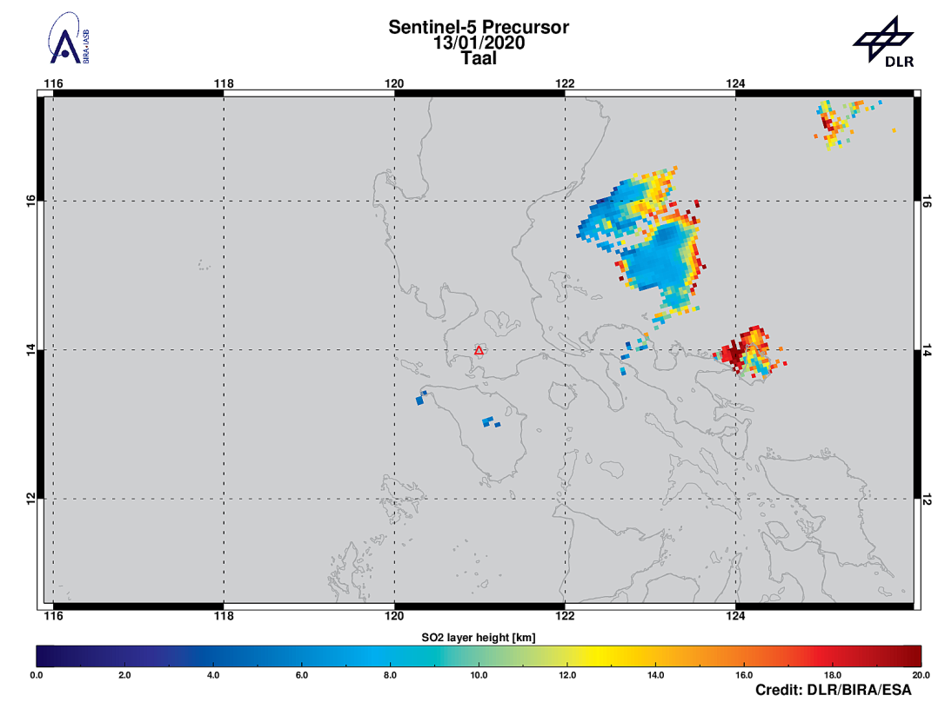
Application to S5p:
Taal eruption Jan 2020
Taal volcanic eruption (Philippines)
SO₂ LH: Up to 18 km (Preliminary)

Slide 14
Summary
A novel method (FP_ILM) for the precise and extremely fast retrieval of volcanic SO2 layer height (LH) based on S5P/TROPOMI data is proposed;
A combined principal components analysis (PCA) and neural network approach (NN) is implemented;
The FP_ILM approach enables for the first time to extract the SO₂ LH information in a matter of seconds for an entire S5P orbit and thus applicable in NRT application.
Development in framework of ESA S5P+I: SO2 LH project.
Hourly S5P SO₂ LH results for volcanic detections @Twitter: @DLRSO2
The algorithm details can be found in
Efremenko D.S., Loyola D., Hedelt P. and Spurr R. // International Journal of Remote Sensing. 2017. V. 38:sup1, P. 1-27. https://doi.org/10.1080/01431161.2017.1348644
Hedelt P., Efremenko D., Loyola D., Spurr R., Clarisse L. // Atmospheric measurement techniques. 2019. V. 12. P. 5503. https://doi.org/10.5194/amt-12-5503-2019

