Slide 1

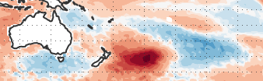




Monitoring Marine HeatWaves in CMEMS ocean analysis systems
MHW Dec 2019
Eric de Boisséson, Magdalena Balmaseda, Hao Zuo
EGU 2020, 8 May 2020
Corr. author: Eric de Boisséson ECMWF, Reading UK
Email address: Eric.Boisseson@ecmwf.int

Slide 2
CMEMS ocean reanalyses
Since 2015, CMEMS has been providing near-real time and multi-year ocean analyses
CMEMS archives host an ensemble of mutli-year global ocean reanalyses: GLORYS (MOI), FOAM (UKMO), C-GLORS (CMCC), ORAS5 (ECMWF)
Both monthly and daily frequency reanalysis fields are available with target to provide 1-month behind real-time updates
Recent increase in the frequency of Marine HeatWave (MHW) events with significant impact on the marine ecosystems and industries
CMEMS products allow in-depth monitoring of those events. Combining with C3S atmospheric reanalyses allows for MHW process attribution

Slide 3
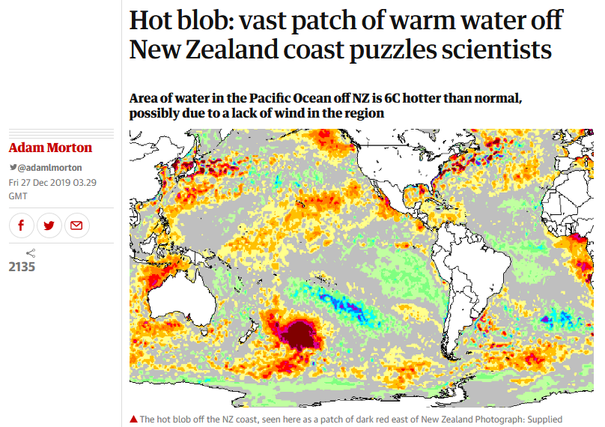
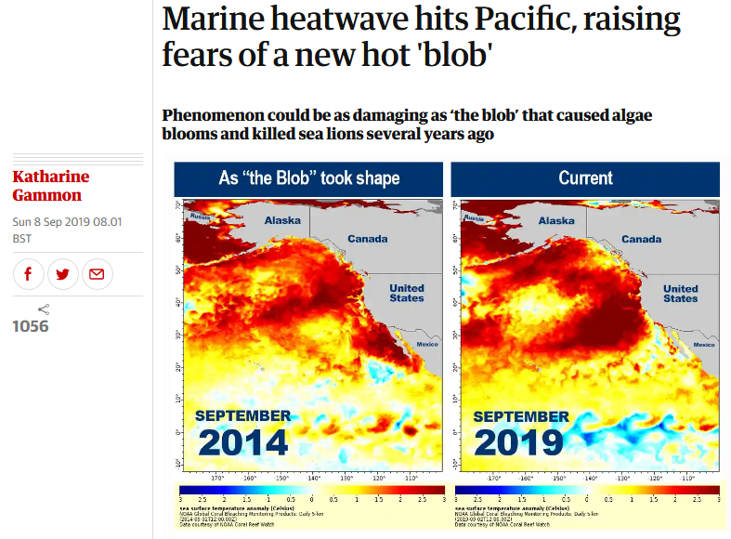
Major MHW events in the past year
From The Guardian website:
27 Dec 2019
8 Sep 2019
Courtesy of theguardian.com
From the ORAS5 near-real-time monitoring (ECMWF website): SST daily maps (anom. wrt clim 1993-2016)
26 Dec 2019
31 Aug 2019
-4 -2 -0.5 0.5 2 4
-4 -2 -0.5 0.5 2 4

Slide 4
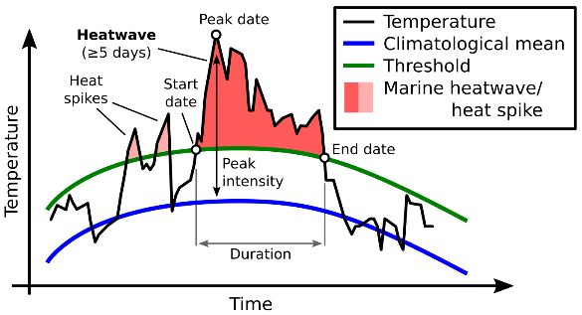
How to detect Marine Heatwave?
Definition (Hodbay et al. 2016): we call Marine HeatWave (MHW) an episode of Sea Surface Temperatures exceeding the 90th percentile for at least 5 days. Successive heatwaves with gaps <=2 days are considered part of the same event
Courtesy of marineheatwaves.org

Slide 5
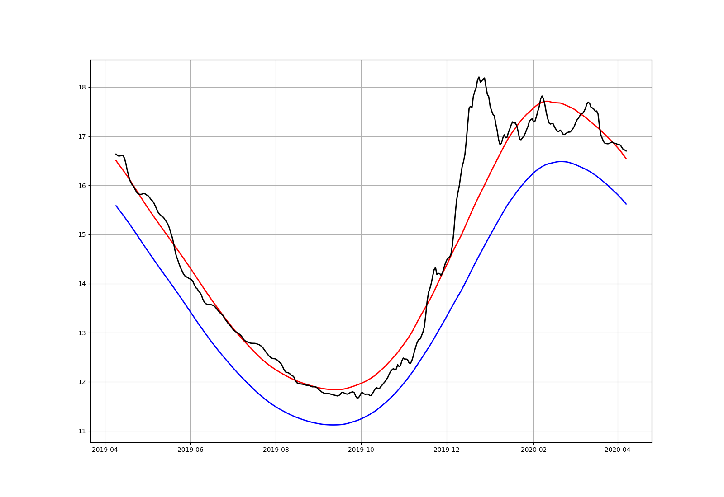
New Zealand December 2019 MHW
ORAS5 SST anomalies wrt clim 1993-2016
ORAS5 Surface wind speed anomalies wrt clim 1993-2016
26 Dec 2019
Dec 2019
-4 -2 -0.5 0.5 2 4
-3 -1.5 -0.4 0.4 1.5 3
ORAS5 SST 1-year timeseries: 35-50S 170-150W
Time-depth Temp. (minus 90th pctl) section: 35-50S 170-150W
0
100
200
18
15
12
04-2019 to 04-2020
SST
SST clim
SST 90pctl
201904 201906 201908 201910 201912 202002 202004
201904 201906 201908 201910 201912 202002 202004
-1.8 -1 -0.2 0.2 1 1.8
Weak wind forcing gives rise to MHW that remains in the first 50m. No propagation at depth

Slide 6
New Zealand December 2019 MHW
ORAS5 SST anomalies wrt clim 1993-2016
ORAS5 Surface wind speed anomalies wrt clim 1993-2016
26 Dec 2019
Dec 2019
-4 -2 -0.5 0.5 2 4
-3 -1.5 -0.4 0.4 1.5 3
ORAS5 SST 1-year timeseries: 35-50S 170-150W
Time-depth Temp. (minus 90th pctl) section: 35-50S 170-150W
0
100
200
18
15
12
04-2019 to 04-2020
SST
SST clim
SST 90pctl
201904 201906 201908 201910 201912 202002 202004
201904 201906 201908 201910 201912 202002 202004
-1.8 -1 -0.2 0.2 1 1.8
Weak wind forcing gives rise to MHW that remains in the first 50m. No propagation at depth

Slide 7
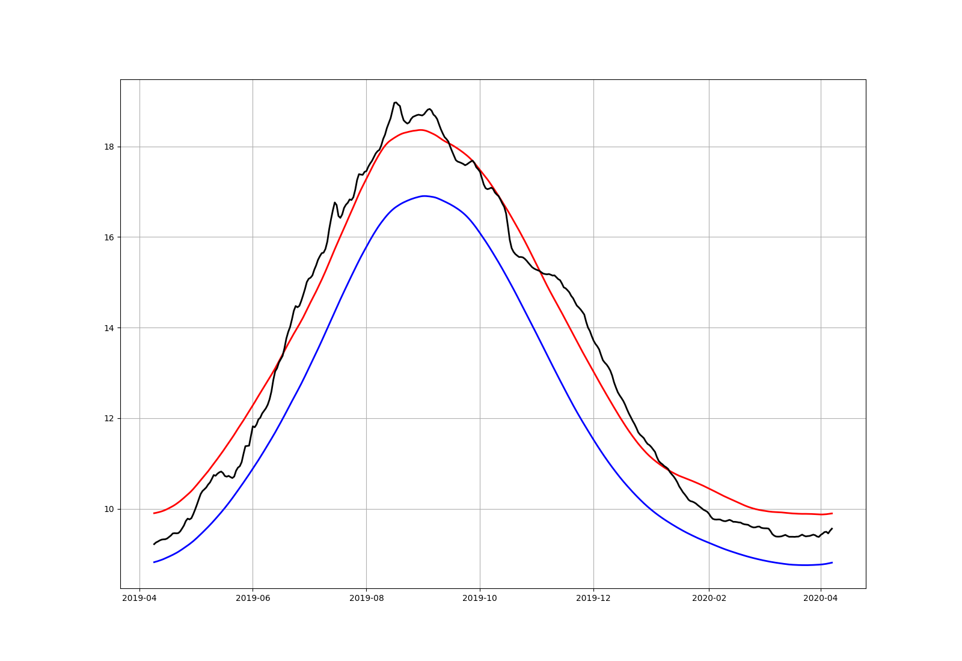
North Pacific summer-autumn 2019 MHW
ORAS5 SST anomalies wrt clim 1993-2016
ORAS5 Incoming Solar HFlx anomalies wrt clim 1993-2016
31 Aug 2019
JJA 2019
-40 -30 -20 -10 10 20 30 40
ORAS5 SST 1-year timeseries: 40-50N 150-130W
Time-depth Temp. (minus 90th pctl) section: 40-50N 150-130W
0
100
200
18
14
10
SST
SST clim
SST 90pctl
04-2019 to 04-2020
201904 201906 201908 201910 201912 202002 202004
201904 201906 201908 201910 201912 202002 202004
-1.8 -1 -0.2 0.2 1 1.8
Weak winds and high solar radiation gives rise to a long MHW event with resurgence a few months later. Hints of propagation deeper than 100m

Slide 8
North Pacific summer-autumn 2019 MHW
ORAS5 SST anomalies wrt clim 1993-2016
ORAS5 Incoming Solar HFlx anomalies wrt clim 1993-2016
31 Aug 2019
JJA 2019
-40 -30 -20 -10 10 20 30 40
ORAS5 SST 1-year timeseries: 40-50N 150-130W
Time-depth Temp. (minus 90th pctl) section: 40-50N 150-130W
0
100
200
18
14
10
SST
SST clim
SST 90pctl
04-2019 to 04-2020
201904 201906 201908 201910 201912 202002 202004
201904 201906 201908 201910 201912 202002 202004
-1.8 -1 -0.2 0.2 1 1.8
Weak winds and high solar radiation gives rise to a long MHW event with resurgence a few months later. Hints of propagation deeper than 100m

Slide 9
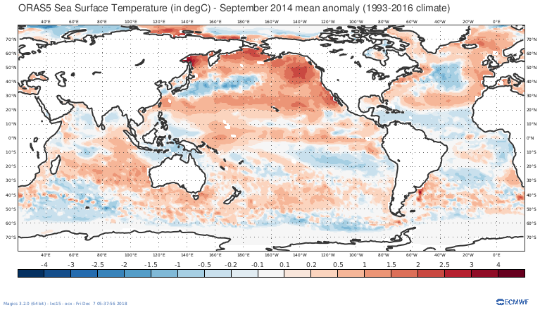
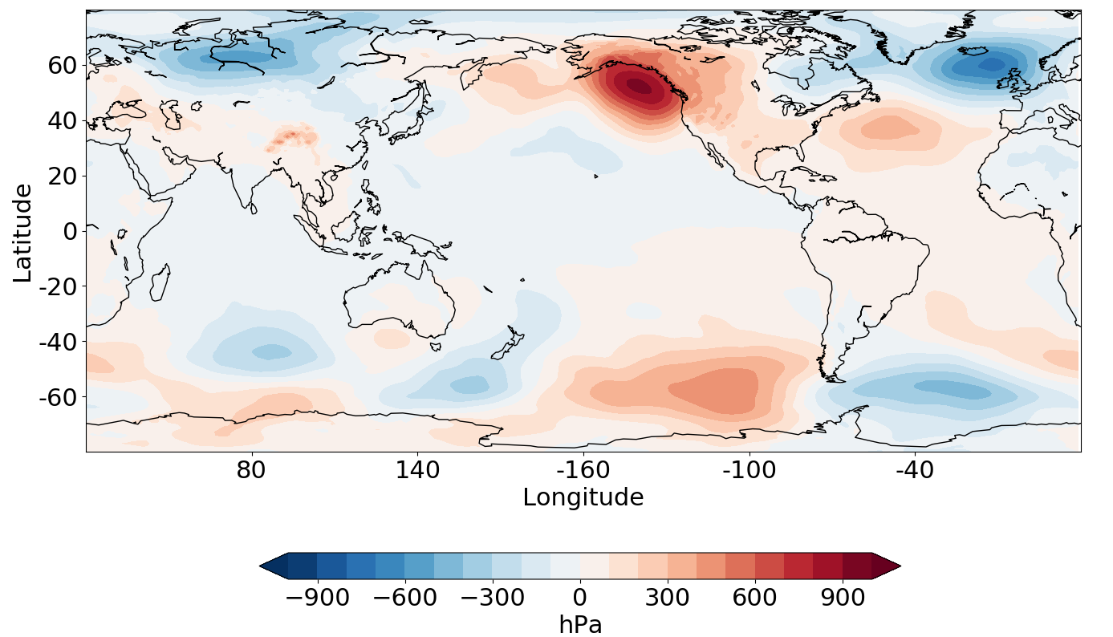
Past MHW event: North Pacific ‘Blob’ (2014-2016)
The ‘Blob’ is the longest MHW on record: 2 years 2014-2016
Linked to a persistent atmospheric situation: RRR (Ridiculously Resilient Ridge)
ORAS5 SST anomalies wrt clim 1993-2016
ERAInt SLP anom Oct 2013 – Jan 2014
Sep 2014
-4 -2 -0.5 0.5 2 4
Time-depth Temp. (minus clim): 40-50N 150-130W
Time-depth Temp. (minus 90th pctl): 40-50N 150-130W
0
100
200
0
100
200
2010 2012 2014 2016 2018 2020
2010 2012 2014 2016 2018 2020
-1.8 -1 -0.2 0.2 1 1.8
-1.8 -1 -0.2 0.2 1 1.8
Notes:
The ‘blob’ started in late 2013. In 2014, the signal had already spread down to 100m depth. The MHW peaked in 2015. By that time the Pacific NE was already anomalously warm down to 300m depth. The MHW finished late early 2016 but there was a resurgence in the late summer. Maybe facilitated by the propagation of the signal at depth. The temperature anomalies have stayed positive until this day. May have favoured the 2019 events and future events. The monitoring of this area will continue. This area is also an important seafood reservoir for N American fisheries. Monitoring the impact on the ecosystems is also important to understand the long-term influence of those MHW events.

Slide 10
Past MHW event: North Pacific ‘Blob’ (2014-2016)
The ‘Blob’ is the longest MHW on record: 2 years 2014-2016
Linked to a persistent atmospheric situation: RRR (Ridiculously Resilient Ridge)
ORAS5 SST anomalies wrt clim 1993-2016
ERAInt SLP anom Oct 2013 – Jan 2014
Sep 2014
-4 -2 -0.5 0.5 2 4
Time-depth Temp. (minus clim): 40-50N 150-130W
Time-depth Temp. (minus 90th pctl): 40-50N 150-130W
0
100
200
0
100
200
2010 2012 2014 2016 2018 2020
2010 2012 2014 2016 2018 2020
-1.8 -1 -0.2 0.2 1 1.8
-1.8 -1 -0.2 0.2 1 1.8
Notes:
The ‘blob’ started in late 2013. In 2014, the signal had already spread down to 100m depth. The MHW peaked in 2015. By that time the Pacific NE was already anomalously warm down to 300m depth. The MHW finished late early 2016 but there was a resurgence in the late summer. Maybe facilitated by the propagation of the signal at depth. The temperature anomalies have stayed positive until this day. May have favoured the 2019 events and future events. The monitoring of this area will continue. This area is also an important seafood reservoir for N American fisheries. Monitoring the impact on the ecosystems is also important to understand the long-term influence of those MHW events.

Slide 11
Conclusions and perspectives
CMEMS and C3S reanalyses can be used to monitor MHW events. Daily frequency essential for accurate detection.
CMEMS data allows to get insight into the depth dimension of MHW
CMEMS reanalyses multi-year records provide climate context. GREP ensemble will provide uncertainty estimates. CMEMS observation-based products could be used for validation
First glance process attribution using C3S atmospheric reanalyses. More sophisticated attribution possible through budget studies
Impact on ecosystems could be investigated in biogeochemical models
Extended range and seasonal forecasts capabilities provide potential for MWH forecasts. This will be investigated in the ECMWF seasonal forecasting system

