Slide 1



Assessment of the Assimilation of TEMPEST-D in the NCEP Global Forecast System
Ting-Chi Wu¹, Lewis Grasso¹, Milija Zupanski¹, Heather Cronk¹,
James Fluke¹, Richard Schulte², Wesley Berg², Anton Kliewer¹,
Christian Kummerow^{1,2}, Philip Partain¹, and Steven Miller¹
Cooperative Institute for Research in the Atmosphere (CIRA), Colorado State University
Department of Atmospheric Science, Colorado State University
Corresponding author’s e-mail: ting-chi.wu@colostate.edu
Special thanks to Changyong Cao, Kevin Garrett, and Kate Friedman of NOAA
EGU General Assembly 2020 : NWP Session AS 1.1
Friday, May 8, 2020

Slide 2
Overview of the Project
Small/Cube satellites (SmallSats) are emerging as a potential solution for monitoring the Earth system with relatively low cost and low risk compared to traditional satellites.
A standard unit of size and mass for a SmallSat is the U, which corresponds to a volume of 10 cm cube and a mass about 1.33 kg.
Our goals as part of a Technology Maturation Program:
  Explore quick and agile methodologies to entrain small-satellites that have limited lifetimes into the NOAA processing stream.
  Develop workflow that would allow NOAA, once it has identified an upcoming mission, to work with partners to ingest, calibrate, validate, and exploit these data in a minimum amount of time.
  Document lessons learned and initial assessment of impact of assimilating SmallSats in NOAA operational data assimilation and forecast systems (FV3GFS)

Slide 3
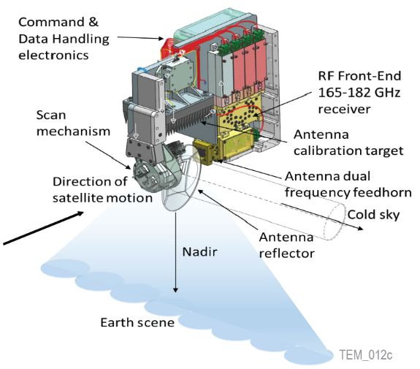
SmallSat: TEMPEST-D Mission
A proposed future mission: Temporal Experiment for Storms and Tropical Systems (TEMPEST).
A demonstration mission in orbit: TEMPEST-Demonstration (TEMPEST-D)
TEMPEST-D was launched on May 21, 2018
In preparation for future TEMPEST mission to deploy a constellation of SmallSats for studying cloud and precipitation processes
Demonstrate the ability to monitor the atmosphere with small satellites
A proof-of-concept for next generation Earth-observing technologies with lower cost and smaller risk
Specification | TEMPEST-D | MHS
Number of channels | 5 | 5
Channel Freq. (GHz) | 87, 164, 174, 178, 181 | 89, 157, 183±1, 183±3, 190
Mass | 3.8 kg | 63 kg
Power | 6.5 W | 74 W
Altitude | 400 km | 820 km
Resolution at nadir | 12.5 km (25 km at 87 GHz) | 15.9 km
Integration time | 5 ms | 18.5 ms
Inclination angle = 51.6˚
~ 400 km altitude
Cross-track scanning (-/+ 60 ˚)
Swath width ~ 825 km
Data downlink to a single ground station at Wallops Island, Virginia
Continuous data is rare.
Notes:
Currently, data from TEMPEST-D is downlinked to a single ground station located at Wallops Island, Virginia, which typically operates Monday through Friday. Due to a limited capacity to downlink observations from the spacecraft, that not all data is brought to the ground. In a typical month, there are about 7‐15 days of continuous data available.

Slide 4
Develop workflow to use SmallSats in NOAA systems
TEMPEST-D is used to demonstrate and establish the workflow for the use of quick and agile methodologies to assimilate SmallSat data into the NOAA NWP system.
Items in the workflow:
  Collect TEMPEST-D data in HDF5 format from the ground station
  Quality assurance of the TEMPEST-D HDF5 data
  Prepare to be converted to BUFR format
  Obtain Community Radiative Transfer Model (CRTM) coefficient files specific to TEMPEST-D
  Develop methodologies for cloud clearing and bias corrections
  Add capabilities to assimilate TEMPEST-D in the NOAA operational data assimilation system - Gridpoint Statistical Interpolation (GSI)
  Conduct cycled data assimilation and forecast experiments following the FV3GFS global-workflow structure
  Develop tools to assess results of the assimilation of TEMPEST-D radiances (clear-sky)

Slide 5
Scientific Question
Are the results of the assimilation of TEMPEST-D radiances consistent with the results of the assimilation of radiances from a well-established sensor; for example, MHS?
By consistent we mean that the use of TEMPEST-D radiances does not deteriorate the results of assimilation compared to the use of MHS radiances.
In the unlikely event of a failure of MHS, TEMPEST-D may represent a reliable backup to ensure the continuous flow of data for assimilation of radiances into an operational NWP system.
We will address this question by conducting a set of data-denial experiments with the use of MHS and TEMPEST-D radiances.

Slide 6
Data Quality Assurance and Prep for BUFR
As part of QA procedure for TEMPEST-D, values of the following variables in the TEMPEST-D HDF5 data files were checked:
  absolute values of the satellite orientation yaw, pitch, and roll < 0.1 degrees
  satellite latitude, longitude, and altitude have to be finite
  zenith and scan angles along with the latitude and longitude of each pixel have to be finite
  since the cross-track scanning sensor on TEMPEST-D spins 360 degrees, measurements of pixels that were off the Earth were removed.
Currently, NCEP BUFR is the standard format to encode satellite radiances data for use by the NOAA operational data assimilation system – GSI.
The Python py-ncepbufr module (https://github.com/JCSDA/py-ncepbufr) is used to encode QAed TEMPEST-D data into NCEP BUFR format data files.

Slide 7
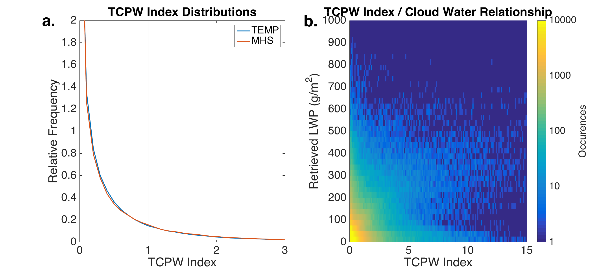
Cloud Clearing Procedure
As a first step, we applied the existing MHS cloud clearing procedure in GSI to TEMPEST-D data. The GSI cloud-clearing procedure for MHS:
Channel | MHS | TEMPEST-D
1 | 89 GHz | 87 GHz
2 | 157 GHz | 164 GHz
3 | 183.311 ± 1.0 GHz | 174 GHz
4 | 183.311 ± 3.0 GHz | 178 GHz
5 | 190.311 GHz | 181 GHz
If the TCPW_{index} > 1, pixel is cloudy and screened out.
Values of the TCPW_{index} computed from MHS data match with values of TCPW_{index} computed from using the TEMPEST-D data.
A direct comparison between retrieved LWP (Schulte et al. 2020) and the TCPW_{index} resulted in a correlation coefficient of 0.37, which suggests TCPW_{index} is not a reliable indicator of cloudiness for TEMPEST-D.

Slide 8
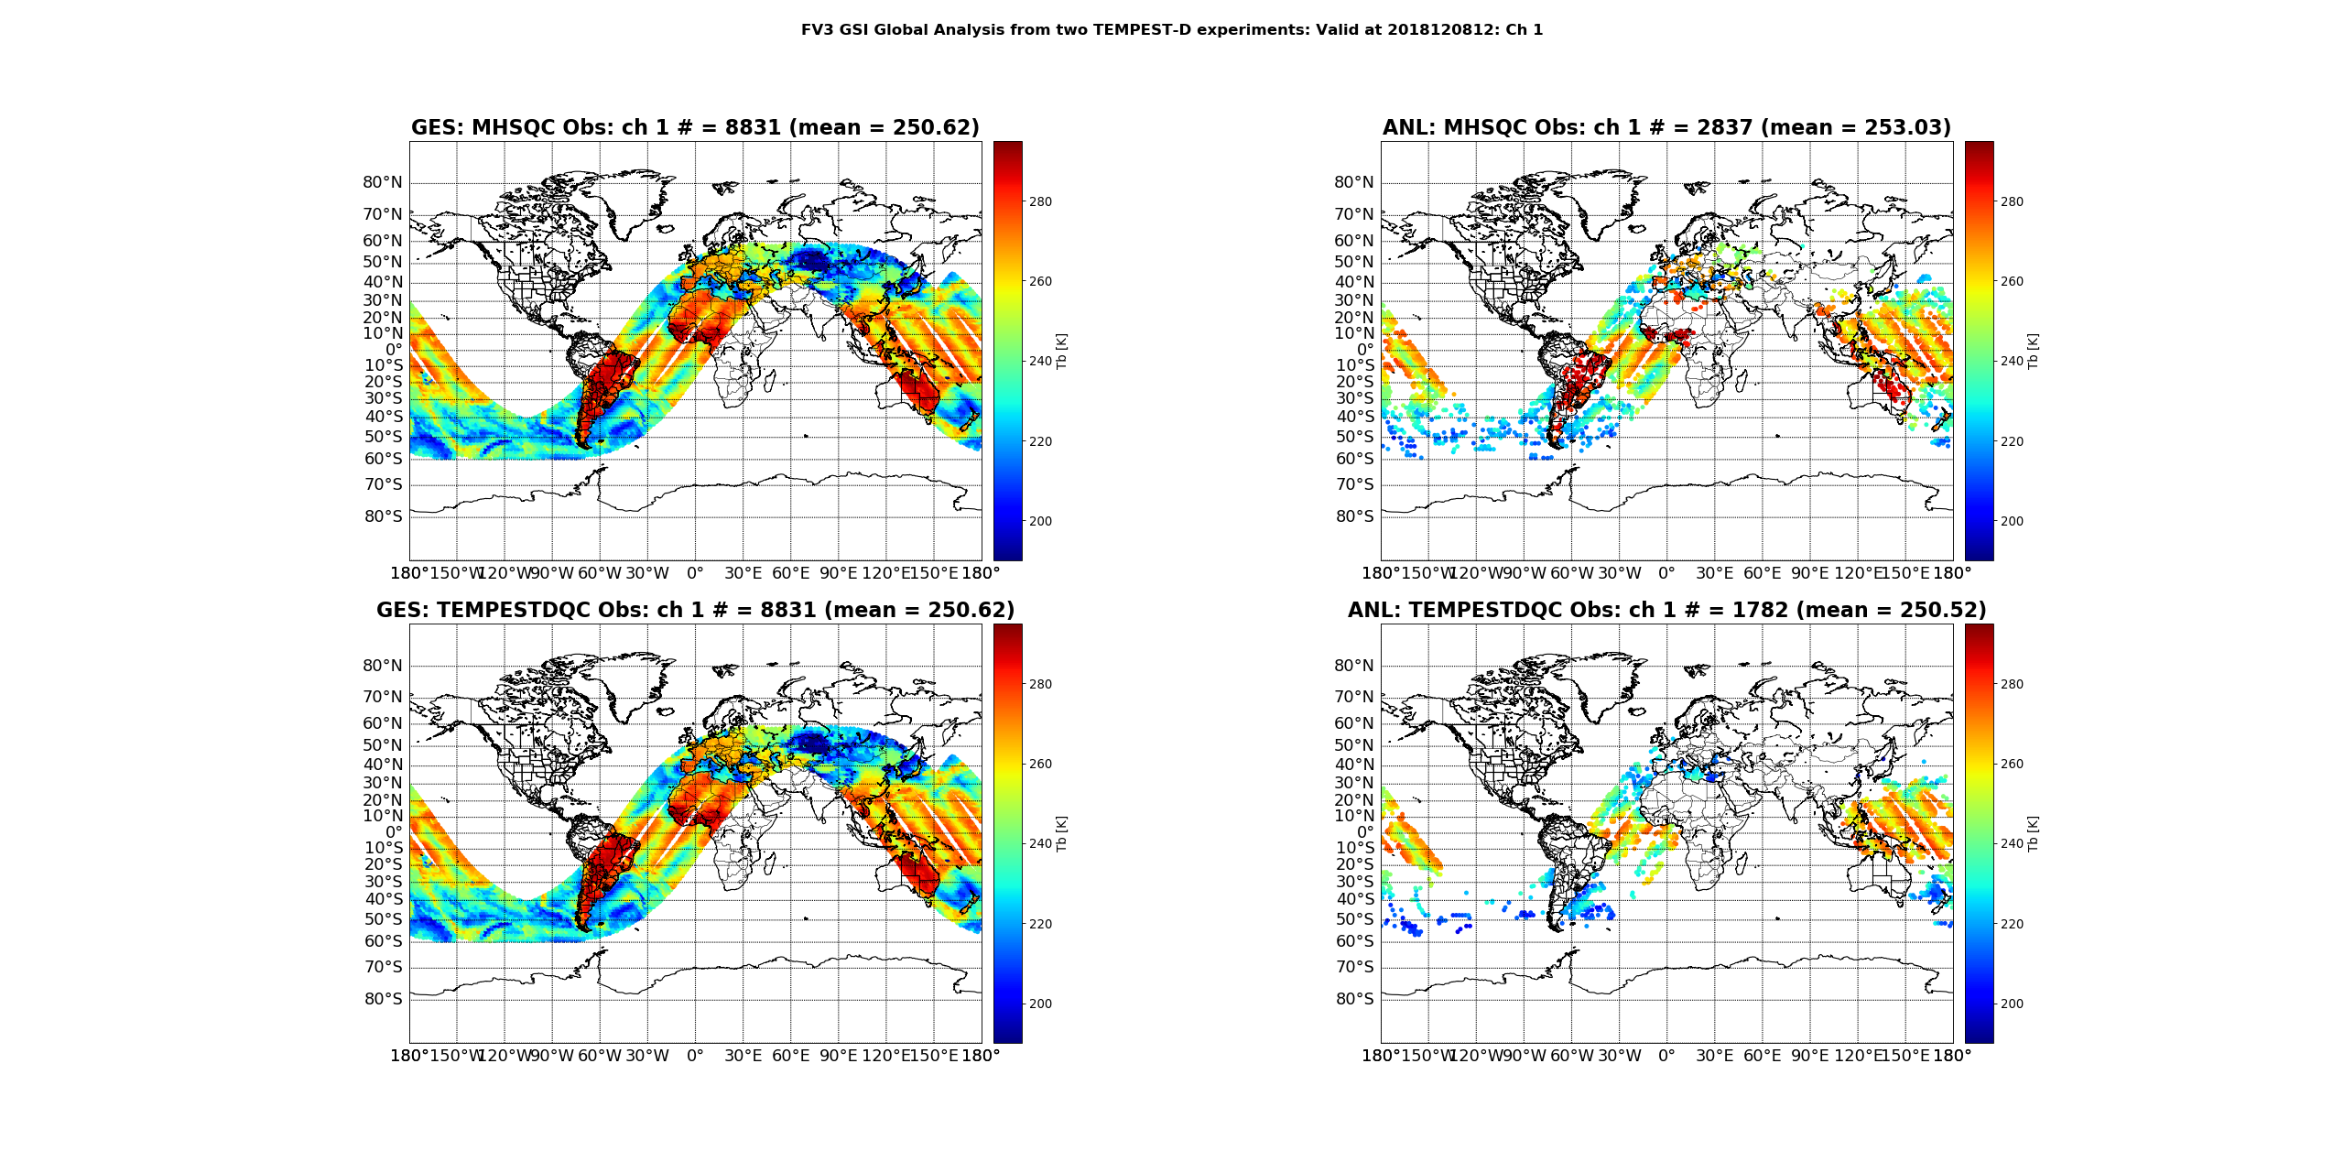
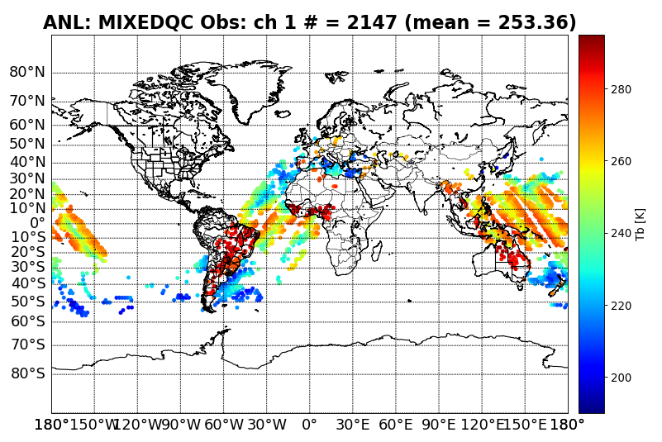
Cloud Clearing Procedure (cont.)
Use MHS Cloud Clearing for land
Use TEMPEST-D Cloud Clearing for ocean
TEMPEST-D all pixels
Use MHS Cloud Clearing
Use TEMPEST-D Cloud Clearing
An alternative TEMPEST-D cloud clearing procedure: use CSU 1DVAR TEMPEST-D Retrieved IWP and LWP (Schulte et al. 2020) and the FV3GFS first-guess IWP and LWP to screen out cloudy pixels that exceed the following thresholds:
  IWP > 0.02 kg m⁻²
  LWP > 0.015 kg m⁻²
However, the TEMPEST-D retrievals are not available over land.
In order to be consistent with the use of over land pixels from other microwave sensors currently used in GSI (e.g. MHS), we apply the MHS cloud clearing procedure on over land TEMPEST-D pixels.

Slide 9
Bias Corrections (GSI VarBC)
GSI uses a variational-based bias correction (VarBC) for satellite radiance assimilation, which allows the update of bias correction along with analysis variables as part of the cost function minimization.
Since there does not exist a set of bias correction coefficients for TEMPEST-D radiances, as a first step, bias correction coefficients from MHS are used.
In the first cycle where TEMPEST-D radiances are assimilated, MHS bias correction coefficients from the previous cycle are used in GSI VarBC to update bias correction coefficients for TEMPEST-D, which are saved and used in the second cycle. From the second cycle onward, TEMPEST-D bias correction coefficients updated from the previous cycle are used in the next cycle.
To account for calibration differences (Tb in K) between MHS and TEMPEST-D (Berg et al. 2020):
Reference Sensor | 87 GHz | 164 GHz | 174 GHz | 178 GHz | 181 GHz
MetOp-A MHS | -0.38 | -0.94 | -0.36 | 0.17 | 1.41
MetOp-B MHS | -0.37 | -1.26 | -0.82 | -0.29 | 1.21
NOAA-19 MHS | -0.45 | -1.88 | -0.77 | -0.33 | 0.35
Mean | -0.4 | -1.46 | -0.69 | -0.22 | 0.88

Slide 10
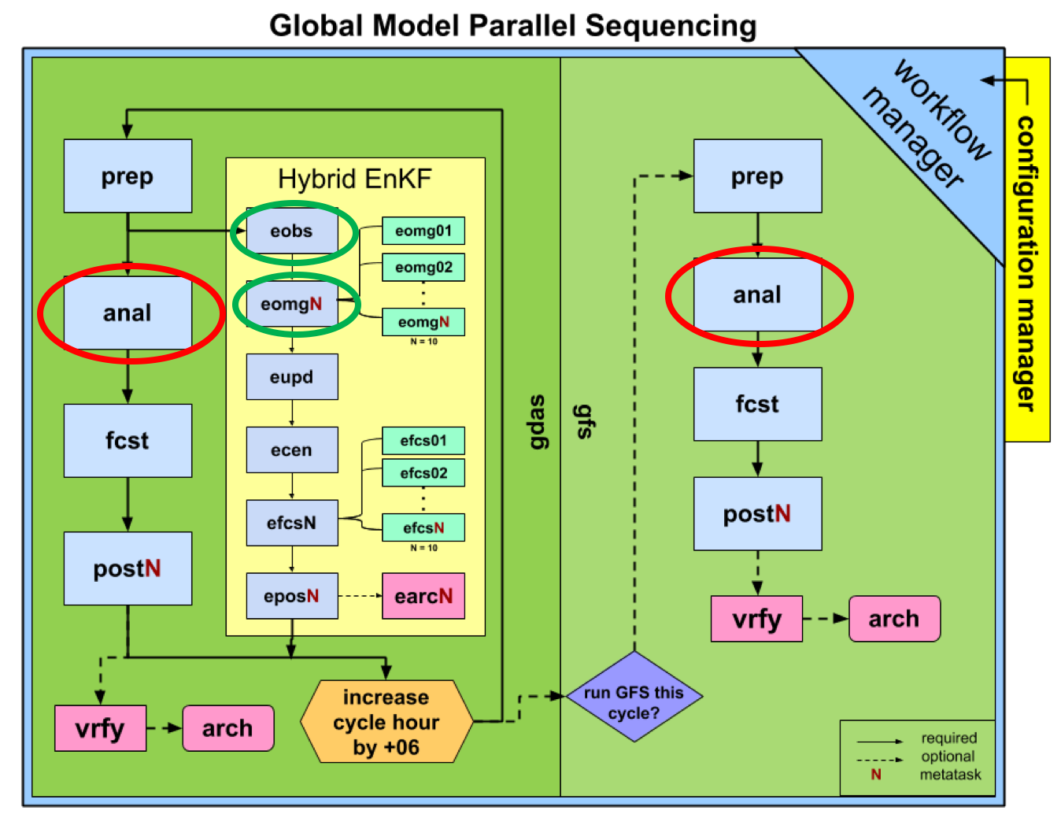
Implement Capability to Assimilate TEMPEST-D Data with GSI
A new branch of GSI was created: tempestd_dev (NOAA Vlab)
The aforementioned methodologies were implemented into tempestd_dev branch to allow the assimilation of TEMPEST-D clear-sky radiances with GSI.
We follow the NOAA Environmental Modeling Center (EMC) GFS global-workflow structure and replace the master branch of GSI with the tempestd_dev branch to facilitate the assimilation of TEMPEST-D radiances.
Credit: EMC GFS global-workflow wiki page
Call GSI for hybrid 4DEnVar analysis
Call GSI as obs operator (observer)

Slide 11
Assimilation Experiment Setup
Three cycled FV3GFS experiments for two time periods (December 8-12, 2018 and May 12-22, 2019):
  Control: assimilate all observations as operational configuration, but only include MHS from NOAA 19 and MetOp-B, and leave GMI out for verification purpose
  AddMHS: same as control, and assimilate MHS from MetOp-A
  AddTEMPESTD: same as control, and assimilate TEMPEST-D
Cycled FV3GFS experiment configuration:
  Deterministic: C384 (nlon, nlat, nlev) = (1536, 768, 64)
  Ensemble (80 members): C192 (nlon, nlat, nlev) = (768, 384, 64)
GFS (the early run) only runs at 00 and 12 UTC cycles
GDAS (the final run) runs at 00, 06, 12, and 18 UTC cycles
Only results from the December 2018 period are shown in this presentation.
Notes:
Note: GPM is left out on purpose so it can be used as an independent source of observations to be used for verification.
MHS on NOAA-18 officially died on October 21, 2018, so it is not mentioned here.

Slide 12
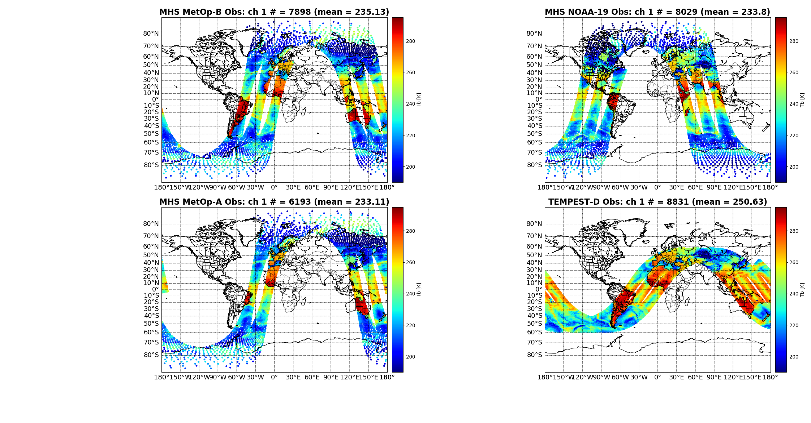
Data coverage: MHS vs. TEMPEST-D
12 UTC
8 December
2018 cycle
Control
AddMHS
AddTEMPESTD

Slide 13
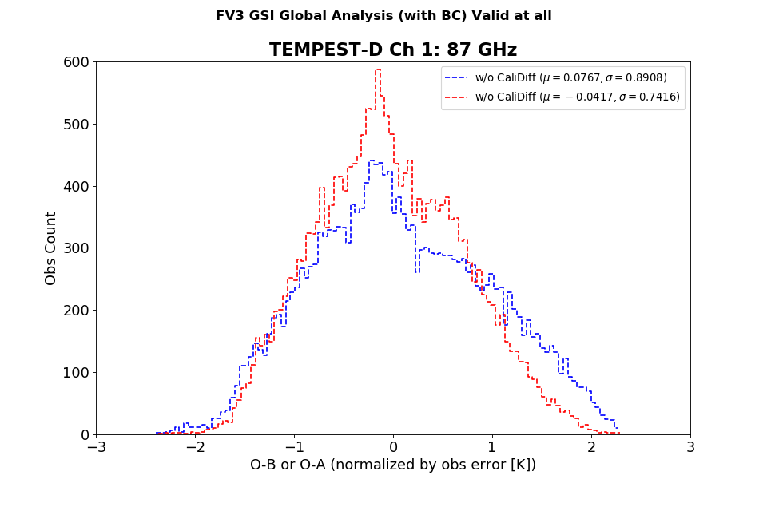
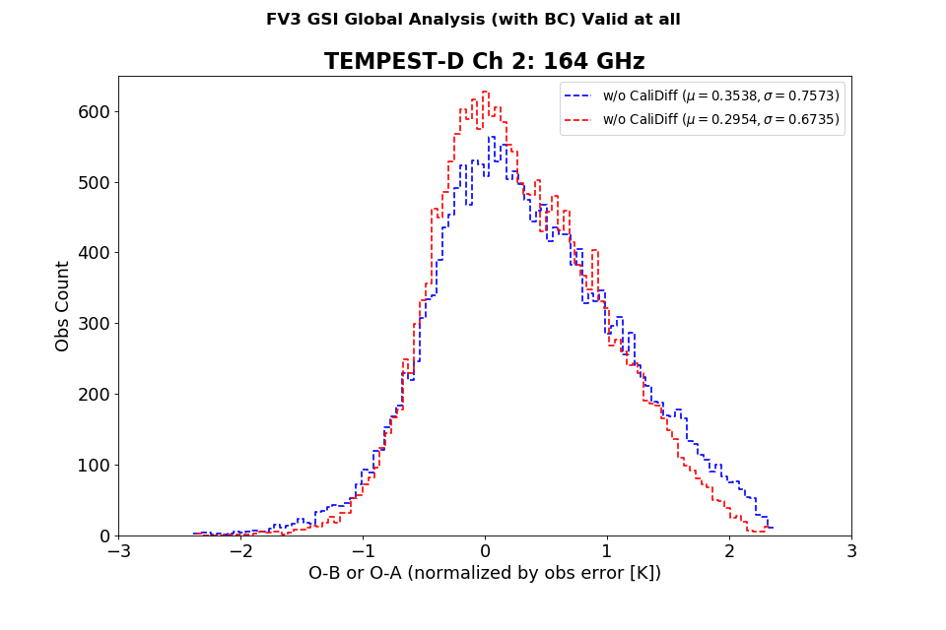
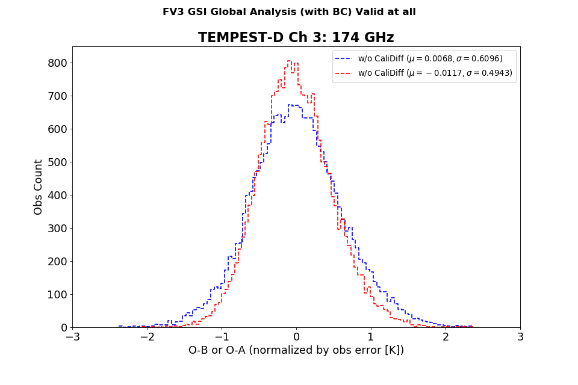
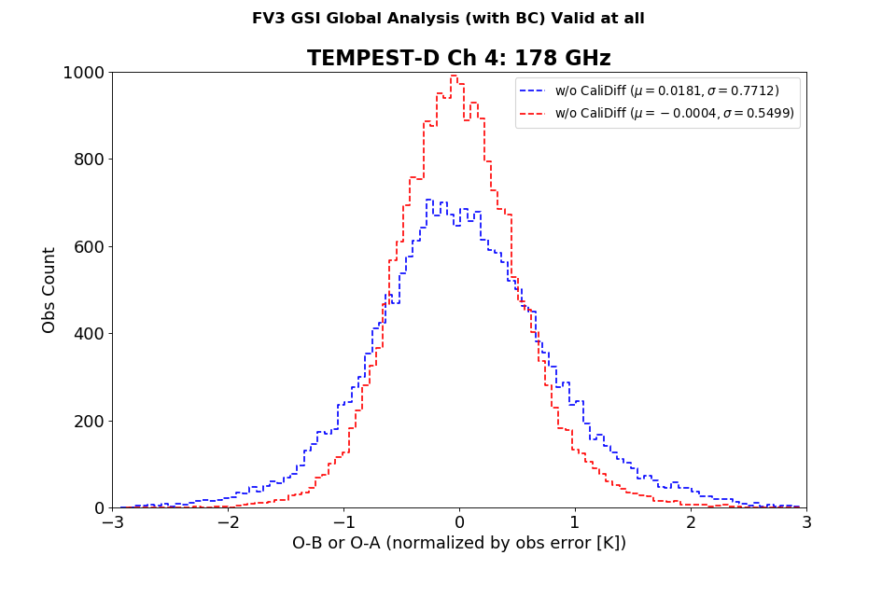
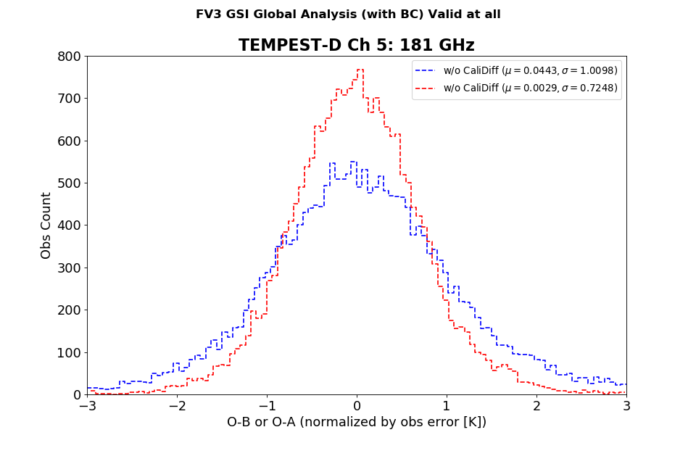
Assimilation Sanity Check: O-B vs. O-A
Observation minus background (O-B)
Observation minus analysis (O-A)
Histogram of O-B vs. O-A collected from all cycles during 8-12 December, 2018.
First cycle BC coefficients come from MHS

Slide 14
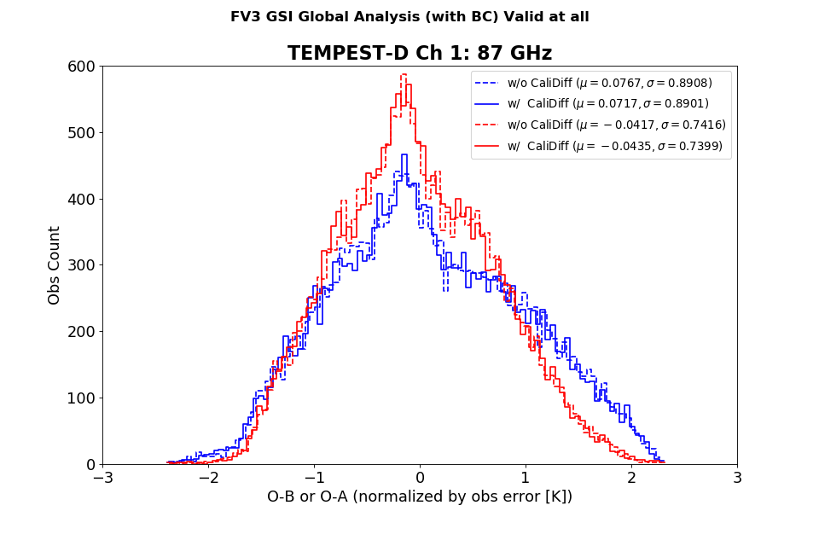
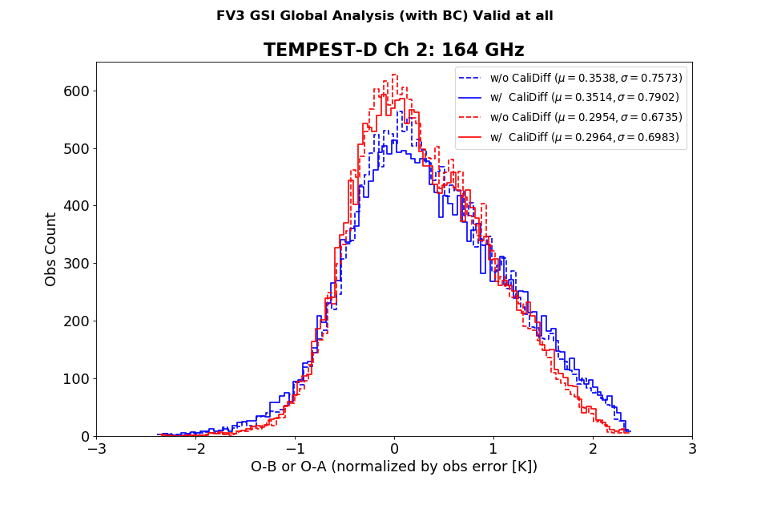
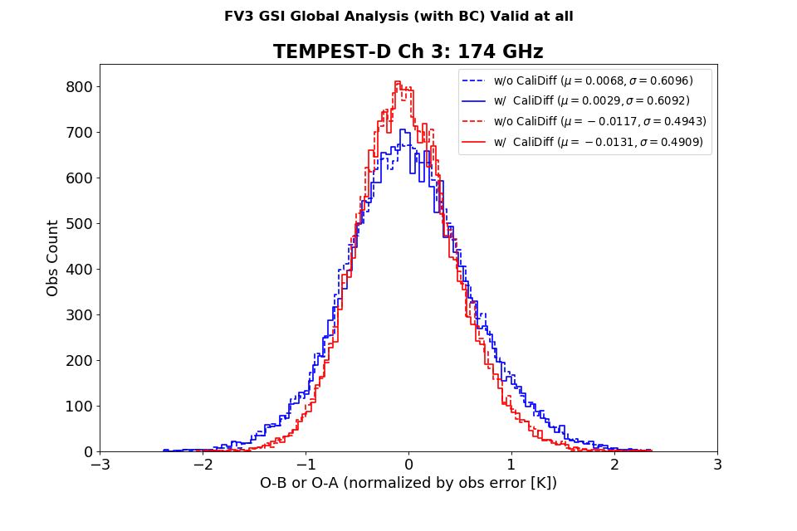
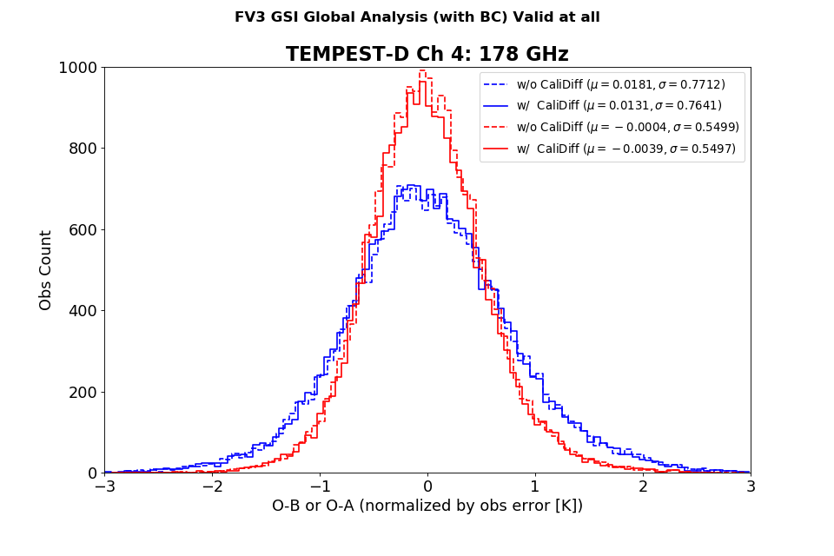
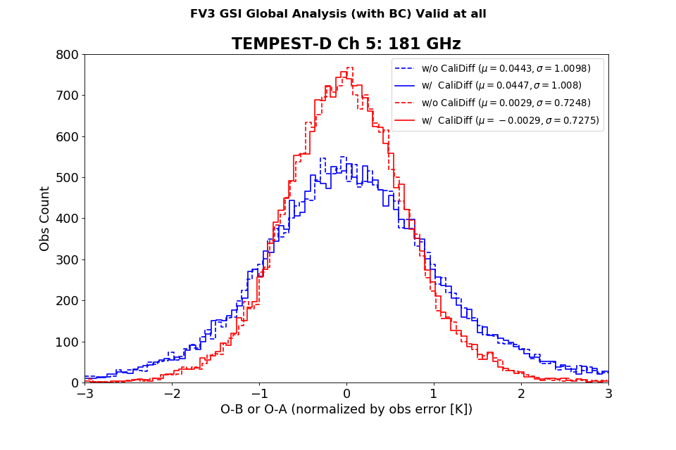
Assimilation Sanity Check: O-B vs. O-A (cont.)
Observation minus background (O-B)
Observation minus analysis (O-A)
Histogram of O-B vs. O-A collected from all cycles during 8-12 December, 2018.
First cycle BC coefficients come from MHS & we take into account calibration differences between MHS and TEMPEST-D
non-gaussian behavior
will exclude channel 2 radiances in a separate experiment ADDTEMPESTD2

Slide 15
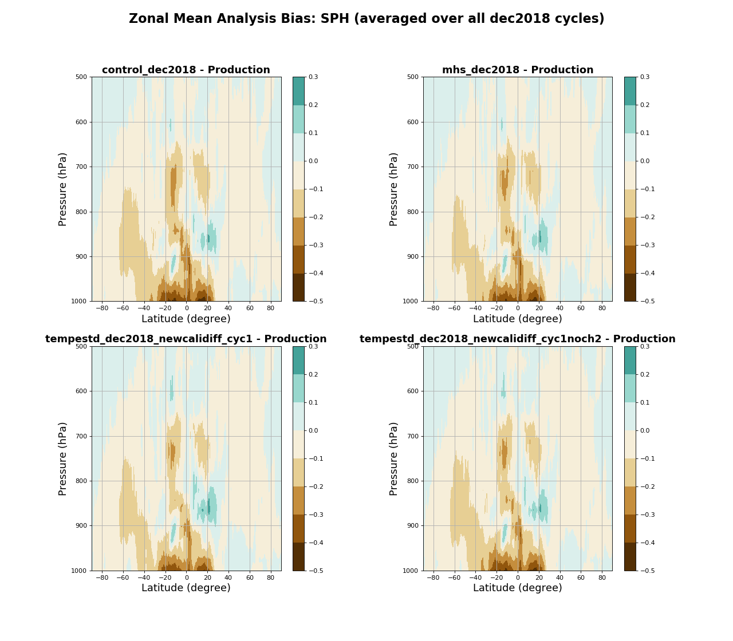
Compared to GDAS Production Analysis
Control - Production
AddMHS - Production
Zonal averaged bias of specific humidity (g/kg)
Composite bias from all cycles during December 8-12, 2018.
A pronounced dry bias in the order of 0.2-0.5 g/kg is evident in the tropical (20ºS – 20ºN) lower tropospheric layers (below 900 hPa).
It appears that the analysis resulted from assimilating TEMPEST-D clear-sky radiances has slightly reduced dry bias near surface over the tropical regions.
AddTEMPESTD - Production
AddTEMPESTD2 - Production

Slide 16
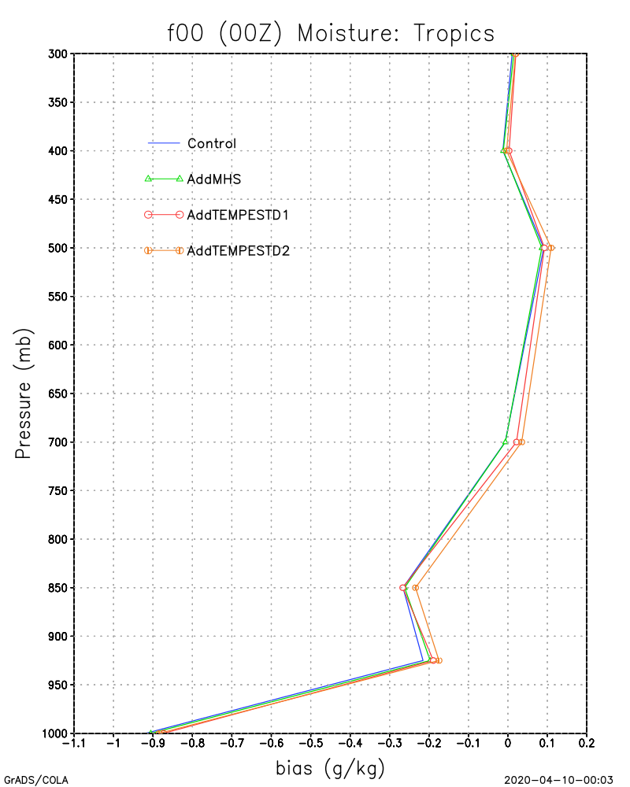
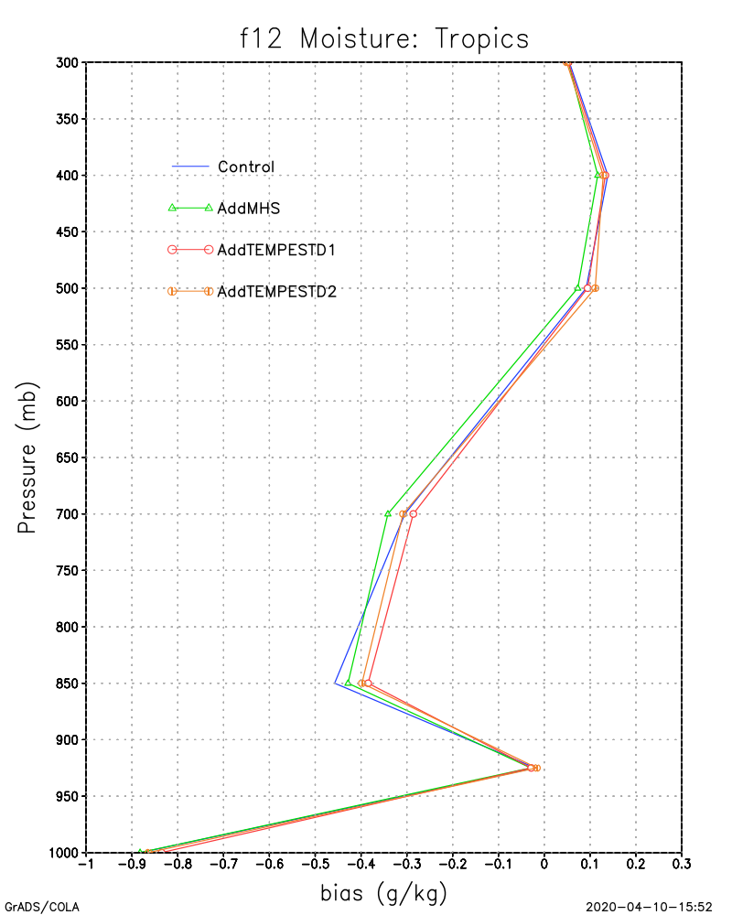
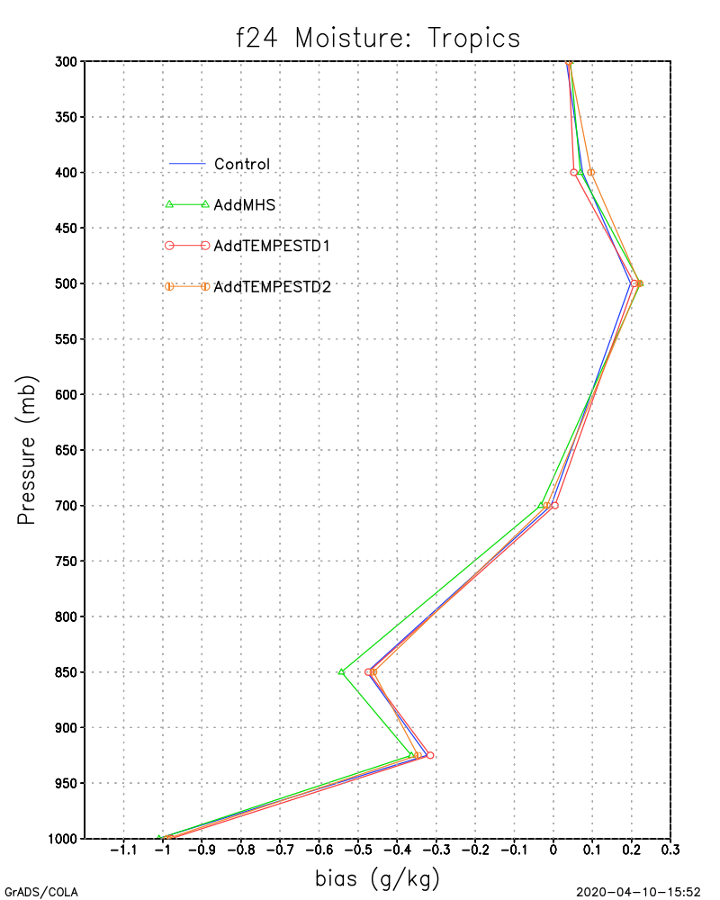
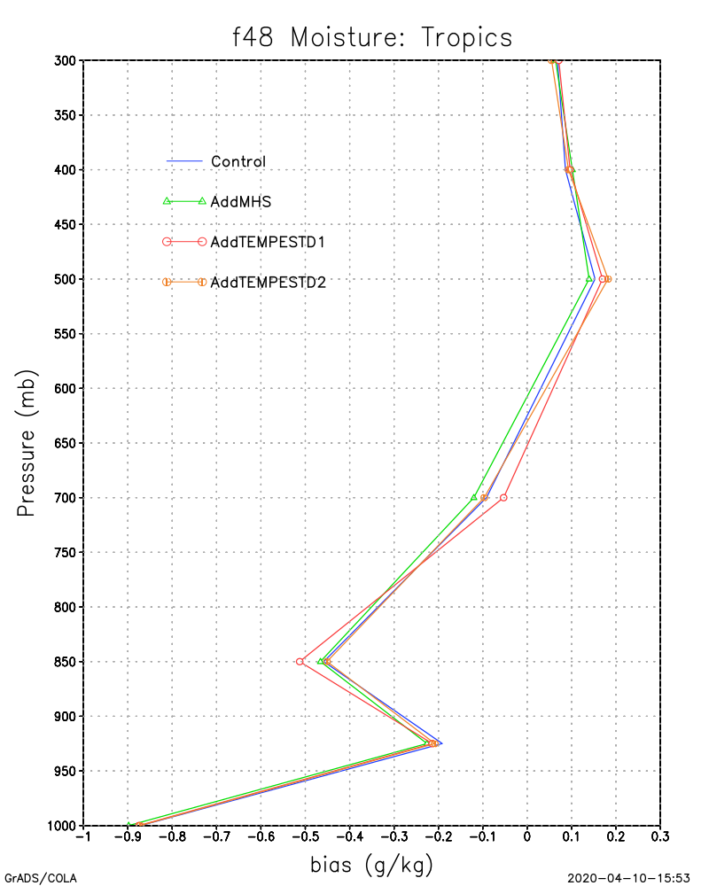
Forecast Skills: standard metrics
Fit-to-Observations: Rawinsondes over Tropical regions (20ºS – 20ºN)
The pronounced dry bias in the lower tropospheric layers is evident in the fit-to-rawinsonde comparison and persists through the first 48 hours of forecasts.
All four experiments have very similar behavior with very small differences among them.

Slide 17
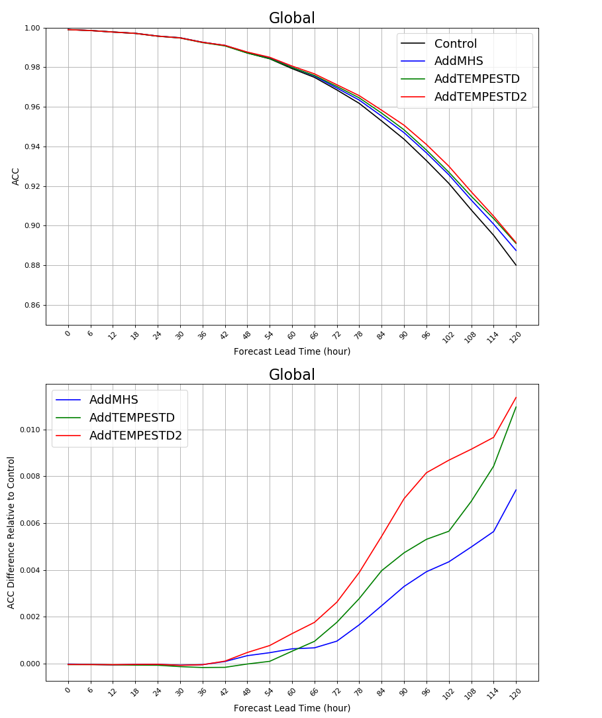
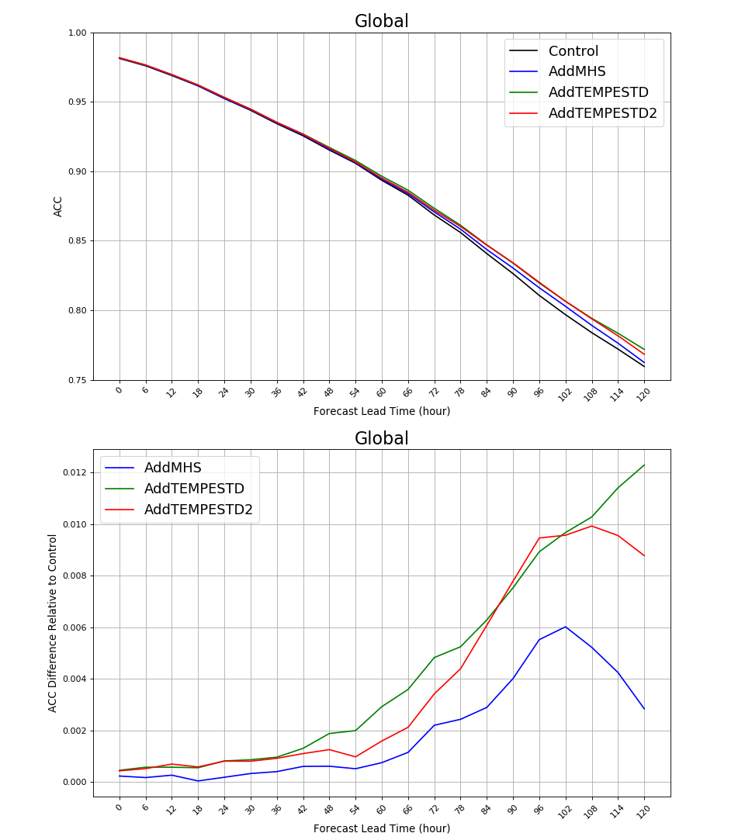
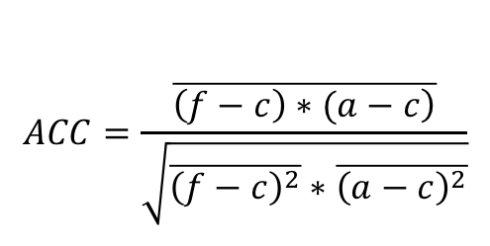
Forecast Skills: standard metrics (cont.)
Anomaly Correlation Coefficient: 500 mb Geopotential Height and TPW
$$ACC=\frac{\overline{\left.\left(f−c\right)∗(a−c\right)}}{\sqrt{\overline{{\left(f−c\right)}^{2}}∗\overline{{\left(a−c\right)}^{2}}}}$$
Global 500 mb GeoHeight ACC
Global TPW ACC
f: forecast cycled FV3GFS experiments
a: GDAS production analysis
c: NCAR/NOAA Reanalysis dataset
ACC is used to assess the quality of a forecast via measuring how well a forecast correlates with the target analysis/verification.
The three Add experiments appear to have similar forecast skills in the first 48 hours in terms of 500 mb geopotential height.
The two Add TEMPESTD experiments have slightly higher forecast scores in terms of TPW, which are likely due to the slightly reduced dry bias in the Tropical region.
Global 500 mb GeoHeight ACC: Relative to Control
Global TPW ACC: Relative to Control

Slide 18
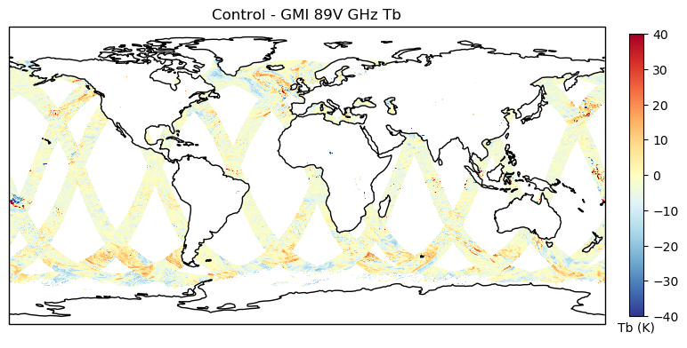
Forecast Skills: Obs vs. Synthetic GMI (work in progress)
Control Synthetic GMI –Observed GMI: 89 V GHz
Use standalone CRTM v2.2.6
Compute synthetic GMI 89V GHz brightness temperature (over ocean scenes only) using output from all four cycled FV3GFS experiments
A daily map of difference for all four experiments
Visual comparison of Synthetic-Obs GMI image suggest no noticeable difference between the Control (shown) and other three Add experiments (not shown).
No noticeable difference may also imply that assimilating TEMPEST-D produces forecasts comparable to other experiments that assimilates MHS, which supports the statement that TEMPEST-D can be a possible back up for MHS.
Notes:
By synthetic we mean, we run a standalone CRTM with input from the forecast of the FV3GFS cycled experiments to create synthetic GMI data

Slide 19
Summary and Lessons Learned
A workflow to quickly assimilate and assess impact of SmallSat data is established under the NCEP GFS framework using TEMPEST-D as a demonstration.
Cycled data assimilation and forecast FV3GFS experiments for two time period, where continuous TEMPEST-D data were available, are performed and examined.
Results, measured in standard metrics, suggest assimilating TEMPEST-D clear-sky radiances are consistent with the assimilation of MHS.
Lessons learned:
  Small satellites may not have the level of data availability required for long-term assimilation (e.g. because of downlink issues, competing scientific priorities, or satellite design), which is essential to appropriately address bias that usually requires monthly to seasonal assessment.
  Because small satellite missions do not have engineering and Cal/Val teams scrutinizing the data, the required quality control for data assimilation experiments must be discovered and applied through trial and error or connections to the instrument teams.
  Small satellite data will be provided in a variety of data formats, each of which will need to be uniquely converted to BUFR files for assimilation into GSI prior to running experiments.

Slide 20
Thank you!
Schulte, R. M., Kummerow, C. D., Berg, W., Reising, S. C., Brown, S. T., Gaier, T. C., Lim, B. H., and Padmanabhan, S. (2020). A Passive Microwave Retrieval Algorithm with Minimal View-Angle Bias : Application to the TEMPEST-D CubeSat Mission. Journal of Atmospheric and Oceanic Technology, 37, 197–210. https://doi.org/10.1175/JTECH-D-19-0163.1
Berg, W., Brown, S. T., Lim, B. H., Reising, S. C., Goncharenko, Y., Kummerow, C. D., Gaier, T. C., and Padmanabhan, S. (2020). Calibration and Validation of the TEMPEST-D CubeSat Radiometer. IEEE Transactions on Geoscience and Remote Sensing, Submitted.
Wu, T.-C., Grasso, L., Zupanski, M., Cronk, H., Fluke, J., Schulte, R., Berg, W., Kliewer, A., Kummerow, C. D., Partain, P., and Miller, S. (2020). Assessment of the Assimilation of TEMPEST-D in the NCEP Global Forecast System. In preparation for submission to Journal of Geophysical Research – Atmosphere.

