Slide 1
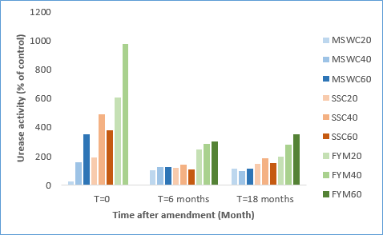
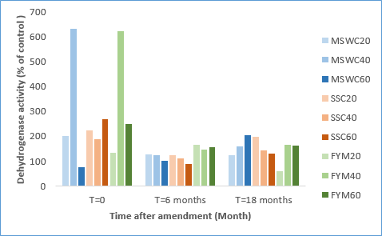
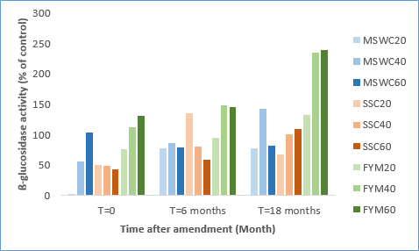
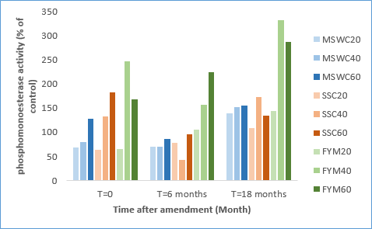
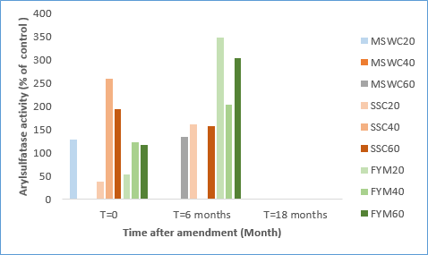
Do different organic amendments effectively improve the soil biochemical activity of very poor arid soils from Tunisia?
H. Oueriemmi^{a,b,c}, P.S. Kidd^{a†}, A. Prieto-Fernándezª, B. Rodríguezª, M. Moussa^{b}, C. Trasar-Cepedaª
ª Department of Soil Biochemistry, IIAG-CSIC, Apartado 122, E-15780 Santiago de Compostela, Spain
^{b} Institute of Arid Regions of Medenine, Tunisia
^{c} High Institute of Water Sciences and Techniques, University of Gabes, 6072 Gabes, Tunisia
INTRODUCTION
Soils from arid and semi-arid ecosystems are generally very low in organic matter content, poor in nutrients and typically with sandy texture. The application of different organic amendments has been proposed as an adequate approach to improve the quality of these soils for their use in agriculture. The use of organic wastes of different origins (agricultural, industrial, urban, etc.) as soil amendments has a dual goal: i) improving soil fertility and quality, ii) reducing the environmental problem that poses the disposal of these residues. Soil enzyme activities have been often used to investigate the impact of different amendments on soil quality, because they are highly sensitive to human or environmental perturbations. The objective of this study was to investigate, by using soil enzyme activities, the effectiveness of three organic residues (composted municipal solid waste, composted sewage sludge and farmyard manure) to improve the quality of one agricultural soil from Tunisia.
MATERIAL AND METHODS
A field trial was established for investigating the effectiveness of the three organic residues to improve the quality of one agricultural soil. The soil had a sandy texture, alkaline pH (pH 8.3) and was very poor in organic matter (0.21 and 0.03% of total C and N, respectively). Each of the organic residues was applied in triplicate at three different doses in nine sub-plots randomly distributed; three untreated sub-plots were also established for comparison. One, 6 and 18 months after the soil amendments, surface (0-20 cm) soil samples were collected from all the treated and untreated subplots. The soil samples were analysed for β−glucosidase, alkaline phosphomonoesterase, urease, arylsulphatase and dehydrogenase following the methods described in García et al. (2003). All the soil samples were also characterised for their main physicochemical properties, following the methods described by Pauwles et al. (1992).
RESULTS AND DISCUSSIONS
Addition of the three organic amendments induced slight increases of the total organic carbon and nutrients content; however, the improvements observed were generally not clearly related with the amount of applied residue (Table 1). The activity of the enzymes increased after the application of the three residues, but these increments were not clearly correlated with the dose of residue and did not consistently varied with the time elapsed after residue application. Generally, the highest increases in the activities were observed for farmyard manure-amended soils (Figure 1). The activity of urease and dehydrogenase with respect to that of the control soil tended to decrease and stabilize after 6 months, while β-glucosidase activity in all the organically-amended soils was maintained nearly constant throughout the duration of the experiment. Arylsulphatase activity was almost negligible, both in control and organically-amended soils. Generally, the highest and more stable along the time activities were found in farmyard manure-amended soils, especially with the highest dose.
Table 1. Main characteristics of the control and treated soils used for the experiment
 | pH _{H2O} | Organic C (%) | Total N (%) | C/N
CNT | 8.3 ± 0.1 | 0.21 ± 0.0 | 0.03 ± 0.0 | 7.2 ± 0.1
MSWC-20 | 8.2 ± 0.0 | 0.31 ± 0.0 | 0.03 ± 0.0 | 9.9 ± 0.2
MSW-40 | 8.5 ± 0.1 | 0.39 ± 0.0 | 0.03 ± 0.0 | 11.4 ± 0.3
MSW-60 | 8.2 ± 0.1 | 0.50 ± 0.0 | 0.04 ± 0.0 | 13.3 ± 0.2
FYM-20 | 8.5 ± 0.1 | 0.38 ± 0.0 | 0.03 ± 0.0 | 11.2 ± 0.6
FYM-40 | 8.5 ± 0.1 | 0.49 ± 0.0 | 0.04 ± 0.0 | 12.8 ± 0.1
FYM-60 | 8.5 ± 0.1 | 0.77 ± 0.0 | 0.04 ± 0.0 | 18.2 ± 0.2
SSC-20 | 8.1 ± 0.1 | 0.34 ± 0.0 | 0.04 ± 0.0 | 9.6 ± 0.3
SSC-40 | 8.2 ± 0.1 | 0.44 ± 0.0 | 0.04 ± 0.0 | 10.8 ± 0.3
SSC-60 | 8.1± 0.1 | 0.80 ± 0.0 | 0.04 ± 0.0 | 17.8 ± 0.2
Table 2 . Main characteristics of the organic materials used for the experiment
Organic materials | MSWC | FYM | SSC
pH _{H2O} | 7.6 ± 0.0 | 8.7 ± 0.0 | 6.2 ± 0.0
CT¹ | 7.2 ± 0.0 | 28.9 ± 1.9 | 22.5 ± 1.1
NT¹ | 0.5 ± 0.0 | 1.2 ± 0.0 | 1.9 ± 0.1
Dehydrogenase² | 0.1 ± 0.0 | 2.7 ± 0.3 | 1.6 ± 0.1
Urease³ | 3.3 ± 0.2 | 93.7 ± 0.0 | 6.2 ± 0.1
β-glucosidase⁴ | 0.1 ± 0.1 | 0.1 ± 0.0 | 0.5 ± 0.0
.
¹ %; ² µmol INTF g⁻¹ h⁻¹; ³ μmol NH₃ g⁻¹ h⁻¹; ⁴ μmol PNP g⁻¹ h⁻¹
CONCLUSIONS
Figure 1. Effect the of organic residues on soil enzyme activities (expressed as percentage of the activity in control plot)
The application of the three organic residues increased the activities of the four hydrolases involved in C, N, P cycles investigated and that of dehydrogenase (an enzyme reflecting the soil microbial activity, but the effect was not equally maintained throughout the time for all the enzyme activities.
The effect on soil hydrolases and on microbial activity of any of the three residues was not very strong nor very slight, nor clearly related with the amount of residue applied.
Farmyard manure, the residue with the highest organic matter content and biological activity, appeared as the most promising organic residue to increase fertility and quality in these very poor soils.
REFERENCES
ACKNOWLEDGMENTS
García C., Gil F., Hernández T., Trasar C. (2003) Técnicas de Análisis de Parámetros Bioquímicos en Suelos: Medida de Actividades Enzimáticas y Biomasa Microbiana, Ediciones Mundi-Prensa, Madrid, 371 p.
Pauwels JM, Van Ranst E, Verloo M, Mvond ZEA. (1992) Manuel de laboratoire de pédologie: Méthodes d’analyse des sols et des plantes”. Publications agricoles – 28. AGCD, Bruxelles.
This research was financially supported by the Xunta de Galicia (IN607A 2017/6), UE Interreg-Sudoe program (SOE1/P5/E0189 project). This work funded by The Institute of Arid Regions, Tunisia.

