Slide 1
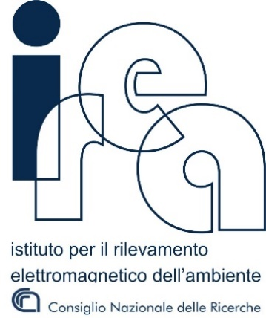
Drone based visual inspections, Infrared Thermography investigations and GPR surveys of the Roman masonry bridge Ponte Lucano, Tivoli, Italy
G. Ludeno¹, C. Biscarini², I. Catapano¹, N. Cavalagli³, F.A. Pepe³, and F. Ubertini3
Institute for Electromagnetic Sensing of the Environment, National Research Council of Italy, Naples, Italy
University for Foreigners of Perugia, UNESCO Chair \Water Resource Management and Culture", Perugia, Italy
Department of Civil and Environmental Engineering, University of Perugia, Perugia, Italy

Slide 2
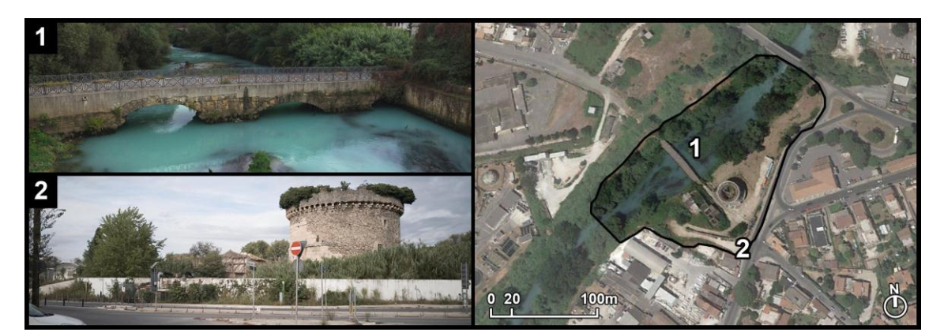
Roman bridge: Ponte Lucano
The case study regards the cooperative use of non-destructive contactless diagnostic technologies as a tool to enhance the amount of information useful to evaluate the structural and material degradation of historical assets.
UAV 3D photogrammetric surveys, allows us a visual inspections of the bridge
Infrared thermography (IRT) allows us to characterize the thermal profile of the bridge and detect its most humid parts
Ground Penetrating Radar (GPR) used to improve knowledge of the bridge subsurface structure

Slide 3
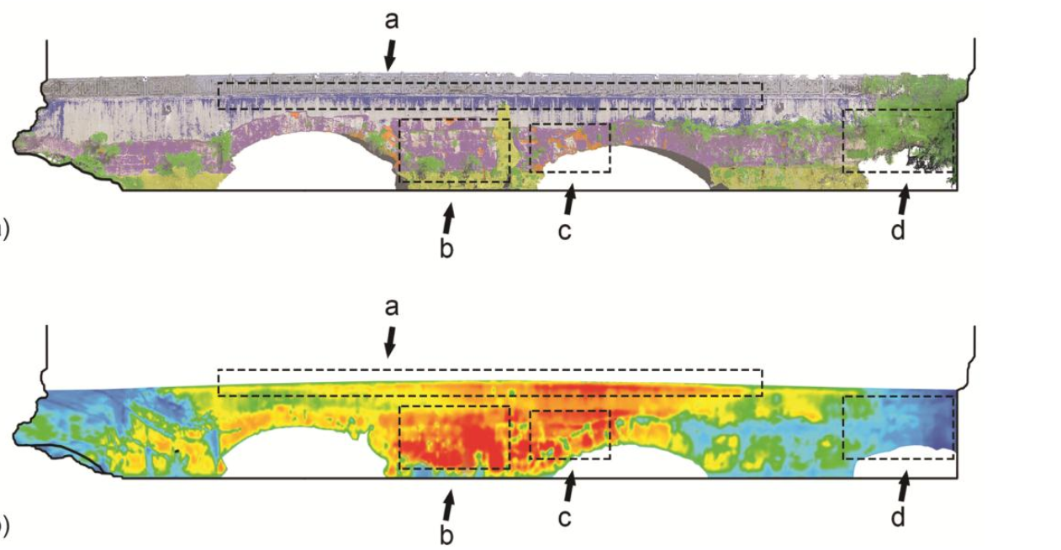
UAV 3D photogrammetry and IRT
UAV 3D photogrammetry
Infrared thermography
The images highlight interesting links between the color maps identifying the material degradation (UAV 3D photogrammetry) and the superficial temperature observed through thermography.

Slide 4
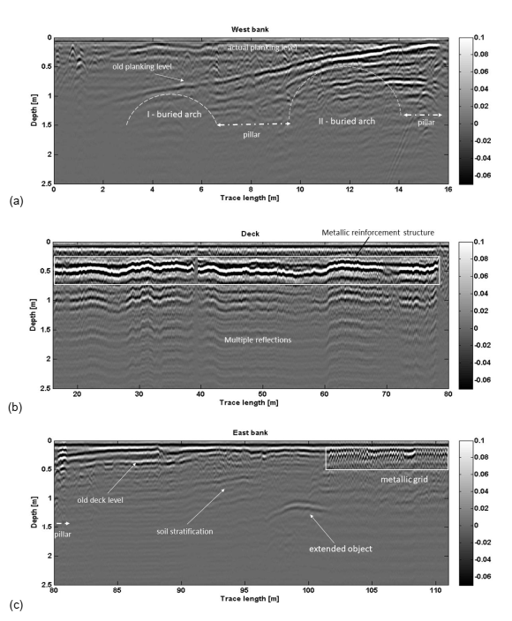
GPR
Figure (a) corresponds to the North side of the bridge and shows the presence of buried structures, which could be the structural elements of the ancient bridge covered by the deposit materials of the river banks.
Figure (b) shows the radargram portion corresponding to the current out-of-banks bridge and allows the localization of the deck level, the arrangement of the stone pavement and the concrete reinforcement structure, which appears at a depth of about 0.5 m.
Figure (c) shows the radargram corresponding to the East side. The old deck level of the bridge appears at x from 82m to 102m at depth ~0.4m. The presence of a reinforcement metallic grid appears from x = 102 m up to the end of the radargram at a depth from 0.20 m to 0.50 m.
Portions of the 600 MHz filtered radargram: (a) West bank; (b) Actual deck; (c) East bank

Slide 5
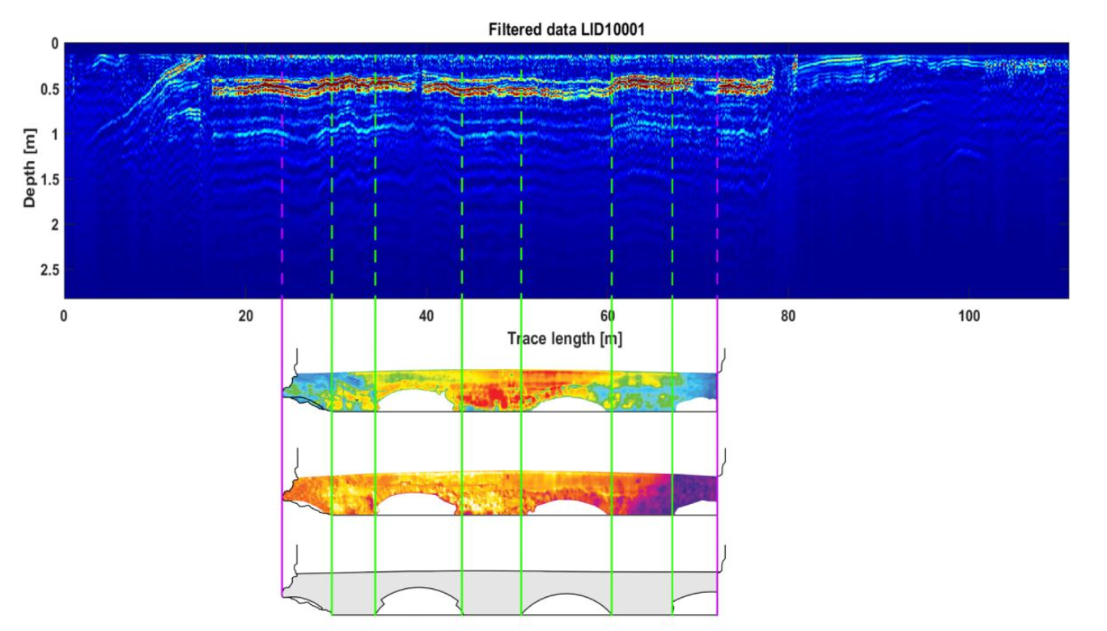
GPR and IRT
The metallic reinforcement structure does not appear at a constant depth and this suggests that where an increased depth is experienced the relative permittivity is higher than the adopted average value. This is coherent with an increased water content. Moreover a soft signal attenuation is observed over the middle arch, while a significant signal attenuation occurs over the first arch of the East side

Slide 6
CONCLUDING REMARKS
Visual inspections via unmanned aerial photogrammetry, as well as thermographic and GPR analysis have been carried out in order to generate a “solid” link between the optical and qualitative analysis.
This work contributes to demonstrating that innovative contactless non-destructive diagnostic tools can work synergistically and provide precious information to aid structural evaluation and guide the design of restoration interventions on landmark historic masterpieces, in a context of preventive conservation of architectural heritage. The illustrated methodology can be extended to a large sample of bridges, which have an important infrastructural function in connecting urban areas, beyond their historical and monumental value.
The presented materials is published in "UAV Photogrammetry, Infrared Thermography and GPR for Enhancing Structural and Material Degradation Evaluation of the Roman Masonry Bridge of Ponte Lucano in Italy", by C. Biscarini, I. Catapano, N. Cavalagli, G. Ludeno, F.A. Pepe, F. Ubertini, accepted for publication in NDT&E International – Special Issue in “Data Fusion, Integration and Advances of Non-Destructive Testing Methods in Civil and Environmental Engineering”.

Slide 7
Thank you all for your attention

