Slide 1
Integrating water isotopes and cosmic ray sensor data with modelling to understand near-surface storage-discharge relationships in managed landscapes
Katya Dimitrova-Petrova *
Josie Geris
Mark Wilkinson
Allan Lilly
Rafael Rosolem
Lucile Verrot
Chris Soulsby
* k.dimitrovap@abdn.ac.uk

Slide 2
Near-surface storage
Runoff generation
Food production
Buffering capacity to extremes

Slide 3
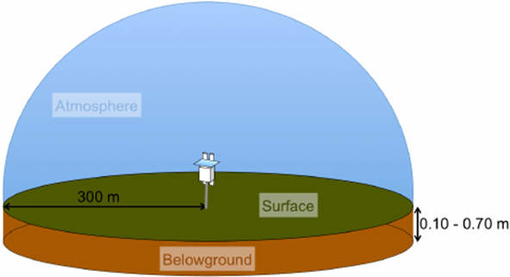
Near-surface storage
Full characterisation is challenging: a combination of methods recommended
δ²H
Water isotopes & transit time modelling:
Timescale of dominant stores and flow paths
Cosmic ray neutron sensor (CRNS):
Large scale near-surface storage dynamics
~ 14ha

Slide 4
Aim and objectives
Aim: Improve understanding of near-surface storage dynamics and their relationship to catchment runoff in a humid managed landscape
Objectives:
Assess spatial patterns and timescales of dominant (subsurface) stores and flow pathways using isotope approaches
Understand catchment scale Near Surface Storage (S_{NS}) dynamics
c) Improve rainfall runoff modelling by including S_{NS} in model calibration

Slide 5
Study site & Methods
Gleys
Podzols
Elsick catchment (~10km²), 90-165 m.a.s.l., NE Scotland, UK
Precipitation 800 mm y⁻¹
PET 350 mm y⁻¹
Peaty podzols
Mobile soil water

Slide 6
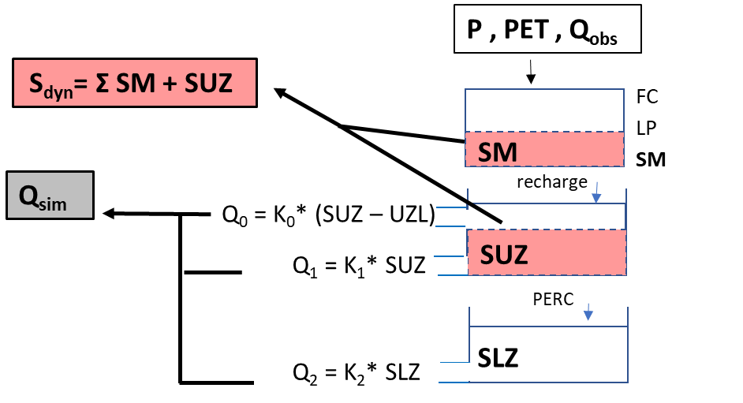
Study site & Methods
Gamma distribution model, Kirchner 2000
Young water fractions,
(<60 days in age)
Kirchner 2016
From: McGuire & McDonnell, 2006
Mobile soil water

Slide 7
Greater isotopic variability during wetter conditions

Slide 8
Stable water isotopes revealed fast and homogeneous responses across soil units and sub-catchments

Slide 9
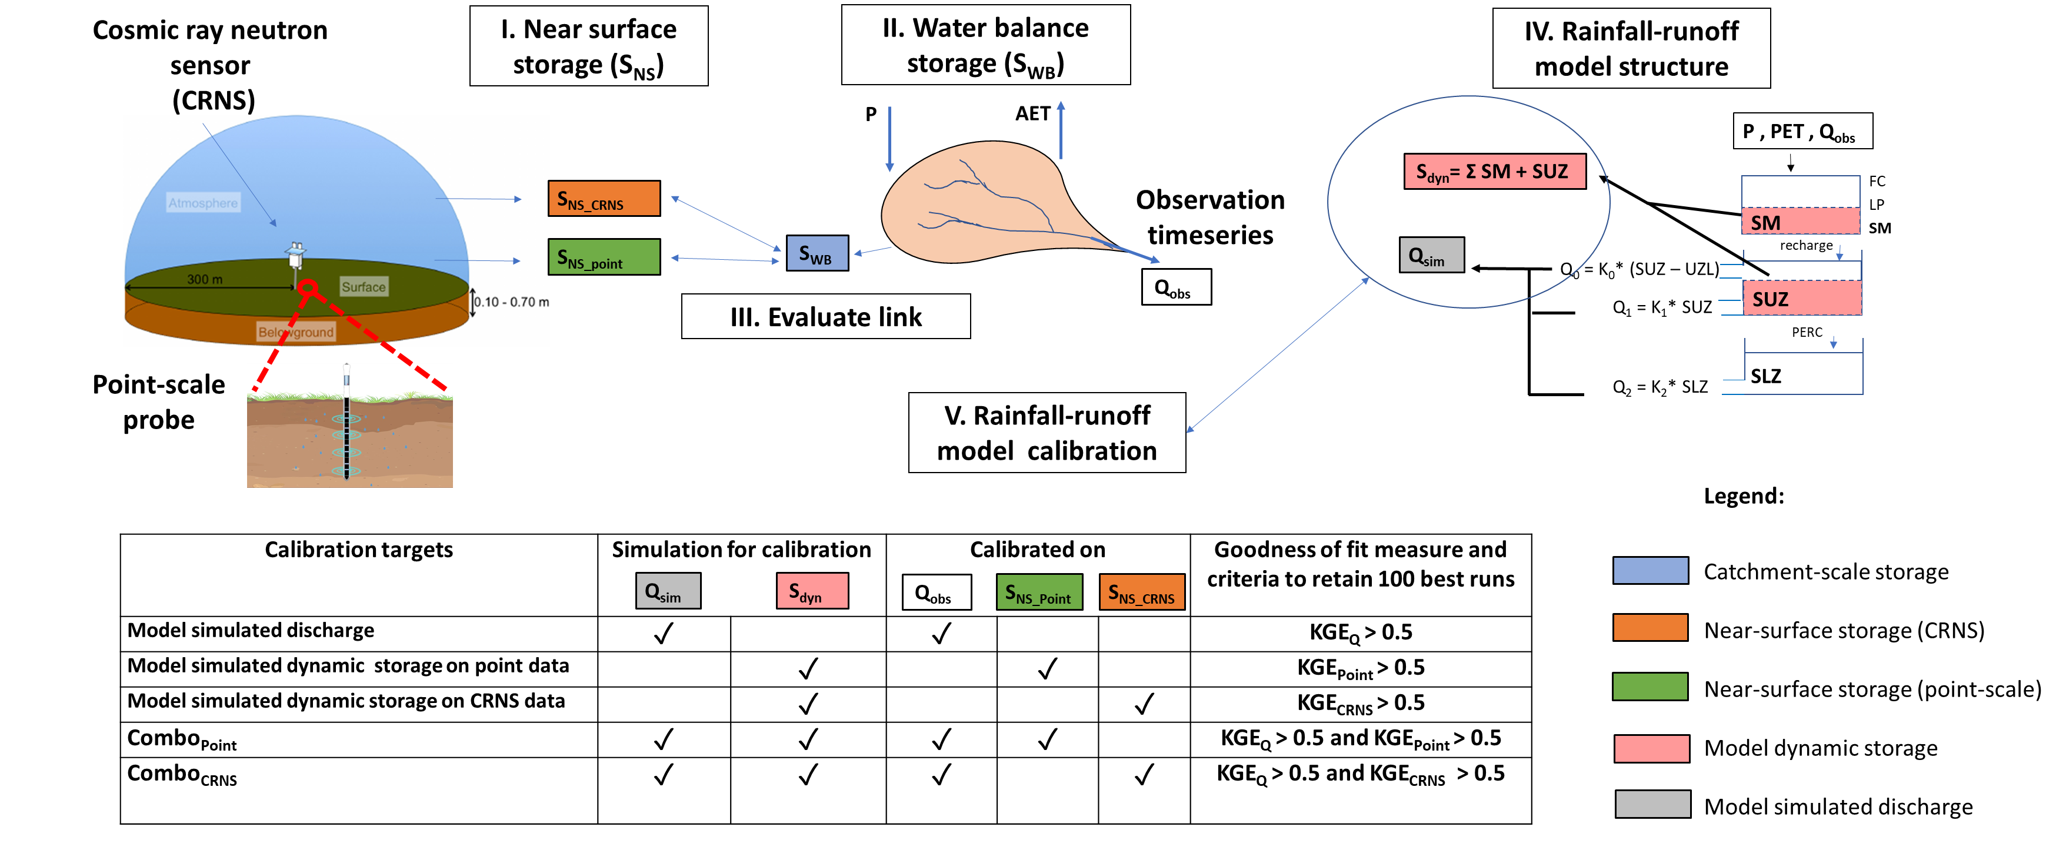
CRS-near surface storage in rainfall-runoff modelling
0-40 cm

Slide 10
CRS near-surface storage related well to catchment scale storage and stream discharge

Slide 11
Model calibration including CRS near-surface storage improved model catchment internal dynamics

Slide 12
Conclusions
Distributed agricultural management produced generally homogeneous responses.
Near-surface processes play important role in regulating streamflow generation.
A combination of approaches and observation scales helped to better understand the hydrological functioning of humid managed landscapes.

Slide 13
Want to know more?
Dimitrova-Petrova, K., Geris, J., Wilkinson, M. E., Lilly, A., & Soulsby, C. (2020). Using isotopes to understand the evolution of water ages in disturbed mixed land-use catchments, Hydrological Processes, (August 2019), 1–19. https://doi.org/10.1002/hyp.13627
Dimitrova-Petrova, K., Geris, J., Wilkinson, M. E., Rosolem, R., Verrot, L., Lilly, A., & Soulsby, C. (2020). Opportunities and challenges in using catchment-scale storage estimates from cosmic ray neutron sensors for rainfall-runoff modelling. Journal of Hydrology, 124878. https://doi.org/10.1016/j.jhydrol.2020.124878

