Slide 1
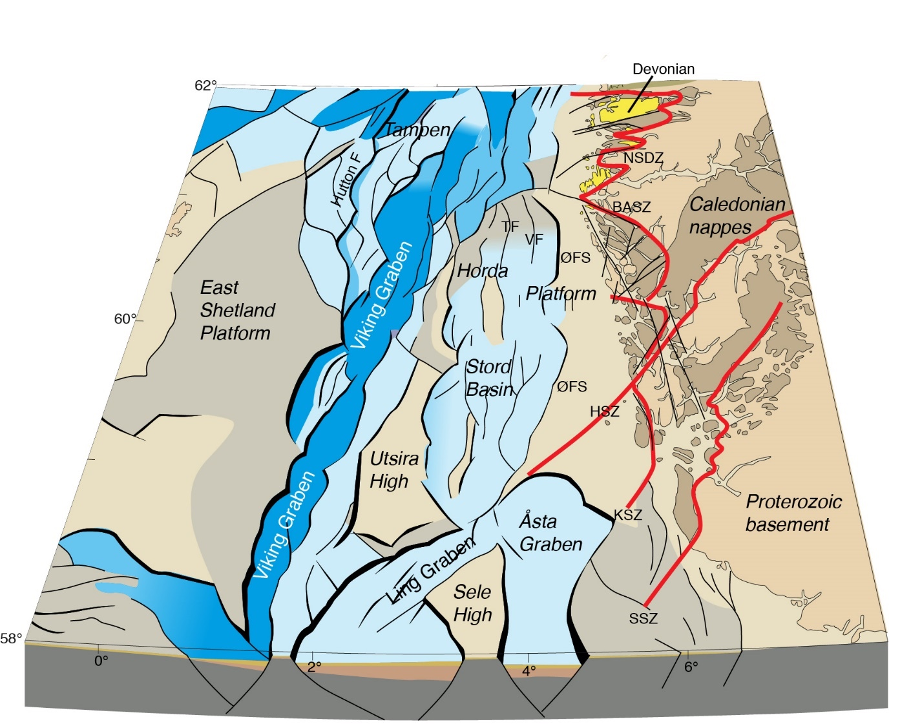
Do Pre-Existing Basement Structures Influence the Geometry and Growth of Normal Faults and Rifts?
Christopher Jackson¹, Luca Collanega², Thomas Phillips¹,
Hamed Fazlikhani³, Antje Lenhart¹, Edoseghe Osagiede³, Catherine Siuda¹, Matthew Reeve¹, Oliver Duffy¹,
Rebecca Bell¹, Atle Rotevatn³, Craig Magee¹, Robert Gawthorpe³, Alexander Coleman¹, Paul Whipp¹, Thomas Kristensen³,
Haakon Fossen³, Anna Breda², Nicola Marsh⁴
¹Basins Research Group (BRG), Department of Earth Science & Engineering, Prince Consort Road, London, SW7 2BP, UK
²Dipartimento di Geoscienze, University of Padova, Via G. Gradenigo, 6, 35131 Padova, Italy
³Geodynamics and Basin Studies Group, Department of Earth Science, University of Bergen, 5020 Bergen, Norway
⁴Aker BP, Føniks, Munkegata 26, Trondheim, Norway
email: c.jackson@imperial.ac.uk
Notes:
Continental rifting is often considered in terms of extension of relatively homogeneous lithosphere. However, continental lithosphere is considerably more complex than envisaged in these idealised models, typically containing a range of structures imparted by previous tectonic events. These structures span a range of scales; from large-scale crustal sutures and orogenic belts, to structures formed at the grain- and even micro-scale. Such pre-existing heterogeneities may; i) reactivate during later tectonic events; ii) act as nucleation sites for later rift-related faults; and iii) localise and modify the regional stress field; thus fundamentally modifying the physiography and evolution of overlying rifts. Field, seismic and potential field data indicate that the reactivation of intrabasement structures may influence the development of rift systems, an observation further supported by numerical and analogue modelling. interactions, primarily due to difficulties in imaging and constraining the 3D geometry of the intrabasement structure. For instance, in seismic reflection data, crystalline basement often appears acoustically transparent due to typically low internal impedance contrasts and large burial depths. Although intrabasement structures have previously been imaged using deep seismic reflection data, these studies have sparse data coverage and are unable to resolve the required detail and 3D geometry of said structures, particularly at upper crustal levels. In addition, interpretations based upon potential field data may be non-unique and of relatively low resolution, with these data typically unable to image discrete structures. In contrast, discrete structures can be analysed in some detail in the field, although these data may not be of sufficient extent to permit truly three-dimensional analysis of large-scale structure.
Despite their importance, the geometry and composition of crystalline basement are largely neglected or simply considered homogeneous in analogue and numerical models; as such, these properties are not explicitly represented in tectono-stratigraphic models of rift development. A better understanding of basement heterogeneity will, however, allow us to: (1) construct more realistic physical and numerical models of rift tectono-stratigraphic development; (2) understand how basement properties control structural inheritance in a range of tectonic settings (e.g., rifts, orogenic belts); and (3) better account for heat-flow variations and impacts in numerical models of basin geodynamics. Our study is also timely, given that intrabasement hydrocarbon plays related to fractured and weathered crystalline basement are becoming increasingly important in the northern North Sea; this has driven interest in the nature and three-dimensional (3-D) geometry of intrabasement structures.

Slide 2
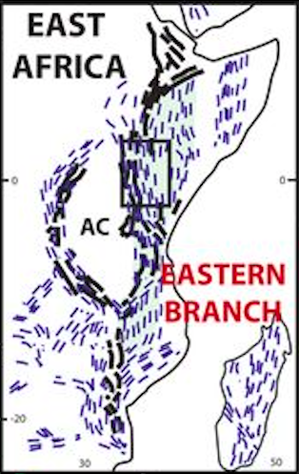
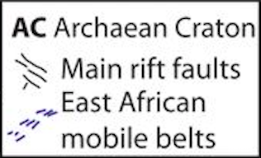
Rationale
Physical models
Natural examples – basin-scale
Natural examples – rift-scale
500 km
Henza et al. (2011)
Phillips & McCaffrey (2019)
Robertson et al. (2015)
Notes:
Determining the sources of crustal reflectivity, and mapping crystalline basement structure and composition require a holistic approach, drawing on a range data types, methods, and scales of observation (e.g. cm-scale physical models to continent-scale natural examples)
Seismic-scale variations in crystalline basement lithology typically produce small impedance contrasts due to minor differences in seismic velocity and density, and do not produce prominent reflections in seismic reflection data. In conjunction with the typically large burial depths of crystalline basement beneath rifts, intrabasement structures are often poorly resolved on seismic reflection data.
However, imaging of crystalline basement may be improved within areas of shallow basement. In addition, intrabasement reflectivity may be enhanced through constructive interference within layered sequences, such as those observed between highly strained mylonite zones and less deformed country rock. Interpretation confidence can be increased given basement-penetrating wells sample Caledonian and Proterozoic crystalline basement, confirming that the mapped deep reflectivity is within crystalline basement.
The geometry and extent of intrabasement reflections also do not mimic that of any reflections in the overlying cover, thus we can readily argue they are not multiples; the intrabasement reflections are also visible across independent seismic datasets, suggesting that they represent real geological boundaries rather than an acquisition- or processing-related geophysical artefact.

Slide 3
Constraining Pre-Rift Basement Structure
Lenhart et al. (2019)
Notes:
Due to its long history of hydrocarbon exploration and production, the northern North Sea rift, the type example of a multiphase rift system influenced by structural inheritance, is the ideal natural laboratory in which to study how preexisting structures and multiple phases of rifting influence the geometric and kinematic development of rifts.
The northern North Sea contains an abundance of geophysical and geological data, including near‐complete coverage by 2‐D (29 2‐D seismic reflection surveys with a total line length of ~315,000 km total length and covering c. 100,000 km2), and 3‐D seismic reflection data, and >6000 boreholes (72 wells penetrate crystalline basement). Seismic line spacing is typically ~3 km and lines image down to ~9s TWT, allowing us to constrain deeper structures and thus the early rift history. The dominant intrabasement frequency within the 2D seismic data is c. 20 Hz; using an interval velocity of 6100 ms1 for crystalline basement.
The geodynamic history and lithological composition of the Proterozoic basement, Caledonian nappes, and Devonian extensional basins and shear zones of onshore west Norway are relatively well-constrained (left). The crystalline basement resulted from terrane accretion during the Sveconorwegian and Caledonian orogenies, the latter culminating in SE-directed thrusting of allochthonous nappes onto the subducting margin (Western Gneiss Region; WGR). Early to Middle Devonian postorogenic extension (ca. 400 Ma) resulted in W- to WNW-directed backsliding of the nappe pile along a reactivated low-angle Caledonian decollement zone, the formation of large-scale WNW-dipping extensional shear zones (Nordfjord-Sogn detachment zone; NSDZ), exhumation of the WGR, and the formation of Devonian continental basins.
These basement units are suspected to form the crystalline basement offshore west Norway, where they are suspected to have influenced the structural evolution of the North Sea rift, but their offshore continuation and 3-D geometry remain unclear. Existing interpretations of the offshore continuation of Caledonian and Devonian structures are based on simple map-view correlations between changes in offshore fault patterns and pronounced onshore structures, without providing evidence for the presence, nature, and geometry of offshore, basement-hosted structures.
We use seismic reflection data to map intrabasement seismic facies changes that define both changes in rock type and structure; i.e. large intrabasement folds identified immediately onshore (lower-left) can be identified offshore (upper-right, this slide and next slide), with this interpretation supported by gravity (lower-right) and magnetic modelling, as well as borehole data (see Lenhart et al., 2019)

Slide 4
Constraining Pre-Rift Basement Structure
Lenhart et al. (2019)
Notes:
Due to its long history of hydrocarbon exploration and production, the northern North Sea rift, the type example of a multiphase rift system influenced by structural inheritance, is the ideal natural laboratory in which to study how preexisting structures and multiple phases of rifting influence the geometric and kinematic development of rifts.
The northern North Sea contains an abundance of geophysical and geological data, including near‐complete coverage by 2‐D (29 2‐D seismic reflection surveys with a total line length of ~315,000 km total length and covering c. 100,000 km2), and 3‐D seismic reflection data, and >6000 boreholes (72 wells penetrate crystalline basement). Seismic line spacing is typically ~3 km and lines image down to ~9s TWT, allowing us to constrain deeper structures and thus the early rift history. The dominant intrabasement frequency within the 2D seismic data is c. 20 Hz; using an interval velocity of 6100 ms1 for crystalline basement.
The geodynamic history and lithological composition of the Proterozoic basement, Caledonian nappes, and Devonian extensional basins and shear zones of onshore west Norway are relatively well-constrained (left). The crystalline basement resulted from terrane accretion during the Sveconorwegian and Caledonian orogenies, the latter culminating in SE-directed thrusting of allochthonous nappes onto the subducting margin (Western Gneiss Region; WGR). Early to Middle Devonian postorogenic extension (ca. 400 Ma) resulted in W- to WNW-directed backsliding of the nappe pile along a reactivated low-angle Caledonian decollement zone, the formation of large-scale WNW-dipping extensional shear zones (Nordfjord-Sogn detachment zone; NSDZ), exhumation of the WGR, and the formation of Devonian continental basins.
These basement units are suspected to form the crystalline basement offshore west Norway, where they are suspected to have influenced the structural evolution of the North Sea rift, but their offshore continuation and 3-D geometry remain unclear. Existing interpretations of the offshore continuation of Caledonian and Devonian structures are based on simple map-view correlations between changes in offshore fault patterns and pronounced onshore structures, without providing evidence for the presence, nature, and geometry of offshore, basement-hosted structures.
We use seismic reflection data to map intrabasement seismic facies changes that define both changes in rock type and structure; i.e. large intrabasement folds identified immediately onshore (lower-left) can be identified offshore (upper-right, this slide and next slide), with this interpretation supported by gravity (lower-right) and magnetic modelling, as well as borehole data (see Lenhart et al., 2019)

Slide 5
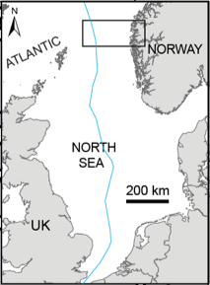
Rift-Scale Segmentation
Rift Phase 1
Rift Phase 2a
Rift Phase 2b
top basement/base RP1
Permo-Triassic
M.Jur-E.Cret.
L.Cret.
Fazlikhani et al. (2017)
Phillips et al. (2019)
Notes:
The top basement/Base RP1 surface records the cumulative effects of RP1 and RP2 basement‐involved fault activity, defining a c.200 km‐wide, predominately N‐trending rift (left) comprises several sub-basins (e.g. Viking Graben, Stord Basin) and bounding structural highs (e.g. Utsira High)
Mapping of sediment thickness (i.e. isochrons; above-right) reveals the long-term rift dynamics, highlighting: (i) the role of pre-existing, intra-crystalline basement structures on fault trends (e.g. local changes in strike) and rift physiography (i.e. segmentation); and (ii) large-scale strain migration between sub-basins, defined by an overall rift narrowing (RP1 to RP2) and a subsequent northward shift in rift activity (RP2 to RP3)

Slide 6
Basin-Scale Segmentation
Phillips et al. (2016)
Notes:
We can identify discrete intra-crystalline basement fractures (e.g. shear zones, such as the Karmøy and Flekkefjord shear zones; top-left) using seismic reflection data, as well as broader seismic facies transitions, folds (see slide 3)
Detailed mapping (right) of their subcrop with top-basement reveals these structures are the offshore continuation of intra-crystalline basement structures identified onshore southern Norway
Offshore core data confirm changes in rock types between shear zone-bound domains (right)
We observe a variety of geometrical and apparent kinematic relationships between intrabasement structure and overlying, rift-related faults (lower-left); these relationships define segmentation at the basin-scale

Slide 7
Fault Segment-/System-Scale Segmentation I
Osagiede et al. (2020)
Osagiede et al. (2020)
Notes:
Segmentation imposed by pre-existing structures is also identified at the fault segment- and system-scale
On the NE flank of the Utsira High (for location see previous slide), a long-lived, intra-basin structural high, we observe a non-colinear normal fault array comprising NE-SW- (e.g. WUHF) and N-S-striking (e.g. HHF) structures (left)
Variance-based mapping of intrabasement structures reveal these faults are underlain by two main shear zones; the Utsira (NE-trending) and Heimdal (WNW-trending) shear zones (for location, see previous slide)
Because of the variations in shear zone trend and rift fault strike, we observe two different geometric (and possibly kinematic) relationships; (i) merging (i.e. WUHF and the Utsira Shear Zone; above-right); and (ii) cross-cutting (i.e. HHF and the Heimdal Shear Zone) (for terminology see slide 4).

Slide 8
Fault Segment-/System-Scale Segmentation I
Osagiede et al. (2020)
Osagiede et al. (2020)
Notes:
Segmentation imposed by pre-existing structures is also identified at the fault segment- and system-scale
On the NE flank of the Utsira High (for location see previous slide), a long-lived, intra-basin structural high, we observe a non-colinear normal fault array comprising NE-SW- (e.g. WUHF) and N-S-striking (e.g. HHF) structures (left)
Variance-based mapping of intrabasement structures reveal these faults are underlain by two main shear zones; the Utsira (NE-trending) and Heimdal (WNW-trending) shear zones (for location, see previous slide)
Because of the variations in shear zone trend and rift fault strike, we observe two different geometric (and possibly kinematic) relationships; (i) merging (i.e. WUHF and the Utsira Shear Zone; above-right); and (ii) cross-cutting (i.e. HHF and the Heimdal Shear Zone) (for terminology see slide 4).

Slide 9
Fault Segment-/System-Scale Segmentation I
Osagiede et al. (2020)
Notes:
Temporal changes in the stratigraphic architecture of Middle to Late Jurassic syn-rift deposits (i.e. syn-tectonic or ‘growth’ strata) may document the kinematic relationships between intrabasement shear zones and overlying, rift-related faults
Tabular growth strata (i.e. Middle Jurassic Sleipner Formation) that are thicker in the hangingwall than the footwall of the WUHF, but which do not thicken towards the fault, may document periods of non-rotational faulting prior to shear zone-fault coupling
Wedge-shaped growth strata (i.e. Middle-Upper Jurassic Hugin, Heather and Draupne formations) that are thicker in the hangingwall than the footwall of the WUHF, and which also thicken towards the fault, may document periods of rotational faulting after shear zone-fault coupling (see kinematic model in animation)

Slide 10
Fault Segment-/System-Scale Segmentation II
Collanega et al. (2018)
Notes:
The influence of pre-existing, intrabasement structures on rift-related normal faulting and basin geometry is well-expressed in the Taranaki Basin, offshore North Island, New Zealand (left) (Cape Egmont Fault=CEF)
Numerous intrabasement structures (indicated with red arrows) are visible on the regional seismic line (right); many of these structures appear physically connected to relatively low-displacement, rift-related normal faults that offset the post-Paleocene sedimentary sequence
Note the position of the study area in the uplifted footwall of the Cape Egmont Fault and the low‐strain, stratigraphically simple setting

Slide 11
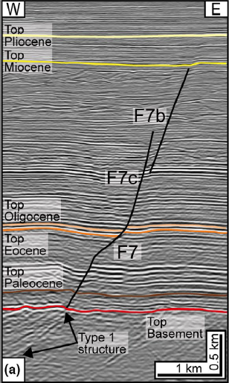
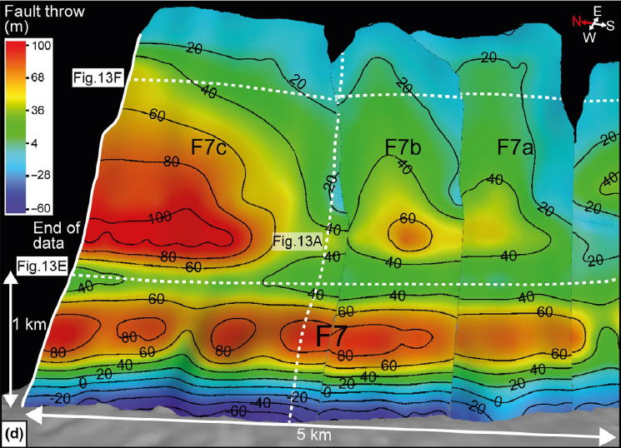
Fault Segment-/System-Scale Segmentation II
Collanega et al. (2018)
Notes:
Despite striking sub-parallel to and at least locally being physically linked to the intrabasement structures (see Collanega et al., 2019), the geometry (left and right) throw patterns (right) on the rift-related cover faults is complex
For example, detailed mapping of F7 reveals: (i) multiple throw maxima (all of which lie some distance above the basement-cover interface); (ii) upward-splaying of the main fault surface
The geometry and throw patterns on this and other rift-related faults likely document: (i) nucleation of faults at two separate structure levels (defined by two belts of relatively high fault throw) above the intrabasement structures, rather than direct reactivation and upward propagation of the latter; (ii) downward propagation of the faults to link with the intrabasement structures; (iii) splaying of the faults during upward propagation

Slide 12
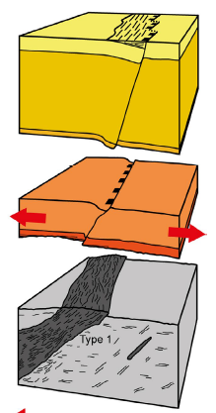
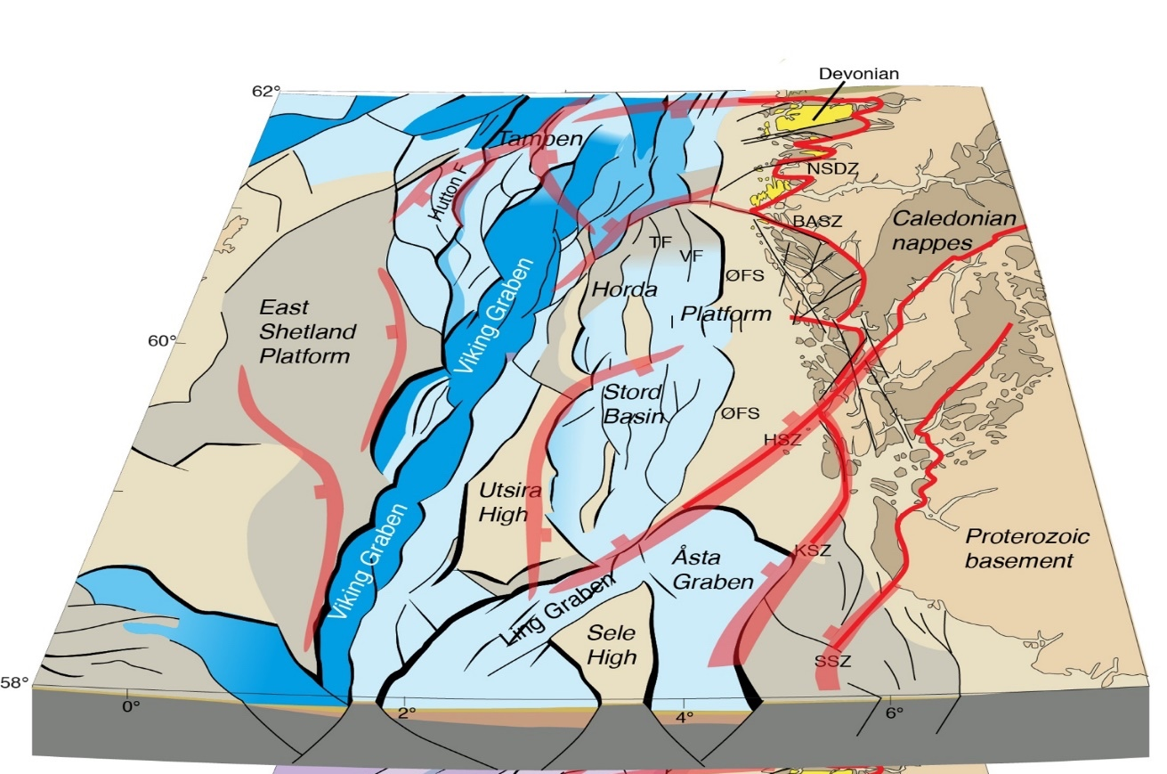
Summary, Discussion and Outlook
increasing scale
Fault-scale
Basin-scale
Rift-scale
Collanega et al. (2018)
Phillips et al. (2019)
Notes:
Our analyses show that km-scale, intra-basement structures can control the nucleation and development of newly formed, rift-related normal faults, most likely due to a local perturbation of the regional stress field. Because of this, simply inverting fault strike for causal extension direction may be incorrect, especially in provinces where pre-existing, intra-basement structures occur. We also show that a detailed kinematic analysis is key to deciphering the temporal as well as the geometric relationships between structures developed at multiple structural levels.

Slide 13
Acknowledgements
Project Partners:
Funding:
Seismic data:
Software:
Notes:
We would like to thank everyone who made this study possible, including those providing logistical support, funding, data, and software

Slide 14
Further Reading
Phillips, T.B., Fazlikhani, H., Gawthorpe, R.L., Fossen, H., Jackson, C.A-L., Bell, R.E., Faleide, J.I., & Rotevatn, A. (2019) The influence of structural inheritance and multiphase extension on rift development, the northern North Sea. Tectonics, 38, 4099-4126.
Lenhart, A., Jackson, C.A-L., Bell, R.E., Duffy, O.B., Gawthorpe, R.L., & Fossen, H. (2019) Structural architecture and composition of crystalline basement offshore west Norway. Lithosphere, 11, 273-293.
Collanega, L., Jackson, C.A-L., Bell, R.E., Coleman, A.J., Lenhart, A., & Breda, A., (2019). Normal fault growth influenced by basement fabrics: the importance of preferential nucleation from pre-existing structures. Basin Research, 31, 659-687.
Osagiede, E.E., Rotevatn, A., Gawthorpe, R.L., Kristensen, T.B., Jackson, C.A-L., & Marsh, N. (2020) Pre-existing intra-basement shear zones influence growth and geometry of non-colinear normal faults, western Utsira High–Heimdal Terrace, North Sea. Journal of Structural Geology, 130, 103908.
Fazlikhani, H., Fossen, H., Gawthorpe, R.L., Faleide, J.I., and Bell, R.E. (2017), Basement structure and its influence on the structural configuration of the northern North Sea rift, Tectonics, 36, 1151– 1177, doi:10.1002/2017TC004514.
Phillips, T.B., Jackson, C.A-L., Bell, R.E., Duffy, O.B., & Fossen, H. (2016). Reactivation of intrabasement structures during rifting: A case study from offshore southern Norway. Journal of Structural Geology, 91, 54-73.

