Slide 1
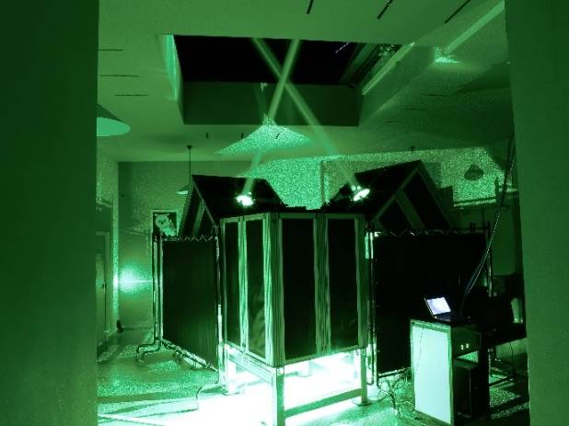
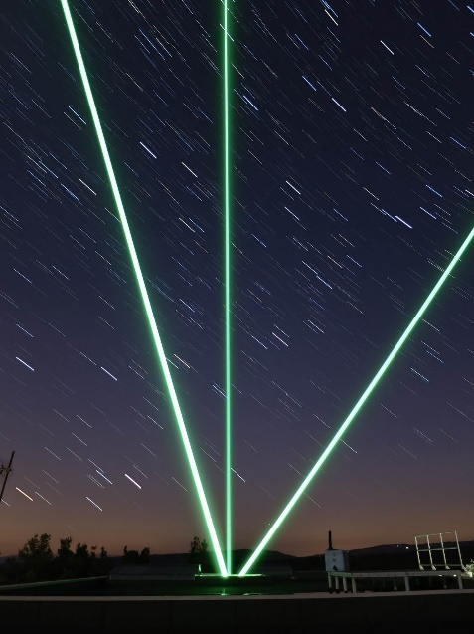
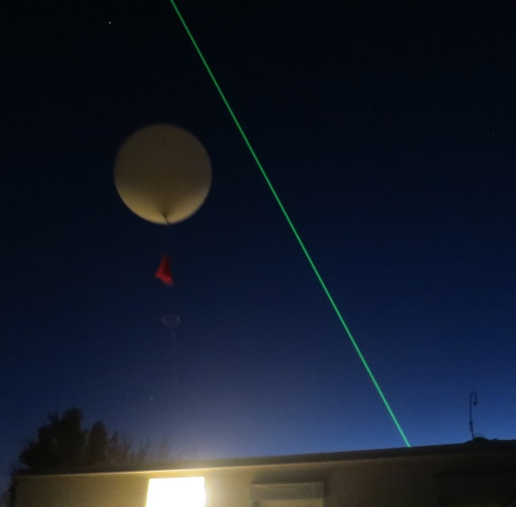
Validation of ESA Aeolus wind observations using French ground-based Rayleigh Doppler lidars at midlatitude and tropical sites
S. M. Khaykin¹, A. Hauchecorne*¹, R. Wing¹, J.-F. Mariscal¹, J. Porteneuve¹, J.-P. Cammas², N. Marquestaut², G. Payen², V. Duflot²
¹ LATMOS-IPSL, UVSQ, Sorbonne Université, CNRS, Guyancourt, France
² OSUR, Université de la Réunion, Saint-Denis, La Réunion, France
EGU General Assembly 2020

Slide 2
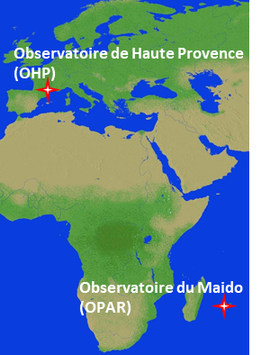
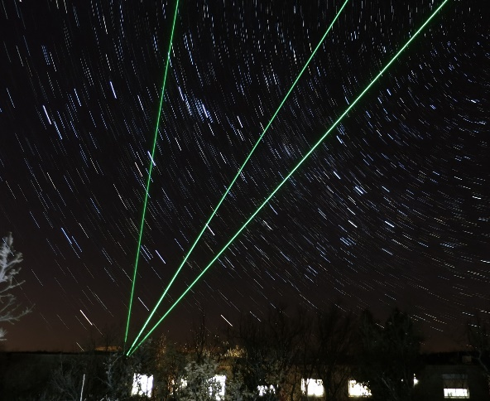
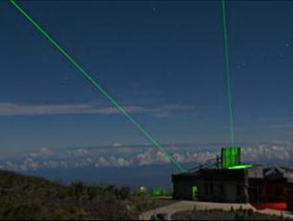
French Rayleigh Doppler wind lidars
Wind lidar systems deployed at Haute-Provence observatory (44°N) and Maïdo observatory (Reunion island, 21°S)
Chanin, M.-L., Garnier, A., Hauchecorne A., Porteneuve J.: A Doppler lidar for measuring winds in the middle atmosphere, GRL, 1989
Khaykin, S. M. et al.: Doppler lidar at Observatoire de Haute-Provence for wind profiling up to 75 km altitude: performance evaluation and observations, AMT, 2020.
Altitude coverage | 5 – 75 km
 | z < 30km | z > 50 km
Vertical resolution | 250 m | 1-2 km
Accuracy | 1 m/s | 5 – 12 m/s
Temporal resolution | 5 min | 30 min
Observatoire de
Haute Provence (OHP)
Maïdo Observatory
(2158 m a.s.l.) Reunion island
Notes:
These are Observatoire de Haute Provence (OHP) in Southern France and high-altitude Maido observatory at La Reunion island.
The Doppler wind lidar deployed at OHP was conceived already in 1989 and the detection method was licensed.
In the last 6 years, the wind lidars underwent a series of technical upgrades, which were largely motivated by the forthcoming Aeolus mission. After these upgrades, the lidar is capable of measuring wind profiles between 5 and 75 km altitude with high vertical and temporal resolution. The accuracy is better than 1 m/s below 30 km for a half an hour integration.

Slide 3
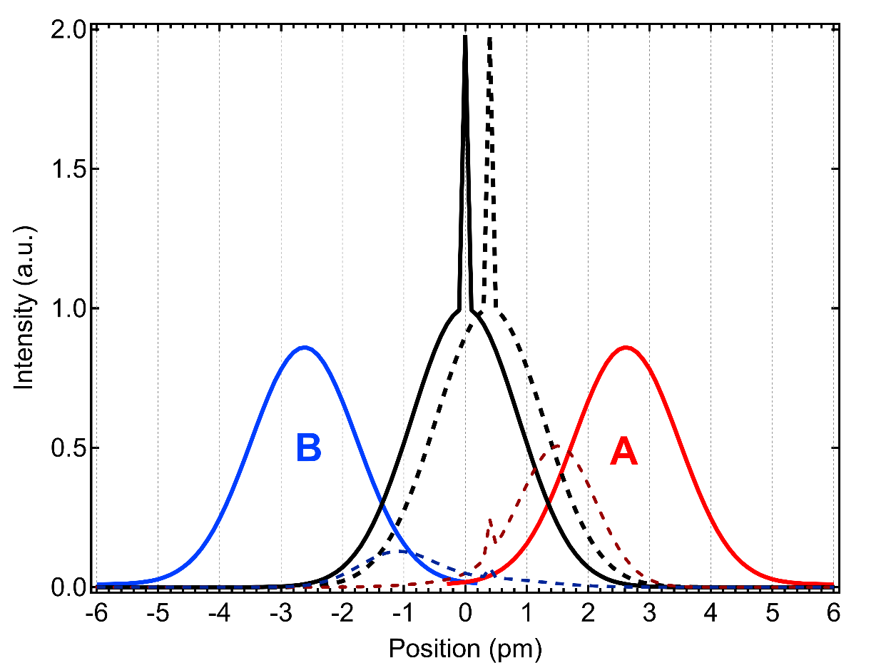
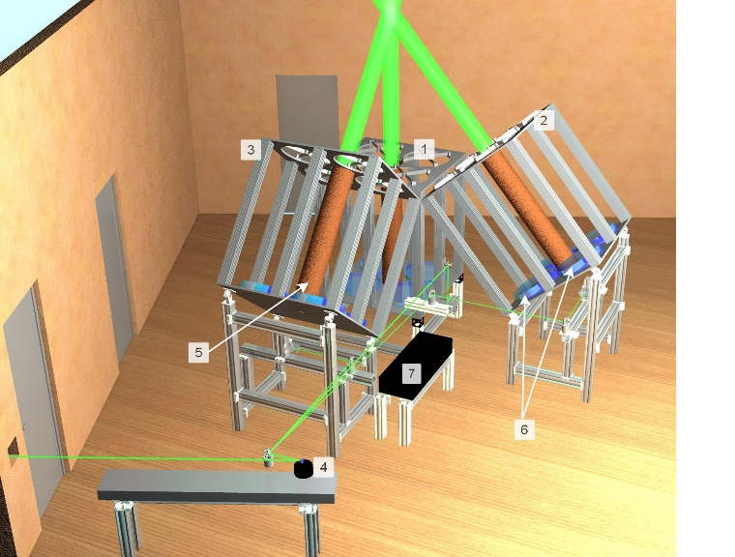
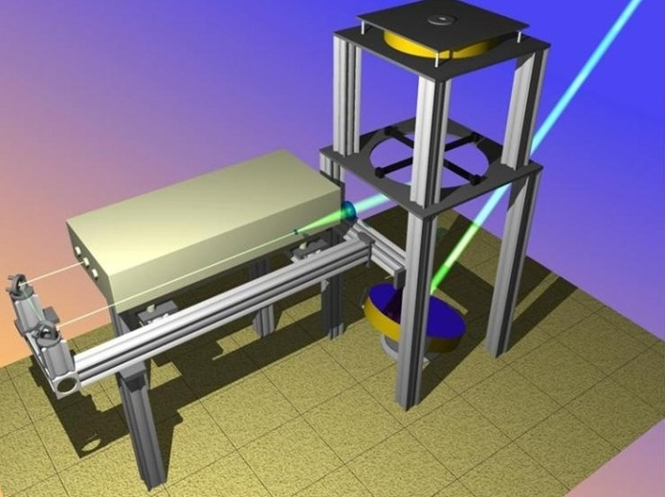
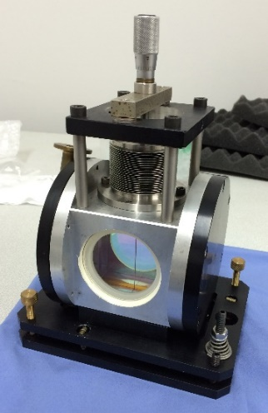
French Rayleigh Doppler wind lidars
Laser : Nd-YAG injection-seeded, 532 nm, 800 mJ/pulse, 30 Hz
Telescope (OHP): 3 assemblies, 0.78 m² each (4 mirrors Ø=500 mm)
Telescope (Maido): Single rotating mirror (Ø=600 mm), 0.27 m²
Lidar power (W·m²) comparable to Aeolus: 18.7 (OHP), 19.4 (Aeolus)
Doppler shift detection : double-edge Fabry-Perot interferometer (same as Aeolus ALADIN Rayleigh channel)
Laser beam is steered between 3 lines-of-sight
Vertical pointing is used to obtain zero Doppler shift reference
Mie line
Doppler-shifted
backscattered line
Rayleigh line
Spectral shapes of the thermally-broadened Rayleigh backscatter line with the thin Mie line on top of it (solid black) and the FPI bandpasses A and B (solid red and blue). The Doppler-shifted backscatter line (corresponding to an imaginary wind speed of 175 m/s) is shown as black dashed curve. The signals transmitted through the A and B bandpasses for the Doppler-shifted backscattering are illustrated by the dashed red and blue curves.
OHP
Maido
Fabry-Perot interferometer in a sealed pressure-controlled housing

Slide 4
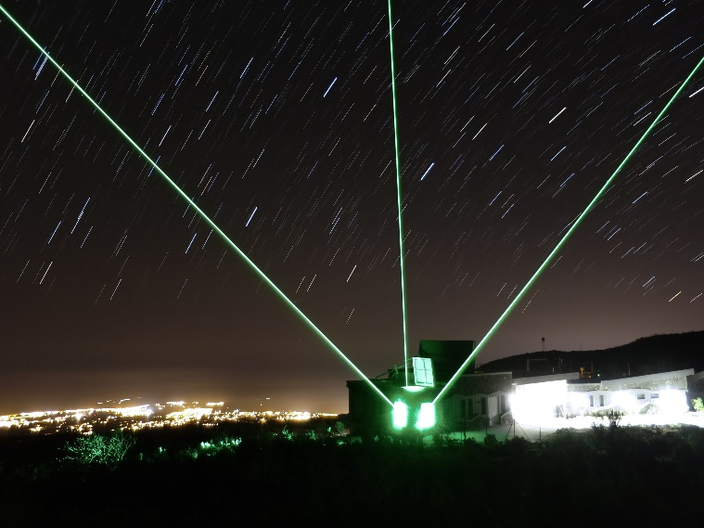
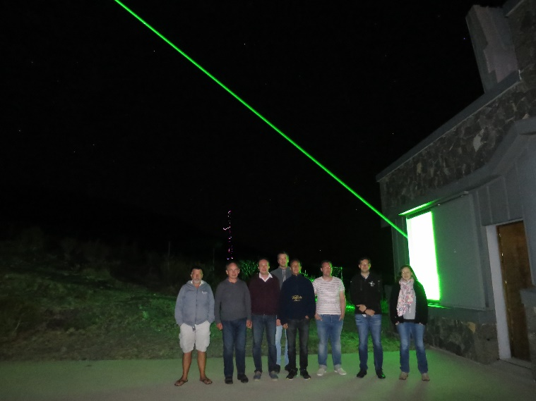
AboVE-Maido campaign
AboVE-Maido: Aeolus Validation Experiment at Maido
16 Sep – 11 Oct 2019, OPAR, Maido observatory
13 nights of lidar operation, 18 radiosoundings
100 h of LiWind lidar operation
Minimum spatial offset with Aeolus: 10 km
Ongoing time-collocated cal/val measurements once per month since November 2019

Slide 5
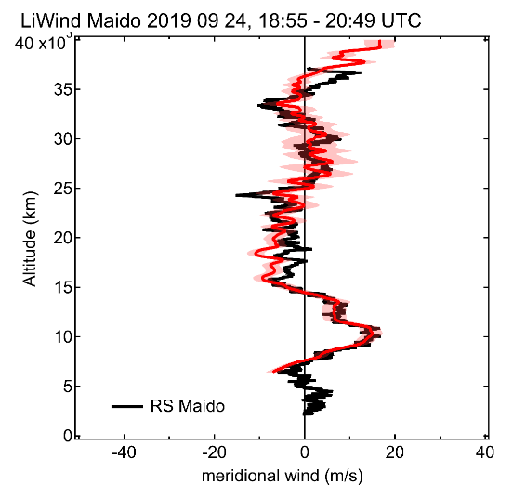
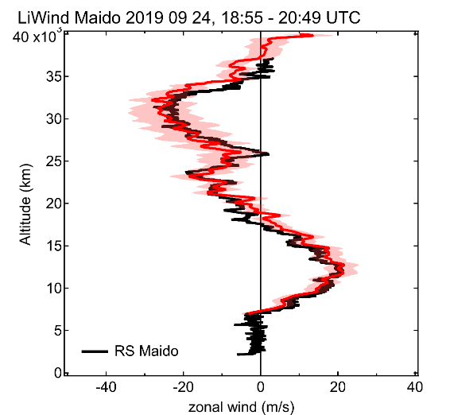
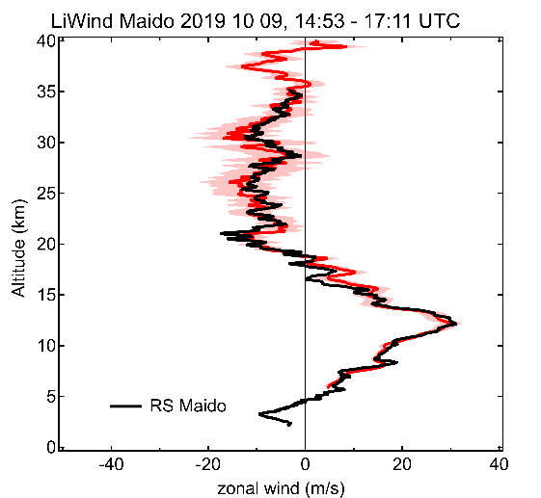
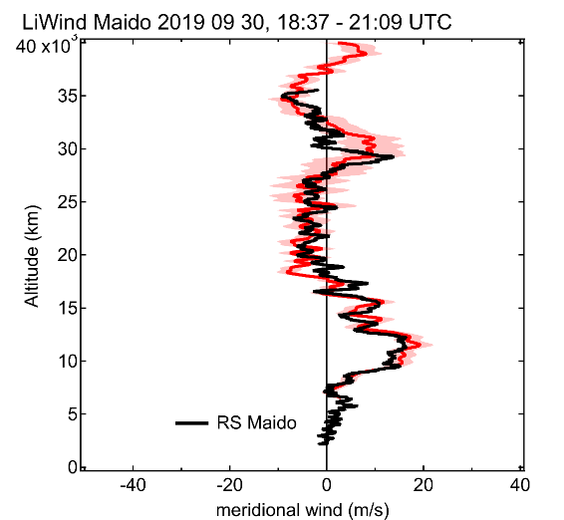
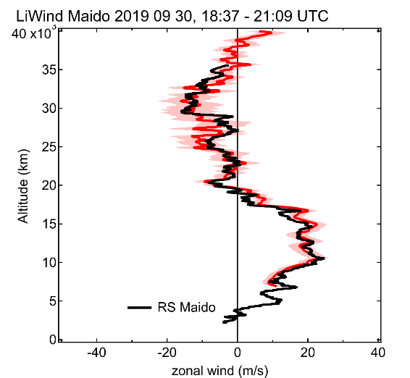
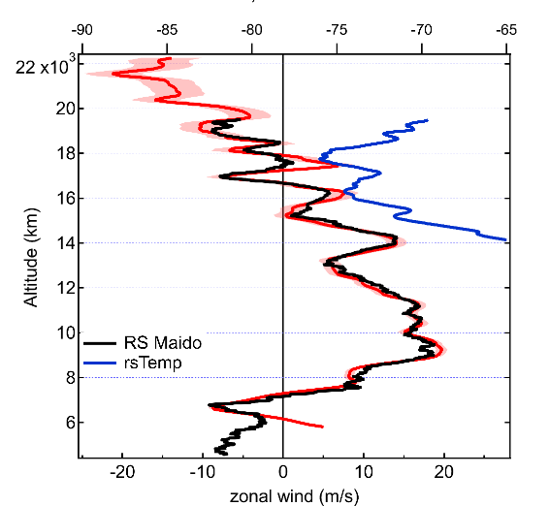
AboVE-Maido campaign: validation of LiWind lidar using radiosondes
Based on 17 radiosonde ascents, the mean bias between RS and LiWind is less than 0.2 m/s

Slide 6
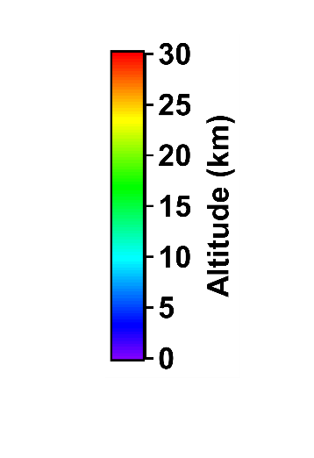
AboVE-Maido campaign: Aeolus validation using LiWind and radiosondes
Aeolus satellite is in sun-synchronous dusk/dawn orbit passing close to La Reunion every week:
Wednesday at 14h40 UT (ascending orbit, 10-30 km away)
Thursday at 2h10 UT (descending orbit 200 km away)
Descending orbit
Ascending orbit
100 km
50 km
Aeolus sampling locations
200 km
LiWind south and east LOS
RS tracks
Google Earth

Slide 7
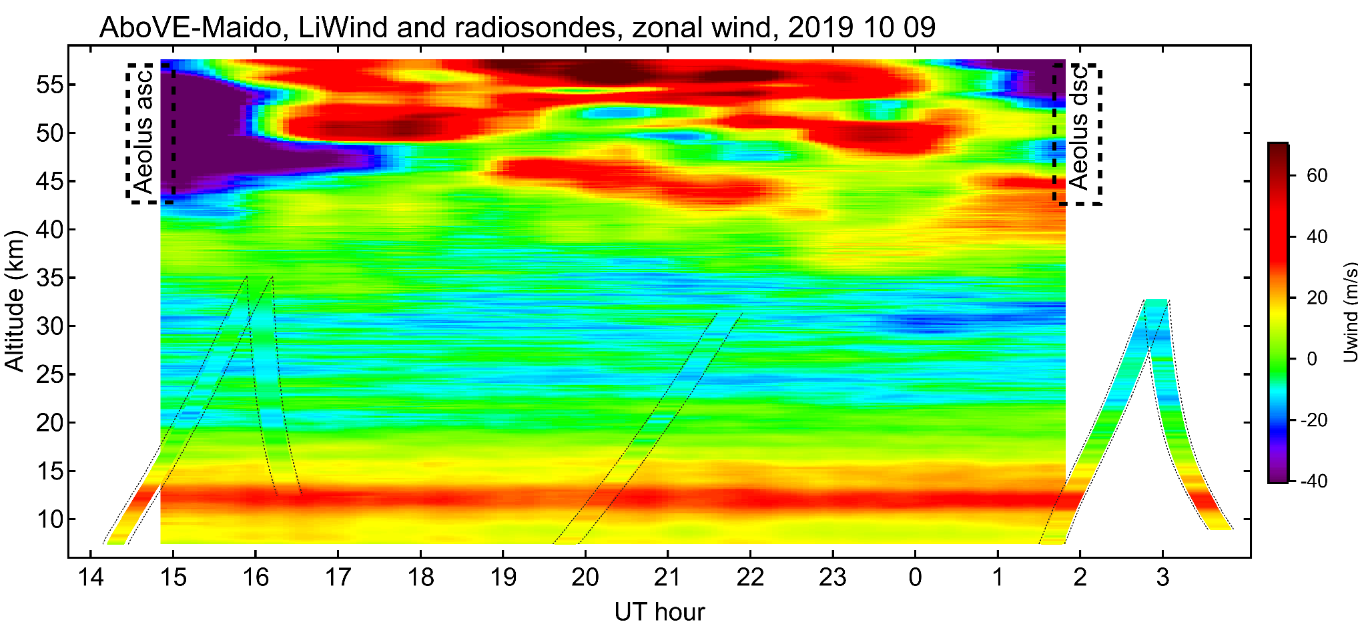
AboVE-Maido campaign: Aeolus validation using LiWind and radiosondes
Example of Cal/Val measurements with 3 radiosoundings and continuous LiWind operation from dusk till dawn: zonal wind
Aeolus overpasses
Semidiural/diurnal tides
Gravity waves
Radiosonde ascent/descent

Slide 8
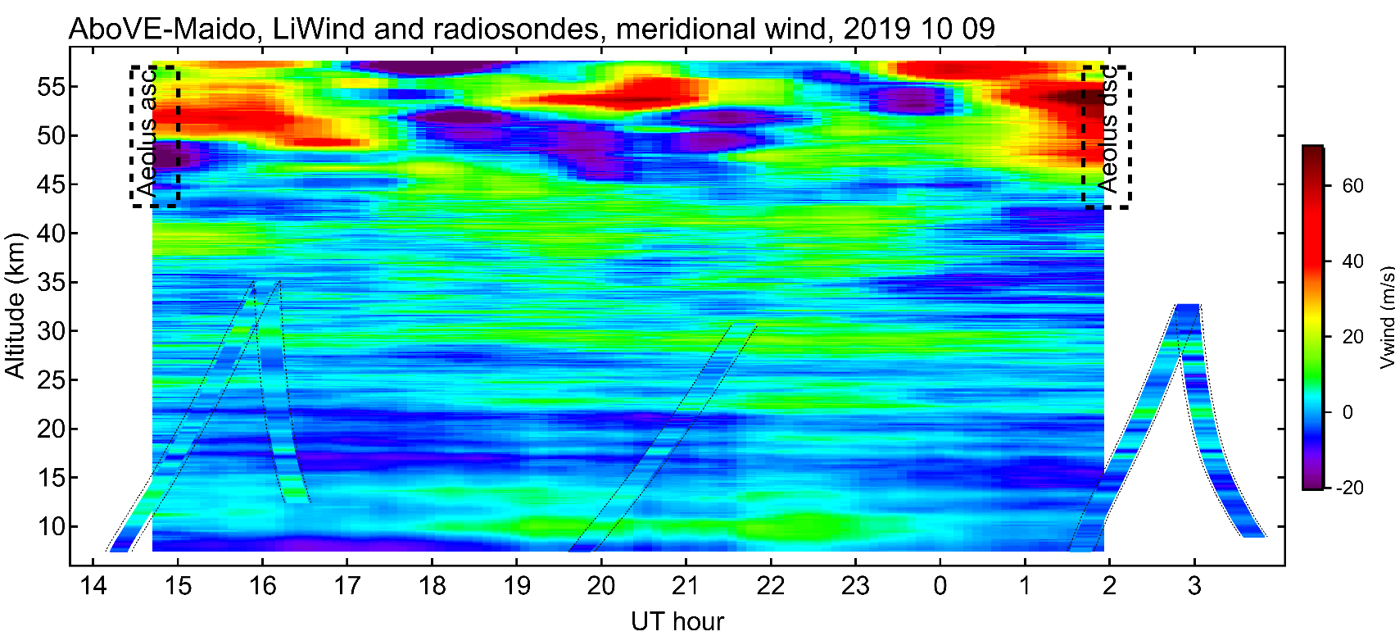
AboVE-Maido campaign: Aeolus validation using LiWind and radiosondes
Example of Cal/Val measurements with 3 radiosoundings and continuous LiWind operation from dusk till dawn: meridional wind
Aeolus overpasses
Semidiural/diurnal tides
Gravity waves
Radiosonde ascent/descent

Slide 9
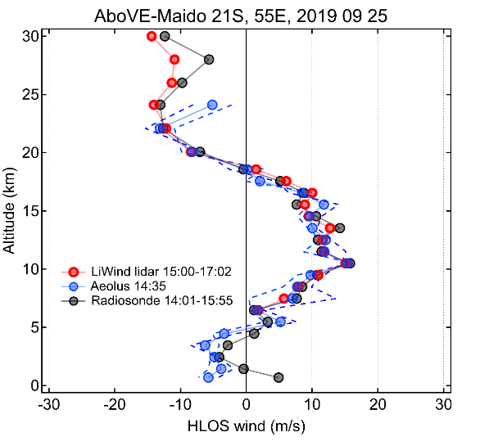
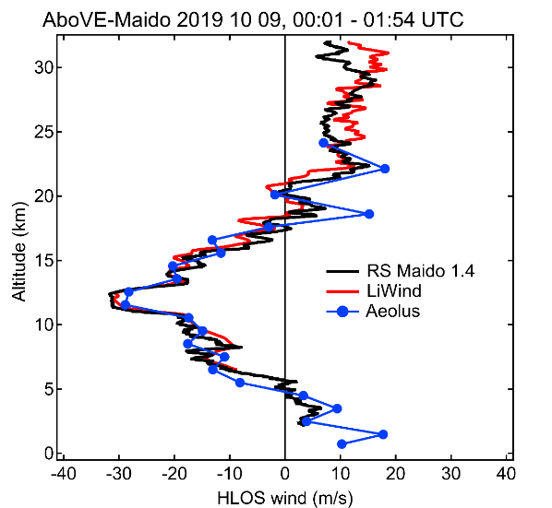
AboVE-Maido campaign: validation of Aeolus L2B Rayleigh-clear using LiWind and radiosondes
During AboVE-Maido, 3 asc + 3 dsc Aeolus-collocated measurements have been done
Perfect timing for the balloon launches and LiWind operation on Cal/Val nights
Preliminary results of Cal/Val are very encouraging, Aeolus appears capable of reproducing vertical structures in the wind profile with scales comparable to its vertical resolution
Case#1 (asc): All data downsampled to Aeolus vertical resolution. Mean bias <1 m/s
Excellent agreement except for the uppermost bin
Figure selected for ESA quarterly report
Case#6 (dsc): Mean bias of + 1.5 m/s
Aeolus resolves gravity waves in the stratosphere

Slide 10
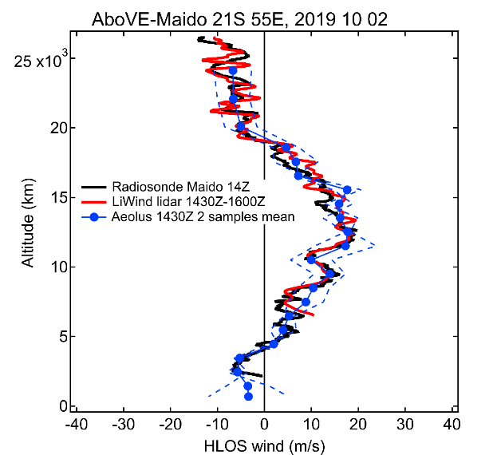
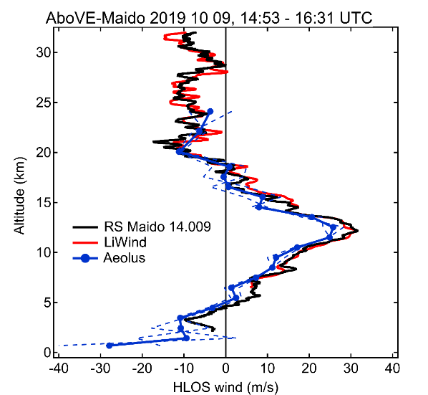
AboVE-Maido campaign: Aeolus validation using LiWind and radiosondes
During AboVE-Maido, 3 asc + 3 dsc Aeolus-collocated measurements have been done
Perfect timing for the balloon launches and LiWind operation on Cal/Val nights
Preliminary results of Cal/Val are very encouraging, Aeolus appears capable of reproducing vertical structures in the wind profile with scales comparable to its vertical resolution
Case#3 (asc): Excellent agreement, mean bias < 1 m/s
Figure produced 1.5 hours after the satellite overpass (Cal/Val in near real time)
Case#5 (asc): Mean bias of -3.6 m/s
The bias in Aeolus wind product varies with time

Slide 11
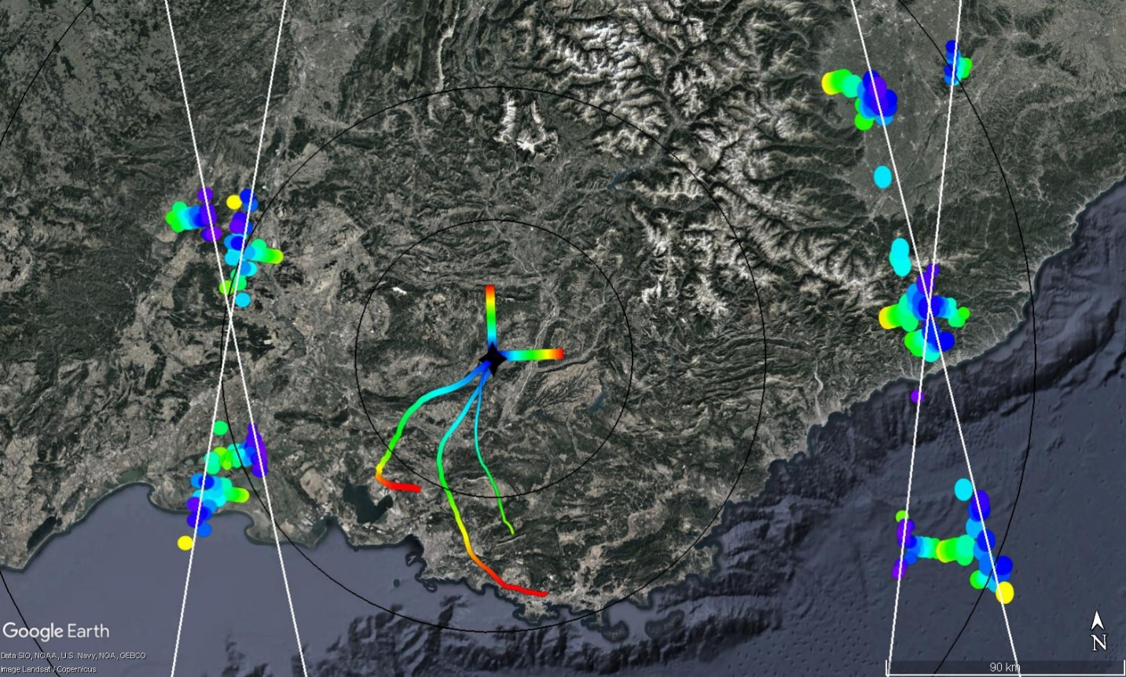
AboVE-OHP campaign
AboVE-OHP: Aeolus Validation Experiment at OHP
5 Jan – 5 Feb 2019, Observatoire de Haute Provence
21 nights of lidar operation, 3 radiosoundings
109 h of Wind lidar operation
Aeolus in standby 13 Jan-21 Feb: missed 14 collocations
5 DWL - Aeolus collocations, 3 RS – Aeolus collocations
Minimum spatial offset: 62 – 165 km
Monday-Tuesday
asc dsc
Sunday-Monday
asc dsc
200 km
100 km
50 km
OHP lidar
Radiosonde ascents
Notes:
I will now talk about the first Aeolus Validation Experiment at OHP, AboVE-OHP campaign that took place last January and included 21 nights of lidar operation and simultaneous radiosoundings. Unfortunately, Aeolus was put in standby shortly after the campaign start and we could validate only a limited number of Aeolus overpasses close to OHP.
This map shows the sampling range of OHP lidar color-coded by altitude, radiosonde tracks and Aeolus sampling locations along ascending and descending orbits. The current orbit of Aeolus is not optimal with respect to OHP location and the minimum distance to nearest overpasses is more than 60 km. Nevertheless, we got some nice cases of intercomparison

Slide 12
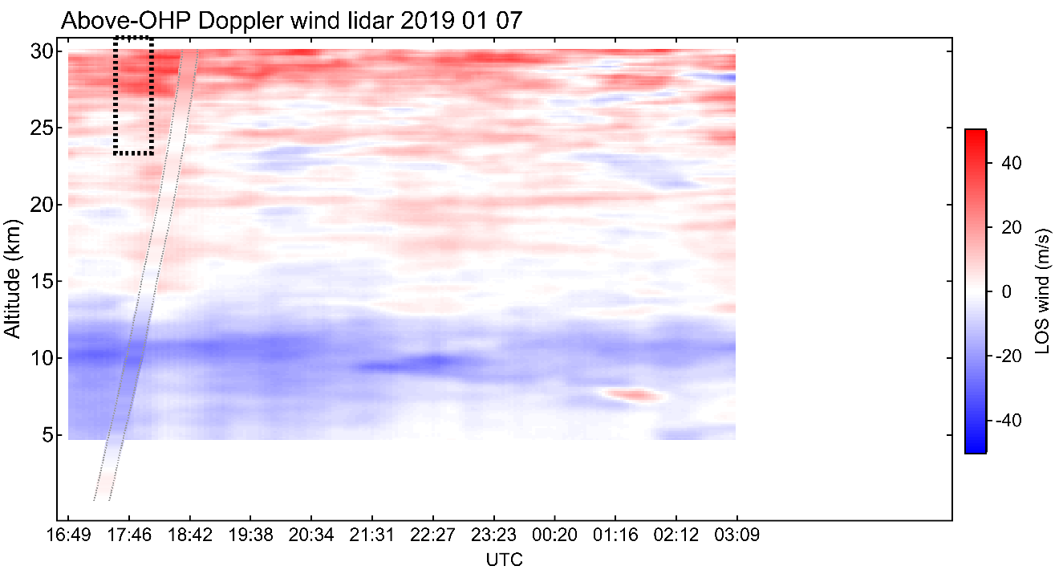
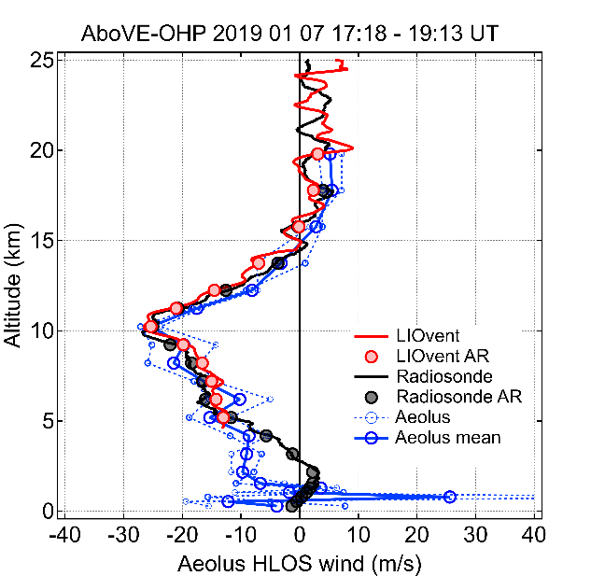
Collocation #3, evening 07 Jan: best case
100 km
Aeolus
50 km
Aeolus
OHP lidar
Radiosonde ascent
Radiosonde ascent
Aeolus - OHPlidar
Mean dif. / st. dev (m/s) | R correl. | Min. hor. distance (km)
+1.7 /3.7 | 0.93 | 108
Khaykin et al., AMT, 2020
Notes:
I will show an example of such case. This is time curtain of wind from OHP lidar, which was started sometime before the Aeolus overpass. This is the radiosonde ascent with the same color-coding as the lidar curtain. These are relative locations of the measurements.
(-)
Here, the blue line shows the OHP lidar profile averaged over this period and projected onto the Aeolus line of sight. The cyan profile is a 2 minutes average and I am going to show how it has evolved over time.

Slide 13
Summary and outlook
Validation of Aeolus using its ground-based Rayleigh DWL predecessor at two French supersites
Dedicated AboVE cal/val campaigns in Haute-Provence (Jan-Feb 2019) and La Reunion (Sep-Oct 2019)
Validation of L2B Rayleigh-clear winds using ground-based lidar and radiosonde measurements precisely collocated in time with Aeolus overpasses
Based on 17 collocated measurements at both sites, the mean bias varied between -3.6 m/s and 2.9 m/s with standard deviation between 3.1 m/s – 8.5 m/s. The bias is generally higher in the uppermost range bin. Correlation better than 0.8 for 96% of overpasses within 120 km / 3 hours
The bias varies over time and appears consistent with the evolution of Aeolus biases with respect to ECMWF operational analysis (not shown)
Aeolus wind profiling is capable of resolving gravity waves in the lower stratosphere: new global information on the kinetic energy of GW
Validation activities are continued at both French supersites with 1 collocated measurements per month provided normal operation conditions
Remote sensing of wind using molecular scattering is challenging!

Slide 14
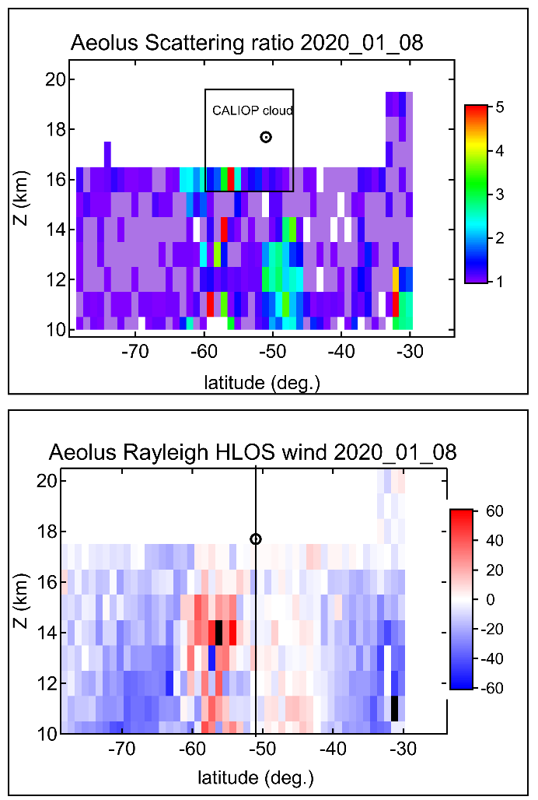
Aeolus captures a smoke-generated vortex in the stratosphere
Extreme wildfires in Australia around New Year’s eve 2020 generate pyroconvection injecting huge amount of combustion products into the stratosphere
Solar heating of carbonaceous aerosol in an intense patch of smoke leads to formation of a confined anticyclone persisting for 3 months in the stratosphere
Aeolus is the only one instrument on Earth to provide a cross-section of wind speed inside a new born-vortex above Southern Pacific
Aeolus sampling across a blob of CO-rich smoke seen by IFS as an isolated region of high vorticity
Aeolus sees the smoke in the stratosphere
Vortex centroid (IFS)
Aeolus captures the wind anomaly associated with the vortex

