Slide 1
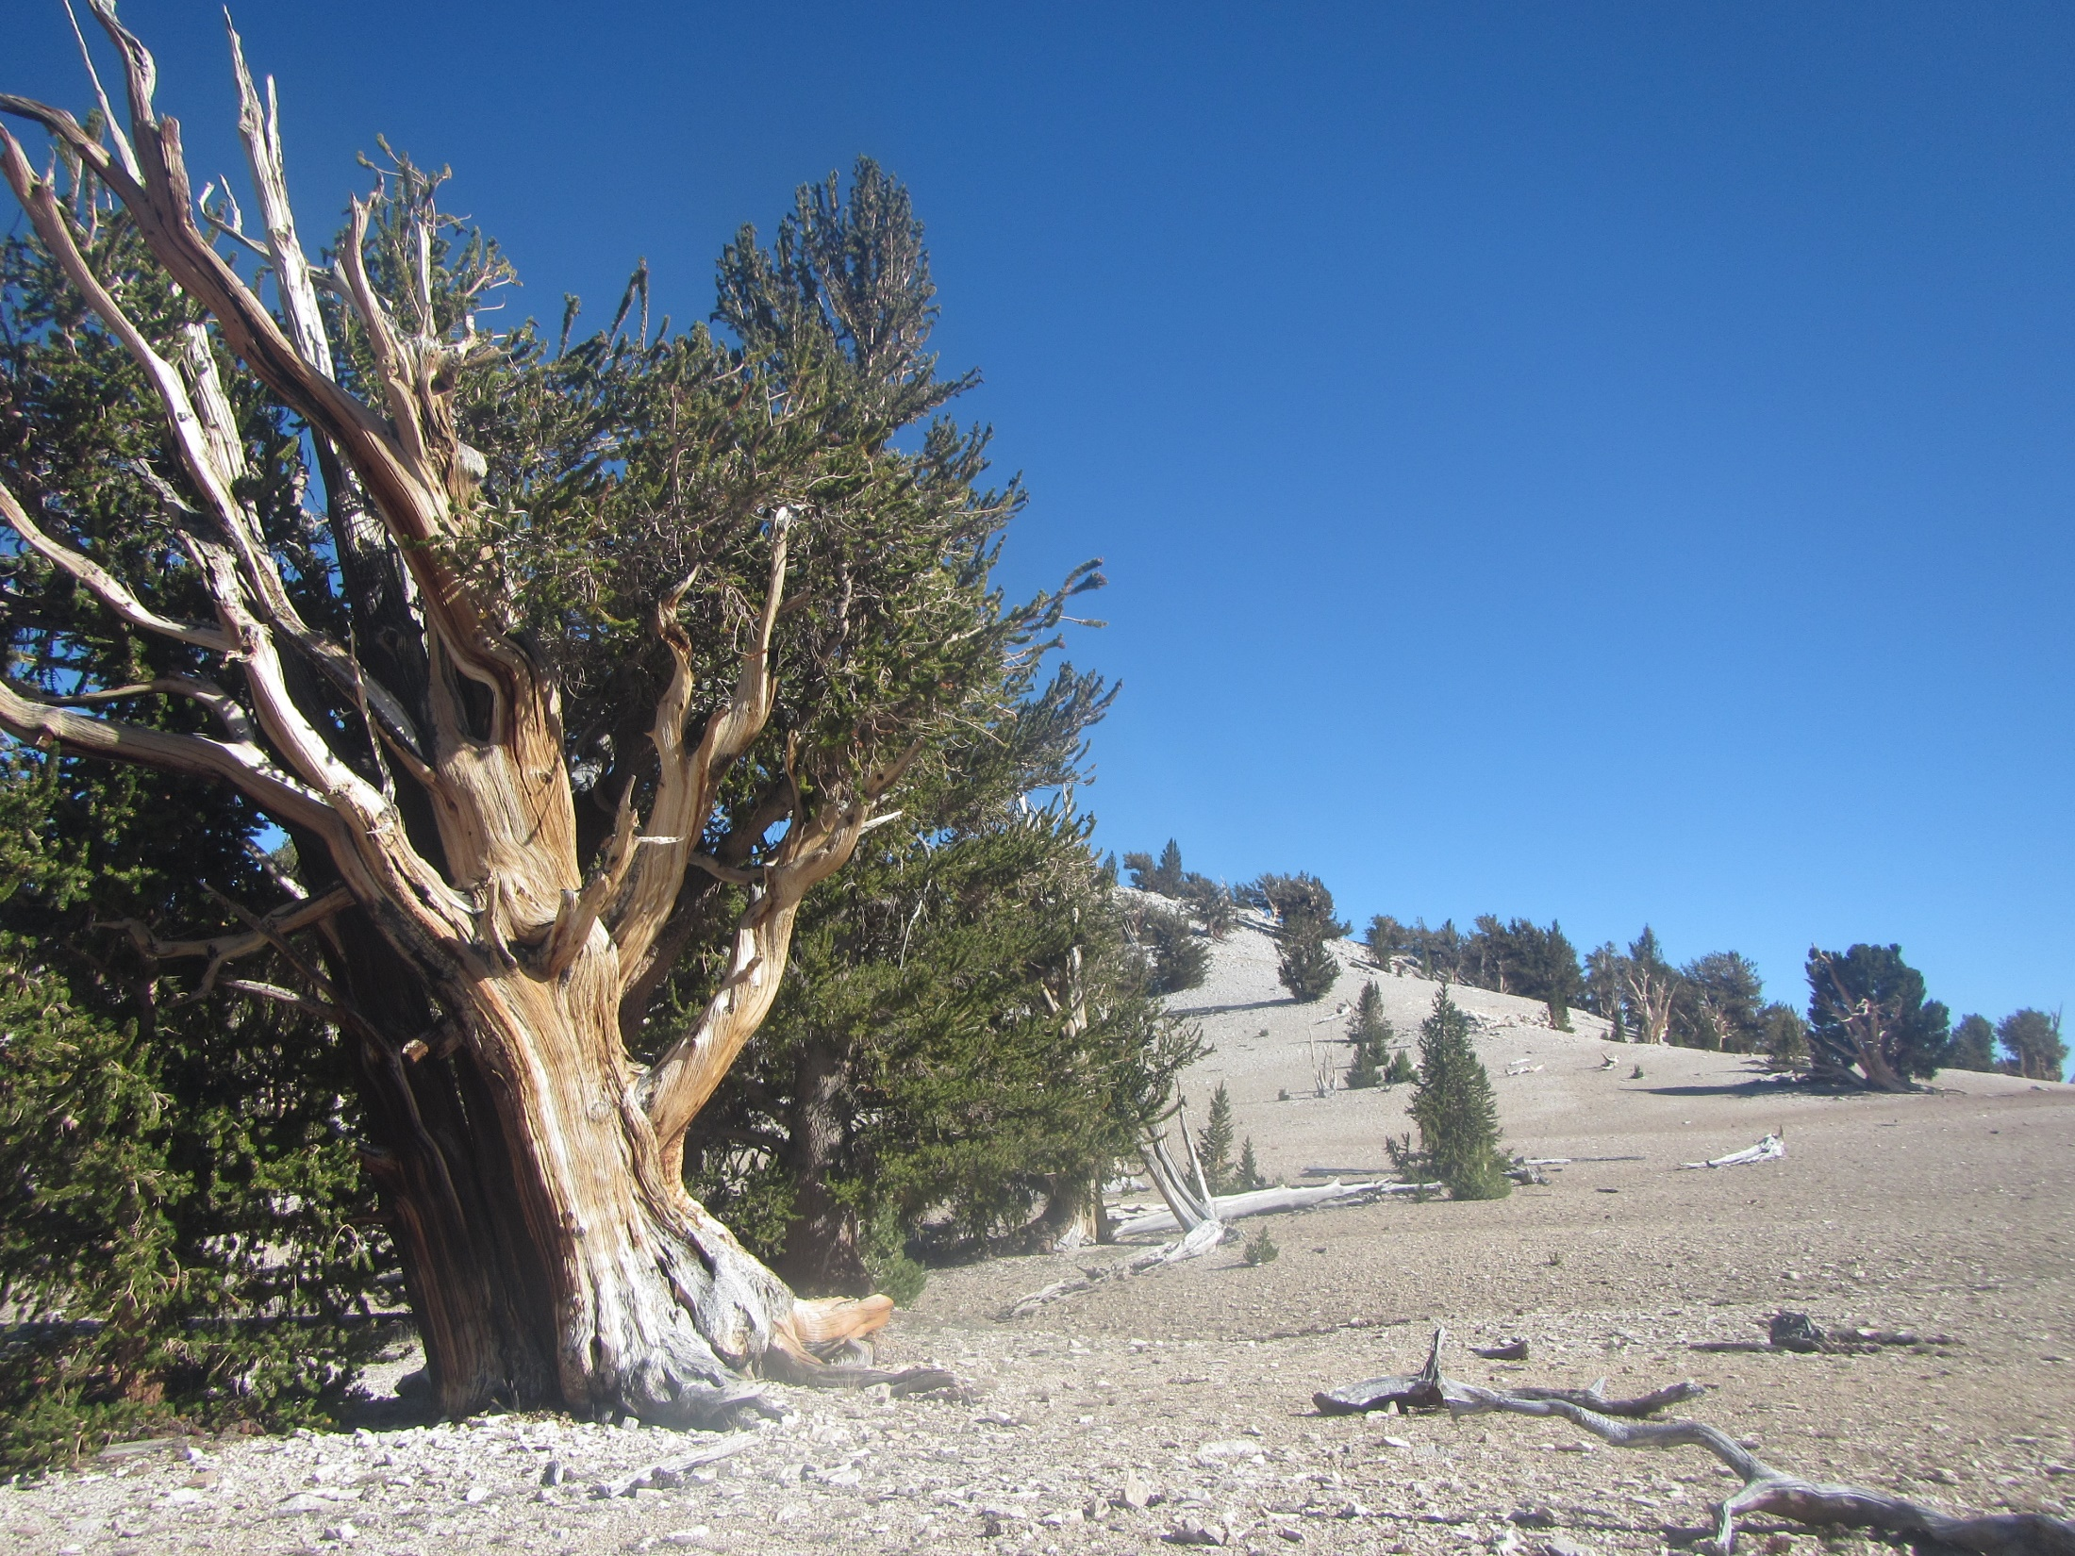

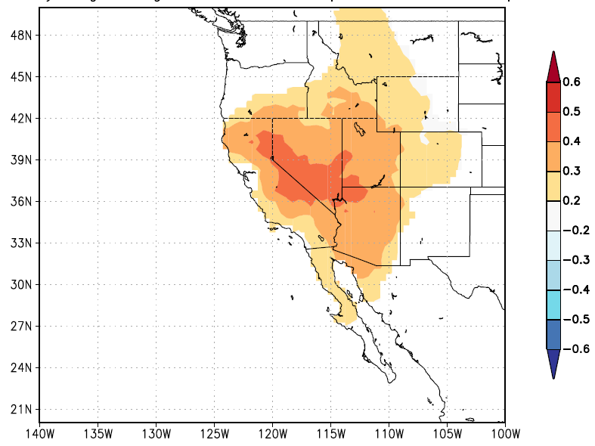


MXD on
Great Basin
Bristlecone
Pine, CA (USA)
Tom De Mil
Matthew Salzer
Charlotte Pearson
Valerie Trouet
Jan Van den Bulcke
1,2
2
2
2
1
1
2
© Tom De Mil, California White Mountains, Patriarch Grove

Slide 2

Goal: a+ 5000 year T sensitive MXD record
Salzer et al. 2014: tree ring width (TRW) record (2575 BCE – 2006 CE)
➔ Temperature signal limited to upper tree-line border
➔ Record is best expressed in decadal time scales, rather than annual scales
➔ Topographic effects (Bunn et al. 2011) and memory effects
➔ Why not Maximum Latewood Density?
MXD was never measured before on bristlecone pine: small rings and very twisted growth
➔ Yeah why not: Use 3D X-ray Computed Tomography (X-ray CT) !

Slide 3
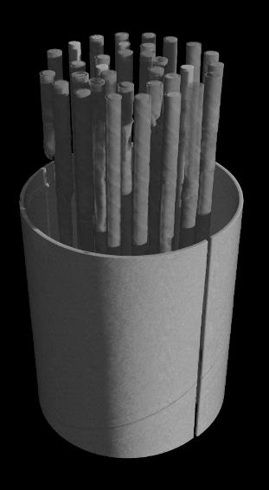
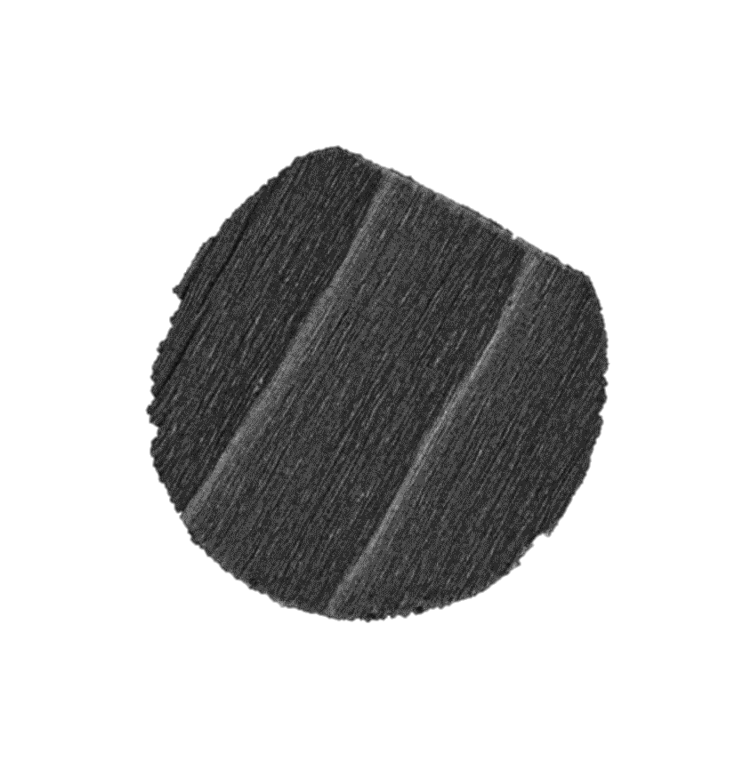

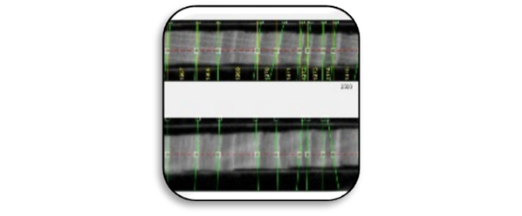
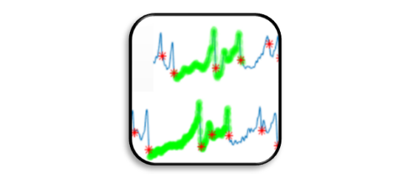
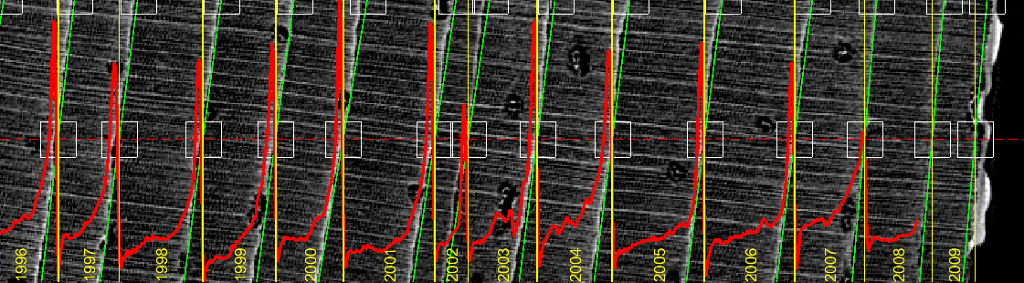
The X-ray CT avenue
Video tutorials:
Densitometry Toolbox
X-ray CT Graphical Interface
Core Comparison (crossdating)
Find out more on http://www.dendrochronomics.ugent.be/

Slide 4

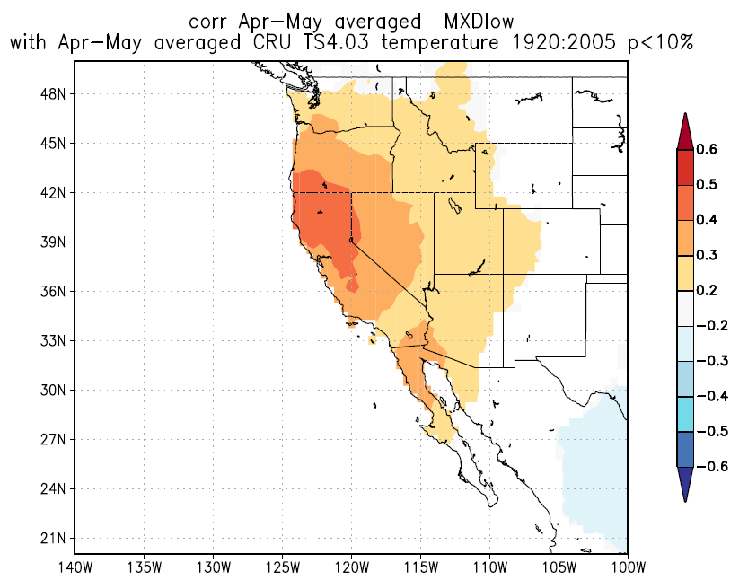
a)
b)
Figure: Proof-of-concept dendroclimatic analysis of a first set of Pinus longaeva MXD series (based on 11 trees). (a) Correlation of the high-elevation MXD chronology with mean temperature during the period 1920-2005, ( CRU TS4.03 for 37.38° N, 118.17°W). Significant correlations (P<0.05) are marked dark-grey (b) Spatial correlation map between the MXD chronology and mean May-August temperature during 1920-2005 (CRU TS.4.03). (c) Correlation of the low-elevation MXD chronology (based on 10 trees) to mean temperature during the period 1920-2005 ( CRU TS4.03 for 37.38° N, 118.17°W). Significant correlations (P<0.05) are marked dark-grey (d) ) Spatial correlation map between the low elevation MXD chronology and mean April-May temperature during 1920-2005 (CRU TS.4.03).
Maps were generated using the KNMI explorer (Trouet & Van Oldenborgh 2013). Sampling location is marked by *.
c)
d)
Better inter-annual timeseries than TRW, more free from autocorrelation effects
Stronger signal at the high-elevation sites

Slide 5




Questions?
Tom.de.mil@ugent.be
http://www.dendrochronomics.ugent.be/

