Slide 1
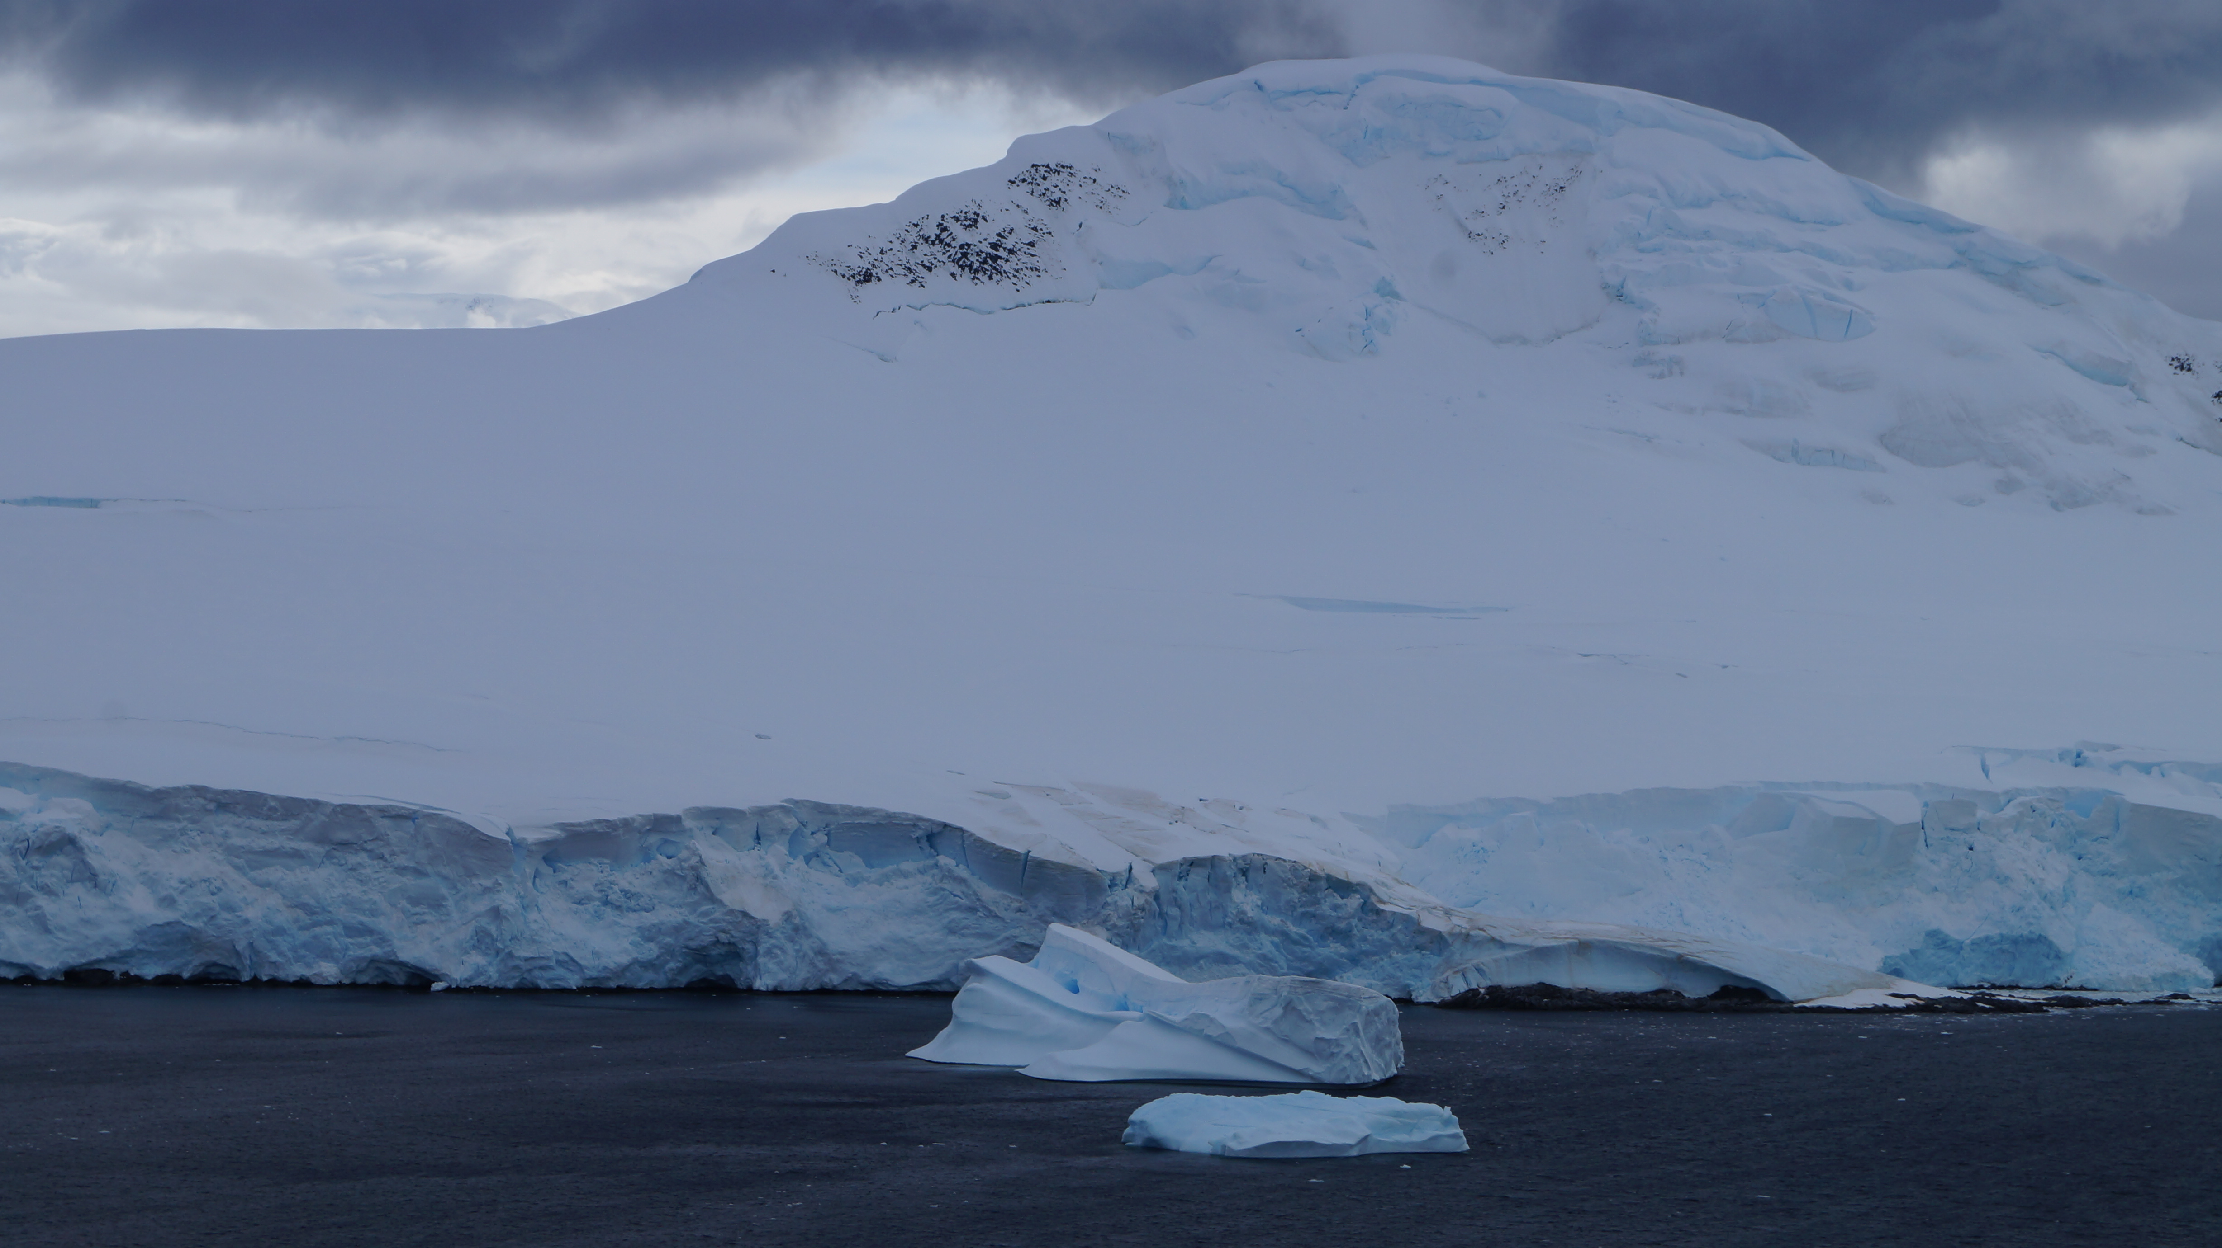
Late Triassic-Jurassic active margin magmatism in southwestern Gondwana: implications for the tectonic evolution of the Antarctic Peninsula, Patagonia and the Weddell Sea
Session GD5.1 – Subduction dynamics from surface to deep mantle
Joaquin Bastias, Richard Spikings, Teal Riley, Alexey Ulianov, Massimo Chiaradia, Urs Schaltegger

Slide 2
Bastias et al. (in review)

Slide 3
Bastias et al. (in review)

Slide 4
Bastias et al. (in review)

Slide 5
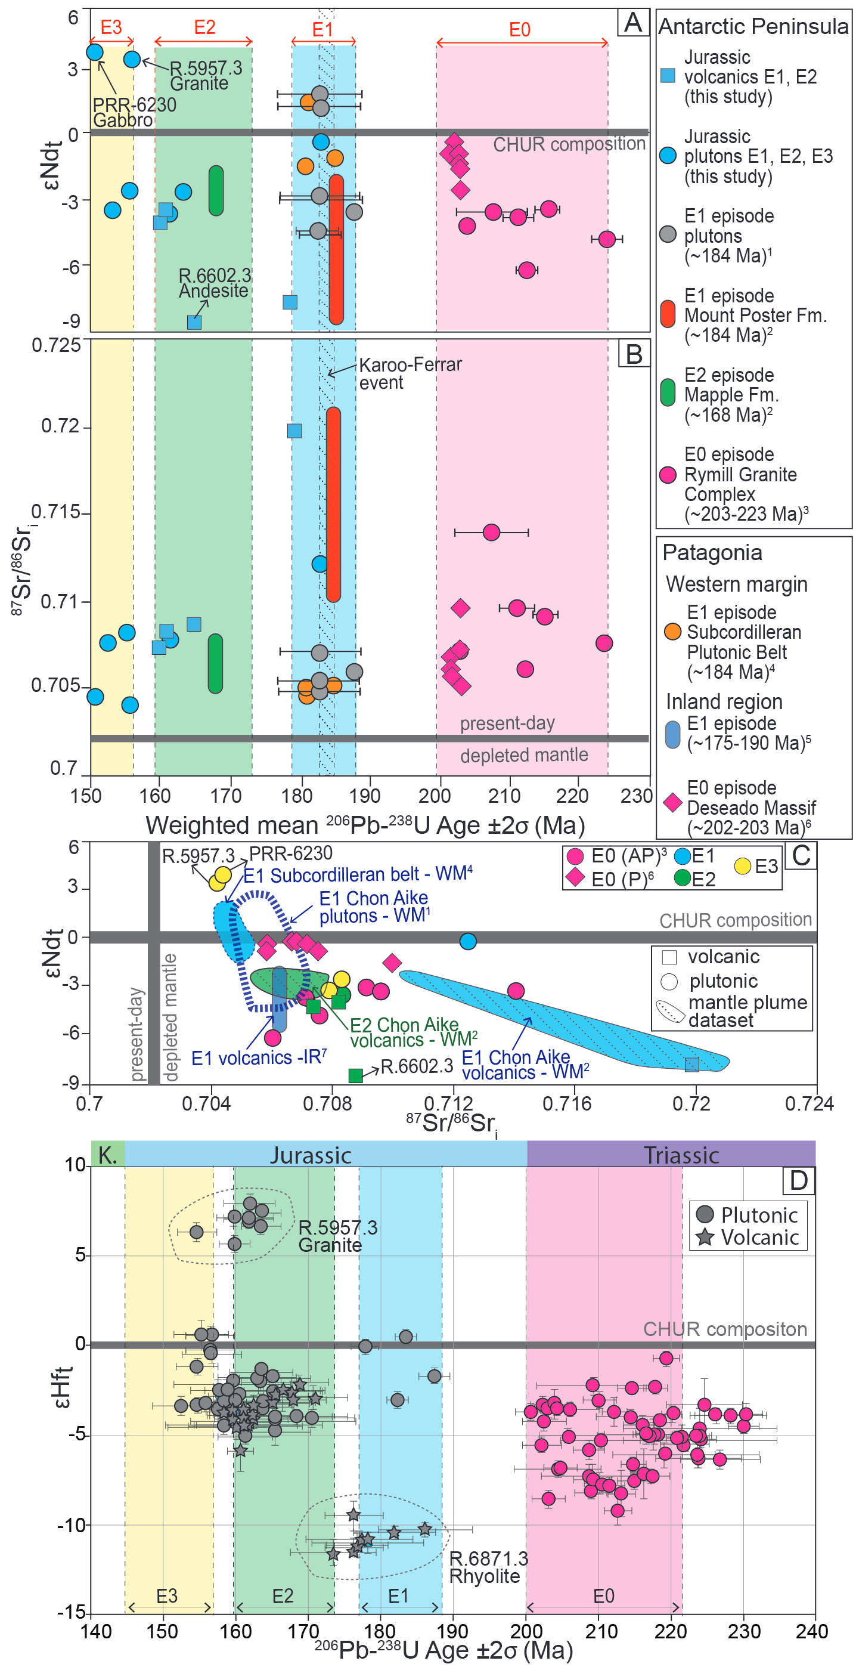
Bastias et al. (in review)

Slide 6
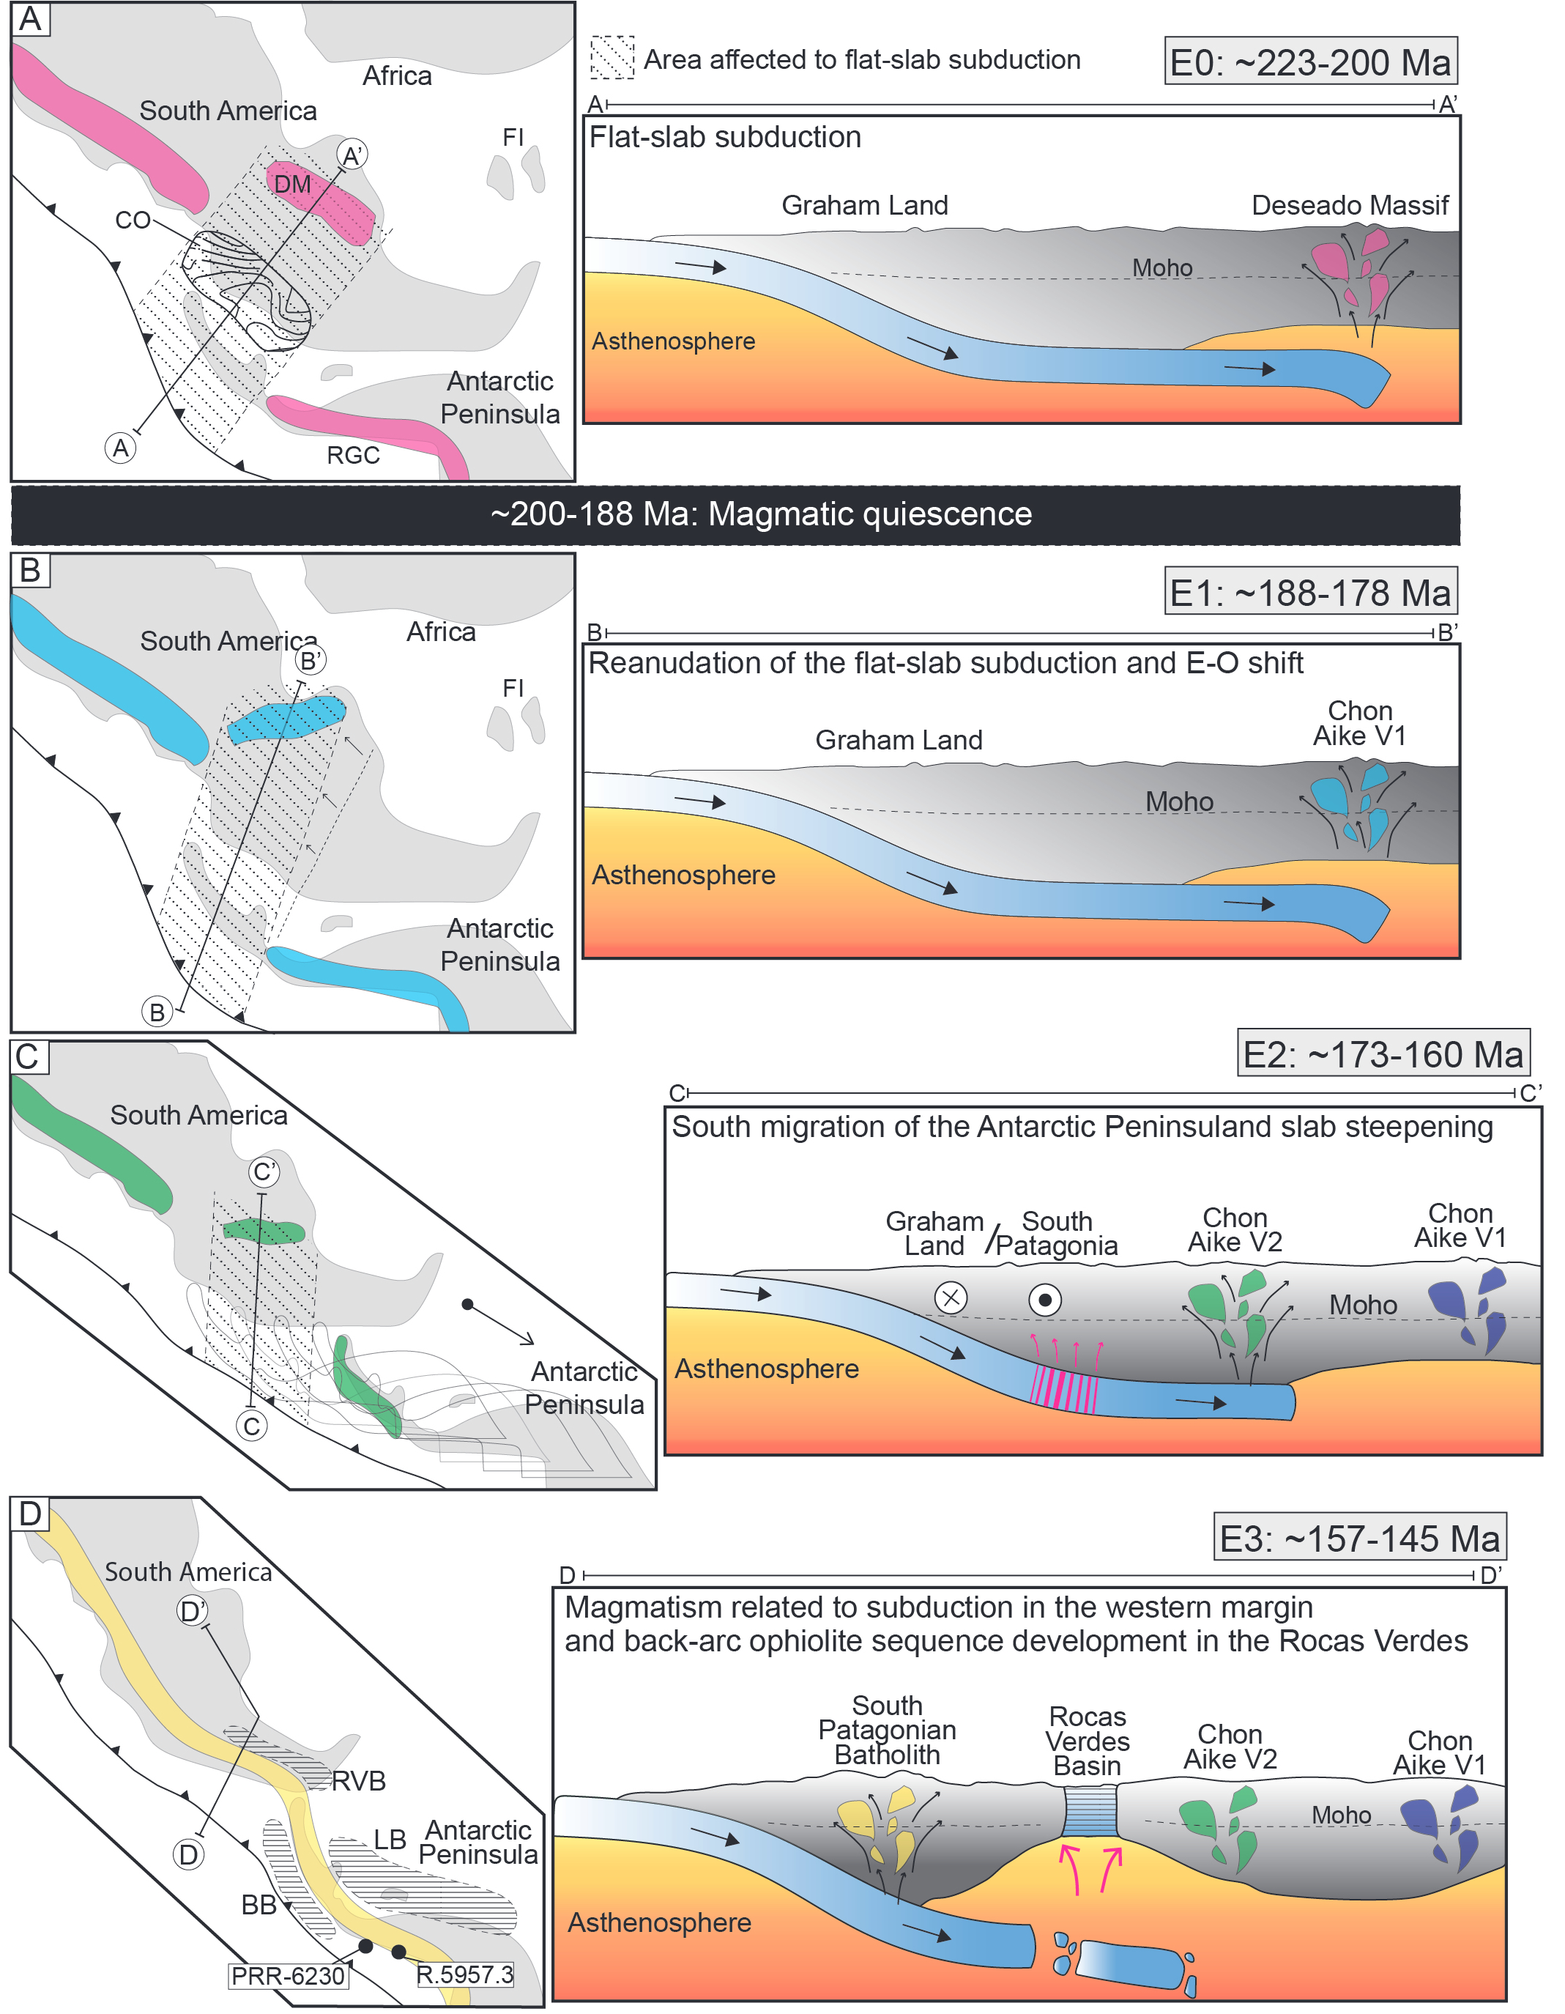
Bastias et al. (in review)

Slide 7
Paleozoic to early Cenozoic
Model after Suarez (1976); Burton-Johnson & Riley (2014) and Bastias et al. (in review)
Configuration of active margin of SW Gondwana
Subduction of the Paleo-Pacific plate
Potentially continuous active subduction
Notes:
The motivation of the thesis
Autochthonous continental arc of the Gondwana margin
Developed since the Mesozoic beneath the supercontinent

Slide 8
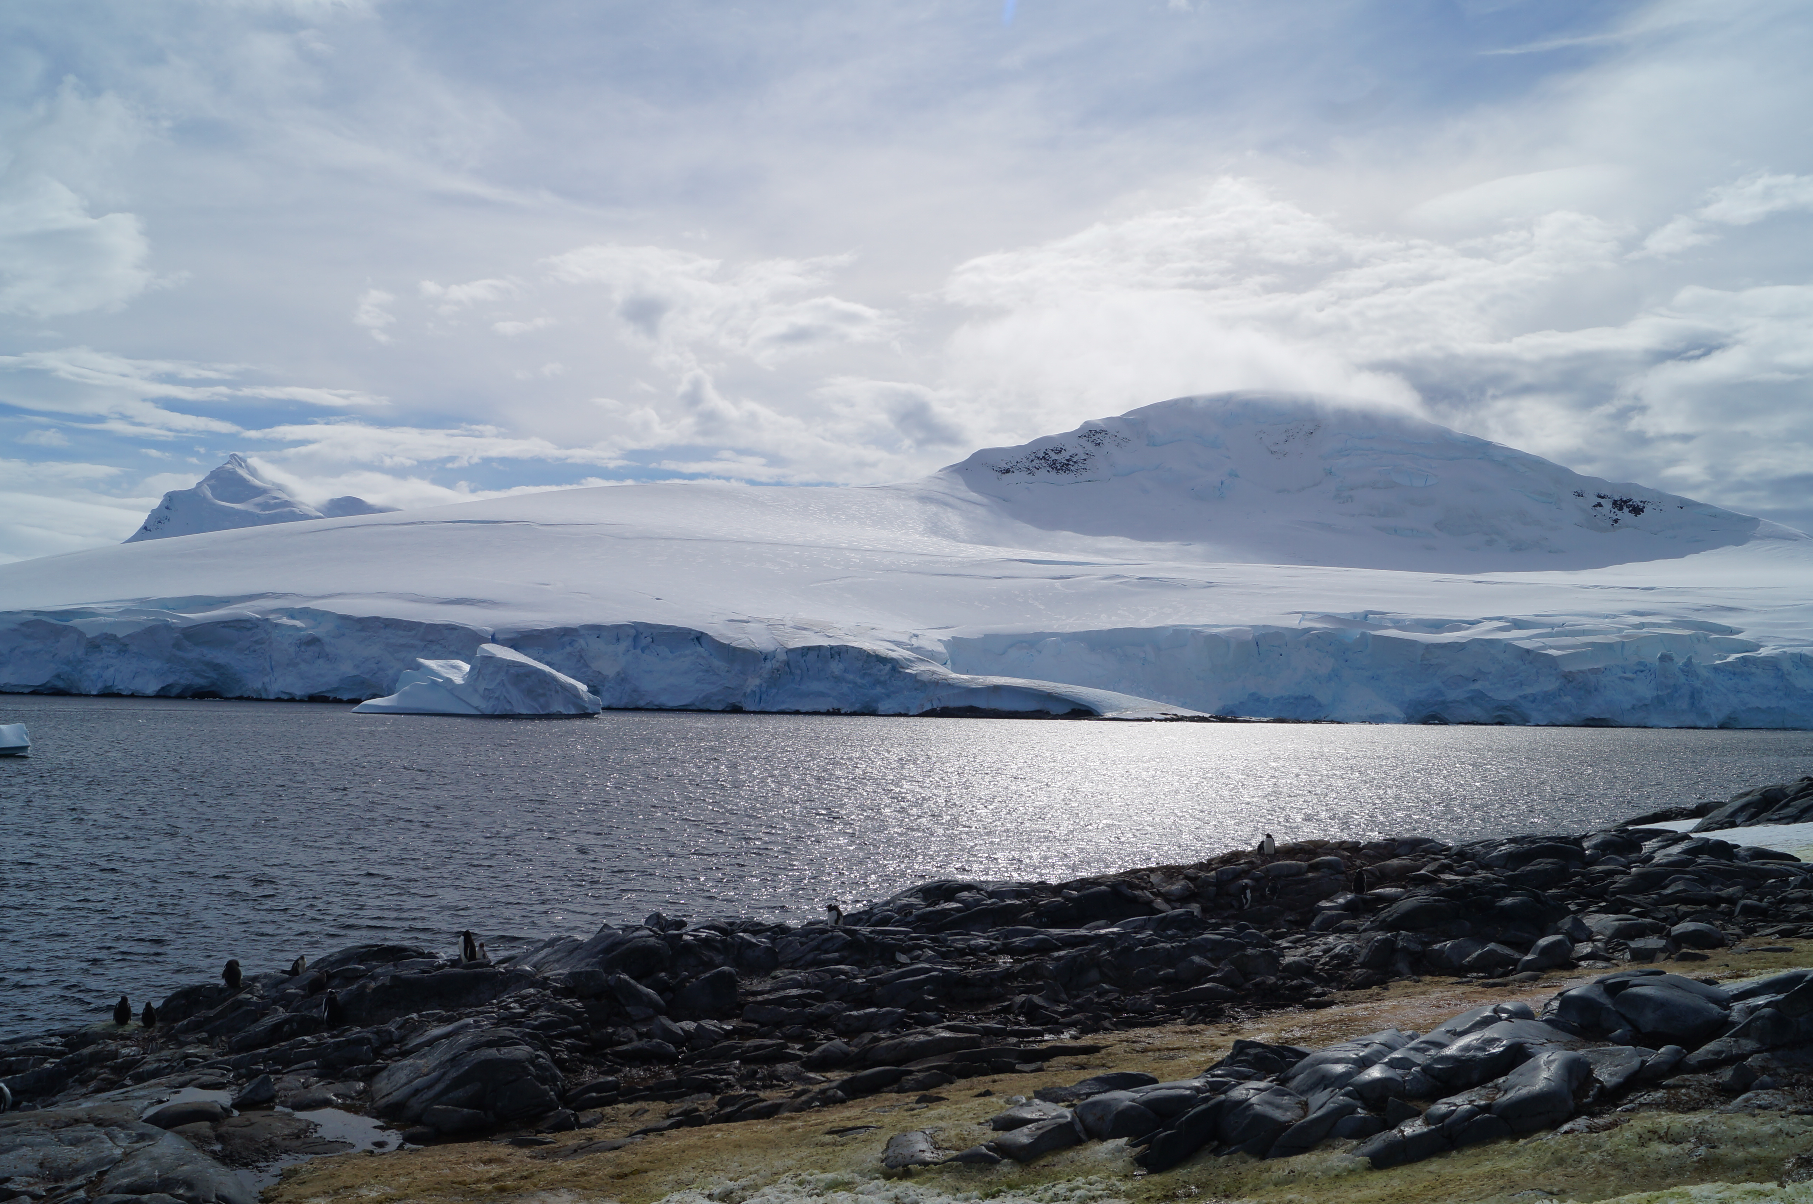
Gracias!

