Slide 1
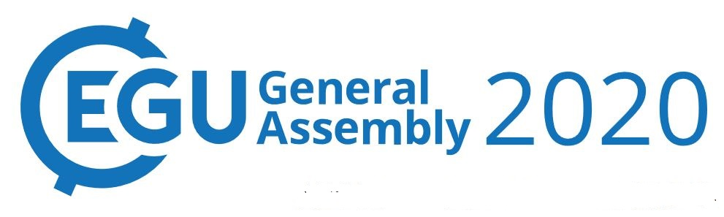

Importance of wind variations and intersecting waveguides near Sri Lanka for the intraseasonal sea level variability along the west coast of India
I. Suresh^{1*}, J. Vialard², M. Lengaigne², T. Izumo², and P. M. Muraleedharan¹
¹ CSIR-National Institute of Oceanography (CSIR-NIO), Goa, India
² LOCEAN-IPSL, Sorbonne Université (UPMC, Univ Paris 06)-CNRS-IRD-MNHN, Paris, France
*isuresh@nio.org/isuresh.nio@gmail.com

Slide 2
Abstract
Remote wind forcing plays a strong role in the Northern Indian Ocean, where oceanic anomalies can travel long distances within the coastal waveguide. Previous studies for instance emphasized that remote equatorial forcing is the main driver of the sea level and currents intraseasonal variability along the west coast of India (WCI). Until now, the main pathway for this connection between the equatorial and coastal waveguides was thought to occur in the eastern equatorial Indian Ocean, through coastal Kelvin waves that propagate around the Bay of Bengal rim and then around Sri Lanka to the WCI (Fig. 1). Using a linear, continuously stratified ocean model, the present study demonstrates that two other mechanisms in fact dominate. First, the equatorial waveguide also intersects the coastal waveguide at the southern tip of India and Sri Lanka, creating a direct connection between the equator and WCI. Rossby waves reflected from the eastern equatorial Indian Ocean boundary indeed have a sufficiently wide meridional scale (Figs. 2 and 3) to induce a pressure signal at the Sri Lankan coast, which eventually propagates to the WCI as a coastal Kelvin wave. Second, local wind variations in the vicinity of Sri Lanka (Fig. 4) generate strong intraseasonal signals, which also propagate to the WCI along the same path. Sensitivity experiments (Fig. 5) indicate that these two new mechanisms (direct equatorial connection and local wind variations near Sri Lanka) dominate the WCI intraseasonal sea level variability, with the “classical” pathway around the Bay of Bengal only coming next (Fig. 6). Other contributions (Bay of Bengal forcing, local WCI forcing) are much weaker.
By providing an improved understanding of the mechanisms that control the WCI thermocline and oxycline variability, our results could have socio-economic implications for regional fisheries and ecosystems.

Slide 3
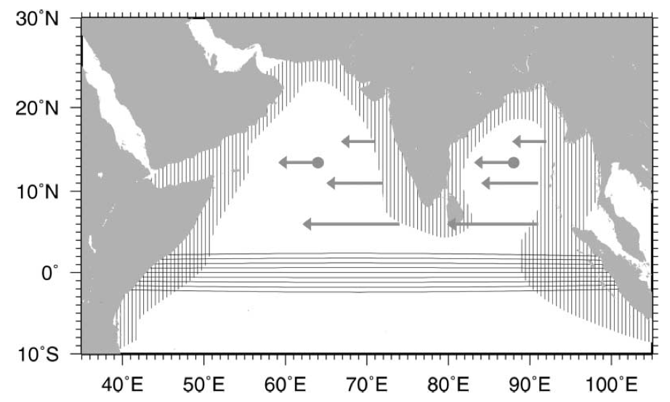
Background & Motivation: the North Indian Ocean (NIO) waveguide
Earlier studies – emphasized importance of remote forcing for seasonal sea level variability along the Indian coast & proposed “leaky waveguide” connecting remote regions of the NIO
Equatorial winds
equatorial Kelvin waves
coastal Kelvin waves in the Bay of Bengal (BoB)
signals turn around Sri Lanka
poleward along the west coast of India (WCI)
Refer to as “classical pathway” or EQB
Fig 1. Schematic showing NIO waveguide
Shankar et al., 2002
Equatorial waveguide
Coastal waveguide
Recent studies demonstrated that such a dynamical link between the equatorial and the coastal waveguides of the NIO exists even at intraseasonal timescale
McCreary et al. 1993, 1996; Shankar and Shetye, 1997; Shankar et al. 2002; Shetye, 1998; Vialard et al., 2009; Suresh et al., 2013

Slide 4
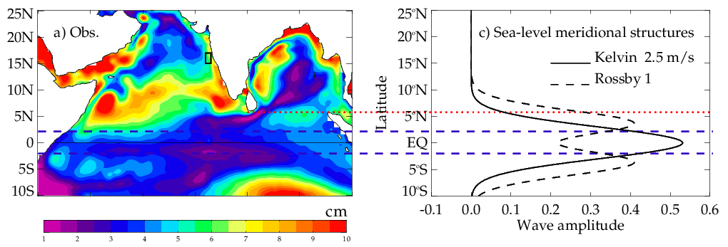
The intersecting waveguides
Fig 2. Theoretical meridional structures of Kelvin and first meridional mode Rossby waves
Amplitude of first baroclinic, first meridional mode Rossby wave at the southern tip of Sri Lanka is 70% of its maximum at 4ºN => equatorial and NIO coastal waveguides intersect at the Sri Lankan coast
Equatorial Rossby waves can potentially trigger Kelvin wave signals at the Sri Lankan coast
Suggestive of a new “direct” connection between the equatorial and the NIO coastal waveguides, which we refer to as EQD

Slide 5
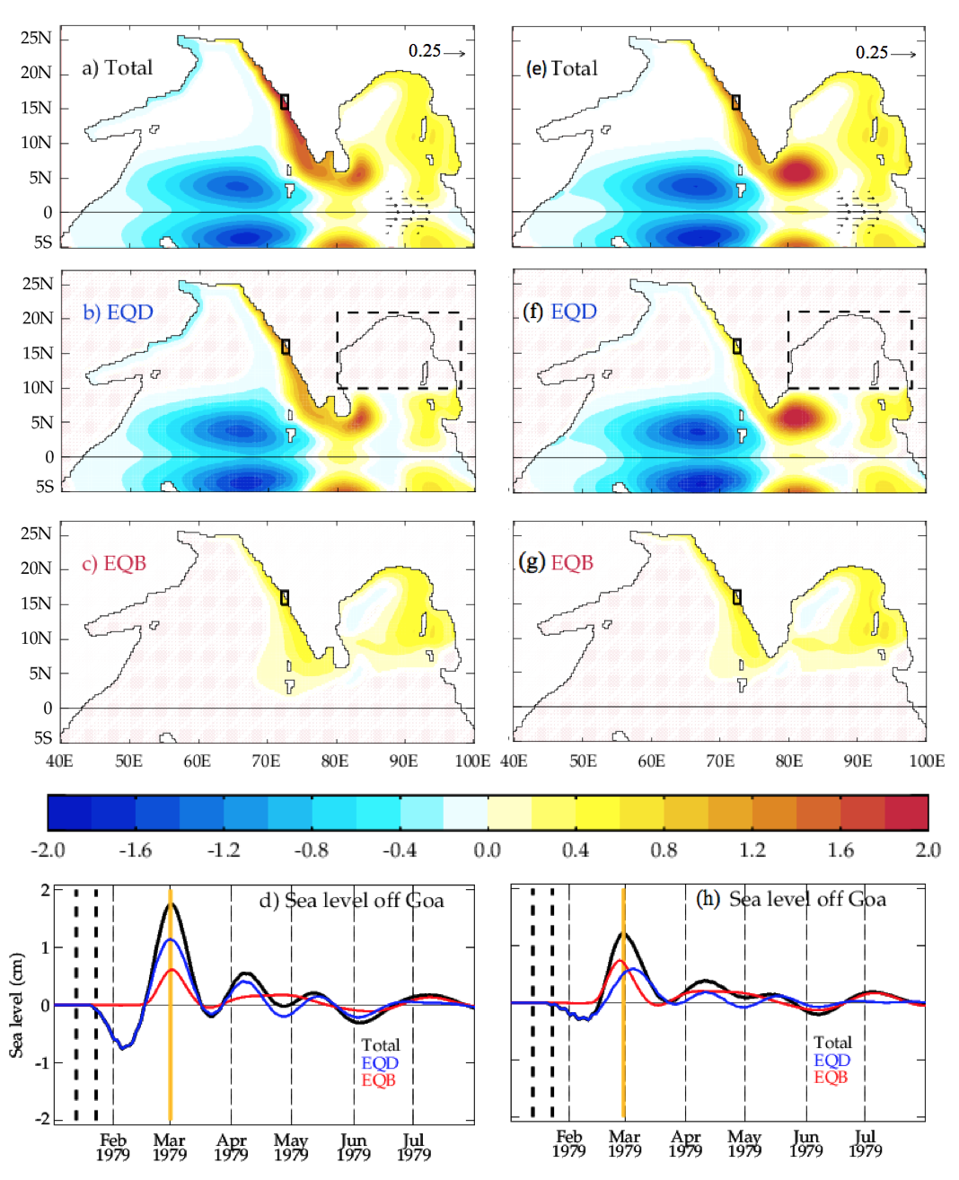
Demonstration of the new direct connection (EQD)
Fig 3. Idealized experiment with a linear, continuously stratified (LCS) model
Response to equatorial westerly wind burst
cm
Suggests that there is indeed a direct connection at the southern tip of India (EQD) associated with equatorial Rossby waves
Role of this EQD process for WCI sea level variability has so far not been explored in the literature!
Respective EQD & EQB contributions?
EQD
EQB

Slide 6
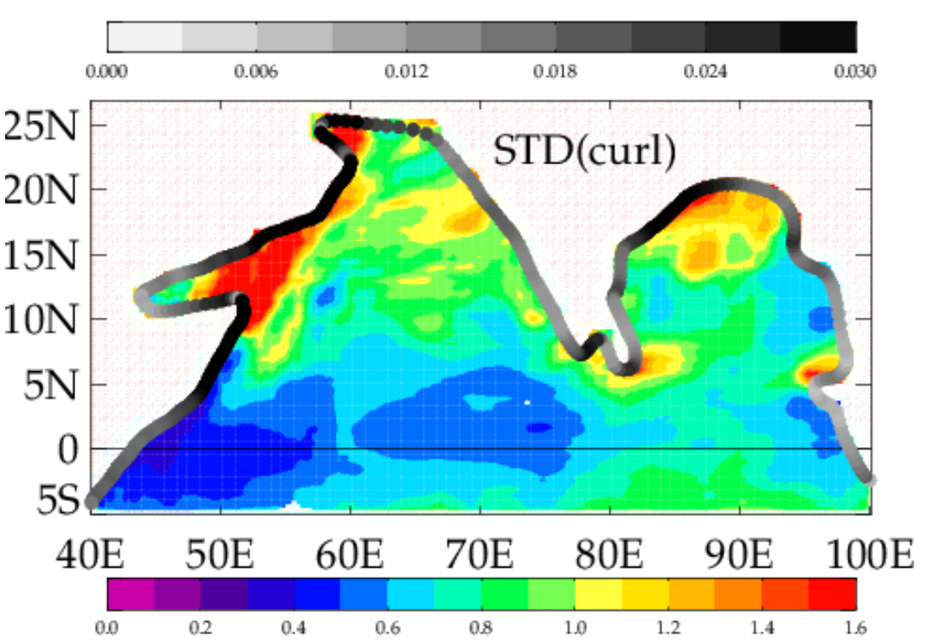
The forcing hotspots
N/m²
Fig 4. Amplitude of intraseasonal wind variations: alongshore forcing (grey scale) and wind-stress curl forcing (color scale)
Strong alongshore forcing
Strong wind-stress curl forcing
Both processes will collectively be referred to as ST process
x 10⁷ N/m³
Suresh et al. (2016) demonstrated that seasonal wind variations near Sri Lanka, i.e. ST process drives most of the seasonal sea level variability along the WCI
What is the role of wind stress forcing near Sri Lanka (ST process) for intraseasonal sea level variability along WCI?

Slide 7
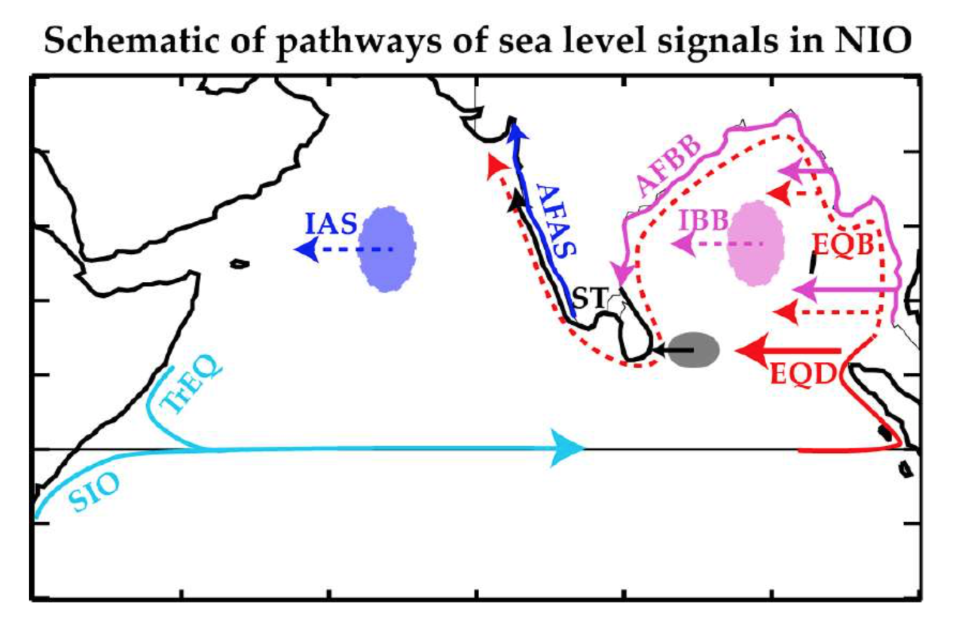
The model and experiments
Fig. 5. Schematic pathways & process decomposition
A linear continuously stratified (LCS) ocean model
LCS model: solves linearized shallow water equations individually for each baroclinic mode
Modified version of McCreary et al. (1996)
Configured for Indian Ocean domain
Forced with Tropflux wind stress anomalies (1979-2013) => CTL simulation
Processes are isolated using sensitivity experiments
Linearity allows isolating the processes: Equatorial (EQB and EQD), Bay of Bengal (BB), southern tip of India (ST) and Arabian Sea (AS) wind forcing
CTL sea level can be decomposed into that due to each process
SL_{CTL} = SL_{EQD} + SL_{EQB} + SL_{ST} + All other processes

Slide 8
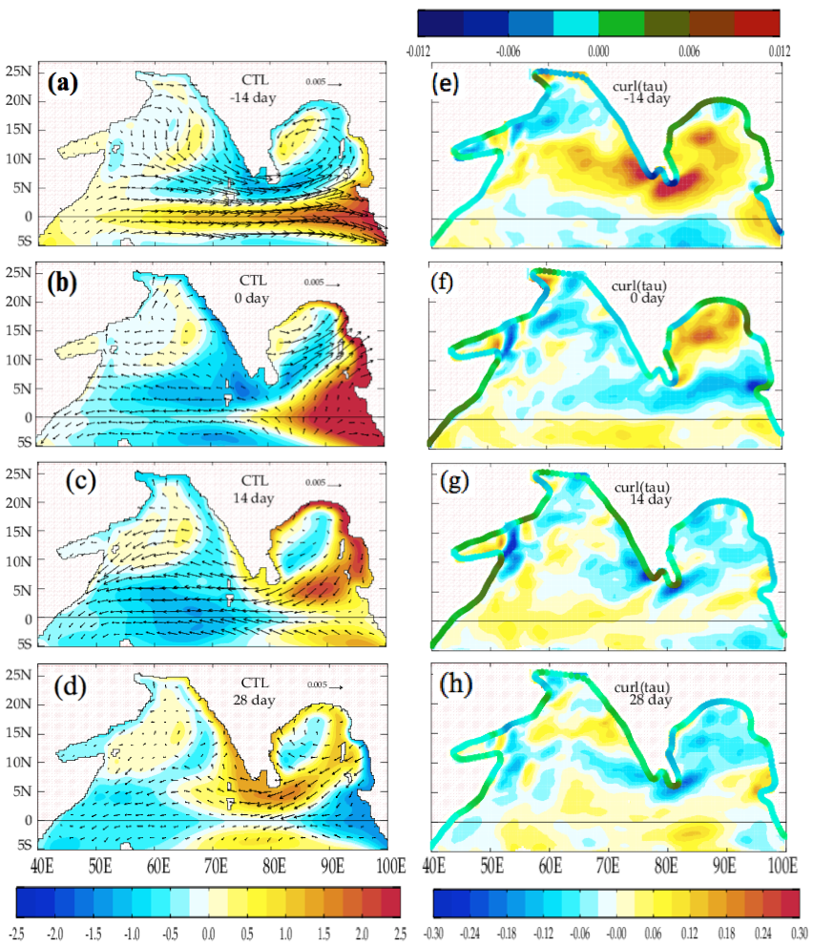
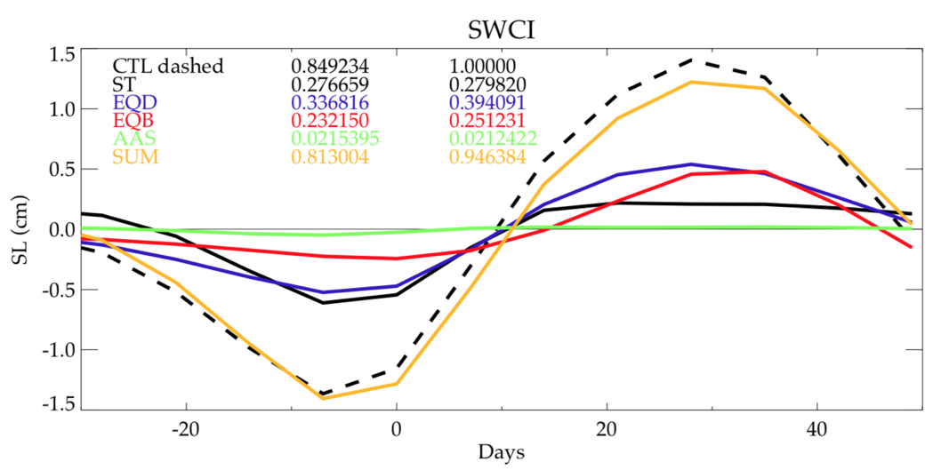
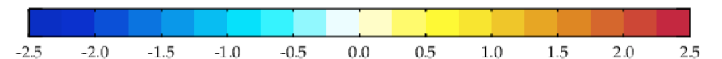
Dominant mechanisms of WCI intraseasonal sea level variability
Fig. 6. West coast of India process decomposition
cm
EQD and ST are the main contributing processes to the WCI intraseasonal sea level variability, followed by EQB

Slide 9
Summary
Using idealized experiments with a linear, continuously stratified model, we demonstrate for the first time, a new direct connection between equatorial waveguide and the west coast of India
Equatorial signals through the above link, i.e. the EQD process, is the dominant mechanism of WCI intraseasonal sea level variability, followed by wind forcing near Sri Lanka (ST) and, finally, the ”classical” equatorial connection through the Bay of Bengal (EQB)
While EQD is also important at interannual timescale, it does not operate at seasonal timescale (not shown)
Suresh et al., Importance of wind variations and intersecting waveguides near Sri Lanka for the intraseasonal sea level variability along the west coast of India, in preparation

Slide 10
References
McCreary, J. P., Jr., Kundu, P.K., & Molinari, R. L. (1993). A numerical investigation of dynamics, thermodynamics and mixed-layer processes in the Indian Ocean. Prog. Oceanogr., 31(3), 181–244, doi:10.1016/0079-6611(93)90002-U.
McCreary, J. P., Han, W., Shankar, D., & Shetye, S. R. (1996). Dynamics of the East India Coastal Current: 2. Numerical solutions. J. Geophys. Res., 101, 13, 993– 14,010, doi:10.1029/96JC00560.
Shankar, D., & Shetye, S. R. (1997). On the dynamics of the Lakshadweep high and low in the southeastern Arabian Sea. J. Geophys. Res., 102, 12551–12562, doi:10.1029/97JC00465.
Shankar, D., Vinayachandran, P. N., & Unnikrishnan, A. S. (2002). The monsoon currents in the North Indian Ocean. Prog. Oceanogr., 52(1), 63–120, doi:10.1016/S0079-6611(02)00024-1.
Shetye, S. R. (1998). West India Coastal Current and Lakshadweep high/low. Sadhana, 23, 637–651.
Suresh, I., Vialard, J., Izumo, T., Lengaigne, M., Han, W., McCreary, J., & Muraleedharan, P. M. (2016). Dominant role of winds near Sri Lanka in driving seasonal sea level variations along the west coast of India. Geophys. Res. Lett., 43, doi:10.1002/ 2016GL069976.
Suresh, I., Vialard, J., Lengaigne, M., Han, W., McCreary, J., Durand, F., & Muraleedharan, P. M. (2013). Origins of wind-driven intraseasonal sea level variations in the North Indian Ocean coastal waveguide. Geophys. Res. Lett., 40, 5740–5744, doi:10.1002/2013GL058312.
Vialard, J., Shenoi, S. S. C., McCreary, J. P., Shankar, D., Durand, F., Fernando, V., & Shetye, S. R. (2009). Intraseasonal response of the northern Indian Ocean coastal waveguide to the Madden-Julian oscillation. Geophys. Res. Lett., 36, L14606, doi:10.1029/2009GL038450.

Slide 11




Thank you

