Slide 1
Emerging heat extremes, adaptation and the speed of socio-economic development
Carl-Friedrich Schleussner, Martha M. Vogel, Peter Pfleiderer, Marina Andrijevic, Friederike E. Otto, and Sonia I. Seneviratne
06.05.20
EGU 2020
ITS3.2/NH10.7/
BG1.35/CL2.36/
CR7.14/NP8.3/
OS1.35

Slide 2
Conceptualising climate resilience through integration of adaptive capacity and climate scenarios
Concentration
Pathways
Scenarios of
Adaptive Capacity
(Resilient) Development
Pathways

Slide 3
An attempt to assess the effectiveness of climate resilience building
Assess the temporal evolution of adaptive capacity (proxy adaptation readiness RDY from Andrijevic et al. 2019)
Assess the temporal evolution of an index for ‘adaptation pressure’ (proxied by number of heat days (NHD) relative to a moving reference period, Vogel et al. forthcoming)
Decide on a ‘relevant’ reference framework => value judgment what constitutes ‘sufficient’ resilience building. Approach: use the recent past as a reference
Andrijevic, M., Crespo Cuaresma, J., Muttarak, R., & Schleussner, C.-F. (2019). Governance in socioeconomic pathways and its role for future adaptive capacity. Nature Sustainability. https://doi.org/10.1038/s41893-019-0405-0

Slide 4
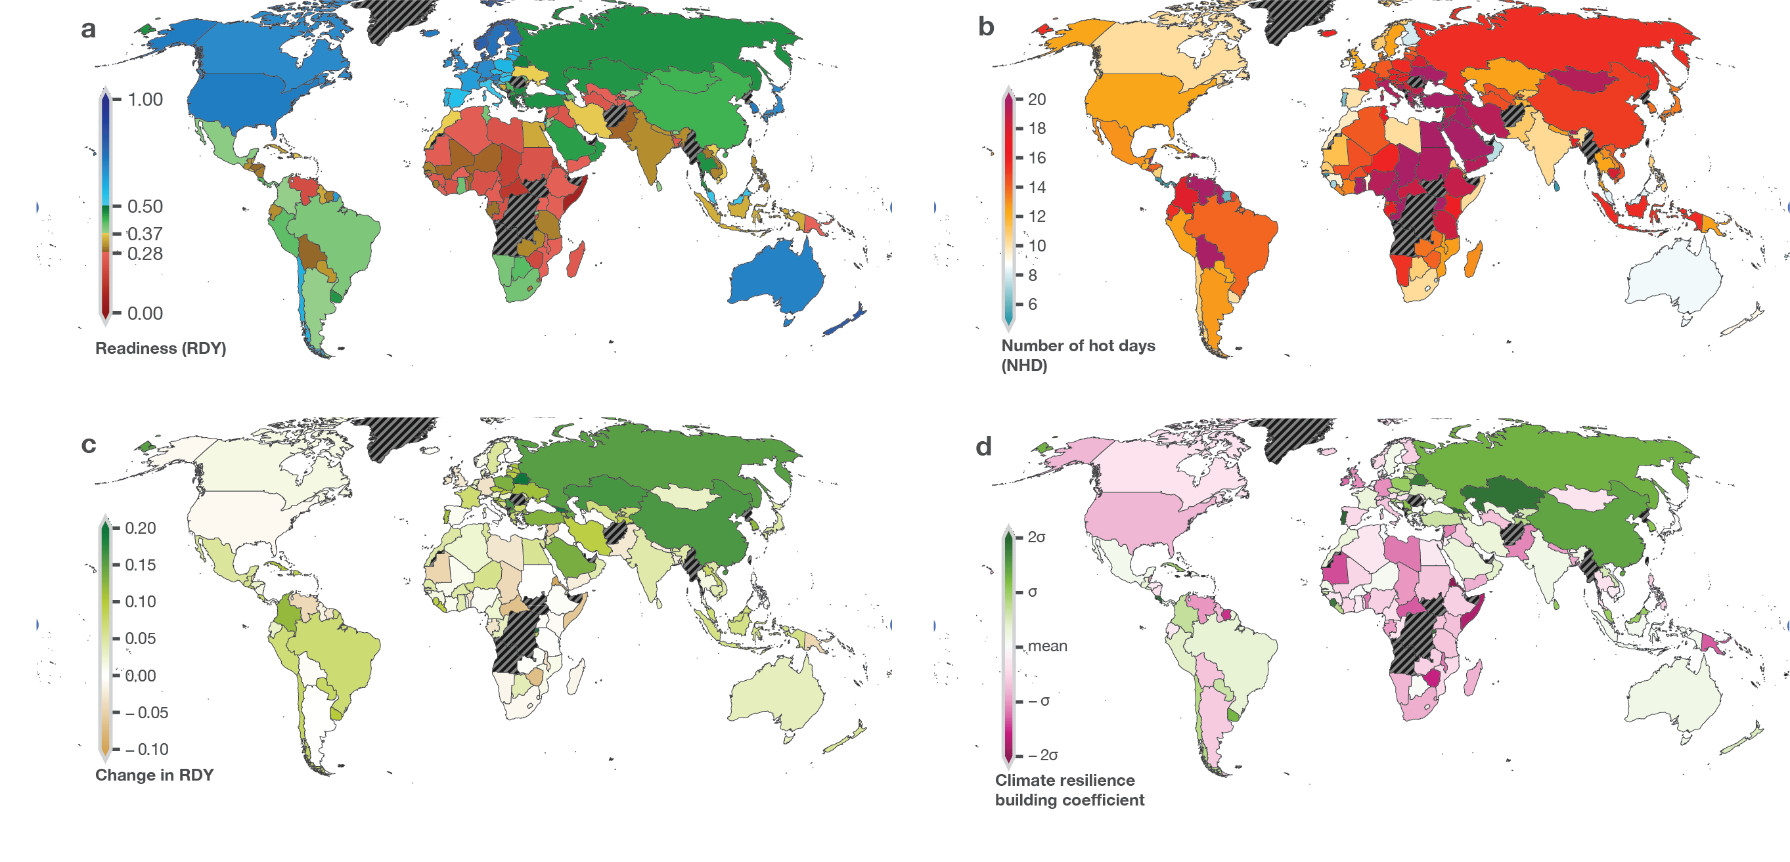
The resilience building experience
Schleussner et al. (in Review)

Slide 5
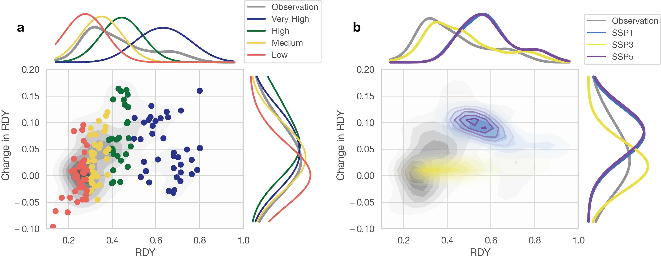
Adaptation readiness observed vs. in SSPs
Country groupings
2050
Observational record doesn’t imply ‘catching up’ of adaptation readiness for everyone, more a ’the medium rich get richer’
SSPs illustrate a diverse range of potential futures together resembling the observed
Schleussner et al. (in Review)
Notes:
adaptation

Slide 6
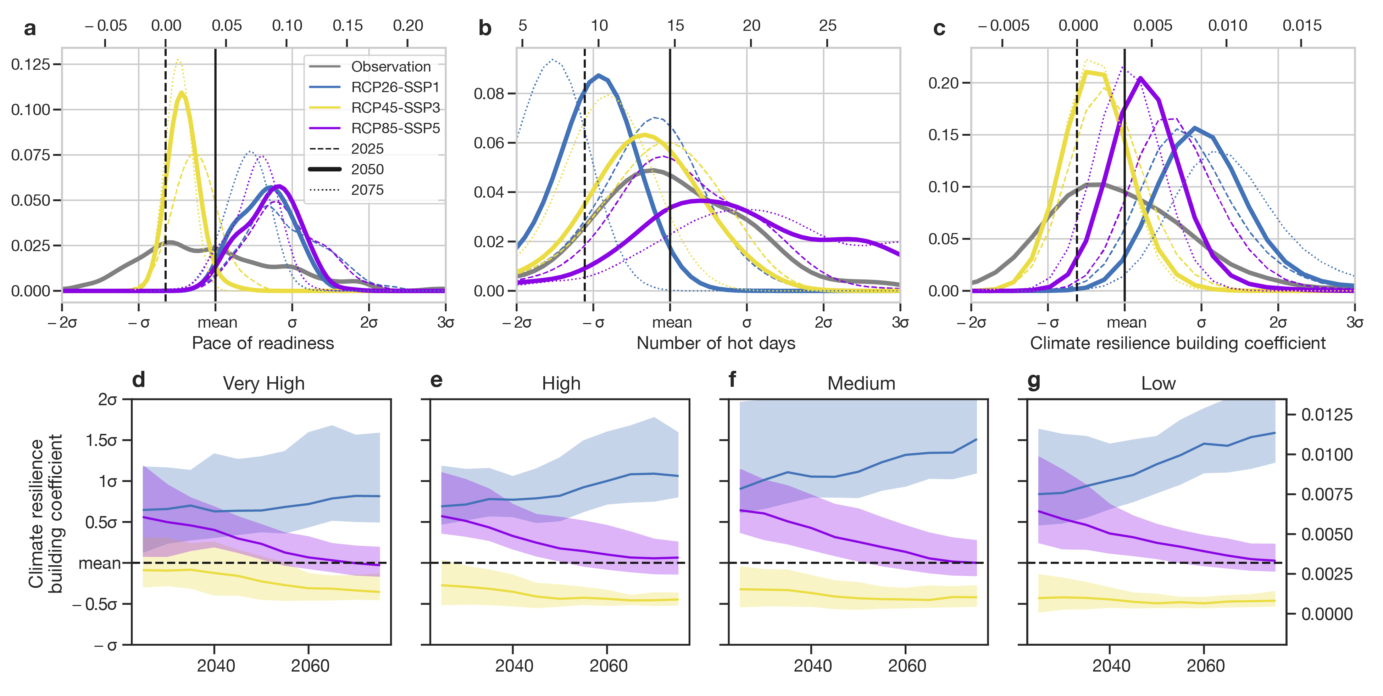
Projecting resilience building
Compared to observed:
Adaptation readiness is slowed down under SSP3, substantially faster in SSP1,5
Hot day emergence is slowed down/remains similar/speeding up under RCP26/45/85
Climate resilience building is similar to observed for RCP45-SSP3 and RCP85-SSP5, only significantly improved for the RCP26-SSP1
Schleussner et al. (in Review)

Slide 7
Projecting resilience building
Country groupings
Difference most pronounced for vulnerable countries in biggest need for resilience building
Schleussner et al. (in Review)

Slide 8
In which world do we want to be in?
Schleussner et al. (in Review)

Slide 9
Thank you for your attention!
Andrijevic M, Crespo Cuaresma J, Muttarak R and Schleussner C-F 2019 Governance in socio-economic pathways and its role for future adaptive capacity Nat. Sustain. Online: http://dx.doi.org/10.1038/s41893-019-0405-0
https://www.carbonbrief.org/guest-post-why-climate-scenarios-need-to-better-incorporate-adaptive-capacity

