Slide 1
The Boundary Layer and its Response to External Forcing at Summit Station Greenland
William Neff, Christopher Cox, Matthew Shupe,
University of Colorado, CIRES, NOAA/ESRL/PSL, Boulder, United States (william.neff@Colorado.edu)
With support from the ICECAPS project.
EGU2020 AS2.2 Boundary Layers in High Latitudes: Physics and Chemistry

Slide 2
Background: A decade-long observatory data set from the summit of Greenland
ICECAPS: 2010-2020 Comprehensive observation of clouds, radiation, and boundary layer evolution
2013 Shupe, M. D., et al. (2013), HIGH AND DRY New Observations of Tropospheric and Cloud Properties above the Greenland Ice Sheet, Bulletin of the American Meteorological Society, 94(2), 169-+.

Slide 3
A few research highlights:
R. Bennartz1, M. D. Shupe2, D. D. Turner3, V. P. Walden4, K. Steffen2,5, C. J. Cox 4, M. S. Kulie6, N. B. Miller6 & C. Pettersen6, July2012 Greenland melt extent enhanced by low-level liquid clouds, Nature, doi:10.1038/nature12002.
Neff, W., G. P. Compo, F. M. Ralph, and M. D. Shupe (2014), Continental
heat anomalies and the extreme melting of the Greenland ice surface in
2012 and 1889, J. Geophys. Res. Atmos.,119, doi:10.1002/2014JD021470.
Bonne, J.-L., et al. (2015), The summer2012Greenlandheatwave:In situ and remote sensing observations of water vapor isotopic composition during an atmospheric river event, J. Geophys. Res. Atmos., 120, doi:10.1002/2014JD022602.
Mattingly, K. S., Mote, T. L., &Fettweis, X. (2018). Atmospheric river impacts on Greenland Ice Sheet surface mass balance. Journal of Geophysical Research: Atmospheres, 123, 8538–8560. https://doi.org/10.1029/2018JD028714.
Neff, W., Atmospheric rivers melt Greenland (2018), Nature Climate Change, 8(10), 857-858, doi:10.1038/s41558-018-0297-4. 2019
Cox, C. J., D. C. Noone, M. Berkelhammer, M. D. Shupe, W. D. Neff, N. B. Miller, V. P. Walden, and K. Steffen (2019), Supercooled liquid fogs over the central Greenland Ice Sheet, Atmospheric Chemistry and Physics, 19(11), 7467-7485, doi:10.5194/acp-19-7467-2019.

Slide 4
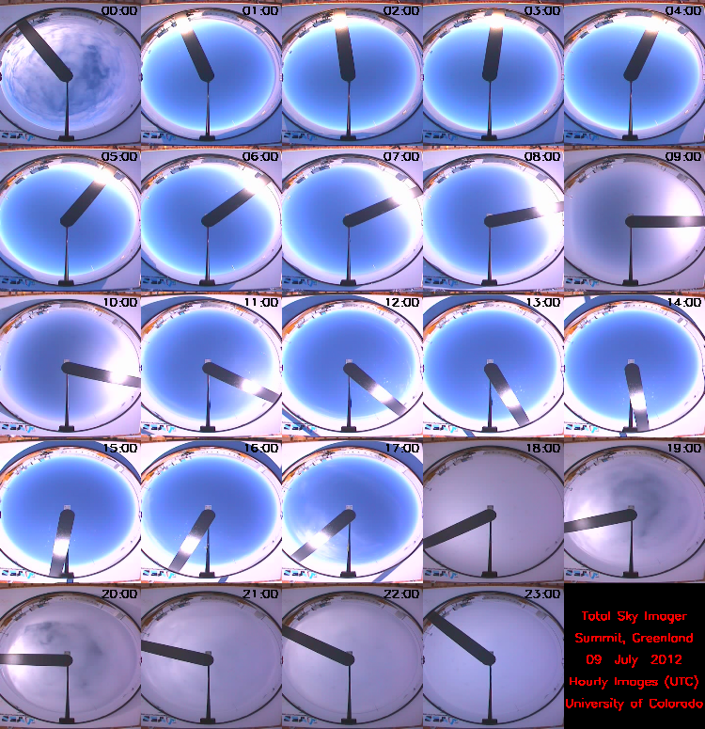
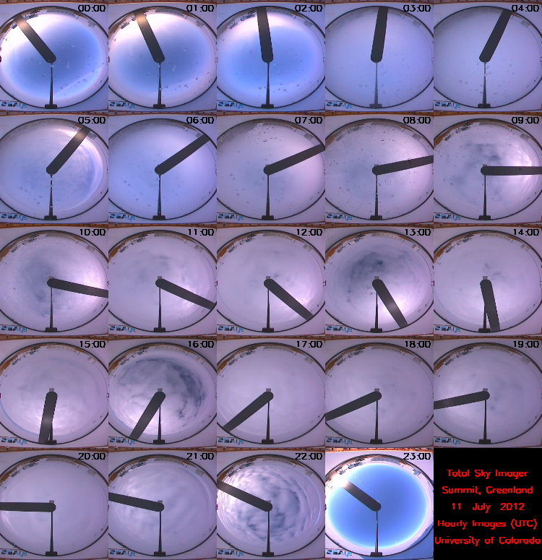
Motivation: During the 2012 melt episode we observed how large-scale synoptic transport events can disturb the boundary layer at Summit.
Hourly all-sky camera images for 9 (left) and 11 (right) July showing clear sky conditions on the first day in concert with extreme low temperatures and strong near-surface stability in the early morning followed by largely overcast skies on the 11th but with distinct sunlight appearing through the clouds.
9 July 0Z
11 July 0Z

Slide 5
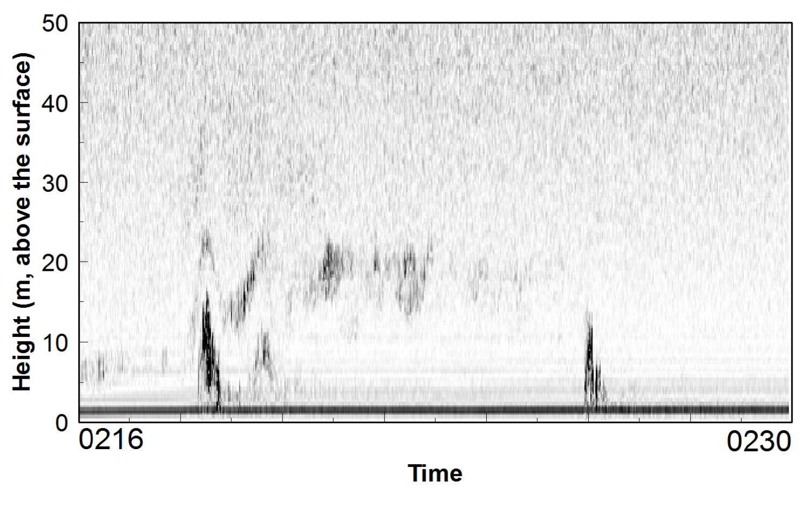
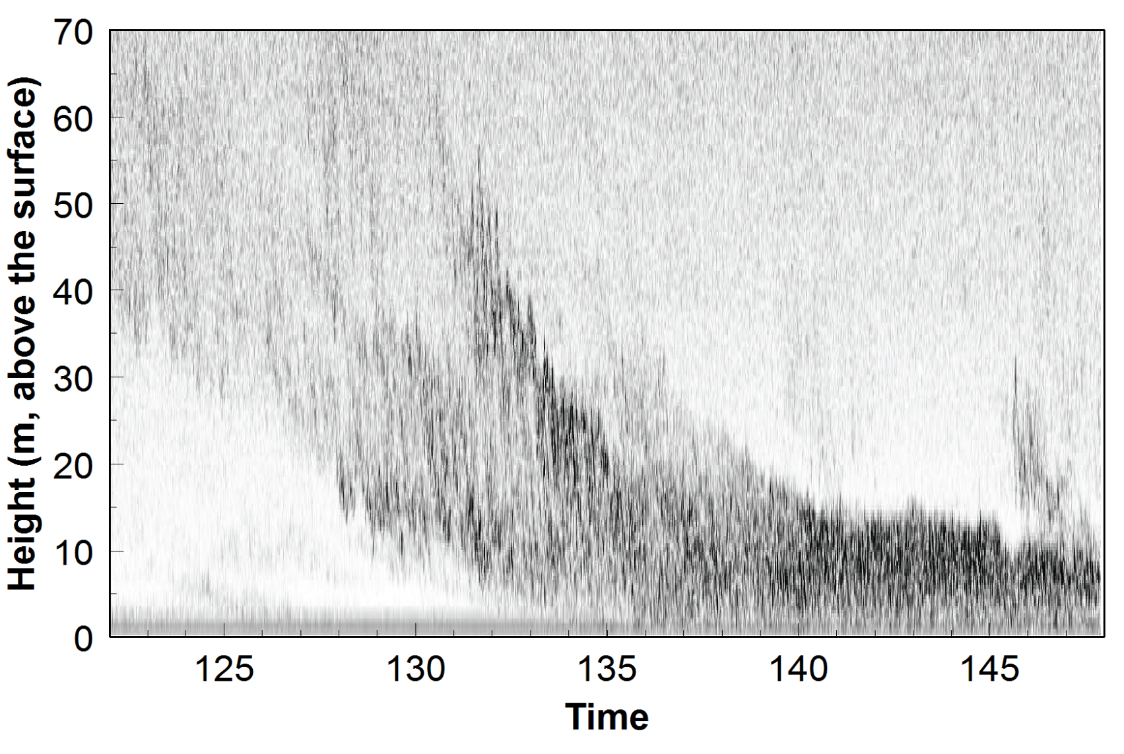
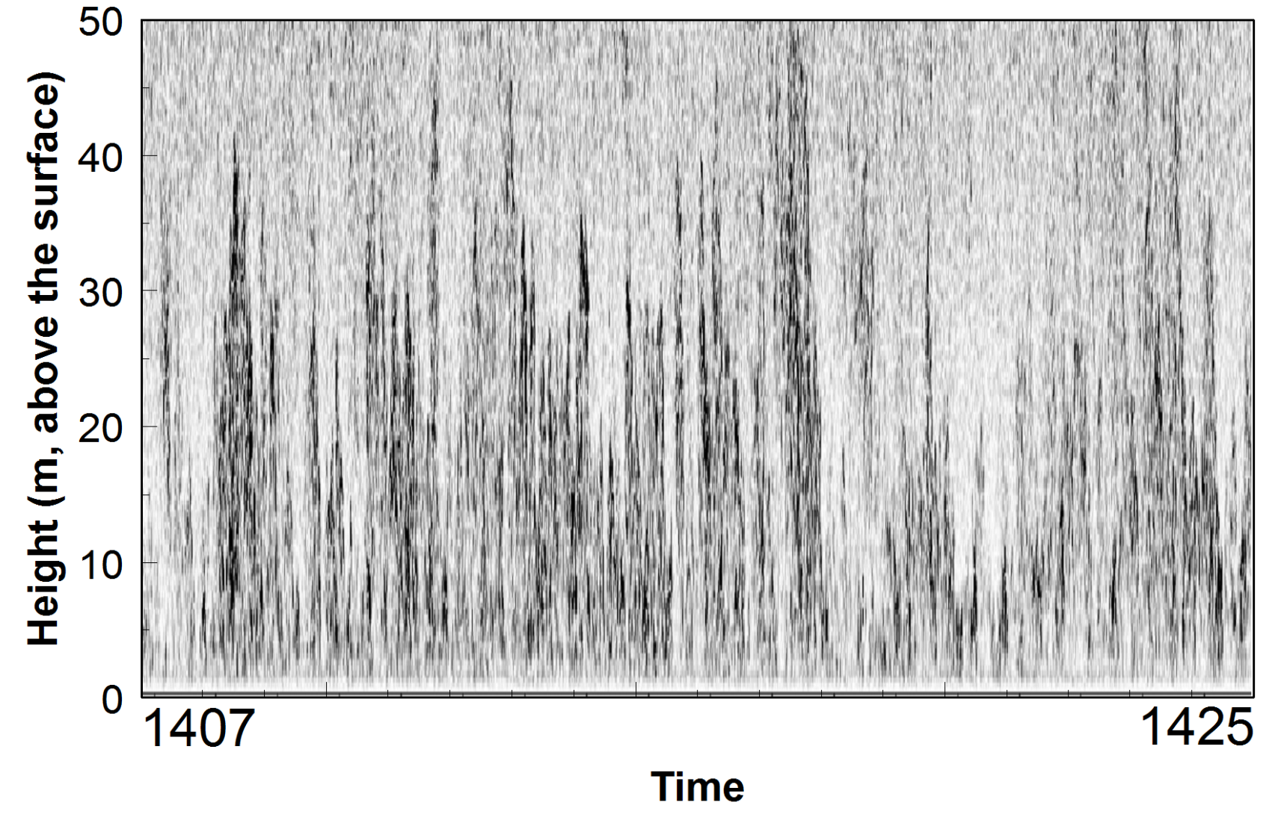
The sodar during the 2012 melt episode shows the boundary layer evolution from very stable to convective in response to synoptic events:
Case A: Sodar image during extreme stability case (~12ºC/8m). Note the intermittent nature of turbulence near the surface and the absence of any echoes at times suggesting nearly laminar flow.
Case B: Early morning on the 11th prior to the melt episode during a period of weak stability (~2º-3ºC/8m).
Despite the appearance of increased mixing the temperature difference between 2- and 10-m stays virtually constant.
Case C: Afternoon on the 11th during the melt episode when the temperature difference is superadiabatic. Vertically oriented structures are individual thermal plumes.

Slide 6
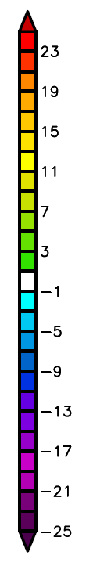
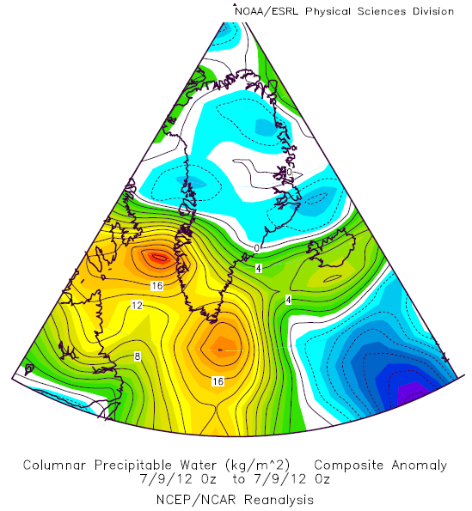
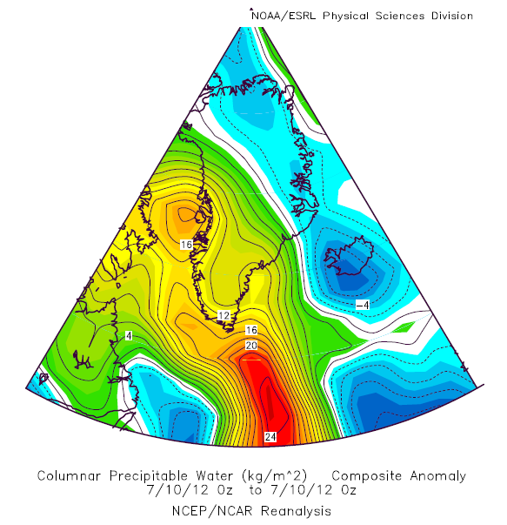
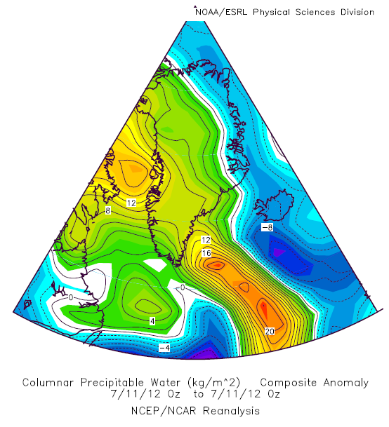
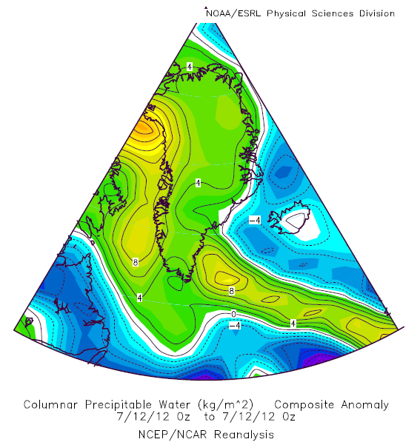
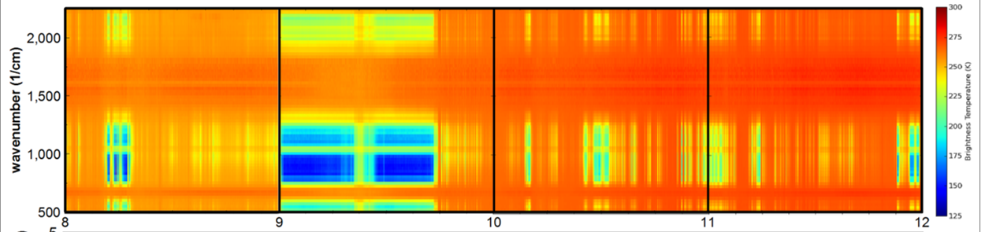
The boundary layer from July 9 through July 11, 2012 evolves in response to the sky brightness temperature:
Integrated Water Vapor Anomaly Spreading Across Greenland
9 July 0Z
10 July 0Z
11 July 0Z
12 July 0Z
Thin, liquid water clouds
Clear Skies
Polar Atmospheric Emitted Radiance Interferometer (PAERI) from the Washington State University: Downwelling sky brightness temperature spectra showing cold sky temperatures in the 750-1250 cm⁻¹ wavenumber bands on 8 and 9 July followed by much warmer brightness temperatures as the warm , cloudy air arrived aloft on 10 and 11 July. (See Shupe et al., 2013 and all-sky camera images on slide 4).

Slide 7
Where is all this leading?
A large-scale synoptic event, in this case an Atmospheric River was not confined to coastal areas but its moisture spread over the highest portions of the ice sheet modifying the surface energy budget and surface winds and hence the boundary layer.
The question then is how often ARs impact Greenland and whether there are other extreme or unusual events affecting the high plateau.

Slide 8
A bit of a review:
An atmospheric river (AR) and a continental heat anomaly played a key role in the melting of the ice sheet in 2012 and 1889 (Neff et al. 2014).
Water vapor isotopic analysis identified the primary moisture source during this event as the subtropical Atlantic (Bonne et al. 2015).
Recent results suggest that the frequency of ARs impacting Greenland has increased since about 2000. (Mattingly et al., 2018)
A major (10% of annual loss) coastal Greenland rain/melting discharge event occurred over four days in late August 2011 (Doyle et al. 2015, Nat. Geoscience).
This August event was initiated by an AR (Neff 2018, Nat. Clim. Change).

Slide 9
Climatology
Given the impacts of ARs on Greenland – from coastal areas and the subsequent transport of moisture over the ice sheet we created a climatology from reanalysis data at points just west of Greenland following results from Mattingly et al. (2018) for increased melting and Liu and Barnes (2015) for increased transport along the west coast during periods of anticyclonic wave breaking.

Slide 10
Liu and Barnes (2015) showed that transport along the western Greenland occurred during cyclonic wave breaking (CWB)
Newman et al.

Slide 11
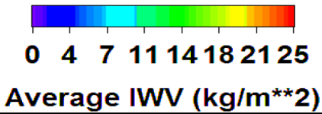
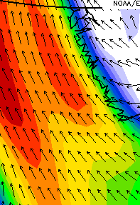
Question: Is there a simple way to characterize the larger synoptic environment producing moisture flux along the west coast of the GIS using single point(s) analysis.
Average JJA IWV 2000-2012, by Wind Speed and Direction at 850 hPa, 60N,50W
Topographic blocking of winds
Wind Speed (m/s)
>13 m/s
West Coast
Barrier Wind
Wind Direction

Slide 12
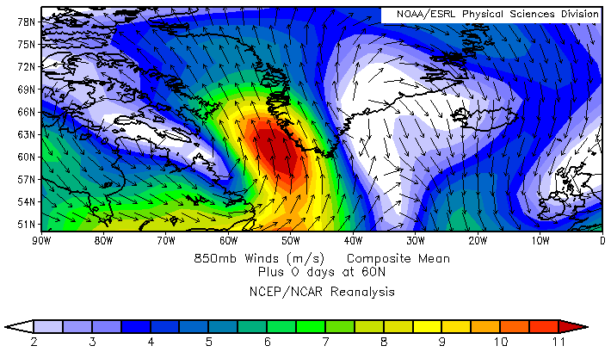
We took advantage of the topographic barrier effect of Greenland for these CWB-type events.
We identified 69 cases between 2000 and 2012 and created composite fields after setting criteria for northward (120º to 180º) transport at 850 hPa as follows:
Composite: Vector winds (850 hPa)
Criteria set at two locations:
65N,55W: IWV> 20 kg/m², WS>10m/s
60N,50W: IWV>25 kg/m², WS>10m/s
Summit Station
65N,55W
60N,50W

Slide 13
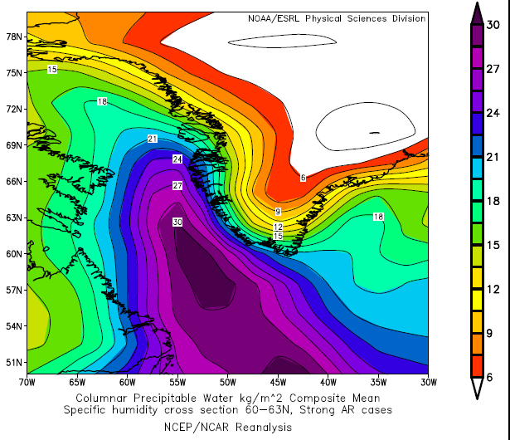
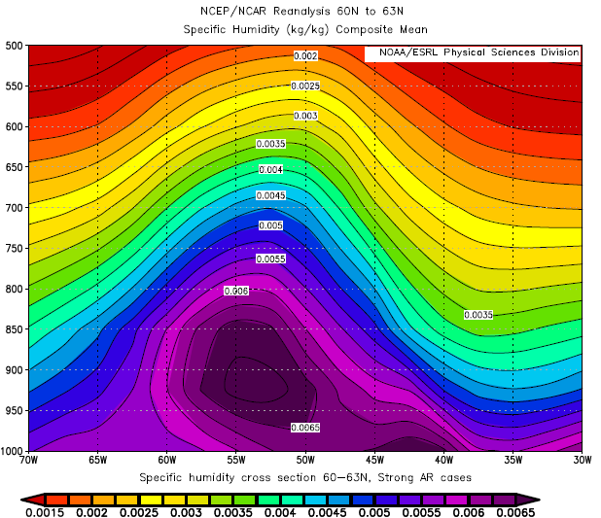
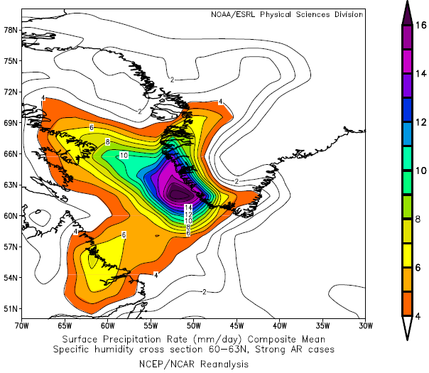
Left: Total column water vapor
Below: Vertical cross-section specific humidity
Lower left: Precipitation rate
Elevation Summit Station
Southern Tip of the GIS

Slide 14
The composite pattern of GPH at 850 hPa for strong ARs from 2000-2012:

Slide 15
The 24-30 August Event compared to Climatology

Slide 16
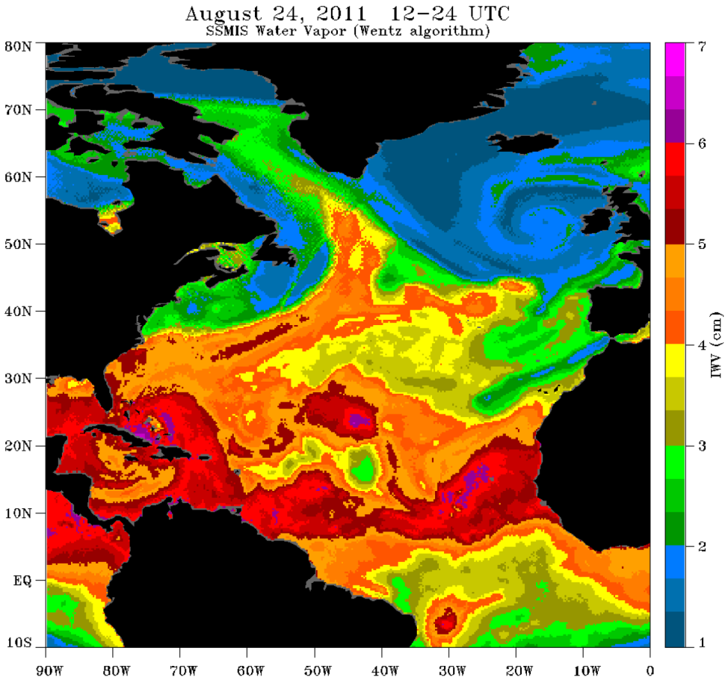
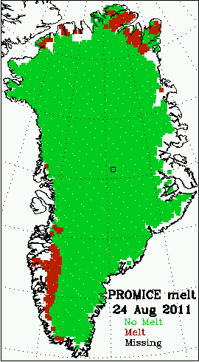
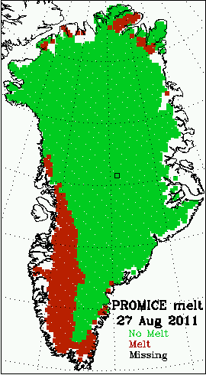
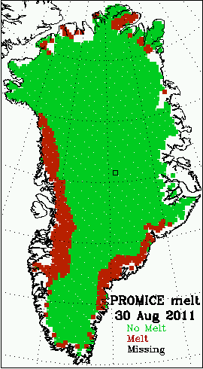
Case study: August 24-31, 2011
Integrated water vapor, 24 August
SSMI Image
Greenland
AR
AR
Moisture
Pathway from the extra-tropics
Heavy Rainfall at
Kangerlussuaq
Melt extent, 24-30 August

Slide 17
Synoptic pattern
The geopotential height field composited for August 24-28, 2011:
The composite GPH pattern of 69 strong ARs from 2000-2012:

Slide 18
Case study: AR and Hurricane Irene
AR
Moisture
Pathway
Irene
Hurricane Irene follows the same pathway as the AR due to the persistent synoptic pattern with the its extratropical cyclone phase arriving at the tip of Greenland
(next slide – use slide show mode in Powerpoint)

Slide 19
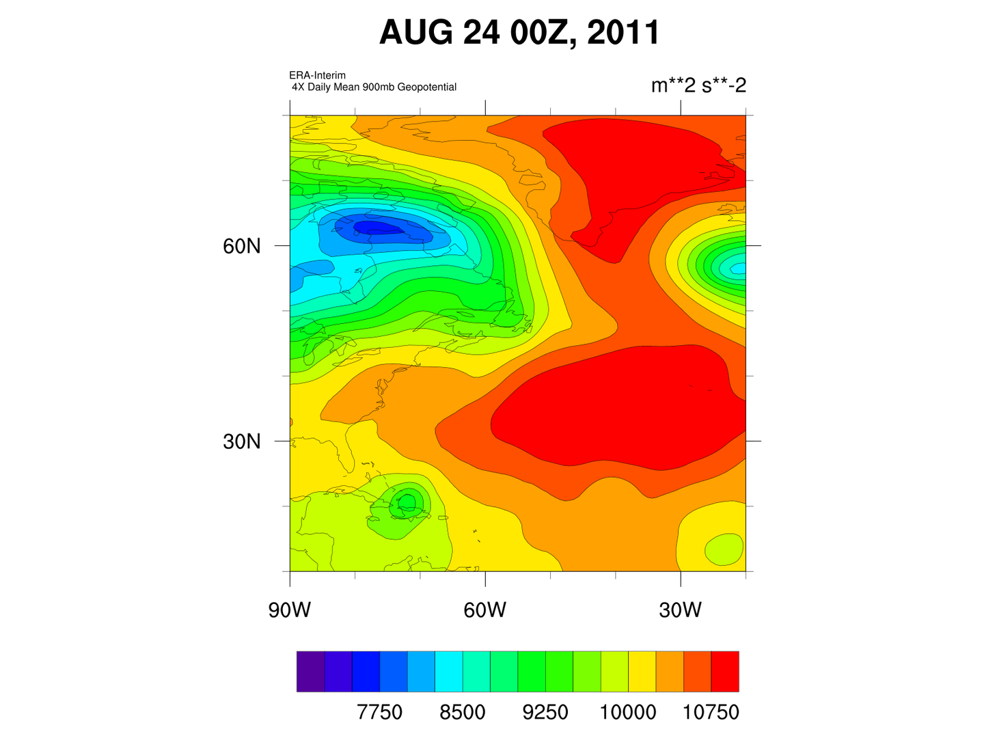
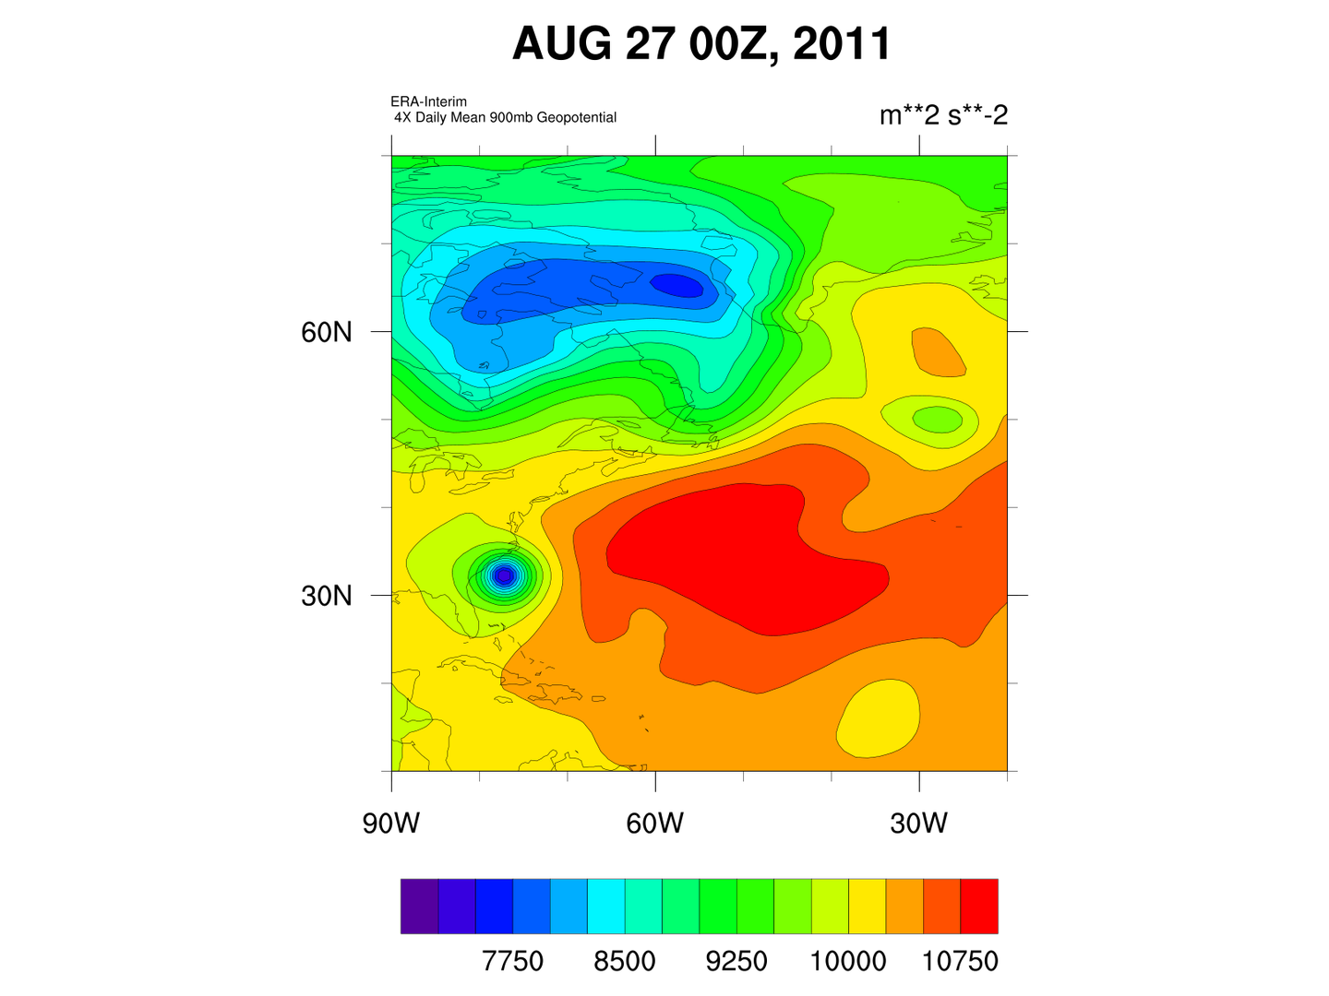
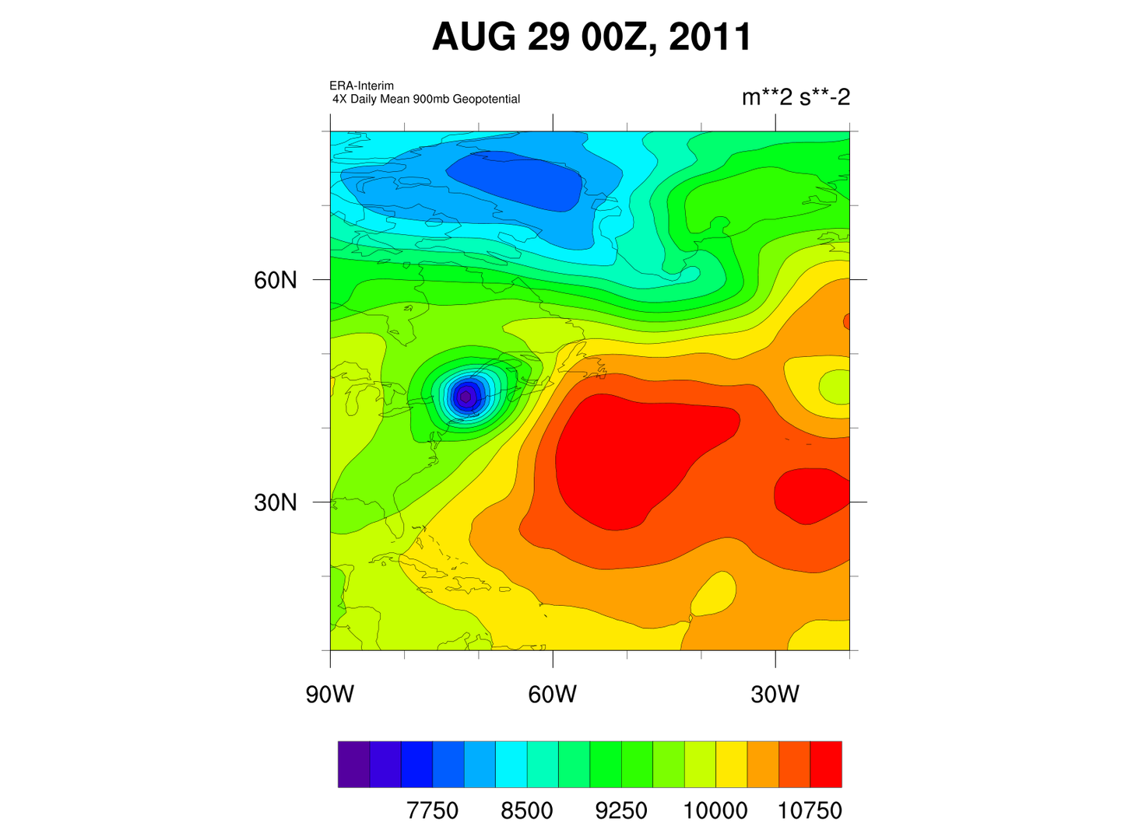
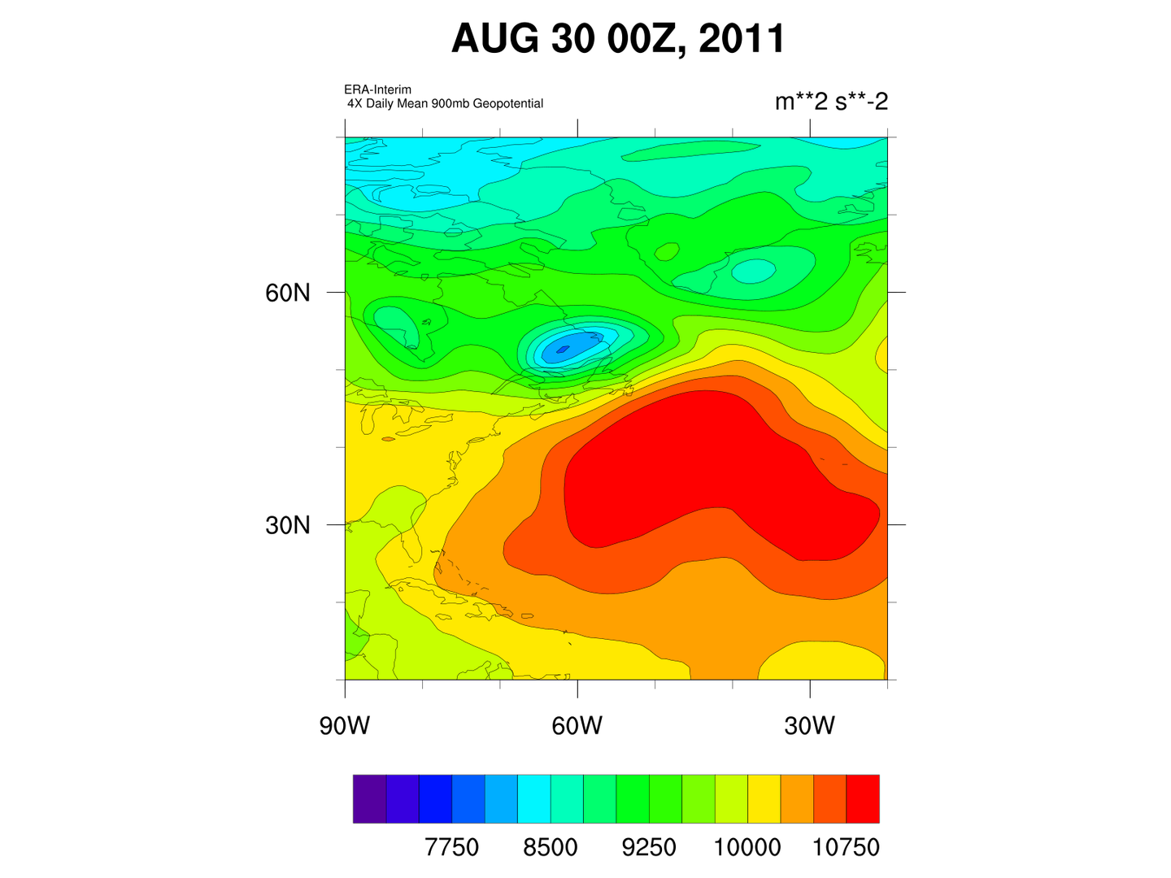
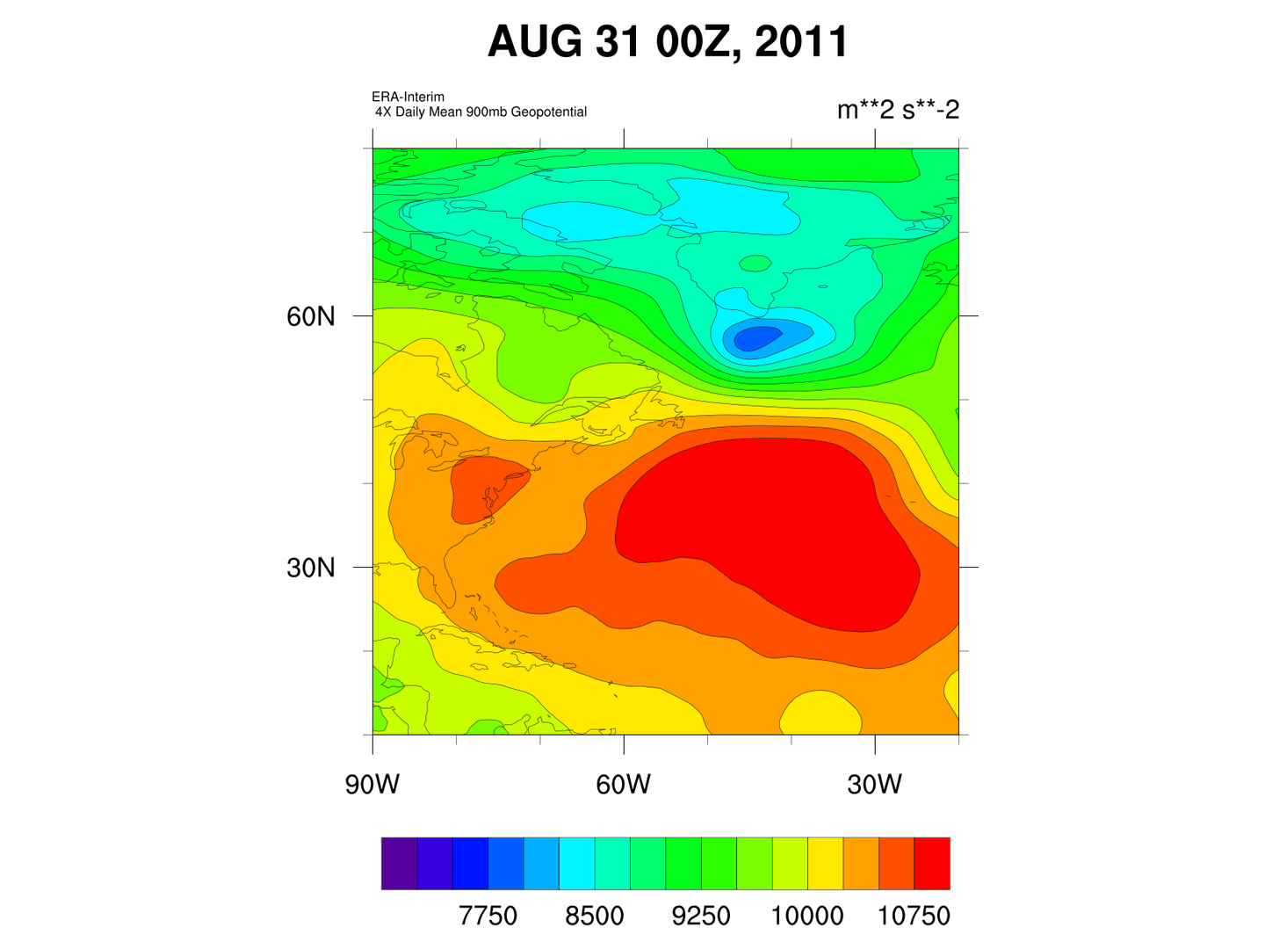
Irene
Irene
Irene
Irene
Irene

Slide 20
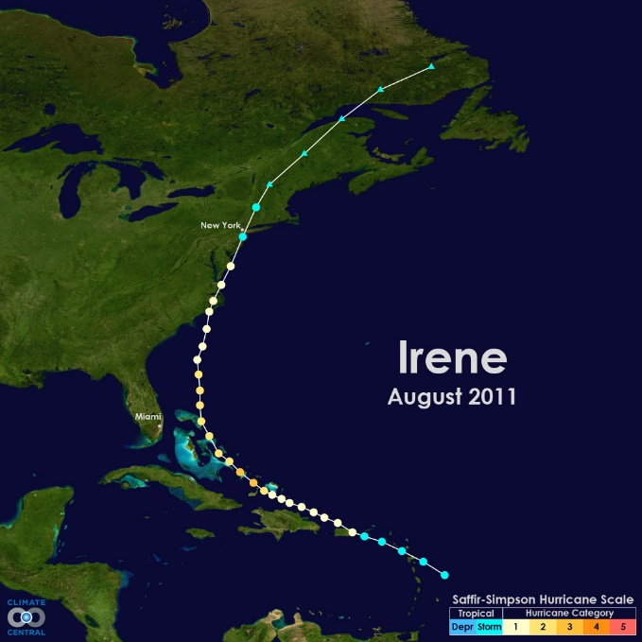
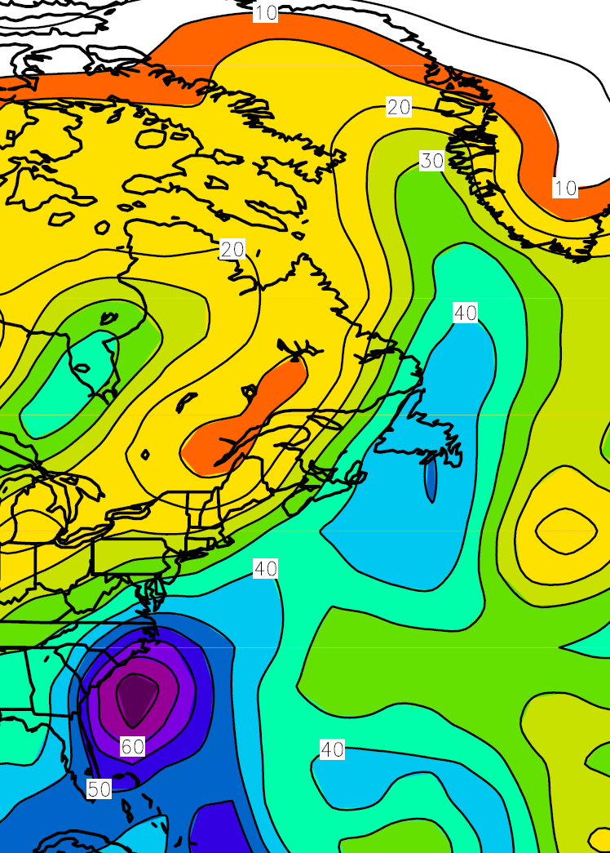

Slide 21
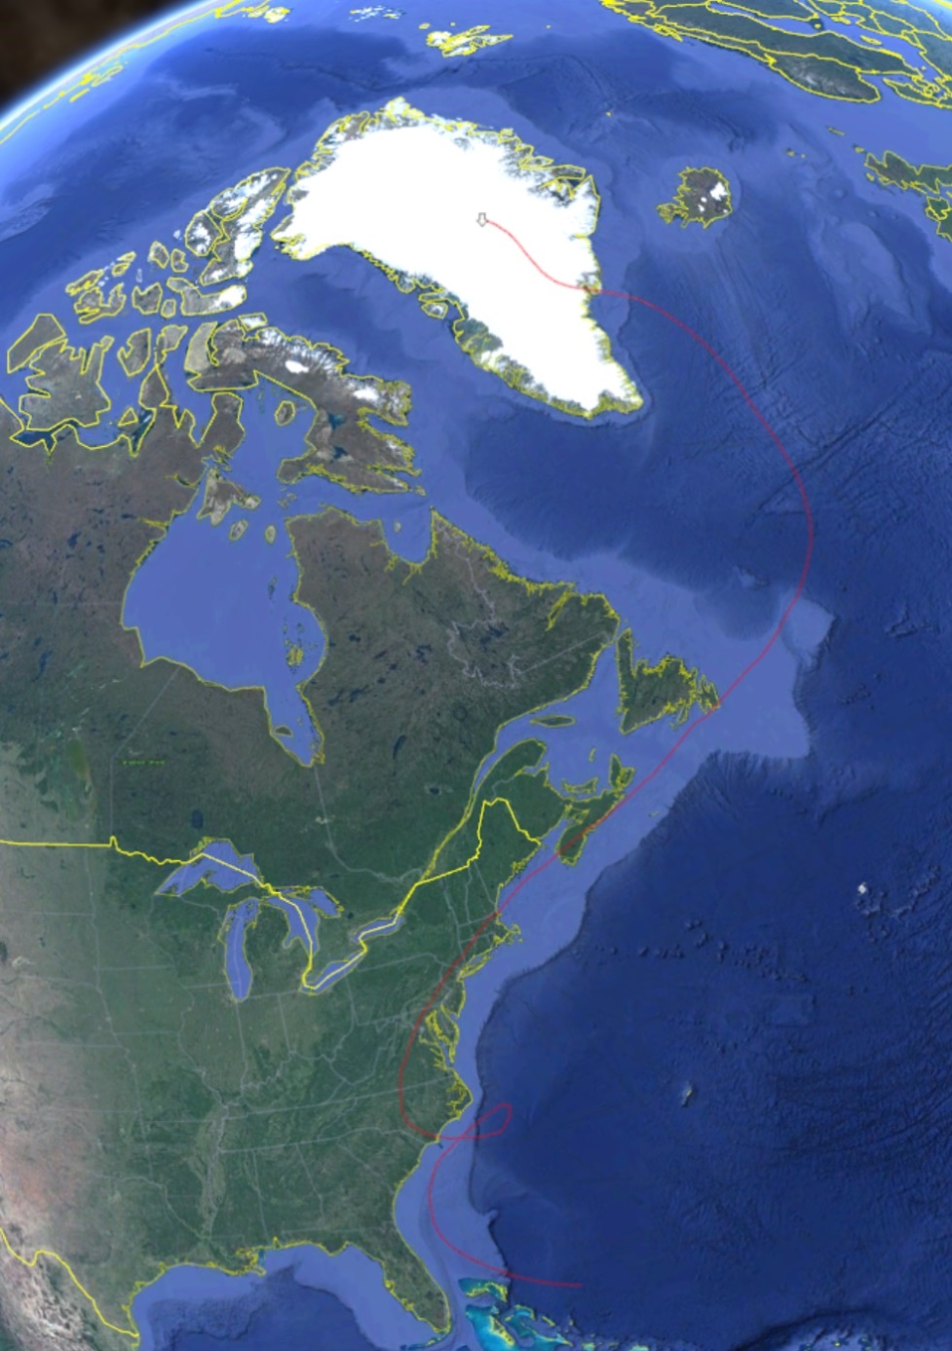
During the period of Hurricane Irene:
Daily snow samples at Summit show a decrease in Deuterium Excess from 23 permil to 12 permil from 24 to 30 August indicative of a southern source consistent with the 2012 melt episode (Bonne et al. 2015).
Summit
30 August
Data: Noone 2018: doi: 10.18739/A2SX6487H
20 August

Slide 22
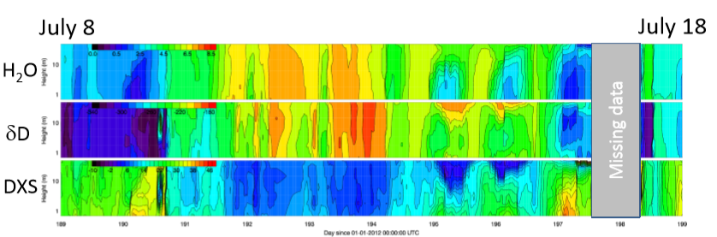
The 24-30 August Event compared to July 2012
In 2012, water vapor isotopes showed a clear signal of moisture from the subtropics arriving over Greenland (Bonne et al. 2015)
July 2012 Melt episode
Noone et al. Unpublished IPICS poster showing decrease in D-excess and increase in water vapor with warmer air.

Slide 23
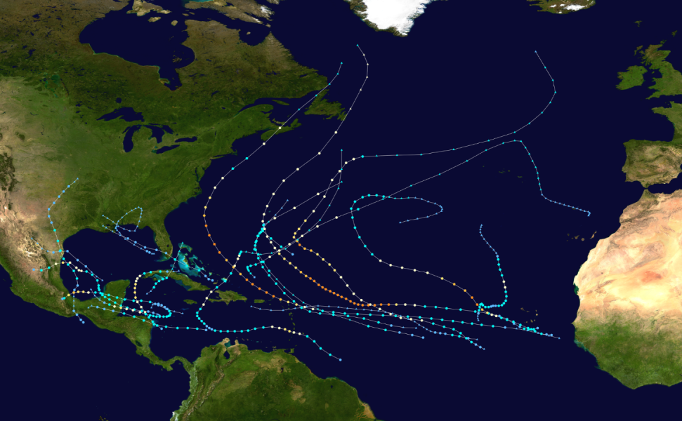
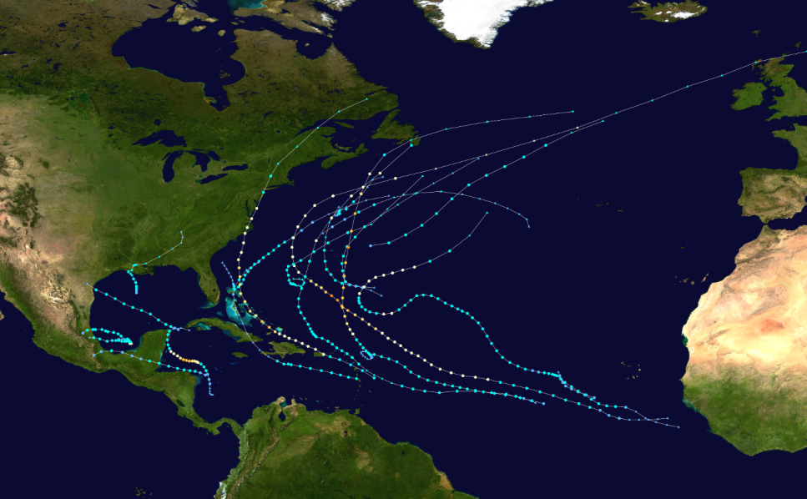
How often do these events occur?
2010
2011
Earl
Igor
Irene
EARL: Melting as far north as the NEEM ice coring site in NW Greenland. (Bonne et al., 2015, Supplemental material)
IGOR: Warm moist air spreading over Greenland: See Solomon et al. 2019, JAS 10.1175/JAS-D-19-0056.1
Irene: Major mass loss from western Greenland coastal areas (Doyle et al. 2015)

Slide 24
Conclusions so far:
Atmospheric Rivers affecting Greenland are usually associated with transport of moisture from the subtropics along the boundary between high pressure over the mid-Atlantic and a low pressure area over the Labrador Sea and NE Canada.
When this pattern is persistent, hurricanes, as they become extratropical, can follow the same path bringing extra warm air and moisture to Greenland (From 2000 to 2012, an average of ~1 per year depending on annual hurricane activity).
Question: In a warmer and wetter world, will melt episodes shift later into hurricane season despite the lower sun elevation? How will these changes affect boundary layer structure going into the Fall over Greenland?

Slide 25
In 2012 (and 1889), the hot air arriving over Greenland originated in the middle of North America.
2019: A summer of continental heat waves (Africa and Europe) and the melting of Greenland.

Slide 26
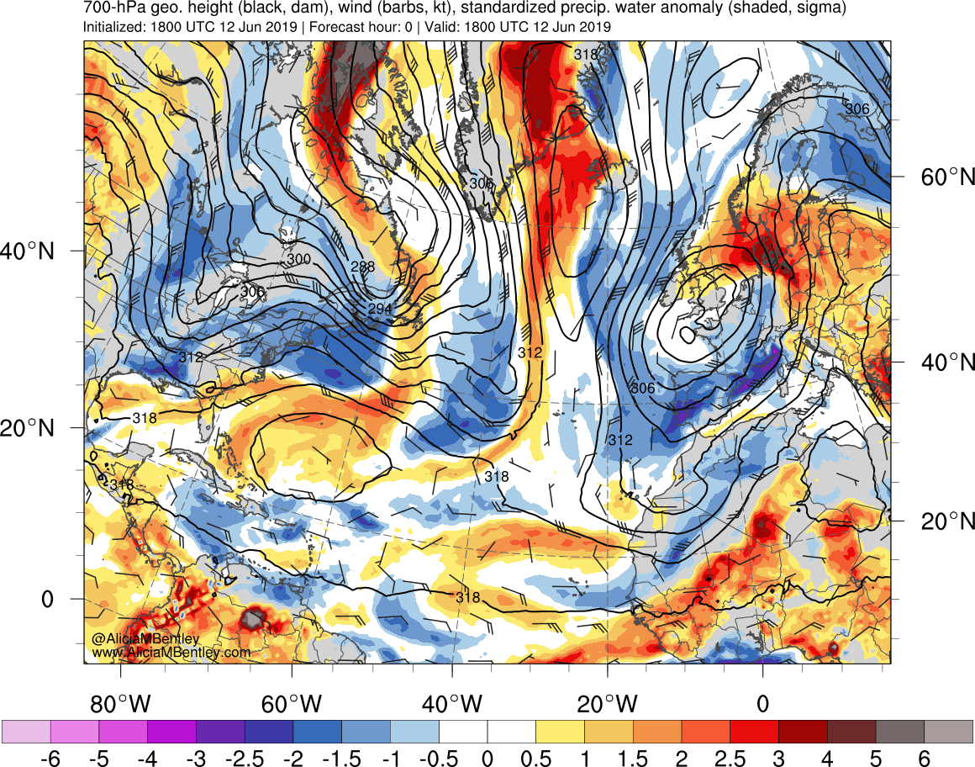
Moisture plume
June
http://www.atmos.albany.edu/student/abentley/realtime.html

Slide 27
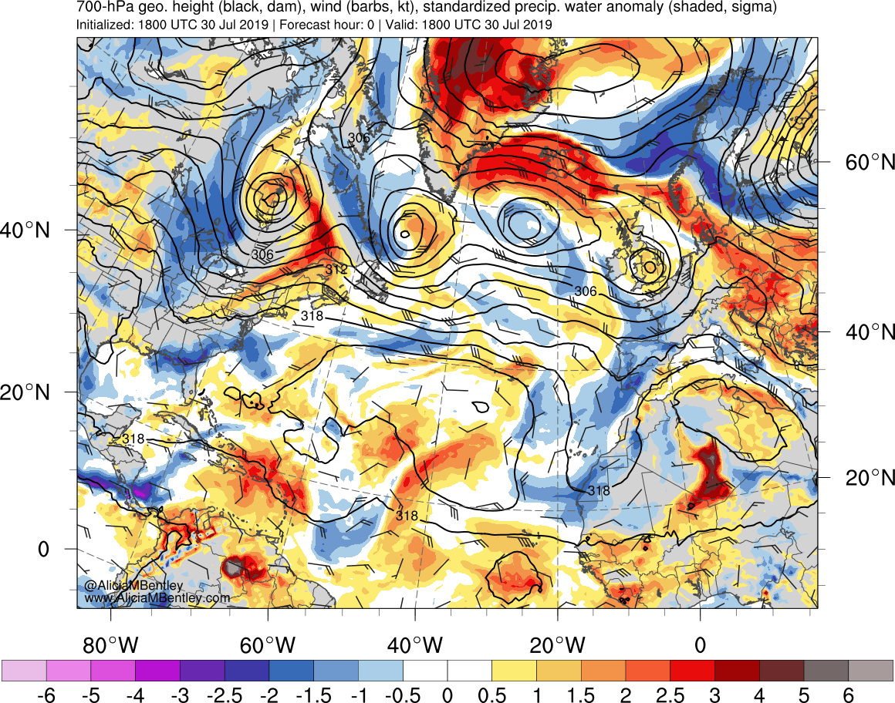
Moisture plume
July
http://www.atmos.albany.edu/student/abentley/realtime.html

Slide 28
Future work:
Complete climatology of heat waves, hurricanes and atmospheric rivers impacting Greenland.
Relate characteristic boundary layer patterns (based on cloud cover and sodar records to specific synoptic regimes.)

