Slide 1


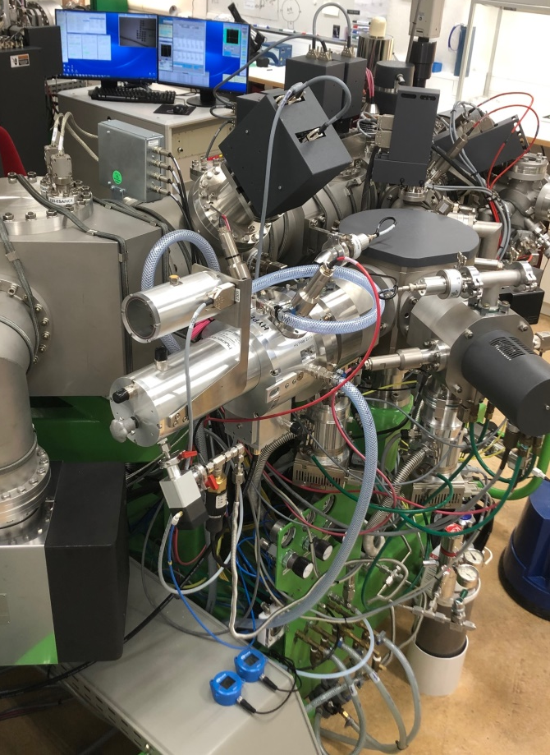
Living up to the Hype(-rion)! – observations on ion microprobe geochronology using a high-brightness oxygen plasma source.
Martin J. Whitehouse & Heejin Jeon
Swedish Museum of Natural History, Stockholm, Sweden, martin.whitehouse@nrm.se
Implementation of high-brightness Hyperion H201 RF plasma oxygen ion source on large-geometry IMS1270/1280/1300 instruments should have significant advantages over the duoplasmatron for geochronology in U-bearing minerals. Notably:
Ca. 3x brightness in O2-, 10x in O-
Maintenance free over long periods
Spectacular long-term beam stability
So, improved spatial (lateral) resolution and/or faster, more precise analysis.
No brainer, right? Read on …
Oregon Physics Hyperion H201 source installed on 1270e7 #302 at NordSIMS

Slide 2
Potential problems in geochronology applications however include:
more rapid aperture degradation in projected aperture mode, so progressive loss of lateral resolution and intensity drift during session
solution: use thicker apertures; drift remains
O₂⁻
150 µm ”thick” ap. ≈ 15 µm spot
(ref. duo intensity, ca. 5 nA)
O₂⁻
Unexpected – apertures actually get smaller before getting bigger! – sputtered aperture lining the tube?
100 µm ”thick” ap ≈ 10 µm spot
(ref. duo intensity, ca. 1.5 nA)

Slide 3
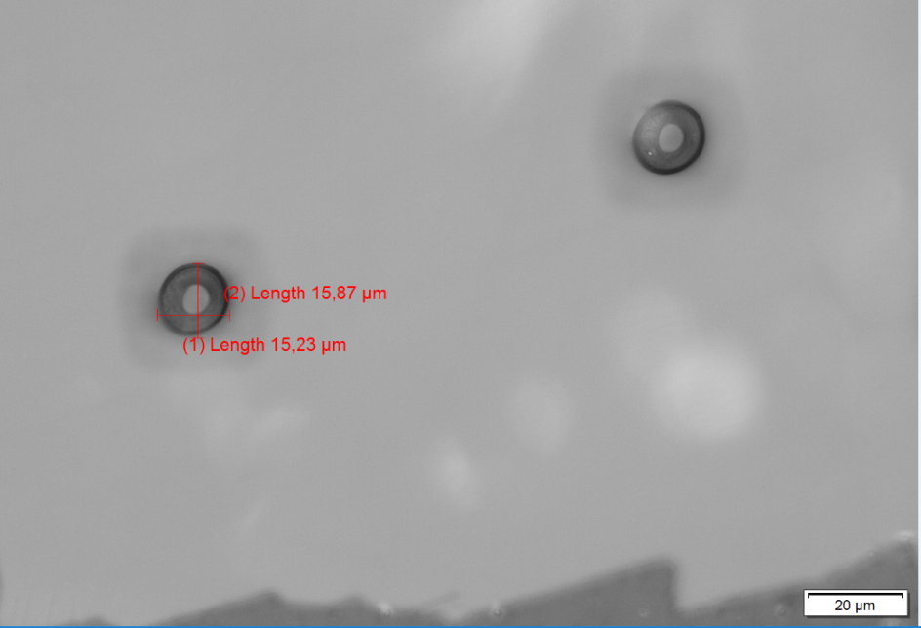
Potential problems in geochronology applications however include:
lack of flat-bottomed crater in focussed beam mode and increased aberrations
solution: raster beam to flatten crater bottom; ”creative” primary beam tuning for aberrations
10 nA, O₂⁻, 5 µm rastered spots in zircon (Au removed);
Preferred geochron spot at NordSIMS

Slide 4
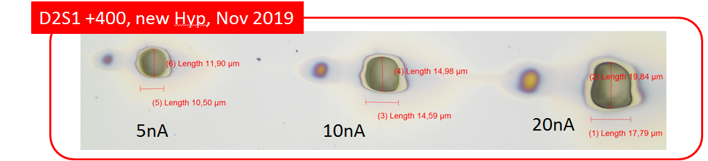
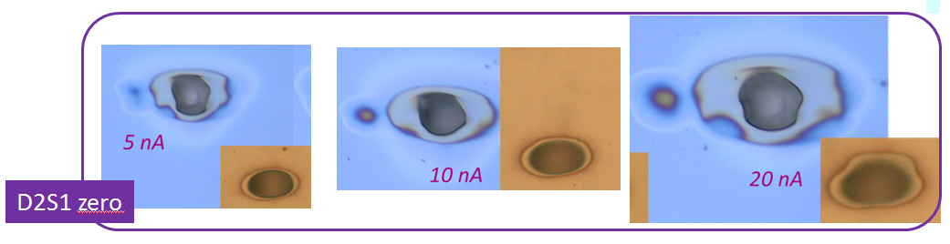
Potential problems in geochronology applications however include:
lack of flat-bottomed crater in focussed beam mode and increased aberrations
solution: raster beam to flatten crater bottom; ”creative” primary beam tuning for aberrations
Unrastered 15 min burns in Si-Ta target

Slide 5
108 zircon geochronology sessions since Nov. 2018
91500 std; most use 10 nA Gaussian + 5 µm raster, O₂ flood. 2 Hyperion sources
Potential problems in geochronology applications however include:
significant aspect ratio change leading to greater depth profiling and possible ”down-hole” effects
solution: raster beam, at expense of lateral resolution
Instrument sensitivity unchanged; scatter likely reflects 91500 Pb concentration heterogeneity and minor tuning variations session to session

Slide 6
108 zircon geochronology sessions since Nov. 2018
91500 std; most use 10 nA Gaussian + 5 µm raster, O₂ flood. 2 Hyperion sources
Potential problems in geochronology applications however include:
significant aspect ratio change leading to greater depth profiling and possible ”down-hole” effects
solution: raster beam, at expense of lateral resolution
Pb isotope ratios unchanged as run progressive; Hyperion & duo data similar

Slide 7
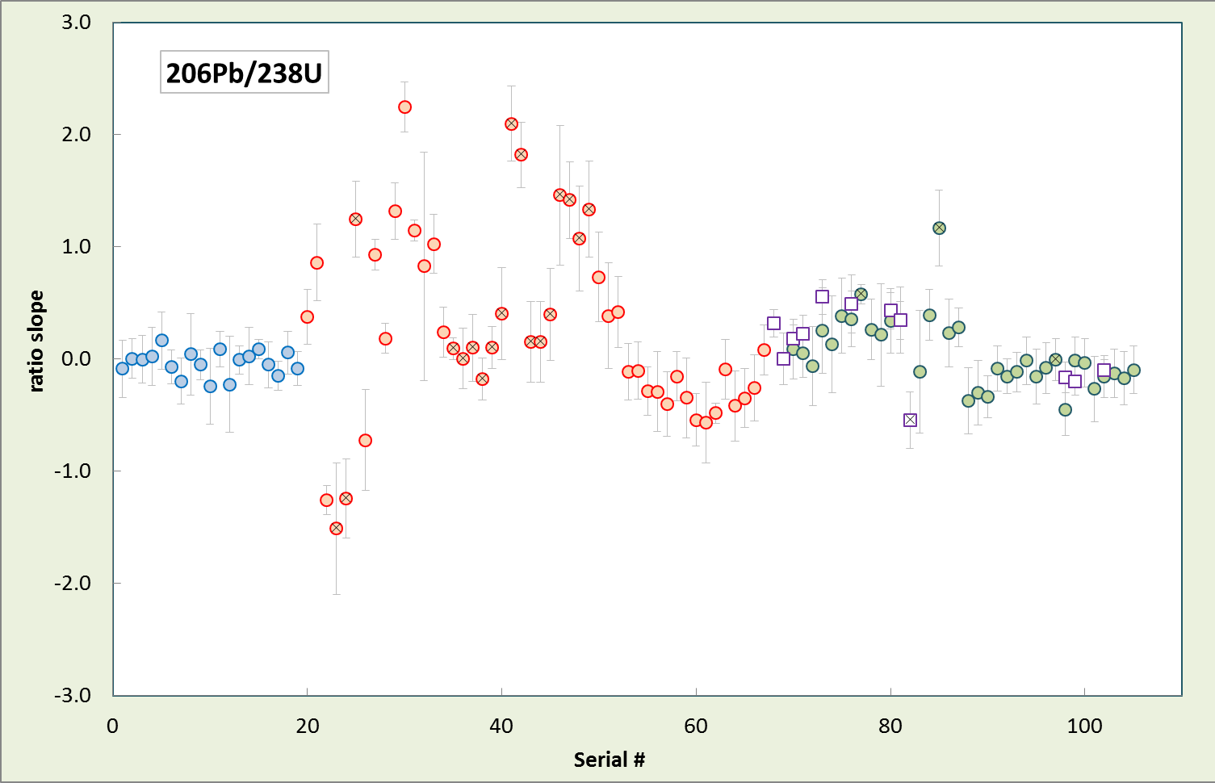
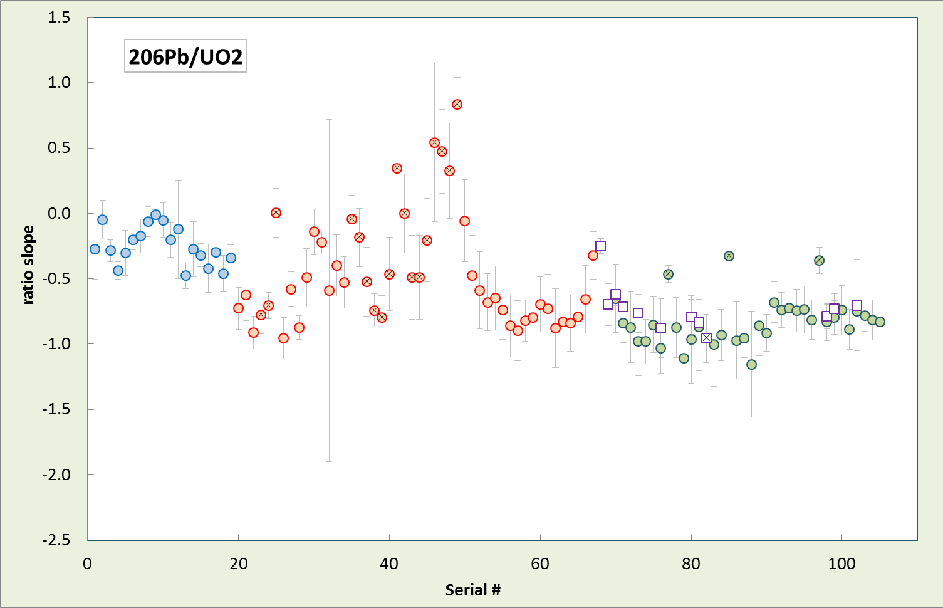
108 zircon geochronology sessions since Nov. 2018
91500 std; most use 10 nA Gaussian + 5 µm raster, O₂ flood. 2 Hyperion sources
Potential problems in geochronology applications however include:
significant aspect ratio change leading to greater depth profiling and possible ”down-hole” effects
solution: raster beam, at expense of lateral resolution; eventually a drift correction?
Surprisingly, ratios involving UO_{x} drift more than ratios involving U with the Hyperion. ? Related to change in oxide formation with deeper crater?
Drift is the same for 80 and 800 ppm zircon

Slide 8
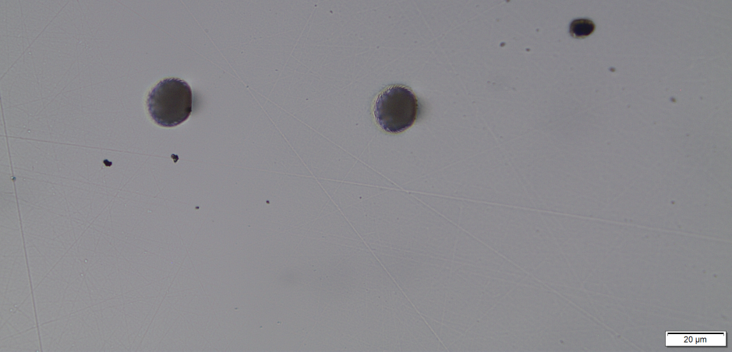
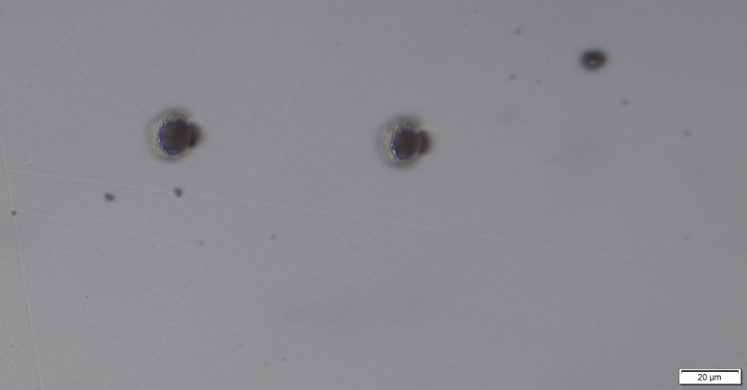
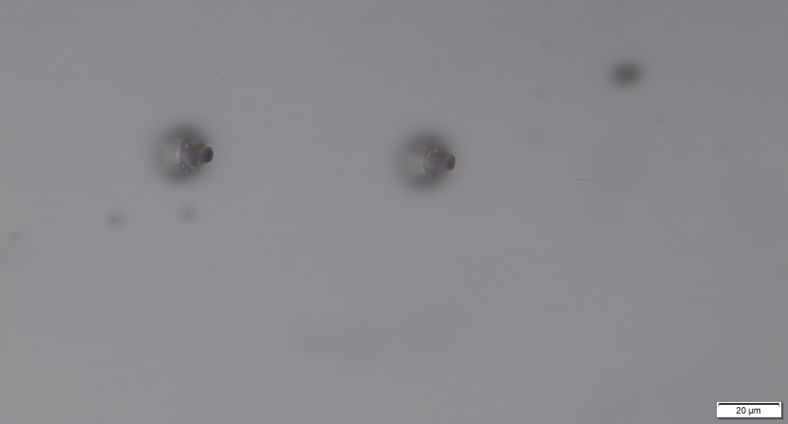
Potential problems in geochronology applications however include:
significant aspect ratio change leading to greater depth profiling and possible ”down-hole” effects
Microscope focus
Beware other matrices:
This is apatite!

