Slide 1

METHODS FOR THE ANALYSIS OF ASBESTOS IN INCOHERENT SOILS
Politecnico di Torino,
Department of Environment, Land and Infrastructure Engineering (DIATI)
Giovanna Zanetti
Oliviero Baietto
Paola Marini

Slide 2
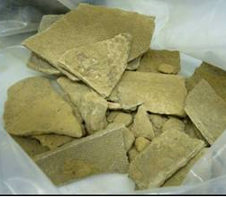
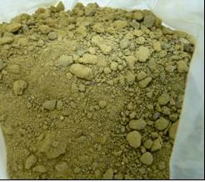
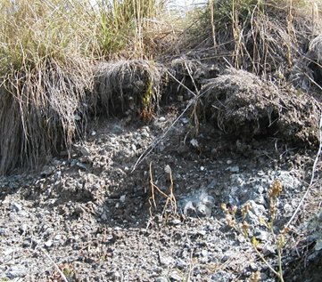
SOILS CONTAMINATED WITH ASBESTOS
ANTHROPOGENIC
NATURAL

Slide 3
ITALIAN LAW IN FORCE FOR ASBESTOS QUANTIFICATION: DM 6/9/94
TECHNOLOGY | USE | LIMITS | RESOLUTION
DRX X-Ray Diffraction | Asbestos weight determination | Concentration >1%
IR Infrared Spectroscopy | Asbestos weight determination | Concentration >1%
SEM Scanning Electron Microscopy | Asbestos weight determination Determination of airborne fibre number concentration | Concentration >0,1% (Quantitative) 0,01%< Concentration>0,1% (semi-quantitative) | 5 nm
PCOM Phase Contrast Optical Microscopy | Asbestos QUALITATIVE determination Determination of airborne fibre number concentration (not used) | Concentration < 1% Fiber diameter > 0,3 μm | 0,2 μm

Slide 4
1/7
Macroscopic observation
PCOM
ANALYSIS METHODOLOGY
If it is possible perform a manual sorting.
If the concentration of asbestos is greater than 1000mg/Kg the analysis is finished
2/7
Quartering and classification of the sample (100/120 gr) into 4 grain size classes. (sieves: 0.6 mm; 0.3 mm; 0.15 mm; 0.075 mm)
3/7
4/7
Preparation of weighed slides using oils with note refractive index

Slide 5
PCOM
5/7
Recognition of different kind of asbestos thanks to their characteristic optical properties
ANALYSIS METHODOLGY
Observation and measuring (length,diameter) of the asbestos fibers on a fixed number of fields
6/7
7/7
Determination of the asbestos content obtained by the relationship between the weights of the fibrous component compared to the granular ones.

Slide 6
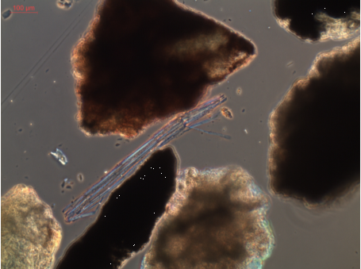
EXAMPLE OF ASBESTOS VISION
RECOGNITION ON THE MICROSCOPIC SLIDE
n=1.550
0,6-0,3 mm
Mass on the slide = 80 mg

Slide 7
1/7
Comminution of the sample until the granulometric spectrum
is in the range between 10 and 100 μm
SEM
ANALYSIS METHODOLGY
Dispersion of a known amount of a powder sample (10 mg) in a known volume of a solution (200 ml) (with surfactant) and put it in a ultrasonic bath
2/7
SEM analysis is used for grain size classes less than 0.15mm
3/7
Filtration of a part of the suspension (7,5 ml/0,375 mg)
on a polycarbonate filter
4/7
Place a portion of the membrane on the stub for SEM analysis and coat it with Au using a Sputter Coater

Slide 8
SEM
5/7
Observation, at a proper magnification, of a number of microscopic fields adequate to the limit of detection
ANALYSIS METHODOLGY
Identification of the asbestos fibres by morphology and X-ray dispersion energy spectroscopy (EDS), and measure of their dimensions
6/7
7/7
Determination of the asbestos content obtained by the relationship between the weights of the fibrous component compared to the one granular.

Slide 9
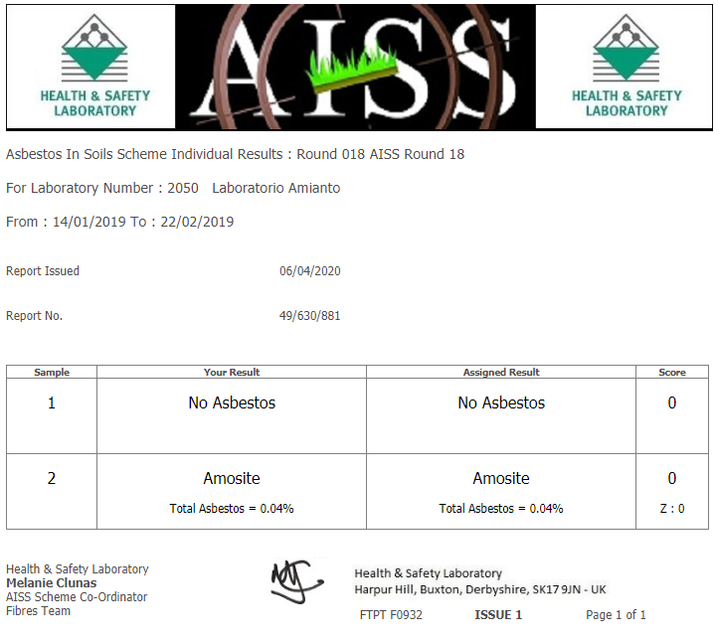

Slide 10
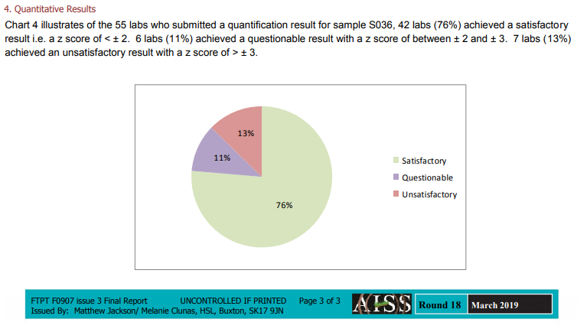

Slide 11
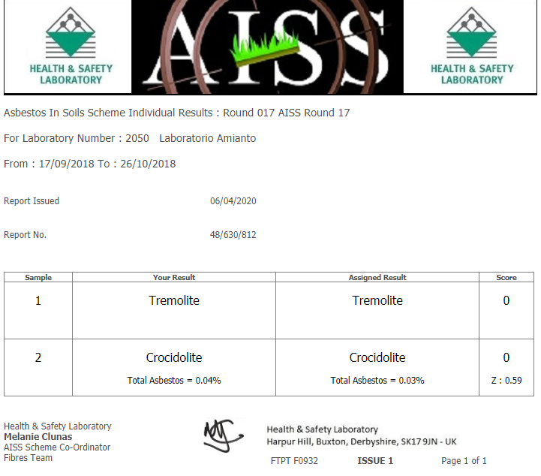

Slide 12
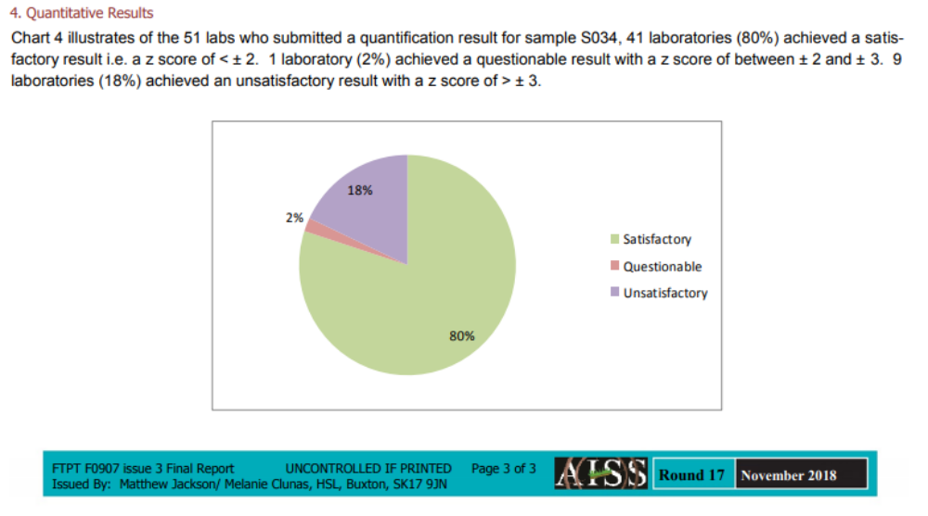

Slide 13
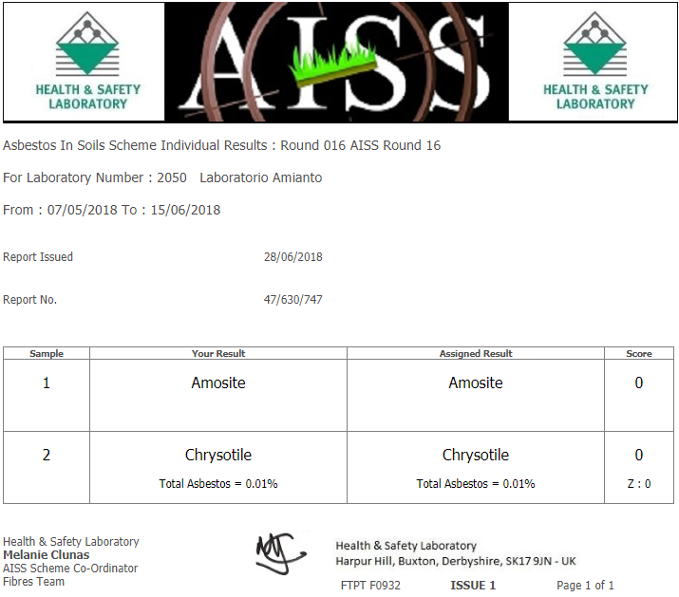

Slide 14
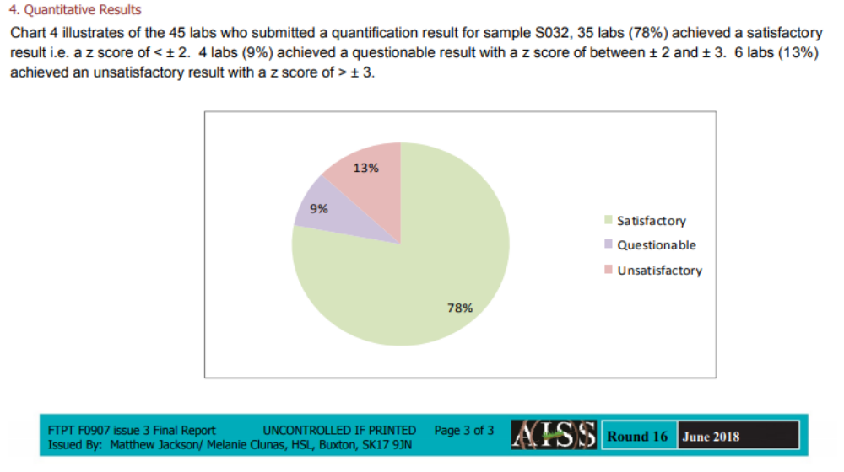

Slide 15
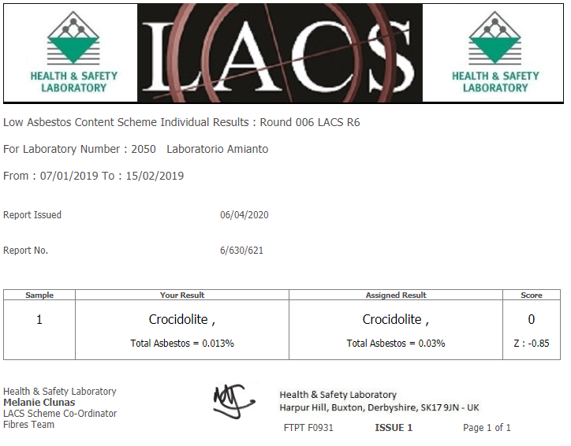

Slide 16
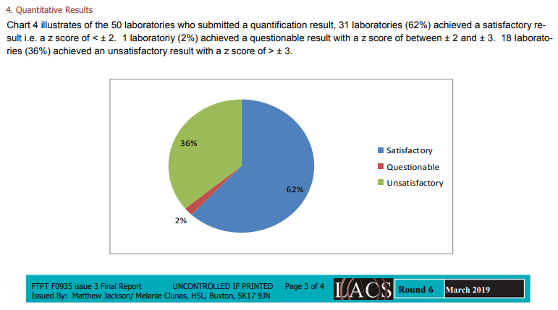

Slide 17
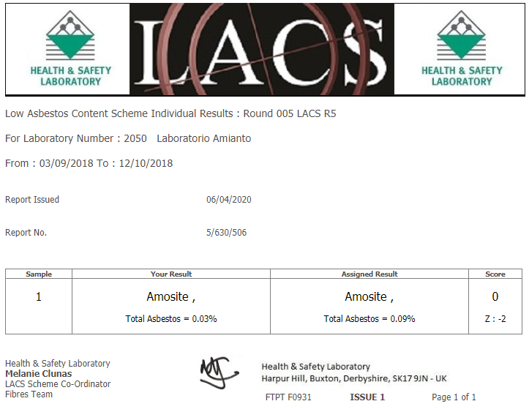

Slide 18
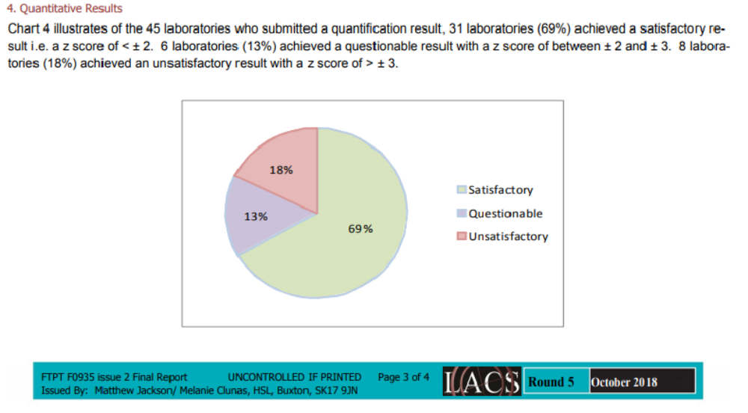

Slide 19
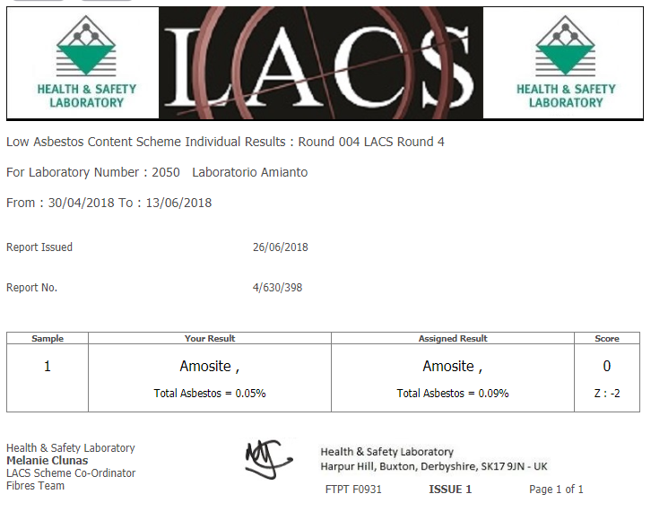

Slide 20
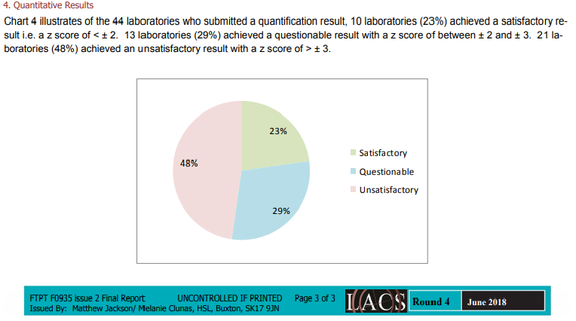

Slide 21
Conclusions
All HSL samples were analyzed with an optical microscope, although the quantities of asbestos contained in the sample were small. This was possible because the fibers were large enough to be observed. Optical microscopy allowed us to observe a more representative sample.
Certainly if we had finished the analysis with the SEM observation of the smaller particle size classes, the results would have been better.
We could also try to read the samples only at SEM, but I fear that, being relatively large fibers, the results may be incorrect without observing a representative sample.

