Slide 1
Learned Criticality in “Supermodels” That Combine Competing Models of the
Earth System With Adaptable Inter-Model Connections
Greg Duane Mao-Lin Shen
Univ. of Bergen, Norway & Univ. of Bergen, Norway
Univ. of Colorado, Boulder, USA

Slide 2
Scale Interactions in Supermodeling
Models differ in their mathematical representations of the same physical processes
Largest differences are in the parameterizations of sub-gridscale processes
Greatest benefit of supermodeling will be in situations where sub-grid-scale processes have a large effect on the entire dynamics

Slide 3
Theory of Self-Organized Criticality (Bak ‘ 87)
Systems gravitate to critical states in which there is no characteristic scale, and there is a free cascade of energy between scales, in a wide variety of circumstances
no characteristic scale → power-law distribution in both sizes and lifetimes of fluctuations: D(s)=s^{-τ} D(t)=t^{-α} so that ⎰ds D(s) s and ⎰dt D(t) t are undefined → linearity in log-log plots D(s) vs. s or D(t) vs. t

Slide 4
How do supermodels compare to their constituent models in regard to critical behavior and fluctuation spectra?
2 examples

Slide 5
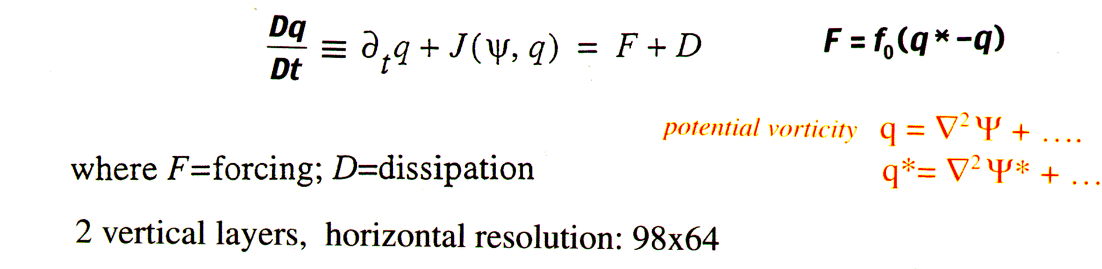
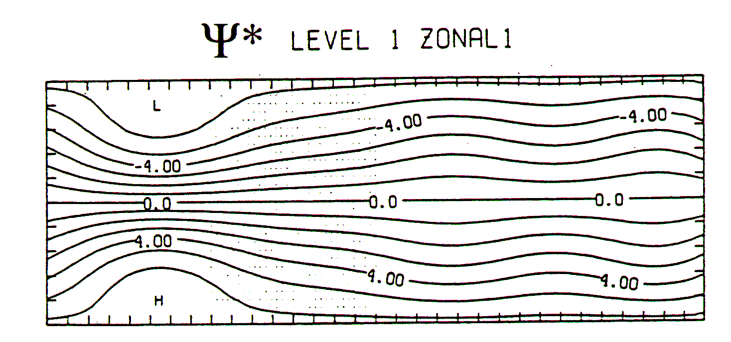
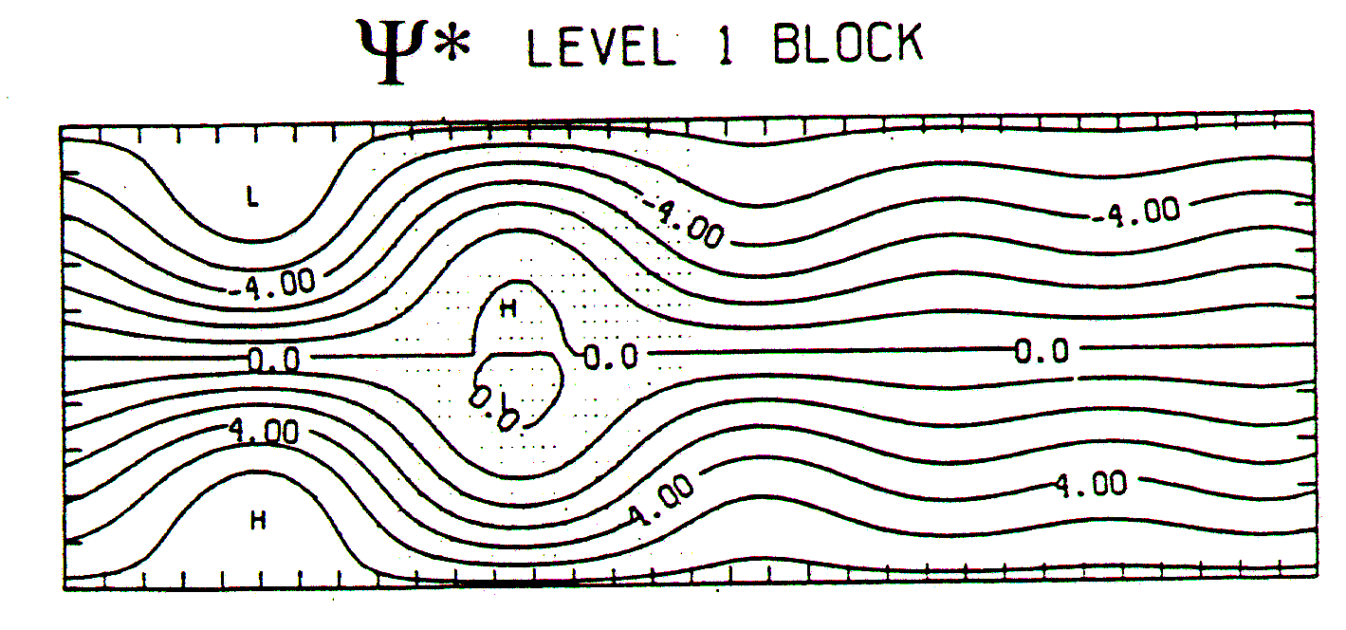
First Example: 2-LAYER QUASIGEOSTROPHIC (QG) MODEL
(Vautard & Legras ’88)
(only upper layer shown)
F contains terms to force a horizontally
uniform, vertically sheared flow, with
a jet in the first quarter of the channel
Weather regimes are defined by persistent patterns:
system vacillates chaotically between the two regimes

Slide 6
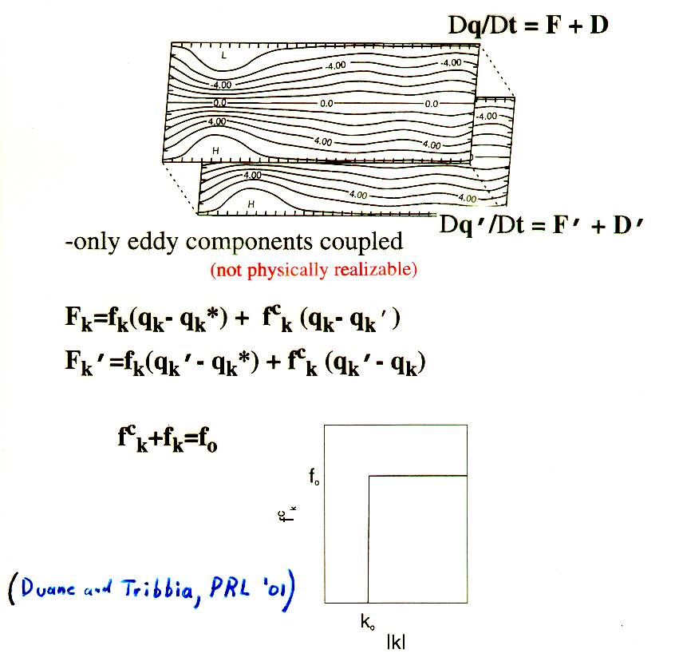
Loosely Coupled
Parallel
Channels
Synchronize
So we can couple two models with different
parameters to form a supermodel.
(Duane & Tribbia, PRL ’01)

Slide 7
Non-monotonic behavior in blocking frequency: No blocking for
large forcing or for small forcing, only for intermediate forcing values
f₀=0 no blocking
(low-amplitude turbulent flow)
f₀=3.0 no blocking
(jet flow)
Averaging fails!
Supermodel⇒
f₀=0.3 blocked/zonal vacillation (and f₀=0.3 can be learned!)

Slide 8
How Does Supermodel Energy Spectrum (vs. wave number)
Compare to Spectra for the Two Separate Models?
Log k
Log k
Log k
Log E
No forcing –
Low amplitude turbulence
Normal forcing-
Blocked/zonal vacillation
Replicated in Supermodel
High forcing-
No blocking
Supermodel spectrum is more log-linear for high wave numbers

Slide 9
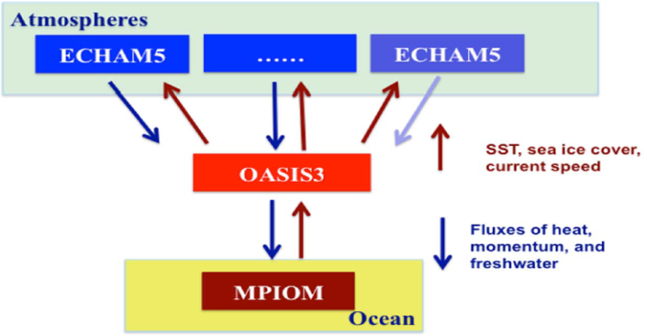
Second Example: COSMOS Supermodel (Mao-Lin)
Coupled Climate Models Connected Only at the
Ocean-Atmosphere Interface
COSMOS model (MPI, Germany)
  AGCM: ECHAM5, T31L19 (~3.75 degrees horizontally)
  OGCM: MPIOM, GR30L40 (~3 degrees)
Nordeng parameterization
Tiedtke parameterization

Slide 10
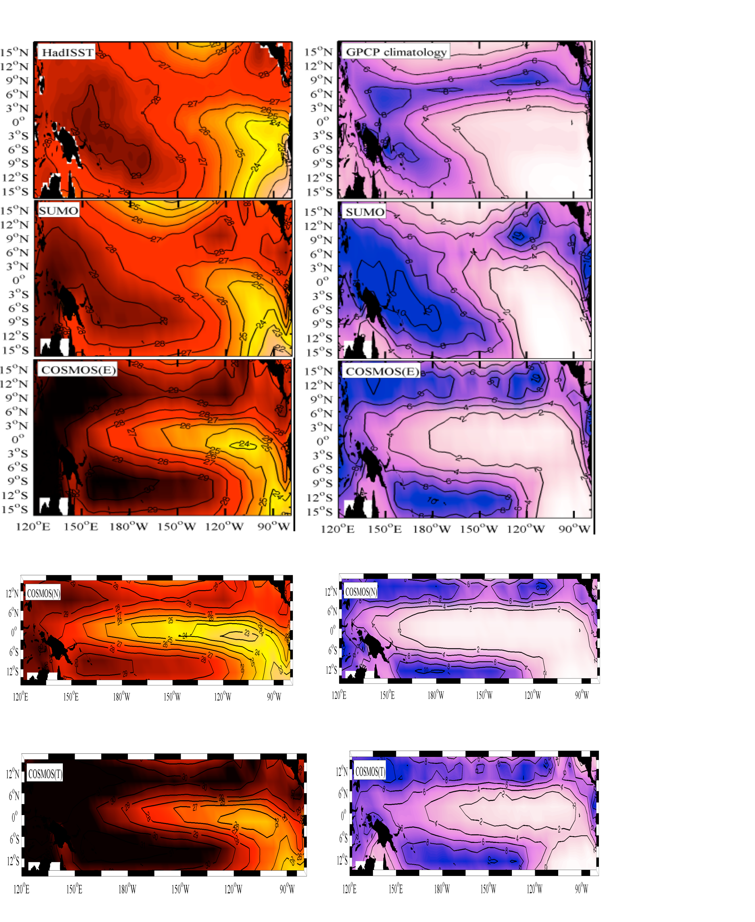
Results With 2 Full Climate Models
Sea-Surface Temp.
Precipitation
All models except
trained supermodel
exhibit an unrealistic
double Inter-Tropical
Convergence Zone
(ITCZ)
Observed
Trained
Supermodel
Equally-Weighted
Supermodel
In this supermodel;
Combine ocean-
atmosphere fluxes
for heat:
momentum:
and water:
Nordeng Model
Tiedtke Model

Slide 11
Single-ITCZ Model is Surrounded by
Double-ITCZ/Permanent-El Nino Models
in Phase Space: Why?
Phase boundaries
are defined by cases
(blue dots) that have
low correlation with
any of the 3 reference
cases

Slide 12
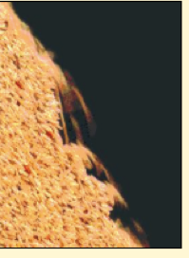
HYPOTHESIS:
The climate system (an open system) tends naturally toward a
critical state.
Trained supermodels reproduce this state, in a way that the
constituent models, with arbitrary parameterizations of the
sub-grid scale processes, cannot. The states of these constituent
models are qualitatively on the same side
of the critical state.
non-monotonic behavior vs. weights
sand
like
self-organizing
sandpile:

Slide 13
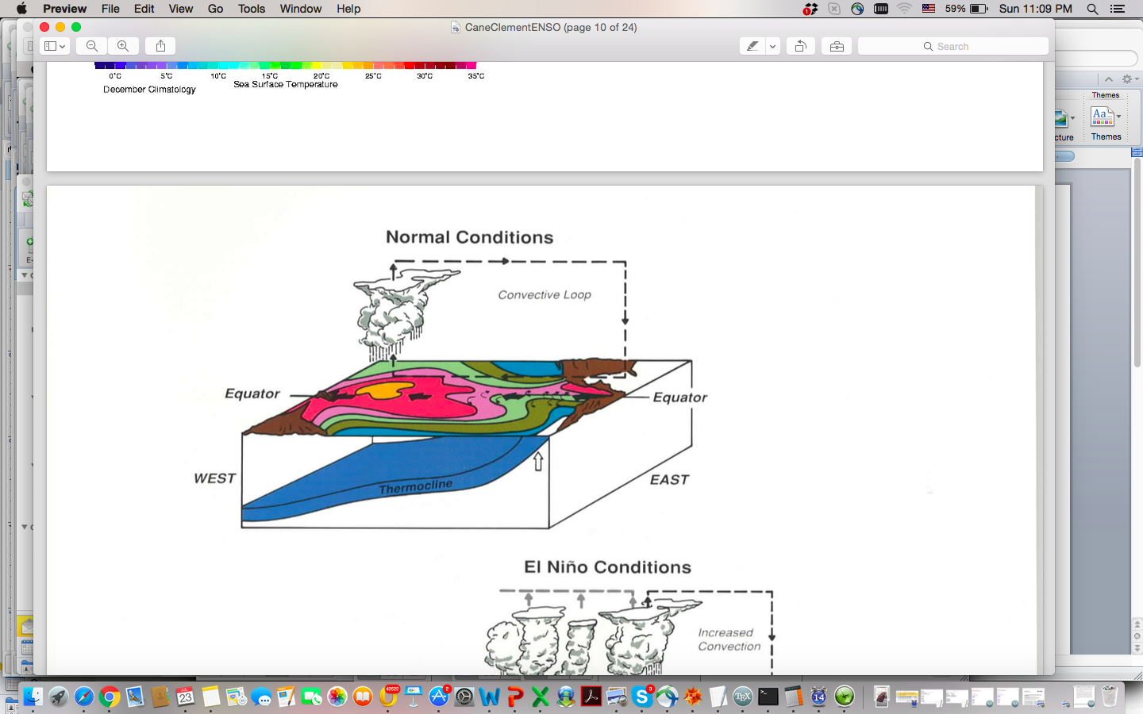
Double ITCZ Mechanism in Nordeng Model
Walker
circulation
Anomalously high zonal wind stress in Nordeng model ->
increased upwelling in Central Pacific ( _{x}) ->
extension of cold tongue ( ) ->
double ITCZ

Slide 14
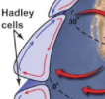
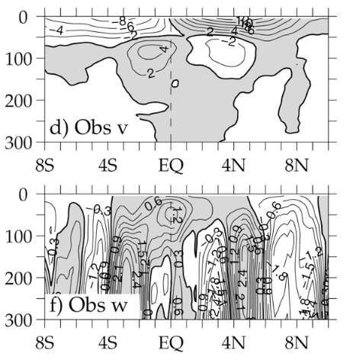
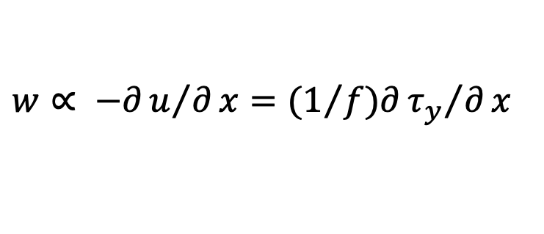
Double ITCZ Mechanism in Tiedtke Model
-depends on 3D structure
Depth (m)
Depth (m)
anomalously low zonal wind stress in Tiedtke model ->
low wind stress curl off equator
via Hadley/Walker coupling ->
increased downwelling in subtropics
upwelling of colder water at equator (tropical ocean cell: )
double ITCZ ( )
$w∝ −∂u/∂x=(1/f)∂{τ_{y}}/∂x$

Slide 15
Supermodel gets correct ITCZ behavior and avoids permanent El Nino, but how does spectrum (vs. frequency) compare to spectra of constituent models?
Tiedtke:
Nordeng:
Supermodel:
Observations:
[Mao-Lin]
Tiedtke and Nordeng appear to be hyper-critical compared to both
the supermodel, which is more like observations, except
Supermodel spectrum is frequency-shifted vs. observations

Slide 16
Conclusion/Hypothesis:
Supermodeling is good for getting criticality and for getting the (almost) correct properties of critical states
Future work:
1) what would be needed to make COSMOS behavior qualitatively correct? -couple atmospheres?
2) verify hypothesis for fully-connected climate models. w.r.t variety of critical phenomena

