Slide 1
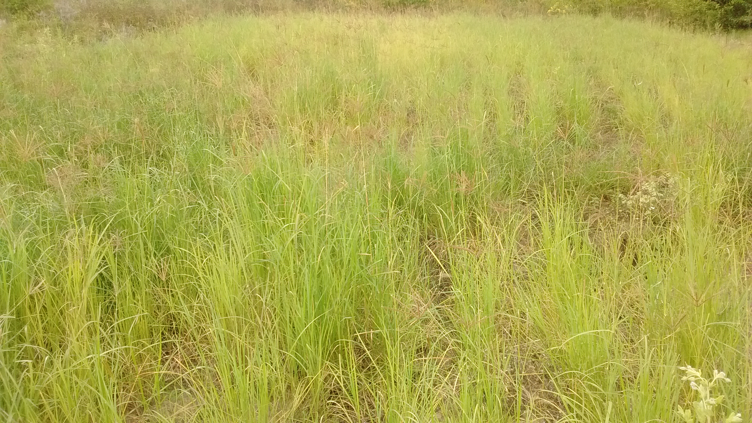

The choice of grass species to combat desertification
in semi-arid Kenyan rangelands is greatly
influenced by their forage value for livestock
Kevin Mganga
Early Career Researcher, Kenya
Emails: kevin.mganga@helsinki.fi and kmganga@seku.ac.ke

Slide 2
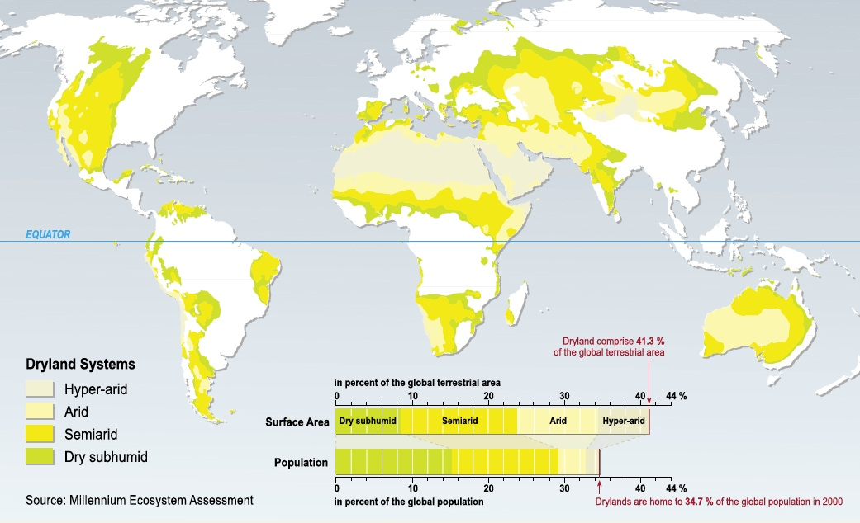
Global Dry Rangeland Systems

Slide 3
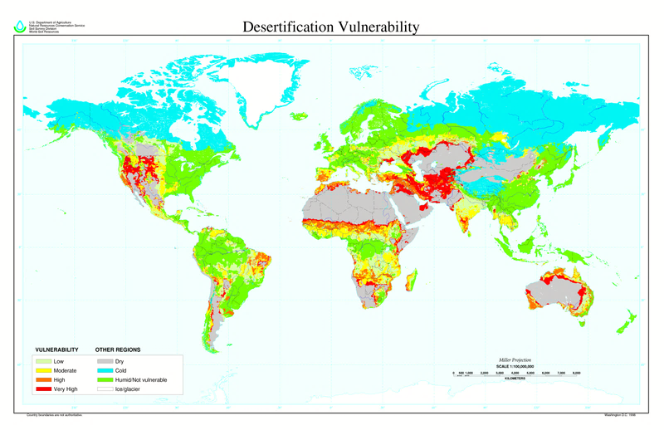
Vulnerability of Drylands to Land Degradation
Source: USDA Natural Resources Conservation Service

Slide 4
Typical Dryland Environments in Africa
Plate 1
Plate 2
Plate 3
Plate 4
Plate 5
Plate 6

Slide 5
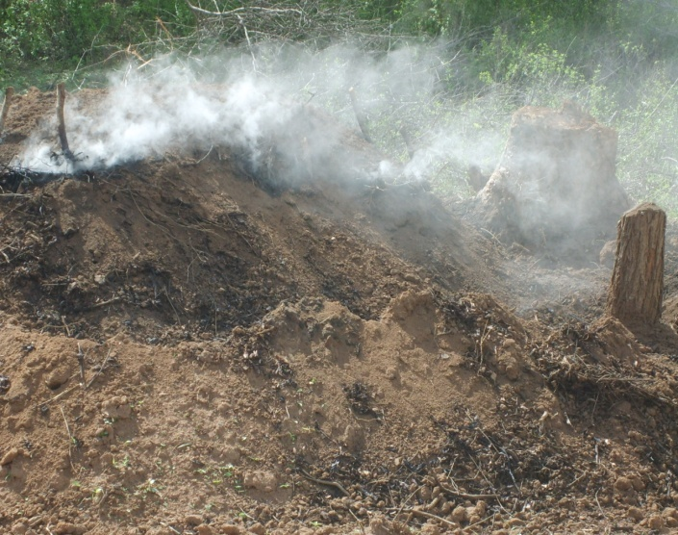
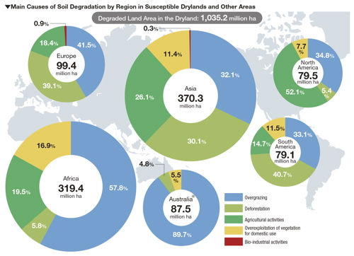
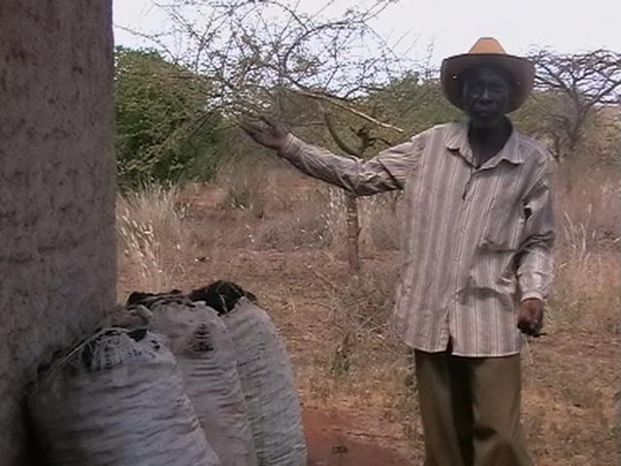
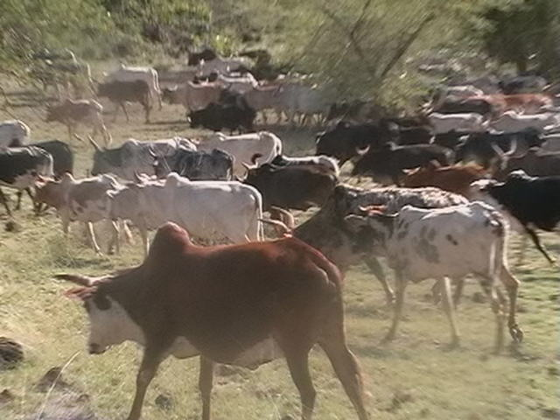
Causes of Land Degradation in Global Dry Rangelands
Source: World atlas of land degradation, 2nd Edition (UNEP)

Slide 6
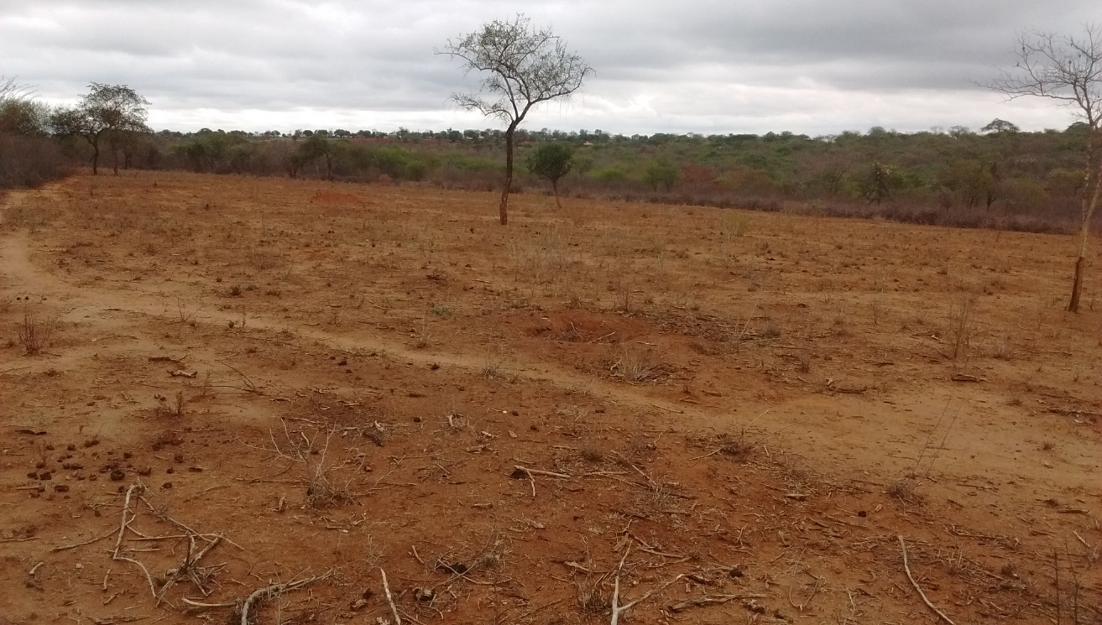
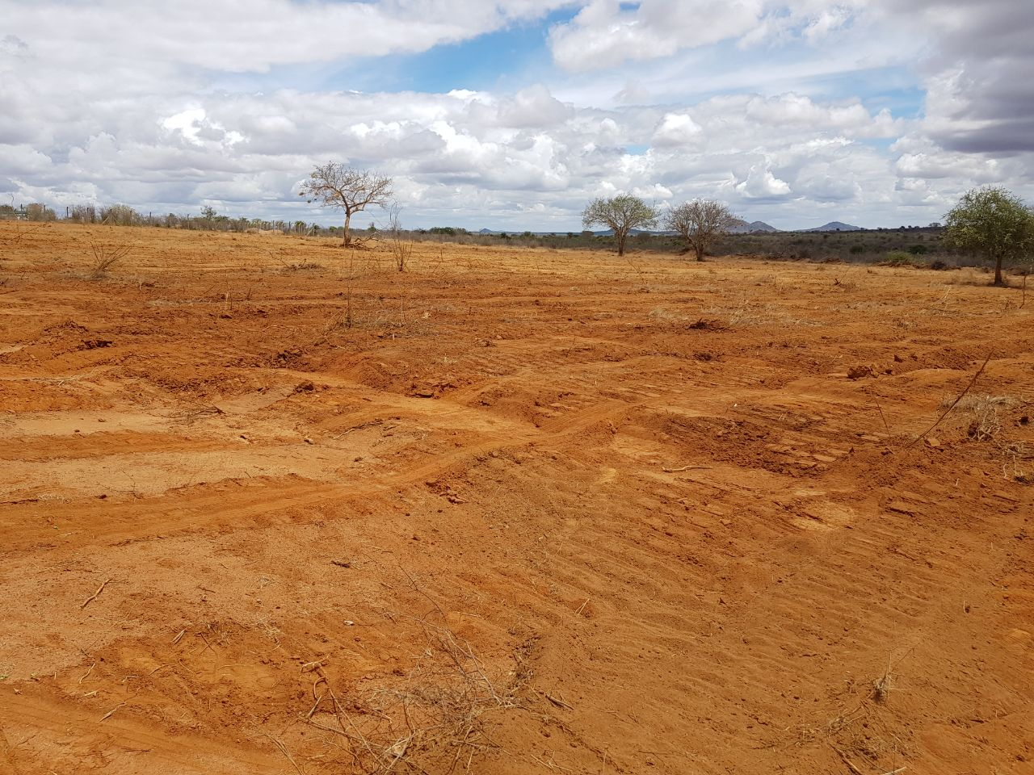

Typical degraded landscapes in African drylands
Major causes of such degradation in African drylands
Overgrazing by free ranging livestock bare soil
Poor agricultural practices deplete soil nutrients
Climatic factors – droughts and floods bare soil + erosion

Slide 7
What options are available to restore such degraded African rangeland landscapes?

Slide 8
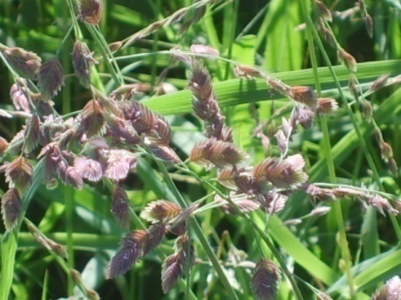
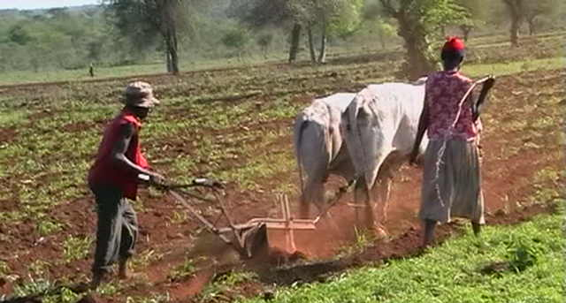
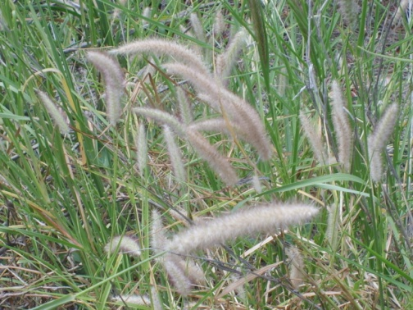
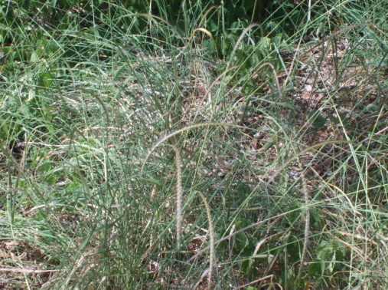
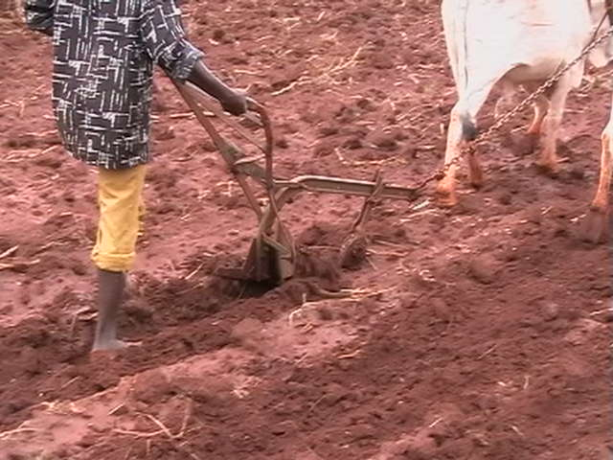
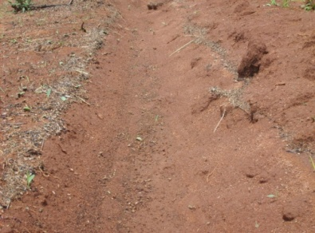
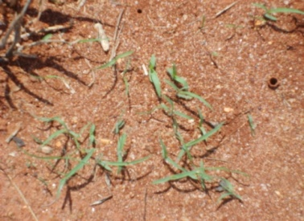
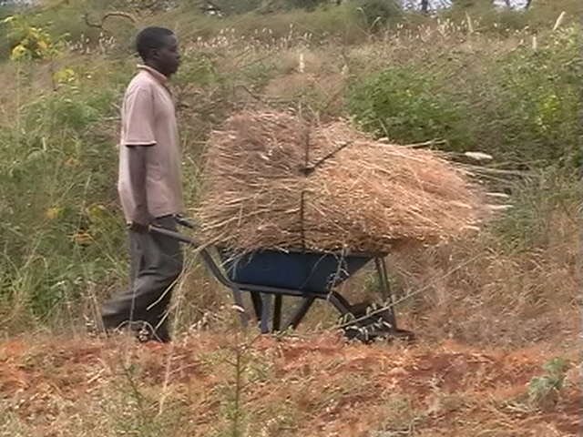
Reseeding with Indigenous Forage Grasses
Eragrostis superba
Cenchrus ciliaris
Enteropogon macrostachyus

Slide 9
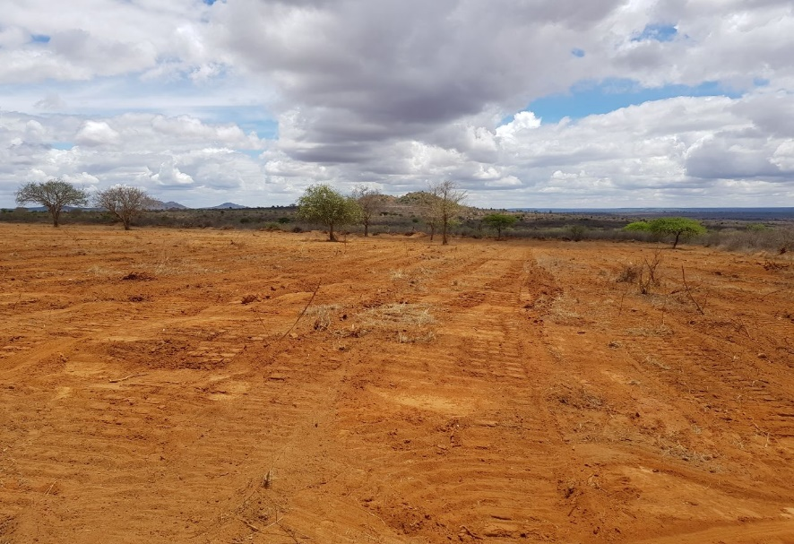

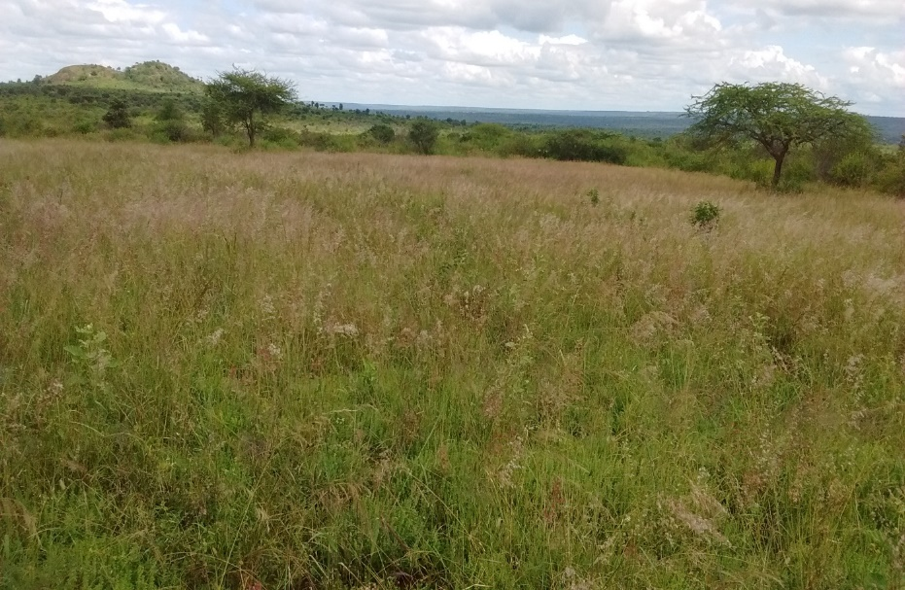
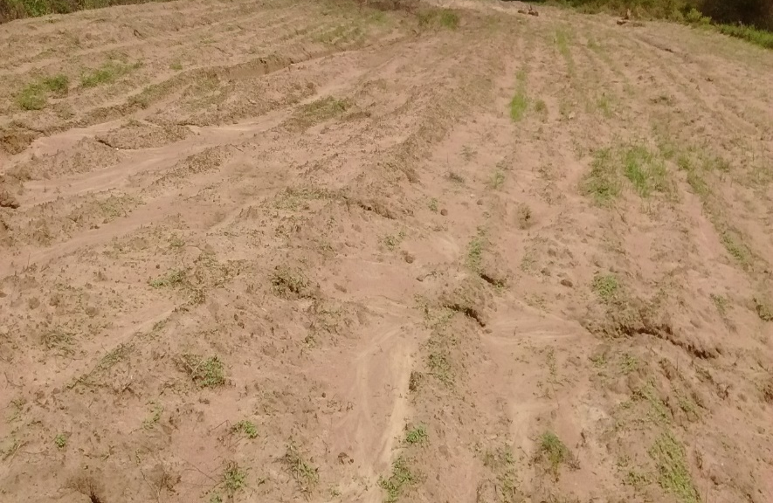


Potential of indigenous grass reseeding
Indigenous grass reseeding
BEFORE
AFTER

Slide 10
Morphoecological characteristics of the grasses
Notes:
Plant cover – Basal, Ground, Canopy, Foliar Cover

Slide 11
Preference of indigenous forage grasses and sowing patterns among agropastoralists in semi-arid rangelands, SE Kenya
Grass species Pure stands | Farmers, % | Binary mixture combination Grass species Farmers, %
Eragrostis superba | 74 | Cenchrus ciliaris/Eragrostis superba | 8
Cenchrus ciliaris | 48 | Cenchrus ciliaris/Enteropogon macrostachyus | 8
Enteropogon macrostachyus | 28 | Eragrostis superba/Enteropogon macrostachyus | 4

Slide 12
Conclusion
  Enteropogon macrostachyus demonstrated the best rehabilitation results during the study period.
  However, Eragrostis superba is the most preferred grass species among agropastoral farmers in southeastern Kenya.
  This is mainly attributed to its high forage value for livestock
  The choice of grass species to combat desertification in semi-arid rangelands in Kenya is much more influenced by their forage value for livestock than their contribution for rehabilitation purposes.

Slide 13


Slide 14
Online reference links
https://knowledge4food.net/research-project/arf3-kenya-rofip/
https://www.nwo.nl/en/research-and-results/research-projects/i/32/29032.html
https://www.facebook.com/TheWaterChannel/playlist/2182862558674113/
https://twitter.com/RoadsForWater/status/1189537576039993344
http://www.thewaterchannel.tv/webinars/597-creating-pastures-in-african-drylands-using-roadwater-harvesting
https://qcat.wocat.net/ar/accounts/user/3292/
https://onlinelibrary.wiley.com/doi/full/10.1111/gfs.12089

