Slide 1
ITCZ-MIP:
An informal MIP designed to address the question
How do changes in ITCZ width affect global climate?
With the ITCZ-MIP Team: Mike Byrne (St Andrews), Oliver Watt-Meyer (Vulcan Inc.), Penny Maher and Mark Webb (UK Met Office) – and new members – Hui Su and Kathleen Schiro (JPL)

Slide 2
Go to the last slide for a video version of the presentation!
(14 min)

Slide 3
Motivation: The ITCZ width changes with warming
ITCZ width decreases with warming in climate model projections (Byrne and Schneider 2016)
ITCZ width has already decreased in some ocean basins in observations (Wodzicki and Rapp 2016)

Slide 4
Motivation: How do changes ITCZ width affect global climate?
ITCZ width changes affect global precipitation (Su et al 2017)
ITCZ width changes might affect climate sensitivity (Mark Webb, Tian et al 2015)
ITCZ and Hadley cell strongly coupled (Byrne) — potential for ITCZ to influence subtropical/extratropical jets and feedbacks
ITCZ width and precipitation distribution closely related (Pendergrass)

Slide 5
Experimental protocol and simulations

Slide 6
Experimental protocol:
Configuration
AquaplanetPerpetual equinox
Slab ocean
Base state q-fluxes from “CTRL” SST pattern (Neale and Hoskins 2000, Williamson et al 2013)
  The narrow equatorial SST peak (compared to Qobs) has a single-ITCZ in most models
Aquaplanet
Medeiros, Stevens, Bony (2015)

Slide 7
Experimental protocol:
Force ITCZ width to change
We wanted something straightforward to apply in different models
We tried multiple approachesQuadruple CO₂ to simulate climate change
Notes:
Mark Webb’s talk – Harrop+Hartmann, Dixit et al 2018
(cloud heating pattern is quite model-dependent)

Slide 8
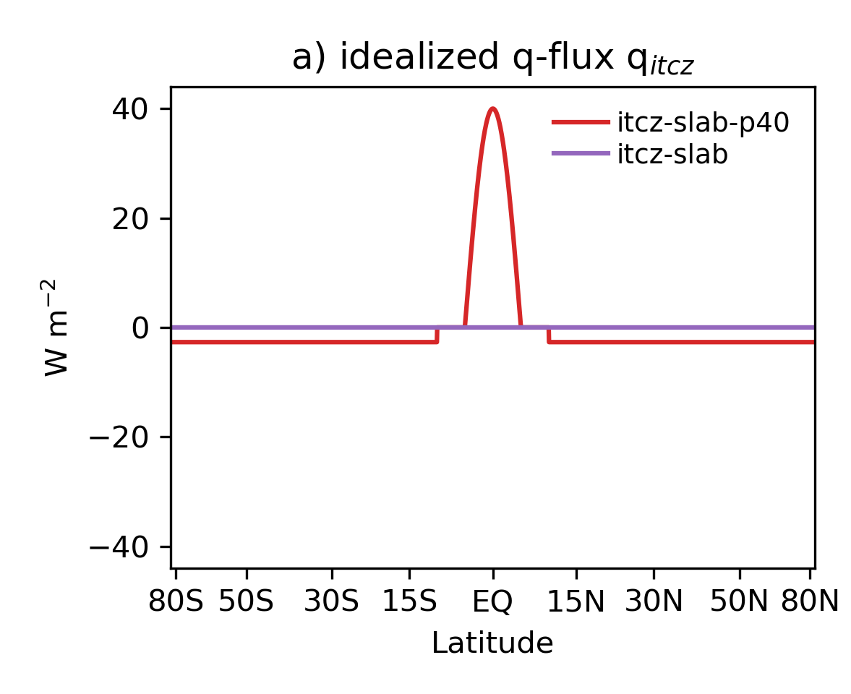
Experimental protocol:
Force ITCZ width to change
Imposed additional q-flux
Impose additional q-fluxes
  deep tropical heating
  compensating cooling outside of the deep tropics, such that total q-flux=0
Apply two magnitudes each of heating and cooling
Quadruple CO₂ to simulate climate change
Notes:
Q itcz = A cos (pi/2 * lat / 5 ) , abs(lat) < 5°

Slide 9
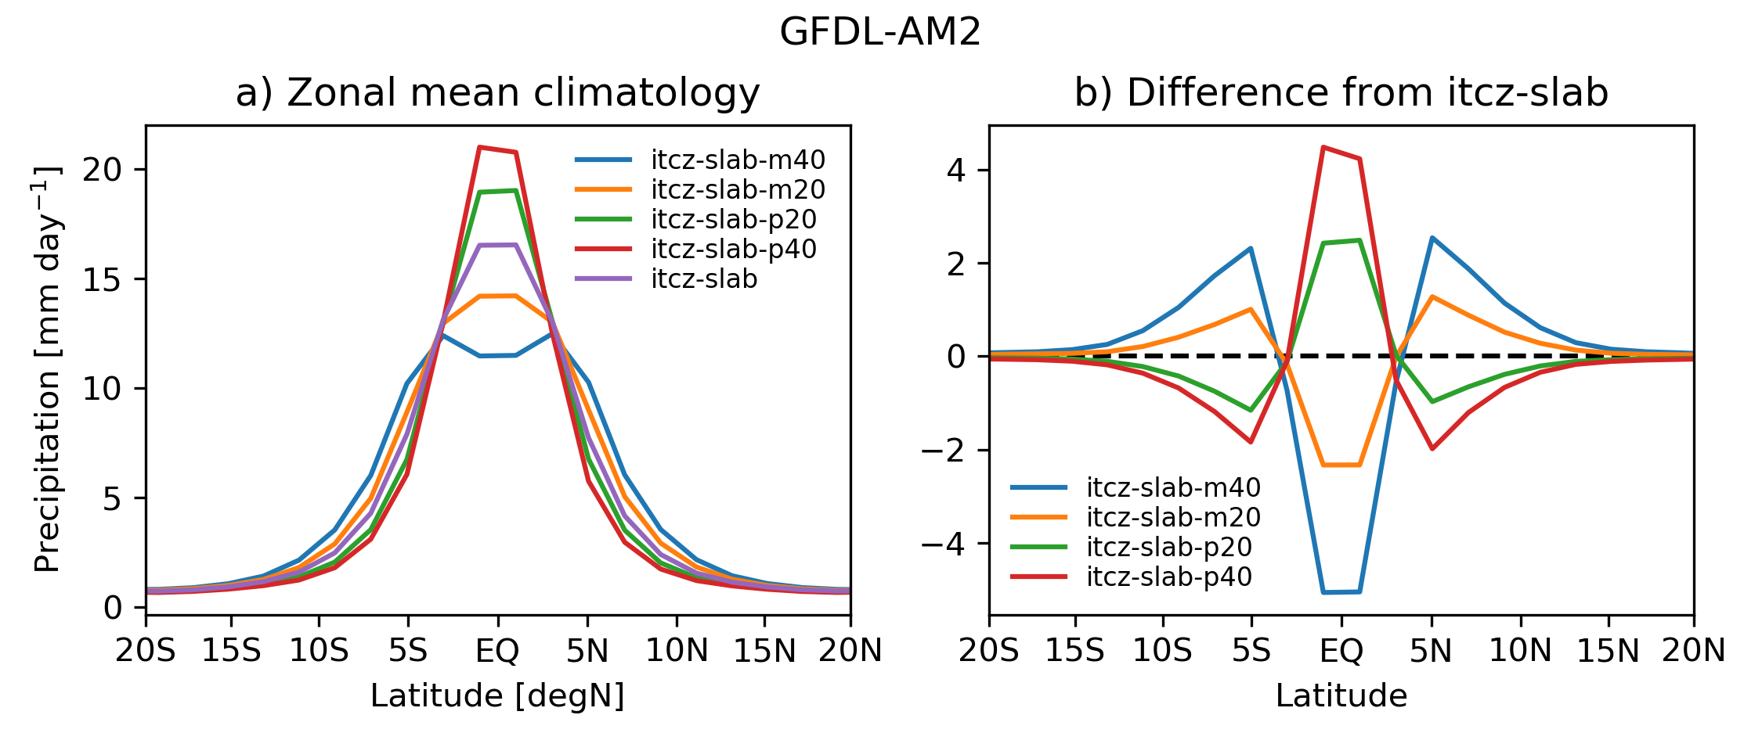
Experimental protocol: Proof of concept

Slide 10
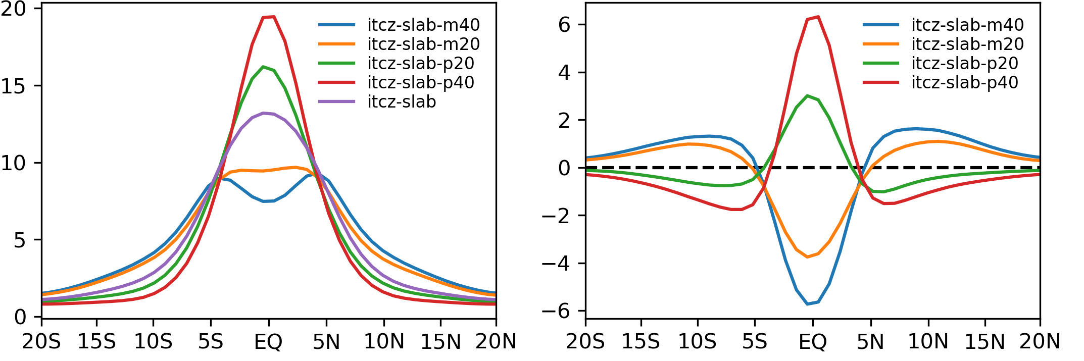
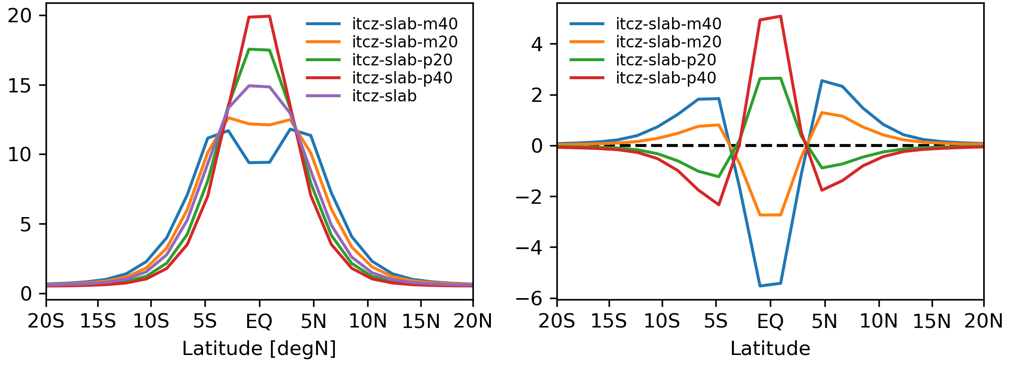
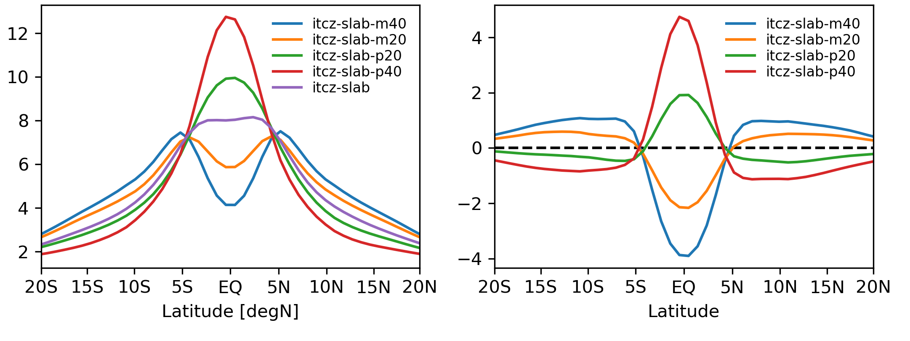
Simulations: Changing ITCZ width
GFDL-AM2
CESM2 (CTRL)
Precipitation [mm/d]
CESM2-QOBS
CESM1

Slide 11
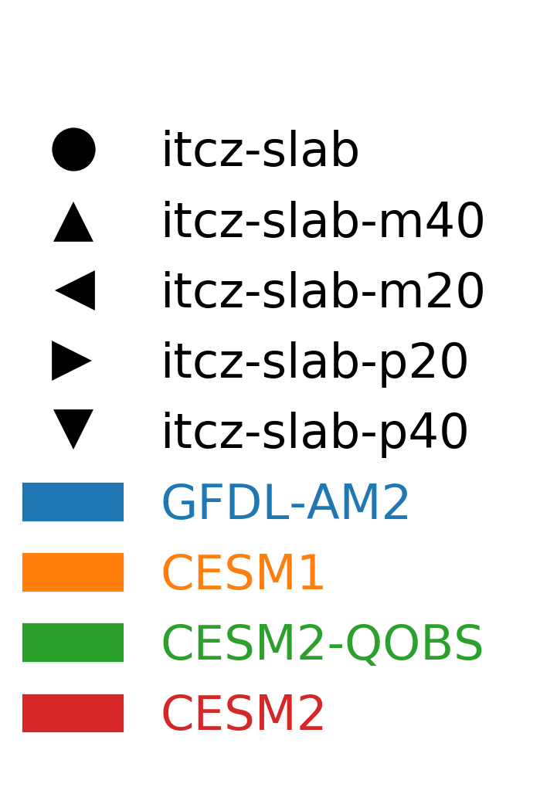
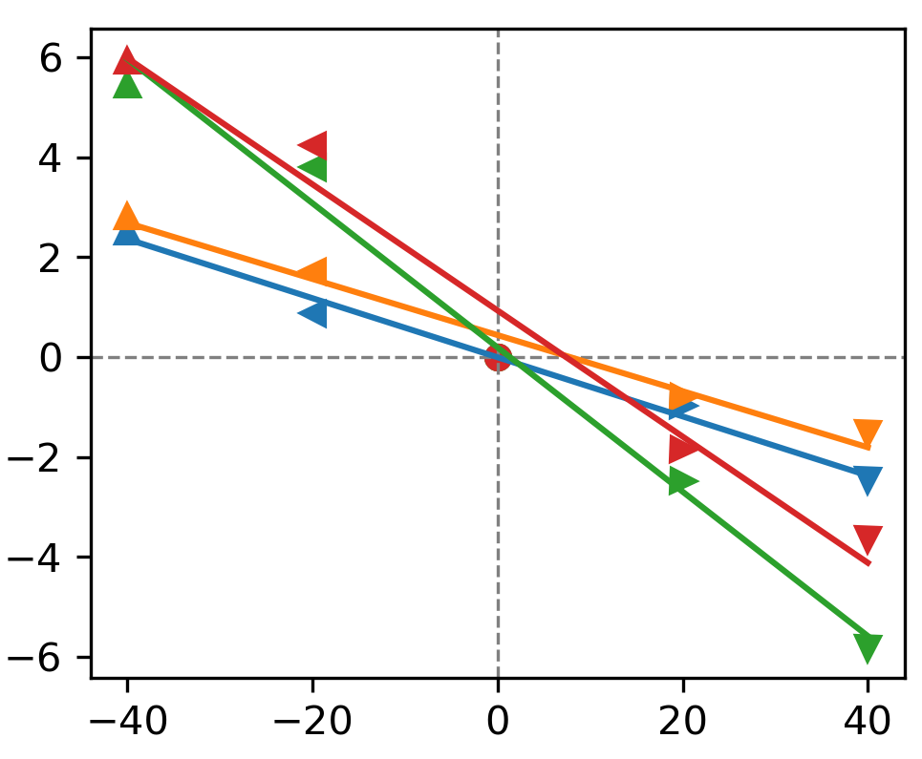
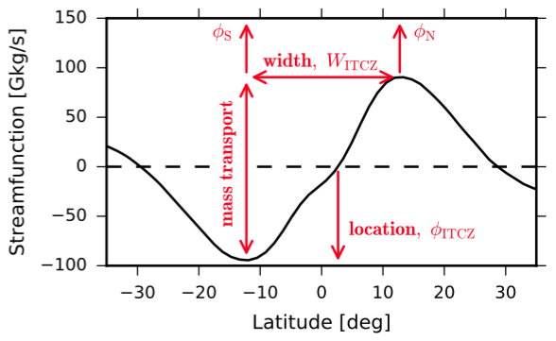
Changing ITCZ width
500 hPa streamfun. [Gkg/s]
ITCZ width change [degrees latitude]
Peak q-flux forcing [W/m²]

Slide 12
The relationship between ITCZ width and strength
Byrne et al (2018) Current Climate Change Reports
The effect ITCZ width changes on global climate

Slide 13
Parallel work
By team members
  Close relationship between ITCZ width and strength (Byrne et al 2018)
  Dynamics of ITCZ width (Byrne and Thomas 2019)
  ITCZ width affects Hadley cell width and eddy driven jet position (Watt-Meyer and Frierson 2019)
  Relationship between upwelling branch area and cloud feedbacks (Hui Su’s group: Su et al 2019, Schiro et al 2019)
  Observed changes in ascent (Su et al 2020)
By the broader community
  Aggregation projects onto ITCZ width (Popp and Bony 2019)
  Seasonal cycle of ITCZ location projects onto ITCZ width (Donohoe et al 2019)

Slide 14
Summary of initial results
The ITCZ-MIP protocol is to apply q-flux heating to the deep tropics that drives narrowing of the ITCZ
  Increases and decreases in width are roughly linear in forcing in three different climate models
Work to understand these responses and their effects on global climate is ongoing!
Please contact me if you’re interested in contributing model simulations or participating in analysis! apgrass@ucar.edu

Slide 15

Notes:
Please click if the video doesn’t play automatically.
This is a video where I simply present the slides contained here.

