Slide 1
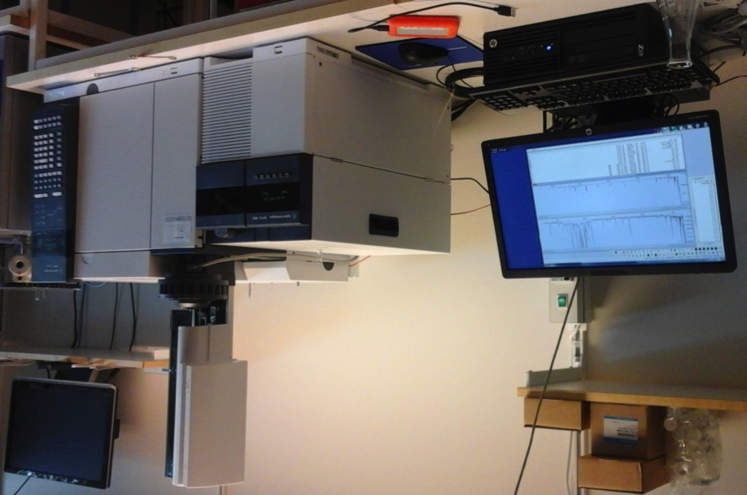

Mapping of sediment carbon in a large tropical reservoir
Sebastian Sobek¹, Raquel Mendonça², Anastasija Isidorova¹, Charlotte Grasset¹
¹ Limnology, Institution for Ecology and Genetics, Uppsala University, Sweden; ² Aquatic Ecology Laboratory, Federal University of Juiz de Fora, Brazil
Why reservoirs: - 40% of inland water C burial (Mendonça et al. 2017, Nature Communications)
- significant CH₄ source (Deemer et al. 2016, BioScience)
- hydropower boom (Zarfl et al. 2015, Aquatic Sciences)
1300 km² Furnas reservoir, Brazil
Sub-bottom profiling and coring
Organic C burial rate, and source
CH₄ saturation in sediment porewater

Slide 2
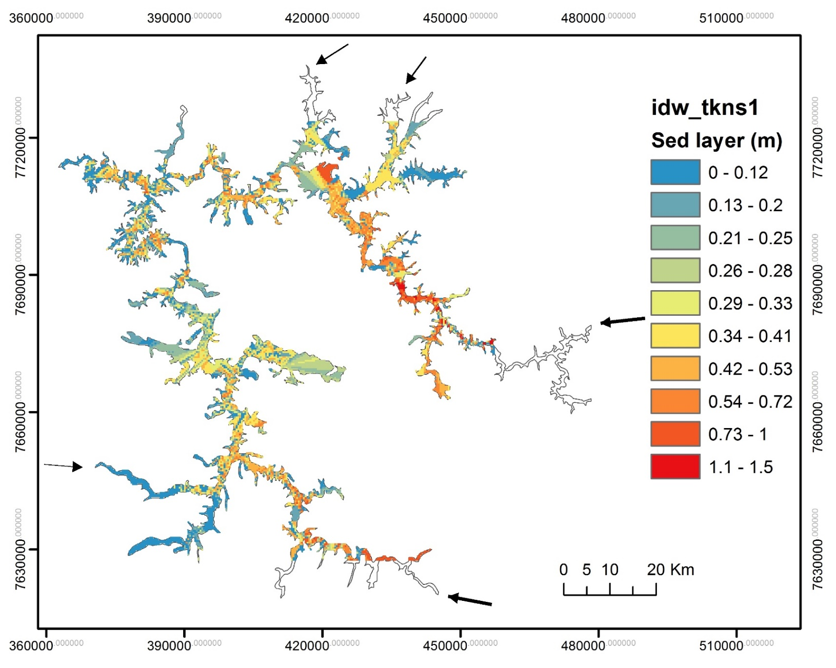
OC burial
(g C m⁻² yr⁻¹)
Spatially weighted mean OC burial rate: 44 g C m⁻² yr⁻¹
Mendonça et al., in prep.

Slide 3
OC sources
Based on n-alkanes and
Bayesian mixing model
Average: 60% land-derived OC
40% aquatic OC → anthropogenic C sink of ~23,000 t C yr⁻¹
Isidorova et al., in prep.

Slide 4
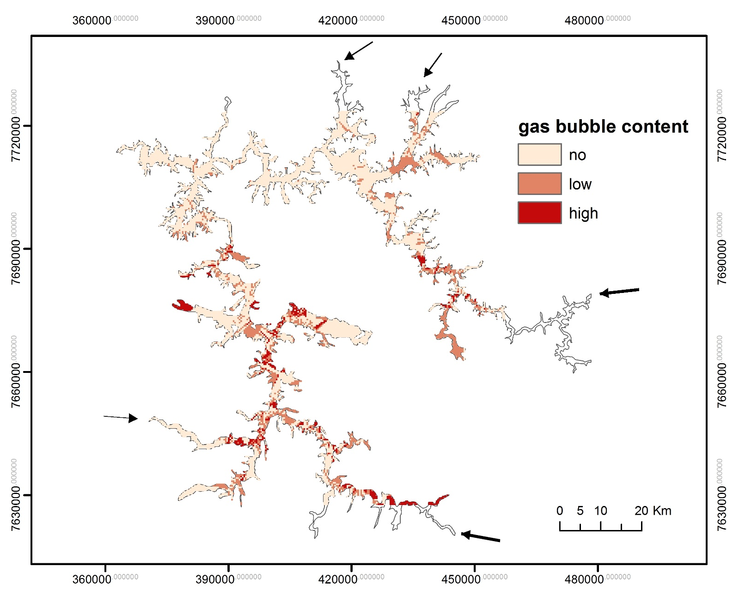
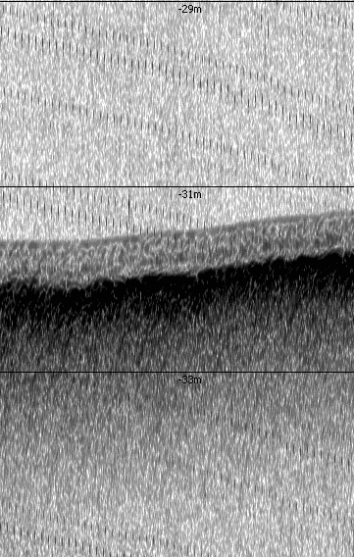
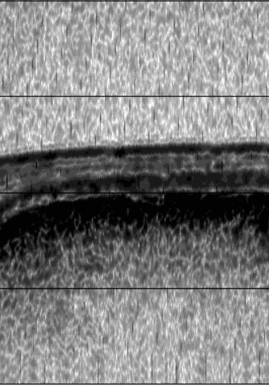
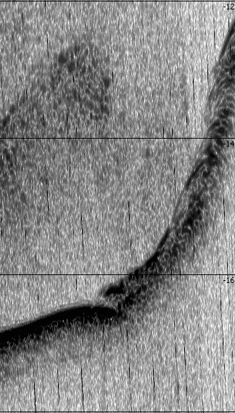
Based on sub-bottom sound reflection and porewater CH₄ concentrations:
2m
100% CH₄ saturation
Frequent large algae blooms
1m
Major river inflow areas
2m
CH₄-rich gas bubbles in sediments:
- 30% of the total sub-bottom survey length (250 km)
- close to river inflows, and where productivity is high
Mendonça et al, in prep.

Slide 5

Thank you!
Carlos Henrique Estrada
Anastasija Isidorova
and
Raquel Mendonça
Many CH₄ gas bubbles High OC burial
→ Hot spots of CH₄ emission and OC burial:
- River inflow areas
- Areas with high ecosystem productivity
The Hydrocarb project team
www.ieg.uu.se/limnology/research/hydrocarb
sebastian.sobek@ebc.uu.se
Mendonça et al, in prep.

