Slide 1
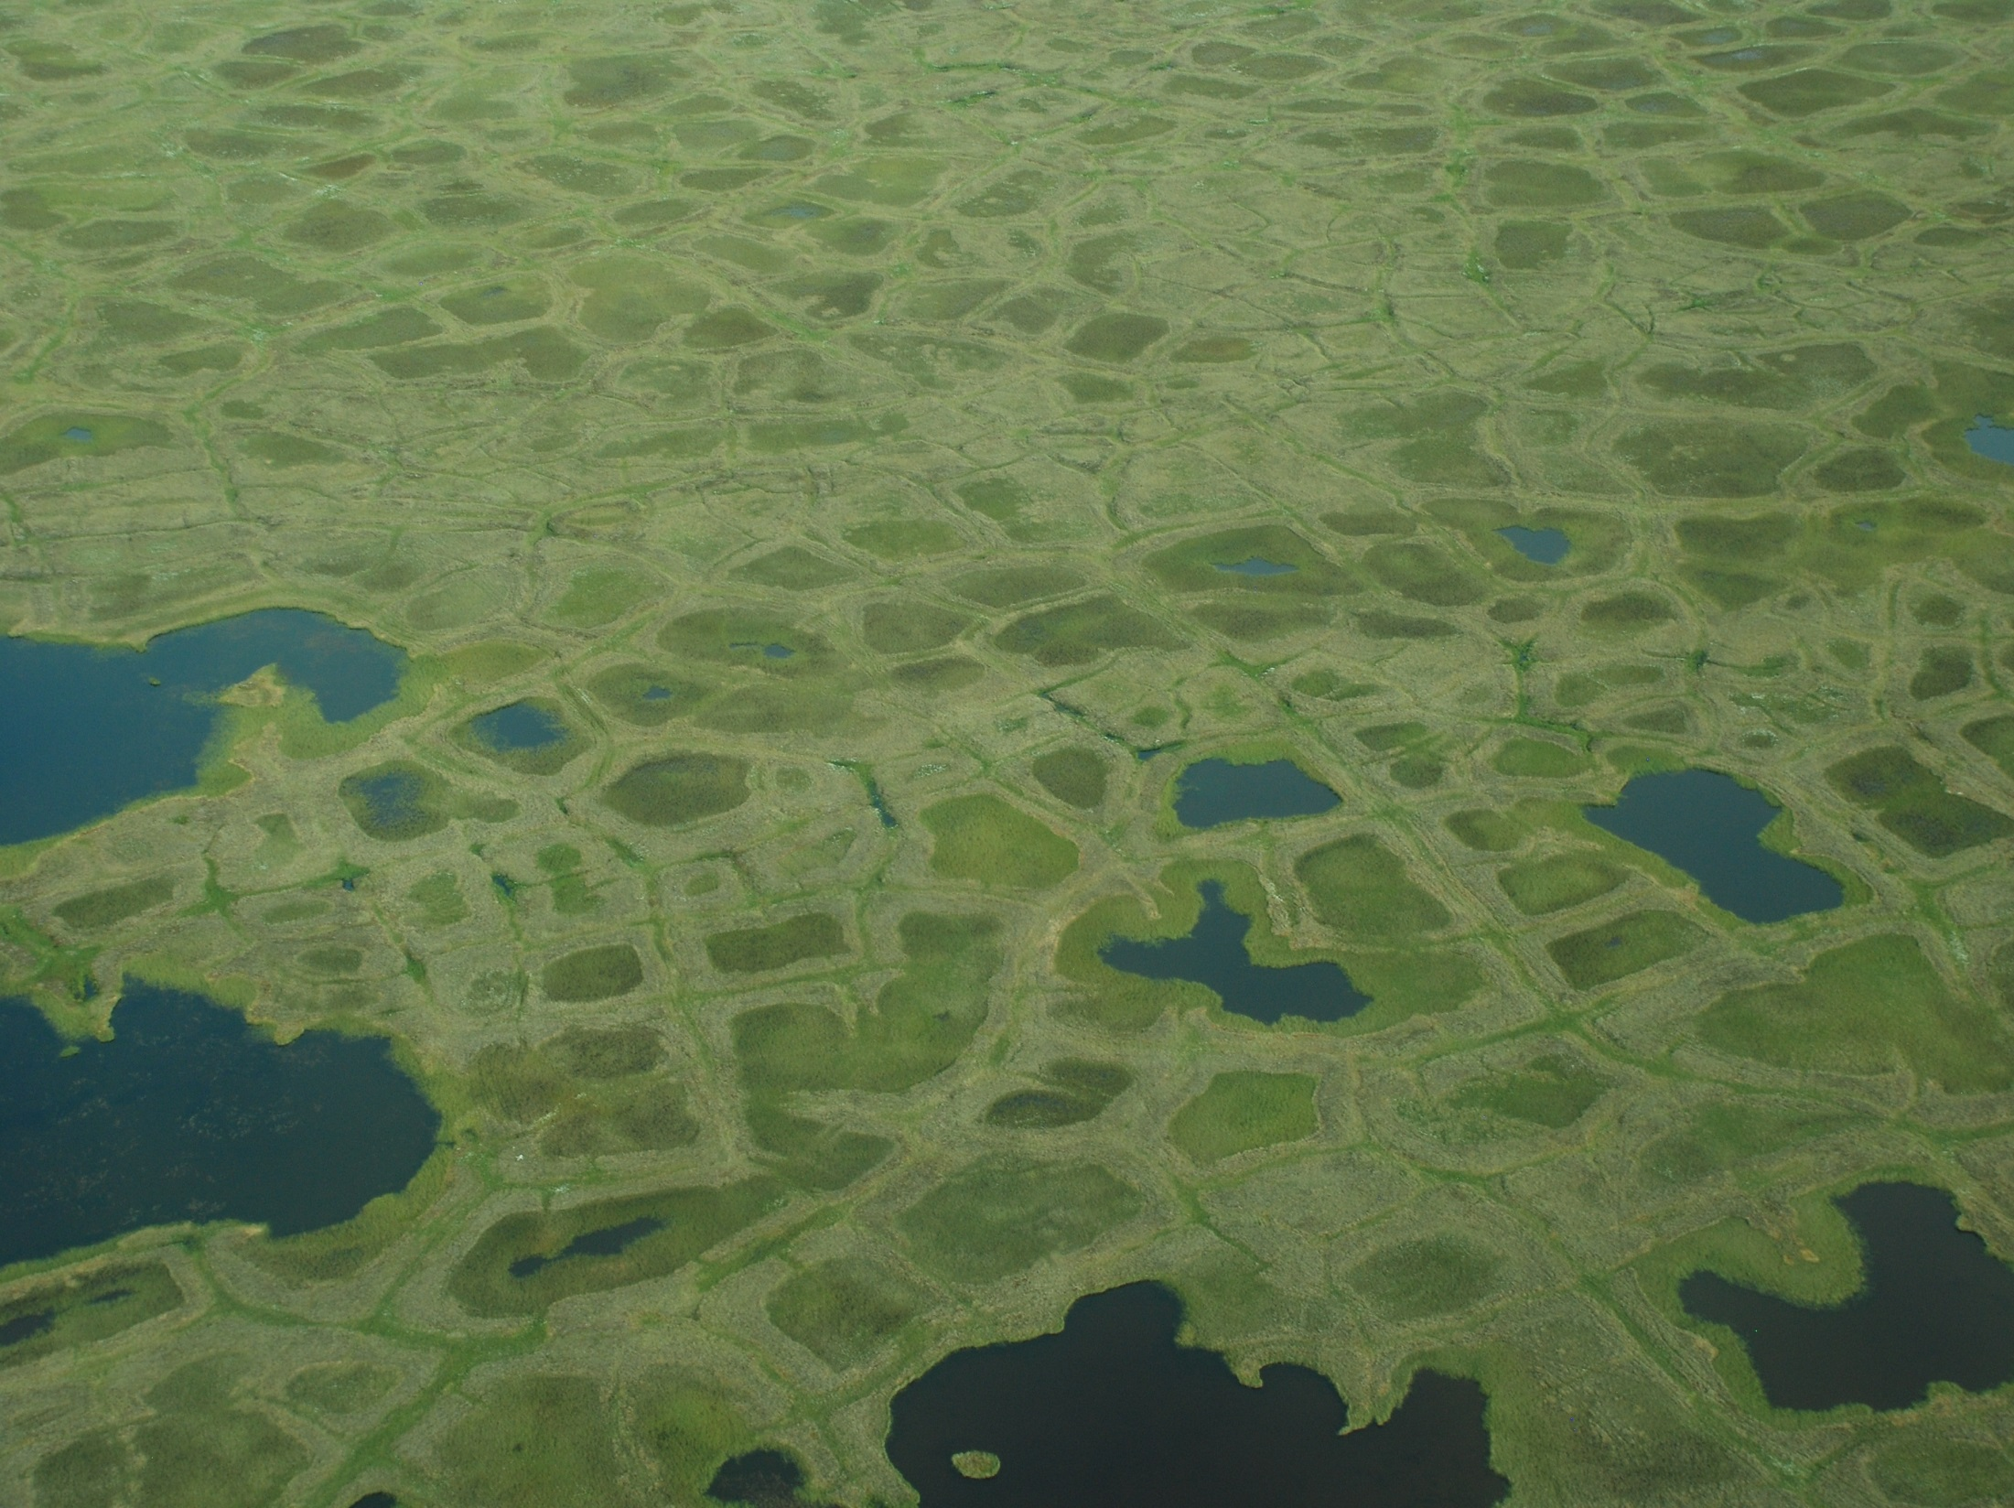
Changes in CO₂ and CH₄ exchange with climate change in an Arctic polygonal tundra depend on rates of permafrost thaw as affected by changes in vegetation and drainage
Grant, R.F.¹, Mekonnen, Z.A.², Riley W.J. ²
¹ Department of Renewable Resources, University of Alberta, Edmonton, AB, Canada T6G 2E3
² Earth Science Division, Lawrence Berkeley National Laboratory, Berkeley, CA
Grant, R.F., Mekonnen, Z.A., Riley W.J., Arora, B and Torn, M.S. 2019. Modelling climate change impacts on an Arctic polygonal tundra. Part 2: Changes in CO₂ and CH₄ exchange depend on rates of permafrost thaw as affected by changes in vegetation and drainage Journal of Geophysical Research: Biogeosciences. DOI: 10.1029/2018JG004645

Slide 2

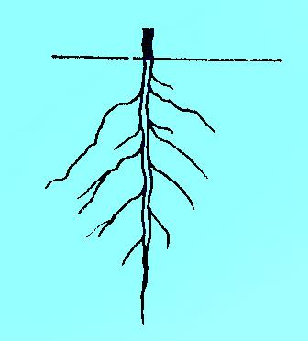
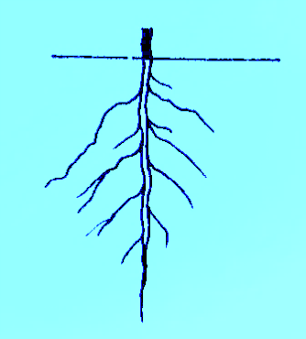
Modelling energy and gas exchange in permafrost-affected ecosystems
Winter
Summer
Snow
ET
Rn, LE, H, G
CH₄
O₂
CO₂
CH₄
Rn, LE, H, G
ET
Rain
evaporation
condensation
transpiration
energy exchange
CO₂ exchange
snowpack
litterfall
freeze-thaw
surface litter
hydraulic uptake
freeze-thaw
litterfall
uptake
hydraulic flow
active layer
conduction, convection
oxidation-reduction
litterfall
uptake
mineralization-immobilization
hydraulic flow
microbial
populations
oxidation-reduction
hydraulic uptake
freeze-thaw
mineralization-immobilization
conduction, convection
SOM
permafrost

Slide 3





Surface gas exchange is coupled with convective – dispersive transfers of gases and solutes through soil profile.
ATMOSPHERE
aerobic
microsites
O_{2m}
O_{2s}
O_{2g}
O_{2s}
O_{2r}
O_{2g}
CH4_{m}
CH_{4s}
CH_{4g}
CH_{4s}
CH_{4g}
oxidation-
reduction
volatilization-
dissolution
root
transport
O_{2m}
O_{2s}
O_{2g}
O_{2s}
O_{2r}
O_{2g}
methano-
genic
microsites
CH4_{m}
CH_{4s}
CH_{4g}
CH_{4s}
CH_{4g}
aqueous
convection-
dispersion
gaseous
convection-
dispersion
root surface
O_{2m}
O_{2s}
O_{2g}
O_{2s}
O_{2r}
O_{2g}
CH4_{m}
CH_{4s}
CH_{4g}
CH_{4s}
CH_{4g}
These transfers govern concentrations of reactants and products in oxidation-reduction reactions
bubbling

Slide 4
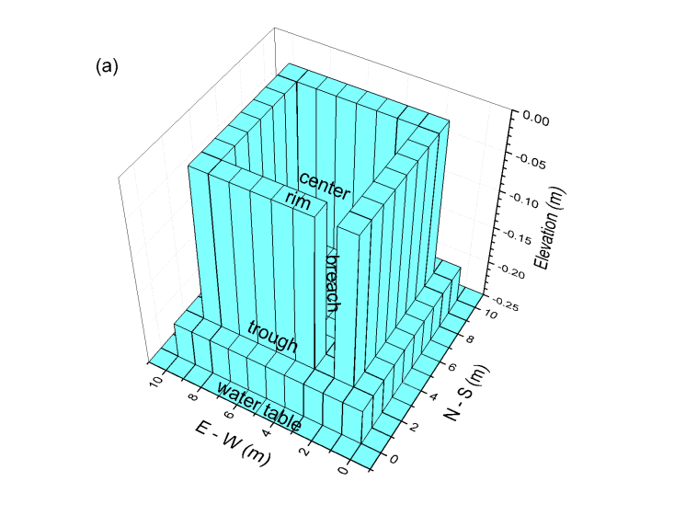
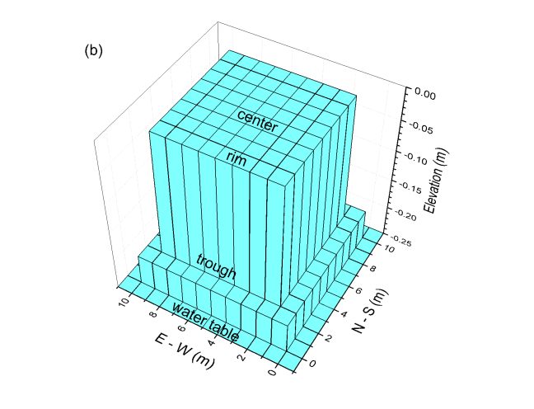
A simplified representation of the low-centered and flat-centered polygons at Barrow used in ecosys

Slide 5
Model Runs
Ecosys was spun up for 35 years with 1981 – 2013 weather data from Xu and Yuan (2016), and with 2013 – 2015 weather data from the NGEE phase I project.
The spinup run was extended through 2 more 35-year cycles under a RCP 8.5 emission scenario downscaled and averaged across 15 CMIP5 models for the grid cell in which BEO is located with seasonal increases in average maximum and minimum temperatures and increases in precipitation and C_{a} from 1981 – 2010 to 2071 – 2100 incremented hourly.
 | Winter (DJF) | Spring (MAM) | Summer (JJA) | Autumn SON)
Max. Temp. (ºC) | 10.97 | 7.08 | 4.53 | 7.25
Min. Temp. (ºC) | 12.80 | 8.28 | 4.84 | 8.30
Precipitation (-) | 1.34 | 1.52 | 1.28 | 1.34
C_{a} (-) | 2.37 | 2.37 | 2.37 | 2.37
Xu, X. and F. Yuan (2016), Meteorological Forcing at Barrow AK 1981-2013. http://ngee-arctic.ornl.gov/. accessed 22 June 2016.

Slide 6
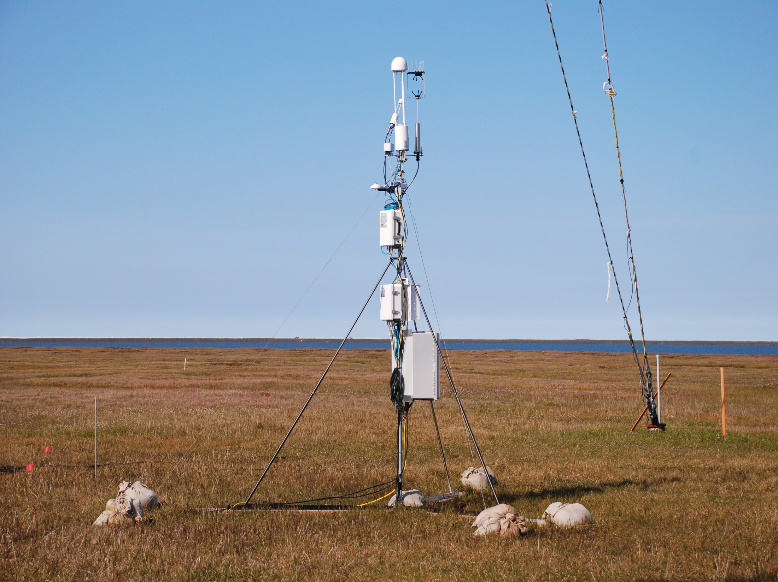
Eddy covariance measurements enable vital tests of model results for CO₂ and energy exchange

Slide 7
Similar T_{a} gives similar GPP but greater R_{e} later in growing season
(a) Radiation and air temperature (T_{a}), and (b) CO₂ fluxes measured during late June (DOY 175 – 178) and early September (DOY 243 – 246) 2015 (symbols) and spatially aggregated CO₂ fluxes modelled in combined LCP and FCP features during the same periods with 2015 weather in 2085 of the baseline run (line). In (b) positive values represent influxes, and negative values effluxes. Measured fluxes from Dengel et al. (2017).

Slide 8
large temporal variation associated with warming events
(a) Air temperature (T_{a}) and precipitation, and (b) CH₄ flux measured during 2014 (symbols) and modelled during 2084 (2014) of the baseline run (line). In (b) positive values represent influxes, and negative values effluxes. Measured fluxes from Zona et al. (2015).

Slide 9
baseline climate change
eventual talik formation
Ice contents of surface litter and soil profiles modelled during 2084 in centers of the (a,b) LCP and (c,d) FCP in the baseline (a,c) and climate change (b,d) runs. Active layers are indicated by ice-free zones in dark blue. Symbols represent measurements of ALD in 2014 by Peterson (2017).

Slide 10
2nd cycle repeats 1st cycle, indicating long-term stability in baseline run
(a) Mean annual temperature (line) and annual precipitation (bars) at Barrow, AK from 1981 to 2015 used in the baseline run from 2016 to 2050 and from 2051 to 2085, and active layer depth (ALD) modelled (lines) on 31 August in troughs, rims and centers of the (b) LCP and (c) FCP and measured in late August 1991 - 2009 at the CALM site in BEO (open circles), late August 2008 by Zona et al. (2011), and in early September 2012 – 2013 by Wood et al. (2015) (open squares).

Slide 11
increasing T_{a}, P,
increasing ALD
deviations from baseline run attributed to changes in C_{a}, T_{a} and precipitation
(a) Mean annual temperature (line) and annual precipitation (bars) at Barrow, AK with meteorological data from 1981 to 2015 incremented hourly from 2016 to 2085 with changes in T_{a} , C_{a} and precipitation (+T_{a} +C_{a} +P), and active layer depth (ALD) modelled on 31 August in troughs, rims and centers of the (b) LCP and (c) FCP.

Slide 12
2nd cycle repeats 1st cycle, indicating long-term stability in baseline run
greater emissions from lower landscape positions
(a) Mean annual temperature (line) and annual precipitation (bars) at Barrow, AK from 1981 to 2015 used in the baseline run from 2016 to 2050 and from 2051 to 2085, and annual CH₄ emissions modelled in troughs, rims and centers of the (b) LCP and (c) FCP. Faint lines indicate standard deviation of values modelled for all grid cells in each feature.

Slide 13
deviations from baseline run attributed to changes in C_{a}, T_{a} and precipitation
(a) Mean annual temperature (line) and annual precipitation (bars) at Barrow, AK with meteorological data from 1981 to 2015 incremented hourly from 2016 to 2085 with +T_{a} +C_{a} +P (see Table 2 in Grant et al., submitted), and annual CH₄ emissions modelled in troughs, rims and centers of the (b) LCP and (c) FCP.

Slide 14
variable increases in net C uptake do not offset increases in CH₄ emissions with RCP 8.5 climate change
Annual net CO₂ exchange modelled in troughs, rims and centers of the (a,c,e) LCP and (b,d,f) FCP at BEO from 2016 to 2085 with meteorological data from 1981 to 2015 (baseline) and with these data incremented hourly with +T_{a} +C_{a} +P.

Slide 15
Summary
RCP 8.5 climate change from 2015 to 2085 increased NPP from 50–150 g C m⁻² y⁻¹ under current climate, consistent with current biometric estimates, to 200–250 g C m⁻² y⁻¹ after 70 years of climate change.
Concurrent increases in heterotrophic respiration (R_{h}) were slightly smaller, so that net CO₂ exchange rose from values of −25 (net emission) to +50 (net uptake) g C m⁻² y⁻¹ under current climate to ones of −10 to +65 g C m⁻² y⁻¹ after 70 years of climate change.
Increases in net CO₂ uptake were offset by increases in CH₄ emissions from 0–6 g C m⁻² y⁻¹ under current climate to 1–20 g C m⁻² y⁻¹ after 70 years of climate change, reducing gains in NEP.
These increases in net CO₂ uptake and CH₄ emissions were modeled with an external WTD that was assumed not to change with climate. Both these increases were smaller if boundary conditions were gradually altered to increase landscape drainage and thereby increase WTD during model runs with climate change.

Slide 16
Large-Scale Applications of Ecosys to Project Climate Change Impacts in Arctic Regions
Mekonnen, Z.A., Riley, W.J. and Grant, R.F. 2018. 21st century tundra shrubification will offset respiratory carbon losses across North America tundra. . Environmental Research Letters 13: 054029
Mekonnen, Z.A., Riley, W.J. and Grant, R.F. 2018. Accelerated nutrient cycling and increased light competition will lead to 21st century shrub expansion in North American Arctic tundra. Journal of Geophysical Research: Biogeosciences 123: 1683-1701.

Slide 17
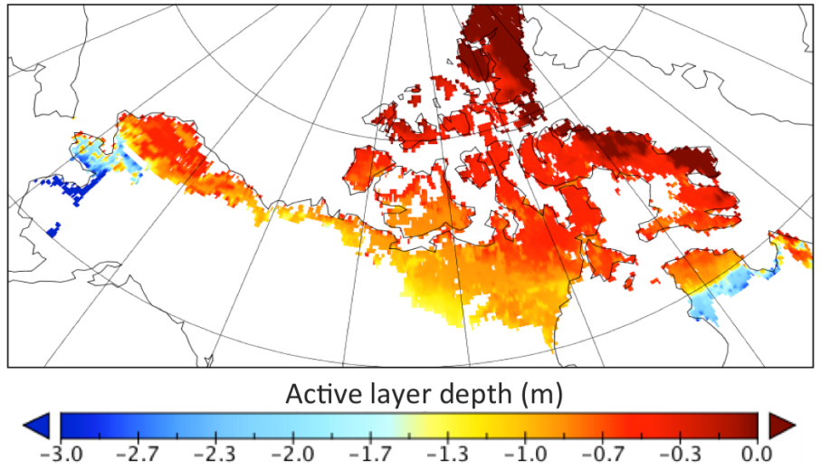
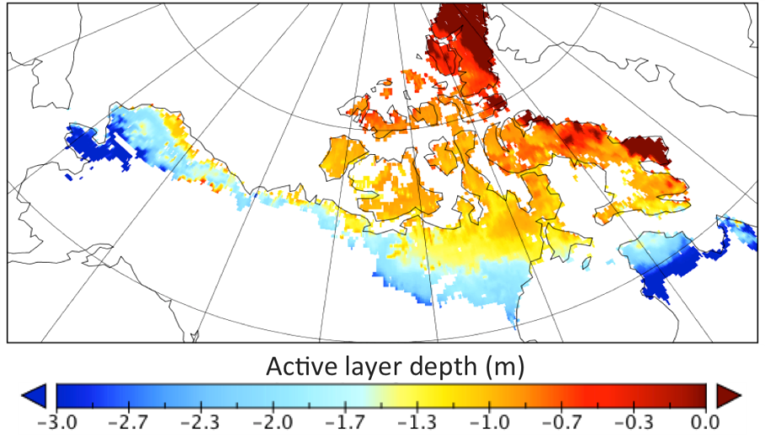
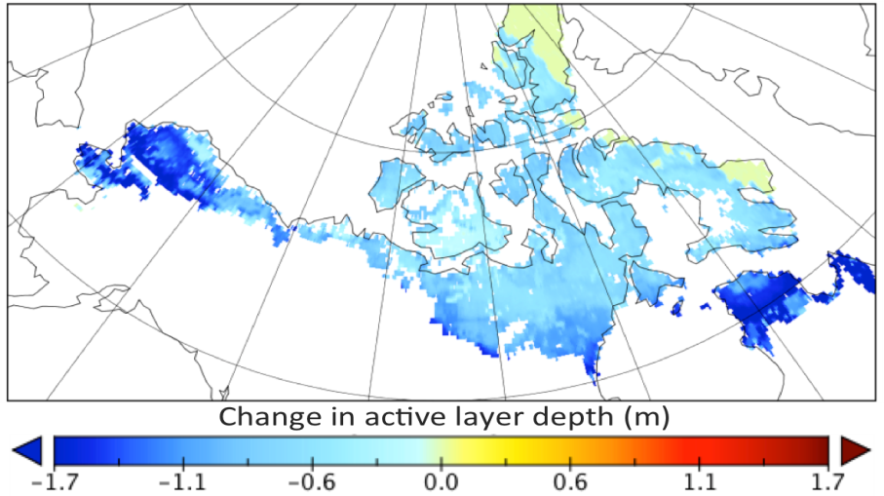
(a) 2006 – 2010
Modeled maximum active layer depth, averaged during (a) 2006 - 2010 vs. (b) 2096 - 2100 across North American tundra ecosystem, and (c) changes in active layer depth (b – a) over the 21st century.
(b) 2096 – 2100
(c) b – a
Greater increases in ALD in southern permafrost zone

Slide 18
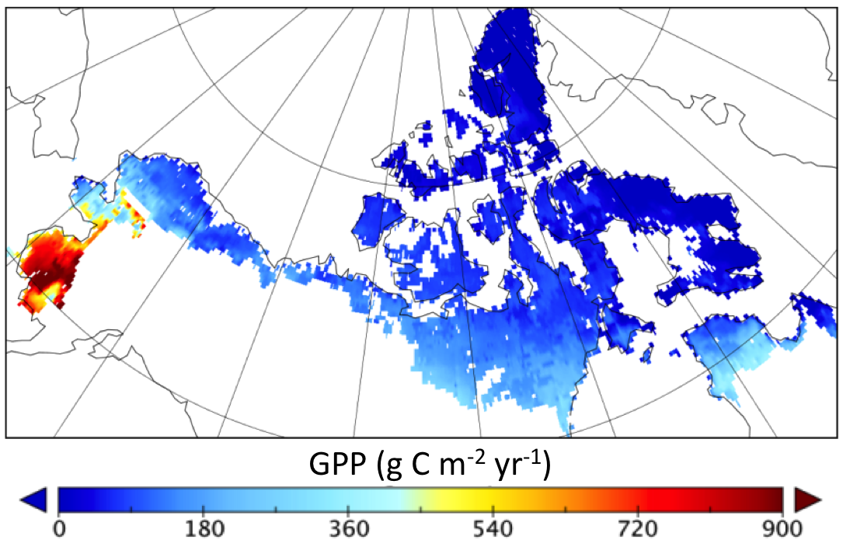
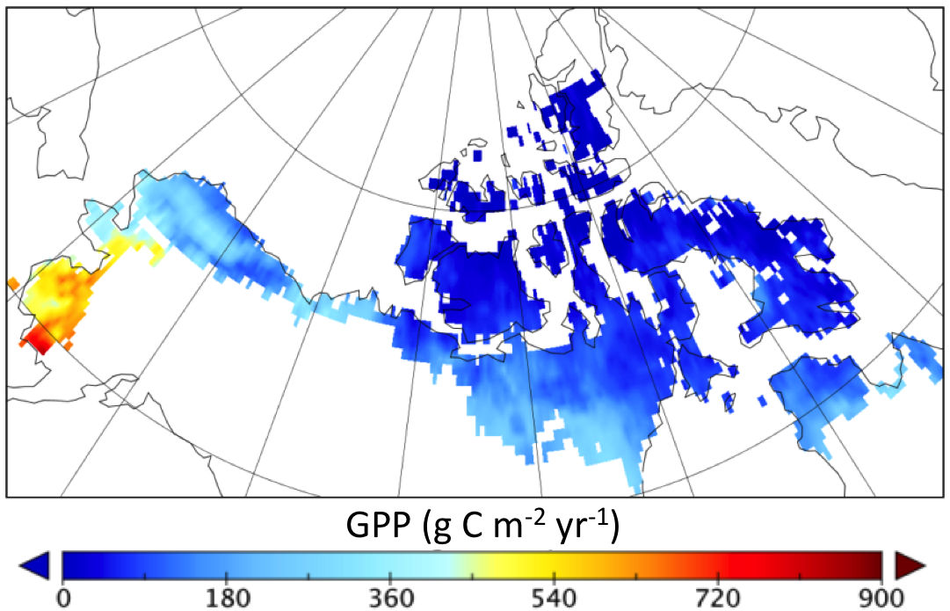
(a)
Long-term (1982 - 2010) annual average (a) modeled GPP (b) GPP upscaled from network of EC observations (Jung et al., 2011). Geographically weighted regression for modeled vs. observed spatial patterns: R² = 0.78.
(b)

Slide 19
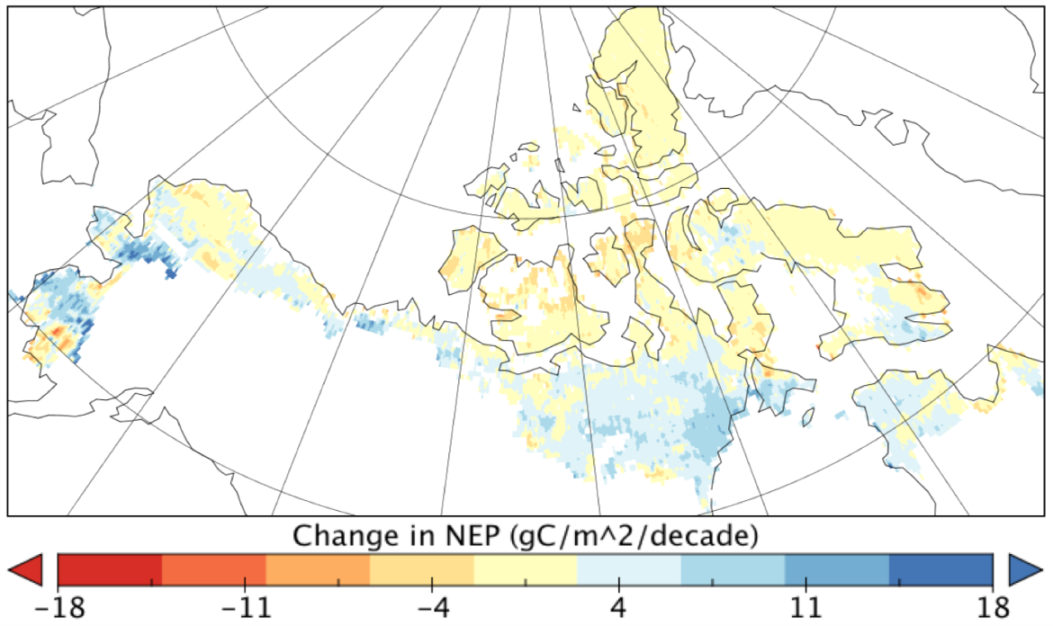
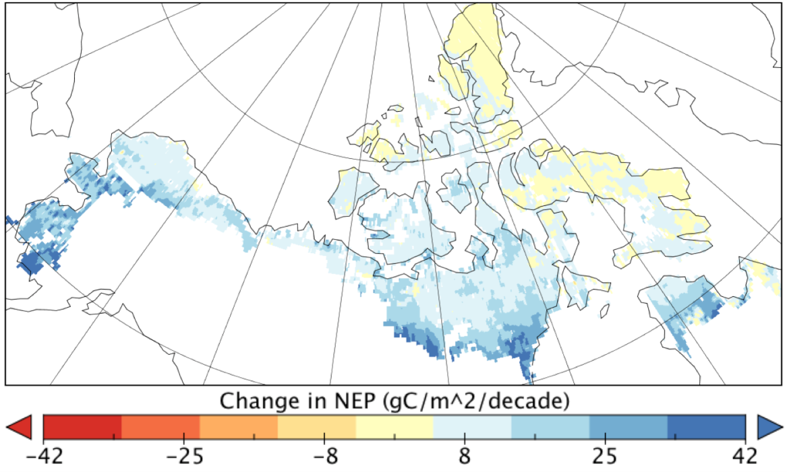
Changes in modeled annual net primary productivity across North America Arctic tundra under (a) recent (1982 to 2010) and (b) future (2010 to 2100 ) climates.
(a)
(b)
Greater increases in southern permafrost zone

