Slide 1
Cartographic Representation of Channel Forms on Planetary Geologic Maps
EGU2020-20298
H. Hargitai
Eotvos Lorand University 1088 Budapest Muzeum krt 6-8. Hungary
hargitaih@caesar.elte.hu
PS6.3 is scheduled for a live chat on Monday, 04 May 2020, 16:15-18:00. I will be available 17.30-18.00

Slide 2
Channels on Planetary geologic maps (1)
No standard: depends on map purpose, and map design.
What are the forms we label as “channels”?
Should the symbol imply… dry channel / ephemeral channel /paleochannel / active channel (during a geologic era) / a valley / arroyo/wadi-like form
How fluvial, outflow and lava (or other) channels should or should not be differentiated on a map / if they can be differentiated in the study?

Slide 3
Channels on Planetary geologic maps (2)
How and where a channel symbol should transform into a polygonal unit symbol?
How channel networks can be mapped / measured in a map where larger channels are shown as units, but smaller ones (“narrow channels”, “small distributary channels” or “small valleys”) as lines?
Separate drainage line map may/ accompany a geologic units map (?)
Interior channels?
Depiction of all Mars channels on a global map is difficult: how to generalize/simplify?
No Venus channel map or database exists
It is not clear how to mark channels within channel belts and cross-bar (islandtop) channels

Slide 4
FGDC Digital Cartographic Standard for Geologic Map Symbolization
25—PLANETARY GEOLOGY FEATURES
EARTH
30—TOPOGRAPHIC AND HYDROGRAPHIC FEATURES
Note: “canali” is a term for lava channels on Venus

Slide 5
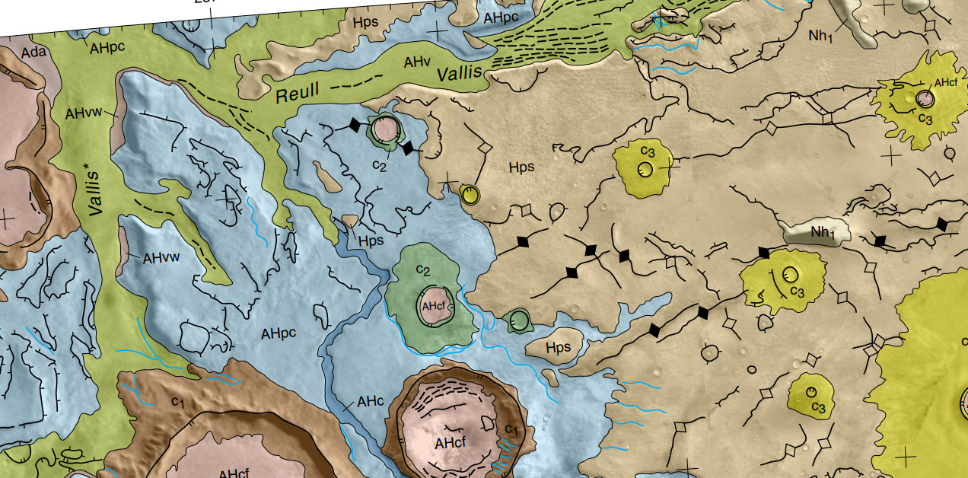
Examples
I2763 Reull Vallis
Valley/channel floor:
AHv, AHc - unit "vallis floor material", "channel material"
Blue line - channel
Black dashed line - lineament ("lineated valley floor)
Channel and "Vallis" is the same
"Channel" is narrow "vallis" or gully etc.

Slide 6
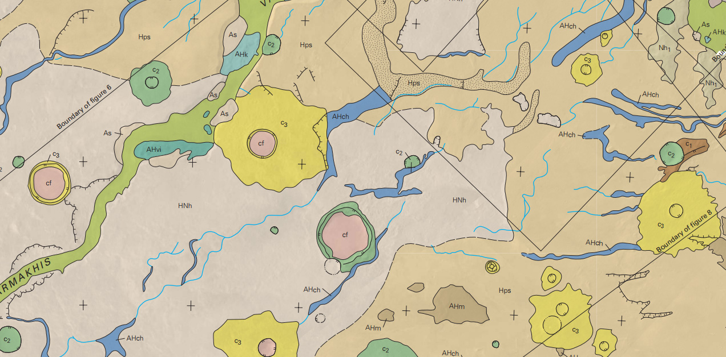
I2557 Dao, Harmakhis, and Reull Valles
Units:
AHch - channel floor "sinuous channels"
Hps - smooth plains material "sediments.. modified by fluvial processes"
AHv - vallis floor "steep walled outflow channels"
Blue line - narrow channel
Channel line transition into channel unit.
Hps transition into channel unit
channel line is just narrow channel unit

Slide 7
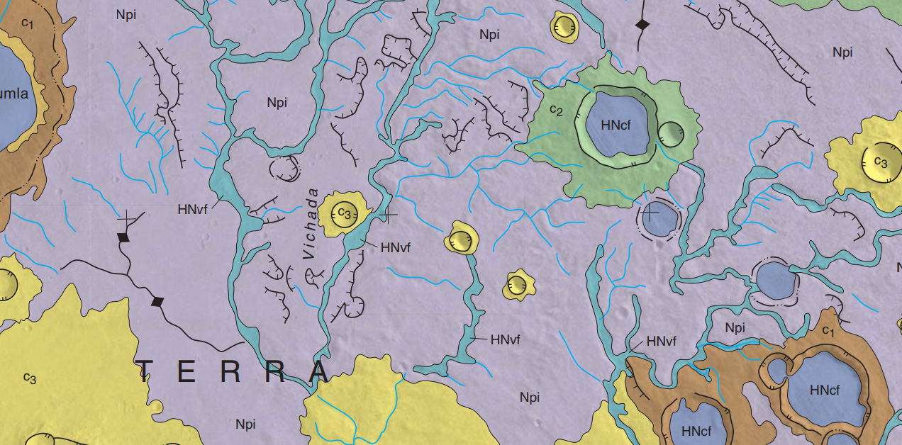
I2934 Tyrrhena Terra
unit:
HnVf - valley floor material
blue line - channel

Slide 8
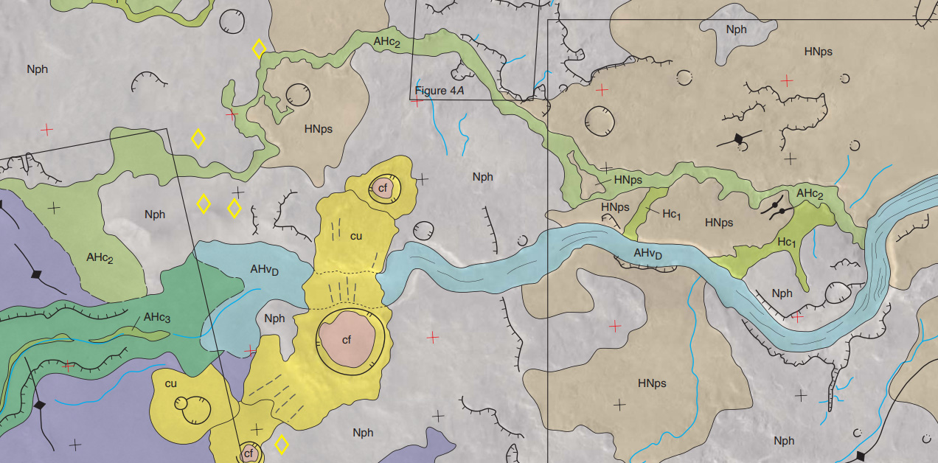
Sim3096 Eastern Hellas Planitia
Units
AHvD X Vallis floor material
HC1, AHc2 etc. Channel floor material
Blue line - Narrow channel
Black. valles floor lineations
Units are distinguished by system and age, not process
Terminal deposit is part of valley floor material

Slide 9
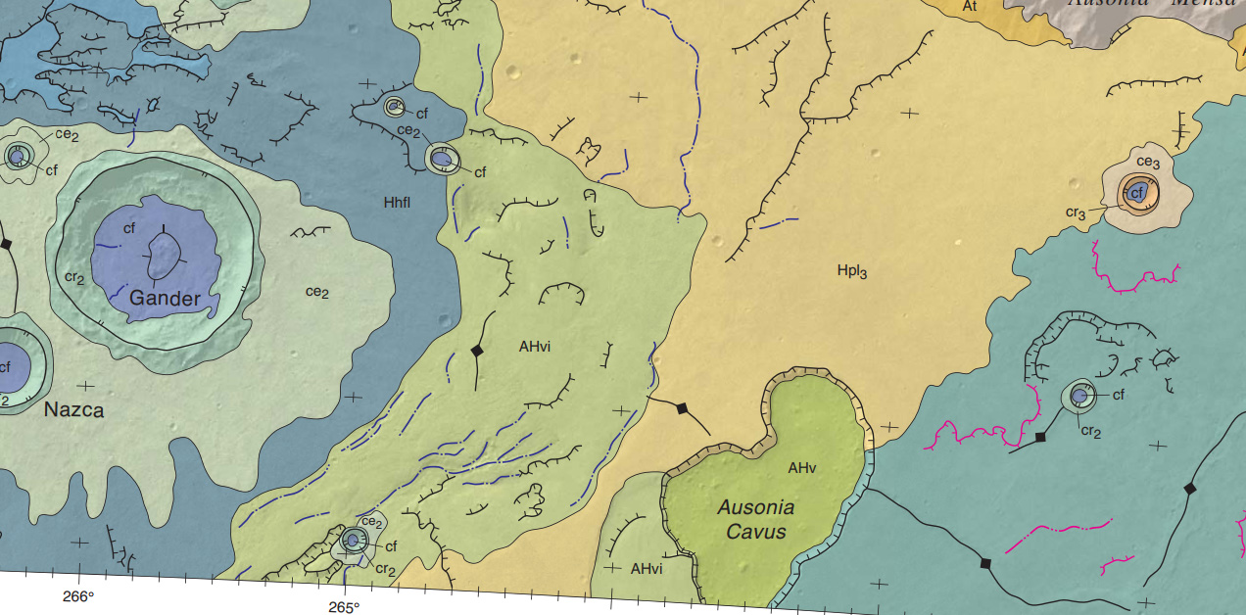
Sim2936 Hadriaca Patera
no channel units on this map
dot-dashed lines:
blue - "channel"
pink - "volcanic channel"
Gully, valley and channel forms are not distinguished

Slide 10
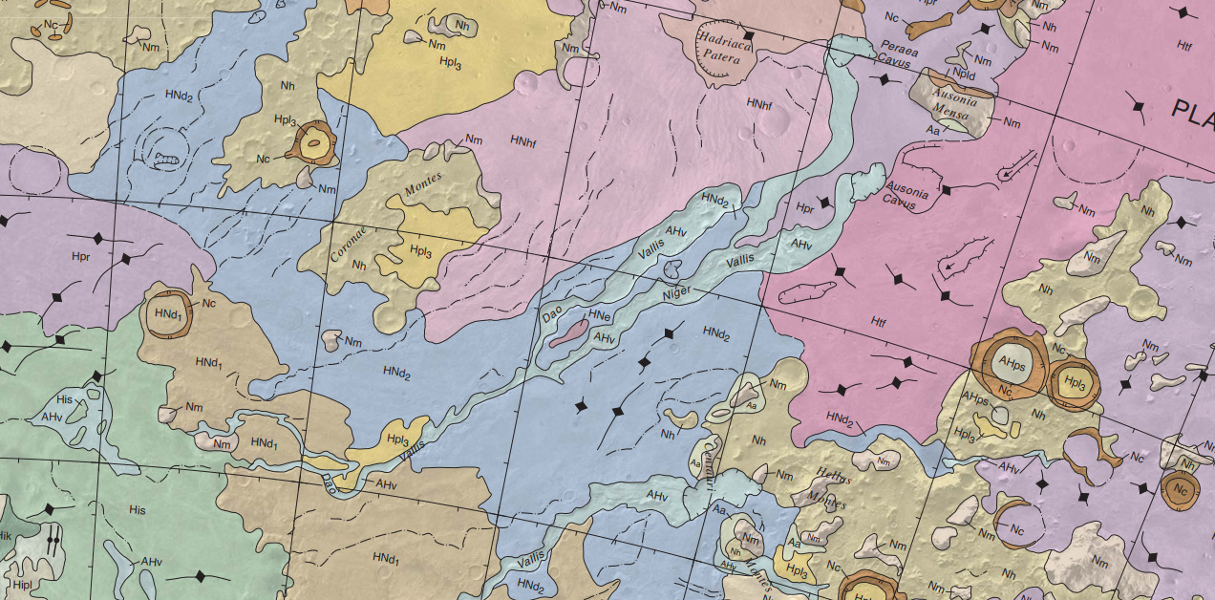
I2694 Hellas
AHv - vallis unit (Dao etc)
dot dashed line: narrow sinuous channel
(up to 1-2 km "narrow" and valley)

Slide 11
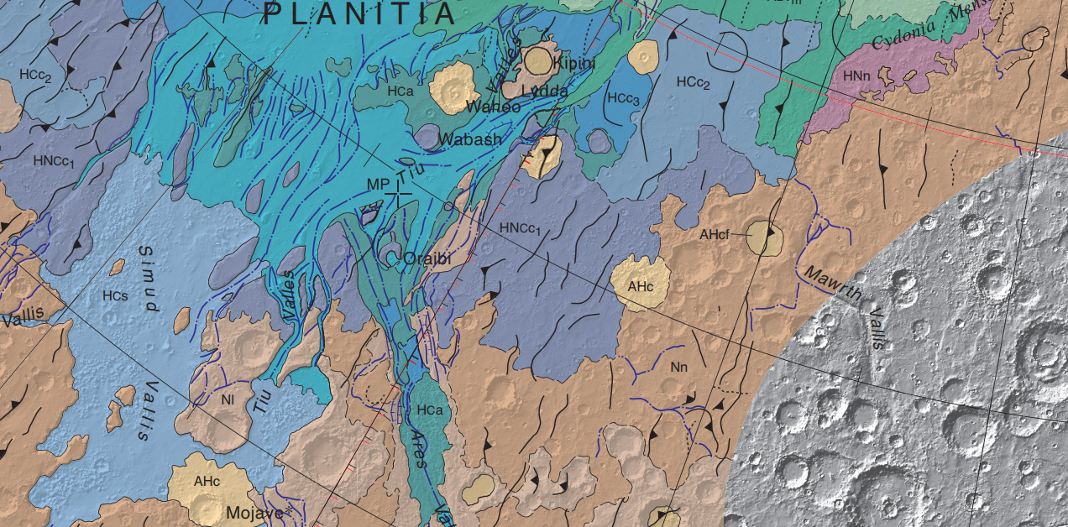
Sim2888 Northern Plains
Units
HCa Ares Vallis etc. units
HCC4D Planitia deposits (debris flow/fluvial flood sediment)
dot dashed line - channel (
Channel may be within units and standalone

Slide 12
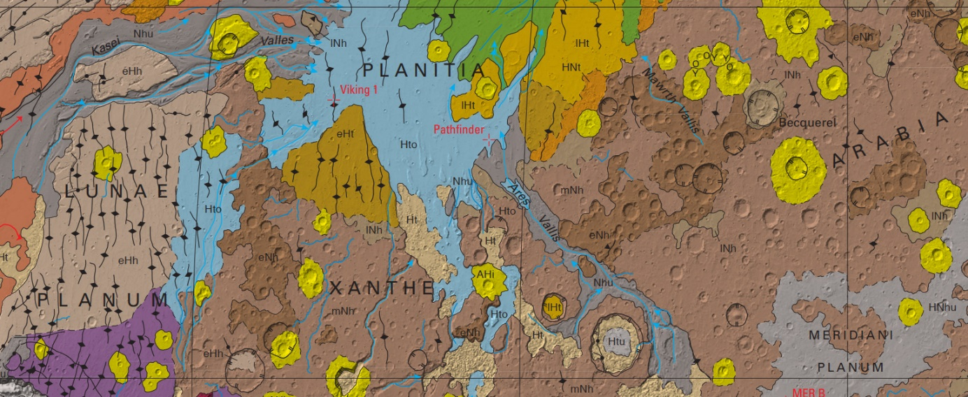
Sim3292 Geologic Map of Mars
Hti plains deposits
NHu -bright channel line with arrow
- "outflow channel" within or with no unit
dark channel line without arrow - "channel"

Slide 13
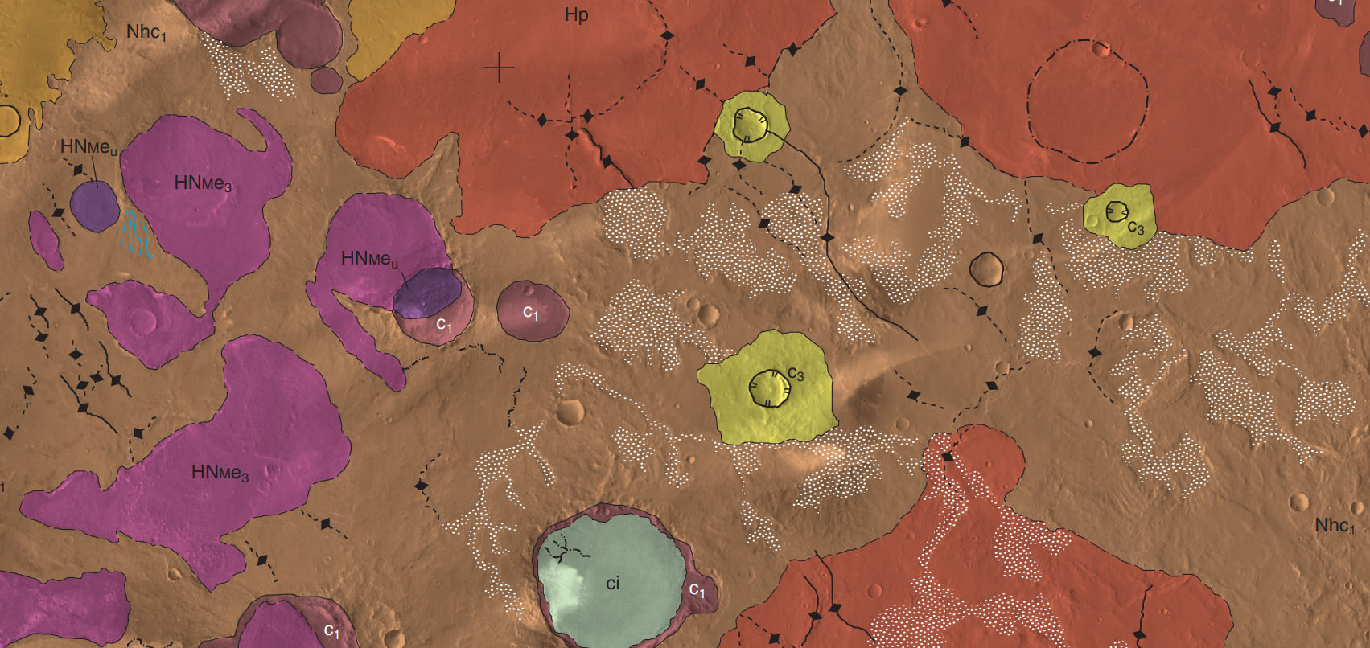
Sim3356 Meridiani Planum
1:2M
Units: none.
„Large regions composed of spatially expansive, integrated fluvial valleys were noted as surficial features (valley surfaces) whereas sporadic individual valleys were mapped as linear features (valleys).”
Valley units are shown using a surficial unit type layed over a base unit (white dotted transparent polygons)
Valley surface—Branching networks of valleys”.
There is another line symbol for „Valley—Line delineates axis of feature”, however it is used only in one place.

Slide 14
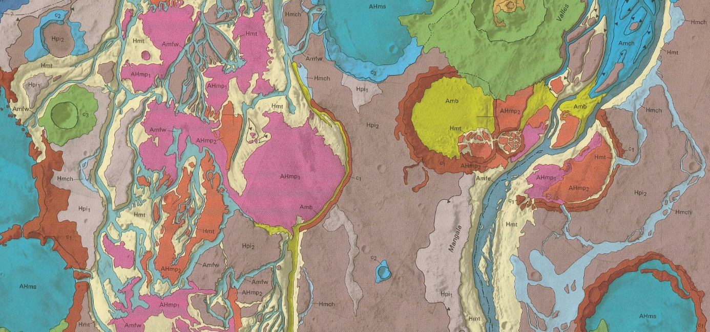
I2294 Mangala Valles
1:500k
Vallis floor units:
Vallis:
amch - young channel- floor material – deposits of „second period of catastrophic flooding” – crater density defined for floor units
amfe - „furrow unit” – channel deposits
„Island” materials:
amb – blocky unit – debris flow deposits, some eroded
hmt – terraced material /may be depositional or erosional
hpi – intercrater plains
c3 - impact
Channel:
black dot dash line „narrow channel”, may include interior channels

Slide 15
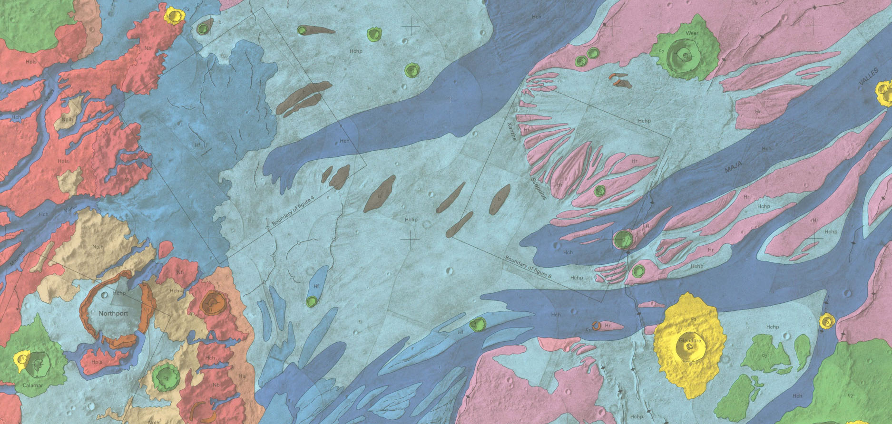
I2432 Maja Valles
1:500k
units –
channel floor
hch – channel material
hchp – light blue - channel flood plain material
island:
hr – pink – ridged plains material
hf – fan material (middle blue)
line: black dot dash: “small dirtributary channel”

Slide 16
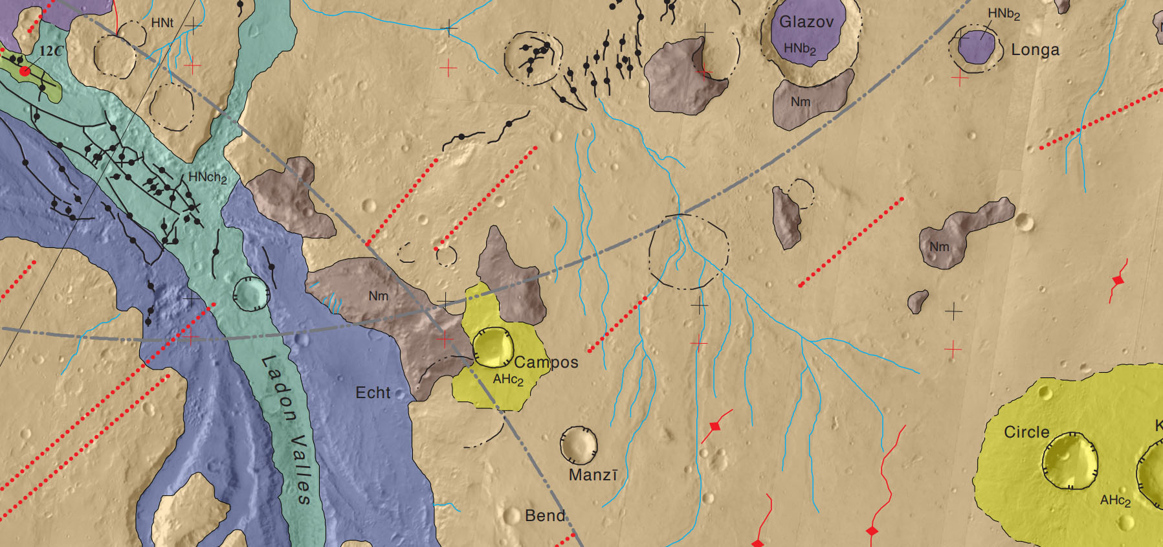
Sim3209 Margarifter Terra
1:1M
Valley unit: Hnch
Channel units
Blue line: Small valley—Line follows valley thalweg
Dotted blue line: „Small entrenched channel—Line follows channel thalweg”. Includes crater wall valleys, valley networks.
Islands are not distinguided by elevation.

Slide 17
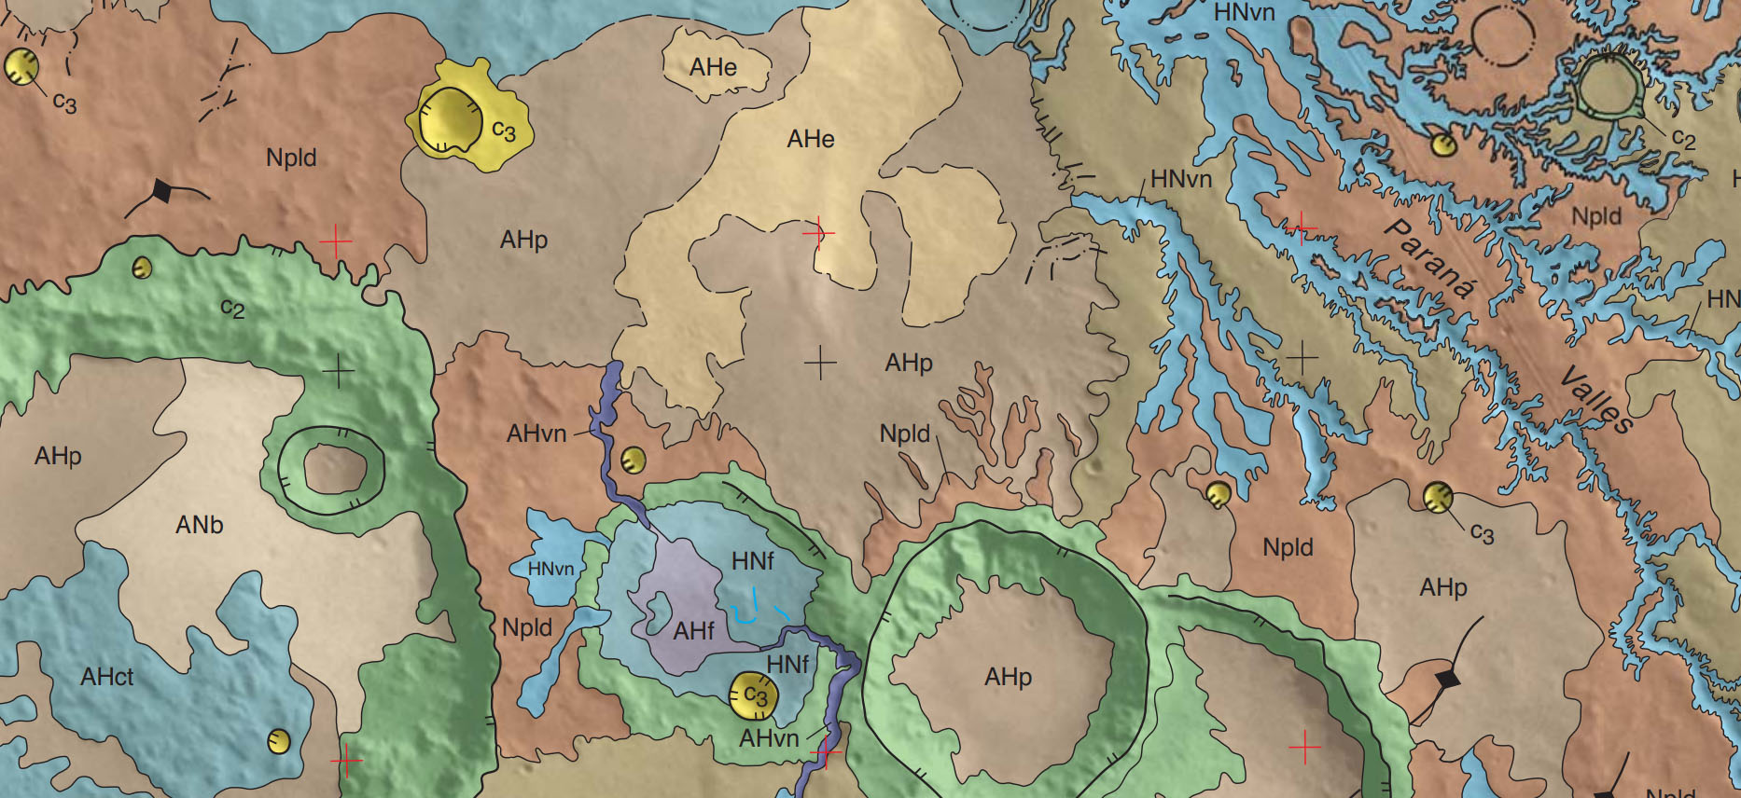
SIM3041 Margaritifer Terra
1:1M
Units:
Hnvn Older valley network material —Generally smooth and widely distributed deposits that fill numerous valleys throughout map area
Ahvn Younger valley network material Deposits within generally isolated, narrow valleys.
blue line: Channel
Black dot-dash line: Small valley (includes tributaries)

Slide 18
Summary
All three possible feature types have been used for mapping valleys/channels: polyline (3209), geologic unit polygon (3041) and surficial unit polygon (polygon over polygon) (3356)
Sometimes line features are used for valleys of any size, sometimes there is a cutoff size but lines are only used for minor systems: lines may be used in the starting sections of large systems, transforming into polygons when the channel width becomes large
The terms valley and channel are not used consistently. Crater wall valleys, gullies, single channels and old valley networks may have the same designation and symbol; but “volcanic” channels may have another.

Slide 19
Literature
Nass A., Van Gasselt S., Jaumann R., Asche H. (2011) Requirements for planetary symbology in geographic information systems. In: ruas A. (Eds) advances in cartography and giscience. Volume 2. Lecture notes in geoinformation and cartography, vol 6. Springer, berlin, heidelberg
Federal geographic data committee [prepared for the federal geographic data committee by the U.S. Geological Survey, 2006, fgdc digital cartographic standard for geologic map symbolization: reston, Va., Federal geographic data committee document number FGDC-STD-013-2006, 290 p., 2 plates
Nass A., Fortezzo. C, Skinner J jr., Hunter, M., Hare, T (2017a) Updated symbol catalogue for geologic and geomorphologic mapping in planetary sciences. 19th EGU general assembly, EGU2017, proceedings from the conference held 23-28 april, 2017 in vienna, austria., P.16858
Nass A., Fortezzo. C, Skinner J jr., Hunter, M., Hare, T (2017b) A review of cartographic symbol for geologic and geomorphologic maps in planetary science. EPSC abstracts vol. 11, epsc2017-627-1, 2017
Hynek, B. M., M. Beach, and M. R. T. Hoke (2010), Updated global map of martian valley networks and implicationsfor climate and hydrologic processes, J. Geophys. Res., 115, E09008, doi:10.1029/2009je003548.

Slide 20
All details from geologic maps are from USGS publications.
USGS-authored or produced data and information are considered to be in the U.S. Public domain.
Creative commons attribution 4.0 international license (CC BY 4.0)
You are free to:
Share — copy and redistribute the material in any medium or format
Adapt — remix, transform, and build upon the material
for any purpose, even commercially.

