Slide 1
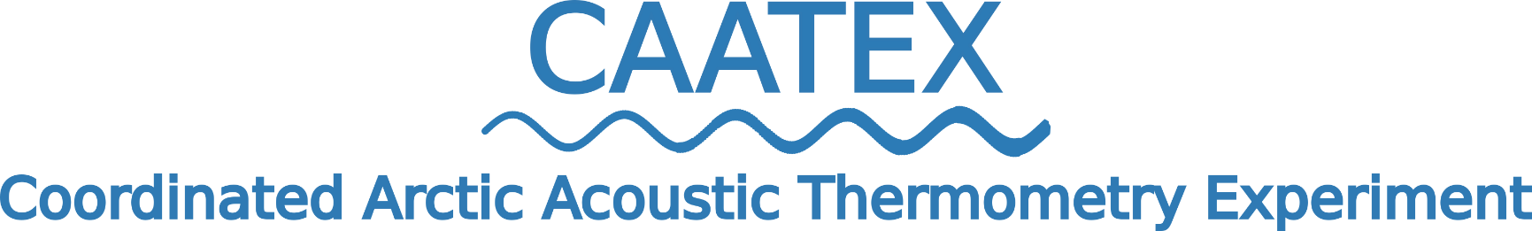
Implementation of a multipurpose Arctic Ocean Observing System
Hanne Sagen, Agnieszka Beszczynska-Möller, Marie-Noelle Houssais, Mathilde Sørensen, Mikael Kristian Sejr, Matthew Dzieciuch, Peter Worcester, Espen Storheim, Florian Geyer, Bjørn Rønning and Stein Sandven

Slide 2
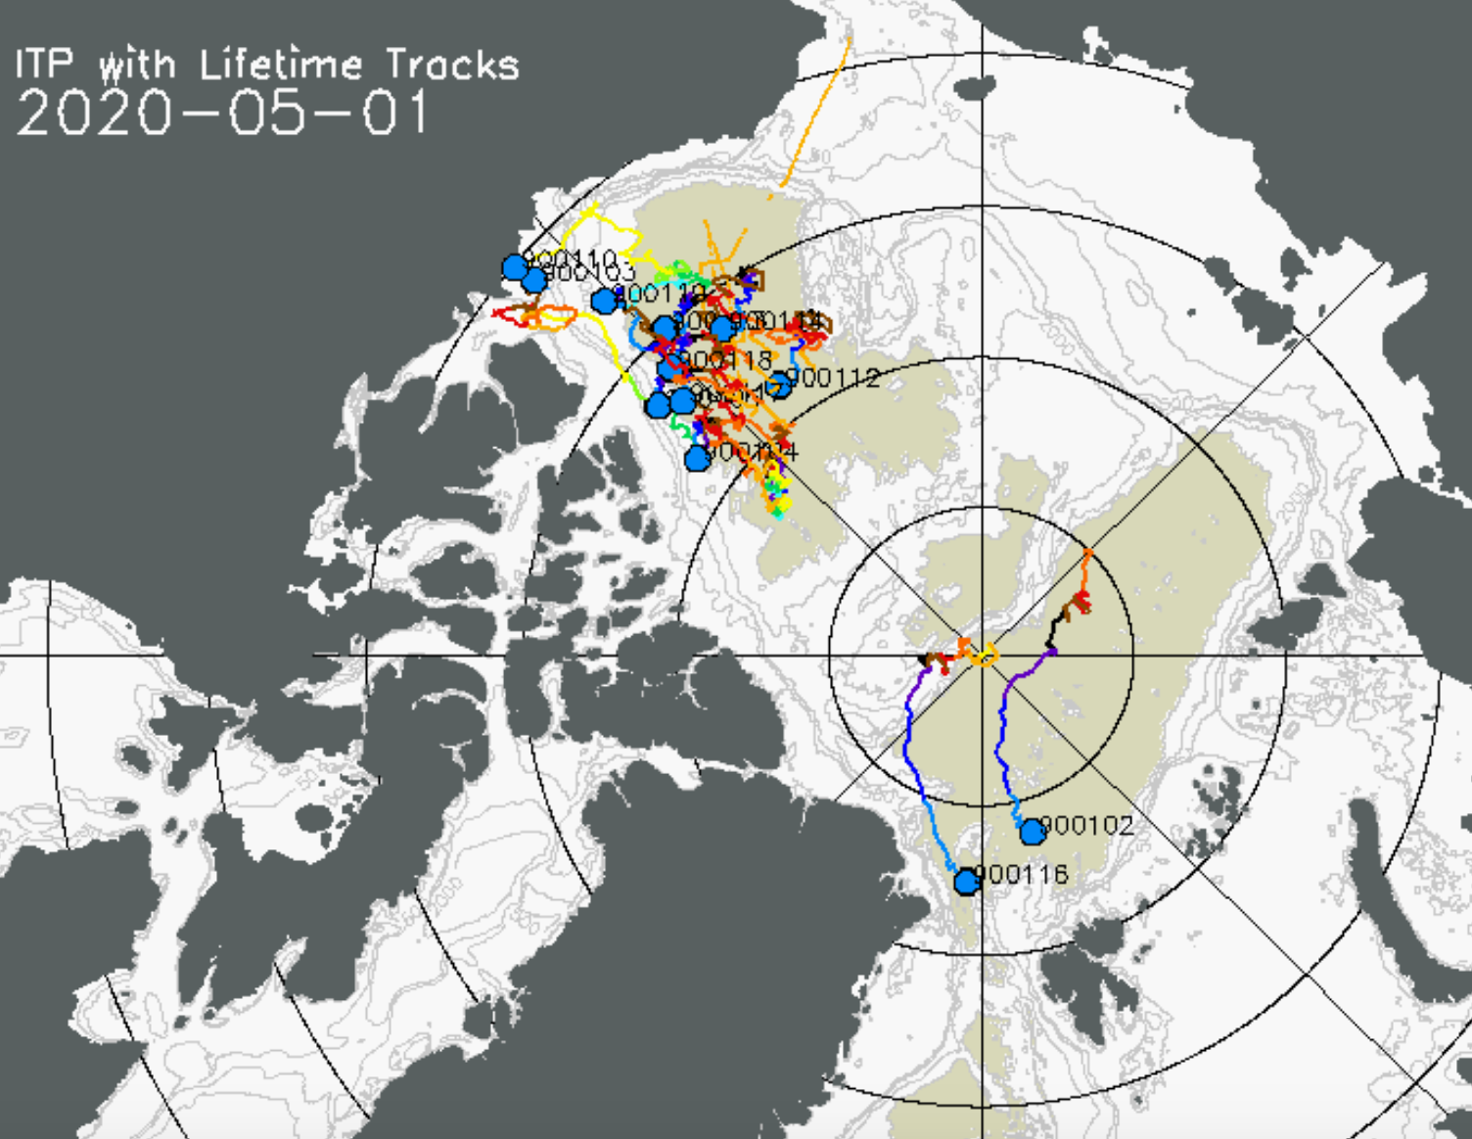
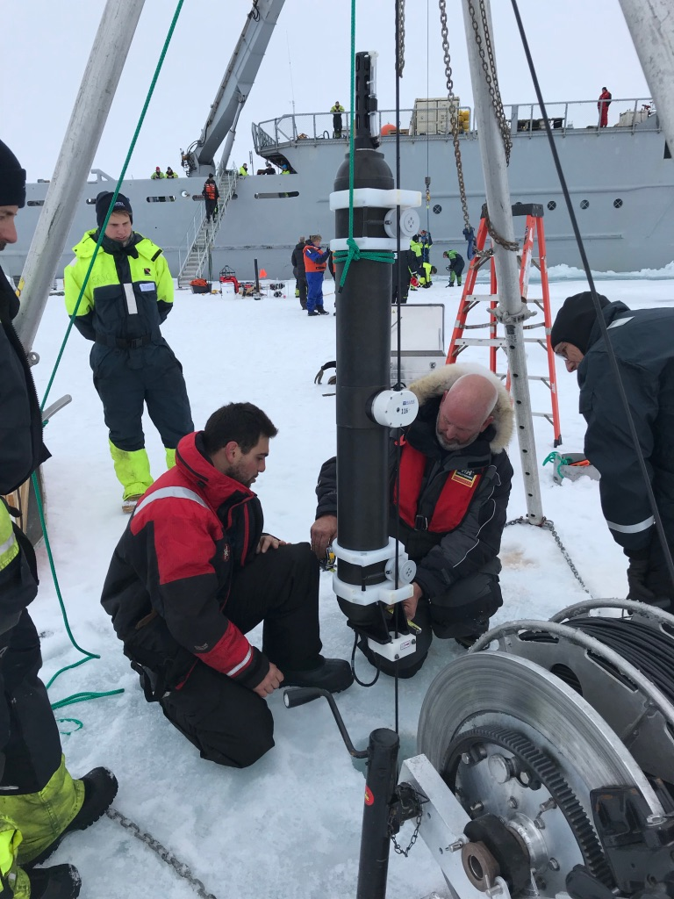
The central Arctic Ocean
The central Arctic Ocean is one of the least observed oceans in the world. This ice-covered region is challenging for ocean observing with respect to technology, logistics and costs.
Many physical, biogeochemical, biological, and geophysical processes in the water column and sea floor under the sea ice are difficult to observe and therefore poorly understood.
http://iabp.apl.washington.edu/maps_daily_oceanbuoys.html
Photo: NERSC

Slide 3
Recommendation from OceanObs19
By 2029 the Arctic should prominently demonstrate that it has a fully developed, implemented, and sustained ocean observing systems that meets at a minimum, earth system prediction needs-but also meets other Arctic critical Arctic Societal Benefit Needs (Lee et al. 2019)

Slide 4
Challenges (technology and sustainability)
Autonomous observing platforms used in the ice-free oceans such as Argo floats, gliders, and autonomous surface vehicles cannot yet be used operationally in ice-covered Arctic regions.
Real time data from ocean under the ice is limited to a few drifting ITPs. ITPs have to be replaced on a regular basis.
Year-round ocean data from fixed moorings are available in delayed mode. Moorings need to be recovered to be refurbished and for download of the data.
Operationalization of the data chain from instruments into the data repositories

Slide 5
Recommendation from OceanObs19
To improve the Arctic Ocean Observing capability OceanObs19 recommended ‘to pilot a sustained multipurpose acoustic network for positioning, tomography, passive acoustics, and communication in an integrated Arctic Observing System, with eventual transition to global coverage’ (Howe et al. 2019).

Slide 6
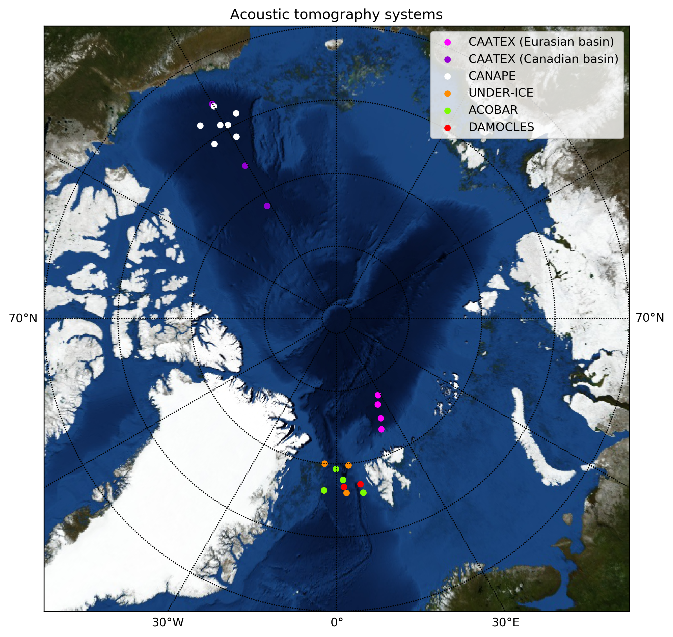
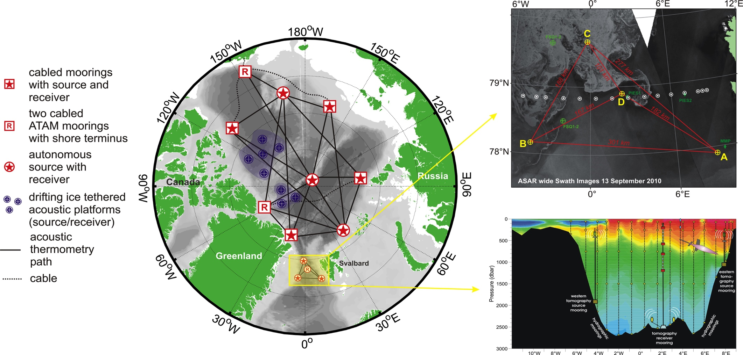
Multipurpose Acoustic Networks in the Integrated Arctic Ocean Observing System
Acoustic networks have been used locally and regionally in the Arctic for underwater acoustic thermometry, geo-positioning for floats and gliders, and passive acoustic. The Coordinated Arctic Acoustic Thermometry Experiment (CAATEX) is a first step toward developing a basin-scale multipurpose acoustic network using modern instrumentation.
A future underwater acoustic network – UW-GPS for floats and gliders, listening system, and to measure averaged temperature and current. (Ref. Mikhalevsky, Sagen, Worcester et al.2015, Howe et al. 2019, Lee et al. 2019)
Notes:
CANAPE & Fram Strait experiments testing the multipurpose acoustic system concept using mid frequency source (In period 2008-2016)
CAATEX – passive acoustics and basin wide thermometry using low frequency source (ONGOING)

Slide 7
Collect new ocean observations covering the central Arctic Ocean
Obtain new knowledge about the decadal changes in heat content of the central Arctic Ocean
Improve our understanding of uncertainties in heat content estimates from climate models
Ice concentration map from University of Bremen (G. Heygster)

Slide 8
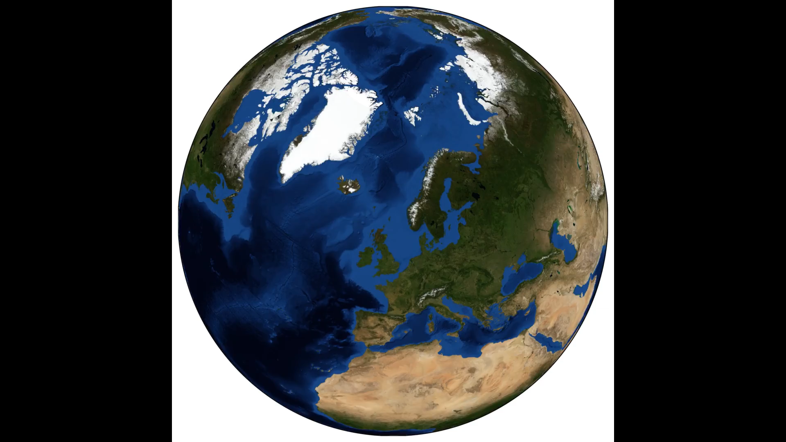
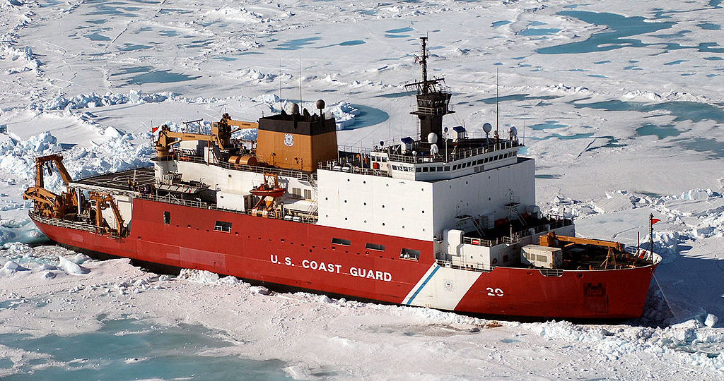


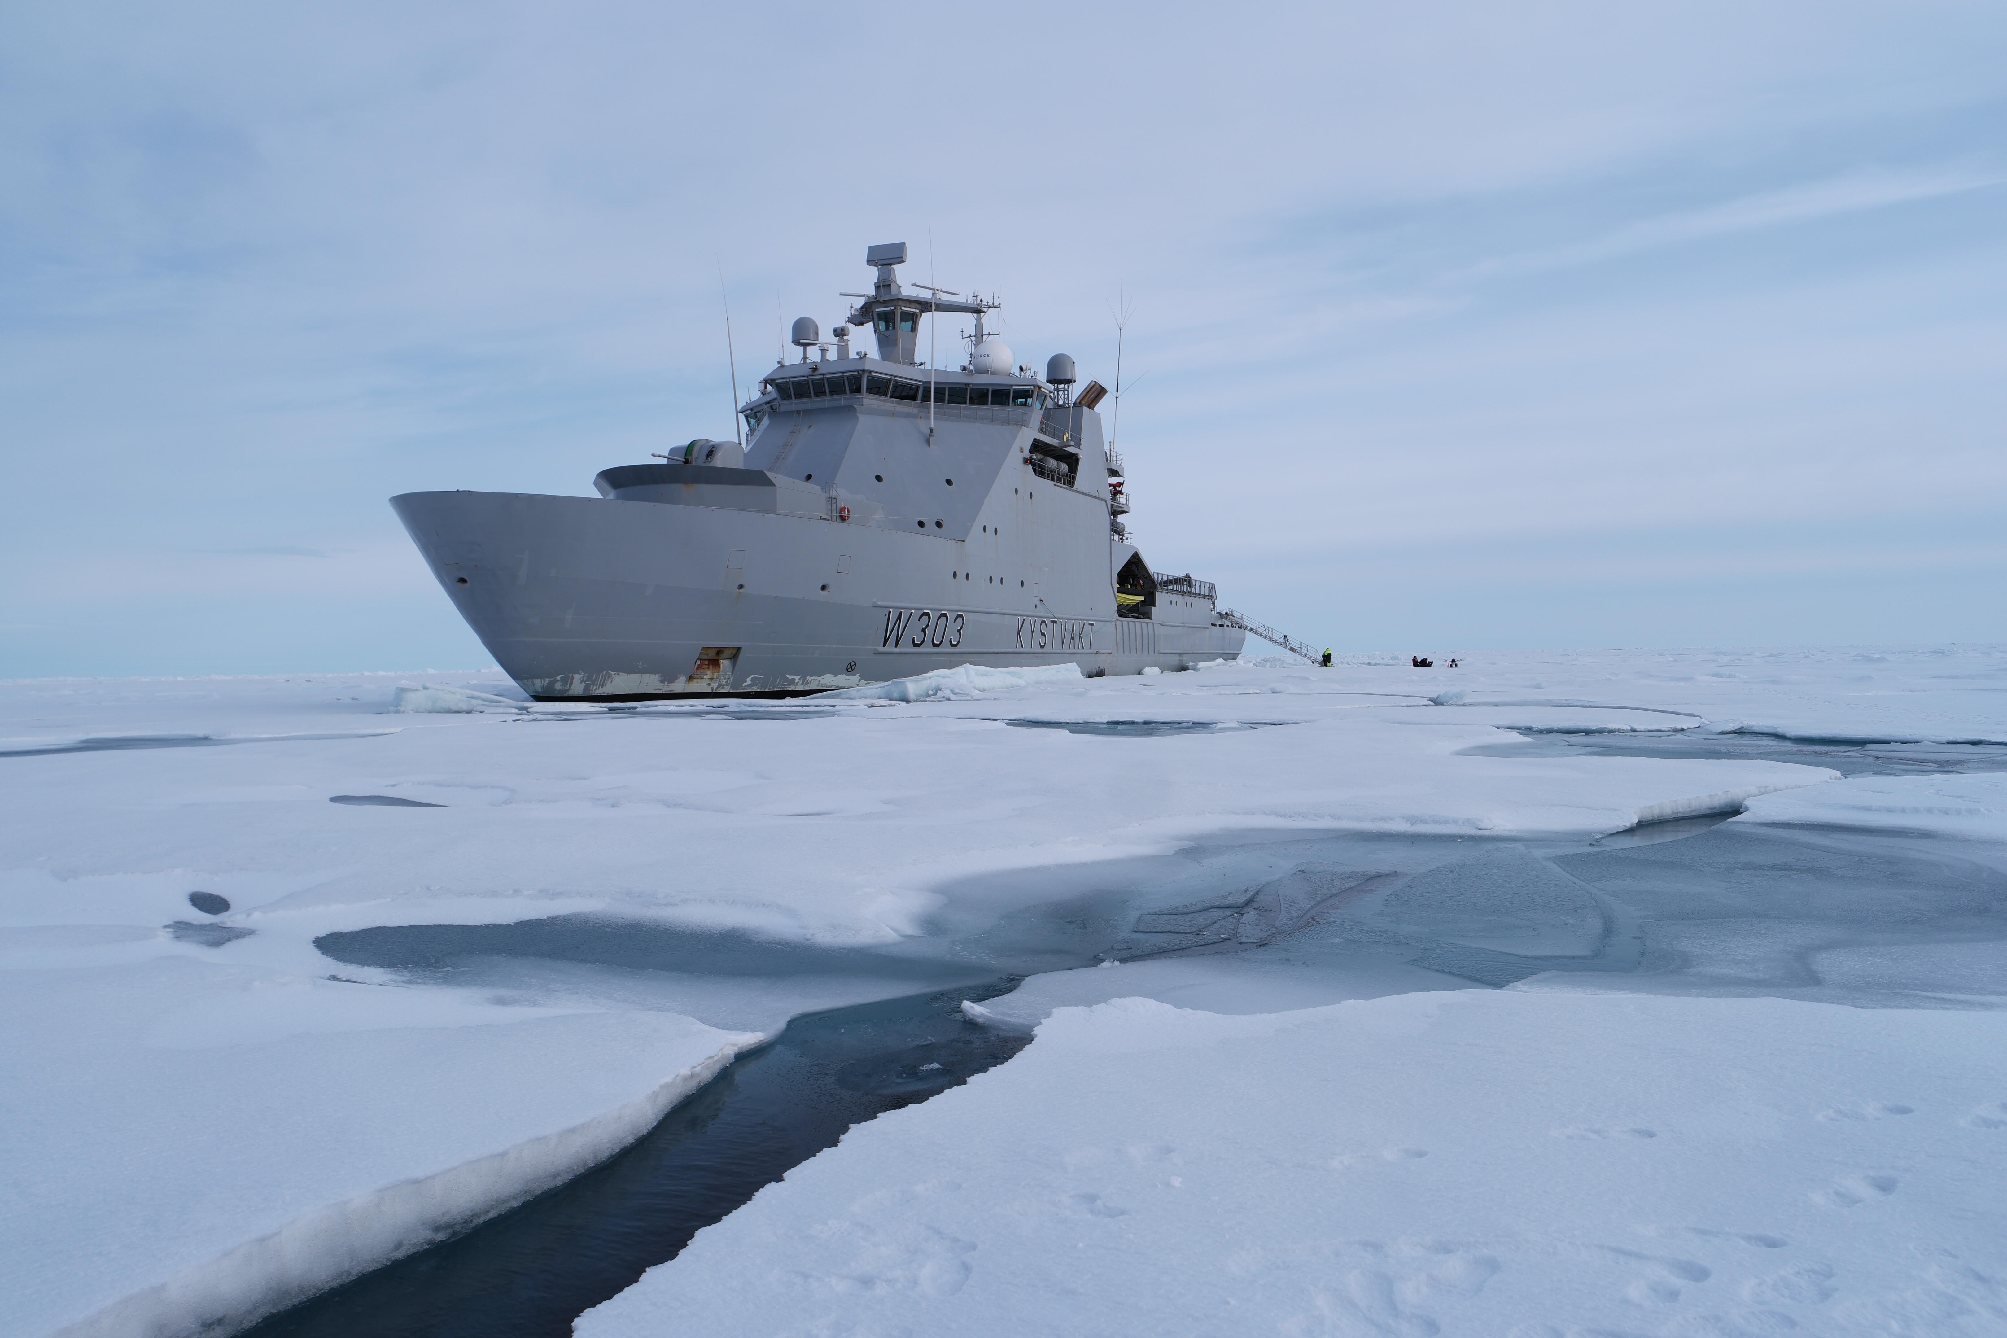
KV Svalbard
Departure/Return Longyearbyen
14.08 2019- 9.9 2019
Lead: Hanne Sagen
USCGC Healy
Cruise period
3.9-14.10 2019
Lead: M. Dzieciuch

Slide 9
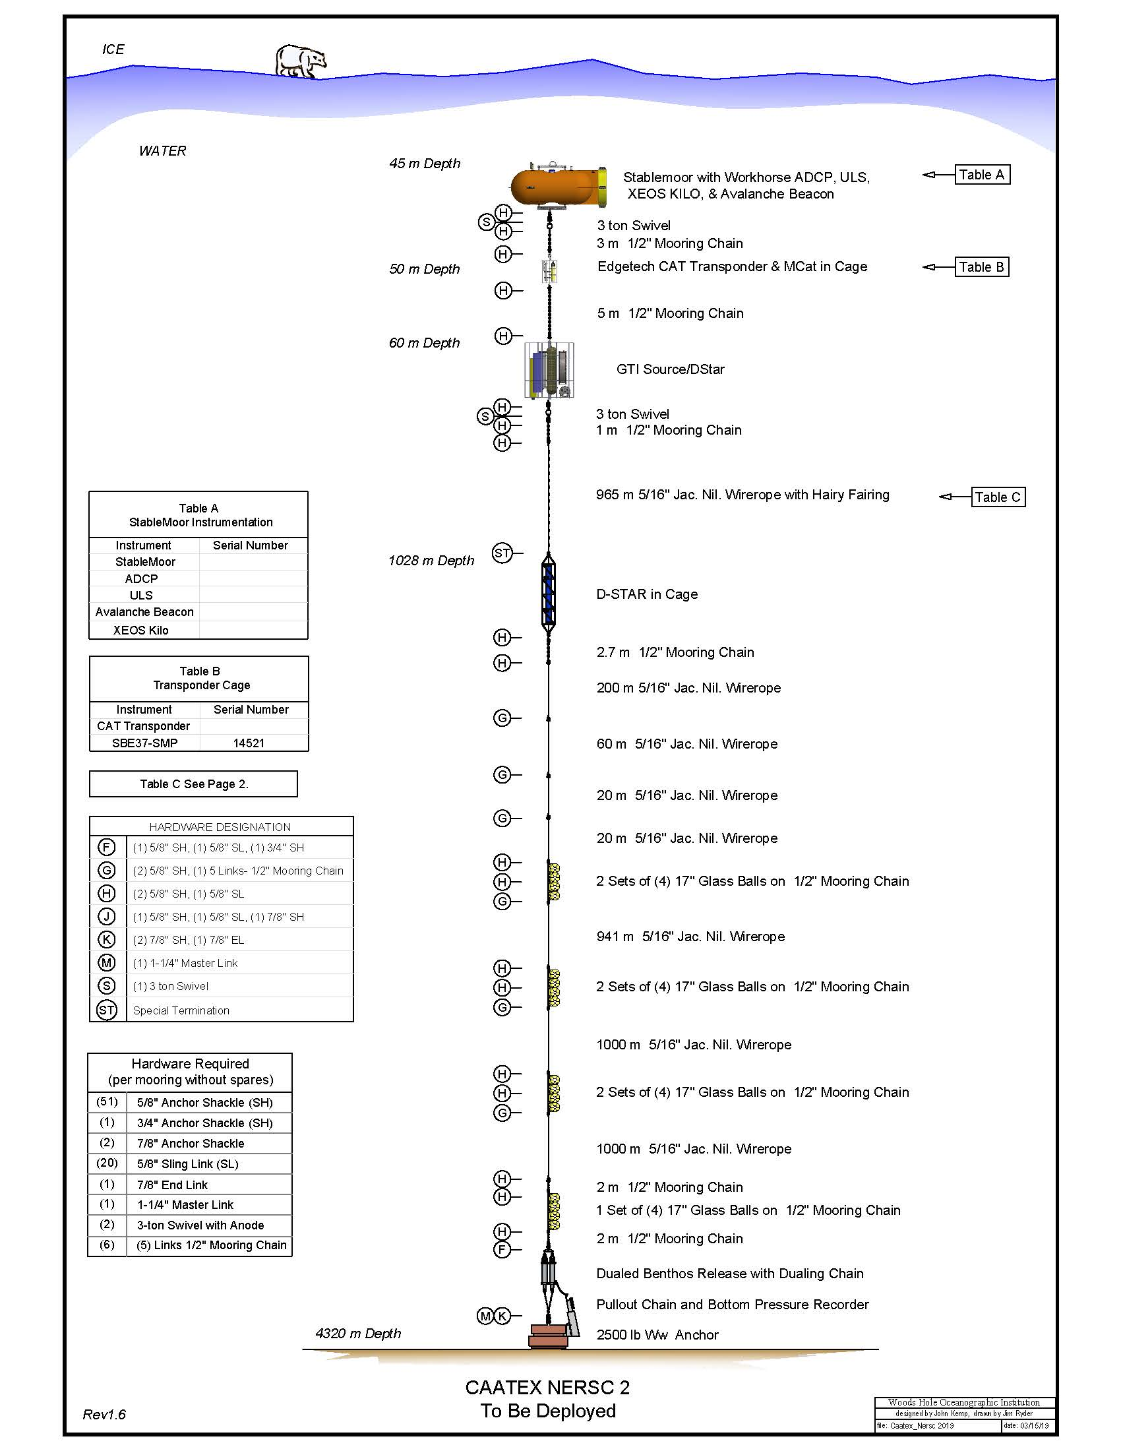
Future Fixed Multi-purpose observing networks
Acoustic network combined with multidisciplinary sensors.
Acoustic network will provide acoustic thermometry, underwater geo-positioning system, and vertical receiver arrays for passive acoustics.
Acoustic networks (regional and basin wide) will support extension of ARGO program into the central Arctic Basin, as well as provide infrastructure for use of gliders in key regions.
Oceanographic instruments integrated into the acoustic moorings will provide multi disciplinary point measurements at each fixed mooring location.
Challenge: Subsurface moorings deliver data in delayed mode.

Slide 10
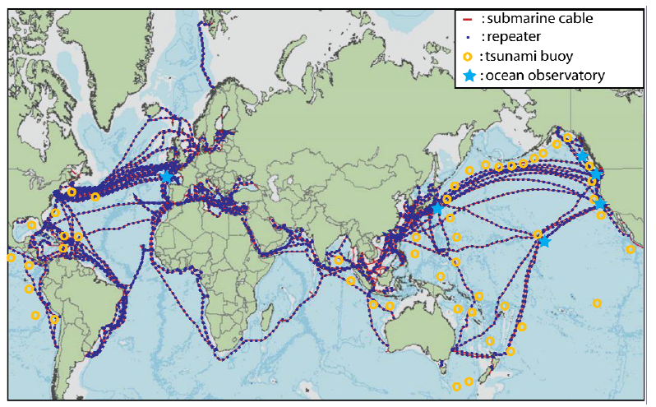
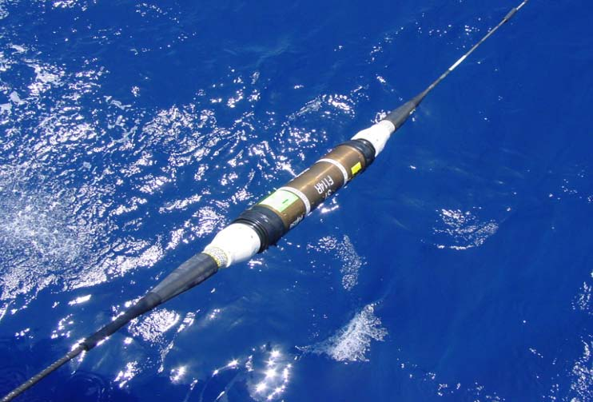
SMART Cables - Basic Concepts
Climate, Oceans, Sea Level
Earthquakes, Tsunamis Global array
SMART cables: first order addition to the ocean-earth observing system, with unique contributions that will strengthen and complement satellite and in-situ systems
Repeater
Telecom + science, shared infrastructure, $
Cable repeaters host sensors, not to interfere
Potential: global spanning, trans-ocean, 1+ Gm
~10,000+ repeaters (~100 km)
10-25 year refresh cycle
Initially: bottom pressure, temperature and acceleration; supplement later (fiber sensing…)
One approach
➜
Cable
Sensor Module
One approach
Install routinely on new cables
Deploy by cable ship, no maintenance
https://www.itu.int/en/ITU-T/climatechange/task-force-sc/Pages/default.aspx
Ref. John You, Nature, 2010 – Harnessing telecoms cables for science
Notes:
Detailed slide, will take time to explain.

Slide 11
Cables –recommendations from OceanObs19
At OceanObs19 it was recommended to transition (telecom+sensing) SMART subsea cable systems from present pilots to trans-ocean implementation, to address climate, ocean circulation, sea level, tsunami and earthquake early warning, ultimately with global coverage.
Cabled observatories, either stand alone or branching from a hybrid system, could provide power and real time communication to support connected water column moorings and sea floor instrumentation as well as docking mobile platforms.

Slide 12
Future – Arctic Ocean Observing System
An international consortium of leading scientists in ocean observing with experience in state-of-the-art technologies on platforms, sensors, subsea cable technology, acoustic communication and data transmission plan to establish a project to implement and test the system based on experience from the CAATEX experiment, INTAROS, and other Arctic observing system experiments.
The INTAROS project is presently developing a Roadmap for an integrated Arctic Observing System, where multipurpose ocean observing systems will be one component.

Slide 13
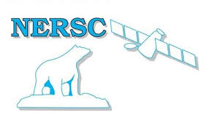


Institution/Project/Country
Nansen Center/CAATEX&INTAROS/NORWAY
Scripps Institution of Oceanography/CAATEX/USA
Woods Hole Oceanographic Institution/CAATEX/USA
Norwegian Polar Institute /CAATEX/MOSAIC/NORWAY
Naval Postgraduate School /CAATEX/USA
Institute of Oceanology – PAS /INTAROS/POLAND
University of Bergen/INTAROS/NORWAY
NORCE/INTAROS/NORWAY
FFI/Other Project/NORWAY
NTNU/Other Project/NORWAY
Metno/Other Project/NORWAY
NIOT-National Institute of Ocean Technology /Other Project/INDIA
DRDC&JASCO/CAATEX/CANADA
SAREX
Norwegian Coastal Authority
International – national collaboration
INTAROS has received funding from the European Union’s Horizon 2020 research and innovationprogram under Grant Agreement No. 727890.

