Slide 1
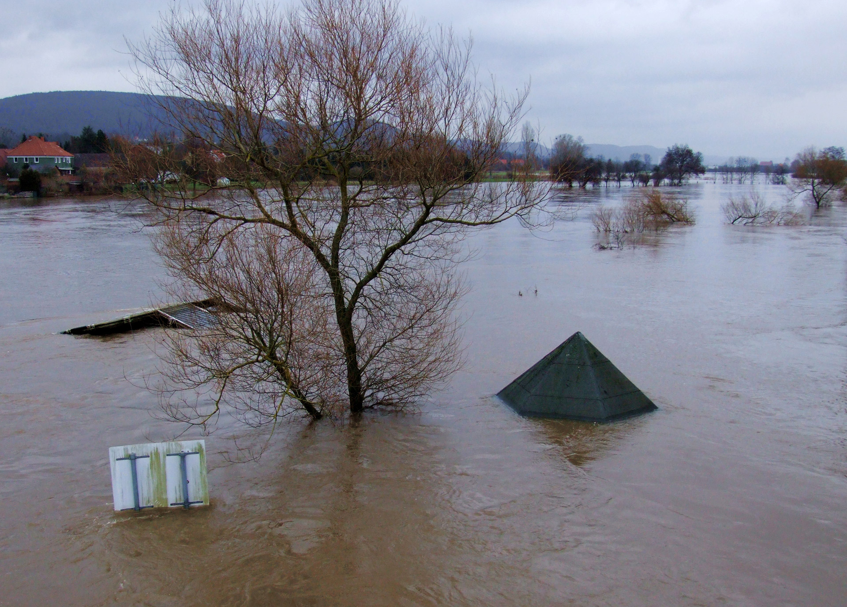
Online | 4–8 May 2020
A conceptual framework for vulnerability and risk assessment in the context of nature-based solutions to hydro-meteorological risks
Mohammed Aminur Rahman Shah, Fabrice G. Renaud, Annie Wild, Carl C. Anderson, Michael Loupis, Depy Panga, Maria Stefanopoulou, Annemarie Polderman, Eija Pouta, Athanasios Votsis, Craig Thomson, Karen Munro, Bidroha Basu, Francesco Pilla, Beatrice Pulvirenti, Elena Toth, Alessio Domeneghetti, Silvana Di Sabatino
Presented by:
Dr Aminur Shah
School of Interdisciplinary Studies
University of Glasgow
04 May 2020
H2020 funded project GA no. 776848
Photo:Flooding of the river Weser in South Lower Saxony, Germany. Source: https://www.publicdomainpictures.net/en/view-image.php?image=24453&picture=flood

Slide 2
Background
There is no vulnerability and risk assessment framework specifically developed in the context of implementing nature-based solutions (NBS) to reduce hydro-meteorological risks
As a part of the OPERANDUM project, this research proposes a conceptual framework for vulnerability and risk assessment in the context of NBS to hydro-meteorological risks
OPERANDUM project: https://www.operandum-project.eu/
Methodology
Literature review
Identifying stakeholders’ priority (through FGD and QS)
Developing impact chains (through FGD and QS)
The conceptual framework is developed mainly considering:
The major components of the Delta-SES risk assessment framework (Sebesvari et al. 2016) and other similar frameworks, and
The proposed principles for NBS endorsed by IUCN (Cohen-Shacham et al. 2016)

Slide 3
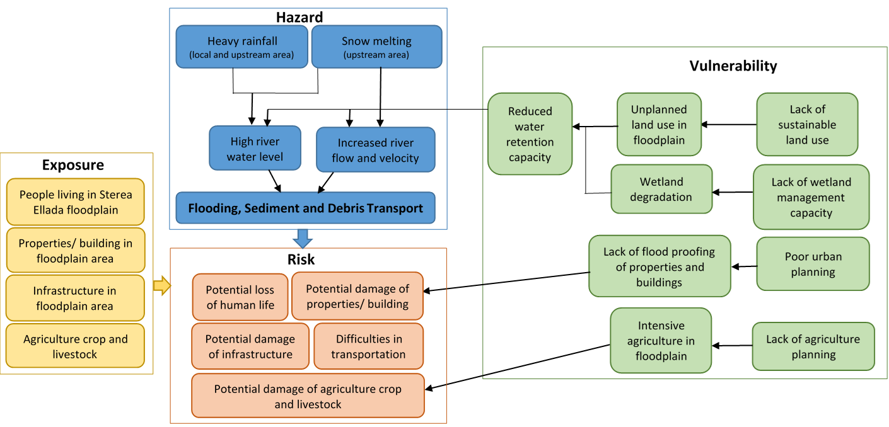
Impact chains developed for the Open-Air Laboratory (OAL)
OALs are the selected hazard prone areas where NBS are implemented
Shows the relationship among hazard, exposure, vulnerability and risks
Impact chain for OAL-Greece

Slide 4
Conceptual framework for vulnerability and risk assessment of SES in the context of NBS (VR-NBS)
IUCN’s NBS principles
P1-nature conservation
P2-synergy with all solutions
P3-site-specific contexts
P4-transperancy & participation
P5-diversity and evolve over time
P6-landscape scale
P7-tradeoffs within SES
P8-policy integration
I U C N’ s N B S P r i n c i p l e s
Nature-based Solutions (NBS)
Reduce magnitude and extent of hazards (e.g. floodplain restoration)
Reduce exposure of SES (e.g. Buffer zone with mangroves)
Reduce vulnerability of SES
(e.g. protected area, afforestation, adaptation policies)
Multiple hydro-meteorological hazards
(factors: magnitude, duration, extent, probability of occurrence)
Exposure of SES
Vulnerability of SES
Catchment
Ecosystem exposure
Ecosystem susceptibility
Ecosystem
robustness
Sub-catchment
Interaction with regional and global scales
Ecological system
Social system exposure
Social susceptibility
Coping and adaptive capacity
NBS Project site
Risk within NBS Project site
Provinces/ Municipalities
SES attributes at various scales
National
Social system
Adapted from Shah et al (2020) A review of hydro-meteorological hazard, vulnerability, and risk assessment frameworks and indicators in the context of nature-based solutions, submitted paper to International journal of Disaster Risk Reduction (under review)
© Authors. All rights reserved
Notes:
Definitions:
Risk: The potential for adverse consequences resulting from the interaction of one or multiple (socio-) natural hazards with vulnerable elements of the SES exposed to these hazards (Hagenlocher et al., 2018: 73).
Hazards: The potential occurrence of a natural or human-induced physical event or trend or physical impact that may cause loss of life, injury, or other health impacts, as well as damage and loss to property, infrastructure, livelihoods, service provision, ecosystems, and environmental resources (IPCC, 2014b:05).
Exposure: The presence of people, livelihoods, species or ecosystems, environmental functions, services, and resources, infrastructure, or economic, social, or cultural assets in places and settings that could be adversely affected (IPCC, 2014b:05).
Vulnerability: The propensity or predisposition to be adversely affected. Vulnerability encompasses a variety of concepts and elements including sensitivity or susceptibility to harm and lack of capacity to cope and adapt (IPCC, 2014b:05).
Susceptibility: The internal predisposition of an element to suffer a certain degree of harm when exposed to a hazard (Sebesvari et al. 2016).
Coping capacity: The ability of people, organizations, and systems, using available skills, resources, and opportunities, to address, manage, and overcome adverse conditions with the aim of achieving basic functioning in the short to medium term (Sebesvari et al. 2016).
Adaptive capacity: The strengths, attributes, structures, resources available to an individual, community, society, or organization that can be used to prepare for and undertake actions to strategically reduce exposure, susceptibility and adverse impacts as well as enhance capacities in the long run (Sebesvari et al. 2016).
Ecosystem robustness: The existence of a set of “strategic options" open to the ecosystem and the capability of the ecosystem to switch among multiple functionalities (Sebesvari et al. 2016).

Slide 5
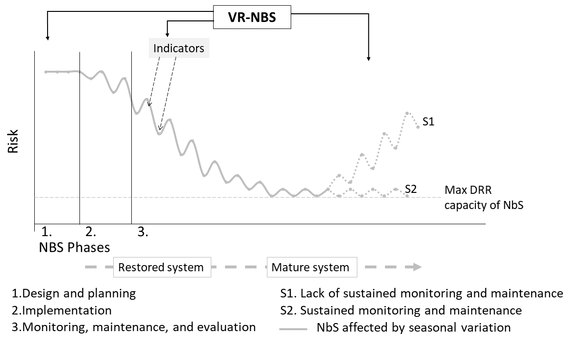
Conceptual framework for V & R assess. in the context of NBS (VR-NBS) (cont…)
Figure: Risk levels for different NBS implementation phases that relies on organic elements. Risk reduction can fluctuate seasonally.
Adapted from Shah et al (2020) A review of hydro-meteorological hazard, vulnerability, and risk assessment frameworks and indicators in the context of nature-based solutions, submitted paper to International journal of Disaster Risk Reduction (under review)
© Authors. All rights reserved

Slide 6
V&R assessment indicators identified
From literature review, FGD, Questionnaire survery
135 indicators, classified by risk components
Further sorting will be done according to SES context of OAL
Examples
Risk component | Indicator Name
Ecosystem Exposure | Ecosystems exposed to flood (%)
Ecosystem Susceptibility | Biodiversity (Scoring or Index)
Ecosystem robustness | Ecosystem Functionality Index (EFI scores)
Social System Exposure | Proportion of total population exposed to multiple hazards (%)
Social Susceptibility | Dependency ratio (%) includes Young (<15 years) and/or Elderly (>65 years)
Coping capacity | Government assistance (% of population covered)
Adaptive capacity | Existence of adaptation policies/strategies (yes/no)

Slide 7
References
Cohen-Shacham, E., Walters, G., Janzen, C. & Maginnis, S. (eds.) (2016). Nature-based Solutions to address global societal challenges. Gland, Switzerland: IUCN. xiii + 97pp.
Sebesvari, Z., Renaud, F. G., Haas, S., Tessler, Z., Hagenlocher, M., Kloos, J., ... & Kuenzer, C. (2016). A review of vulnerability indicators for deltaic social–ecological systems. Sustainability Science, 11(4), 575-590.
Thank you

