Slide 1



Examples of DAFNE application to multi-temporal and multi-frequency remote sensed images and geomorphic data for accurate flood mapping.
A. D'Addabbo, A. Refice, F. Lovergine, and G. Pasquariello
IREA, CNR, Bari, Italy (annarita.daddabbo@cnr.it)

Slide 2

DAFNE (DAta Fusion by bayesian Network)
An open-source Matlab® toolbox
available at
https://github.com/adaddabbo/DAFNE.git
It is able to work with different kinds of data and it is able to opportunely fuse them.
It performs data fusion in different ways
It is based on bayesian networks
Reference:
A. D'Addabbo, A. Refice, F. P. Lovergine, G. Pasquariello, Computers and Geosciences 112 (2018), pp.64–75
Notes:
DAFNE (DAta Fusion by bayesian NEtwork) is a Matlab® toolbox to produce accurate probabilistic flood maps, following the spatial and temporal evolution of an inundation, by using multi-temporal and/or multi-sensor data fusion.
It is a tool able to work each time with different kinds of data —remotely sensed images acquired by different sensors (optical/SAR), hydrologic information, model runs etc.— and it is able to opportunely fuse them if more data are available about a considered flood event.
Moreover, DAFNE can perform data fusion also in different ways. For example, all the images acquired at different times by the same sensor can be analyzed together, and are treated independently by the ones obtained from other sources; however, the tool could be easily tweaked to adopt other processing schemes, e.g. considering imagery data from different sources together, or divided by acquisition date.
It is based on the capability of Bayesian Networks to organize a priori knowledge and information extracted by heterogeneous data.
It is now available on github.

Slide 3
DAFNE (DAta Fusion by bayesian Network)
1 2 3 4 5 6 7 8 9 10 11 12 13 14 15 16 17 18 19 20 …
Day
FLOOD
Image
Source 1
m1=4
M=3
Image
Source 2
m2=1
Input
Image
Source 3
m3=3
N=1
Ancillary
Datum 1
Output
P=4
Probability maps
Notes:
The toolbox works by joining the following generic classes of input data:
M multi-temporal imagery sets, each one composed by m_{i}=1,…,M images acquired at different times, on the same geographical area from the same, ith, source. Data coming from different platforms and sensors can be considered;
N ancillary information datasets from different sources.
DAFNE provides, as output products, P probability maps, depicting for each pixel the probability value that the corresponding area has been reached by the inundation. A probability map is produced for each date and time, during a flood event, in correspondence of which at least one image has been acquired, as schematized in figure

Slide 4
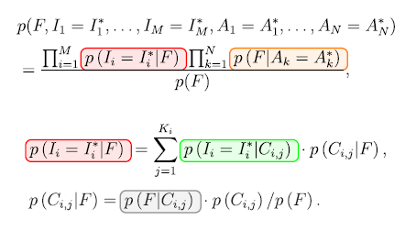
DAFNE (DAta Fusion by bayesian Network)
DAFNE is composed of 5 modules
image
segmentation
Each module computes different parts of the Bayesian equation giving the posterior probability of each output pixel being inundated.
Each module can be substituted with another one in the user's availability, producing the same outputs but in a different way.
If new data become available, DAFNE modularity allows to re-use the unmodified parts and to compute only the new probability terms.
electromagnetic
modeling
image
modeling
probabilistic
flood map
computation
ancillary data
modelling
Notes:
In more details, DAFNE is composed of 5 modules:
Each module computes different parts of the posterior probability value given as output for each input pixel;
Each module can be substituted with another one in the user’s availability
Eventually, if new data are available, D. modularity allows to compute only the new probability terms.

Slide 5
DAFNE (DAta Fusion by bayesian Network)
These 3 modules must be run in sequence.
But they can be run in parallel for each image data source.
This module carries out the clustering of each of the M independent imagery data sets. It can be useful when multi-temporal data are considered, in order to capture different image signal response classes.
In the present version, the K-means algorithm is used.
image
segmentation
This module models the electromagnetic response of different classes in flood and no flood conditions.
The current version automatically supports and processes the following input data: SAR backscattered intensity images (X – C – L band), InSAR coherence data, optical multispectral data or indices (e.g. NDVI)
electromagnetic
modeling
image
modeling
This module puts together the outputs of the previous ones.
Notes:
The first 3 modules are:
The image segmentation module
The electromagnetic modeling one
And the image modeling one.
They must be run in sequence, but they can be run in parallel for each image data source.
The image segmentation module carries out the clustering of each of the M independent imagery data sets. It can be particularly useful when multi-temporal data set are available, but in some simple situation it can bypassed or substituted by simple thresholding techniques.
By default it applies the K-means algorithm. Different algorithms can be considered as well.
The e.m. module models the electromagnetic response of different classes in flood and no flood conditions. In the version available on github,
it works automatically for the following input data: SAR backscattered intensity images (X band/ C band; support for L band is currently being implemented), InSAR coherence data, NDVI
It can be also sostituted by another model in the user’s availability.
The image modeling module puts together the outputs of the previous ones.

Slide 6
DAFNE (DAta Fusion by bayesian Network)
image
segmentation
This module models the ancillary data contribution with respect to the flood condition.
At the present time, two types of ancillary data can be considered, i.e. the distance from the river, and the geomorphic flooding index (GFI).
electromagnetic
modeling
This module computes the probabilistic flood maps in correspondence of each input image acquired during a flood event, using the results obtained by the other modules.
image
modeling
probabilistic
flood map
computation
ancillary data
modelling
Notes:
The ancillary data modelling module models the contribution of the ancillary data. In the present version, 2 types of data can be considered : the distance from the river and the geomorphic flooding index It can be sostituted by another model in the user’s availability allowing to consider other type of data.
The probabilistic flood map computation module is the final one computing the output maps by putting together the results obtained by the other modules.

Slide 7
TEST event 1: Bradano river, South of Italy (2010, Nov 3-6)
MULTI-TEMPORAL
MULTI-SENSOR
DATA SET
OCTOBER
NOVEMBER
…. 2 3 ... …. 10 …. …. 3 4 5 6 …. …. 11 …
FLOOD
Day
SAR σ⁰ images
m1=6
M=3
SAR γ images
m2=2
Input
NDVI by
Rapideye image
m3=1
N=1
distance from the river
Output
P=4
Probability maps
Notes:
The first test event presented here concerns a flood occured on November 2010 and concerning the Bradano River, in the South of Italy. This is an example of multi-temporal, multi-sensor dataset because it is composed of 6 COSMO-SkyMed SAR backscaterring intensity images, 2 SAR coherence images and an optical Rapideye image that has been used to compute the NDVI index. In particular, 2 SAR backscaterring intensity images, 1 coherence image and the optical one have been acquired during the inundation. The other ones are used as reference images to oppotunely identify flooded area, altough corresponding to different, and sometimes challenging, land use classes.

Slide 8
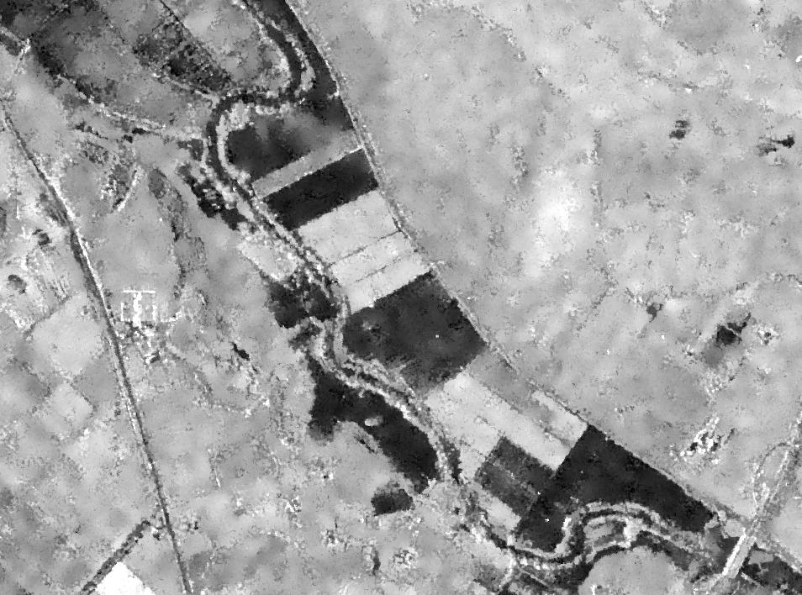
DAFNE (DAta Fusion by bayesian Network)
CSK Intensity 03-NOV-2010
Example of image segmentation module application
02-OCT | 03-OCT | 10-OCT | 03-NOV | 04-NOV | 11-NOV
-9.17 | -9.04 | -9.62 | -16.74 | -7.32 | -8.68
-8.03 | -8.89 | -9.47 | -9.45 | -16.59 | -9.55
-9.02 | -9.34 | -10.05 | -13.93 | -17.48 | -17.32
-7.00 | -7.40 | -7.79 | -5.25 | -4.79 | -6.59
-6.97 | -8.13 | -8.79 | -6.56 | -6.24 | -8.59
-17.11 | -17.36 | -17.56 | -16.76 | -16.68 | -17.08
-1.65 | -2.16 | -2.48 | -0.04 | 0.19 | -1.96
03-NOV | 04-NOV
0.90 | 0.10
0.10 | 0.90
0.90 | 0.90
0.70 | 0.70
0.70 | 0.70
0.10 | 0.10
0.05 | 0.05
Flooded on 03-NOV
Flooded on 04-NOV
Flooded on both days
Double bounce
Permanent water
Some examples of centroid values (dB) computed by the image segmentation module
Probability values computed by the electromagnetic modeling module
Notes:
In particular, the application of the image segmentation module and the availability of SAR intensity multi-temporal data have allowed to recognize flooded bare soils, but also inundated agricultural area, such as vineyards, presenting the double bounce effect.

Slide 9
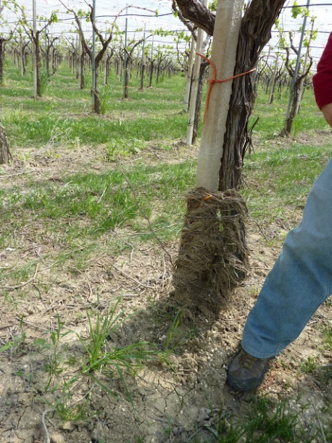
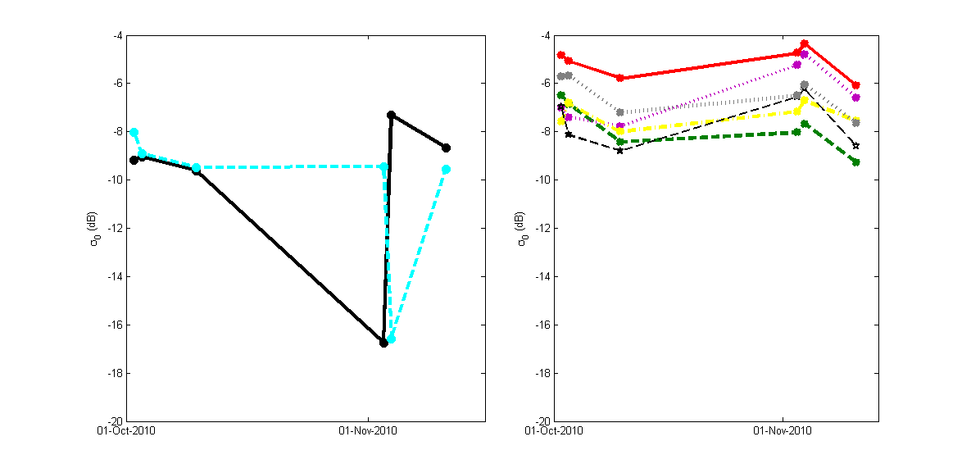
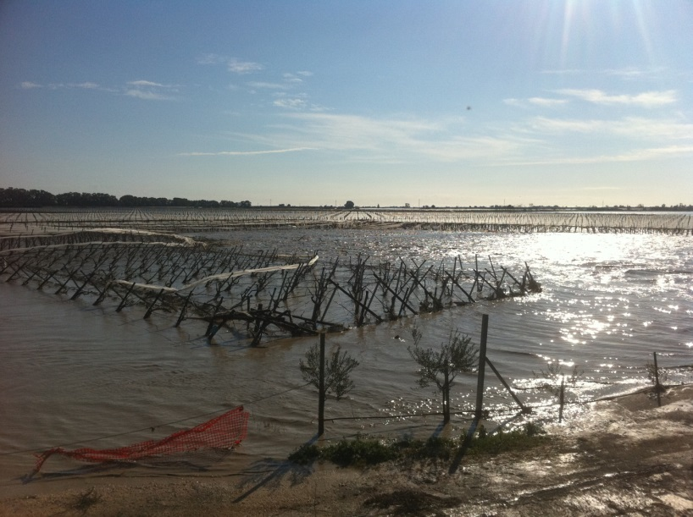
DAFNE (DAta Fusion by bayesian Network)
CSK Intensity 03-NOV-2010
Example of image segmentation module application
Double
bounce
Sediments showing
water level
bare soils
vineyard
Notes:
Flooded areas completely covered by calm water, are characterized in sigma0 intensity images by low values. Instead, flooded areas with emerging structures (such as vineyard) are characterized by sigma0 intensity values higher than the ones exhibiting when the same are not flooded. In order to opportunely recognize these areas a multi-temporal data set is useful, together with the application of the image segmentation modules.

Slide 10
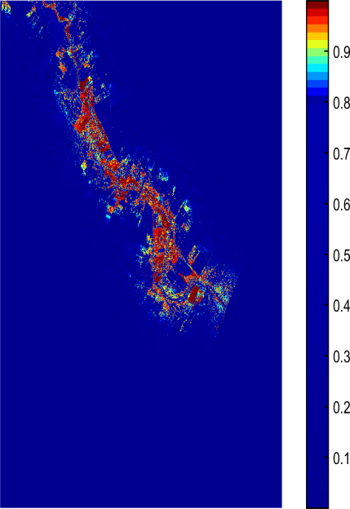
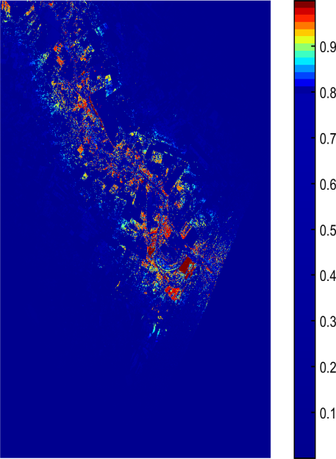
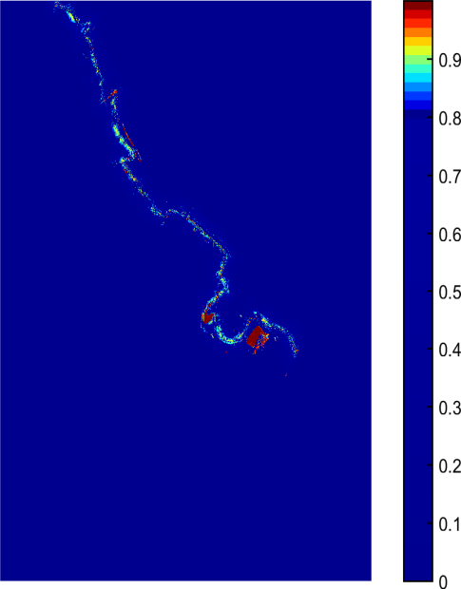
TEST event 1: Bradano river, South of Italy (2010, Nov 3-6)
Output maps and evaluation:
2010/11/3
2010/11/4
2010/11/6
The maps, computed for Nov. 3 and 4, have been compared with reference maps independently obtained.
 | AUC | OA
Nov. 3 | 0.94 | 92%
Nov. 4 | 0.82 | 96%
Notes:
DAFNE has provided, as output products, 3 probability maps, depicting for each pixel the probability value that the corresponding area has been reached by the inundation. Two of them have been compared with reference maps, obtaining overall accuracies greater than 90%.

Slide 11
TEST event 2: Strymonas river, Greece (2015, Apr 1-Sept 15)
MULTI-TEMPORAL
MULTI-SENSOR
DATA SET
Notes:
The second example of DAFNE application is a multi-temporal and multi-sensor data set capturing a flood event occured in greece in 2015.
The available data set is composed of 1 SAR backscattering intensity image acquired by COSMO SKYMed satellite (and so by a SAR sensor in X band), 5 SAR backscattering intensity images acquired by the Sentinel 1 satellite (a SAR C band sensor) and 13 Landsat 8 optical images.
This data set allows to follow the flood evolution in time from the beginning of April until the half of September. On the right a superposition of the output maps (opportunely binarized) obtained by DAFNE has been reported.

Slide 12
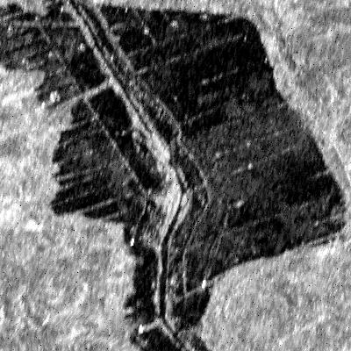
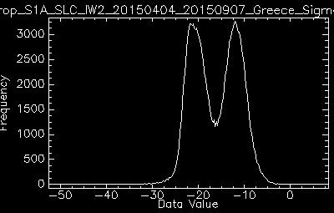
DAFNE (DAta Fusion by bayesian Network)
Example in which the image segmentation module has not been applied
S1 Intensity 04-APR-2015
THRESHOLDING
Notes:
This is also an example in which the image segmentation data set has not been used because a simple thresholding allows to efficiently delineate the flooded area.

Slide 13
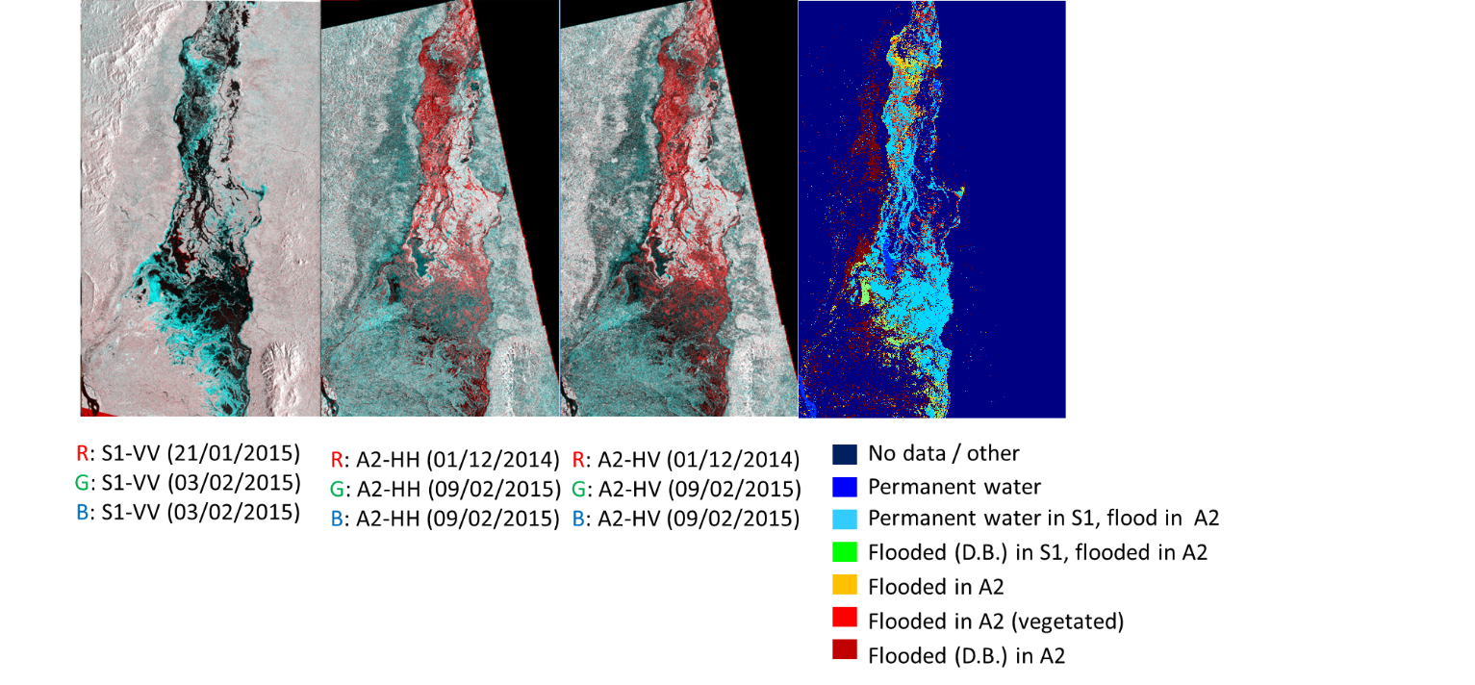
TEST event 3: Zambesi river, Mozambique (2015, February)
MULTI-TEMPORAL
MULTI-FREQUENCY
MULTI-POLARIZATION
DATA SET
Sentinel-1 -VV | ALOS 2 - HH-HV
 | 01/12/2014
11/12/2014
 | 09/02/2015
15/02/2015
Notes:
The last example of DAFNE application is a multi-temporal ,multi-frequency and multi-polarization data set concerning a flood event occured in Mozambique in 2015.
The available data set is composed of 2 SAR backscattering intensity images acquired by the Sentinel 1 satellite (C band sensor) in VV polarization and 4 ALOS 2 images (L band sensor) in HH e HV polarization. In this case, the febraury images can be considered as concurrently acquired because no changes have been intercurred between the 2 acquisition. In this case, the multi-frequency and multi-polarized information opportunely combined by DAFNE allow to oppotunely recognize challanging flooded areas, such as wetlands or forests. On the right, the flooded mask obtained in which different classes with different signal behaviour are reported with different color in order to highlight the importance to opportunely fuse multi-frequency data.

Slide 14
Conclusions
Flood monitoring is a pressing requirement in view of climate change
Increasing amounts of RS data allow for unprecedented precision and coverage, but algorithms need to be tuned
DAFNE is an open-source, modular Matlab toolbox which allows to test and tune new algorithms and methods to:
  increase precision of existing algorithms
  test new data fusion approaches
  collect and organize knowledge base about e.m. backscatter models (radar, optical etc.)
  validate parallel processing schemes
Notes:
In conclusion, three different application of DAFNE toolbox has been showned, highlighting different ways to combine data by DAFNE and its high capability to manage and fuse different kinds of data.

