Slide 1




Linking remotely sensed vegetation structure and soil contamination data to monitor oil spill driven degradation in the Niger Delta Mangrove
Isa Kwabe, Matthew Brolly, Raymond Ward, Christopher Joyce
School of Environment and Technology
University of Brighton

Slide 2
Context: Hydrocarbon exploitation in the Niger Delta region has caused a drastic decline in the region’s biodiversity and ecological resources from spills (James et al., 2013).
Field sites
Forty sites comprising two broad (Fringe and Estuarine classes divided into high (H) and low (L) spill sites. Thus FrL, FrH, EsL and EsH are the degraded sites while FrC and EsC are the control
Spill volume is taken from IPIECA and NOSDRA standard and modified to suit sampling strategy
Key Indicators
Soil: contamination (Type, scale nature)
Mangrove (Greenness, canopy cover i.e LAI) and ground validation using
1. Aim: Establish links between oil-induced mangrove degradation due to oil spill and enhance remote detection of affected areas.
2. Objective: Utilize soil sampling, vegetation analysis, and remotely sensed indices to devise a framework for monitoring impact of oil pollution on Mangrove forests.

Slide 3
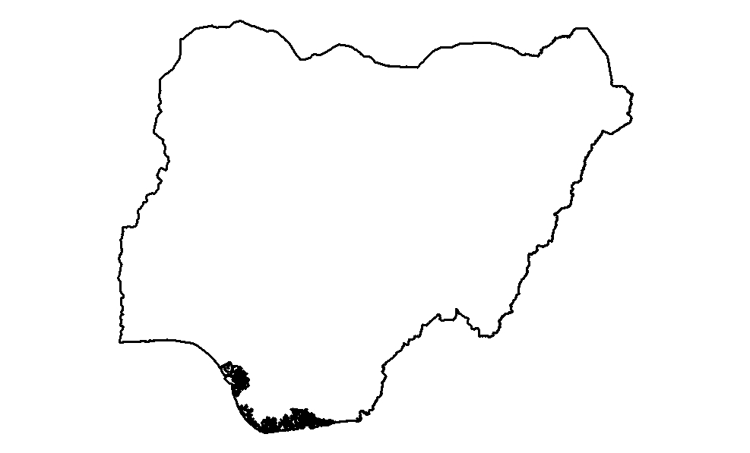
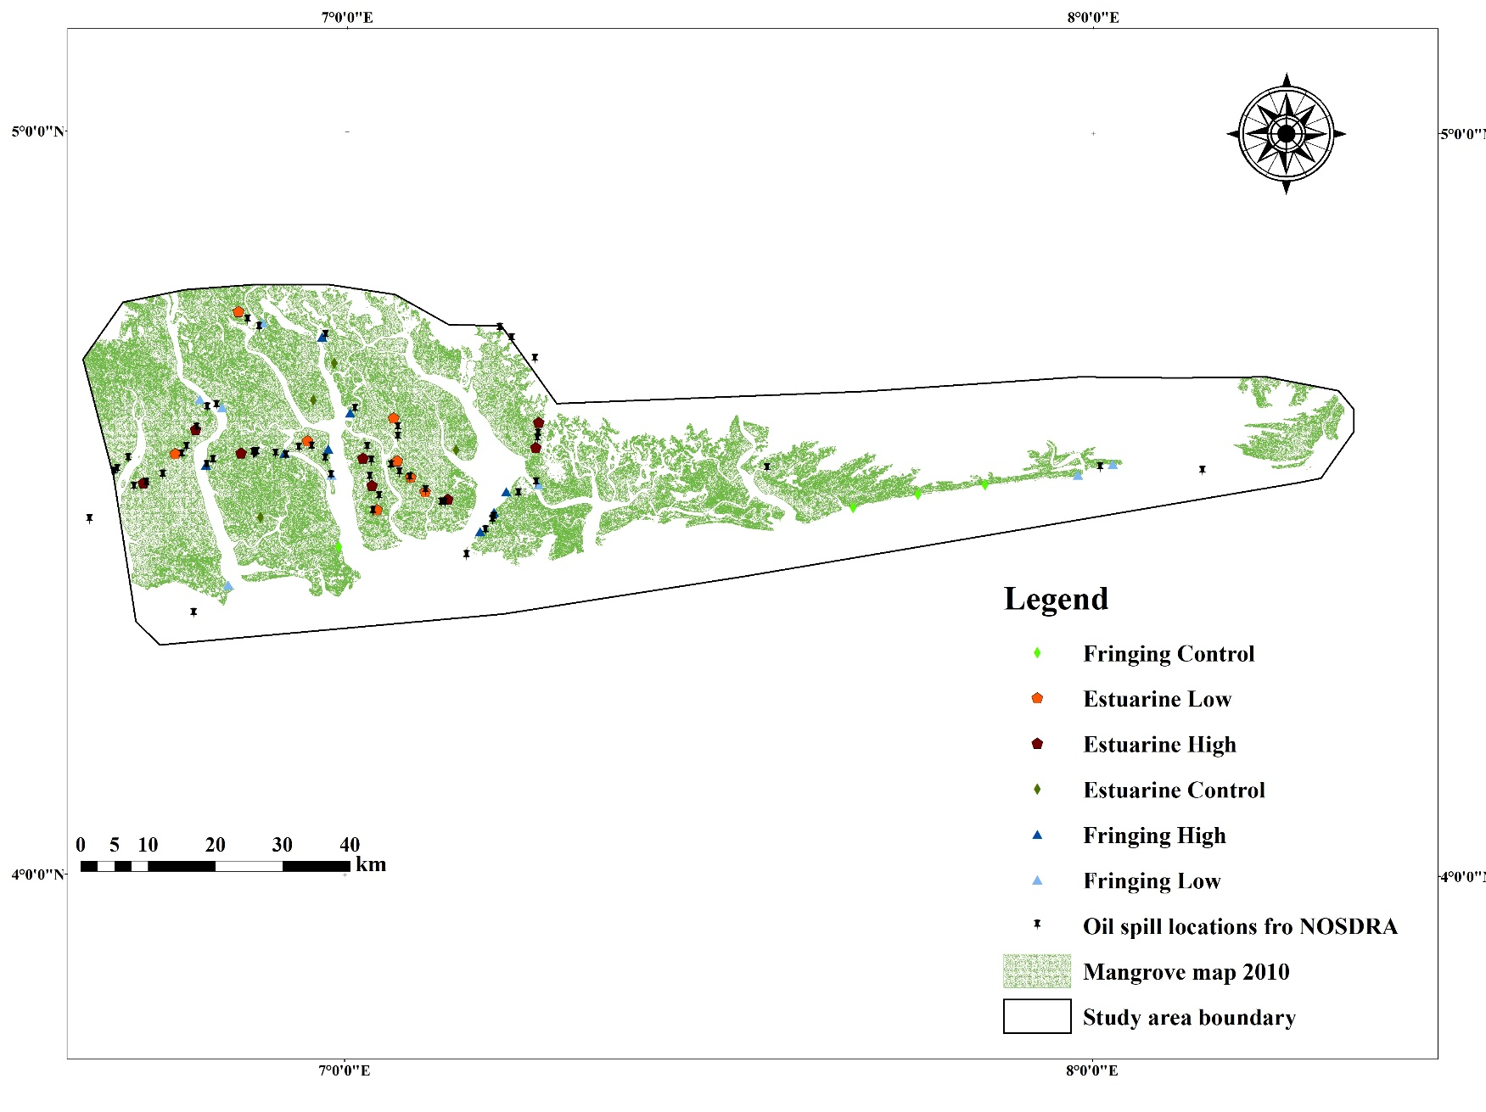
Map of Nigeria above and study area showing sampling points on right

Slide 4
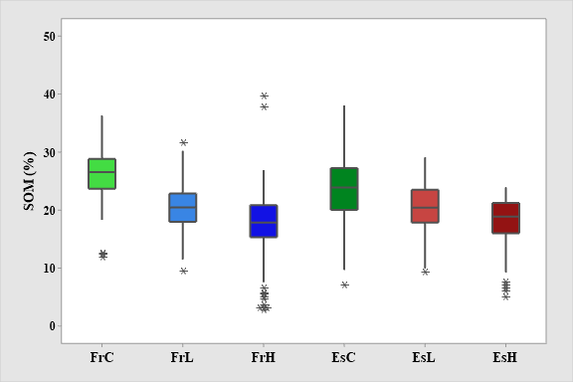
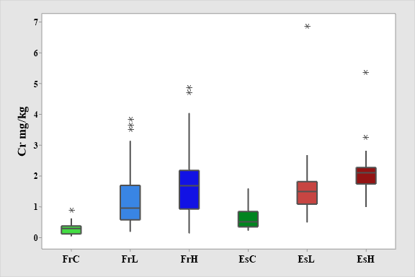
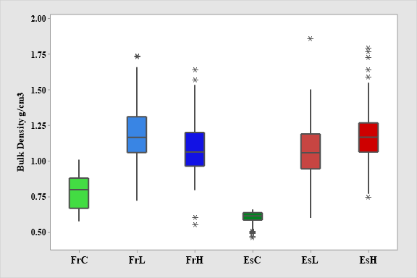
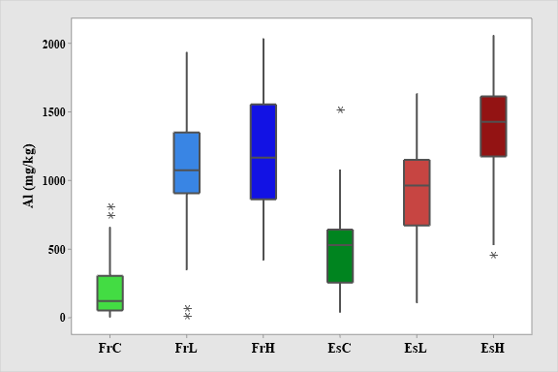
Laboratory results: Soil indices SOM (a), Chromium (b) Bulk density (C) Aluminum (d) significant difference is depicted by P value . Tukey’s post hoc grouping shows similar sites by letters
a)
P = 0.000 F = 48.47
b)
P = <0.005 F = 70.98
A
B
C
D
C
D
c)
P = <0.005 F = 498.32
d)
P = 0.000 F = 290.80
A
B
A
B
C
D

Slide 5
b)

Slide 6
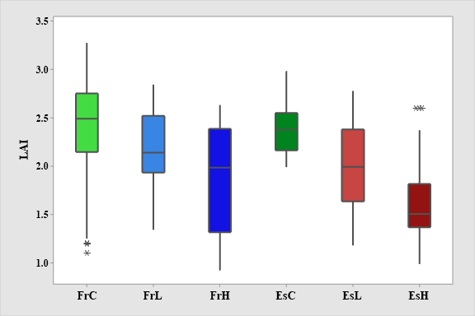
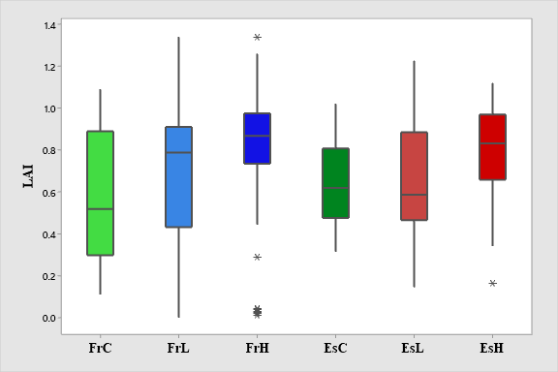
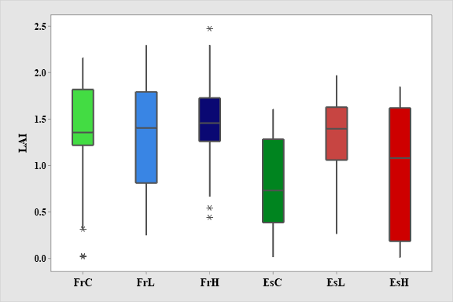
Remote sensing results showing Landsat LAI from 2016 (a), 2003 (b) and 1986 (c). LAI from present day shows differenced between degraded and control sites and differed significantly (P –value 0.003) between the classes which is not observed in 2003 and 1986 data. Tukey’s post hoc grouping shows sites that are similar represented by letters. Sites that share a letter are similar.
B
A
A, B
A
A
B
B
A, B
A
A
A
A
B
B
B
B
C
B
a)
b)
c)

Slide 7
Results from Machine Learning classification of Niger delta mangroves using Artificial Neural Networks (ANN), Support Vector Machine (SVM), Logistic Regression (LR) and Random Forest (RF). These tools were used to combine pollutant data that have shown influence on oil-induced mangrove degradation in the study area to categorize mangrove trees based on LAI response to pollutant levels.
LAI classification results
Accuracy assessment of machine Learning tools used

Slide 8
Key findings
There is a strong link between reported spill size, heavy metal pollution and soil bulk density and organic matter.
There is also a clear link between pollution and mangrove degradation highlighted by the LAI results.
Effectively, the base data can be utilized in machine learning to model mangrove status all over the Niger delta. This has potential for informing global initiatives and climate studies e.g UNREDD+ and SDGs

Slide 9
Conclusion
Machine Learning
GEDI LiDAR waveforms
Artificial Neural Networks (ANN)
Logistic Regression (LR)
Random forest (RF)
Support Vector Machine (SVM)
Present potential to model the impacts of oil pollution on mangroves in the Niger Delta using LAI and field data, useful for the identification of vulnerable and high risk areas
Identifying entry points for the application of GEDI Lidar waveforms to characterize forest structure based on spill contamination response (Silva et al., 2018).

