Slide 1
Unsupervised Classification of Convective Organisation in EUREC4A with Deep Learning
Leif Denby, University of Leeds, UK
Neural network (NN) trained unsupervised* on boreal winter 2018-2019 to produce similar embedding vectors for similar cloud structures
Spatial map of NN predictions from sliding-window of 200km x 200km tiles fed to neural network from GOES-16 RGB composites
100D embedding vectors reduced with Principle Component Analysis of embedding vector output across all days during campaign
90% of variance in embedding vector captured by first 5 PCA dims
1) NN produces contiguous regions, larger than the tile size (!), with similar embedding vectors, i.e. NN can identify organisation larger than it was trained on
2) Different PCA components appear to capture organisation on different scales / of different types
*: see L Denby 2020 for details

Slide 2
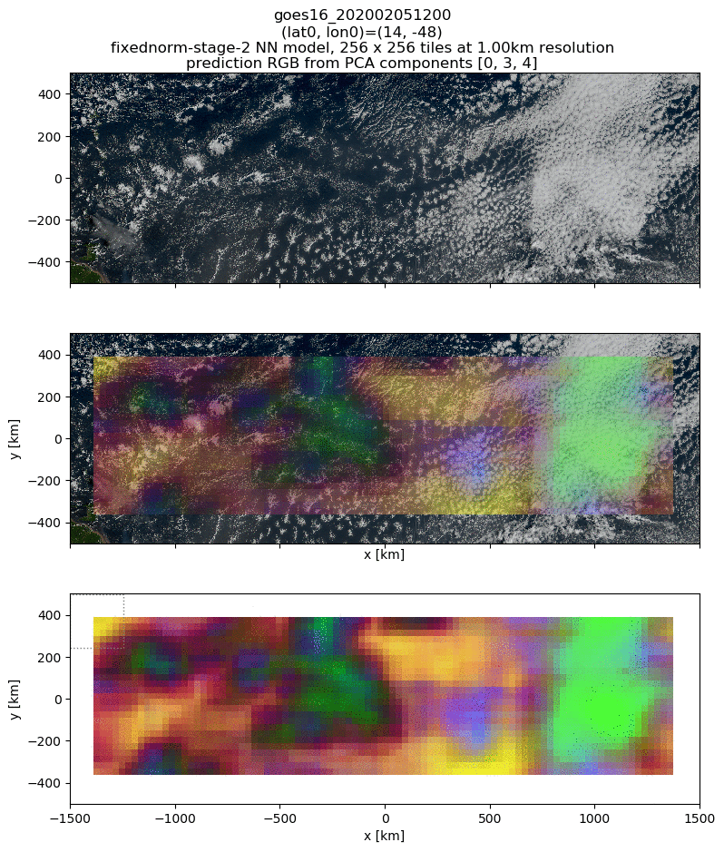
Unsupervised Classification of Convective Organisation in EUREC4A with Deep Learning
Leif Denby, University of Leeds, UK
Regions of distinct types of organisation can be seen by forming RGB composites from PCA components (picking here 1st, 4th and 5th components)
Appear to be able to pick up cold-pool arcs, “sugar” cloud-cover and larger “flower” clouds
Next steps:
Identify contiguous regions of organisation to produce hierarchy of types of organisation
Composite ERA5 reanalysis and observations from campaign to study environmental conditions for each type
Produce netCDF dataset for EUREC4A community with organisation types (and underlying embedding vector data?)

