Slide 1


Micromagnetic modeling of silicate-hosted magnetic inclusions using SEM-FIB slice-and-view nanotomography.
E.S. Nikolaisen¹*, R.J. Harrison², K. Fabian¹, S.A. McEnroe¹.
1) Norwegian University of Science and Technology (NTNU), Department of Geoscience and Petroleum. S. P. Andersens veg 15a, 7031 Trondheim, NORWAY, E-mail: (*Correspondence: evennikolaisen@ntnu.no)
2) University of Cambridge, Department of Earth Sciences. Downing Street, Cambridge CB2 3EQ, UK

Slide 2
What can micromagnetic modelling with real particle shapes achieve?
Domain state diagnosis is commonly performed using hysteresis and FORC measurements of bulk samples, then analyzed with a number of diagnostic diagrams (e.g. the Day diagram, Néel diagram, Butler-Banerjee diagram).
This study performs domain-state diagnosis using a detailed combination of 3D tomography and micromagnetic modelling of naturally formed silicate-hosted magnetite inclusions.
Dataset containing >400 particles of magnetite measuring between 0.022 – 0.420 µm (equivalent sphere diameter).
Hysteresis properties and diagnostic plots of all particles are modelled individually, with each data point representing an average of 20 simulations in different external field directions.
Micromagnetic modelling reveals that inclusions contained within a single silicate grain adopt multiple domain states that span the entire range of common domain-state diagnostic plots.

Slide 3
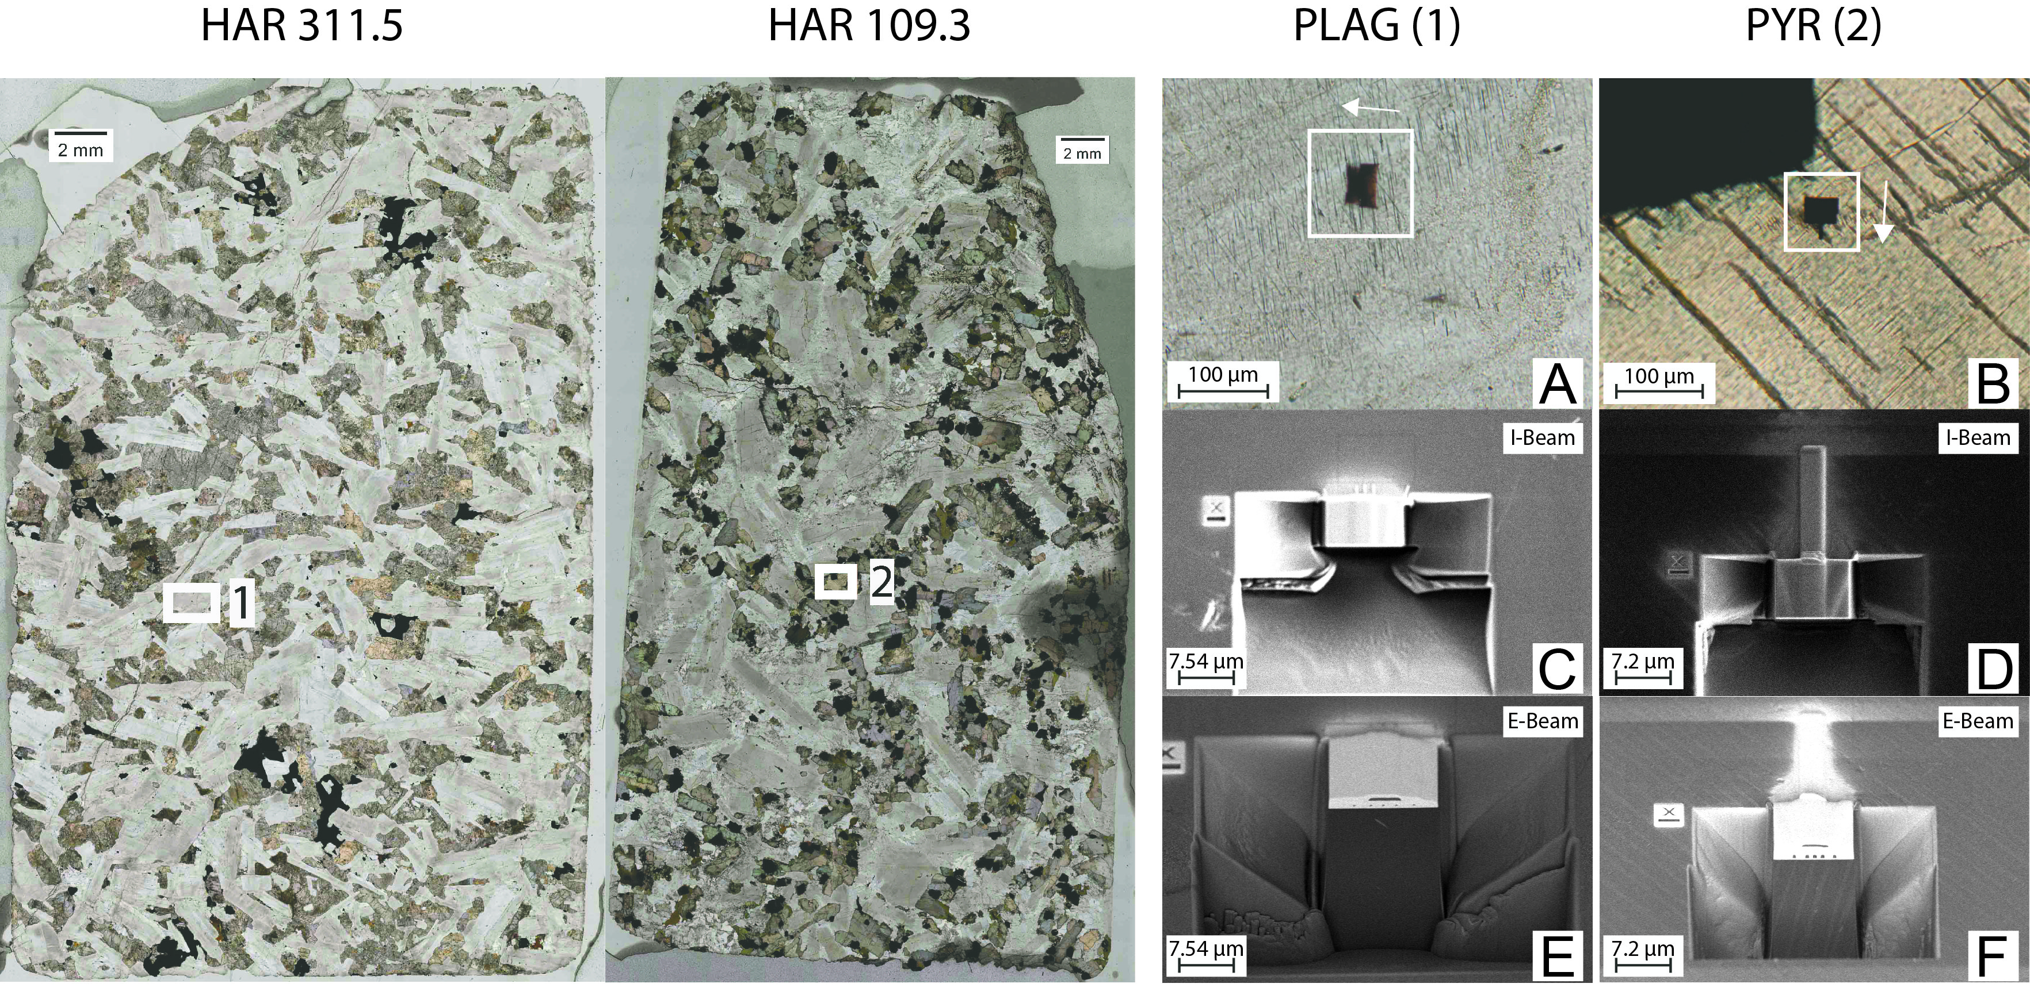
SEM-FIB Slice-and-View workflow
Selecting area of interest with primary
formed silicates and confirmed
magnetite inclusions with EDS.
For this study the selected areas are
in plagioclase (area 1) and pyroxene
(area 2)
The sample are two thin sections from drill cores from the Harcus intrusion in SW Australia, where there is a significant magnetic anomaly that makes the area of interest for micromagnetic studies. The numbering next to “HAR” represent the depth in the drill cores where the samples are extracted.
Adding Pt protective layer with carbon
fiducials for image alignment.
Cutting trenches (C-F) and
cleaning front face.
Automated milling sequence with fixed
slice thickness (white arrow in A and B
showing milling direction).
Platinum fiducial in upper right corner
of the trenches for milling alignment.

Slide 4
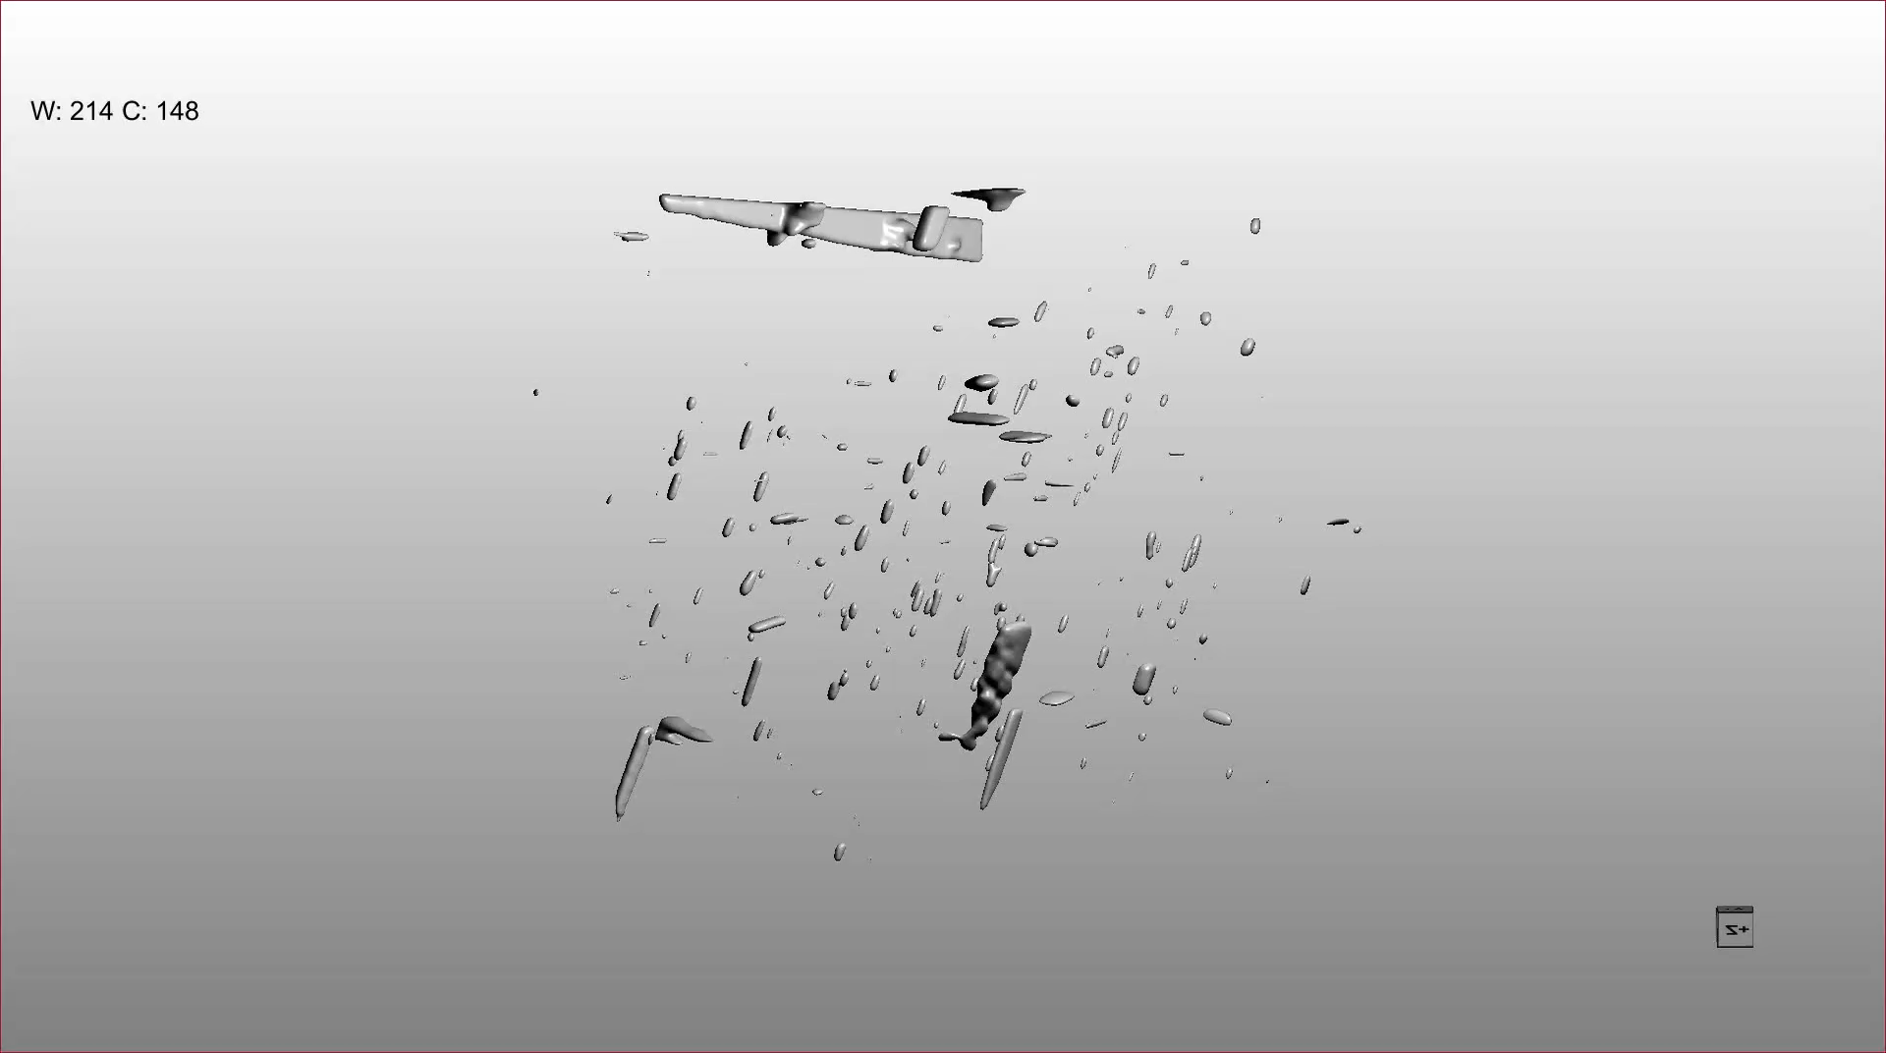
Generating finite element meshes for the observed magnetite particles
Aligning the image stack and
image filtering.
Generating meshes in Paraview
and applying correct voxel
dimensions.
(Animation of magnetite
particles in pyroxene)

Slide 5
Plagioclase hosted magnetite (slice thickness 30nm)

Slide 6
Pyroxene hosted magnetite (slice thickness 10nm)

Slide 7
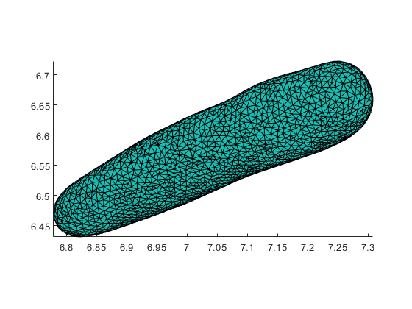
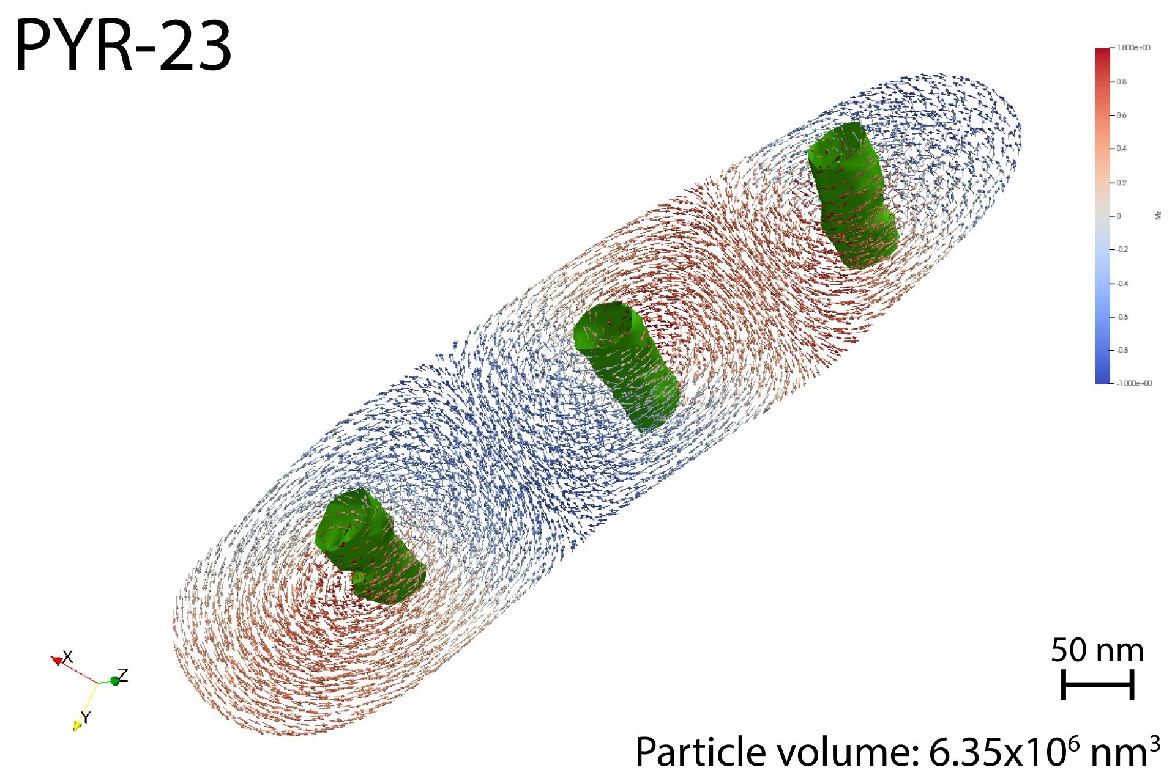
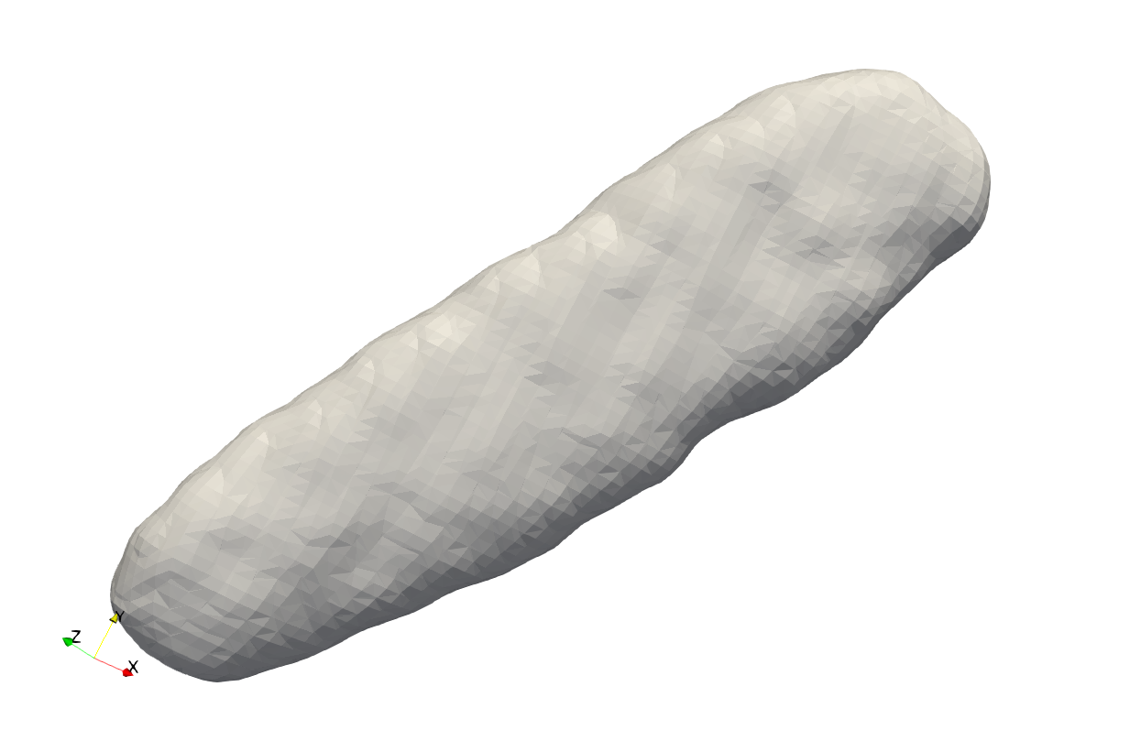

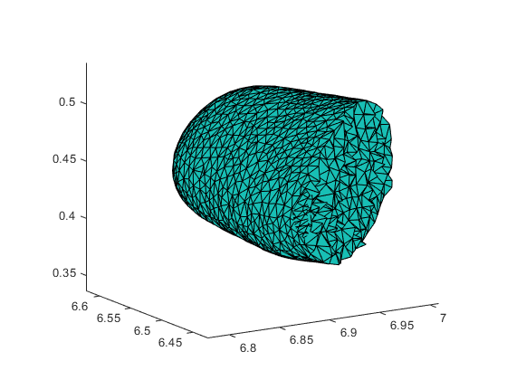
Mesh smoothing and magnetic modeling
Of 162 total particles hosted by plagioclase, 140 were modelled.
Of 282 total particles hosted by pyroxene, 273 were modelled.
Because of computer memory and software limitations the larges particles were not computable
From both datasets the individual particle meshes were extracted for separate micromagnetic modeling.
Initial mesh
with slicing artifacts
Solidify mesh with iso2mesh (MATLAB)
Magnetic model (MERRILL)
Smoothened

Slide 8
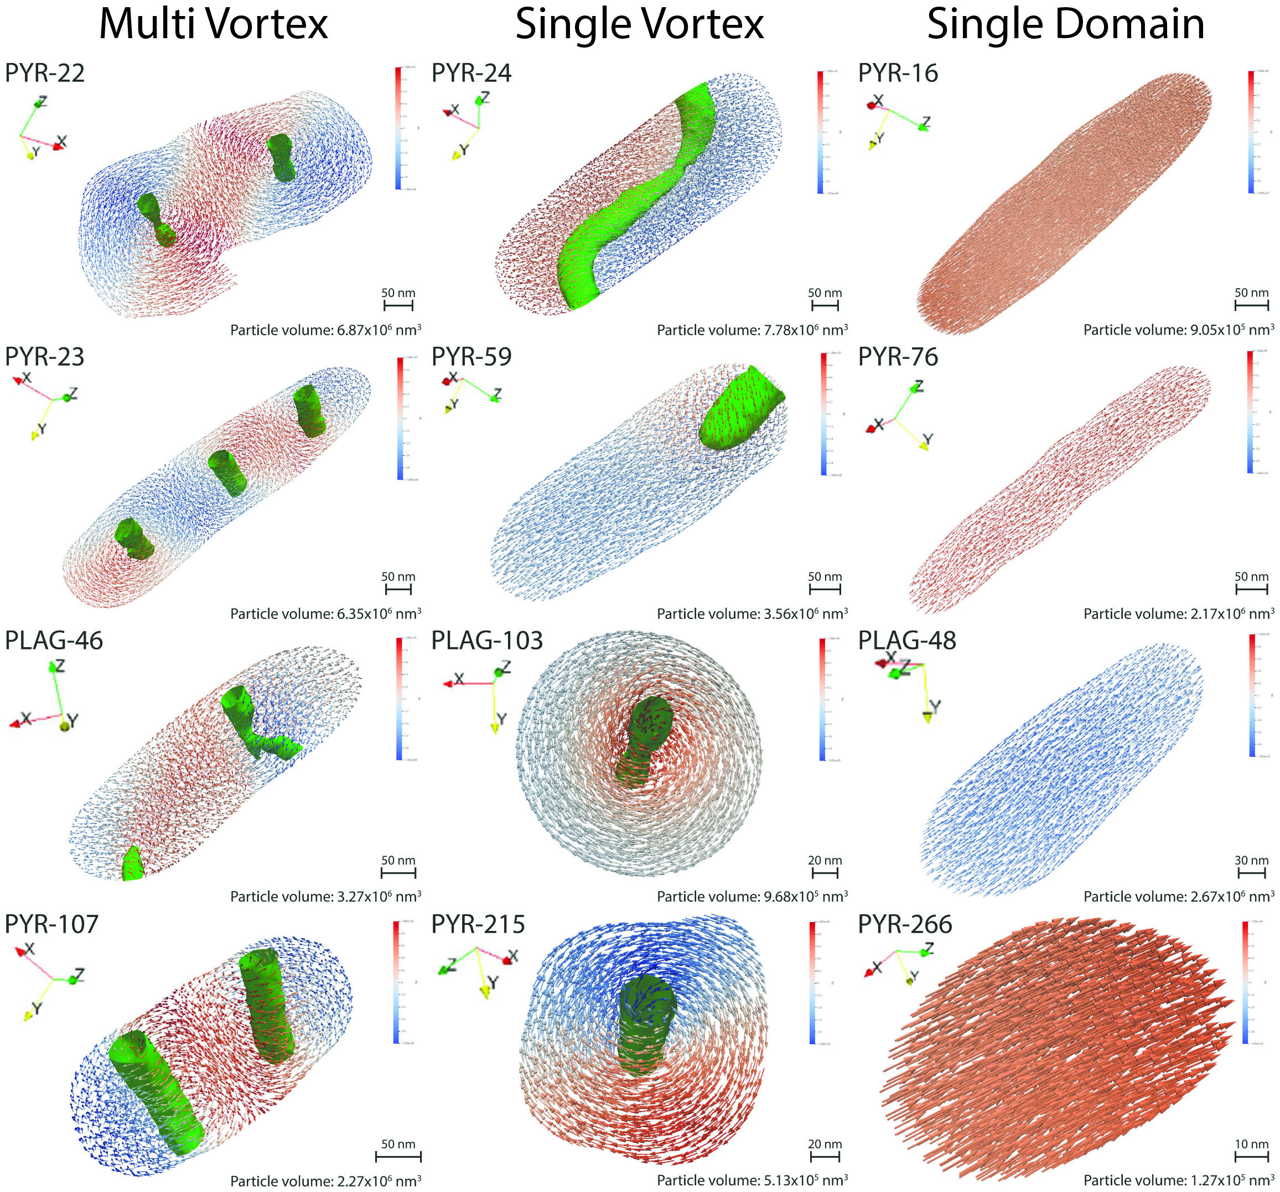
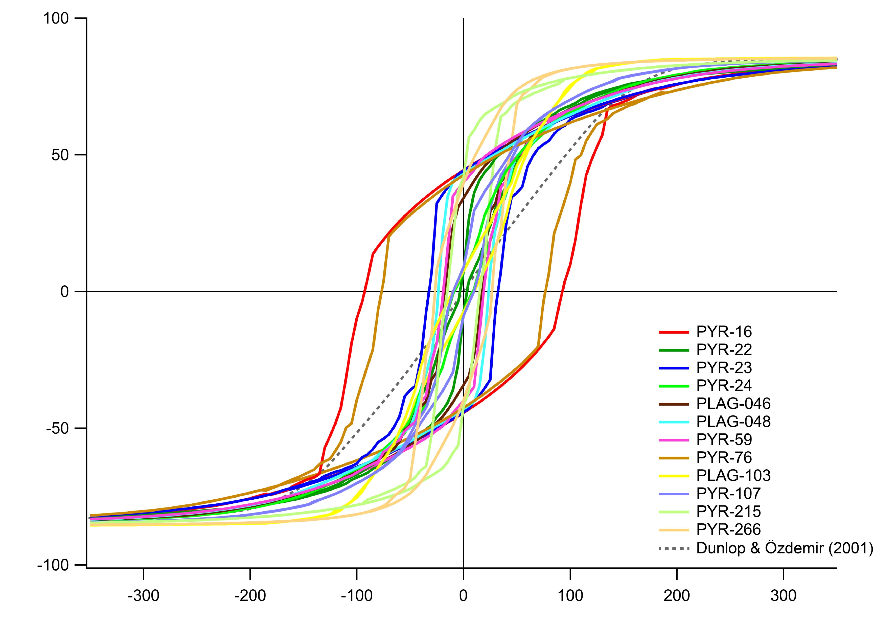
Magnetic modelling
Selected particles in different domain states, indicated in bold text within the following diagrams.
Arrows in the magnetic models are color-coded by their vertical z-component (Green axis). Red = up and blue = down.
Green vortex cores enclose volumes of increased helicity.
Normalized moment
Field (mT)

Slide 9
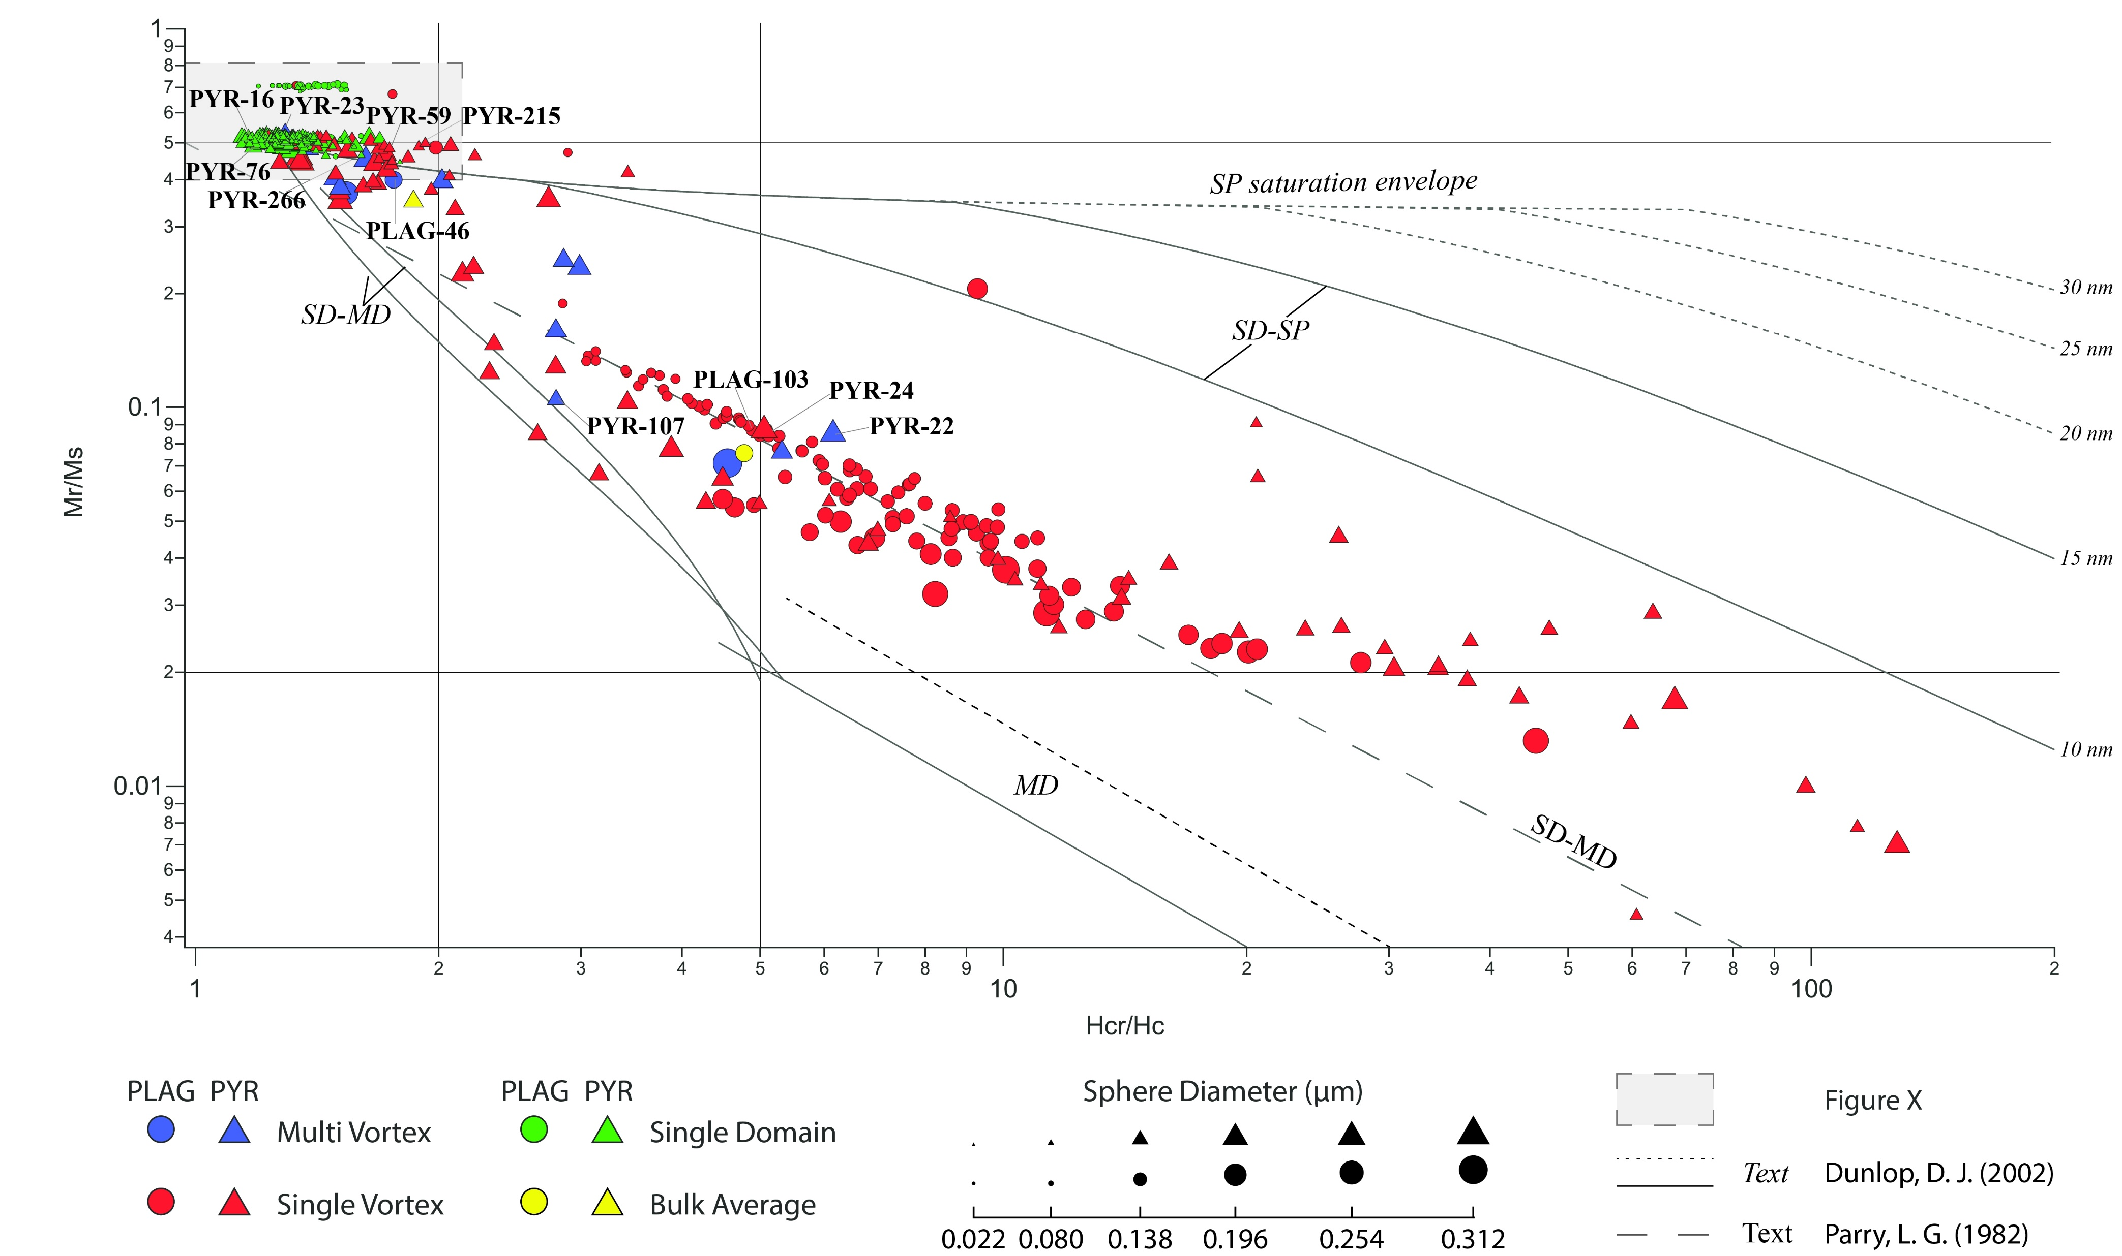
Day diagram
Single domain region
Notes:
Each point in the following diagrams represents the Mr, Ms, Hc and Hcr values from an average curve constructed of measurements in 20 field directions. The directions were calculated from a Fibonacci sphere for equidimensional distribution.
The traditional Day diagram was expected to show a gradual increase in particle size with lower Mr/Ms and Higher Hcr/Hc ratios. However this is far from what is observed, where there is only a general cluster of the SD particles. The other domain states show no systematic trend in relation to grain size. MV particles that in general represents the larges particles actually trends towards the SD region of the diagram.
It is also evident that the theoretical mixing lines established by Dunlop (2002) also does not match up well with the trends of our dataset. A possible explanation is since every point is calculated individually there is a multi componential mixing of domain states. Because of the natural geometric shapes of the modelled particles and they therefore display this signature. A mixing line that does match perfectly with trend of pour data set comes from Parry (1982) and is a trend line representing a bimodal distribution with a mixture of SD and MD particles.

Slide 10
0.8
Single domain region of Day diagram
0.7
0.6
0.5
0.4
Notes:
Highlighted by this figure is the SD region of the Day diagram. Evident is the variability of coexisting particle sizes in this region that is way larger than the theoretical upper critical limit of SD particles. This mixing of domain states within this region suggest that particles behave different between the remanence state observed when minimized in zero field from a random initial state and high field hysteresis. Here there is also evidence that microscopic diference in geometry can be a controlling factor for larger particles to obtain a different domain state during high field hysteresis.
At Mr/Ms = 0.7 there is cluster of particles that approach the region for cubic anisotropy. These particles are in fact oblate and they therefor plot in this region because there is crystallographic direction that fixes the magnetic easy axis. We tested the possibility that due to the particles small size, their meshes was dominated by voxel shapes as the particles is represented by few pixels. Increasing the smoothing of these meshes had no effect on the magnetic modelling and we can therefore conclude that these are existing particles in nature and would plot in the same region.

Slide 11
Néel diagram
Single Vortex cluster
Notes:
The Néel diagram display as expected a comparable domain distribution as the Day diagram. In Tauxe (2002) the SD spread is explained to display the increase in Hc is proportional to the particle length to width ratio. The particles that align with the “central ridge” of uniaxial particles do show an increase in the L/W ratio. This means that the higher Hc values have the highest L/W ratios (10-14:1) and that the lower Hc values have the lowest ratios (1.3:1). However inbetween there no progressive L/W ratio increase connected to an increase in Hc values. However there is a weak tendency that the MV particles do have a higher L/W ratio compared to the surrounding SD particles at lower Hc values.

Slide 12
Single vortex cluster of Néel diagram
Notes:
The main differences between Néel and Day diagrams for this dataset is that there are two main clusters of particles. Below 14 mT there is a SV dominant cluster of particles. Most profound is the curved trend with increasing Hc, estimated to be caused by the decreasing internal demagnetizing field. Here there is also added in larger particles (purple) with magnetic signatures closer to the MD state. General tendencies is that lower Hc values is represented by larger particles. The smallest particles are close to spherical in shape.

Slide 13
Butler diagram
Notes:
The Butler diagram show a clear connection between observed remanence state and theoretical domain state separation lines. Also evident is that elongated particles is mainly hosted by pyroxene (triangle), while plagioclase (round) form more equidimensional particles. The non interaction boundary between SD and SSD+MD particles from Muxworthy & Williams (2009) almost fits our observed domain states. We would suggest slight adjustment at lower axis ratios.
We also have indicated that non of the observed remanent states fit the theoretical domain signature of MD particles and this diagram support this. If particles locations within both the Day and Néel diagrams was indicating their theoretical domain state, than the majority of these particles would have been wrongly identified.

Slide 14
Conclusion
There is no systematic change in particle size that follows either the increase or decrease of Mr/Ms or Hc/Hcr ratios.
Where particles plot in Day or Néel diagrams does not give a reliable domain state estimation.
Even such small sample volumes contain the whole range of domain states.
The Butler-Banerjee plot provides dependable domain classification for single-domain versus single-vortex particles, but does not account for the multi-vortex state.
Challenges with this method and further research
Time consuming.
Only possible to investigate volumes equal to or smaller than those presented within this study.
There is a mismatch between observed remanence states obtained during zero-field relaxation from a random initial state and the high-field hysteresis behavior.
We see comparable pattern between the Néel diagram and FORC diagrams from other areas, but we need single-crystal FORC diagrams to obtain properly comparable results.

Slide 15
References
Bowles, J. A., A. Morris, M. A. Tivey, and I. Lascu (2020), Magnetic mineral populations in lower oceanic crustal gabbros (atlantis bank, SW indian ridge): Implications for marine magnetic anomalies, Geochemistry, Geophysics, Geosystems,21(3), doi:51410.1029/2019gc008847.
Butler, R. F., and S. K. Banerjee (1975), Theoretical single-domain grain size range in magnetite and titanomagnetite, J. Geophys. Res.,80, 4049 – 4058.
Dunlop, D. J (2002), Theory an application of the day plot (mr/ms versus hcr/hc) 1. theoretical curves and tests using titanomagnetite data, J. Geophys. Res.,107, 1–22.
Dunlop, D. J., and Ö. Özdemir (2001), Rock magnetism: fundamentals and frontiers, vol. 3, Cambridge university press.
Muxworthy, A. R., and W. Williams (2008), Critical superparamagnetic/single-domain grain sizes in interacting magnetite particles: implications for magnetosome crystals, Journal of The Royal Society Interface, 6(41), 1207–1212, doi:10.1098/rsif.2008.0462.
Parry, L. (1982), Magnetization of immobilized particle dispersions with two distinct particle sizes, Physics of the Earth and Planetary interiors, 28(3), 230–241
Tauxe, L., H. N. Bertram, and C. Seberino (2002), Physical interpretation of hysteresis loops: Micromagnetic modeling of fine particle magnetite, Geochemistry Geophysics Geosystems, 3, art. no.–1055.

Slide 16
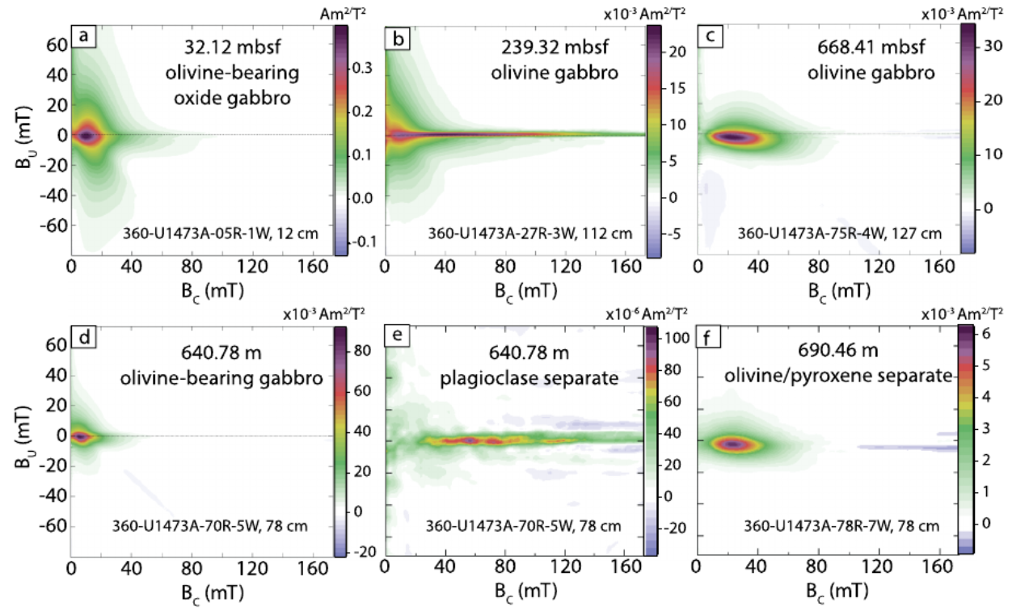
Appendix 1
Bowles, J. A. et al. (2020), Figure 3

