Slide 1
On the use of Geostationary Lightning Mapper (GLM) data as proxy for heavy precipitation
¹Vandoir Bourscheidt, ²Maria-Helena Ramos
¹ Federal University of São Carlos (UFSCar, Brazil) - currently visiting scientist at INRAE
² National Institute for Research on Agriculture, Food and Environment (INRAE, Antony, France)
EGU session HS7.1 - Precipitation measurement: techniques, processes and hydrological applications at the catchment scale, Tuesday, 05 May 2020

Slide 2
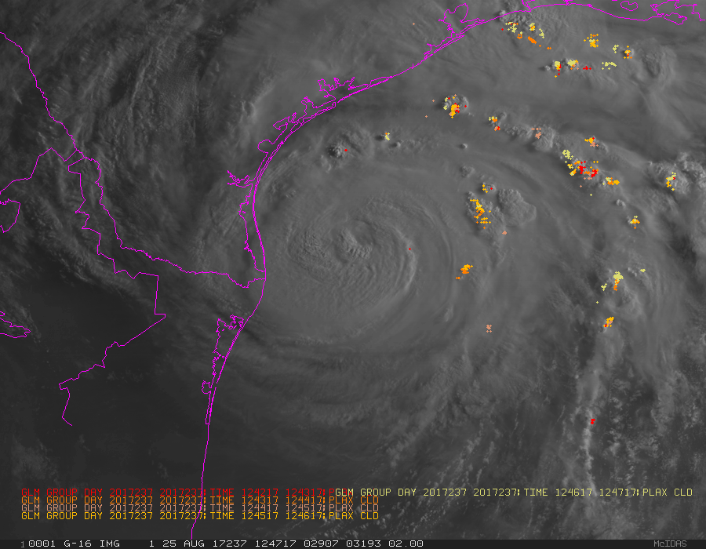
Motivation Lightning data from GLM
On the use of Geostationary Lightning Mapper data as proxy for heavy precipitation
Outline
Geostationary Lightning Mapping (GLM) is a new sensor onboard GOES fourth generation (G16 and G17) with the unprecedent capability to detect the luminous energy from lightning at every few seconds and for whole Americas and Pacific (centered at 75°W and 137°W);
Similar sensors will be available on other satellites (METEOSAT and Fengyun) in the close future, hopefully extending its coverage to the entire world.
Since applications are expected to advance over deep convection and severe weather, hydrological rainfall-runoff models could benefit specially from the perspective of heavy rainfall events;
Studies of its applicability (and limitations) are just starting;
Motivation
Background
Material and methods
Results
Final remarks

Slide 3
On the use of Geostationary Lightning Mapper data as proxy for heavy precipitation
Background Lightning x Precipitation relationship
Outline
Several studies suggest a reasonable relation between lightning data and precipitation;
Relations include:
Rainfall-lightning ratio (RLR) approach or rain mass per lightning (e.g. Tapia, Smith and Dixon, 1997)
The direct lightning-precipitation relationship (LPR) (e.g. Minjarez-Sosa et al. 2017; Zhou, Qie and S. Soula, 2001)
Probabilistic and qualitative relationships using classes (e.g. Xu et al., 2013; Morales and Anagnostou, 2003)
Most of the studies are based on the comparison of lightning data against Weather Radar and Gauges;
General observation suggest lightning as a tool to classify/distinguish precipitating systems;
Motivation
Background
Material and methods
Results
Final remarks

Slide 4
On the use of Geostationary Lightning Mapper data as proxy for heavy precipitation
Material and methods
Outline
General idea: evaluate GLM against gauges and weather radar data
Based on the physical aspects of lightning that constitute its products (flash, groups, energy, flash area, etc.), GLM data may be analyzed in several ways.
For the present work, three approaches will be evaluated:
Use the gridded product (GLM GRIDS);
Evaluate a Gaussian Kernel (KDE) method to spread discharges over an area;
Count detected flash (filtered by quality flag);
Besides, different areas will be considered:
Average around ground stations
Average over watershed areas (based only on the radar)
Pixel by pixel
Motivation
Background
Material and methods
About the GLM GRIDDED product
About the study area
Results
Final remarks
Example of GLM flashes and related KDE

Slide 5
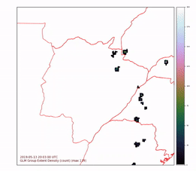
On the use of Geostationary Lightning Mapper data as proxy for heavy precipitation
About the GLM gridded product
Outline
Gridded format implemented by Bruning et al. (2019) for operational use that aggregates multiple information from original GLM file;
Product with the same grid as GOES ABI (fixed grid);
More focused on the meteorological aspects of lightning occurrence;
Possibility to obtain many variables at once.
Data is downloaded as NETCDF and afterward converted in a grid with 2x2km and hourly time steps
6 products are used in this study:
Flash extent density (FED)
Group extent density (GED)
Flash centroid average (FCT)
Group centroid average (GCT)
Flash Area (Farea, in km²)
Group Area (Garea, km²)
Motivation
Background
Material and methods
About the GLM GRIDDED product
About the study area
Results
Final remarks

Slide 6
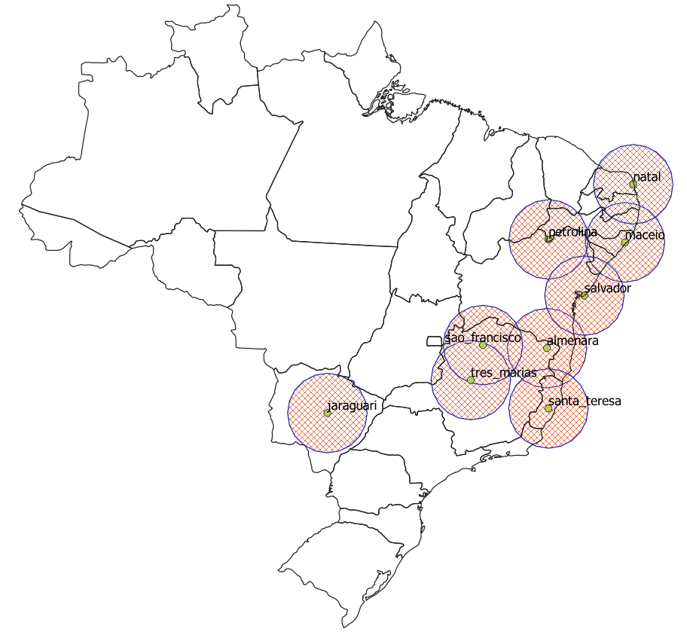
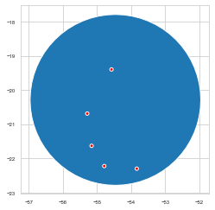
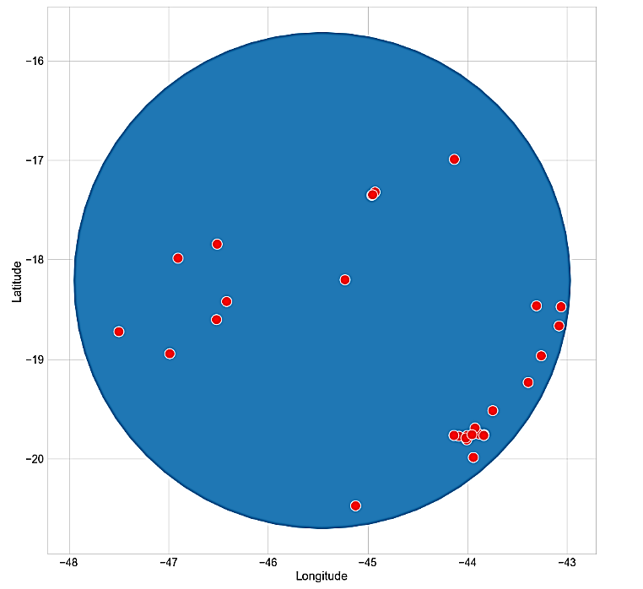
On the use of Geostationary Lightning Mapper data as proxy for heavy precipitation
About the study area
Outline
Data for this analysis result from CEMADEN (Brazilian National Centre for Monitoring and Early Warning of Natural Disasters)
Radar and Gauge data were selected based on its availability
Ready to use “rain product” was further processed to improve relation against rain gauges based on simple arithmetic and a spatial filter (Wiener)
Analysis were conducted in 2 areas:
Jaraguari (MS)
Tres Marias (MG)
Period:
27 Jan 2020 – 15 Mar 2020
Motivation
Background
Material and methods
About the GLM GRIDDED product
About the study area
Results
Final remarks
Jaraguari
Tres Marias
Radar evaluated so far

Slide 7
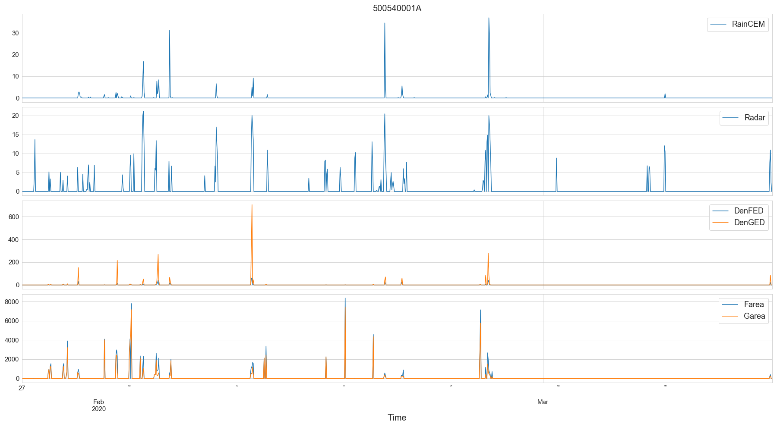
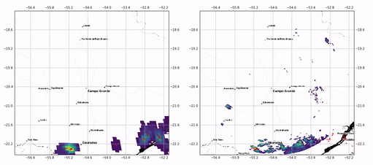
On the use of Geostationary Lightning Mapper data as proxy for heavy precipitation
Overview (using Gauges)
Time series analysis and general relationship
Outline
Lightning is more “localized” than radar
Gauges X Radar fits better with LOG SCALE
Relation between Flash /Group Area and Density might be useful
Motivation
Background
Material and methods
Results
Overview
Radar x Gauges
Radar x GLM
Final remarks
GLM GRIDS
RADAR

Slide 8
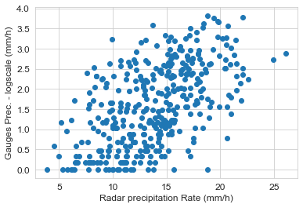
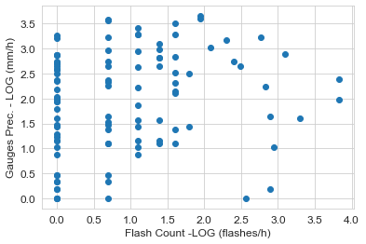
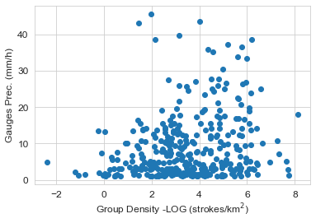
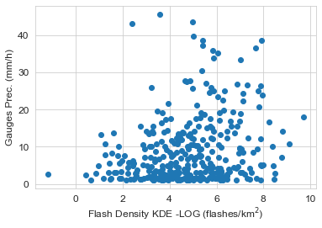
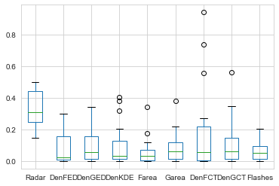
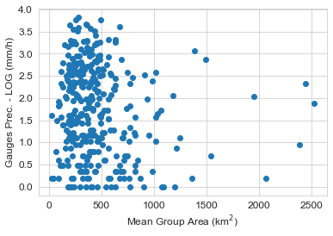
On the use of Geostationary Lightning Mapper data as proxy for heavy precipitation
Overview (using Gauges)
Time series analysis and general relationship
Outline
Low/No relation between GLM vs. Gauges: effect of GLM pixel size?
Relation varies for individual stations (see boxplot)
Low improvements in multiple regression (<0.1)
Motivation
Background
Material and methods
Results
Overview
Radar x Gauges
Radar x GLM
Final remarks
 | N | R2
Radar | 297 | 0,300
Farea | 427 | 0,025
Garea | 427 | 0,042
LOG(Gauges) x
Gauges x
Log(DenFED) | 336 | 0,026
Log(DenGED) | 336 | 0,041
Log(DenKDE) | 336 | 0,053
LOG(Gauges) x
Log(DenFCT) | 169 | 0,063
Log(DenGCT) | 252 | 0,015
Log(Flashes) | 104 | 0,034
Boxplot of R² values distribution over gauge stations

Slide 9
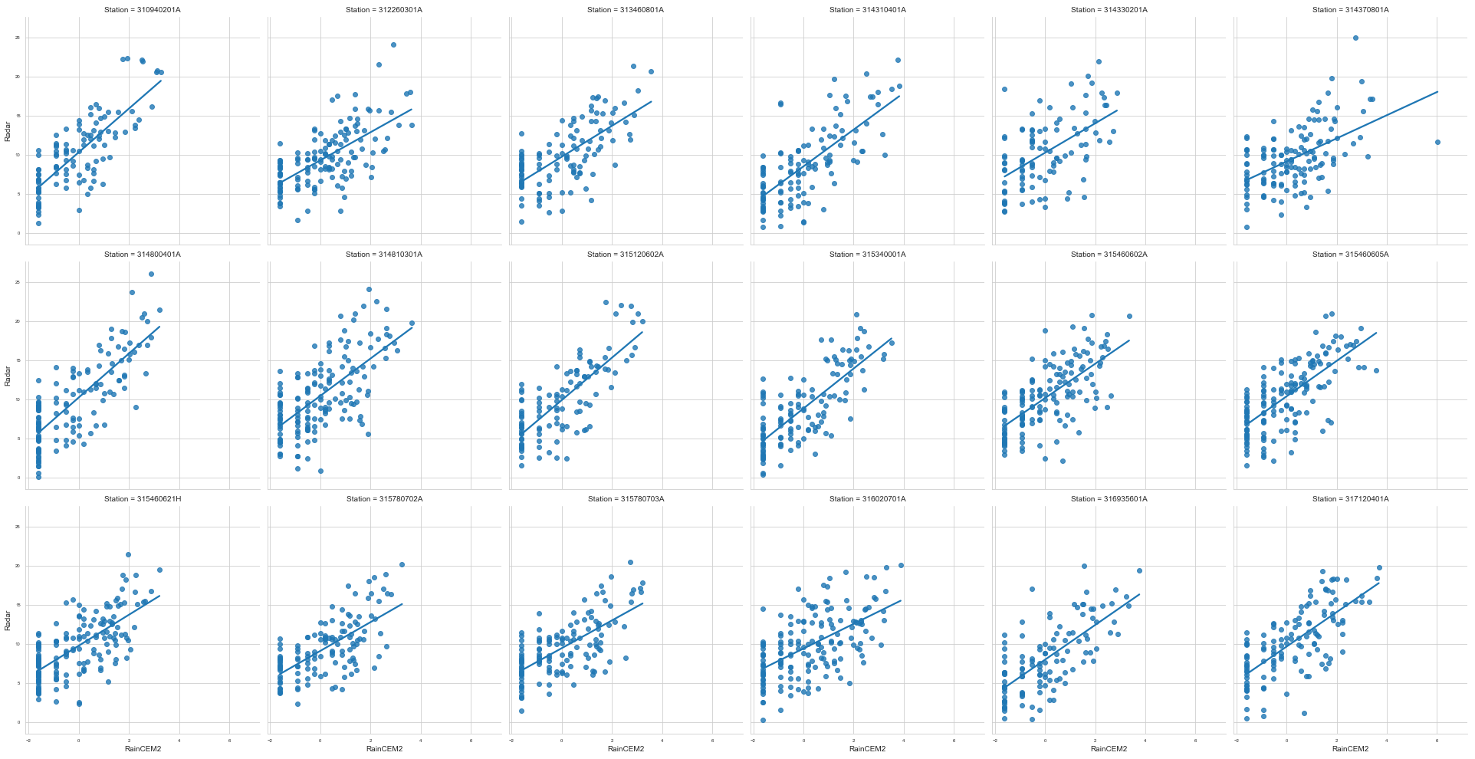
On the use of Geostationary Lightning Mapper data as proxy for heavy precipitation
Radar versus Gauges
Example for Tres Marias radar/stations
Outline
The relation includes LOG transformation on precipitation data.
A good agreement is observed for all stations; results are similar for Jaraguari.
Motivation
Background
Material and methods
Results
Overview
Radar x Gauges
Radar x GLM
Final remarks

Slide 10
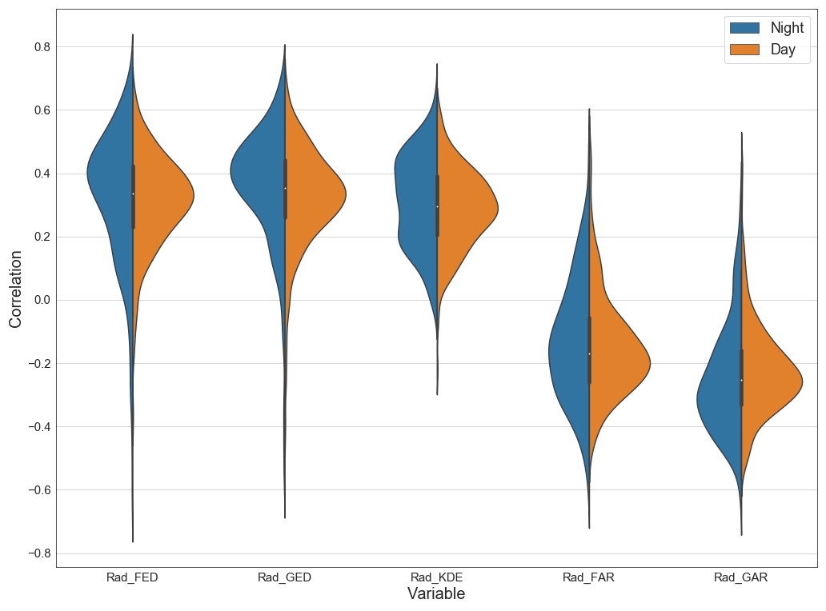
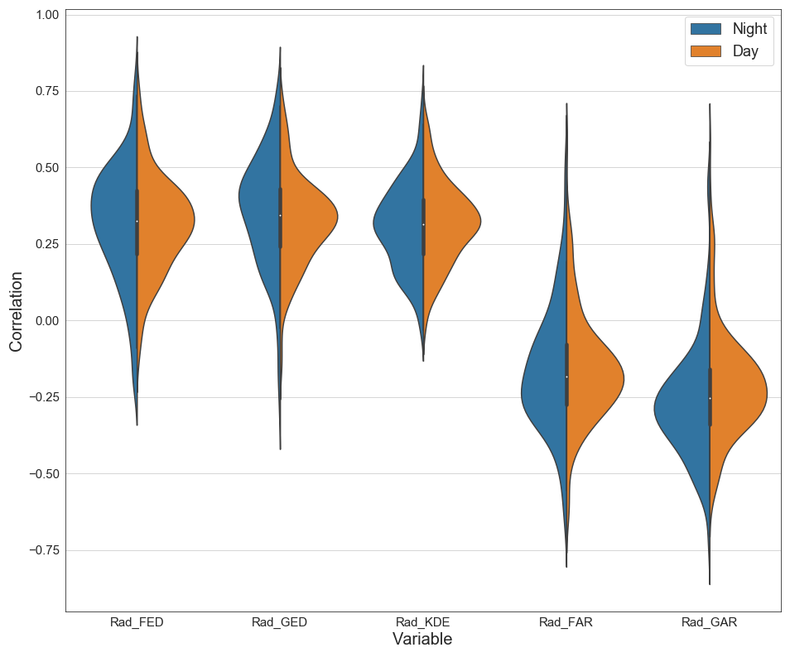
On the use of Geostationary Lightning Mapper data as proxy for heavy precipitation
Radar versus GLM
Pixel-by-pixel analysis
Outline
The analysis was conducted at both regions
Day-night variations seem to be important
Variables with higher relation were chosen:
Radar vs. FED Radar vs. GED Radar vs. Group Area
Radar vs. KDE Radar vs. Flash Area
Motivation
Background
Material and methods
Results
Overview
Radar x Gauges
Radar x GLM
Final remarks
Jaraguari
Tres Marias

Slide 11
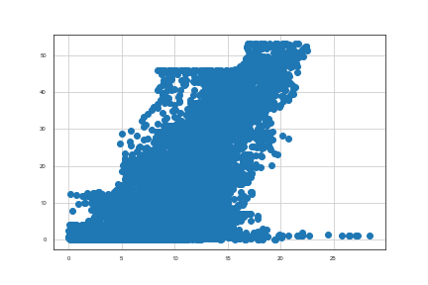
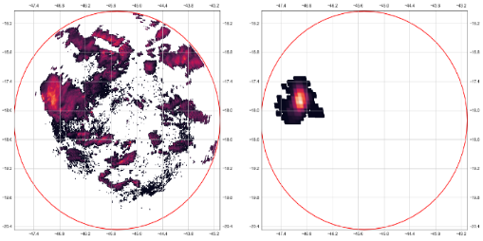
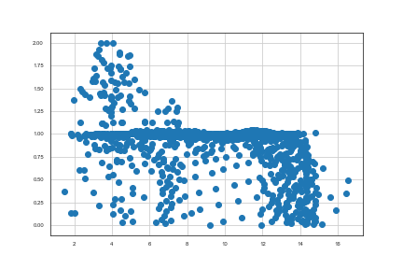
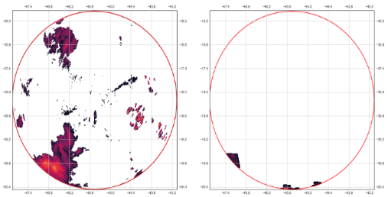
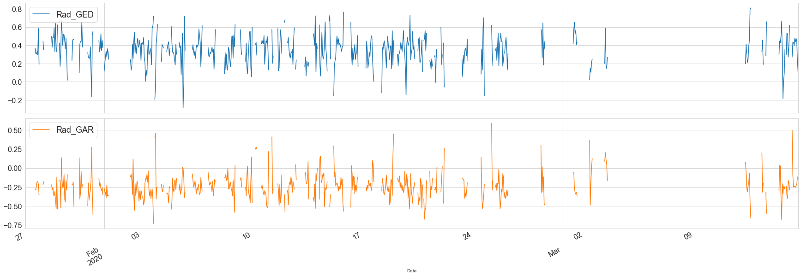
On the use of Geostationary Lightning Mapper data as proxy for heavy precipitation
Radar versus GLM
Pixel-by-pixel analysis – correlation over time
Outline
Two variables are presented: Group Density and Group Area
Correlation (Pearson) varies over time depending mainly on the amount of coverage between radar and GLM
Large (small) R values for higher (lower) co-coverages
Motivation
Background
Material and methods
Results
Overview
Radar x Gauges
Radar x GLM
Final remarks

Slide 12
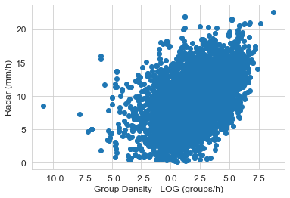
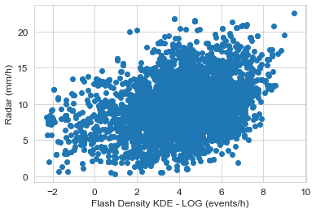
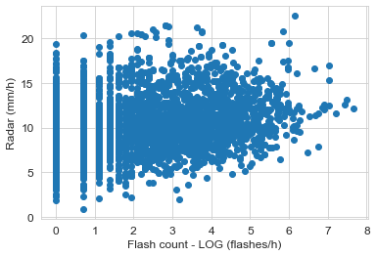
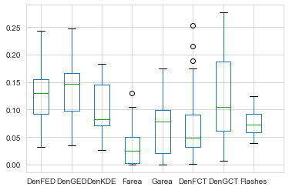
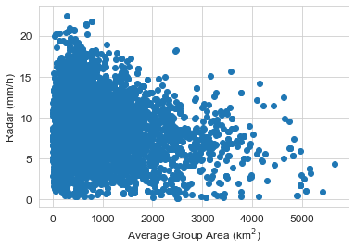
On the use of Geostationary Lightning Mapper data as proxy for heavy precipitation
Radar versus GLM
Analysis for watersheds - relation between products
Outline
Relationship GLMxRadar is better than GLMxGauges (slide 8)
Inverse relation for Flash /Group Area might be useful to improve multiple regression models
Group Density (logscale) shows the best relationship with radar
Motivation
Background
Material and methods
Results
Overview
Radar x Gauges
Radar x GLM
Final remarks
R² (GLM x Radar) distribution for many watersheds and for each GLM variable (lower axis)

Slide 13
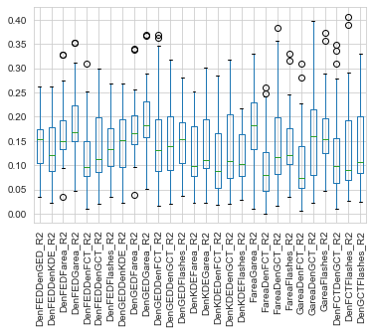
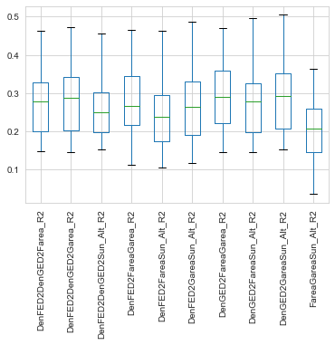
On the use of Geostationary Lightning Mapper data as proxy for heavy precipitation
Radar versus GLM
Analysis for watersheds – multiple variables
Outline
Multiple regression suggested: Log(Group Density) + Group Area + Solar Elevation (Day/Night condition)
R2 improved by 50% compared to a single variable.
Motivation
Background
Material and methods
Results
Overview
Radar x Gauges
Radar x GLM
Final remarks

Slide 14
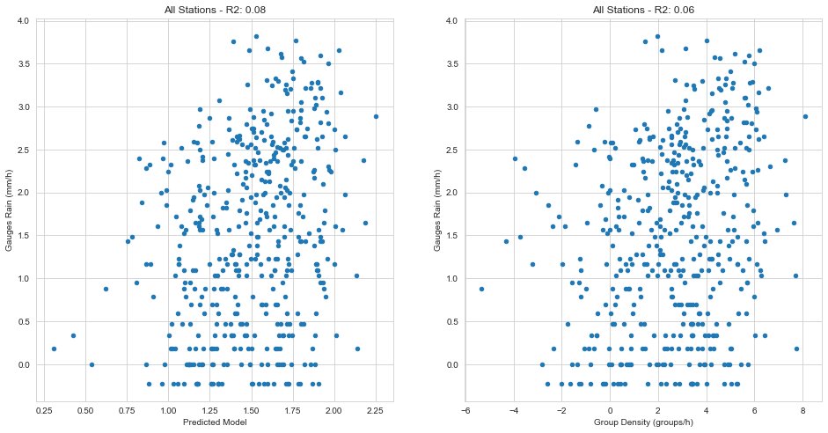
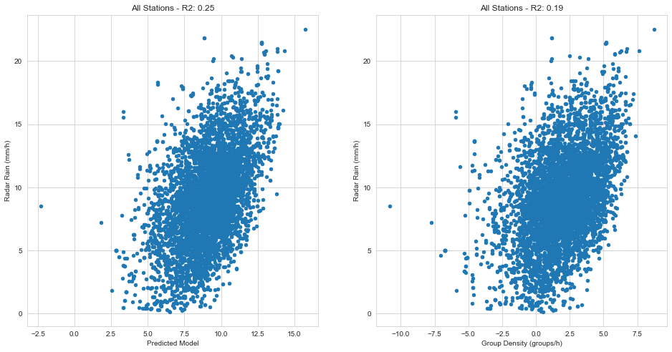
On the use of Geostationary Lightning Mapper data as proxy for heavy precipitation
Radar versus GLM
Analysis for gauges and watersheds – multiple variables
Outline
Multiple regression suggested: Log(Group Density) + Group Area + Solar Elevation (Day/Night condition)
R2 improved by 25% compared to a single variable.
Motivation
Background
Material and methods
Results
Overview
Radar x Gauges
Radar x GLM
Final remarks
Gauges
Watersheds

Slide 15
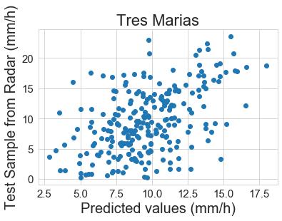
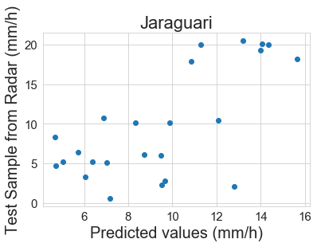
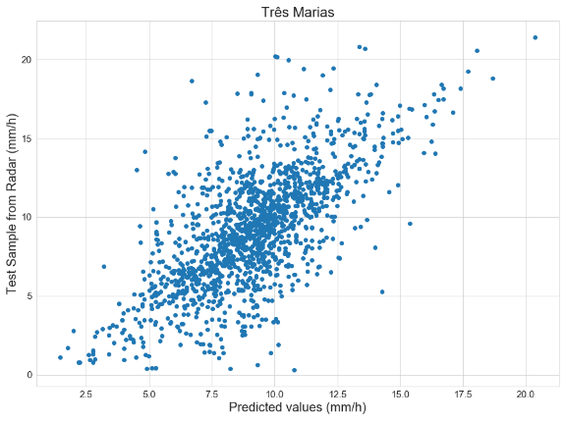
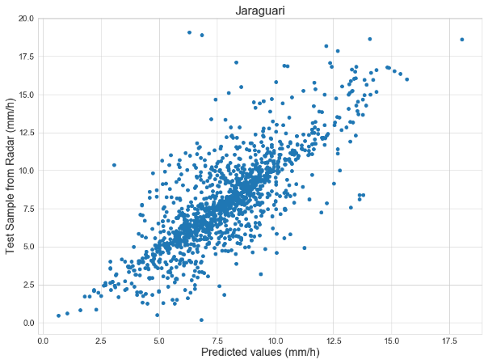
On the use of Geostationary Lightning Mapper data as proxy for heavy precipitation
Radar versus GLM
Analysis for gauges and watersheds – multiple variables
Outline
Random Forest applied to the variables using radar
Relation (and N) is lower for gauges than over watersheds
Motivation
Background
Material and methods
Results
Overview
Radar x Gauges
Radar x GLM
Final remarks
MSE: 21.02
R2: 0.24
Importance:
DenGED: 0.37
Garea: 0.35
Sun_Alt : 0.29
MSE: 25.12
R2: 0.44
Importance:
DenGED: 0.43
Garea: 0.32
Sun_Alt: 0.25
Gauges
MSE: 6.88
R2: 0.48
Importance:
DenGED: 0.44
Garea: 0.3
Sun_Alt: 0.26
MSE: 3.59
R2: 0.61
IMportance:
DenGED : 0.46
Garea: 0.28
Sun_Alt : 0.26
Watersheds

Slide 16
On the use of Geostationary Lightning Mapper data as proxy for heavy precipitation
Final Remarks
Outline
Radar and gauges relationship is good considering a LOG scale
GLM is better related to radar than gauges possibly due to GLM pixel size limitation (originally ~8km);
Relationship increases when considering values averaged over the watershed areas;
General low relationship probably associated with the flash duration and flash rate trade-off (as discussed in Zhang and Cummins 2020): some severe systems seem to present less flashes than expected;
The join flash area and group density analysis seems promising, bearing in mind that smaller areas maybe more related to more intense thunderstorms
Next steps:
Evaluate the predicted models (regression and RF) with a hydrological model;
Extend the analysis over a larger dataset to confirm or improve the results.
Motivation
Background
Material and methods
Results
Final remarks

Slide 17
On the use of Geostationary Lightning Mapper data as proxy for heavy precipitation
Final remarks
Outline
Mentioned references:
Zhang, D., & Cummins, K. L. ( 2020). Time evolution of satellite‐based optical properties in lightning flashes, and its impact on GLM flash detection. Journal of Geophysical Research: Atmospheres, 125, e2019JD032024. https://doi.org/10.1029/2019JD032024
Minjarez-Sosa, C.M., C.L. Castro, K.L. Cummins, J. Waissmann, and D.K. Adams, 2017: An Improved QPE over Complex Terrain Employing Cloud-to-Ground Lightning Occurrences. J. Appl. Meteor. Climatol., 56, 2489–2507, https://doi.org/10.1175/JAMC-D-16-0097.1
Xu, W., R.F. Adler, and N. Wang, 2013: Improving Geostationary Satellite Rainfall Estimates Using Lightning Observations: Underlying Lightning–Rainfall–Cloud Relationships. J. Appl. Meteor. Climatol., 52, 213–229, https://doi.org/10.1175/JAMC-D-12-040.1
Zhou, Y., Qie, X., and Soula, S.: A study of the relationship between cloud-to-ground lightning and precipitation in the convective weather system in China, Ann. Geophys., 20, 107–113, https://doi.org/10.5194/angeo-20-107-2002, 2002.
Bruning, E., Tillier, C. E., Edgington, S. F., Rudlosky, S. D., Zajic, J., Gravelle, C., et al. ( 2019). Meteorological imagery for the geostationary lightning mapper. Journal of Geophysical Research: Atmospheres, 2019; 124: 14285– 14309. https://doi.org/10.1029/2019JD030874
Morales, C.A. and E.N. Anagnostou, 2003: Extending the Capabilities of High-Frequency Rainfall Estimation from Geostationary-Based Satellite Infrared via a Network of Long-Range Lightning Observations. J. Hydrometeor., 4, 141–159, https://doi.org/10.1175/1525-7541(2003)4<141:ETCOHR>2.0.CO;2
Tapia, A., J.A. Smith, and M. Dixon, 1998: Estimation of Convective Rainfall from Lightning Observations. J. Appl. Meteor., 37, 1497–1509, https://doi.org/10.1175/1520-0450(1998)037<1497:EOCRFL>2.0.CO;2
Acknowledgments:
The authors would like to thank the Brazilian Agency CAPES for the financial support (process n. 88887.466472/2019-00).
Motivation
Background
Material and methods
Results
Final remarks

