Slide 1
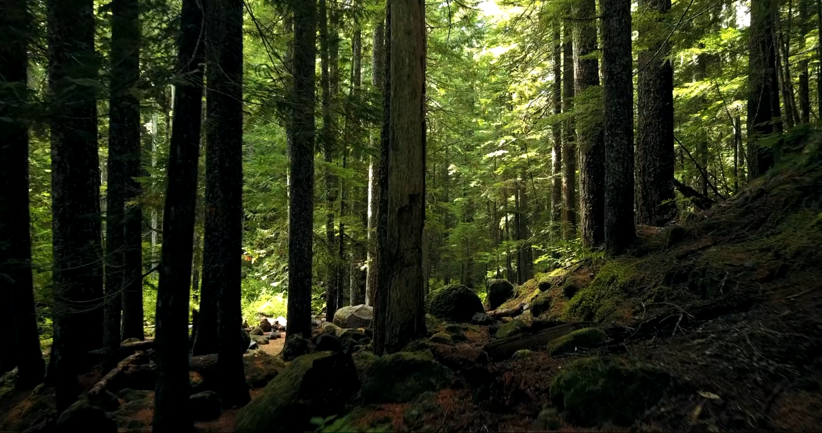
The Italian TREETALKER NETWORK (ITT-Net)
continuous large scale monitoring of tree functional traits and vulnerabilities to climate change

Slide 2
The ITT-NET project aims to respond to one of the grand societal challenges: the impact of climate changes on forests ecosystem services.
To address this problem we use an innovative Internet of Things (IoT) wireless technology (TreeTalker) to monitor, at large spatial scale and with a fine temporal resolution, tree physiological parameters related to water transport, tree growth, foliage development and tree stability.
This large network of 400 individual trees (30 forest plots) is a unique and unprecedented worldwide example of real time monitoring of individual tree biological responses at regional scale.
This allow us to relate, from hourly, daily, seasonal to inter-annual frequency, the causal dependency of climate events and environmental disturbances with tree functionality and resilience.

Slide 3
The Partnership
University of Tuscia (R. Valentini – coordinator)
University of Bolzano (G. Tonon)
Mach Foundation (D. Gianelle)
University of Florence (C. Cocozza)
University of Molise (R. Tognetti)
University of Campania (G. Battipaglia)
University of Palermo (T. La Mantia)

Slide 5
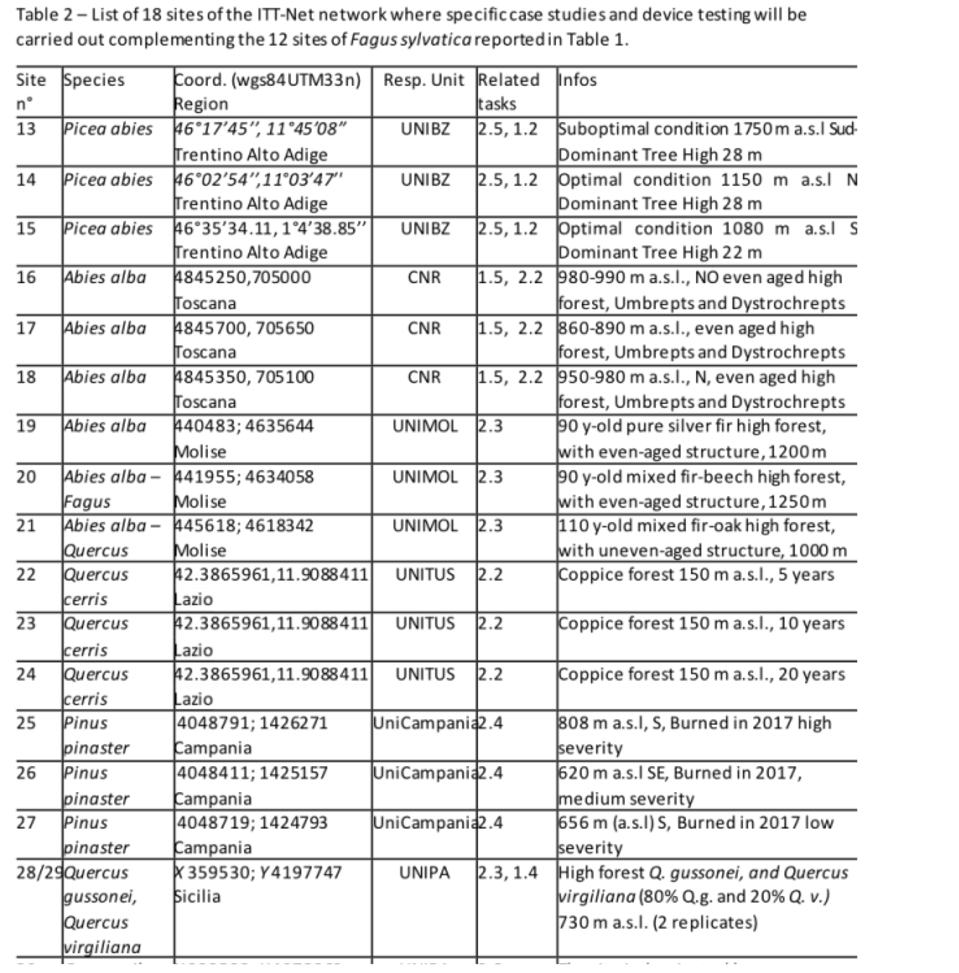

Slide 6
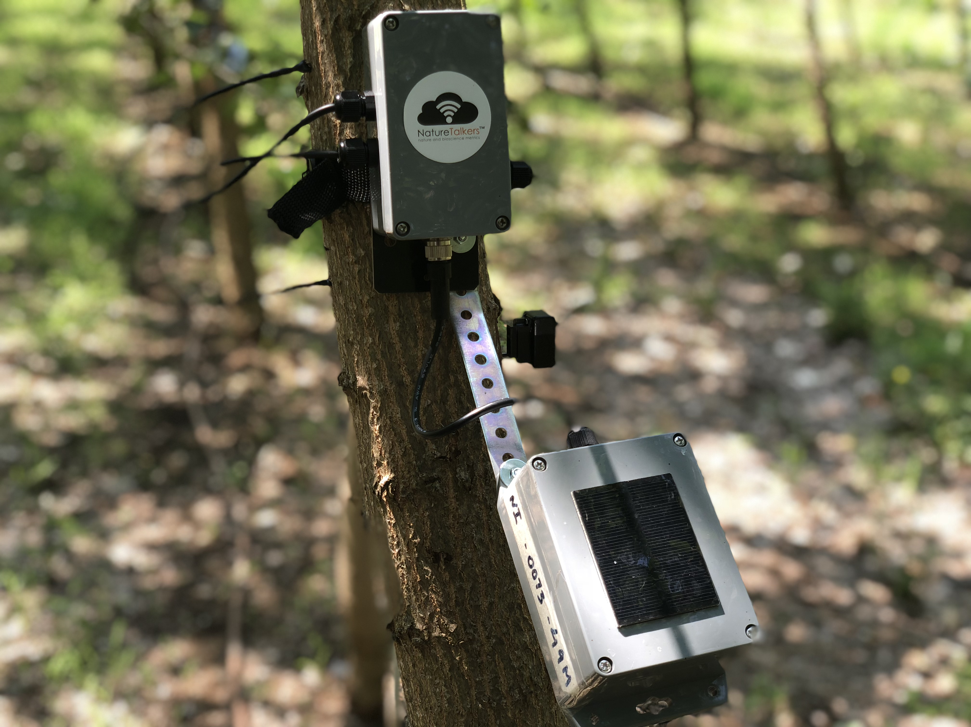



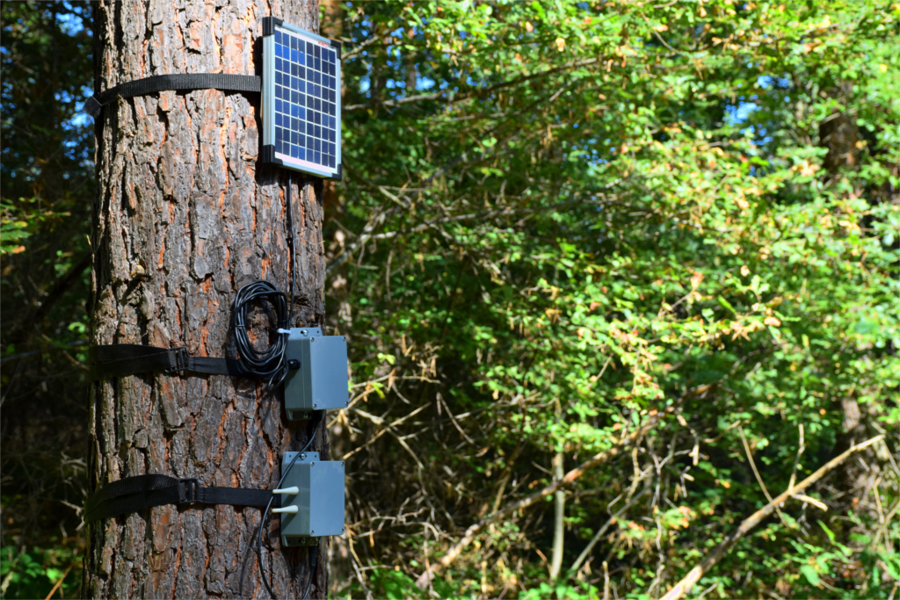
The TreeTalker®
12 bands spectrometer
LoRa transceiver
IR radial growth sensor
Accelerometer sensor
Cache memory for data storage and external download
Modular probes for sap flow and stem humidity
Connector to long life batteries or solar panel

Slide 7
To know more about TreeTalker technology go to:
EGU2020-12895 | New approaches in tree phenomics using IoT technologies and AI machine learning : the TreeTalker network Riccardo Valentini

