Slide 1
MODEL ADEQUACY TESTS FOR IMPROVING PREDICTIONS IN UNGAUGED BASINS
Cristina Prieto, Nataliya Le Vine, Dmitri Kavetski, César Álvarez, and Raúl Medina
Prieto C, Le Vine N, Kavetski D, et al. ( 2019)
Flow prediction in ungauged catchments using probabilistic Random Forests regionalization and new statistical adequacy tests.
Water Resources Research, 55. https://doi.org/10.1029/2018WR023254

Slide 2
Introduction
Objective
Method and Data
Results
Conclusions

Slide 3
Introduction
Introduction
Objective
Method and Data
Results
Conclusions

Slide 4
Water management & the economy based on it depend on making reliable predictions of available water resources

Slide 5
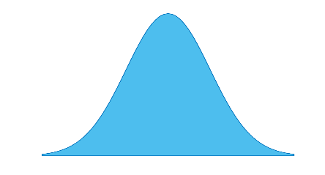
SOURCES OF UNCERTAINTY
INPUT (e.g. rainfall, PET)
MODEL PARAMETERS
perfect data assumption
extensively reported
COMMON PRACTICE:
USE A PRE-SELECTED HYDROLOGICAL & REGIONALIZATION MODEL
WITHOUT TESTING THEIR ADEQUACY
MODEL & DATA > PARAMETRIC
MODEL HARDEST TO CHARACTERIZE
one-size-fits-all assumption
MODEL STRUCTURE
SIMULATED HIDROLOGICAL INDICES
(e.g. mean anual flow)
OBSERVATIONS TO EVALUATE METHODS
(e.g. streamflow)
REGIONALIZED INDICES
uncertainty in hydrological indices,
regionalization procedure, catchment descriptors; etc

Slide 6
Introduction
Method and Data
Results
Conclusions
2. Objective

Slide 7
1
Improve Bayesian predictions in ungauged catchments: treatment of hydrological indices
2
Develop statistical tests to evaluate a priori
hydrological & regionalization models adequacy
If a model is inadequate a priori =>
the modeler is spared the effort
in estimating model parameters
2
2
3
1
3
Assess model adequacy tests:
Identify main source of uncertainty?
3
=>Is the hydrological model or regionalization procedure?

Slide 8
Introduction
Objective
Results
Conclusions
3. Method and Data

Slide 9
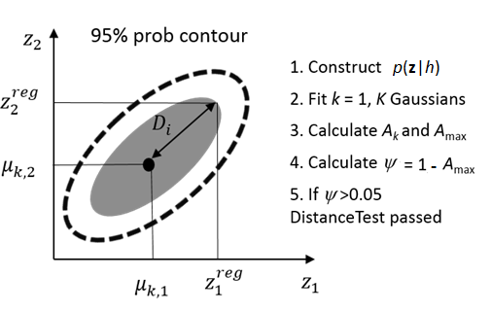
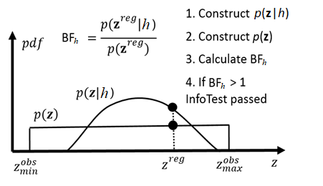
ADEQUACY TEST:
A model is adequate if it passes DistanceTest & InfoTest
InfoTest
Quantifies information added by a model w.r.t. prior knowledge
e.g. H_{o} : Does the hydrological model h add information about $z_{}^{reg}$ beyond our prior knowledge?
DistanceTest
Quantifies ability of a model (hydrological or regionalization) to reproduce available hydrological info
e.g. H_{o}: Is the hydrological model h likely to reproduce $z_{}^{reg}$ ?

Slide 10
CASE STUDY DESCRIPTION
92 natural gauged catchments in North Spain
103 hydrological indices
e.g. mean & standard deviation of annual and monthly flow
PCA to reduce hydro indices to a compact set = flow index PCs
3. 16 catchment descriptors
climate, topography, basin geometry, land use and geology
4. Random Forest (RF) regression to regionalize flow indices
Predictors = catchment descriptors
Predictands = flow indices in PC space
Residuals distribution estimated via a leave-one-out strategy
5. Hydrological model: PDM (Moore, 2007)
conceptual lumped model common in research/operational work
Moore RJ The PDM rainfall-runoff model, HESS 11 483–499, https://doi.org/10.5194/hess-11-483-2007.

Slide 11
CASE STUDY SCENARIOS
Sce 0: Assumes $z_{}^{obs}$ is available
Allow checking regionalization model & hydrological model
Sce 1: Base Case: Intended usage of the framework
PDM forced with observed inputs.
Regionalized flow index PCs $z_{}^{reg}$ via Random Forest
Sce 2: Improved Regionalization model
PDM forced with observations + accurate & noise reduced regionalization
Sce 3: Perfect Hydrological model & Realistic Regionalization model
PDM is replaced by observations of flows + regionalization model = Sce 1
Sce 4: Perfect Hydrological model & Improved Regionalization model
PDM is replaced by observations of flows + regionalization model = Sce 2
Sce 2-4 investigate:
what happens if we improve different model components?

Slide 12
Introduction
Objective
Method and Data
Conclusions
Results

Slide 13
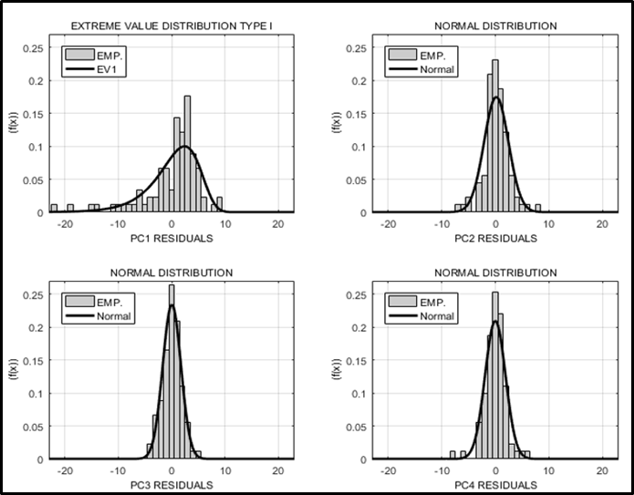
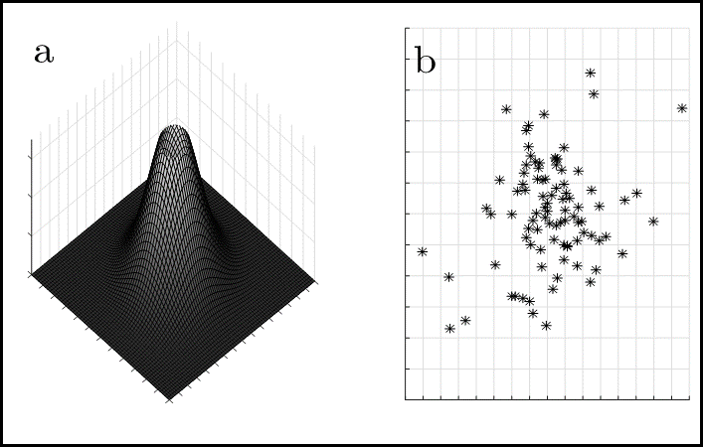
REGIONALISATION OF FLOW INDEX PCs
4 PCs explain 88% of total variability: 63%, 12%, 7%, and 5%
Regionalization precision: between 10% and 16%
Residual errors of regionalization model and corresponding (empirical) likelihood functions are shown below

Slide 14
MODEL ADEQUACY TESTS: PCs SPACE
Sce 0: $z_{}^{obs}$ is available - proof of concept
Regionalization model passes the adequacy test for $z_{}^{obs}$ in 12/16 catchments
Hydrological model passes the adequacy test for $z_{}^{obs}$ in 3/16 catchments
Sce 1: $z_{}^{reg}$ is available. Intended usage of the framework
Hydrological model passes the adequacy test for $z_{}^{reg}$ in 1/16 catchments
Sce 2: Regionalization model is improved
Hydrological model does not pass adequacy test for $z_{}^{reg}$ in any catchment
Sce 3: Hydrological model is perfect
Hydrological model passes adequacy test for $z_{}^{reg}$ in 7/16 catchments
Sce 4: Hydrological model is perfect + Regionalization model is improved
Hydrological model passes the adequacy test for $z_{}^{reg}$ in 12/16 catchments
Adequacy tests tell: hydrological model is the main source of uncertainty

Slide 15
PREDICTION QUALITY IN FLOW SPACE
Hydrological model error precludes an improvement in flow predictions even if the regionalization model is improved (Sce 2)
The results are assessed via
a) NSE_{prob}
b) Coverage of 95% prob lim
Sce1
Sce2
Catchment where hydro model passes the adequacy test in Sce 1
Catchment that passes the adequacy test
Sce 1: $z_{}^{reg}$ is available. Intended usage of the framework
Sce 2: Regionalization is improved

Slide 16
PREDICTION QUALITY IN FLOW SPACE
Hydrological model error precludes an improvement in flow predictions even if the regionalization model is improved (Sce 2)
The results are assessed via
a) NSE_{prob}
b) Coverage of 95% prob lim
Sce1
Sce1
Sce2
Sce2
Catchments where hydro model fails adequacy tests in Sce 1
Sce 1: $z_{}^{reg}$ is available. Intended usage of the framework
Sce 2: Regionalization is improved

Slide 17
PREDICTION QUALITY IN FLOW SPACE
When there is no hydrological model error (Sce 3), improved regionalization results (Sce 4) in better flow predictions
The results are assessed via
a) NSE_{prob}
b) Coverage of 95% prob lim
0
Sce3
Sce4
Catchments where hydro model passes adequacy tests in Sce 3
Adeqacy tests are necessary but insufficient condition for a model be capable to predict streamflow
0
Sce 3: Perfect hydrological model

Slide 18
PREDICTION QUALITY IN FLOW SPACE
When there is no hydrological model error (Sce 3), improved regionalization results (Sce 4) in better flow predictions
The results are assessed via
a) NSE_{prob}
b) Coverage of 95% prob lim
0
Sce3
Sce4
0
Catchments that do not pass the adequacy test in Sce 1
Sce 3: Perfect hydrological model
Sce 4: Perfect hydrological model
& improved regionalization procedure

Slide 19
PREDICTION QUALITY IN FLOW SPACE
Leizaran catchment, Basque Country: Hydrological model passes adequacy test

Slide 20
PREDICTION QUALITY IN FLOW SPACE
Leizaran catchment, Basque Country: Hydrological model passes adequacy test
When hydro model is adequate in Sce 1, improving regionalization (eg, Sce 2) does not make a big difference in the performance of predictions

Slide 21
PREDICTION QUALITY IN FLOW SPACE
Leizaran catchment, Basque Country: Hydrological model passes adequacy test
When hydrological model is perfect & regionalization is improved (Sce 4) => improve in NSprob & 95% prob

Slide 22
Introduction
Objective
Method and Data
Results
5. Conclusions

Slide 23
CONCLUSIONS
Hydrological index space reduced via PCA & broken stick method
sufficient information for regionalization using Random Forests regression
2. New adequacy tests for hydrological and regionalization models
DistanceTest: can a model reproduce the flow PCs?
InfoTest: how much new information is added by the model?
Can guide the model improvement process
If a hydrological model passes adequacy test
=>improve regionalization model to improve flow predictions
If Hydro model fails adequacy test
=>improving regionalization model will not improve flow predictions!
Necessary but insufficient condition for a model be able to predict streamflow
Some key case study results
4 PCs sufficient to summarise 103 hydrological indices
Priority should be given to improving the hydrological model and its inputs

Slide 24
THANK YOU FOR YOUR ATTENTION
prietoc@unican.es
Prieto C, Le Vine N, Kavetski D, et al. ( 2019)
Flow prediction in ungauged catchments using probabilistic Random Forests regionalization and new statistical adequacy tests.
Water Resources Research, 55. https://doi.org/10.1029/2018WR023254
“Everything is Uncertain and
Everything Changes”

