Slide 1


ENHANCING GEODIVERSITY IN THE MATESE REGIONAL PARK (SOUTHERN ITALY) USING DPSIR MODEL
Online | 4–8 May 2020
GM12.1/EOS6.3 Essential variables influencing geodiversity: contributions to geoheritage in response to global change
Magliulo P., Russo F., Valente A.
Dipartimento di Scienze e Tecnologie, Università del Sannio (Benevento), Italia

Slide 2
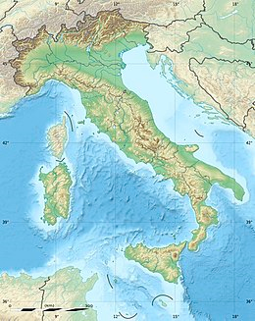
MATESE REGIONAL PARK (SOUTHERN ITALY)
… is located in the center of Italian peninsula on an area of more than 33,300 hectares.
… was established with regional law in 1993, but its transformation into a National Park is underway.
The territory of the park mainly includes the Matese mountain massif with its peaks reaching 2000 m.

Slide 3
DPSIR model for evaluation of the geodiversity in the Matese Regional Park
Direct stresses from the anthropic system to …
Quantity and quality of geological resources
STATE
IMPACTS
RESPONSES
DRIVERS
PRESSURES
Effects on the anthropic system due to changes in …
Anthropic activities and processes …
Actions of the anthropic system to solve problems …

Slide 4
Main environmental indicators for DPSIR
Geosites
Soil erosion Groundwater Seismogenetic faults
Vandalism/Abusiveness
Floods and landslides
Less water available
Seismic Effects
Regional Policy Planning guidance Monitoring Educational programme
Tourism Animal breding Agricolture Food and Wine
Climate change
Point source pollution
Use of water resources
Land use changes

Slide 5
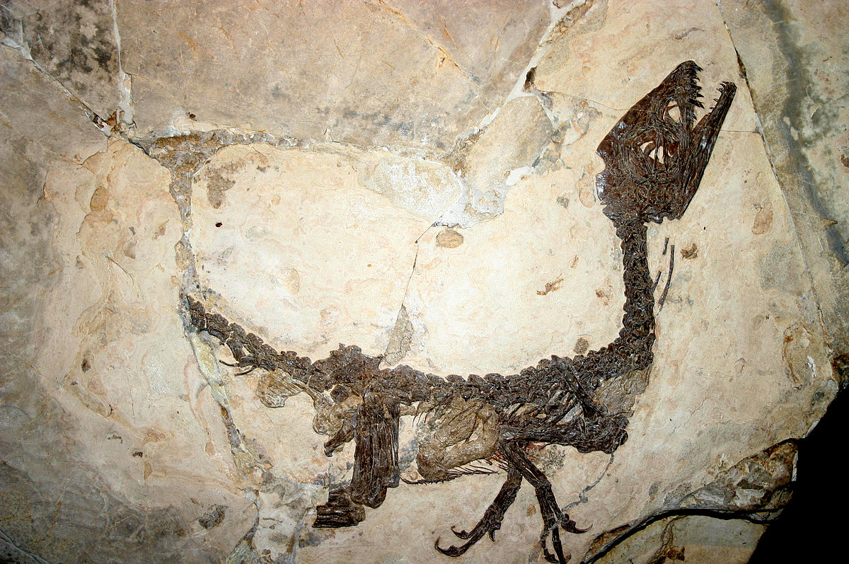
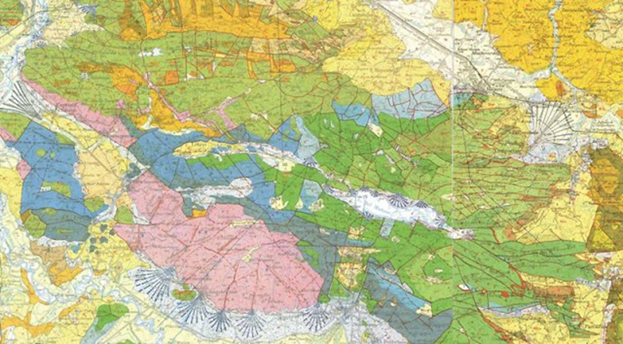
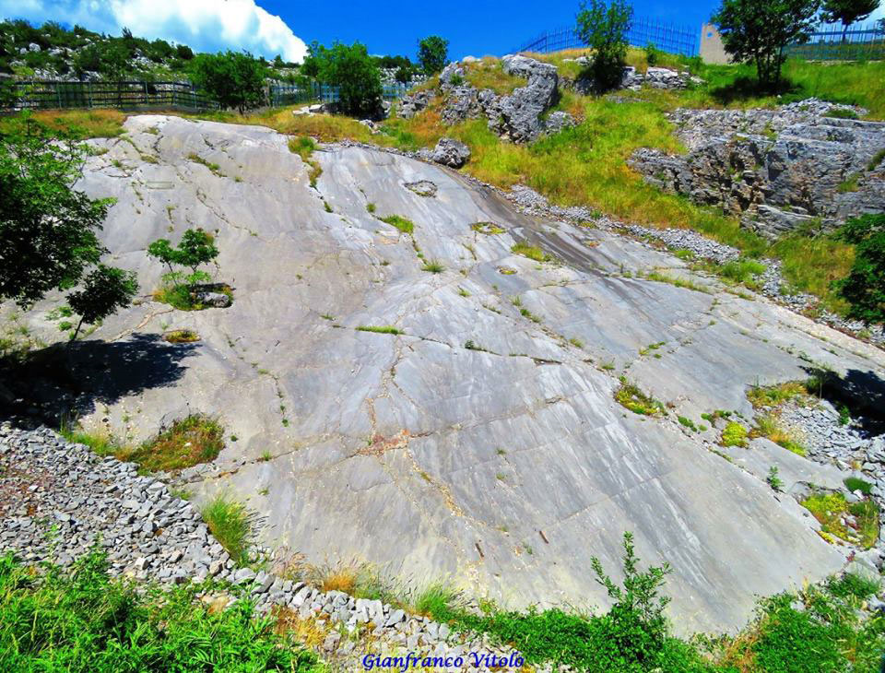
Most relevant indicators for STATE
In the Mesozoic shallow marine carbonate succession, which mostly built the Matese Mts., exceptional fossils are present
e.g. Scipioniyx samniticus: a dinosaur cub
Outcrop of the fossiliferous deposit

Slide 6
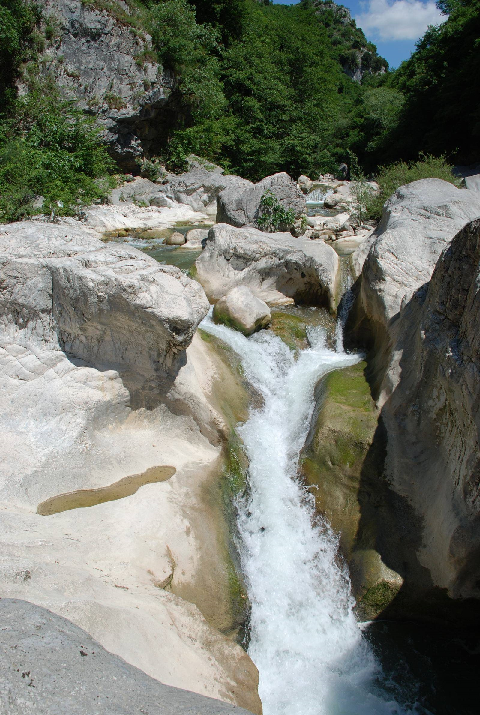
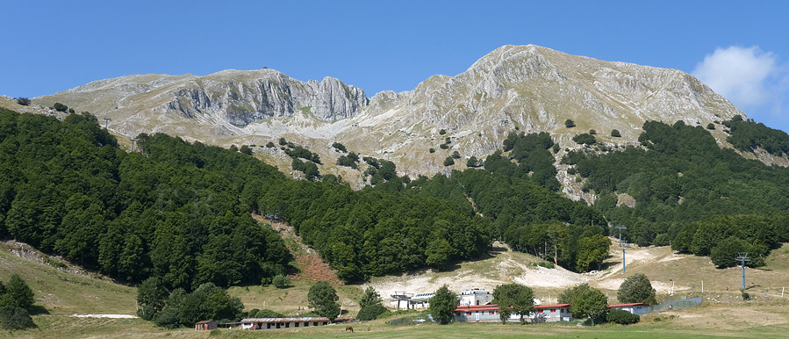
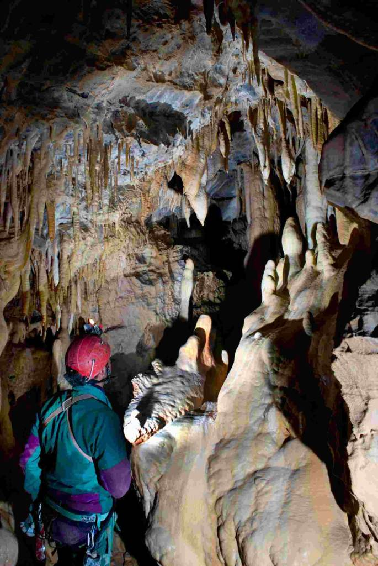
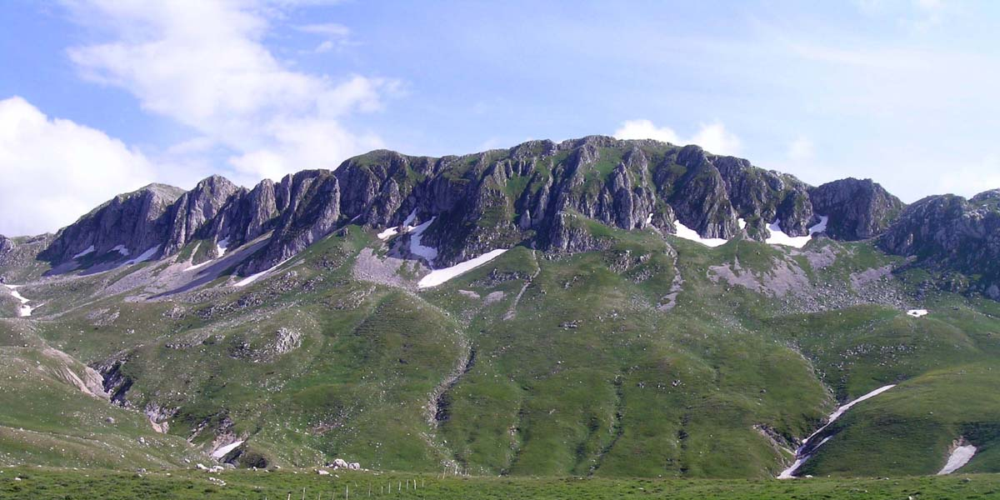
… in the STATE could be also relevant…
A
D
B
C
In the Matese landscape are visible fluvial (A), glacial (B), slope (C) and karst morphotypes (D)…

Slide 7
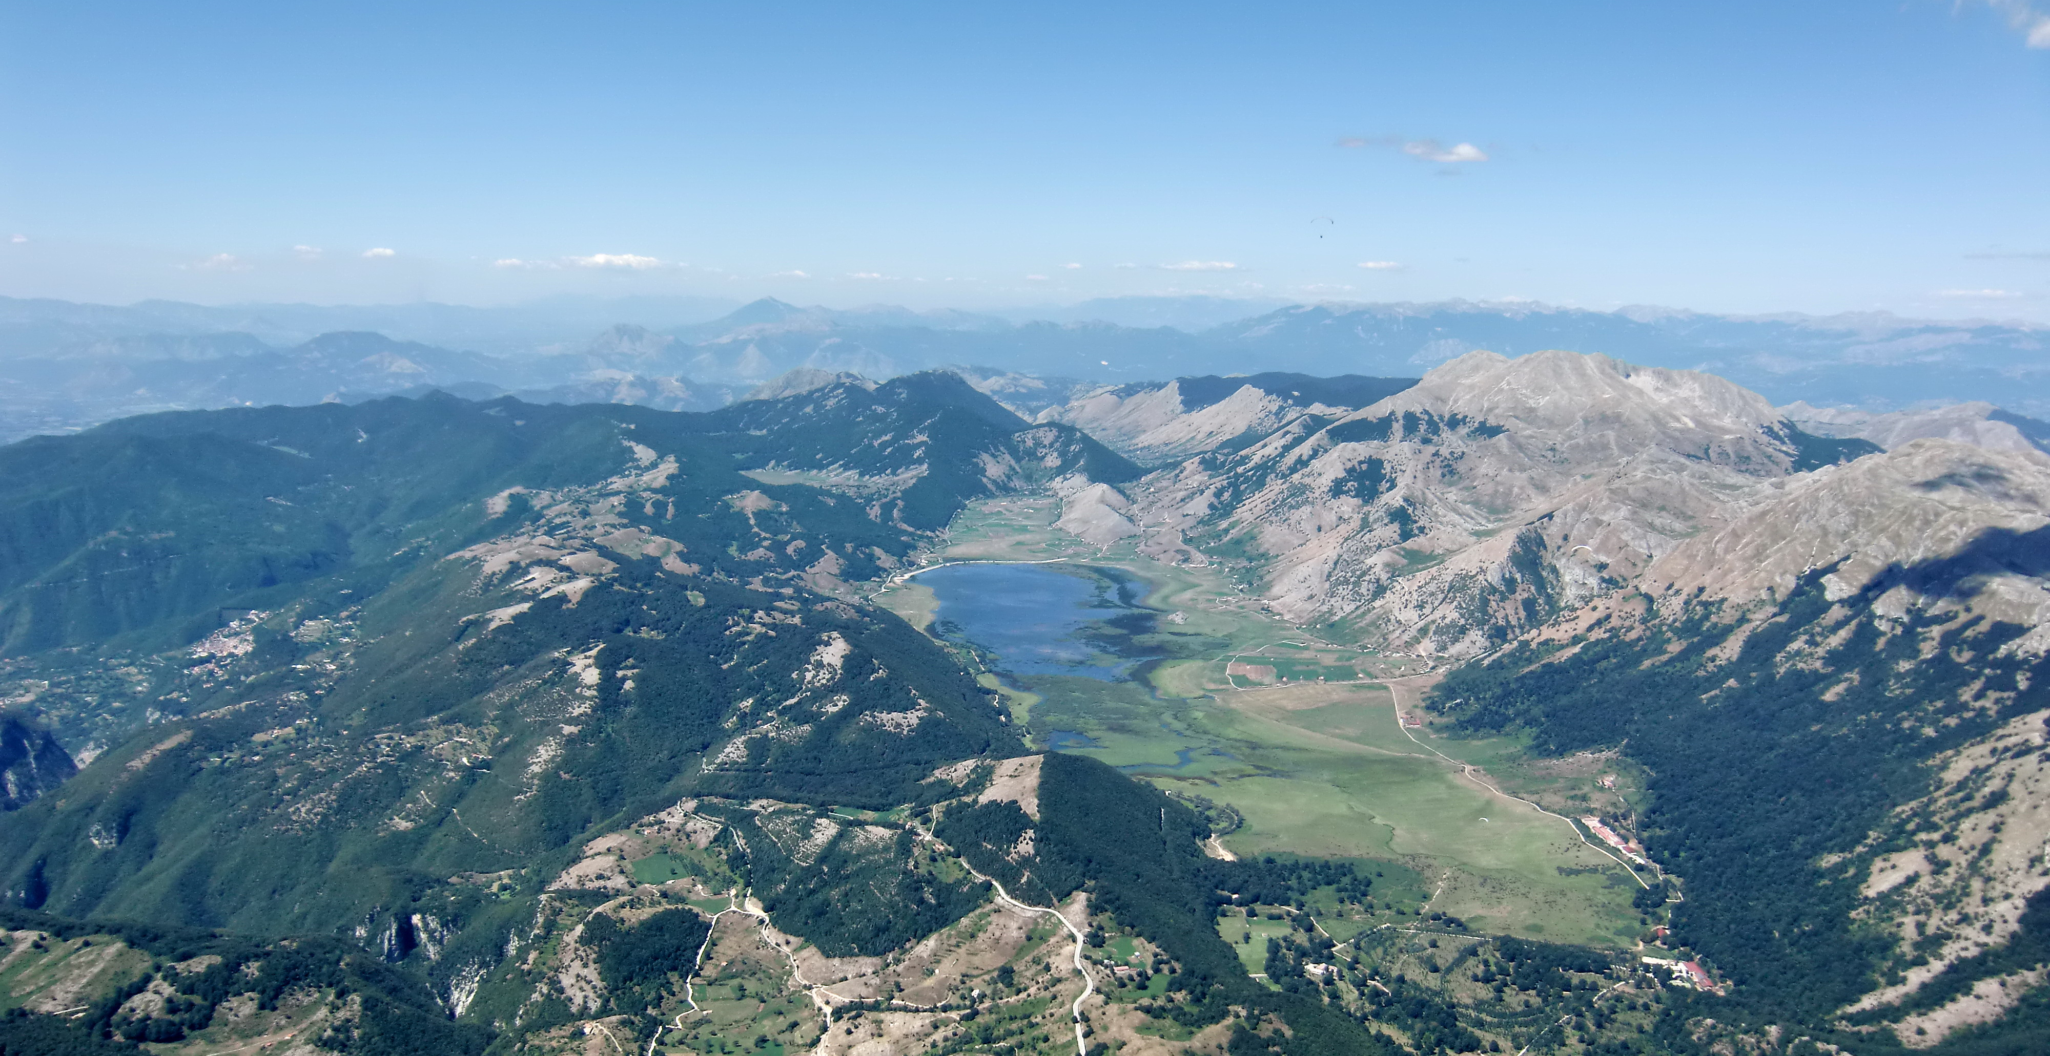
Most relevant indicators for STATE
Matese Lake polje
The great diffusion of the karst phenomena, both epigean and hypogean, has contributed to fuelling an underground water circulation important for quantity and quality.
Several springs placed at the base of the reliefs have been exploited for domestic, agricultural, livestock uses and even for energy production…

Slide 8
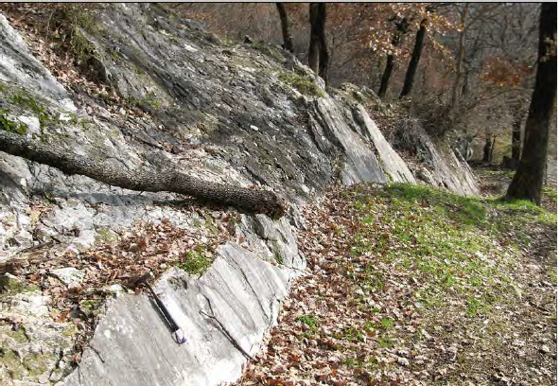
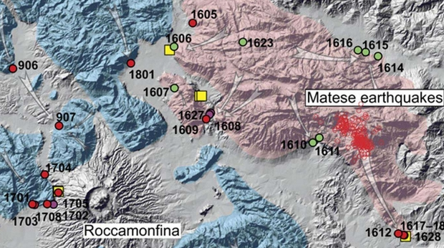
Most relevant indicators for STATE
Several outcrops show evidence of Quaternary to late Quaternary activity of normal faults. Some of them in the north-eastern area are responsible of the most recent events.
e.g. Fault in Prata Sannita (SW area of Matese Mts.)
… provoke, cause IMPACTS

Slide 9
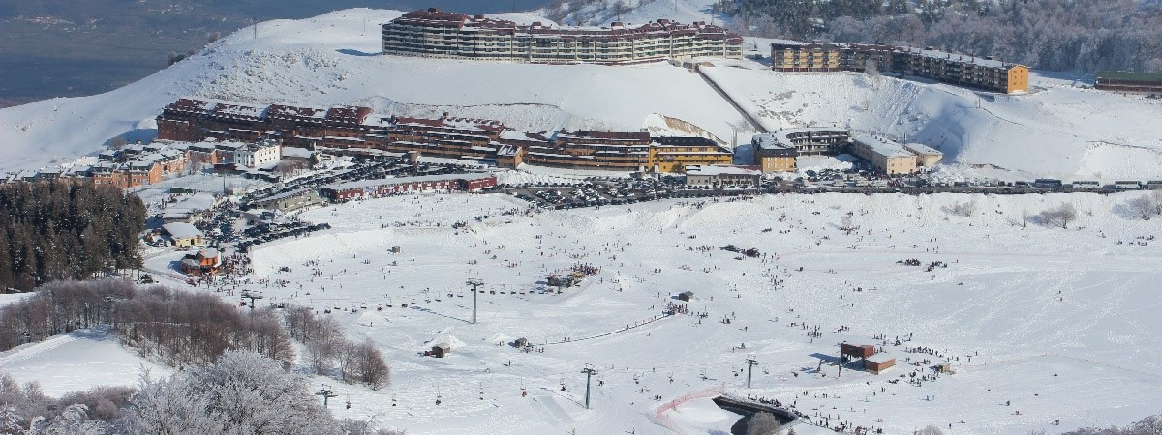
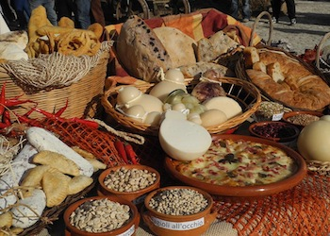
DRIVING FORCES in the Matese area
Sports and environmental tourism represent an important resource
The meat of sheep, cattle and pigs from the Matese pastures are recognized for their high quality as well as all milk derivatives. These products are often enjoyed directly in the production places.
… generate PRESSURES

Slide 10
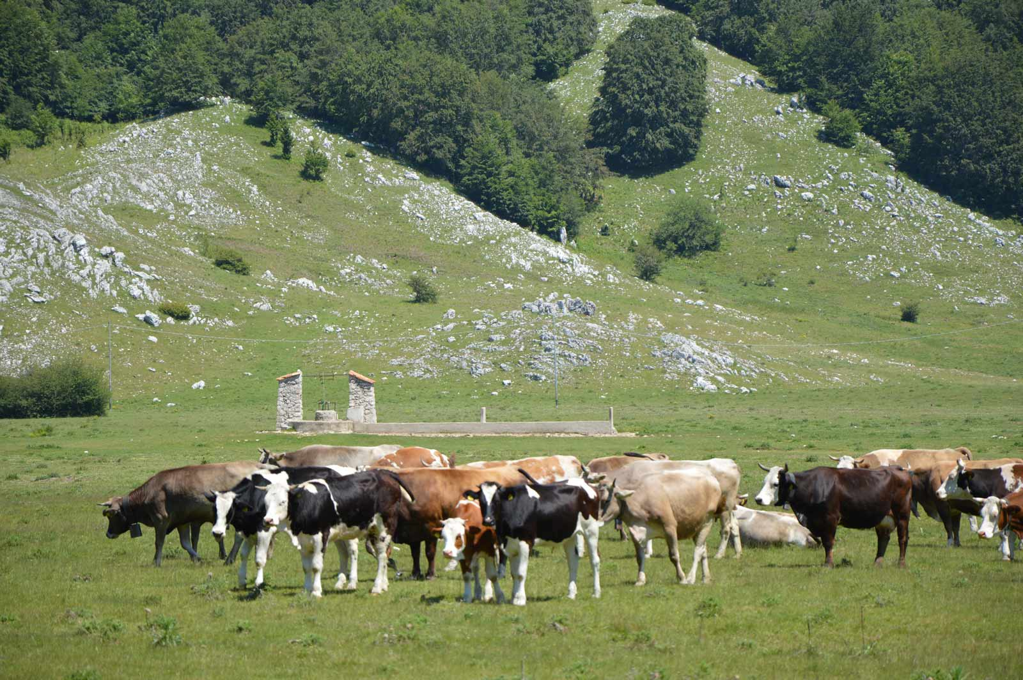
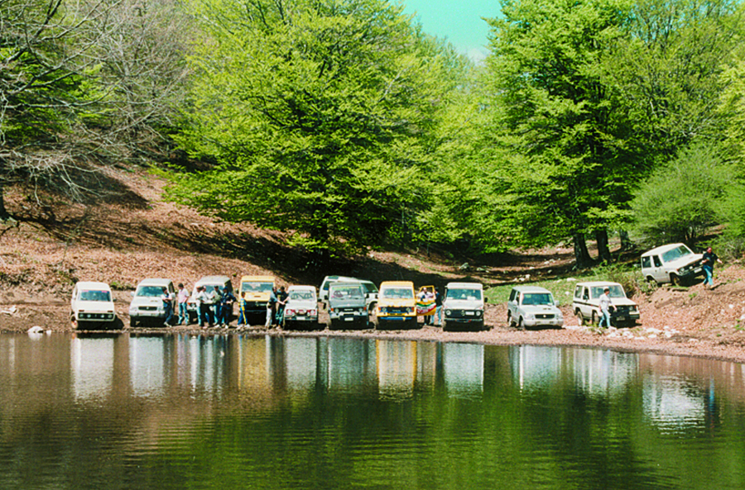
Highest PRESSURE … for the geodiversity of Matese
Phenomena of microbiological pollution, induced by grazing of cattle and use of organic fertilizers in agriculture, favored by the high vulnerability of the Matese groundwater
Recreation outside the tourism system, without any control
… influence, modify STATE

Slide 11
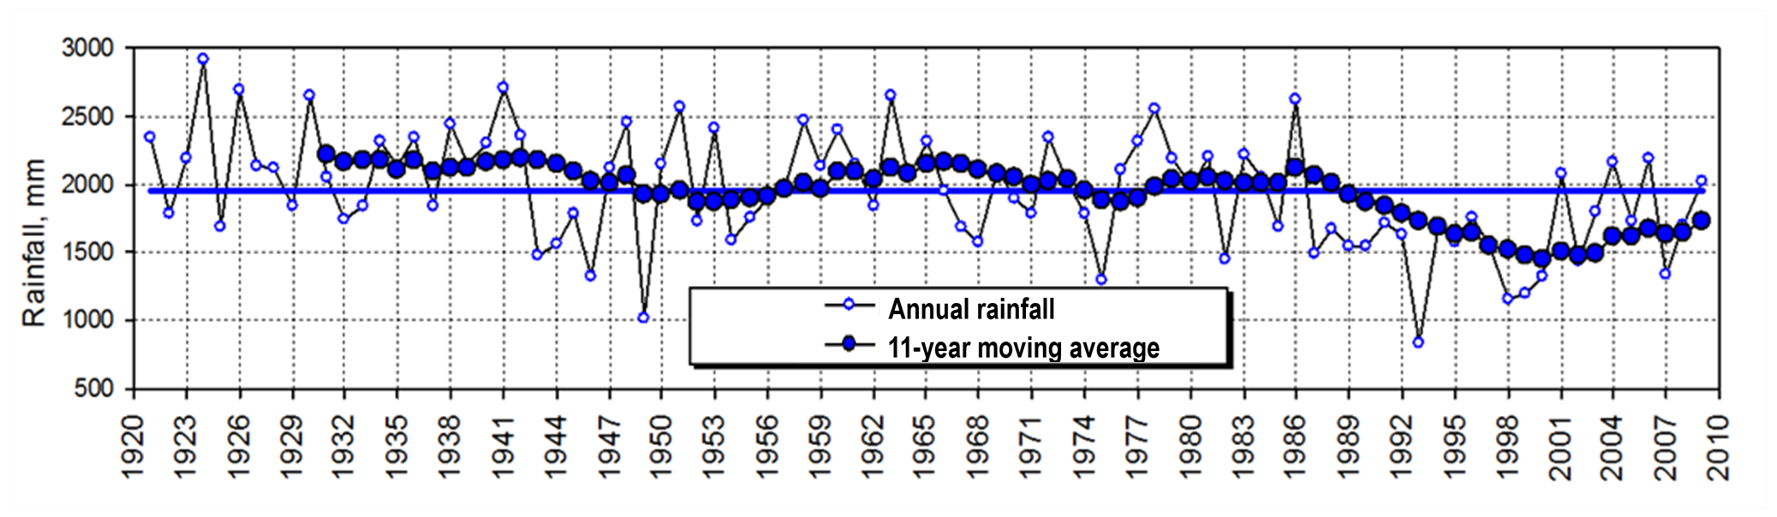
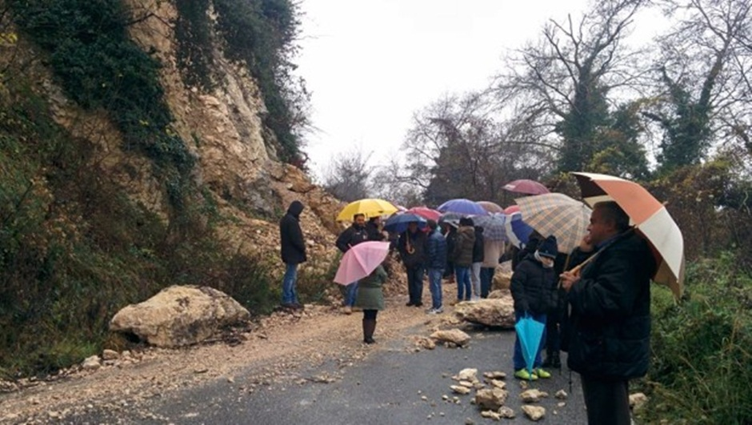
Main IMPACTS … for the geodiversity of Matese
Increasing temperatures and especially decreasing rainfall tend to modify the available quantity of groundwater …
Falls/topples from the limestone successions and slides/flows in the arenaceous-clay successions affect the access and the infrastructures to the park area and sometimes residences ...
… stimulate, ask for RESPONSES

Slide 12
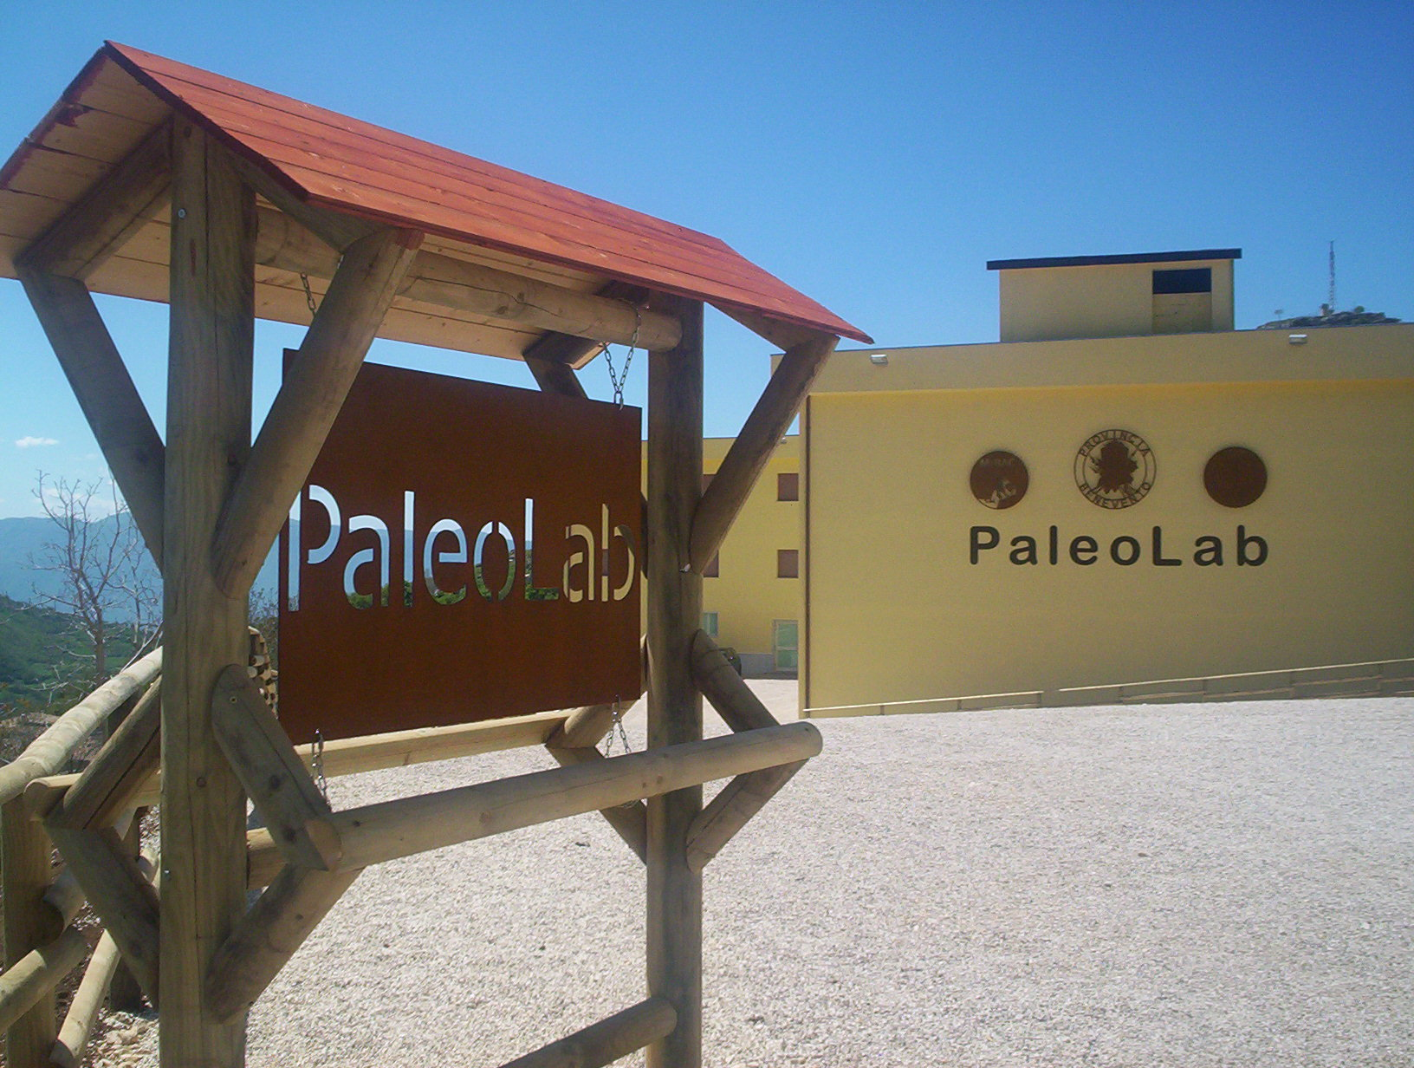
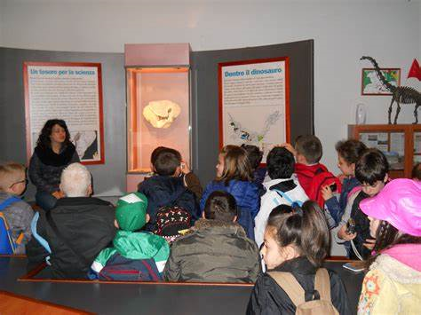

RESPONSES to enhance … the geodiversity of Matese
The Regional Park of Matese represents the main response to the protection and sustainable development of a natural territory, which includes a relevant geological heritage. Park planning, as well as regional program, will be able to preserve and manage this heritage in an integrated way.
PaleoLab is a geo-paleontological park with its museum built in the fossil deposit where the dinosaur cub was found with other fishes, reptiles and amphibians
In addition to prevent vandalism, this park promotes educational programs, starting from primary schools, and researches, involving scientists from all over the world.

Slide 13
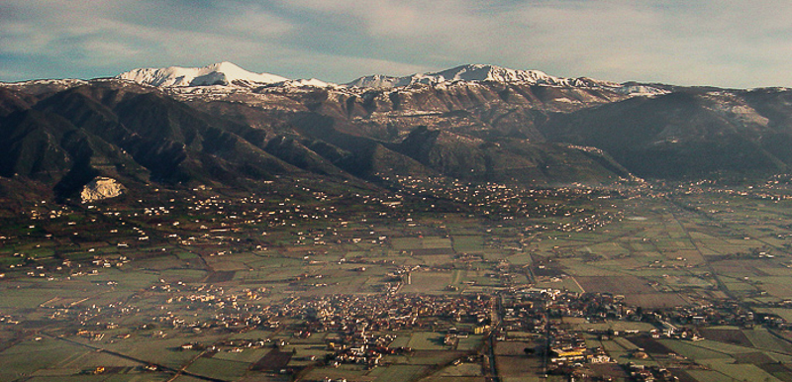
Conclusions
The geodiversity of the Matese Regional Park is somewhat varied in scientific, aesthetic and educational terms. In order to recognize its importance in a territorial context, the DPSIR method has been developed. Therefore, we assessed: the pressures to which this geological heritage is subject, also for climate changes, and the impacts that can prevent their conservation or even their use. However, some responses, already implemented, may make this geodiversity a driving force for the territory.

