Slide 1
EGU 5th of May 2020
10:45 – 12:30 live chat
High frequency water isotopes records during glacial/interglacial cycles on EPICA Dome C ice core.
LSCE: Antoine Grisart, Amaelle Landais, Frederic Prié, Bénédicte Minster, Elise Fourré, Jean Jouzel, Valérie Masson-Delmotte, Katy Pol
Alfred-Wegener-Institut : Mathieu Casado, Thomas Laepple, Maria Hörhold
University of Copenhagen: Vasileios Gkinis, Bo Vinther, Trevor Popp
University Venice: Barbara Stenni

Slide 2
Outline
Compilation of available high resolution δD and δ¹⁸O profiles over the EPICA Dome C (EDC) ice core (published and unpublished / old and new data).
Basic spectral analyses on some sections
  -> diffusion length

Slide 3
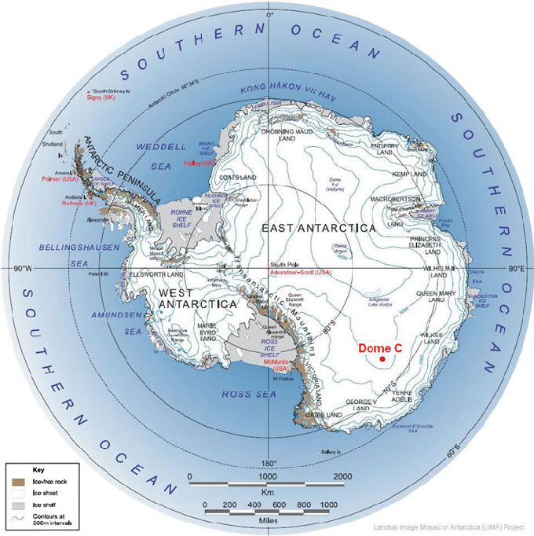
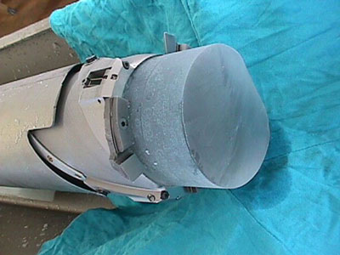
EPICA Dome C ice core location in Antarctica
The core is 3200 m long
And present a 800 ka continuous record

Slide 4
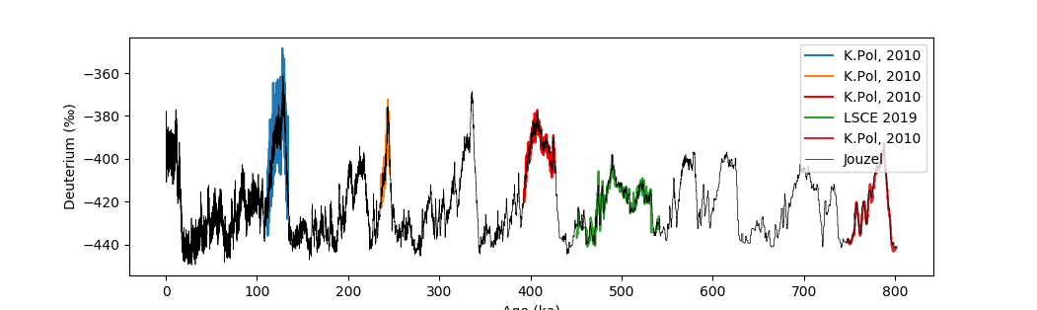
Summary of data collected on the EDC core: δD
1.
Many interglacial were measured in high resolution (11cm) compared to the low resolution (55cm)
High
resolution
Low
resolution
2007
Age (ka)
Notes:
Insister sur ce qui a été nouveau
Pas publier orange et vert

Slide 5
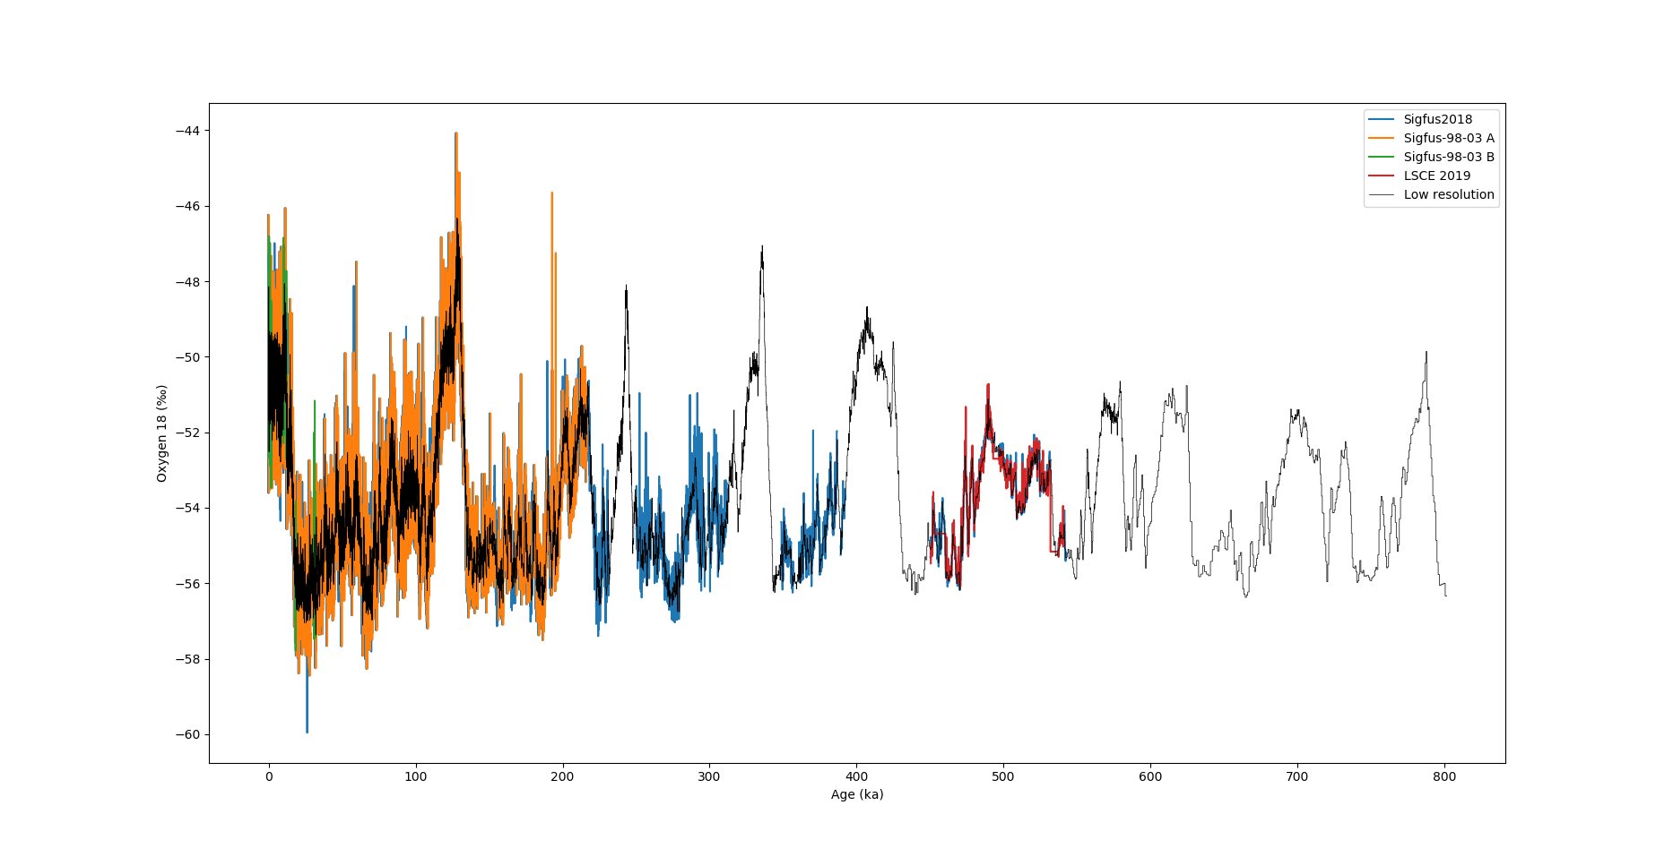
Summary of data collected on the EDC core: δ¹⁸O
1.
2.5 cm resolution was performed on the top of the core (last 30 ka).
11 cm resolution over the last 542 ka with some discontinuities.
11 cm
2.5 cm
11 cm
11 cm
55 cm
δ¹⁸O
Age (ka)
Notes:
Légende un peu petite
Insister sur ce qui a été mesuré par moi, et sur ce qui a pas été publié

Slide 6
Signal variability on different interglacial periods on the EDC core
2.
11 cm δD data are available on some interglacial periods until MIS 19
Comparison of signal frequency over warm periods (MIS 5, 11, 13 and 19)

Slide 7
Spectral analyses over several interstadials
2.
Spectral analyses on age scale
MIS 5
MIS 11
12 ka
12 ka
MIS 13
MIS 19
12 ka
12 ka
Notes:
Flèche sur tous 12ka

Slide 8
Spectral analyses on MIS 5, 11, 13 and 19
2.
2.4 ka
Spectral analyses on age scale
Preliminary analyses
1.9 ka
Analyseries
Interpolation over 12 ky with a
step resolution of 150 yrs
MTM analysis
Mid resolution
1.6 ka
1 ka
0.8 ka
0.5 ka
MIS 5
MIS 11
MIS 13
MIS 19
Notes:
Semble voir ça mais attend le bruit rouge
MIS 19 : pas plus infos 11 que 55 cm
Superposition 55 et 11 cm sur MIS 13 pour montre que pas trop perte signal

Slide 9
Spectral analyses on MIS 5, 11, 13 and 19
2.
2.4 ka
Spectral analyses on age scale
Preliminary analyses
1.9 ka
High frequency signals are much more attenuated for MIS 13 and 19 than for MIS 5 and 11
1.6 ka
1 ka
0.8 ka
0.5 ka
MIS 5
MIS 11
MIS 13
MIS 19
Notes:
Semble voir ça mais attend le bruit rouge
MIS 19 : pas plus infos 11 que 55 cm
Superposition 55 et 11 cm sur MIS 13 pour montre que pas trop perte signal

Slide 10
Spectral analyses on MIS 5, 11, 13 and 19
Spectral analyses on depth scale
MIS 5
MIS 11
10 m
10 m
MIS 13
MIS 19
10 m
10 m

Slide 11
Spectral analyses on MIS 5, 11, 13 and 19
Preliminary analyses
Spectral analyses on depth scale
Analyseries
No interpolation
Step resolution 0.11 m
MTM analysis
Mid resolution
MIS 5
MIS 11
MIS 13
MIS 19
(m⁻²)

Slide 12
Spectral analyses on MIS 5, 11, 13 and 19
Preliminary analyses
Spectral analyses on depth scale
MIS5 MIS11 MIS13 MIS19
Diffusion 0.06 0.07 0.11 0.21
length (m)
Calculations of the diffusion lengths following Gkinis et al., 2011; Jones et al., 2017
MIS 5
MIS 11
MIS 13
MIS 19
(m⁻²)

Slide 13
Conclusion and perspectives
-New δD record over MIS 13 permits to better constrain diffusion of the signal over the deeper part of the EDC ice core
- MIS 13 (~2900 m deep) is significantly less affected by diffusion than MIS 19 (almost 3200 m deep)
- Can these results be used to predict the loss of information from δD and δ¹⁸O over the deepest part of the Beyond EPICA ice core ?

