Slide 1
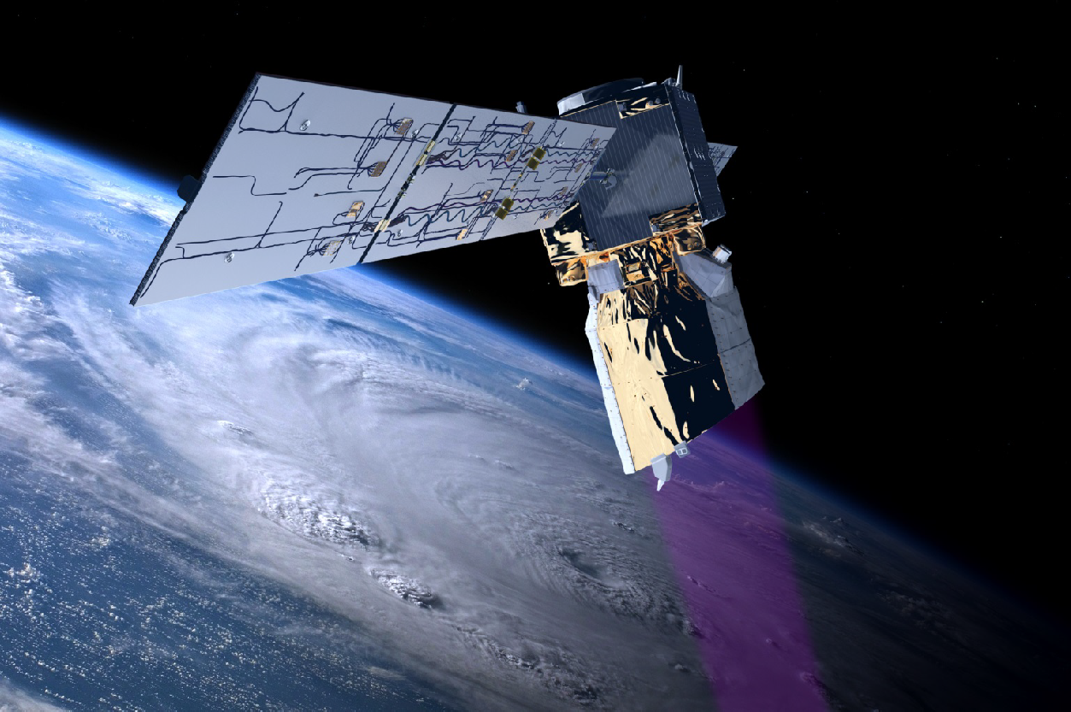
Aeolus success and Follow-On
Aeolus © ESA
Ad.Stoffelen@knmi.nl

Slide 2
Stoffelen and Marseille, 1998

Slide 3
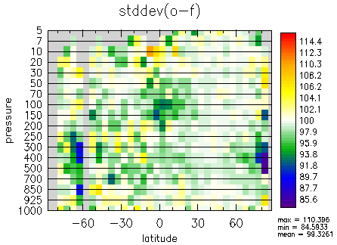
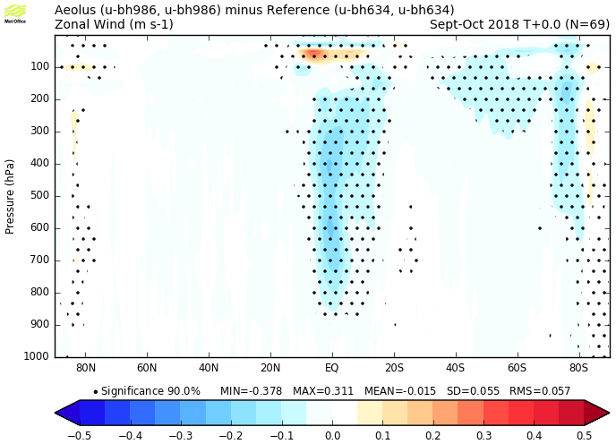
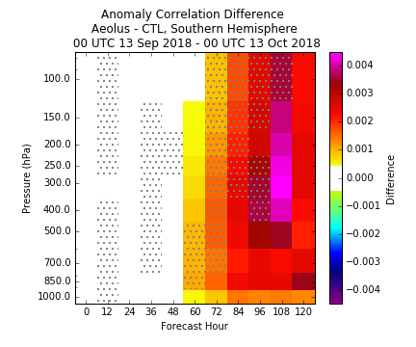
Very positive results on the use of Aeolus in NWP was presented at the September 2019 NWP Impact Assessment Working Meeting
Even noisy Aeolus data demonstrates its value
Impact will double when noise error SD is reduced by a factor 2
10%
better
15%
better
ECMWF wind impact 72-hour forecast
UK Metoffice zonal wind analysis improve when Aeolus is assimilated. Blue colors imply improvements.
Deutscher Wetterdienst comparison against radiosondes show large improvement.
NASA GMAO height forecasts improved, especially for Southern Hemisphere 48-120 hour forecasts. Red colors mean improved forecasts.
NOAA also presented very positive tropical and Southern Hemisphere forecast impact (not shown).

Slide 4
Summary and Conclusions
Requirement for upper air wind profiles remains strong for all WMO weather and climate application areas;
Radiosonde observation show the highest impact of all (non-satellite radiance) observations, and the highest impact of all on a per observation basis;
Network is difficult to expand (difficult even to maintain as is);
Aircraft observations provide a very valuable complement to the radiosonde network;
Coverage is driven by operational and commercial constraints of airline traffic, not by WMO requirements;
A constellation of space-based wind lidars could provide an excellent combination of horizontal, vertical and temporal resolution meeting key WMO requirements;
We look forward to seeing the results from Aeolus/ADM!
WMO, Lars-Peter Riishojgaard, EUMETSAT, 29/5/’18

Slide 5
PIEW – Final presentation Prediction Improvement for Extreme Weather ESTEC, 25-10-2005
Gert-Jan Marseille
Ad Stoffelen
Jan Barkmeijer

Slide 6
Conclusions
SOSEs have been applied to ADM-Aeolus and various candidate follow-on scenarios for a database of cases with bad ECMWF 2-day forecasts
Aeolus is capable to resolve part of the analysis error structures in data sparse areas
Measuring wind vector profiles instead of LOS components over the Northern Hemisphere oceans gives “only” a 50% forecast improvement
A larger improvement of 70% is achieved by a more uniform distribution of LOS wind observations
This may be achieved by two Aeolus in orbit (tandem)
A third Aeolus in orbit gives still a significant improvement over the North Atlantic
Storm track targeting over the Atlantic by dual-inclination works (but elsewhere its value is limited)

Slide 7
SOSE - summary - flowchart
Ana-
ly- sis
Model State
t = 0
Forecast Run
t = 0 → 48 h
Analysis is used as
pseudo-truth to simulate DWL
Forecast
t = 48 h
Key Errors
t = 0
Sensitivity Computation
t = 48 h → 0 h
Forecast Error
t = 48 h
Analysis
t = 48 h
Forecast Run
t = 0 → 48 h
Updated State
t = 0
Ana-
ly- sis
Better Forecast
t = 48 h
Ana-
ly- sis

Slide 8
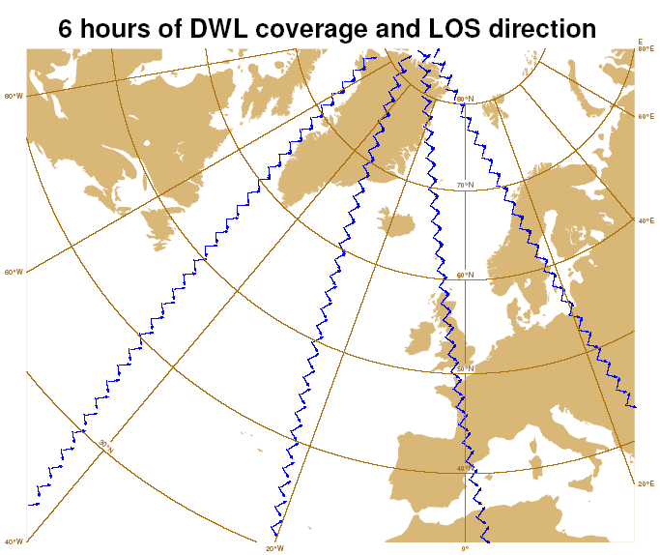
ADM follow-on candidates
Dual perspective
Tandem-Aeolus
information content single LOS vs. dual-perspective

Slide 9
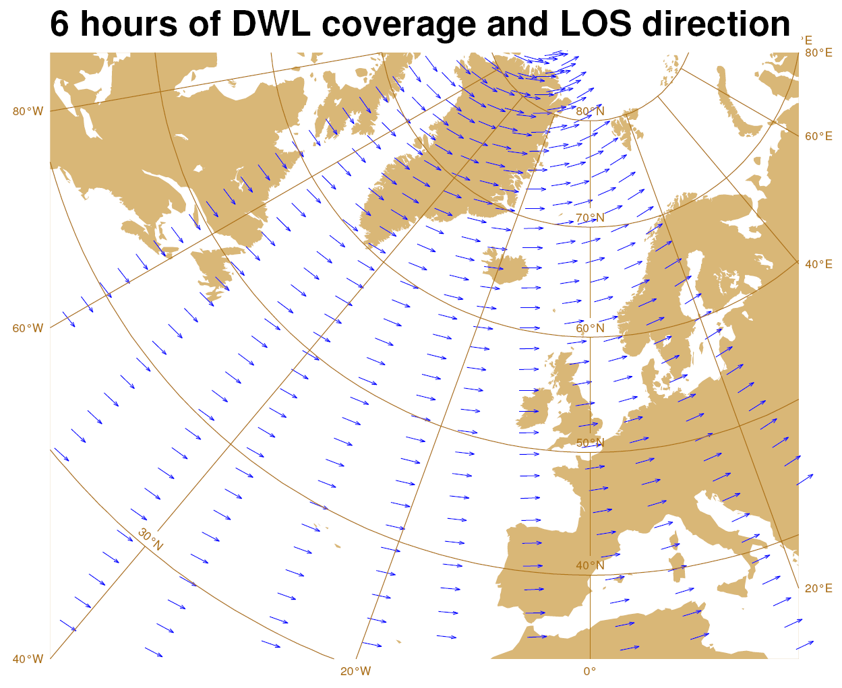
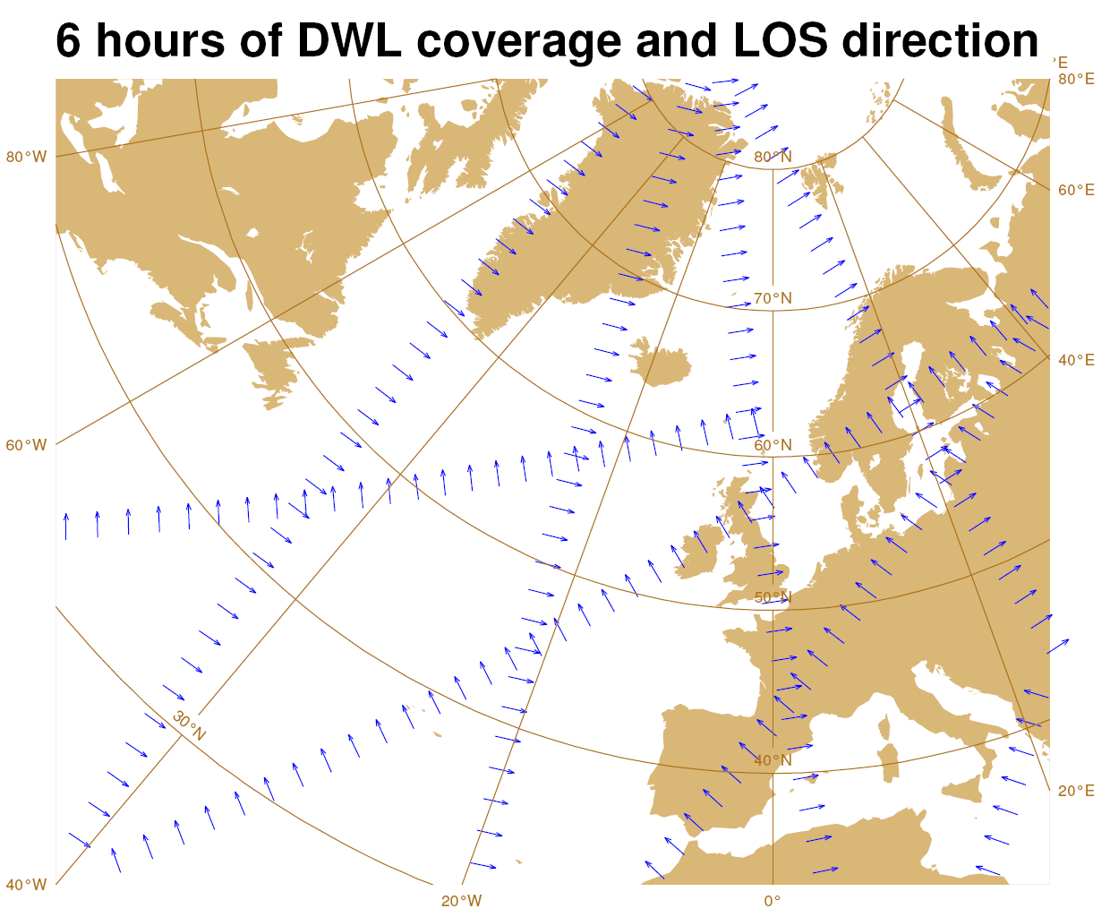
Additional ADM follow-on scenarios
Triple-Aeolus
Dual-inclination (“alternative” dual-perspective)
Storm track targetting

Slide 10
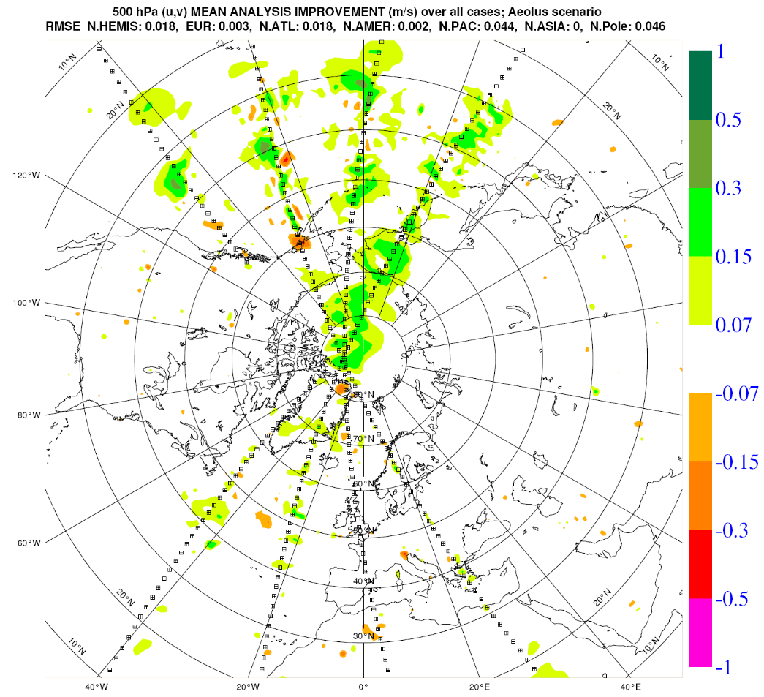
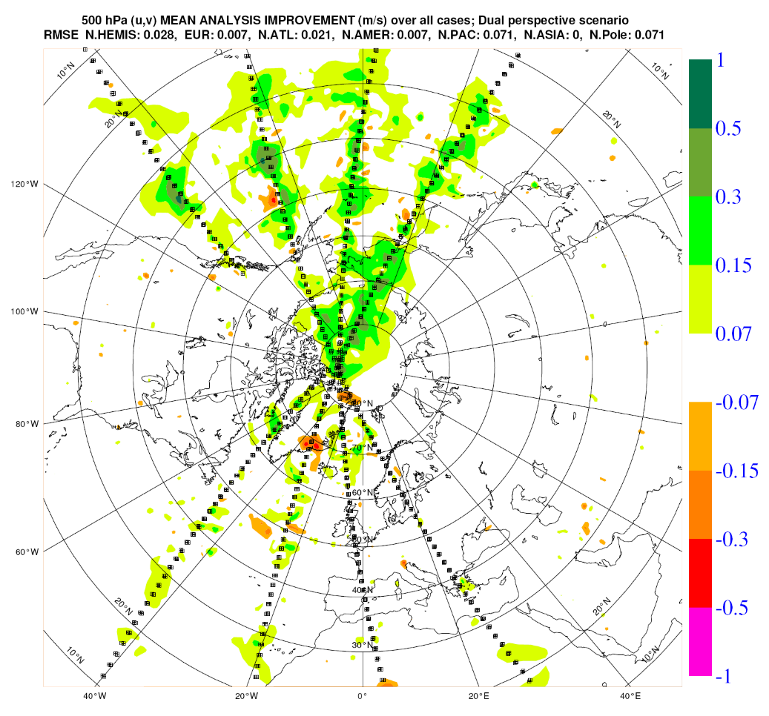
DWL analysis impact - 500 hPa wind
Aeolus
Dual-Persp.
Dual-perspective better than single LOS (Aeolus)

Slide 11
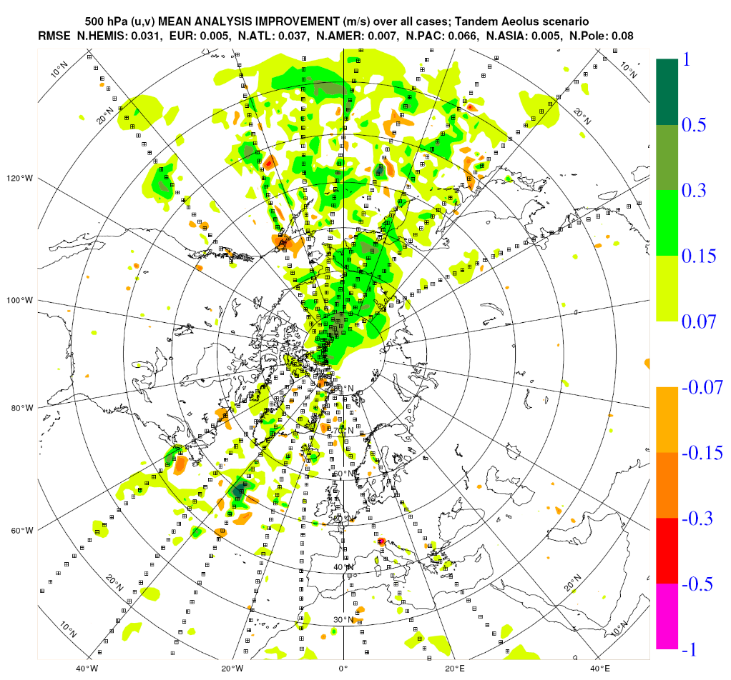
DWL analysis impact – 500 hPa wind
Aeolus
Tandem
Tandem-Aeolus scenario recovers large scale structures

Slide 12
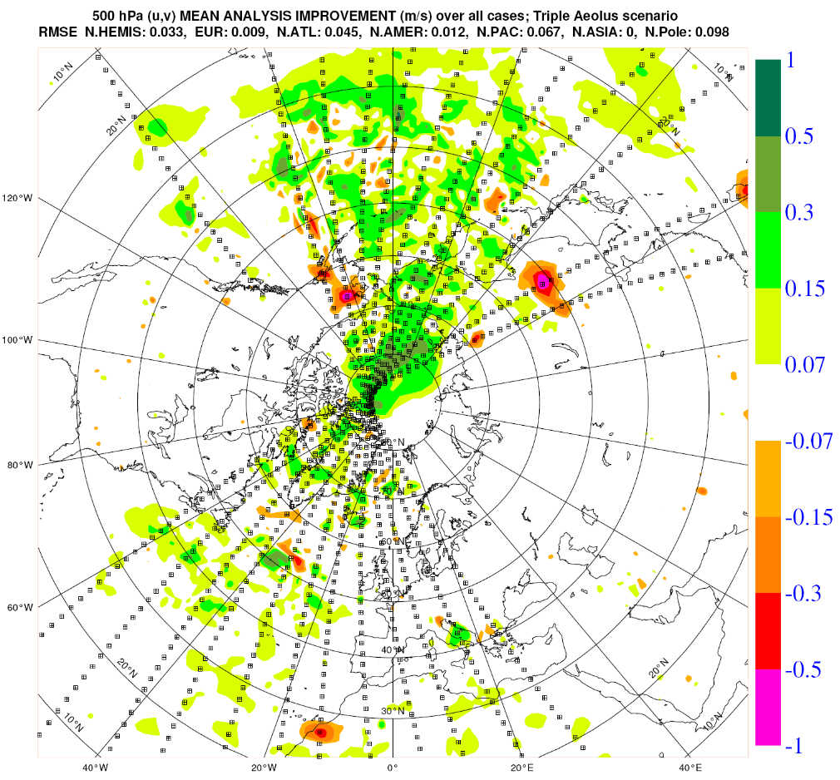
DWL analysis impact – 500 hPa wind
Tandem
Triple
triple-Aeolus has added value over the Atlantic

Slide 13
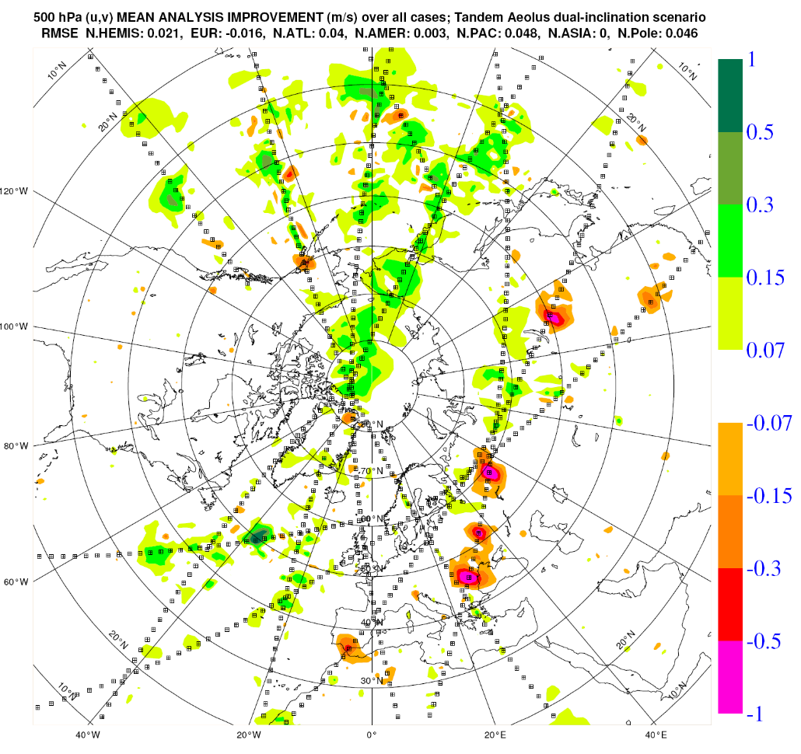
DWL analysis impact – 500 hPa wind
Tandem
Dual-incl
Dual-inclination scenario better samples the storm-track region over the Atlantic
Dual-inclination scenario has many observations over data dense continents

Slide 14
DWL forecast impact – 500 hPa geop. height
(%) | N.Hemis | N.Atlantic | Europe | N.Pacific | N.America | N.Pole
Aeolus | 4.9 | 2.9 | 2.8 | 6.6 | 5.4 | 9.9
Dual-perspective | 7.3 | 3.9 | 3.8 | 9.8 | 8.5 | 14.1
Tandem-Aeolus | 8.0 | 5.0 | 5.3 | 11.1 | 7.4 | 15.8
Dual-inclination | 6.6 | 4.4 | 4.7 | 8.5 | 5.8 | 10.8
Triple-Aeolus | 9.8 | 6.4 | 8.0 | 13.1 | 8.8 | 18.3
Added value of Triple-Aeolus largest for Europe
Europe: Forecast improvement linear with # Aeolus’

Slide 15
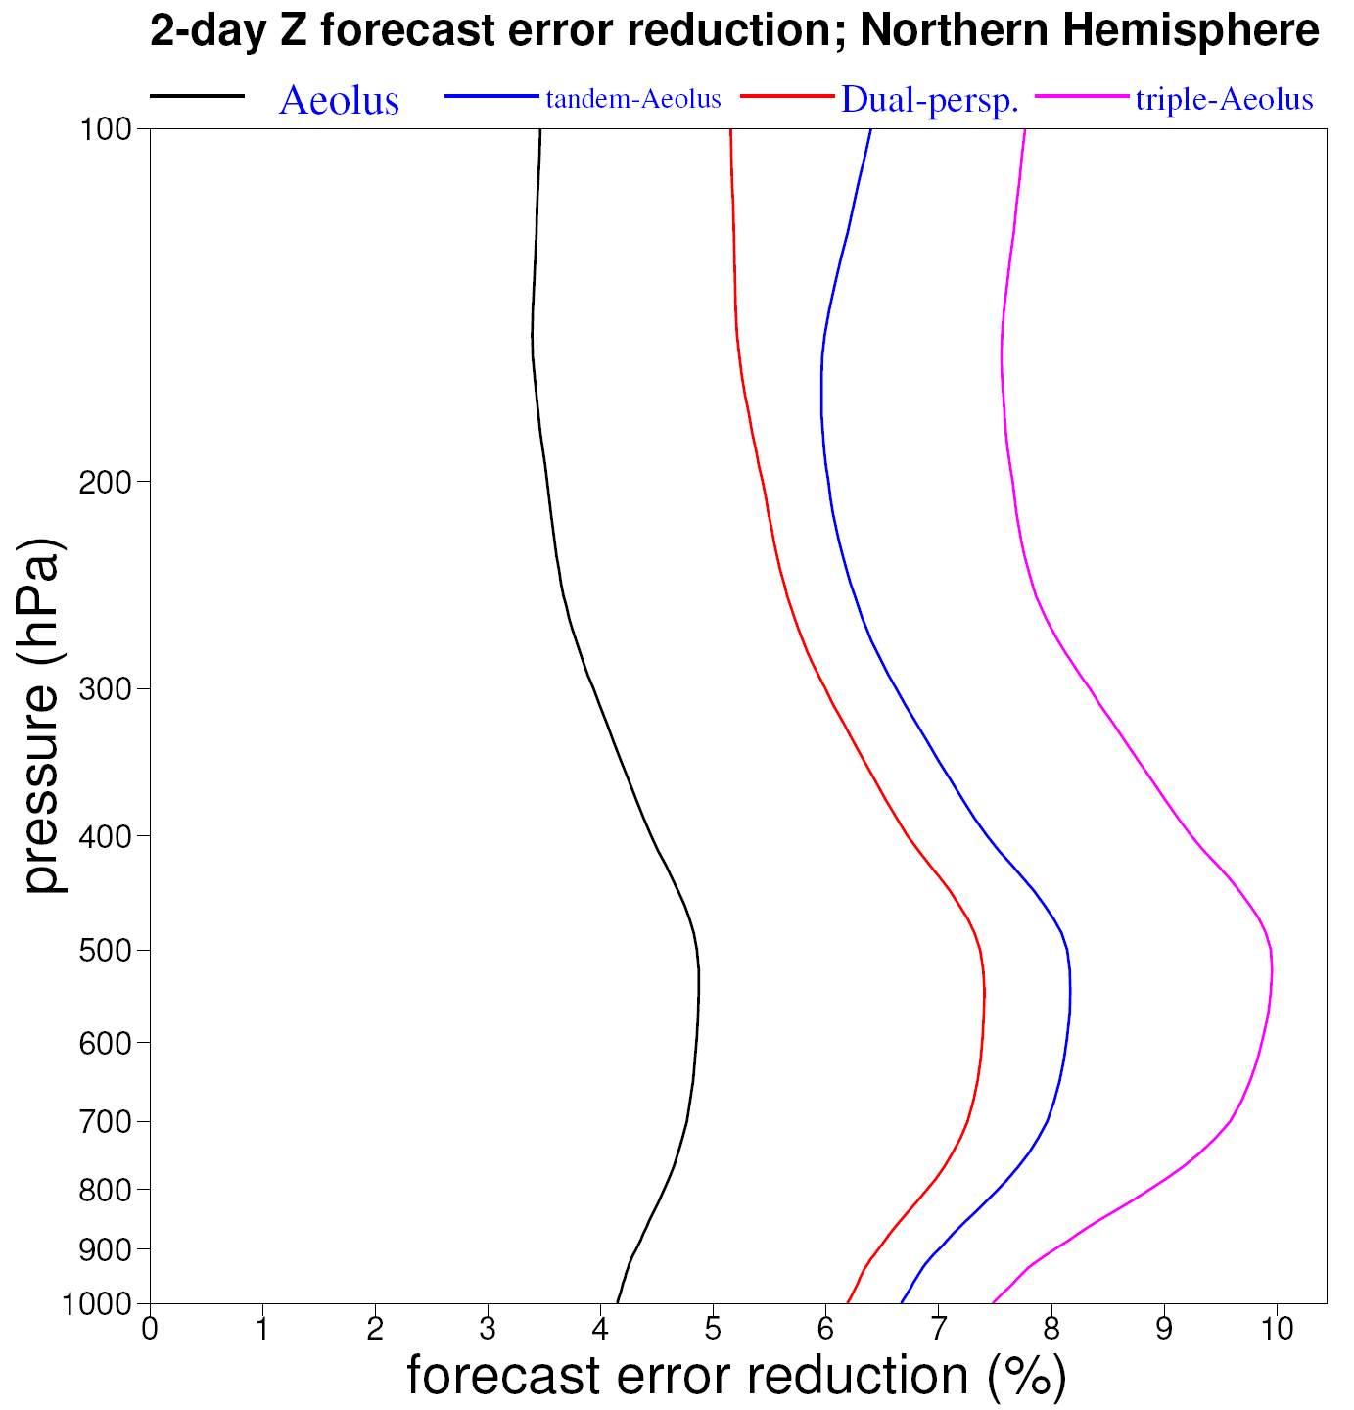
DWL forecast impact – 500 hPa geop. height
Result very consistent in the vertical
Aeolus
Dual-pers.
Tandem
Triple

Slide 16
Recommendations
Adopt SOSE approach, e.g. to test ADM vertical sampling modes
SOSE cycling for series of pseudo-truth / long-loop 4D-Var?
Besides sampling of 12UTC window, also test sampling in the other 6-hour windows, in particular for dual-inclination impact assessment
Test Aeolus follow-up missions in tropical region (Nedjeljka)
Just fly more Aeolus-type instruments!

Slide 18
Aeolus at EGU 2020
Session AS1.35: Aeolus data and its application
Ad Stoffelen, Sebastian Bley, Anne Grete Straume, Jonas von Bismarck
=> 7x15 minutes 16:9 oral presentations + poster session
(Invited) Aeolus: ESA’s wind mission. Status and future challenges, Tommaso Parrinello, Anne Grete Straume, Jonas Von Bismark, Sebastian Bley, Viet Duc Tran, Peggy Fischer, Thomas Kanitz, Denny Wernham, Thorsten Fehr, Emilio Alvarez, Oliver Reitebuch, and Isabell Krisch
(Invited) Data quality of Aeolus wind measurements, Isabell Krisch and the Aeolus DISC
(Invited) An Assessment of the Impact of Aeolus Doppler Wind Lidar Observations for Use in Numerical Weather Prediction at ECMWF, Michael P. Rennie and Lars Isaksen
Validation of Aeolus winds using atmospheric radars in Arctic Sweden and in Antarctica and NWP modelling, Magnus Lindskog, Evgenia Belova, Peter Voelger, Sheila Kirkwood, Heiner Körnich, Susanna Hagelin, Sourav Chatterjee, and Karathazhiyath Satheesan
Aeolus aerosol and cloud product, Alain Dabas, Thomas Flament, Dimitri Trapon, and Dorit Huber
Influence of Aeolus data assimilation on the representation of gravity waves in ECMWF analysis fields, Isabell Krisch, Michael Rennie, Bernd Kaifler, Sonja Gisinger, Oliver Reitebuch, and Markus Rapp
Statistically based calibration/validation control of space-borne lidars: application to ALADIN lidar onboard ADM/Aeolus, Artem Feofilov, Helene Chepfer, Vincent Noel, and Marjolaine Chiriaco
ESA’s Wind Lidar Mission Aeolus – Instrument Performance and Stability, Thomas Kanitz, Benjamin Witschas, Uwe Marksteiner, Thomas Flament, Michael Rennie, Marc Schillinger, Tommaso Parrinello, Denny Wernham, and Oliver Reitebuch
The application of ATLID techniques for aerosol/cloud retrievals to ALADIN, David Donovan, Gert-Jan van Zadelhoff, Thomas Flament, Dimitri Trapon, and Holgar Baars
Experimental Validation and Assimilation of Aeolus Wind Observations, Anne Martin, Alexander Geiss, A. Cress, and M. Weissmann
Aeolus follow-on configurations, Gert-Jan Marseille and Ad Stoffelen

Slide 19
Aeolus at EGU 2020
One million feet view of Level-2 Processing Facility managed at European Centre for Medium-Range Weather Forecasts (ECMWF), Rakesh Prithiviraj, Ioannis Mallas, Cristiano Zanna
Stratospheric Australian fire smoke layers over Punta Arenas, Chile, measured by ground-based lidar and AEOLUS, Kevin Ohneiser, Holger Baars, Cristofer Jimenez, Johannes Bühl, Patric Seifert, Athina Floutsi, Martin Radenz, Ulla Wandinger, and Albert Ansmann
Aeolus / ALADIN data analysis in Korea, Hyemin Shin, Myoung-Hwan Ahn, Jisoo Kim, and Chu-Yong Chung
Aeolus Calibration, Validation and Science Campaigns, Thorsten Fehr, Vassilis Amiridis, Sebastian Bley, Philippe Cocquerez, Christian Lemmerz, Griša Močnik, Gail Skofronick-Jackson, and Anne Grete Straume
Validation of ESA Aeolus wind observations using French ground- based Rayleigh Doppler lidars at midlatitude and tropical sites, Alain Hauchecorne, S. Khaykin, R. Wing, Jean-François Mariscal, J. Porteneuve, Jean-Pierre Cammas, N. Marquestaut, G. Payen, and V. Duflot
The ESA-funded Aeolus/EarthCARE Aerosol Assimilation Study, Julie Letertre-Danczak, A. Benedetti, S. Quesada-Ruiz, A. Dabas, T. Flament
Validation of Aeolus aerosol and wind products with sophisticated ground-based instruments in the Northern and Southern Hemisphere, Holger Baars, Alina Herzog, Ronny Engelmann, Johannes Bühl, Martin Radenz, Patric Seifert, Albert Ansmann, Dietrich Althausen, Birgit Heese, Julian Hofer, Kevin Ohneiser, K. Hanbuch, E. Basharova, T. Gülbas, A. Chudnovsky, B. Barja, M. Filioglou, M. Komppula, and U. Wandiger
Consolidation of Aeolus FMA and FMB datasets in the DSI X-PReSS Consortium: Methodology used to generate Master Datasets and the results that have been achieved, Nicola Comparetti, Gianluca Colamussi, Marta De Laurentis, Michel Douzal, Peggy Fischer, Alessandra Paciucci, Bart Schipperijn, Joost Smeets, and Marcella Veneziani
Aeolus: Payload Ground segment operations. Status, performances and evolution, Peggy Fischer, Luca Mellano, Marta De Laurentis, Stefano Aprile, and Antonio Biscuso
Validation for ESA’s Aeolus Mission using the in-situ instruments at Canadian Arctic and reanalysis data, Chih-Chun Chou, Paul Kushner, Zen Mariani, Peter Rodriguez, and Christopher Fletcher
AEOLUS weekly mission planning concept and strategy, Marta De Laurentis, Peggy Fischer, Loretta Mizzi, and Luca Mellano
The ERATOSTHENES Remote Sensing Supersite: Ground-truth observations over Cyprus, Rodanthi-Elisavet Mamouri, Argyro Nisantzi, Albert Ansmann, Johannes Bühl, Patric Seifert, Holger Baars, Vassilis Amiridis, Ulla Wandinger, and Diofantos Hadjimitsis
VirES for Aeolus - Online visual analysis of Aeolus data, Daniel Santillan Pedrosa, C. Schiller, M. Meringer, O. Reitebuch, F. Weiler, D. Huber

Slide 20
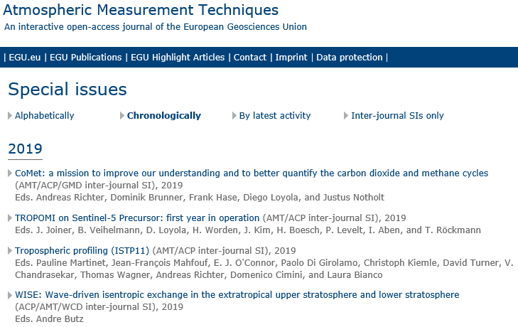
Special issue AMT
Open access
AMT-Discussion for cross-referencing
Issue logo
Preface or overview paper
Paper avatar
Collection of published papers in AMT(D)/ACP/ ..
Linked to EGU2020 session, but not restrictive
Digital; see ->
>20 paper copies if desired; price TBD
Needs editors

Slide 21
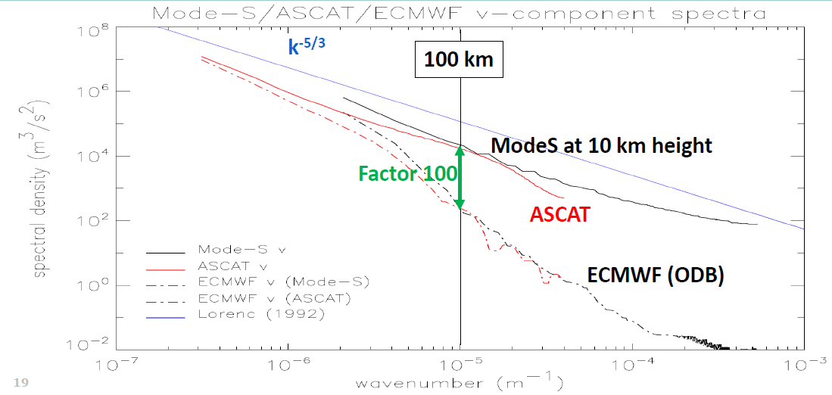
Grid distance 9 km, resolved scales ~150 km H/V aspect ratio ~100

