Slide 1
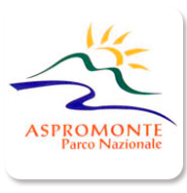
Aspromonte Geopark Project: a natural laboratory to show the slow
movement of the Earth system
Gaetano Ortolano1, Sabrina Santagati2, Damiano Gravina1, Sergio Tralongo2æ, Chiara Parisi2, and
Rosolino Cirrincione1
1-Dipartimento di Scienze Biologiche, Geologiche e Ambientali (DBGA), Università di Catania
2 – Ente Parco Nazionale dell’Aspromonte

Slide 2
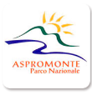
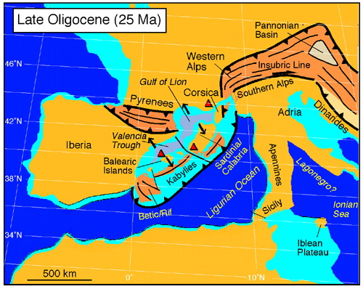
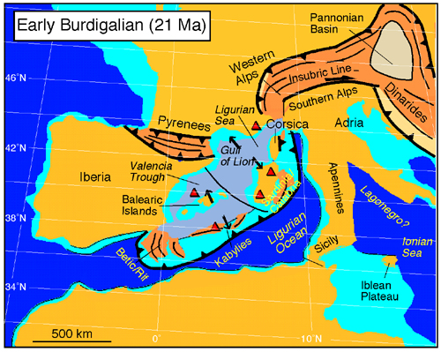
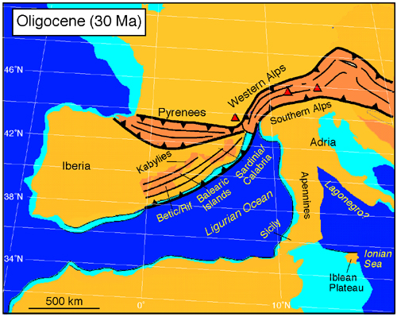
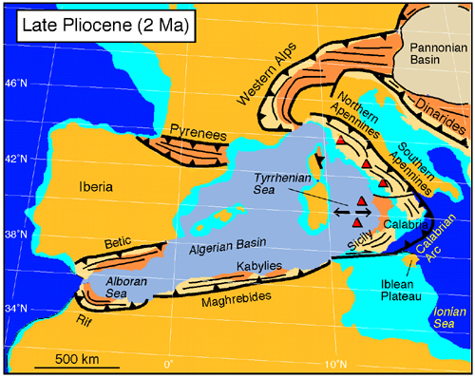
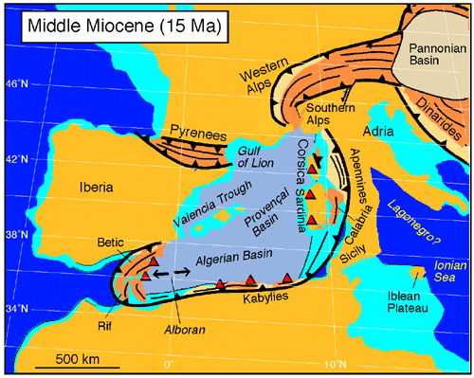
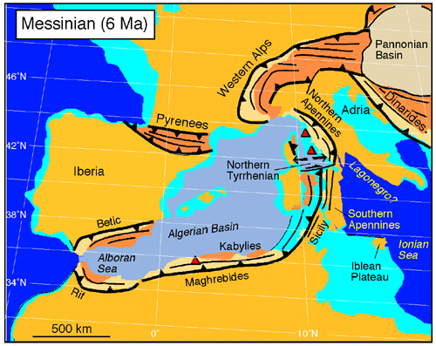
Aspromonte Geopark Project: a natural laboratory to …by Ortolano et al.,…
The geological history of the Aspromonte Massif is strictly correlated with most wide unitary geodynamic scenario represented by the geological evolution of the Calabria-Peloritani Orogen (CPO). This ribbon-like microplate represents a piece of the Eurasia block nowadays inserted within the Apennine-Maghrebian chain system of African origin, forming the backbone of the Italian peninsula
(Rosenbaum, G., Lister, G. and Duboz, C. 2002)
(Rosenbaum, G., Lister, G. and Duboz, C. 2002)
(Rosenbaum, G., Lister, G. and Duboz, C. 2002)
(Rosenbaum, G., Lister, G. and Duboz, C. 2002)
(Rosenbaum, G., Lister, G. and Duboz, C. 2002)
(Rosenbaum, G., Lister, G. and Duboz, C. 2002)
INTRO
SCENARIO
PURPOSE
CONCLUSION

Slide 3
Aspromonte Geopark Project: a natural laboratory to …by Ortolano et al.,…
CPO geodynamics is a matter of great interest for geologists from every part of the world: The Aspromonte Massif indeed, within this complex geodynamic scenario, can be interpreted as a fragment of the European continent, moved eastward for the opening of the Tyrrhenian Sea, and superimposed on the African margin deformed and crumpled during the collision between Europe and Africa. The challenging aim of the Aspromonte territory as candidate to enter within the UNESCO global Geoparks network is that to translate this unique geoheritage, cultural, immaterial heritage and landscape resource in a synergistic plan useful to making accessible from below the knowledge of this patrimony to the local population which in turn will be able to use that awareness for the development for people of all backgrounds and ages, a new touristic purpose (geotourism, ecotourism, experiential tourism, ...), as well as educational, scientific and research purposes. In particular, visitors and travelers will have the opportunity to get to know and explore the geological processes that have shaped the Earth's crust producing the spectacular shapes of the landscape of southern Calabria
INTRO
SCENARIO
PURPOSE
CONCLUSION

Slide 4
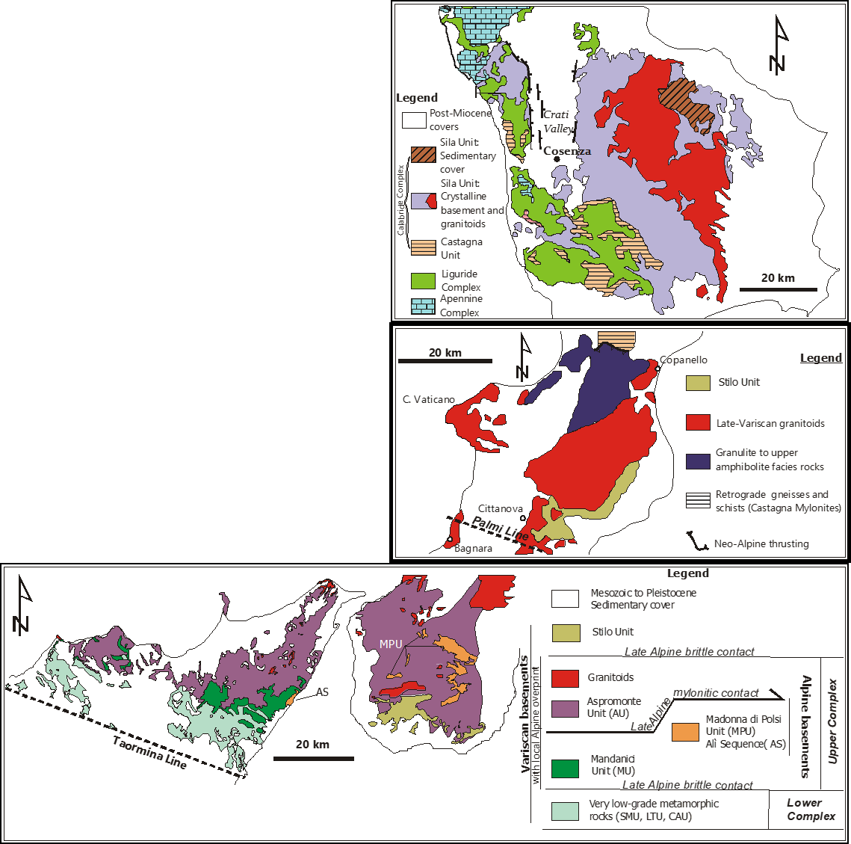
The Aspromonte Geopark project rises from the peculiar geological history of this sector of the
southern Italian peninsula, apparently in continuity with the rest of the thin-skinned thrust-sheet system of the Apennine-Magrebian orogenic system, although characterized by deep-seated crystalline basement rocks, interpreted as fragmented relics of a sector of the original southern European Variscan chain (Cirrincione et al., 2015).

Slide 5
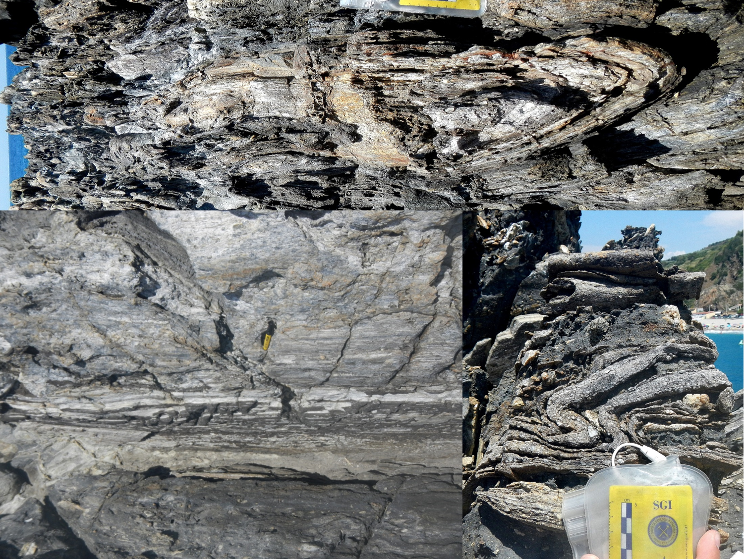
This peculiar geological heritage allows the preservation of an articulated geodiversity that contribute to the unraveling of two orogenesis (i.e. Variscan and Alpine), testified by the presence of intensively deformed metamorphic rocks, involved in two orogenic cycles (Ortolano et al., 2005; 2020), as well as in the occurrence of syn-orogenic sedimentary deposits covered in turn by the back thrusting of the Varicolori Clays and the final deposition of the Gessoso-solfifera succession.
INTRO
SCENARIO
PURPOSE
CONCLUSION

Slide 6
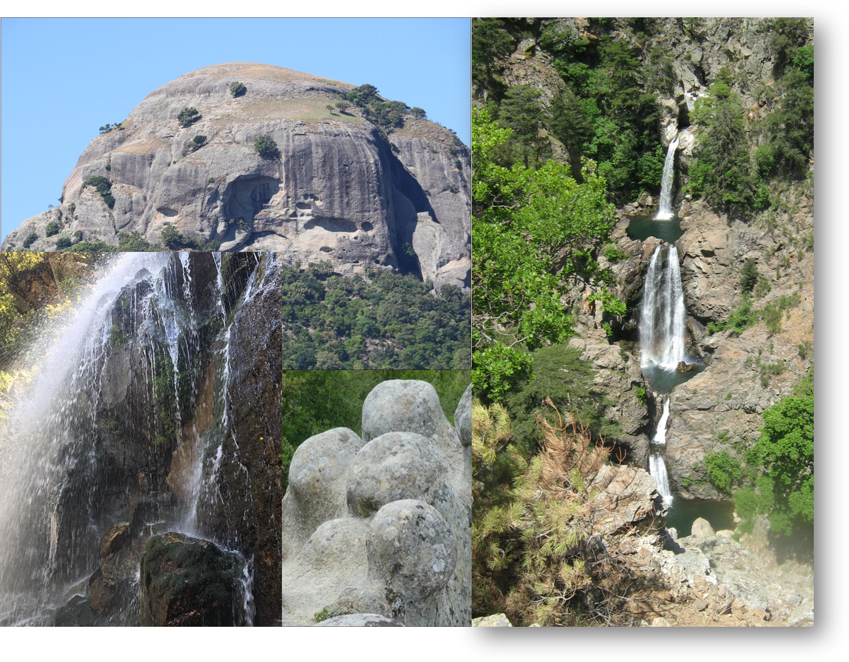
INTRO
SCENARIO
PURPOSE
CONCLUSION

Slide 7
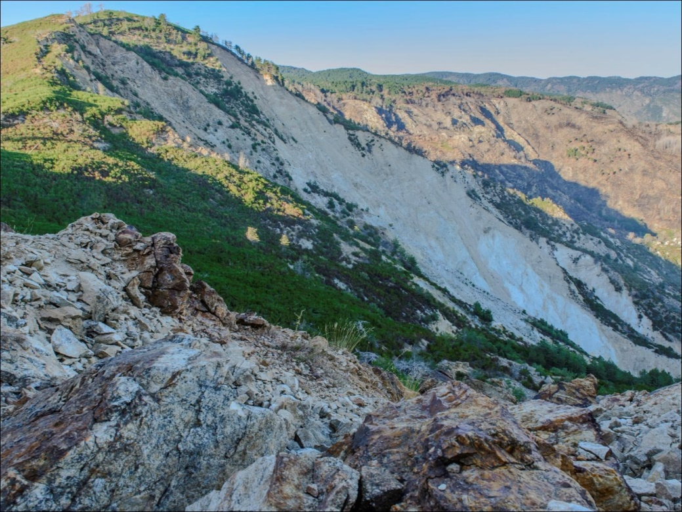
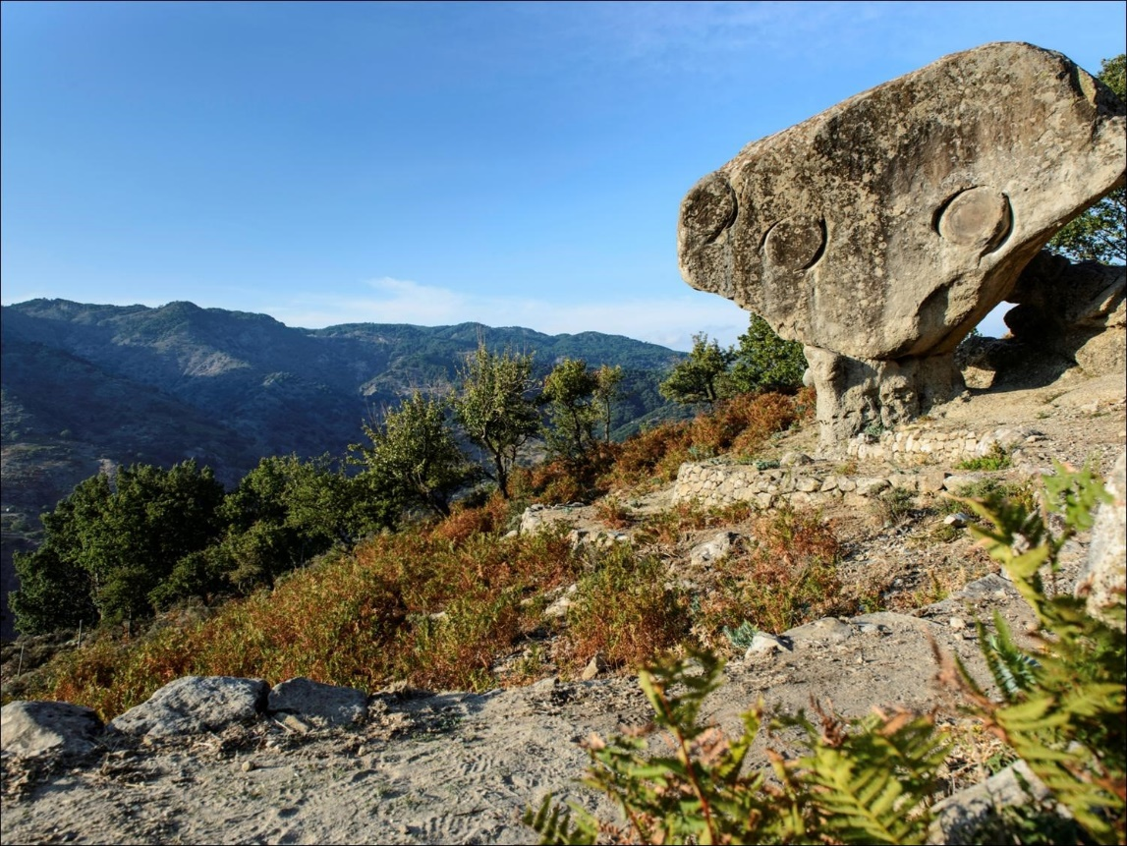
Aspromonte Geopark Project: a natural laboratory to …by Ortolano et al.,…
The rising Aspromonte Geopark counts, up to now, 89 geosites, eight of which are of international importance and five inserted within territorial and cultural landscape units
INTRO
SCENARIO
PURPOSE
CONCLUSION

Slide 8
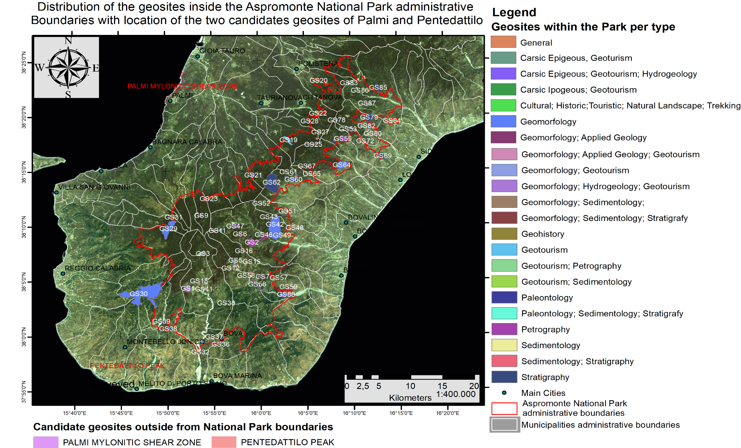
Based on what has been described, it is clear that the geological and the geomorphological features of the Aspromonte Massif are very unique in the geological and geographic panorama
INTRO
SCENARIO
PURPOSE
CONCLUSION

Slide 9
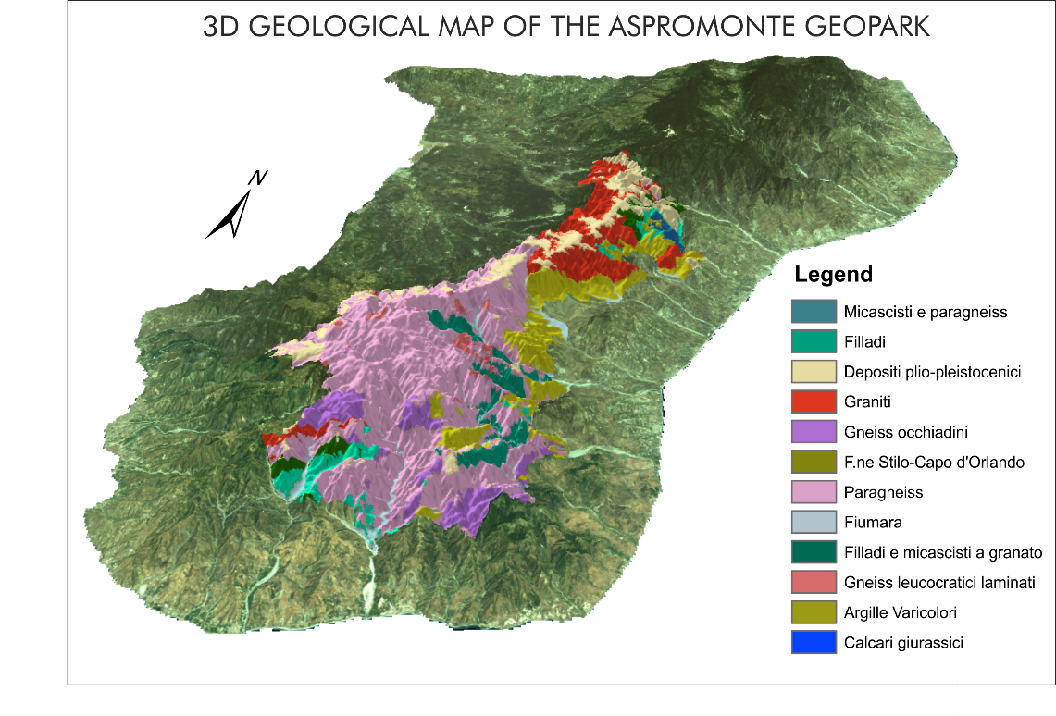
Many of these geosites are able to experiment new ways to communicate, with the aid of
new technologies (i.e. WEB-GIS, 3D Virtual outcrop reconstruction and VR), the slow movement of the Earth crust, testified and preserved in different geosites, where is possible to observe clearly the presence of mylonitic rocks (i.e. rocks involved in high strain-rate regime undergoing plastic deformation) as well as the occurrence of several types of folding system activation, such as flow perturbation fold system evolving to sheath folds (Fazio et al., 2017; 2018; Ortolano et al., 2020)
INTRO
SCENARIO
PURPOSE
CONCLUSION

Slide 10
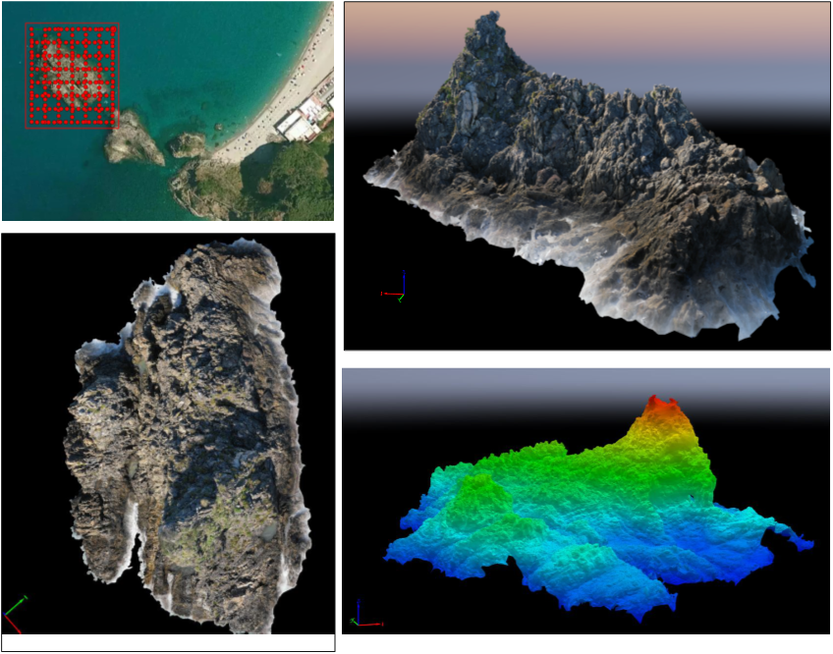
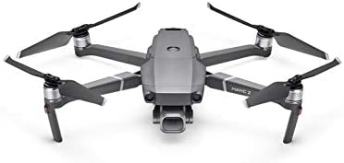
INTRO
SCENARIO
PURPOSE
CONCLUSION

Slide 11
Aspromonte Geopark Project: a natural laboratory to …by Ortolano et al.,…
INTRO
SCENARIO
PURPOSE
CONCLUSION

Slide 12
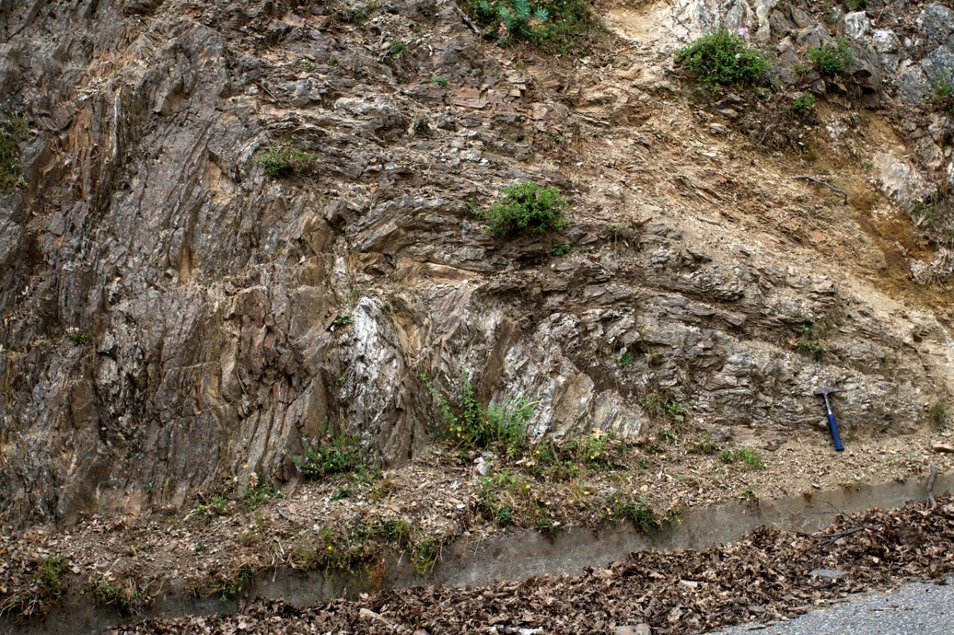
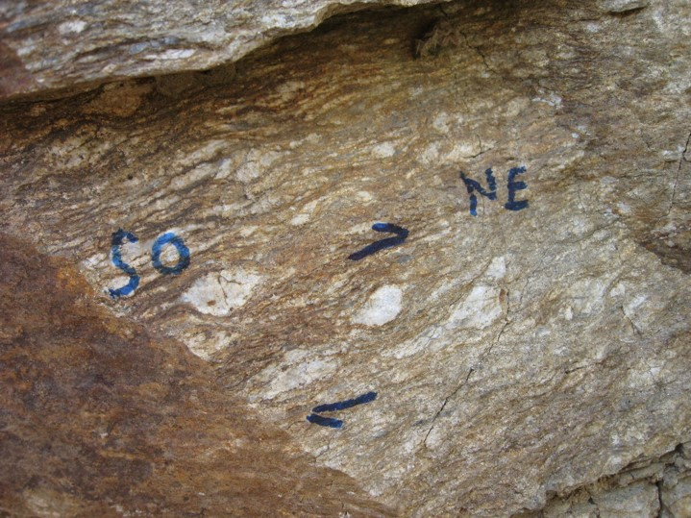
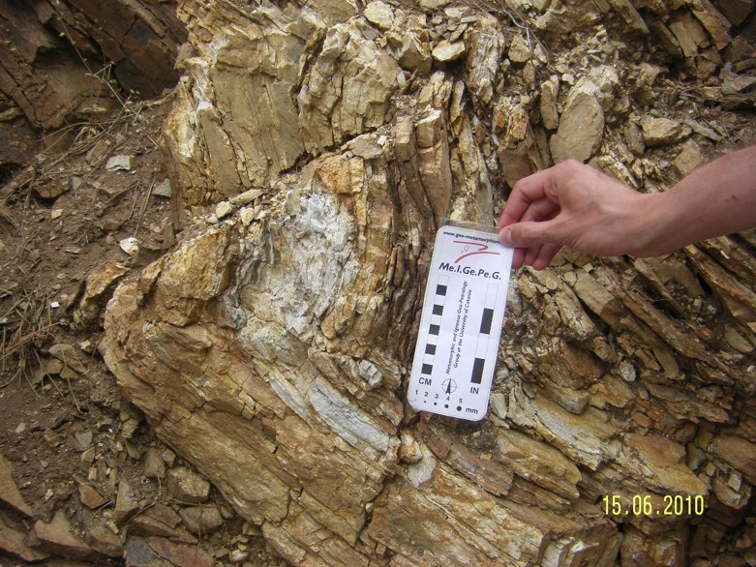
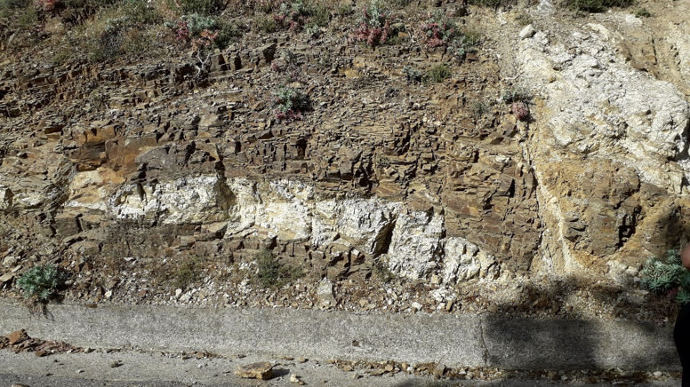
INTRO
SCENARIO
PURPOSE
CONCLUSION

Slide 13
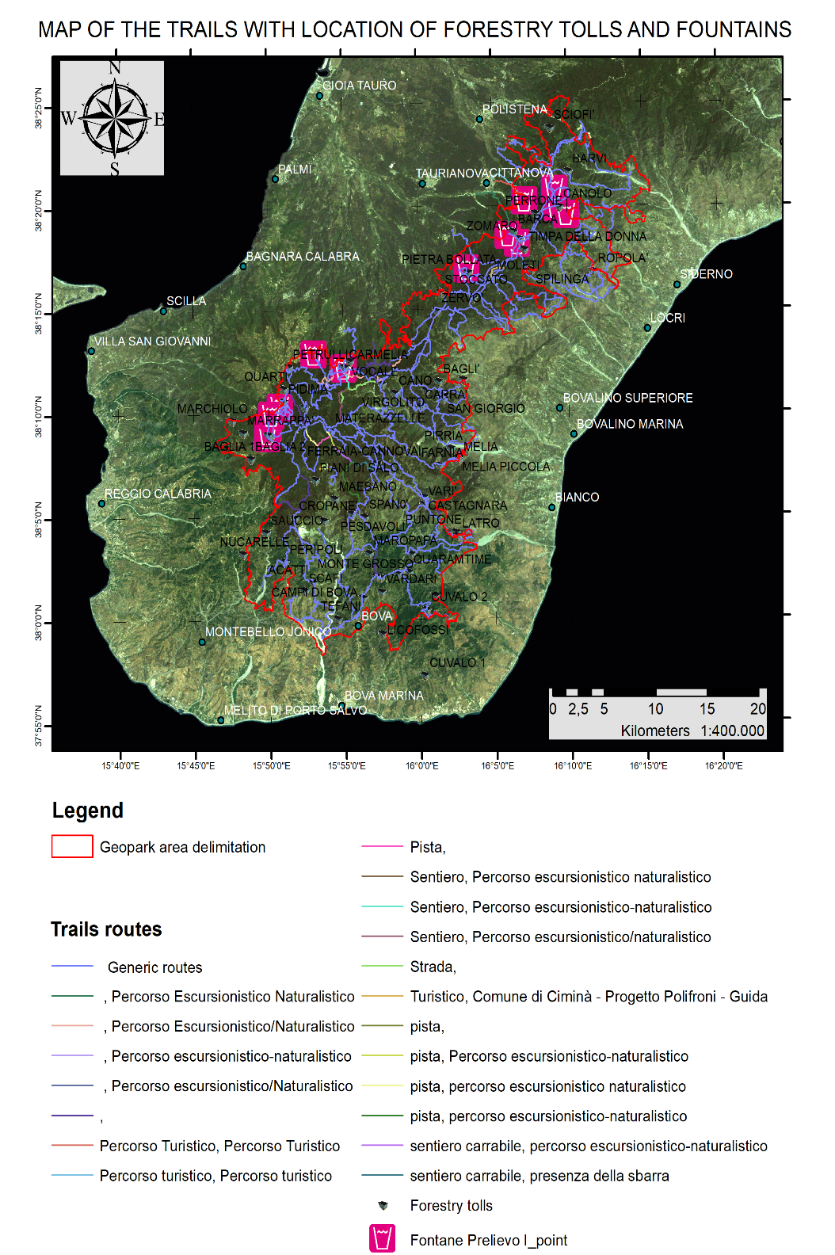
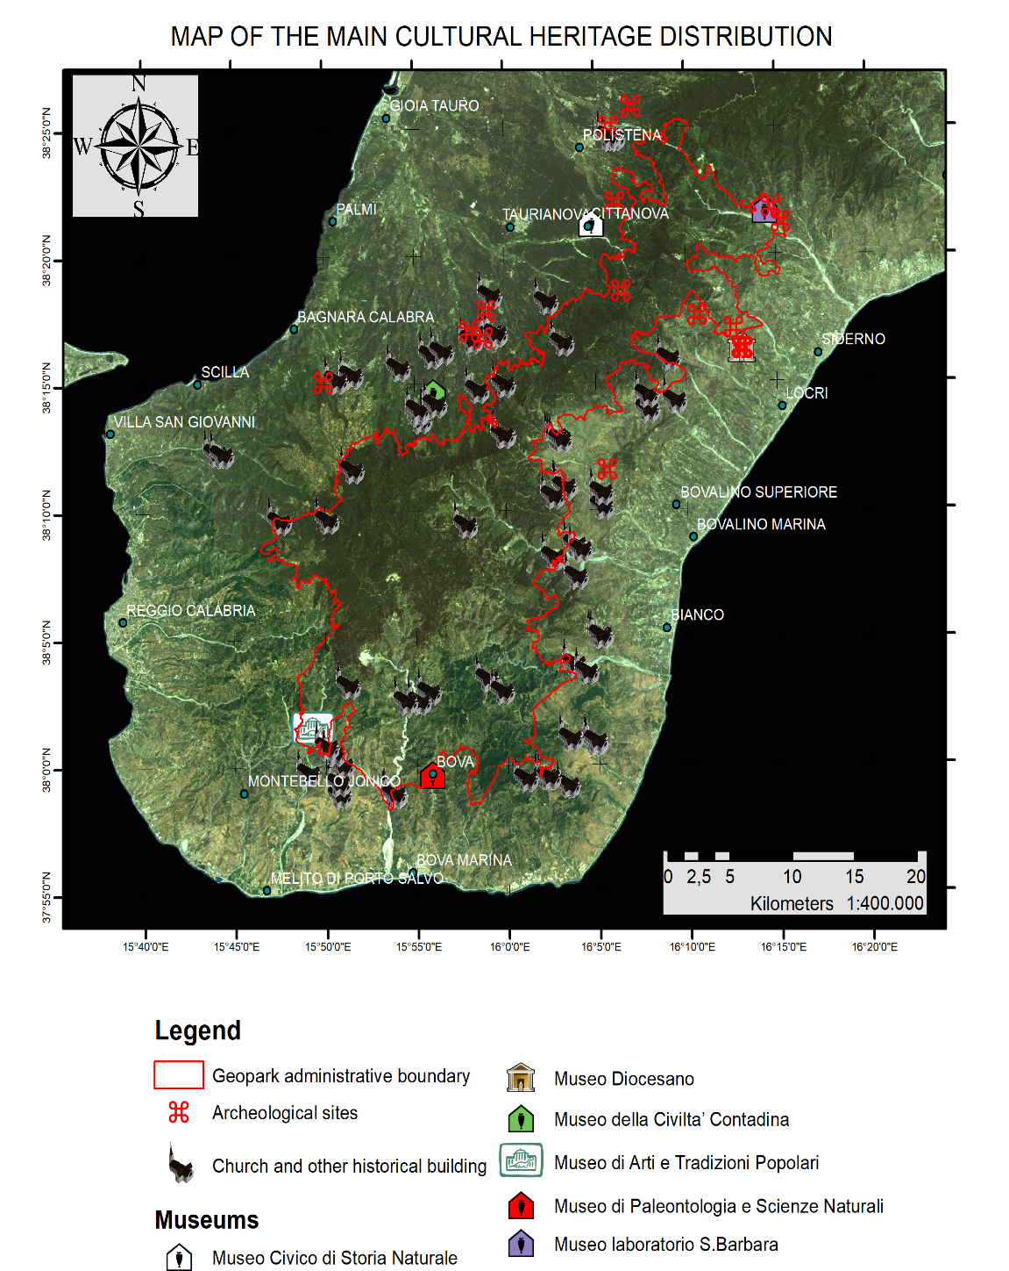
INTRO
SCENARIO
PURPOSE
CONCLUSION

Slide 14
The geological peculiarity of the Aspromonte Massif can communicate as the metamorphic rocks can be read as an Earth moving view where are enclosed pieces of the memory of the rock incessant slow movement of
Earth interior.
INTRO
METHODS
APPLICATION
CONCLUSION

Slide 15
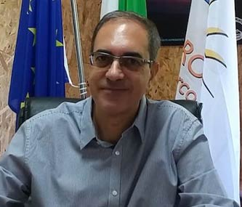
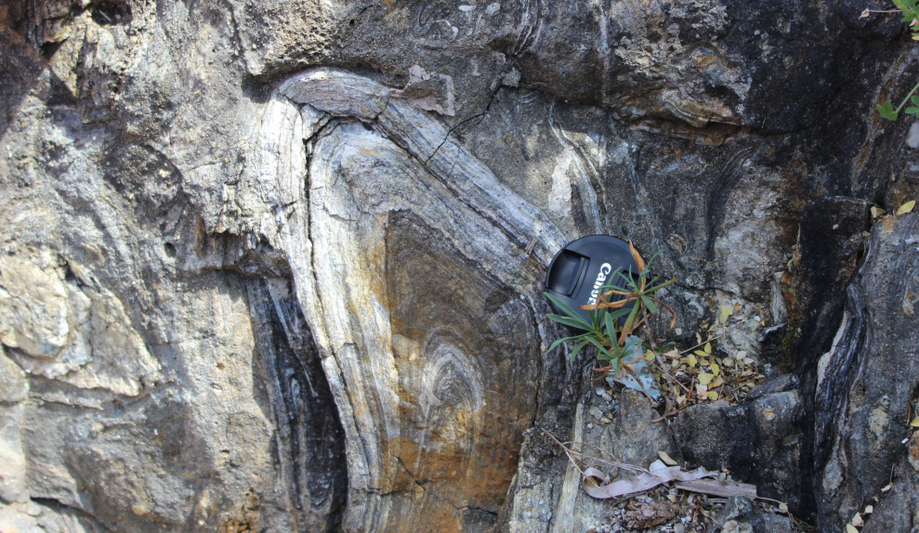
IN MEMORY OF OUR GOOD FRIEND DOTT. SERGIO TRALONGO (past director of the Aspromonte National Park)

Slide 16
Cited references
Cirrincione, R., Fazio, E., Fiannacca, P., Ortolano, G., Pezzino, A., Punturo, R. (2015). Period. Mineral., 84(3B), 701-749.
Fazio E., Ortolano G., Visalli A., Cirrincione R., Pezzino R., (2018). Ital. J. Geosci., Vol. 137 (2018). (https://doi.org/10.3301/IJG.2018.09).
Fazio, E., Ortolano, G., Cirrincione, R. (2017) International Journal of Earth Sciences, 106 (6), pp. 2039-2040.
Ortolano, G., Cirrincione, R., Pezzino, A. 2005 Schweizerische Mineralogische und Petrographische Mitteilungen, 85 (1), pp. 31-56.
Ortolano, G., Fazio, E., Visalli, R., Alsop, G.I., Pagano, M., Cirrincione, R. 2020. Journal of Structural Geology, 131, art. no. 103956.

